Slide 1
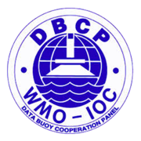
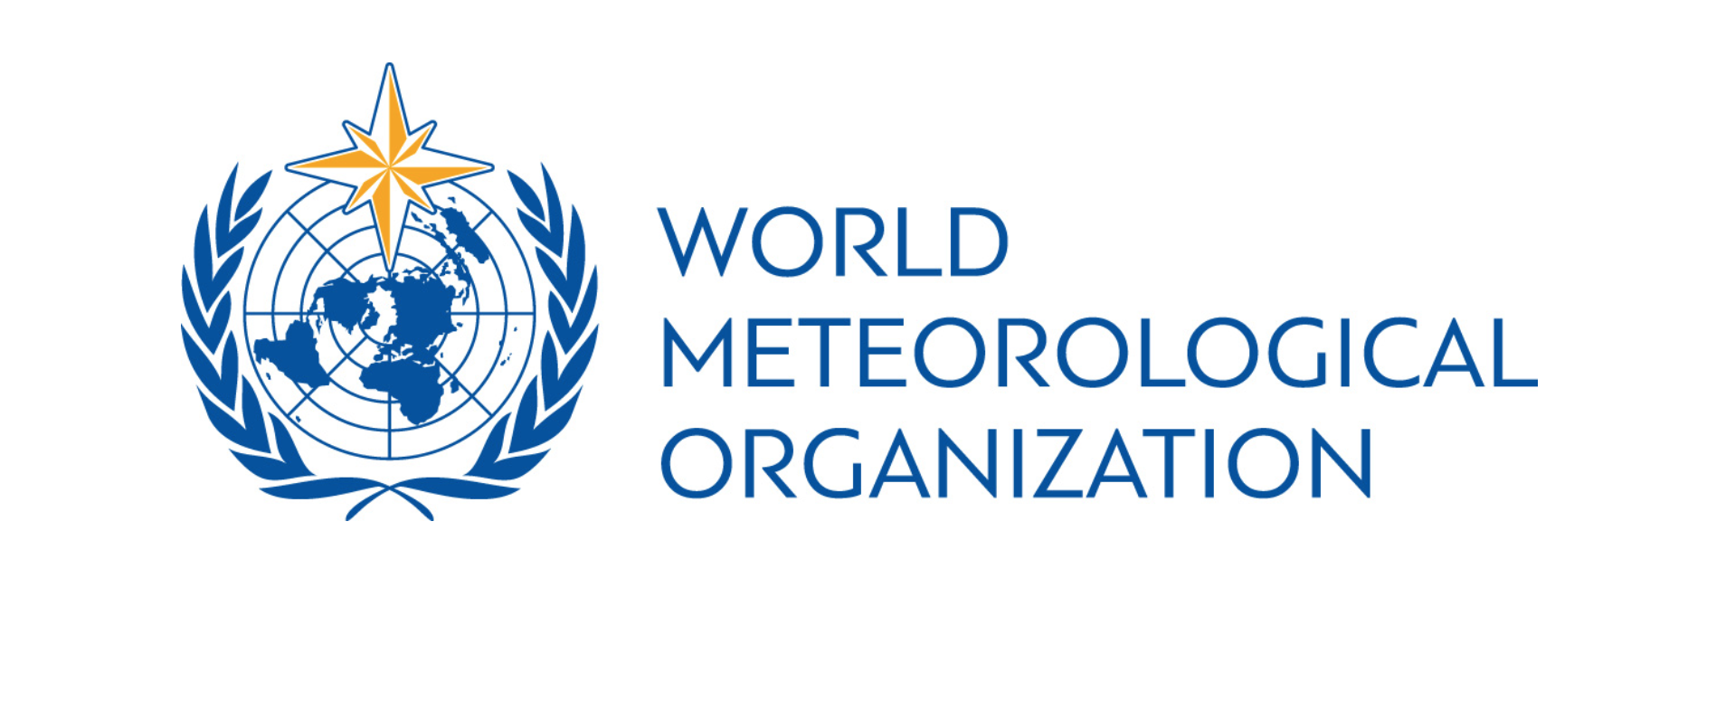
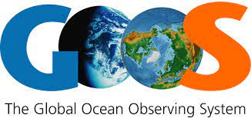
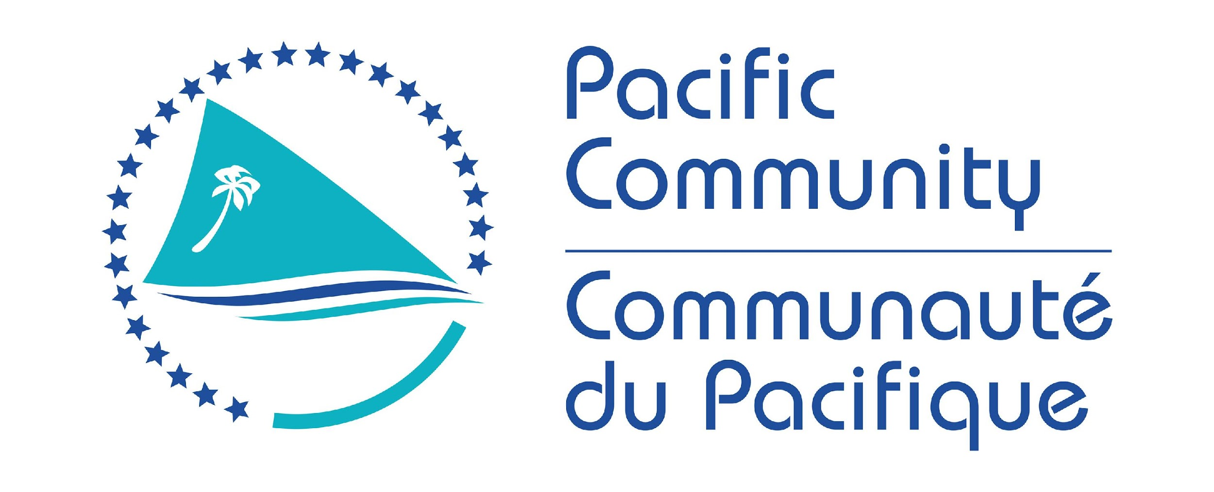
Fifth Pacific Islands Training Workshop on
Ocean Observations and Data Applications (PI-5)
27-28 May and 10-11 June 2021 (Fiji Time, UTC+12)
Lessons learnt from RAMA array & TPOS 2020
Presented by: Dr. Sid Thurston and Cheyenne Stienbarger
Email: sidney.thurston@noaa.gov and cheyenne.stienbarger@noaa.gov

Slide 2
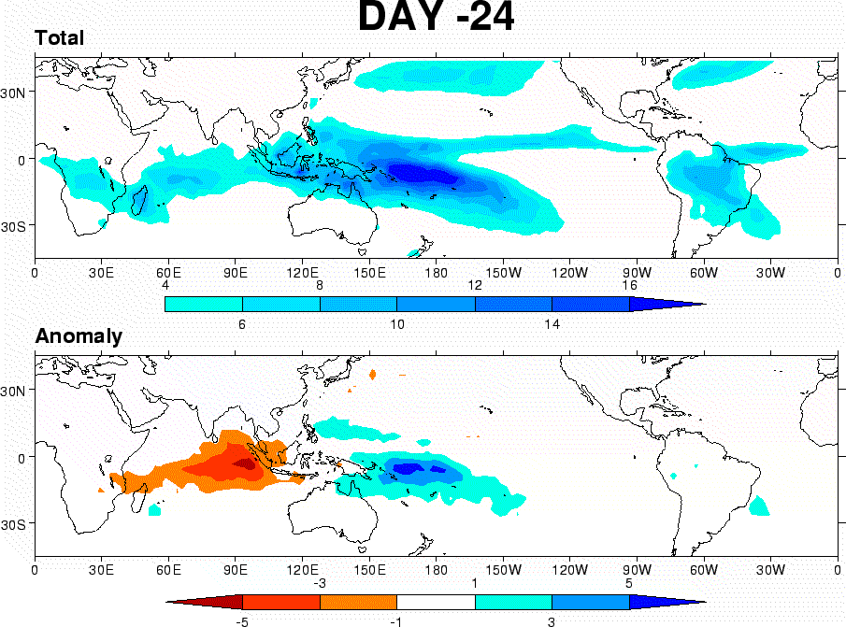
The Role of Indian & Pacific Ocean Observations in
Monitoring the Madden-Julian Oscillation (MJO) To Improve S2S Forecasts
Take Home Messages
1. Why PI Care: The MJO, a major source of S2S Predictability, originates over the Western Indian Ocean with Global Impacts
(Next slide):
Generation of tropical cyclones in all 3 ocean basins, ,
Atmospheric rivers rainfall,
Onset of El Nino events (seamlessly links weather and S2S to seasonal forecasting),
Active-break periods of the Asian Monsoon.
2. Need for Indian & Pacific Ocean Observations (Next slide):
- Air-sea interaction critical to a) MJO Genesis, b) Propagation, and c) Influence on ENSO
- Air-sea coupling enhances MJO prediction skill
3. Leadership in delivering Indian Ocean observations to inform the study and prediction of the MJO (Second slide),
4. Gaps and Challenges - How PI Can Add Value (Final slide):
Observations – model integration
Gaps in the Maritime Continent (MC)
Enhanced PanTropical Coordination

Slide 3
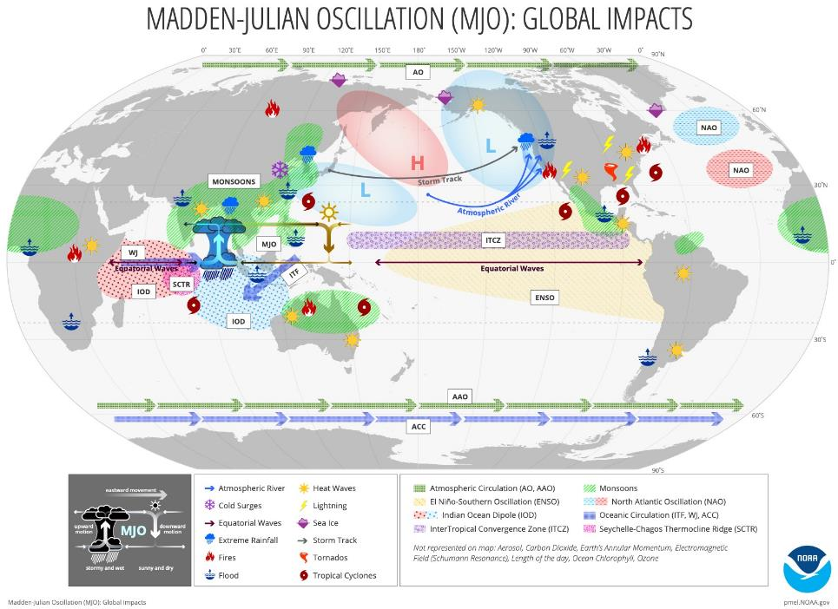
Fifth Pacific Islands Training Workshop on Ocean Observations and Data Applications (PI-5)
a) Genesis: Role of the Seychelles-
Chagos Thermal Ridge (SCTR)
b) Propagation: Barrier
effect of the Indo-Pacific
Maritime Continent
c) Influence on ENSO: Interaction with the warm pool
Pineapple Express (a MJO event)
A significant amount of the deep tropical moisture traverses the
Hawaiian Islands on its way towards western North America.
Evolution of a pineapple express leading to a heavy west coast
precipitation event

Slide 4
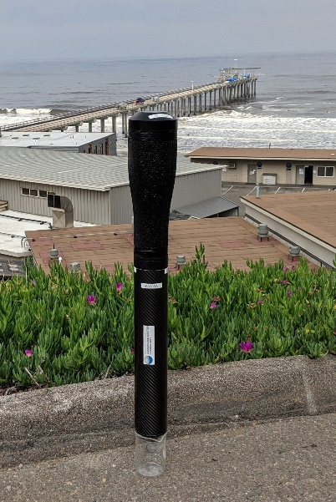
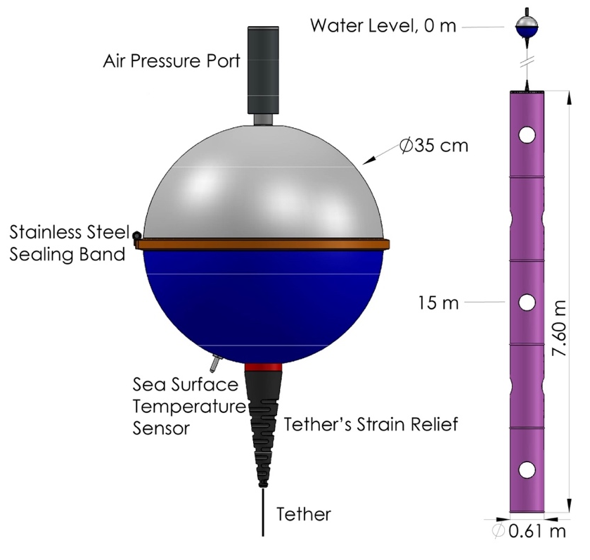
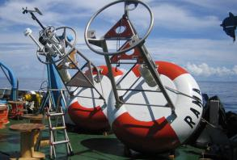
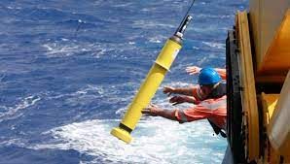
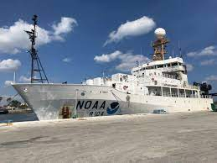
Fifth Pacific Islands Training Workshop on Ocean Observations and Data Applications (PI-5)
NOAA Contributes Significantly to the Multinational Indian Ocean Observing System (IndOOS)
Research Moored Array for African-Asian-Australian Monsoon Analysis and Prediction (RAMA);
To encourage scientific and technological initiatives, in the participating countries, to meet the objectives of IndOOS;
To enhance and facilitate data and information sharing with regard to IndOOS.
Beal et al. 2020

Slide 5
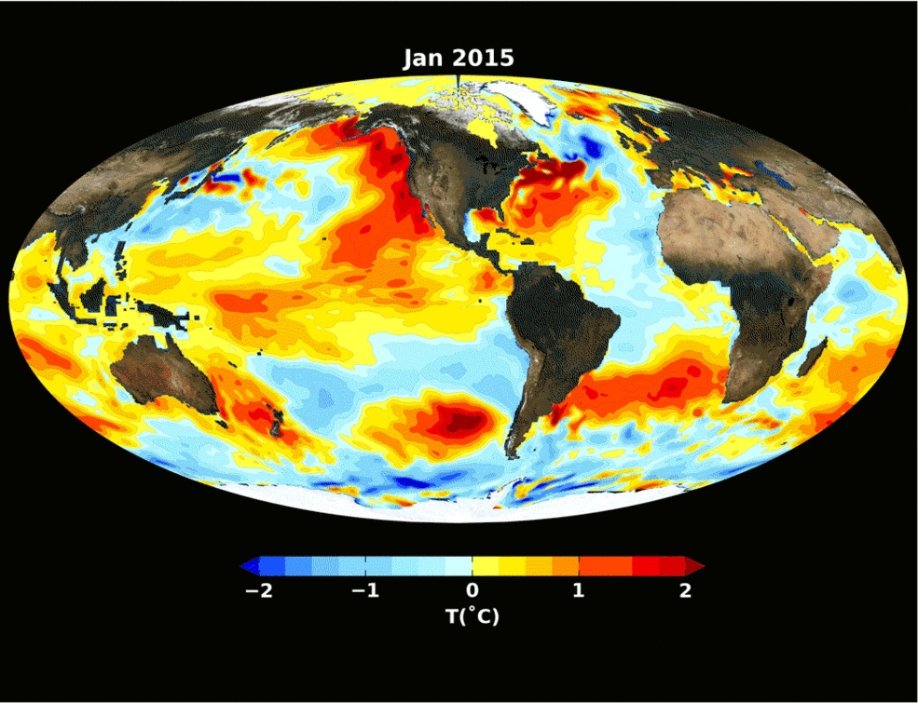
ENSO and the Tropical Pacific
The tropical Pacific Ocean has global impact. It is the source of one of the strongest and most predictable natural control on global climate and extreme weather - El Niño Southern Oscillation (ENSO).
The Tropical Pacific Observing System (TPOS) works to support better understanding and prediction of ENSO, which influences temperature and precipitation across the globe.
Observing the ocean and atmosphere in the tropical Pacific is essential for local and global communities.
NASA.gov

Slide 6
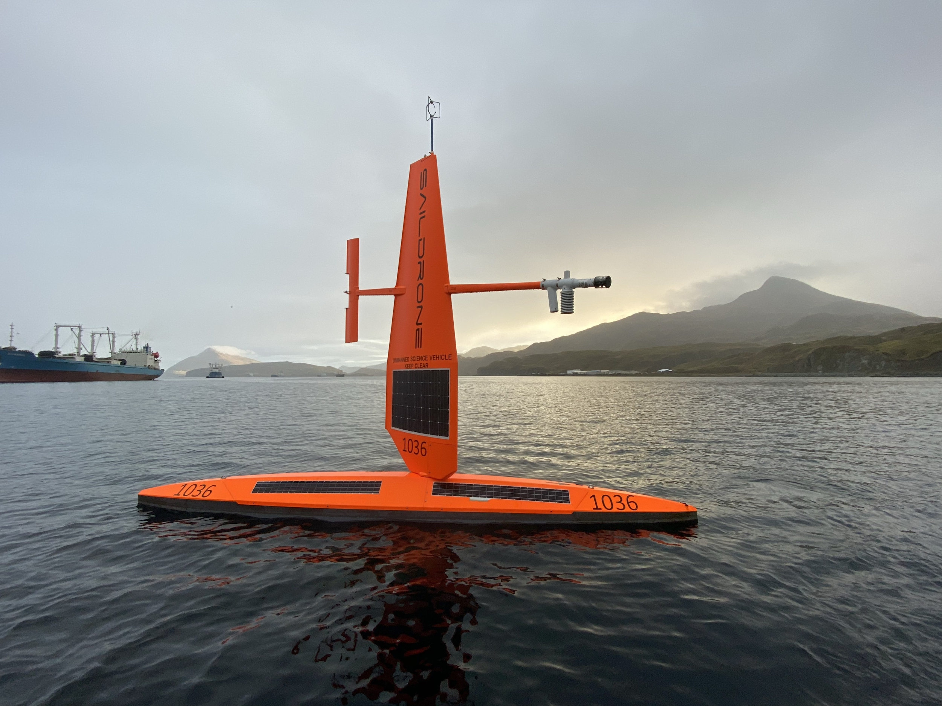
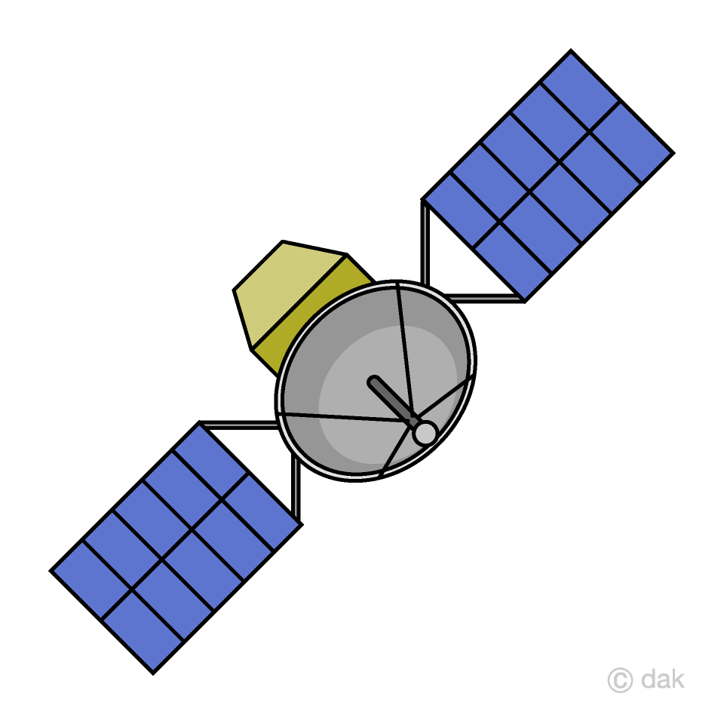
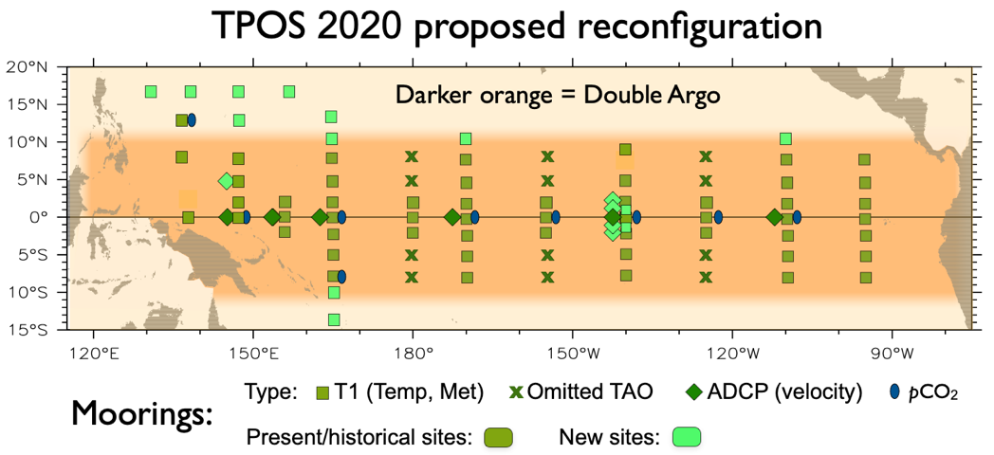
Buoys
Satellites
Argo
TPOS 2020 was an international effort to advance our understanding and prediction of tropical Pacific variability. The project:
Published three reports to present a refreshed, integrated observing system design
Worked to reinvigorate agency interest, funding of many pilots and process studies (by NOAA, JAMSTEC, MNR and other agencies)
Aimed for enhanced effectiveness for all stakeholders
USV

Slide 7
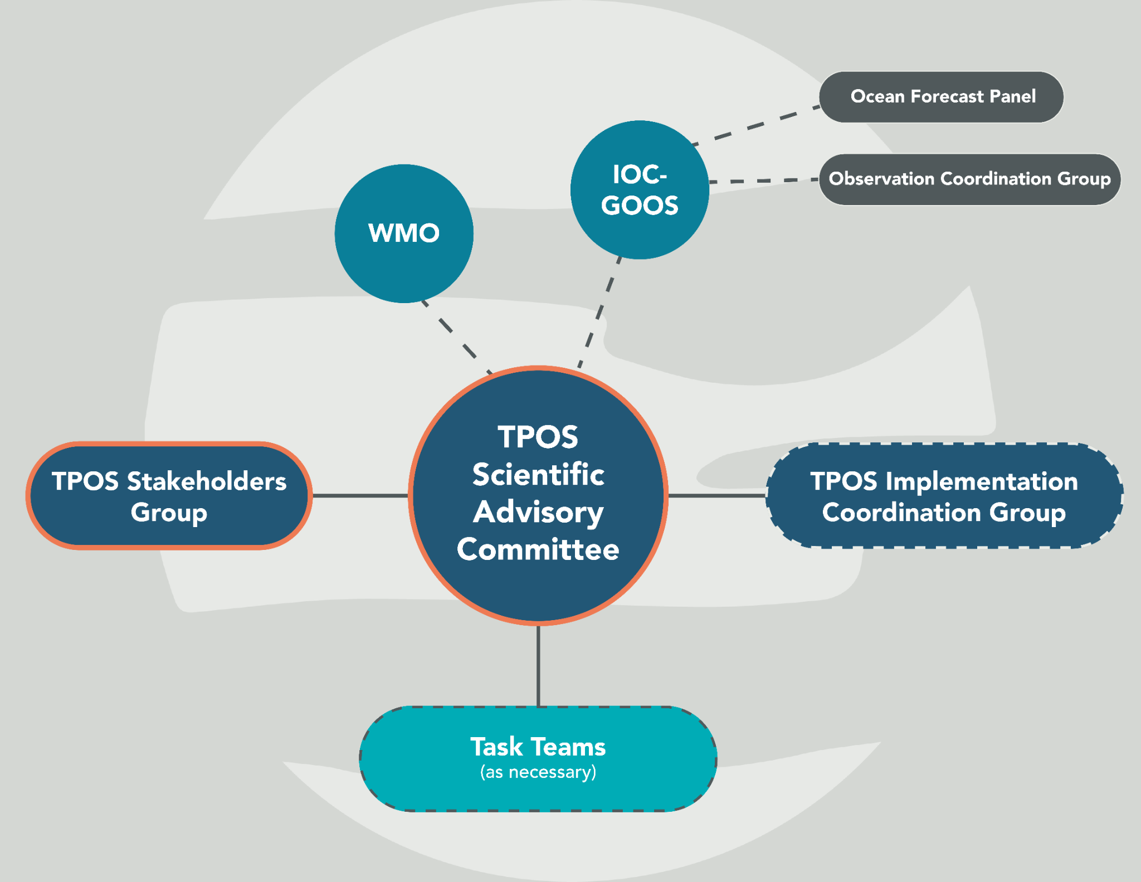
Current status & looking ahead:
Circulate the Final Report to the public
Governance transition
Seek opportunities to begin implementing TPOS 2020 recommendations
Stakeholder engagement
USV

Slide 8
Thank You
Thank You!
NOAA Global Ocean Monitoring and Observing Program (GOMO)
cheyenne.stienbarger@noaa.gov
Sidney.Thurston@noaa.gov

