Slide 1
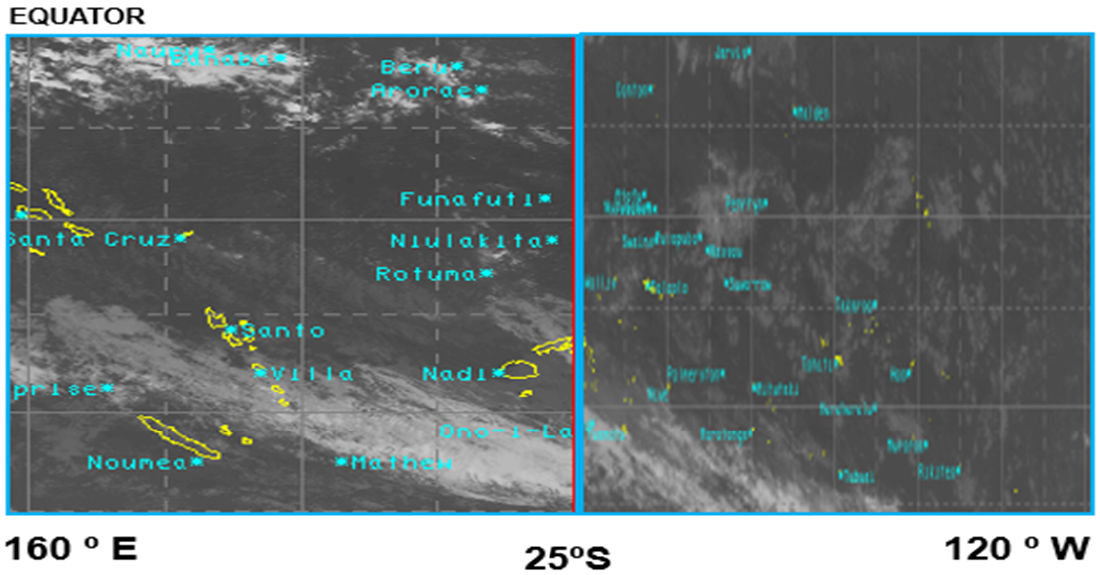
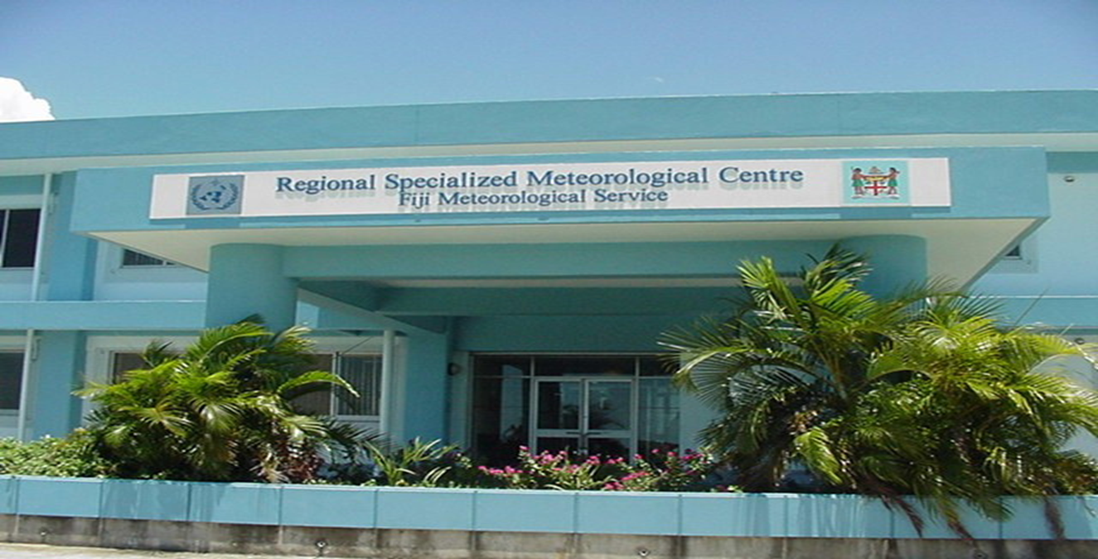
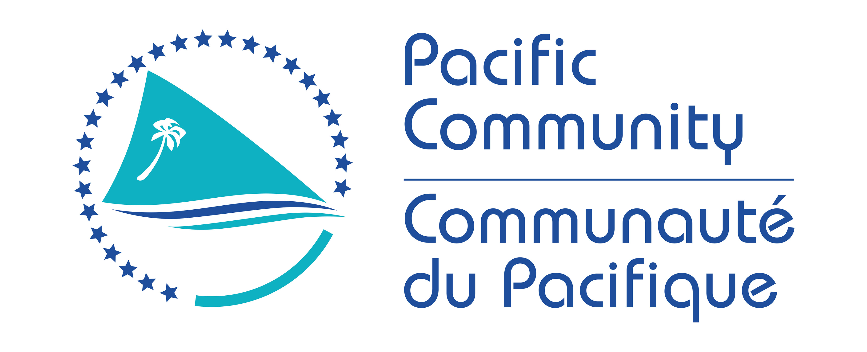
Fifth Pacific Islands Training Workshop on
Ocean Observations and Data Applications (PI-5)
27-28 May and 10-11 June 2021 (Fiji Time, UTC+12)
FIJI COUNTRY REPORT
Presented by: Stephen Meke
Email: stephen.meke@gmail.com

Slide 2
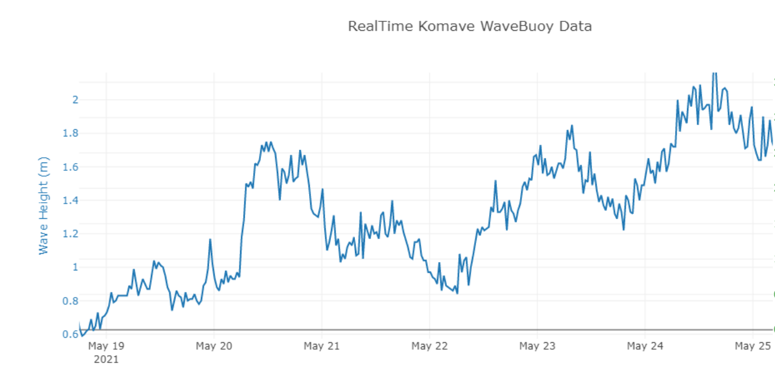
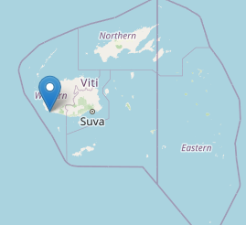
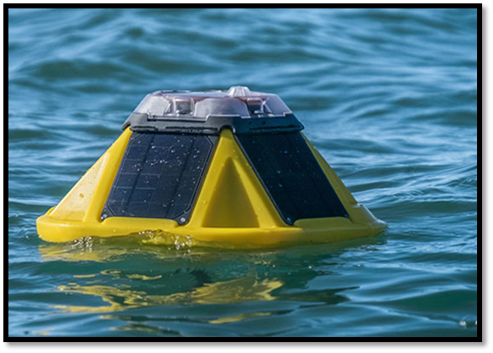
New instrumentation since 2019:
Wave Buoy off the Coral Coast:
Monitor Southern Ocean Swell
Support validation of wave Forecast
Provide insight on TC wave (e.g. TC Harold)
3 Pressure Sensors along the Coral Coast:
Monitor water level at the shore
Validate and improve inundation forecast
Instrumentation in the pipeline:
Deployment of Wave Buoy off Suva:
Support Suva Port Authority and Shipping industry
Research and possibly way forward for the region
-> Compare SoFar and SCRIPPS light weight wave buoys
Notes:
The establishment of a real-time wave ocean observation station off the Coral Coast aims at collecting southern ocean swell, provide our forecasters with real-time validation data to increase our confidence and the reliability of our wave and inundation related warnings, support planning and safety at sea for local communities (e.g. that can check the real-time data to plan their fishing activities?). The wave buoy is also instrumental to help FMS validate and assess our ocean prediction product during TC. The Wave buoy measured a 5.9m wave during TC Harold.
Providing real-time wave data also increase our visibility – ( check example of media coverage from 2018 in the last slide - don t have to mention it is from 2018….☺
Pressure sensors are retrieved and swapped every 6month - did not happen due to COVID ☺
Wave buoy off Suva is designed to support Suva Port Authority and the shipping industry with the strengthening of navigational safety around Suva Port as it is one of Fiji ‘s most critical asset.
The Suva site will also be used as a research site. We are planning to deploy 2 light weight wave buoys from two different manufacturers to compare and provide us with insight on the best way forward. We are currently focusing on light weight wave buoys are their cost and the resources needed for deployment are much lower than the more traditional wave buoys (e.g. wave rider buoys) which would require large logistical effort and associated $$.

Slide 3
Ocean Science Capacity since 2019:
Ocean Outlook including on video
High Resolution Wave Forecast for the Southwest Fiji Waters (CIFDP project)
High Resolution Inundation Forecast for the Coral Coast areas (CIFDP Project)
Training under CIFDP
Currently FMS has one of its senior forecaster doing MSc in TC Wave modelling in Japan
TOPIC | TYPE OF TRAINING | PARTICIPANTS
Basic Wave Modelling | Workshop Training | Forecasters
Ocean and Coastal Processes | Workshop Training | Forecasters
Wave Buoy Deployment | Hands On Training during Deployments | FMS Technician
Water Level Monitoring | Hands On Training during retrieval and swapping of pressure sensors | FMS Technician
Post TC coastal Inundation Survey | Hands On Training during Post disaster Survey after TC Harold and TC Yasa | FMS staff
Notes:
Nothing to add!

Slide 4
What do you hope to learn or take way from this training?
The instruments used by other NMHS for ocean and wave monitoring
The data available (resource) that could be used for real-time wave and ocean monitoring
The capacity of other NMHS to sustain and maintain the monitoring instruments out there.

Slide 5
