Slide 1
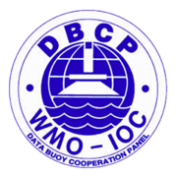
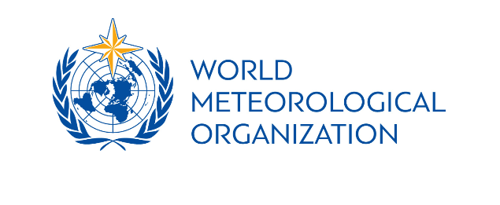
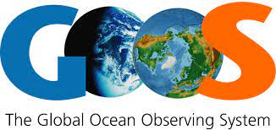
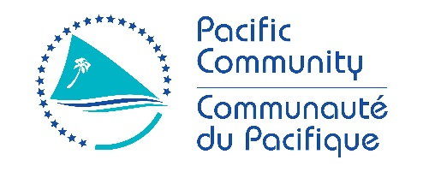
Fifth Pacific Islands Training Workshop on
Ocean Observations and Data Applications (PI-5)
27-28 May and 10-11 June 2021 (Fiji Time, UTC+12)
Title of the talk: COUNTRY REPORT:
Federated States of Micronesia Weather Service offices:
Presented by: Sosten. Sos
Email: sosten.sos@noaa.gov

Slide 2
THERE ARE THREE WEATHER SERVICE OFFICES ACROSS THE VAST AREA OF THE FSM; POHNPEI, CHUUK AND YAP STATES AND ARE COVERED UNDER THE PACIFIC TSUNAMI WARNING CENTER IN EWA BEACH, HAWAII WHICH FALLS UNDER THE NATIONAL OCEANIC AND ATMOSPHERIC ADMINISTRATION (NOAA, U.S.A). IN ADDITION, THE NORTH-WEST PACIFIC TSUNAMI WARNING CENTER IN JAPAN ALSO ASSISTS IN PROVIDING TSUNAMI INFORMATION WHEN NECESSARY. ALL BULLETINS ARE BEING ISSUED BY THESE TWO TSUNAMI CENTERS. AND IF THERE IS A POSSIBILITY OF TSUNAMI THREATS TO THE ISLANDS, THEN THE NATIONAL AND LOCAL AUTHORITIES ARE ISSUING THE WARNINGS WHEN DEEMED NECESSARY. THIS HAS BEEN THE PROCEDURE WHEN THE NEW PRODUCTS WAS ISSUED FEW YEARS AGO.

Slide 3
The United States supports disaster risk reduction programs aimed at saving lives and reducing the impact of disasters. The U.S. Geological Survey (USGS), USAID, and NOAA support early warning systems for earthquakes, tsunamis, tropical cyclones, and volcanos. USGS is working to install new equipment. NOAA has trained more than 200 weather forecasters and emergency managers from Pacific Island countries, including several graduates who have become Directors of National Meteorological Services in their home countries. NOAA will also increase efforts to train Pacific officials to locate earthquakes and assess potential for destructive tsunamis. NOAA will expand the distribution of emergency communication devices throughout the region, connecting islands where emergency communication is extremely limited or non-existent.

Slide 4
Thank you very much.

