Slide 1
Fifth Data Buoy Cooperation Panel Pacific Islands Training Workshop on Ocean Observations and Data Applications
DBCP-PI-5
Boris Kelly-Gerreyn
Chair DBCP
Bureau of Meteorology
Australia

Slide 2
The Data Buoy Cooperation Panel Global coordination of deployment, operations and technology of surface ocean observations

Slide 3
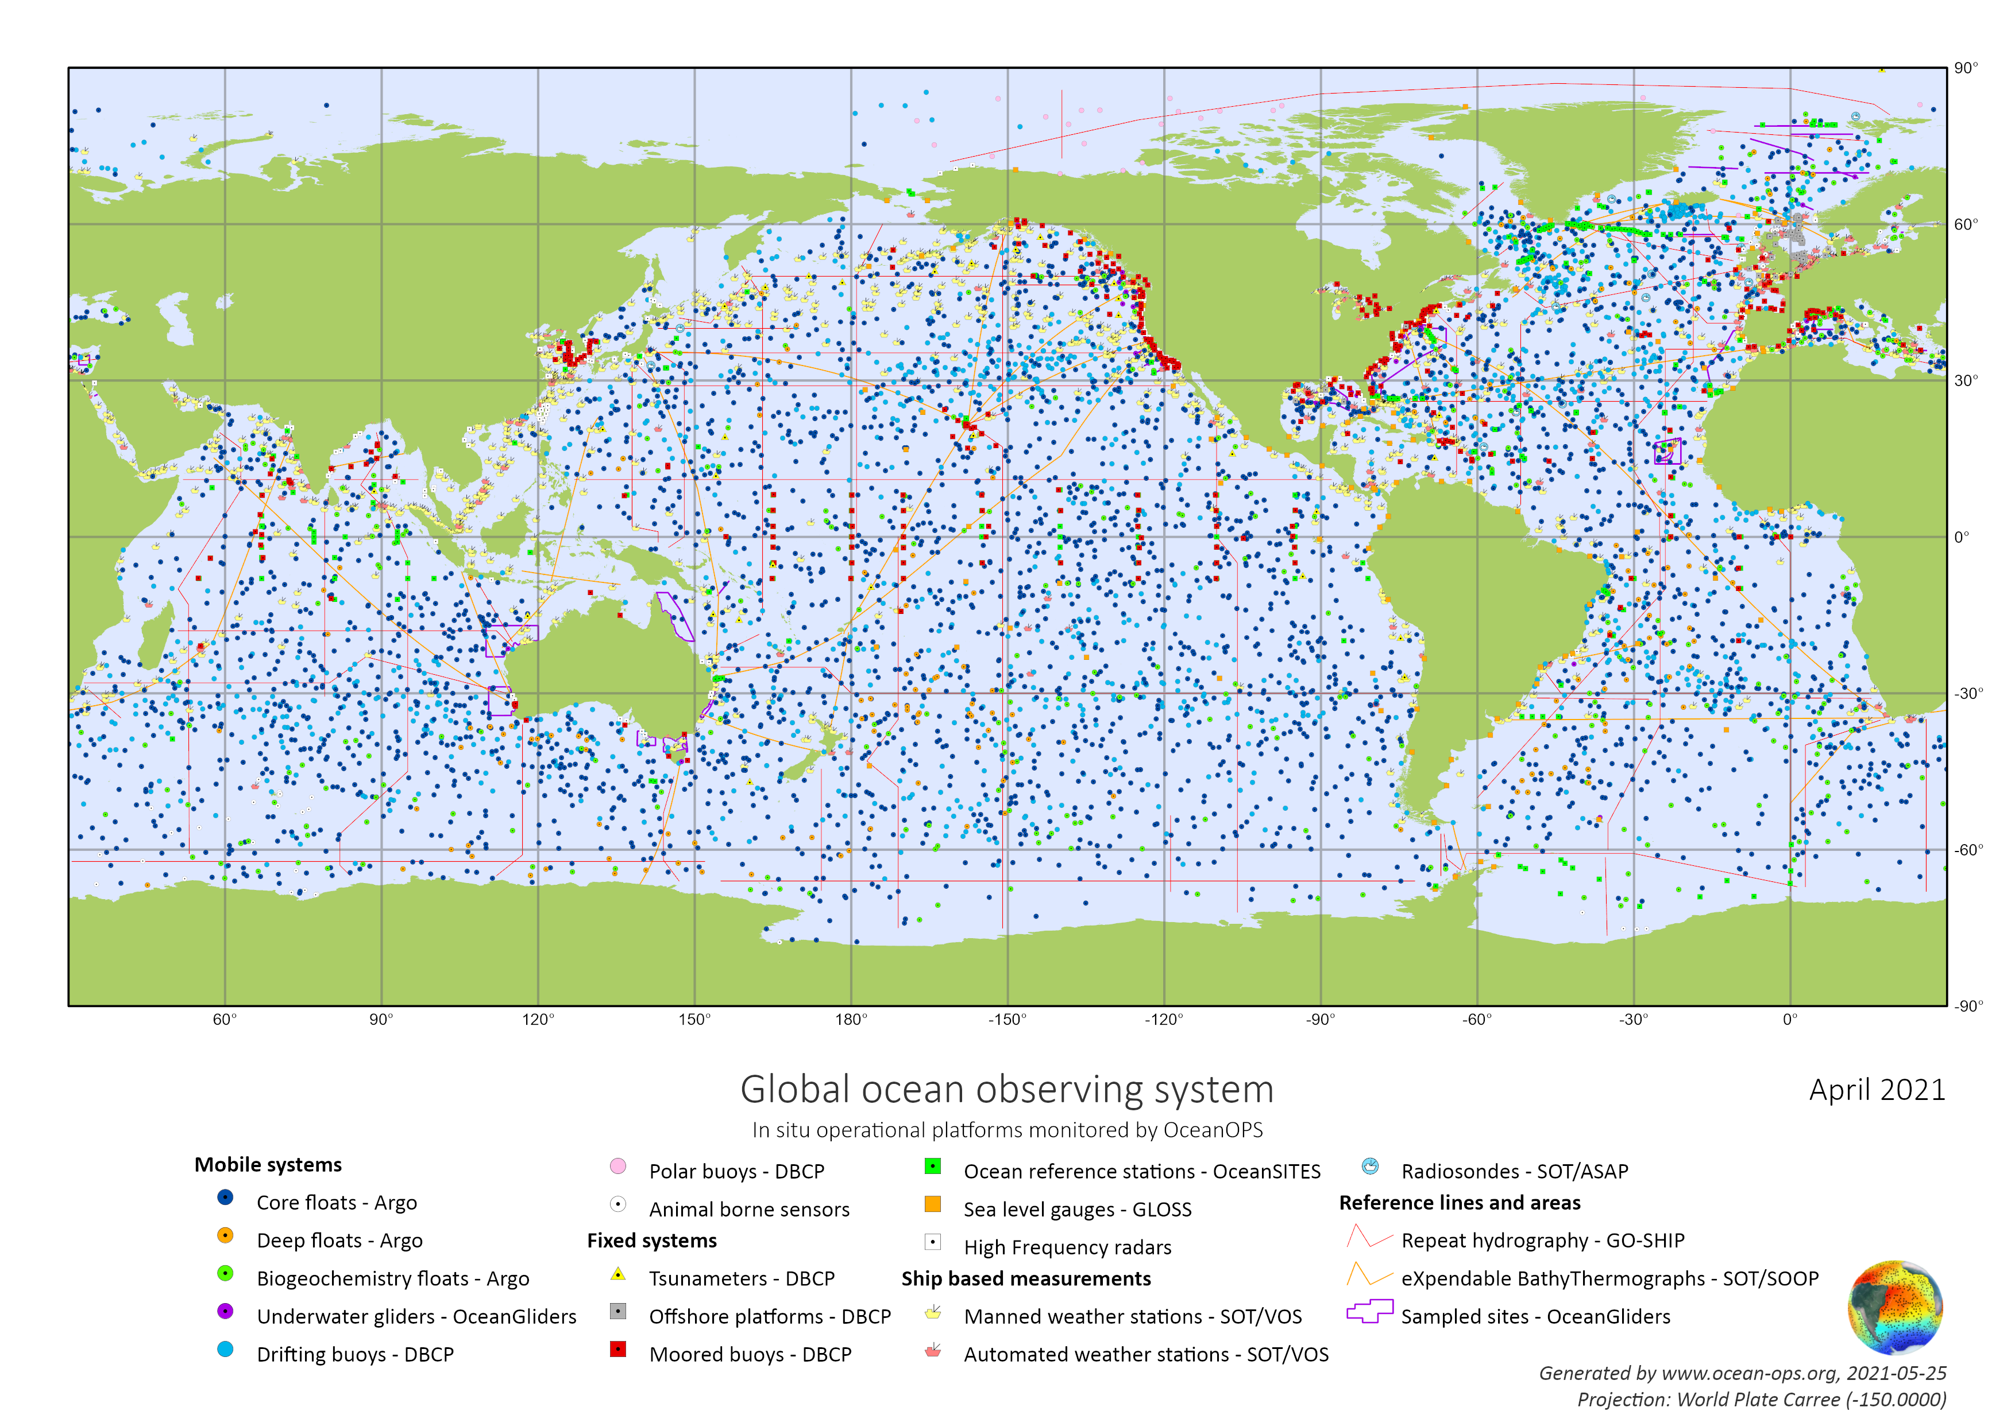
Global in situ Ocean Observing

Slide 4
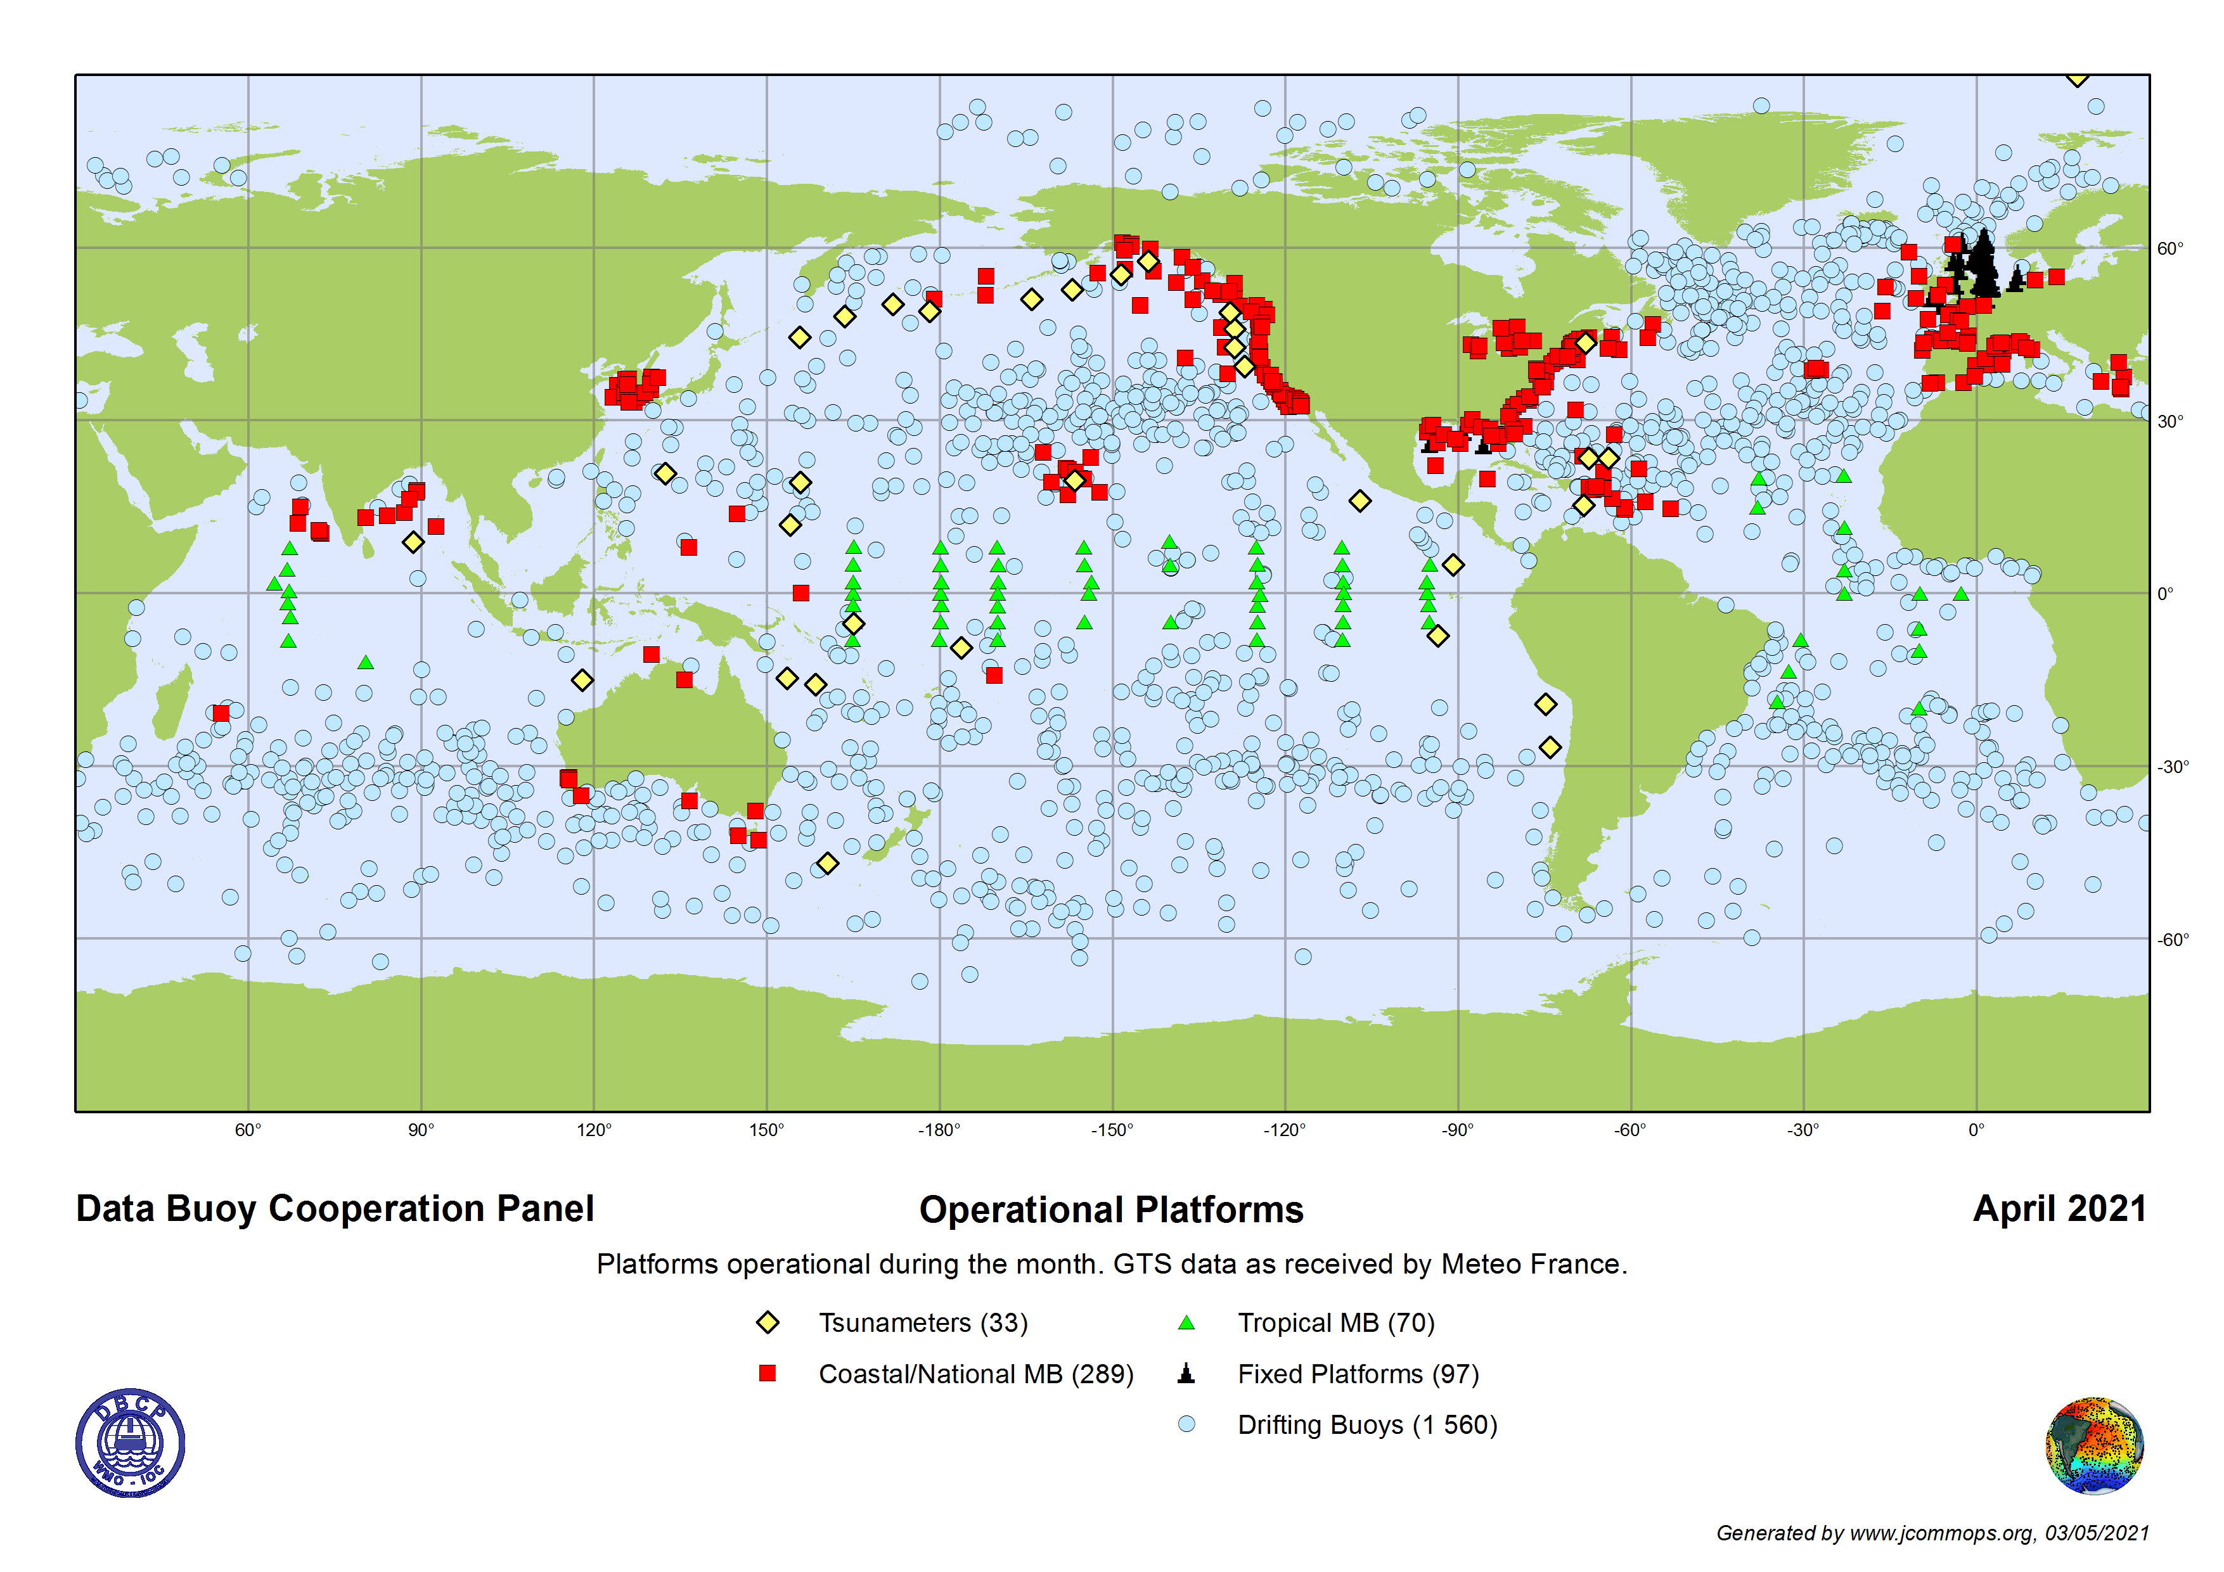
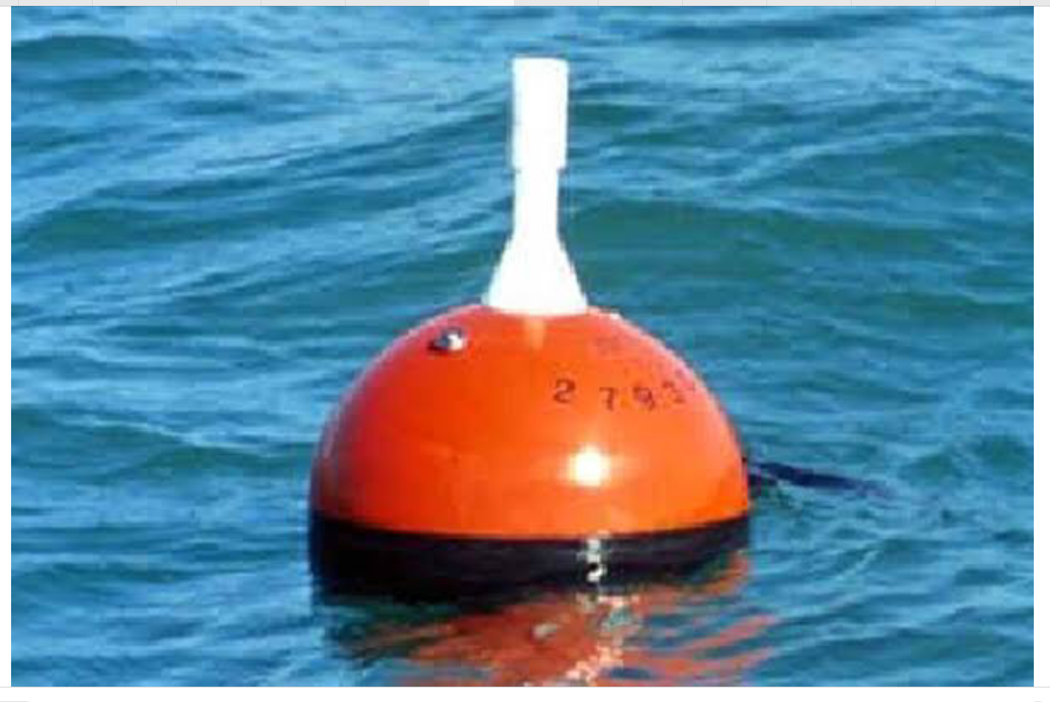
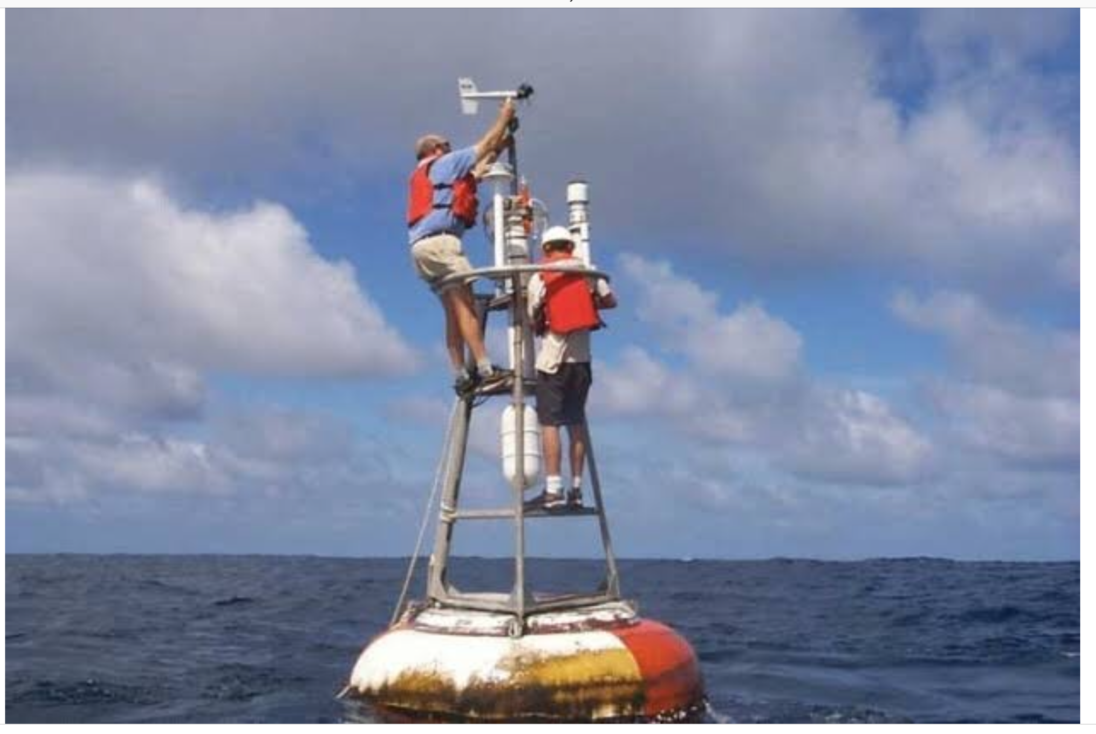
The Data Buoy Cooperation Panel Bit…
Met-Ocean buoys
Drifting buoys
Wave buoys
Temp, Pressure, Salinity, currents, wind, waves are primary observations
Tsunami buoys

Slide 5
Global distribution of drifting, tsunami, wave and met-ocean buoys
Climate monitoring, prediction and research
Ocean research
Weather and ocean forecasting
Maritime safety
Model verification
Disaster risk reduction

Slide 6
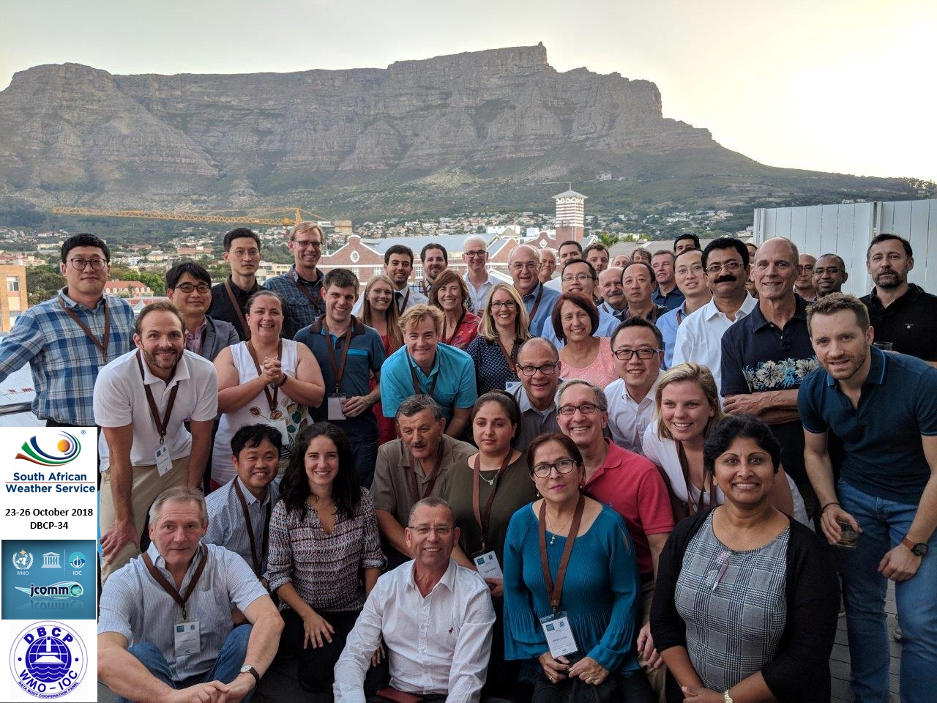
Evolution of the DBCP
DBCP-1
DBCP-34
1985
2018
Operators
Engineers
Scientists
Manufacturers
Coordinate deployment, quantity, quality and
timeliness of the data
To improve
local & global weather forecasts
climate studies/research and
oceanographic research
In 1993 remit expanded to provide international coordination for moored buoy programmes

Slide 7
DBCP governance
WMO & IOC
Secretariats
Exec Board
Technical
coordinator
Task Teams
Action Groups
e.g. METADATA
STANDARDS
Pilot Projects
e.g. INDIAN OCEAN
DEPLOYMENTS
e.g. HIGH RESOLUTION
SST BUOYS

Slide 8
Global distribution of drifting, tsunami, wave and met-ocean buoys
Drifting Buoy – 18 countries: 5 x 5 degrees, 1250 buoys
On GTS within 1 hour
85% using Iridium
100% BUFR
2 GDACs
On GTS within 1 hour
~5% using Iridium
35% BUFR
No GDAC
Moored Buoys – 20+ countries
Coastal stations (289)
Tao-Triton, PIRATA & RAMA
(70)
Tsunami Buoys
(33)

Slide 9
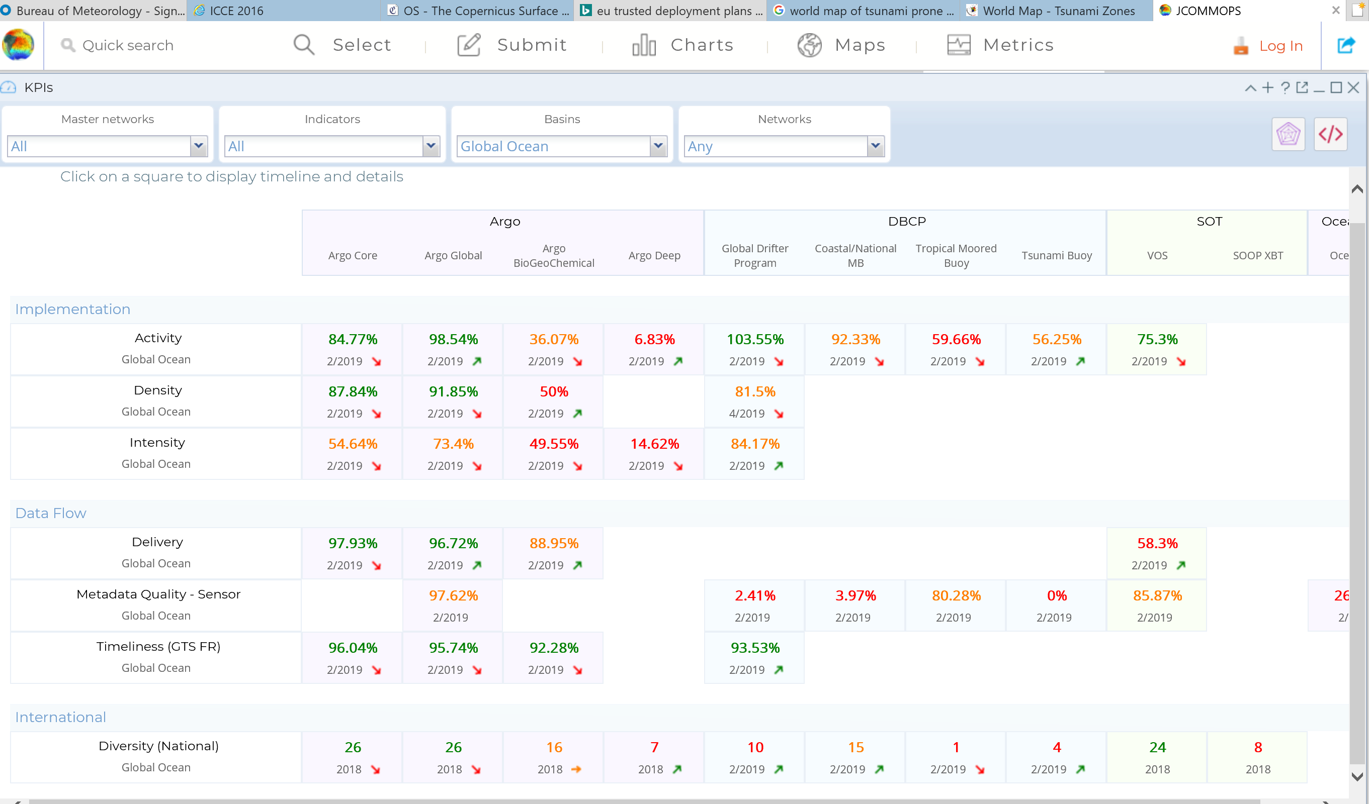
Monitoring and Mapping- OceanOPS

Slide 10
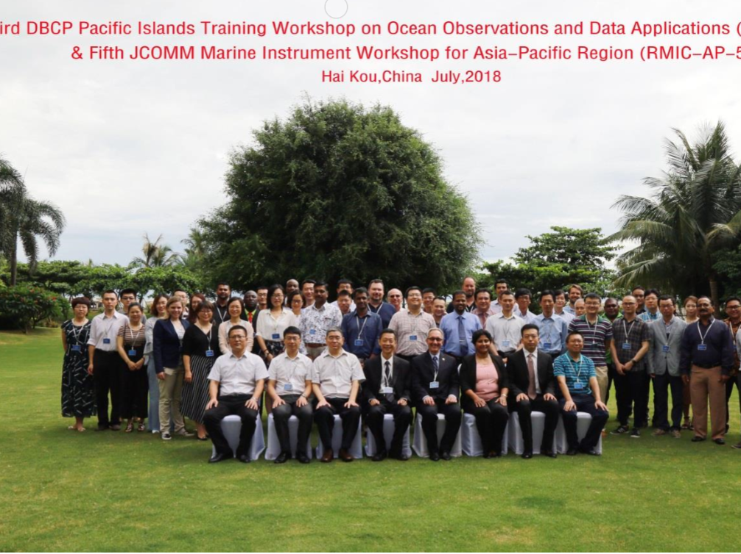
Capacity Development - Next PI-4 @ OceanObs19

Slide 11
Vandalism in Brazil
Brazil National Report
DBCP – NO.34, Cape Town, 23-26 October 2018
Cdr. Paulo Roberto COSTA JUNIOR
Brazilian Navy Hydrographic Center

Slide 12
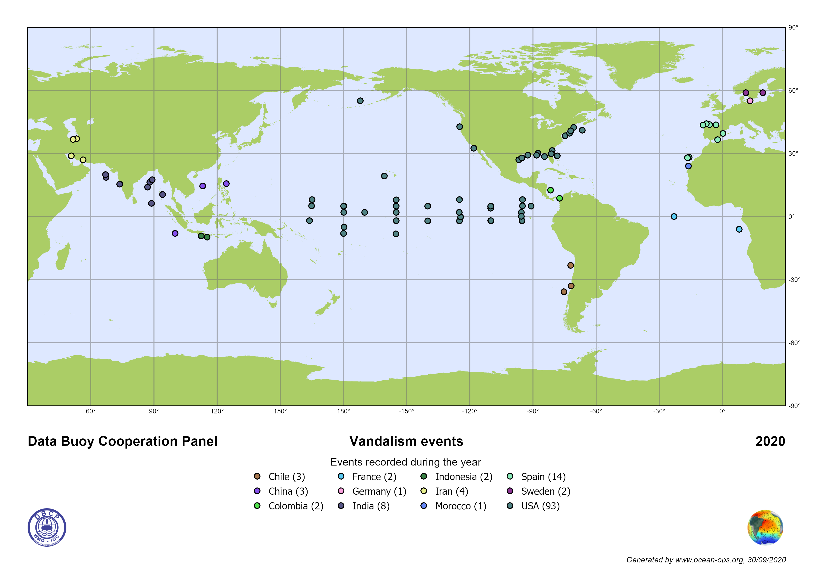
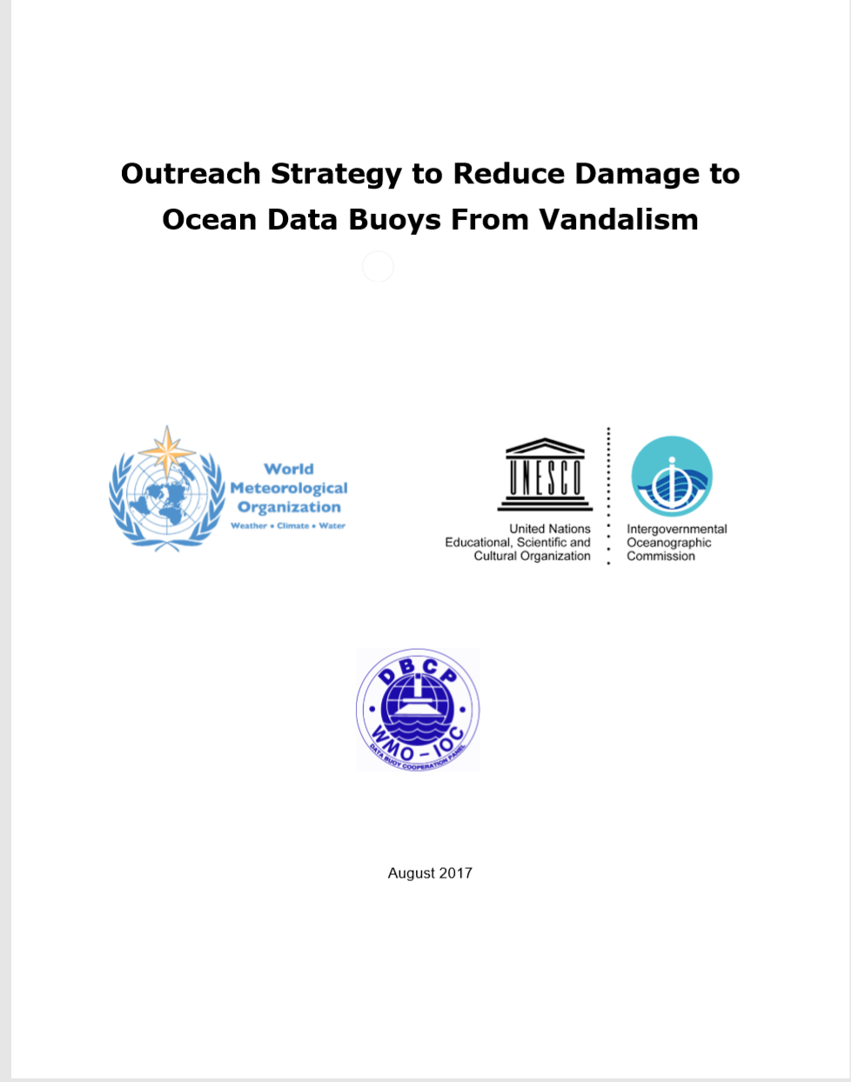
Vandalism Events 2019-2020
12 Member countries
135 Incidents

Slide 13
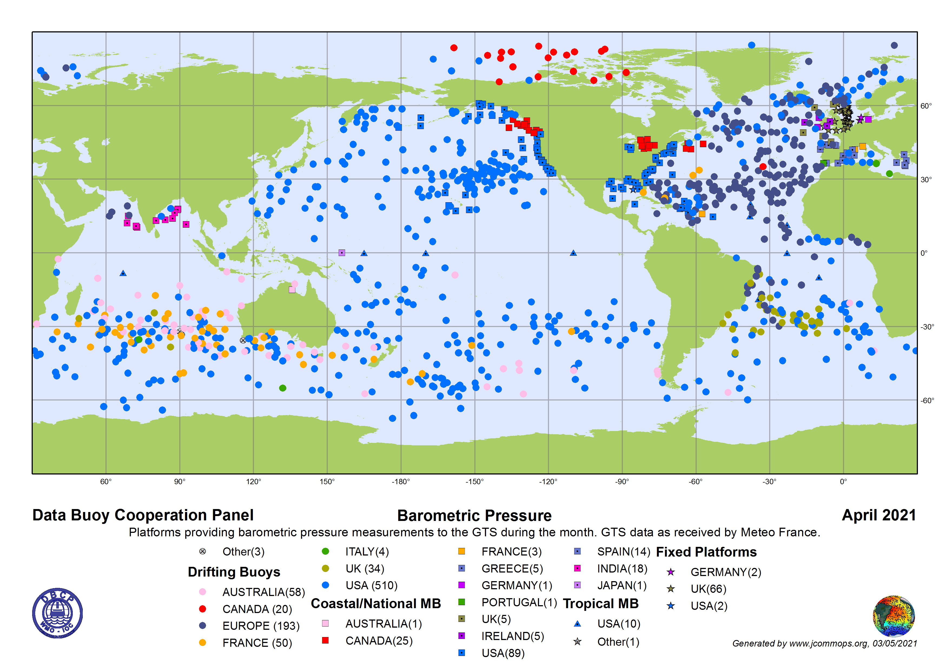
Coverage gaps – e.g. pressure…

Slide 14
New technologies
Adoption via GOOS FOO model
concept – pilot – mature

Slide 15
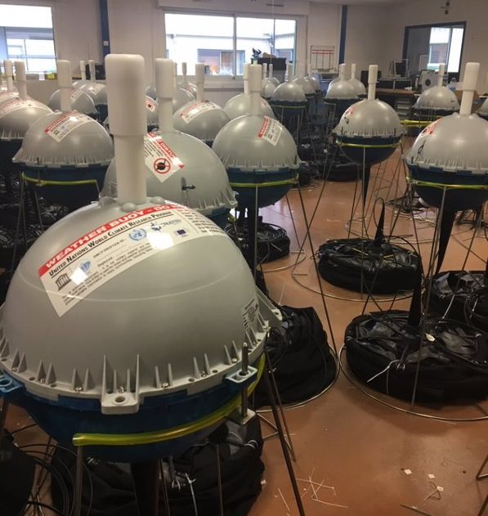
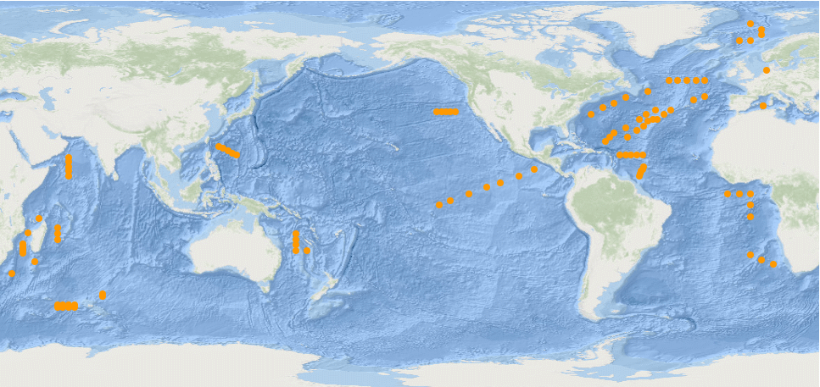
High resolution sea surface temperature buoys for climate studies
Will better drifter SST improve satellite SST retrievals? (Sentinel-3)
Poli et al., 2019 (Ocean Sci., 15, 199-214, 2019)
Uncertainty better than 0.01K

Slide 16
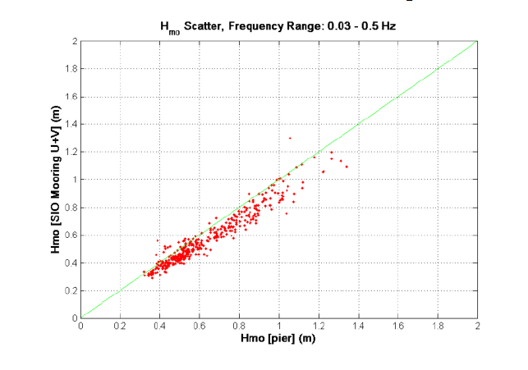
Directional Wave Spectra Drifting Buoy –
Towards a new era of global ocean wave measurements
Uses GPS
Trialled against Datawell buoys in many locations
Planning to rollout to a global array of 500 or so over next 5 years.
Luca Centurioni and Lancelot Braasch
Langrangian Drifter Lab @ Scripps Institution of Oceanography

Slide 17
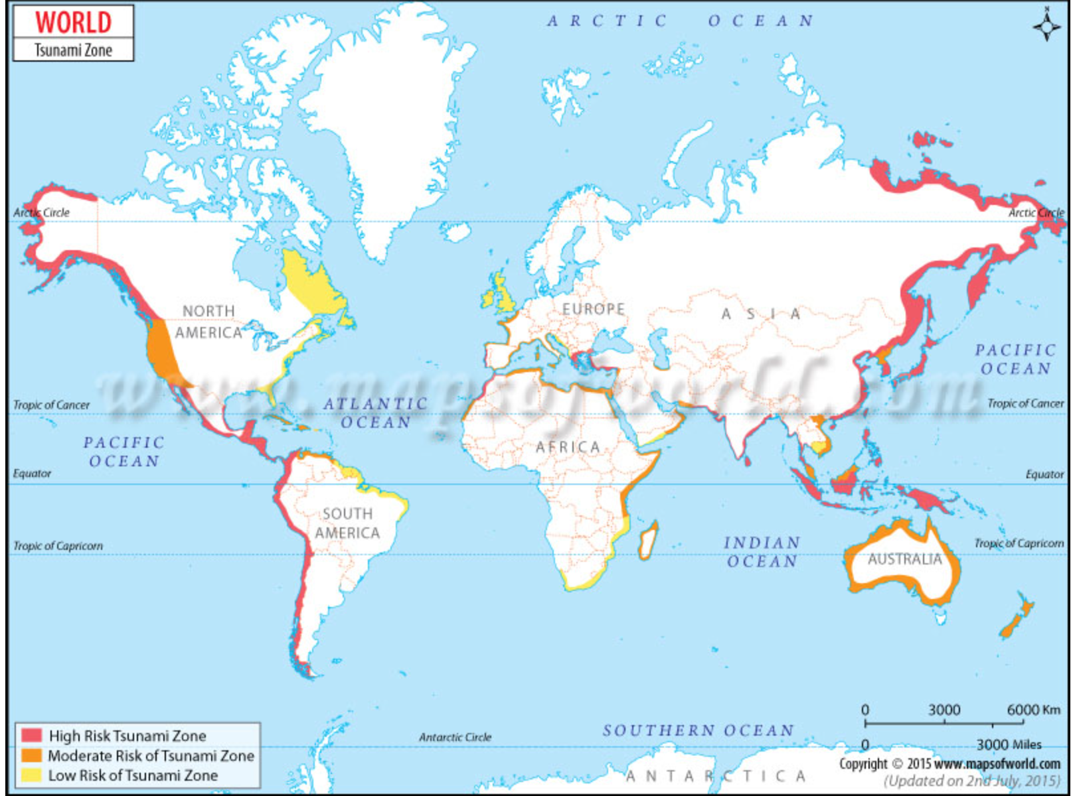
Tsunami detection needs you!
Calling
Artists
Engineers
Scientists
Students
Mathematicians
Teachers
Data scientists
Geophysicists
Architects
Anyone with an interest!
YOU
The DBCP wants to host a workshop to design a new way of detecting tsunamis – within 12 months.

Slide 18
The DBCP Way
Tools that we develop and share

Slide 19
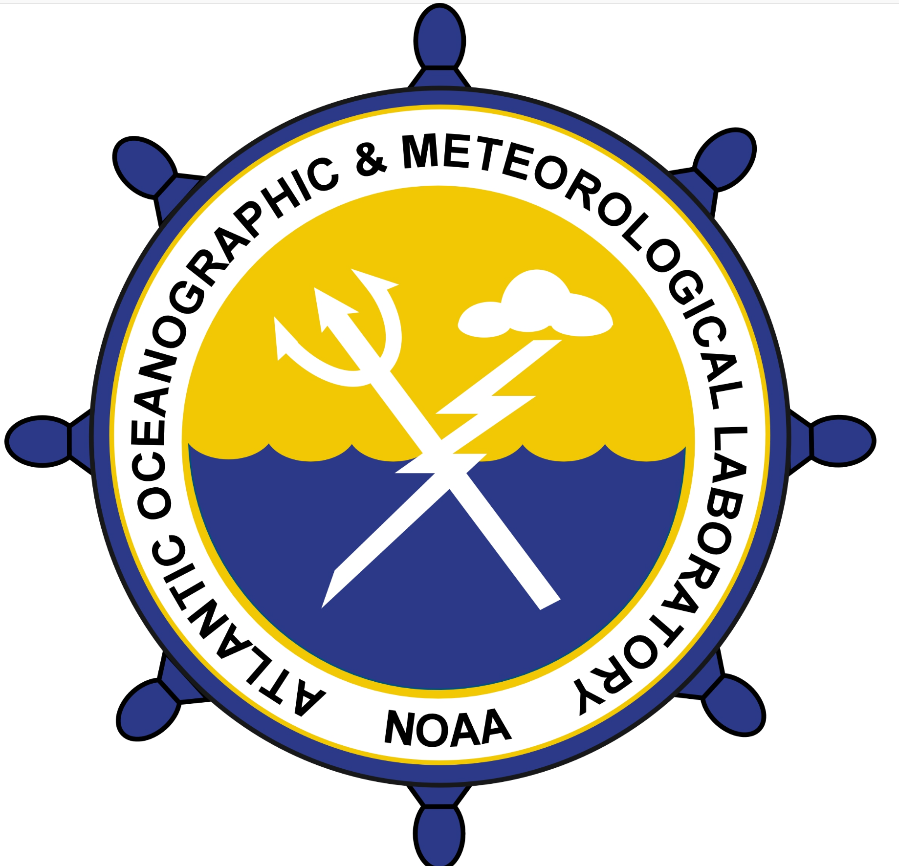
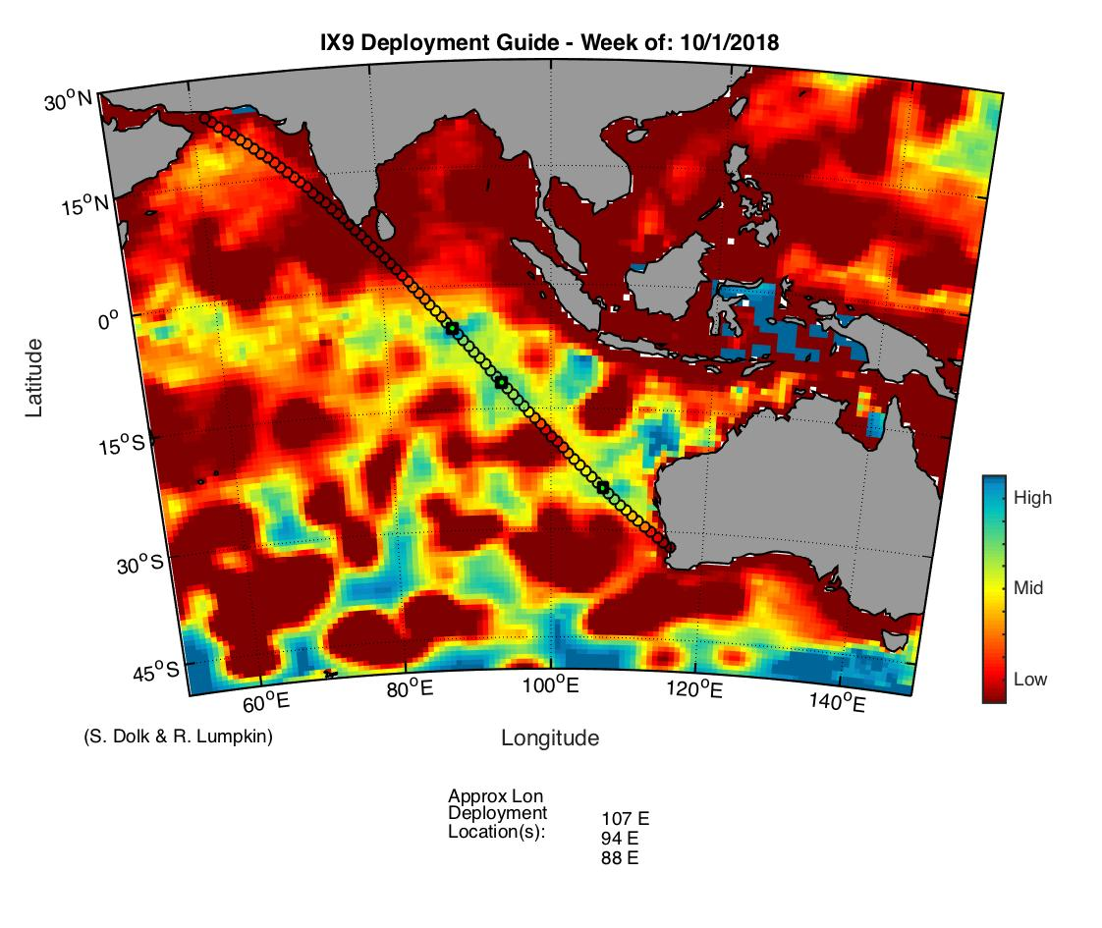
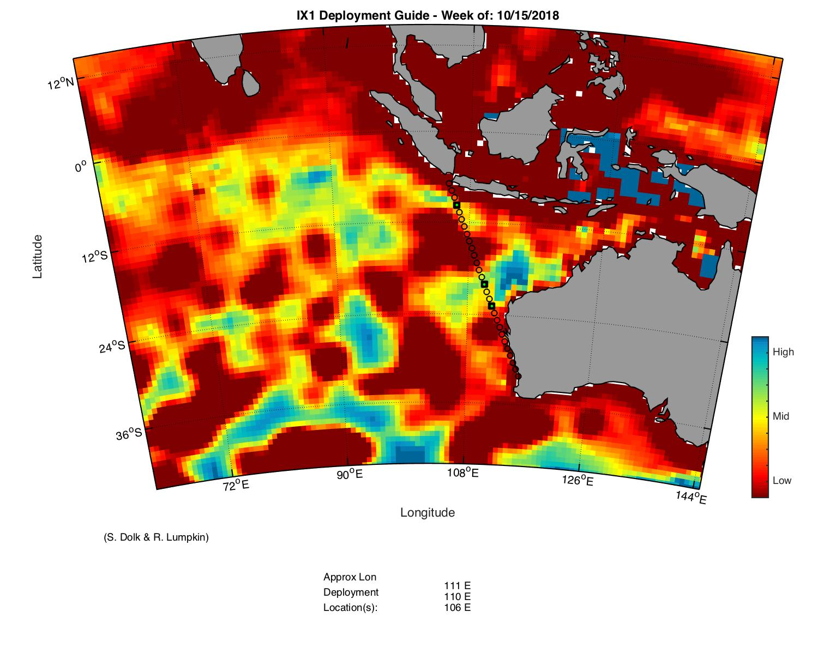
For optimal deployment – drifters Beware of death zones!

Slide 20
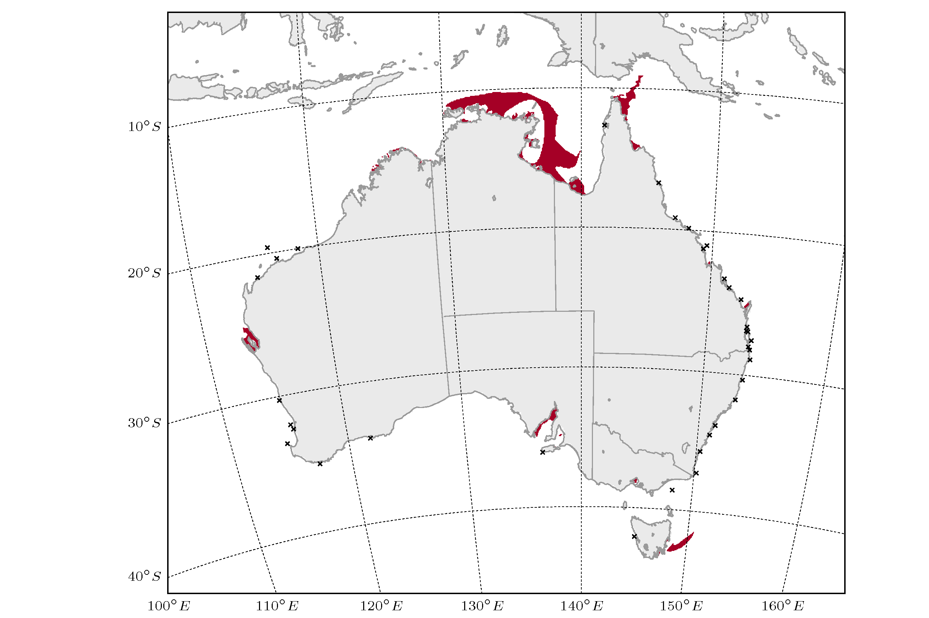
For optimal network design - wave buoys
Wave buoy
locations
Network gaps
Greenslade et al., 2018
Notes:
More interesting is the regions are well represented by the network, despite being far from buoys – Great Australian Bight, Timor Sea

Slide 21
Working on…
Stronger end-user engagement
Environmental stewardship
Navigating through WMO and JCOMM reforms
New strategy

Slide 22
Working on…
Stronger end-user engagement
Environmental stewardship
Navigating through WMO and JCOMM reforms
New strategy

Slide 23
Thank yous
Rachel Jiang
Zulfikar Begg
Molly Powers
Fan Jiang
Long Jiang
Champika Gallage
Sid Thurston

