Slide 1
WMO’s Global Basic Observing Network and the Systematic Observations Financing Facility
- an observing program case study
Lars Peter Riishojgaard, WMO Secretariat

Slide 2
Outline
The meteorological value chain, the global nature of meteorology and the role of WMO;
The need for a global observing network and the difficulty of establishing and maintaining it;
The Global Basic Observing Network (GBON);
Paying for GBON;
Final remarks;

Slide 3
International exchange of data is a major purpose of WMO (WMO Convention, Art. 2 b)
What does it take?
Requirements and gap analysis;
WMO Technical Commissions and their working structures; RRR
Outreach and advocacy – analyzing and explaining benefits of data exchange to stakeholders;
All of WMO; Experts, TCs, RAs, EC, Congress, SG,…;
Data policy – general commitment of national governments to exchange certain data for certain purpose(s);
E.g. WMO Res. 40, 25, 60; new draft WMO data policy resolution;
Regulatory material – agreement on specifics of data exchange (what, when, where, how, …);
E.g. GBON provisions, approved by WMO Infrastructure Commission last week;
Financial and technical support if needed; capacity development;
E.g. CREWS, SOFF; WMO with development and climate finance institutions, ….

Slide 4
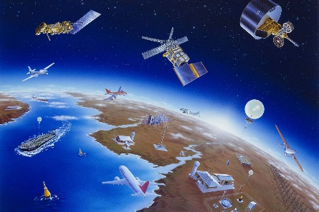
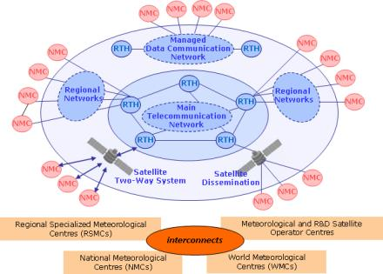
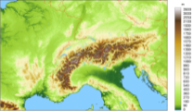
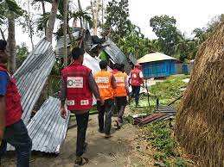
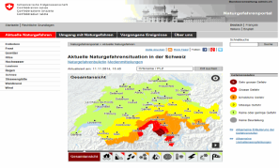
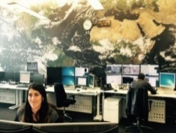
The meteorological value chain
Activities underpinning all weather and climate-related activities; this can ONLY be implemented globally
Weather and climate observations
International exchange of observations
Global numerical weather predition (NWP) for weather and climate
All links in the chain must operate effectively in order to yield success
Activities implemented and undertaken primarily at a national level
Effective decision-making based on climate services
Dissemination and outreach to people and sectors
Weather forecasts, early warnings and climate products and services to users

Slide 5
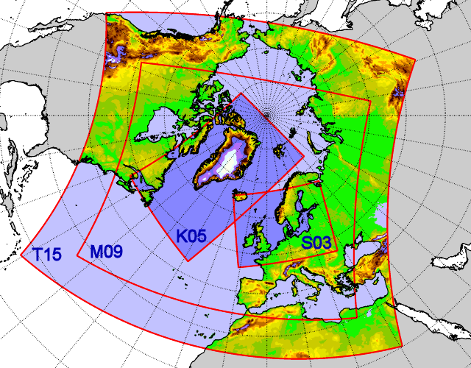
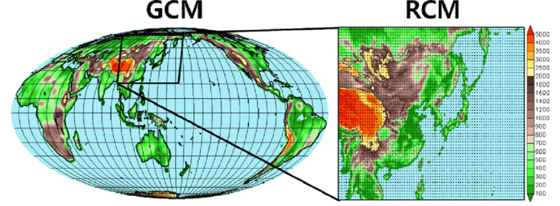
“Weather and climate know no boundaries”
The atmosphere has no horizontal boundaries, and all attempts to independently model limited geographic areas of it have failed;
Therefore, all weather and climate prediction starts from global modeling (NWP); this requires continuous, world-wide real-time supply of observations;
High resolution local weather and climate information obtained via limited area modeling (left) or downscaling (right), both starting from global model data
Without local observations available to the global model, the quality of local model/downscaled data will be poor

Slide 6
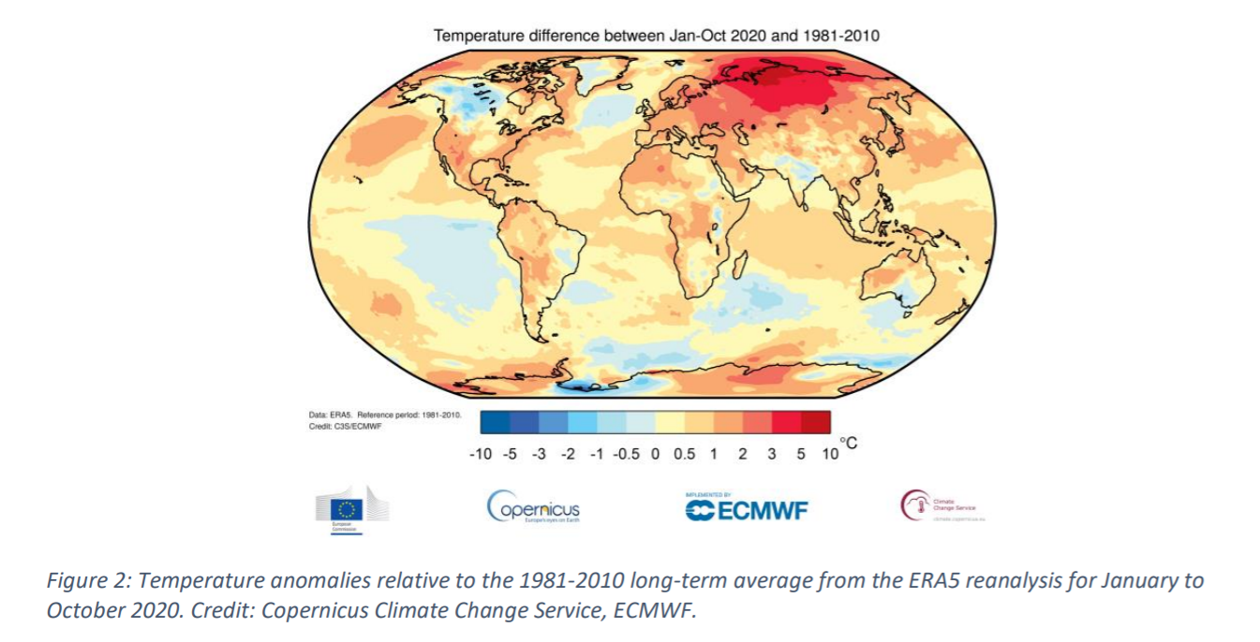
Global numerical weather prediction (NWP) for weather and climate
NWP: Enabling USD 130B annual world-wide economic benefits of weather prediction (Kull et al., 2021)
Assessing NWP quality: Both skill (forecast quality) and range (useful future extent of prediction ) objectively defined and measured
Global NWP systems used also for reanalysis: Reprocessing of multi-year sequences of past weather events using historical observations
Reanalysis: Primary source of information about climate, climate change; basis for climate prediction, projection and adaptation
Reanalysis quality measured same way as weather prediction quality, i.e. same observations needed to improve both climate monitoring and weather prediction
Economic impact of climate analysis data, e.g. for adaptation likely to be even bigger

Slide 7
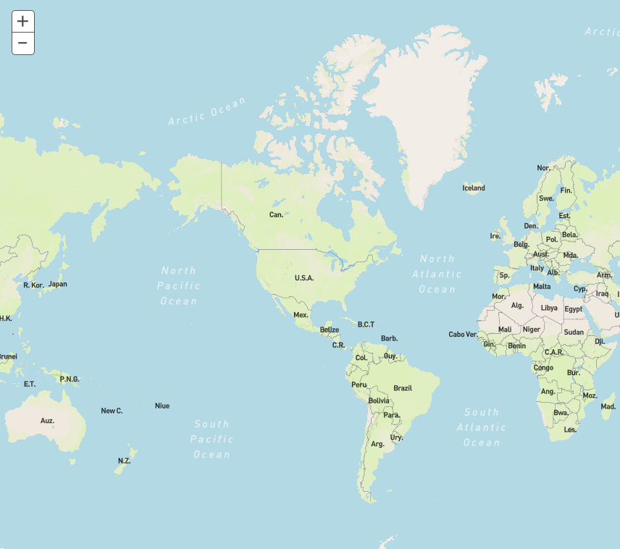
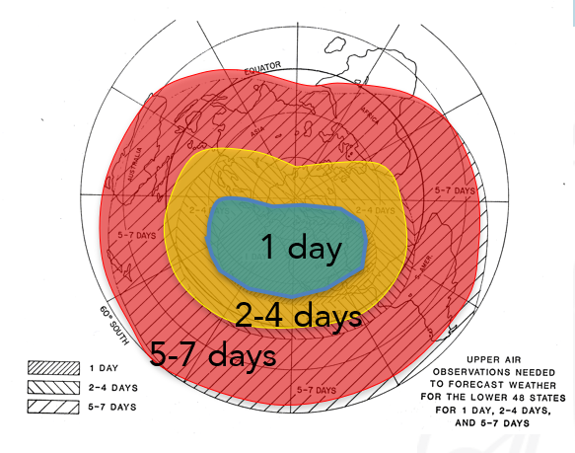
Global need for observations
The atmosphere has no horizontal boundaries, and all attempts to independently model limited geographic areas of it have failed;
Lack of observations limits ability to understand and predict weather and climate, both locally and globally;
Weather prediction beyond 3-4 days for any location on the globe requires exchange of observations world-wide.
Lack of observations will initially lead to poor quality of model data locally; over time this will spread globally.
“Ignorance knows no boundaries”
Example: Lack of observations in red area limits 7-10 day forecast skill in green area; weather/climate knowledge in red area poor!
Example: Required areal coverage of observational data for weather prediction over the United States for different ranges

Slide 8
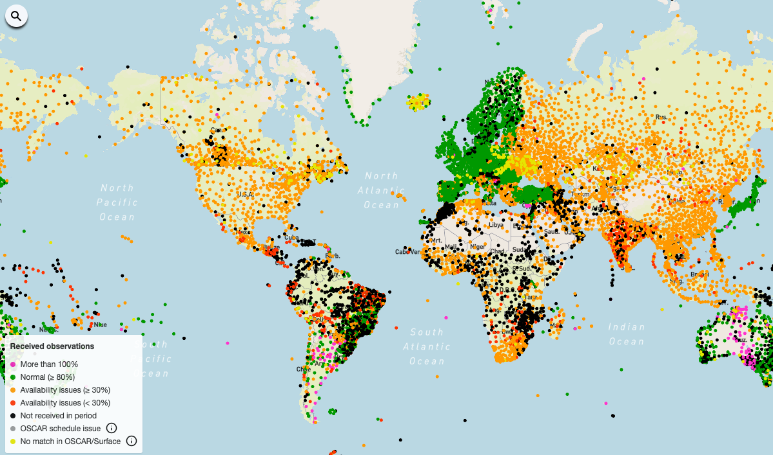
Current state of international exchange of observations and why this is a problem - local and global implications
In many areas the exchange of surface-based observations has been stagnant or declining since 1995; red/black areas do not meet draft GBON provisions.
Meanwhile model resolutions have increased by factors of 1,000-10,000 since 1995!
Areas not in green indicate lost opportunities for generating high quality weather and climate data products; quality of local weather and climate products will be especially poor in areas with red or black stations
Surface pressure observations received by global NWP Centers on Apr 27 2021, 12Z)
(source: WIGOS Data Quality Monitoring System)

Slide 9
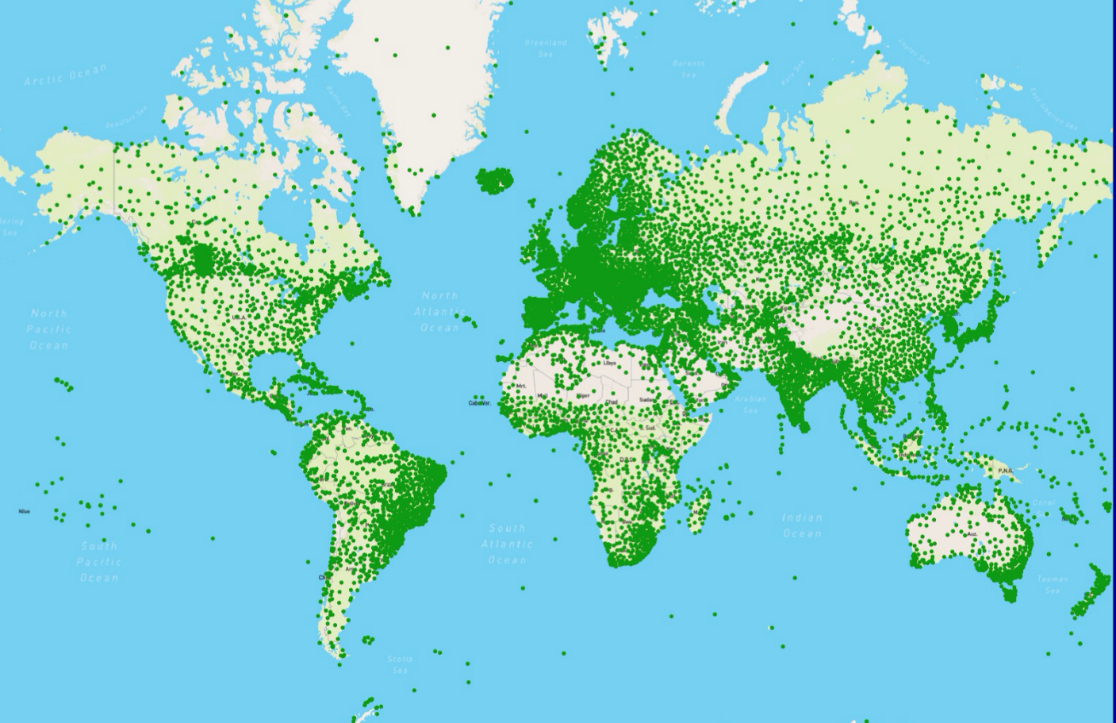
The WMO Global Basic Observing Network (GBON)
- a regulatory initiative to strengthen supply of observations for global NWP
GBON is a network based on a global design agreed between 193 countries, and that will help to turn data coverage map green;
Regulatory material to specify obligation of countries to acquire and exchange certain observations at set minimum horizontal resolution and at set minimum frequency;
Once regulations are approved, GBON can be implemented immediately in the developed world;
Potential benefits of full implementation of GBON in countries with largest data coverage gaps estimated to be around USD 5 billion per year, due to improvements in weather prediction (weather alone, potential climate-related benefits not yet assessed)

Slide 10
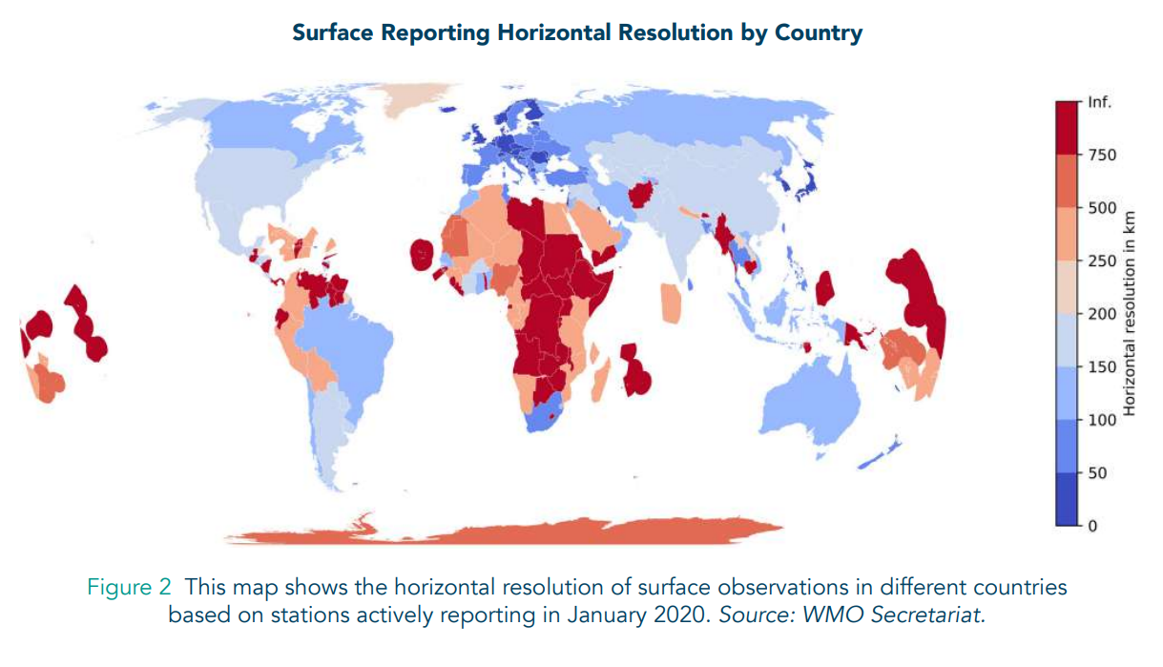
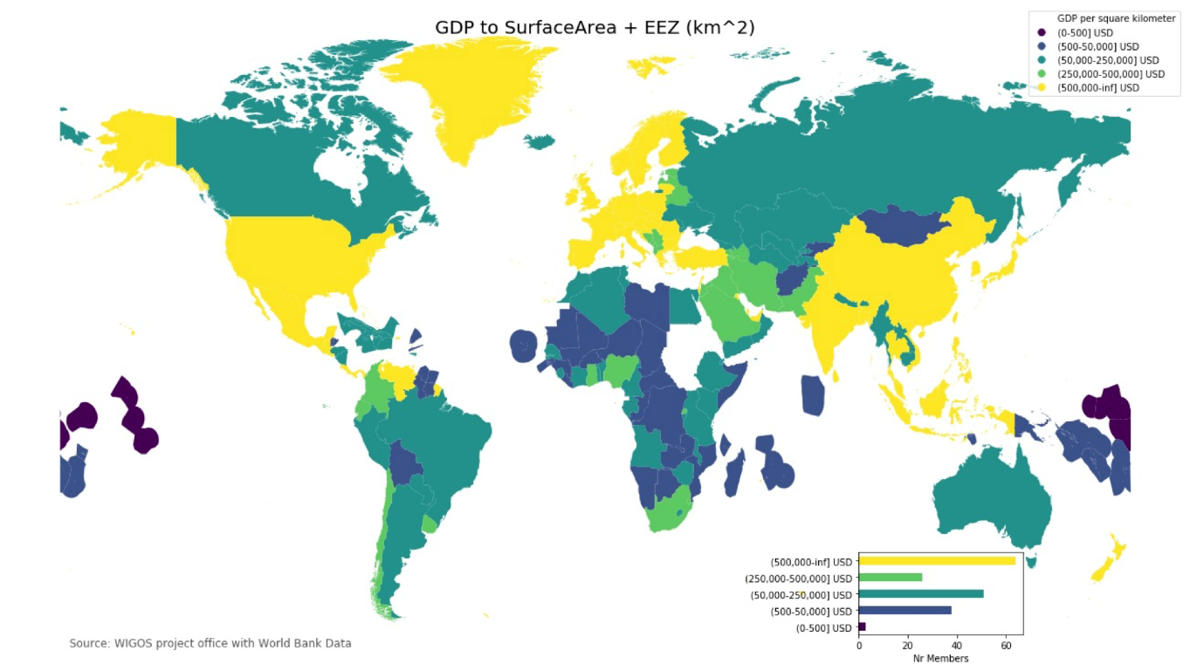
The Systematic Observations Financing Facility (SOFF)
Why is it needed?
WMO Convention and Paris Agreement implicitly assume that observations is solely a national responsibility
Ability to observe (left panel): Observing systems in countries depicted in red fail to meet minimum observations requirements for weather and climate analysis and prediction
Ability to pay (right panel): Affordability of observing responsibility (GDP/km2 of surface area) of countries in yellow up to ten million times higher than for countries in dark blue

Slide 11
What is the SOFF?
A global initiative to address a foundational problem in a systematic manner – missing surface-based observations from developing countries
A dedicated and innovative financing mechanism that will provide grants and technical assistance to achieve sustained GBON compliance, with a focus on LDCs and SIDS
A multi-partner initiative and commitment of the Alliance for Hydromet Development (coalition of 13 major climate and development finance partners), spearheaded by WMO
An initiative supported by beneficiary countries and international partners

Slide 12
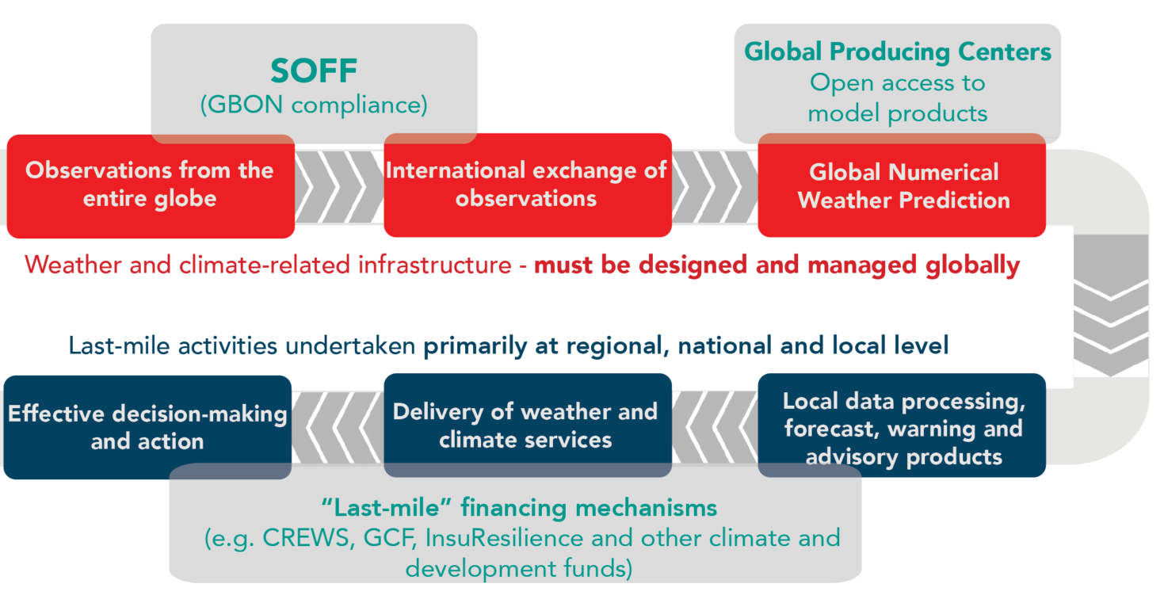
How will SOFF outputs translate into last-mile benefits?
SOFF systematic focus on the initial link in the value chain, as a necessary basis for any regional or national weather and climate services

Slide 13
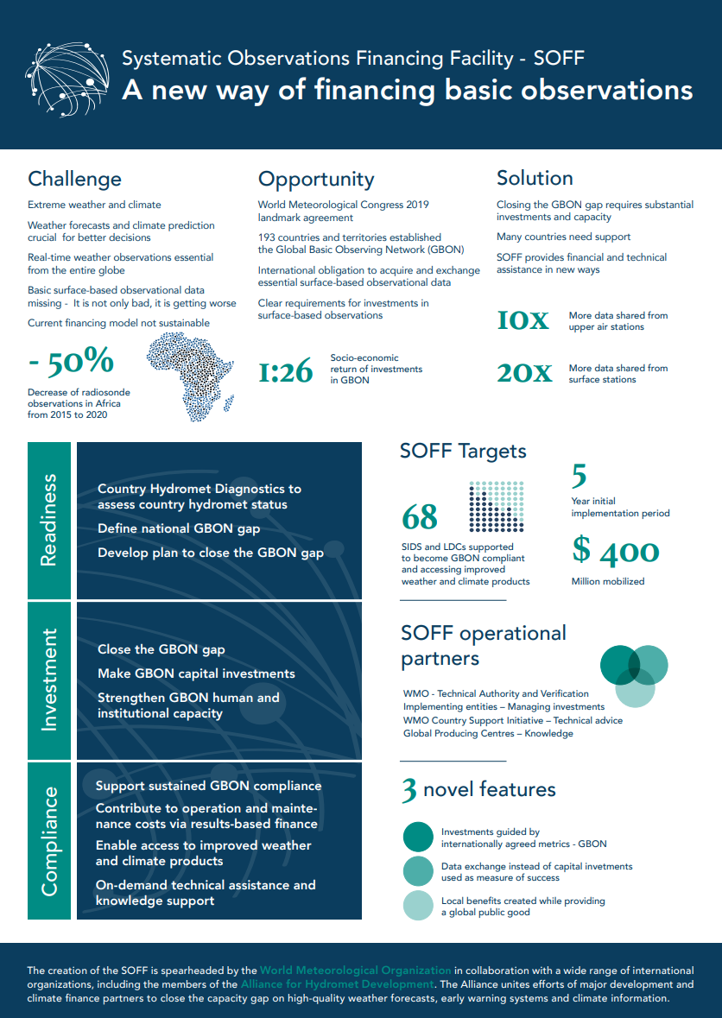
More information
Find out more about SOFF in our communication and knowledge products available here:
https://public.wmo.int/en/our-mandate/how-we-do-it/development-partnerships/Innovating-finance
SOFF statements of support from countries and partners
SOFF executive summary
SOFF Infographic
SOFF Brochure
SOFF video
The Systematic Observations Financing Facility - How will it work
The value of Surface Based Meteorological Observation Data Costs and benefits of the Global Basic Observing Network
The gaps in the Global Basic Observing Network
The value of GBON Exploring the Insurance Sector

Slide 14
Final remarks - what is the relevance of this for GOOS and OCG?
Frequently asked question among WMO Members:“Why no marine (or ocean) observations in GBON?“
The case for these observations is clear, but is it also clearly and broadly understood outside the GOOS community?
Observational remit of national governments does not naturally extend into high seas; will continued reliance on volunteerism be “good enough“?
A global financing mechanism could arguably make sense also for ocean observations;
Opportunities for WMO and IOC to work together on increasing awareness and linking this to the broader global agenda – SDGs, Sendai Framework, Paris Agreement, etc.

