Slide 1
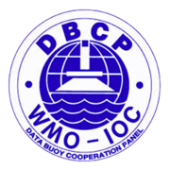
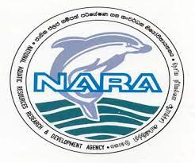
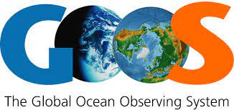
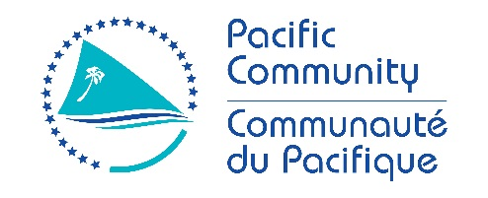
Fifth Pacific Islands Training Workshop on
Ocean Observations and Data Applications (PI-5)
27-28 May and 10-11 June 2021 (Fiji Time, UTC+12)
Country Report : Sri Lanka
Presented by : K.W. Indika,
National Aquatic Resources Research and Development Agency.
Email: iweligamage@yahoo.com, iweligamage@nara.ac.lk

Slide 2
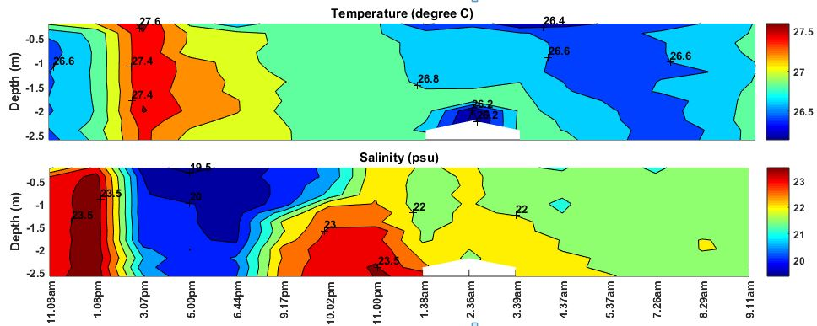
One CTD 9 Plus and CTD 19 Plus, Two MicroCAT /CTD
New instrumentation since 2019:
(e.g. CTD, Temperature logger, tide gauge, wave buoy)

Slide 3
New instrumentation since 2019:
(e.g. CTD, Temperature logger, tide gauge, wave buoy)
Two Microcat /CTD “ : Sri Lanka : NARA and China: FIO - Bilateral Research Project

Slide 4
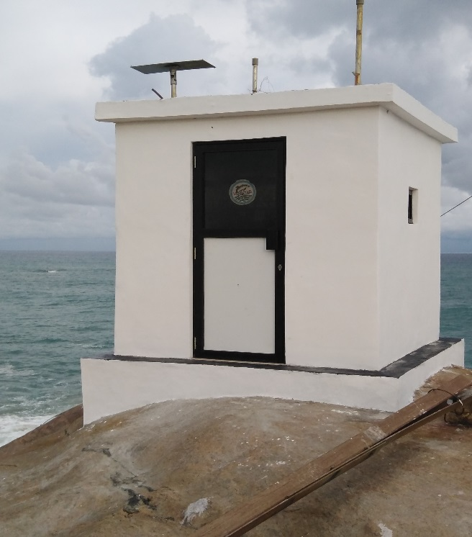
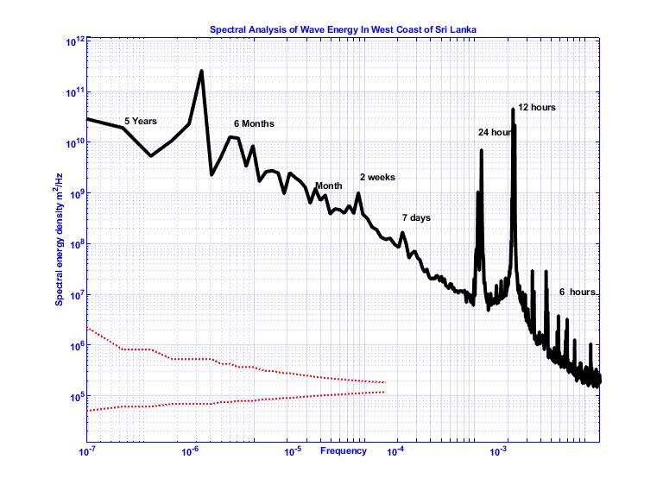
New instrumentation since 2019:
(e.g. CTD, Temperature logger, tide gauge, wave buoy)
One tide gauge

Slide 5
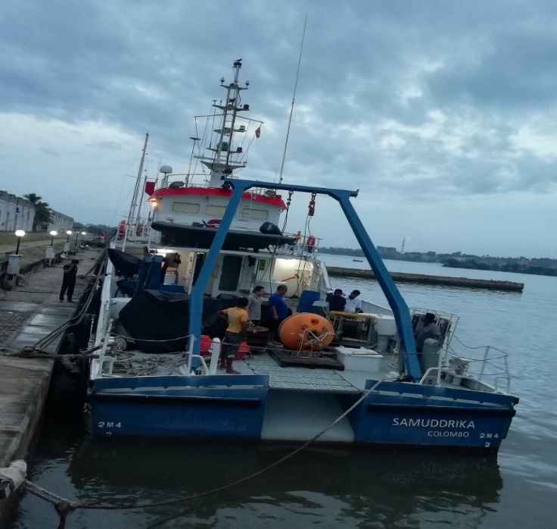
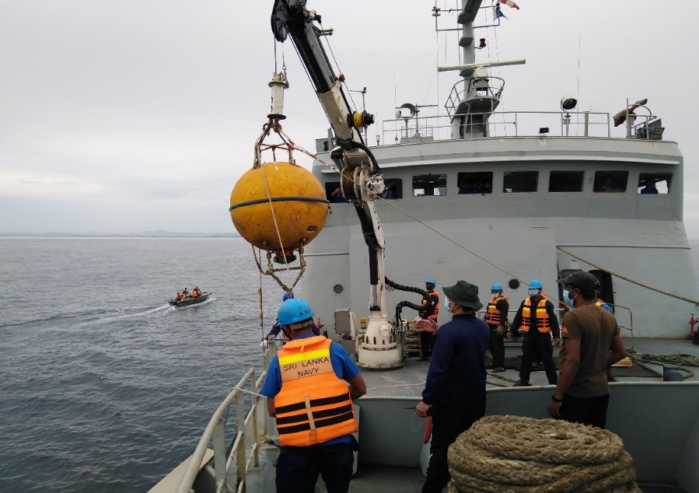
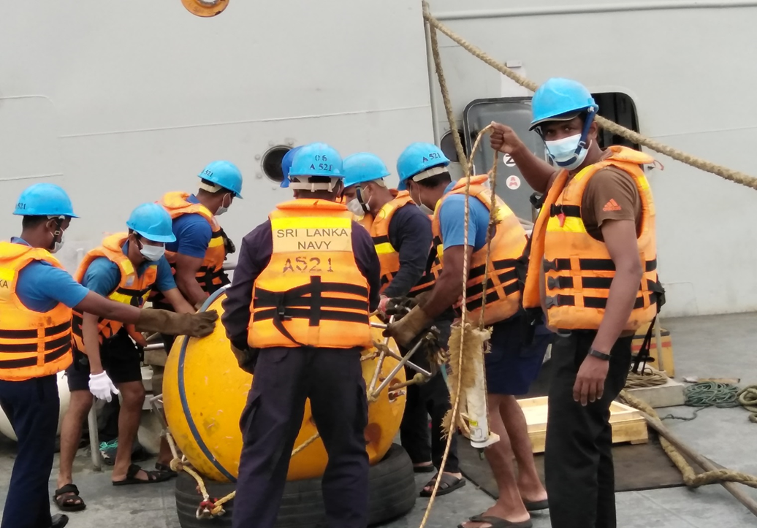
New instrumentation since 2019:
(e.g. CTD, Temperature logger, tide gauge, wave buoy)
One Sub Surface buoy : Sri Lanka and China joint project

Slide 6
New instrumentation since 2019:
(e.g. CTD, Temperature logger, tide gauge, wave buoy)
Sea Gliders : Sri Lanka USA bilateral research project

Slide 7
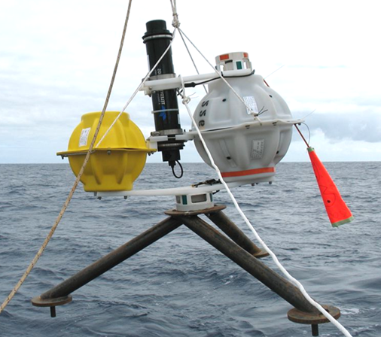
New instrumentation since 2019:
(e.g. CTD, Temperature logger, tide gauge, wave buoy)
Two Pressure Inverted Eco sounder (PIES). Sri Lanka and USA bilateral research project
PIES measure acoustic travel time to the surface and bottom pressure (two different integrals related to density and temperature)
Acoustic modem allows data retrieval from ships or gliders
Deployment durations of 4+ years
Instrumentation in the pipeline:
(e.g. any upcoming projects that may include instrumentation)
Two Pressure Inverted Eco sounder (PIES)

Slide 8
Ocean Science Capacity since 2019:
Any new staff with the ocean portfolio? Had been done
No
Any ocean science/oceanography training completed by staff:
No
Any staff with ocean science/oceanography certifications or on study leave?
One officer on study leave for MPhil

Slide 9
What do you hope to learn or take way from this training?
Update with latest technology for ocean observation
Work together and cooperation between regional centres
Training opportunities for enhance knowledge and capacity for oceanic data application and development
Thank You

