Slide 1
TUVALU OCEAN OUTLOOK
Tavau Vaaia – Simeona Forecast Division Tuvalu Meteorological Service MPWIELMD
Email: tamanuku06@gmail.com; tuvmet@gmail.com
Phone 20736

Slide 2
Outline
Introduction
Ocean Outlook
Dissemination
Tools – monitoring ocean
Gaps & Challenges
Recommendation

Slide 3
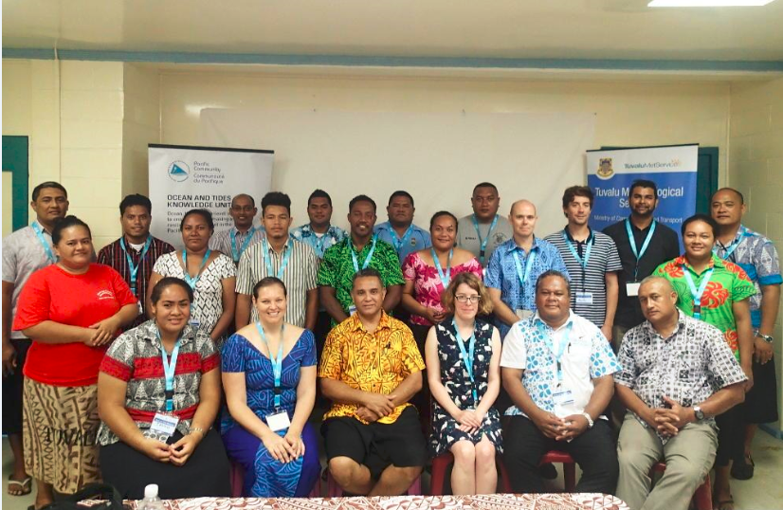
Introduction
Ocean & Tides Training Workshop: 23rd – 27th October 2017
Key stakeholders attended the workshop:
Fisheries Department
Marine and Port Services
Tuvalu Broadcasting Corporation
Maritime
Lands & Survey Department

Slide 4
..cont..
1st Ocean Outlook issued 26th February 2018
SPC Training Attachment: 16th – 18th April 2018
Mini – NCOF November 2018
Preparation and Dissemination procedures formulated.
Community consultations

Slide 5
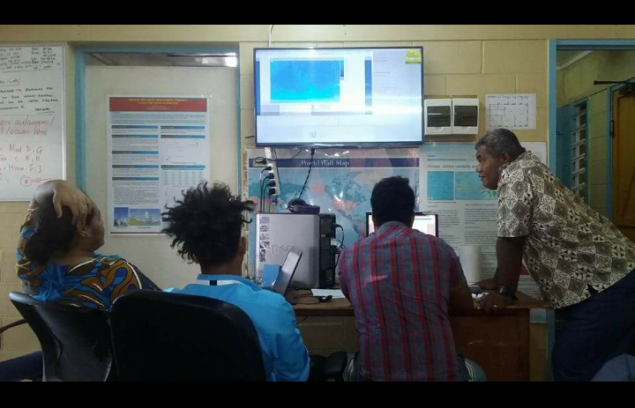
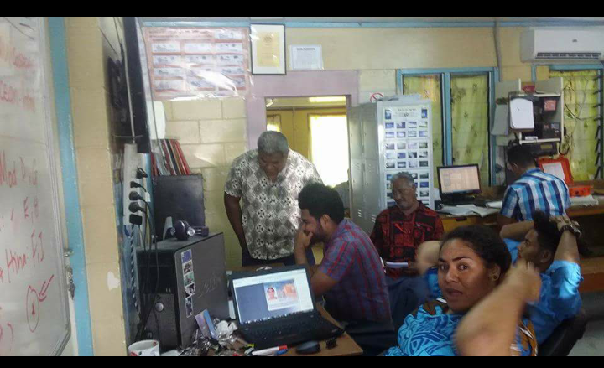
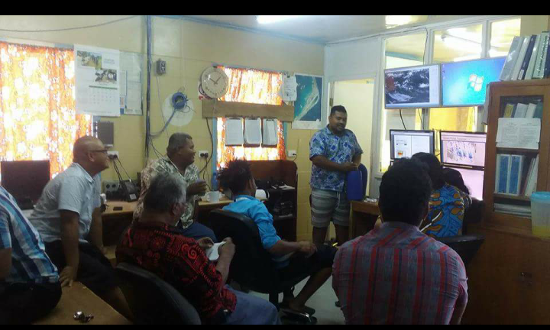
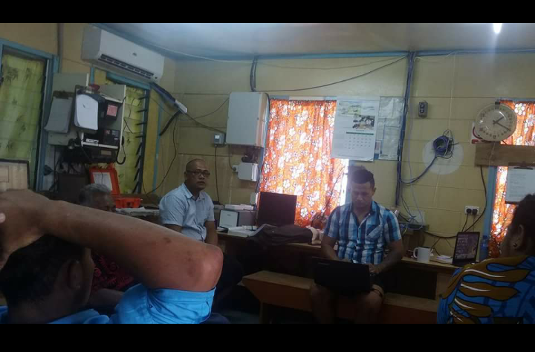
..cont..
In-office training

Slide 6
Dissemination
Tuvalu Met Service
community
Government staff
Island Councils

Slide 7
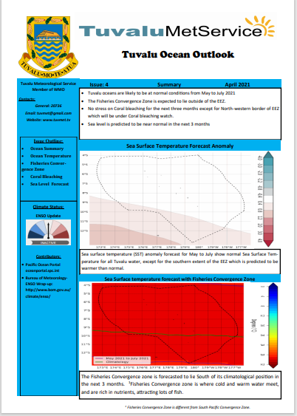
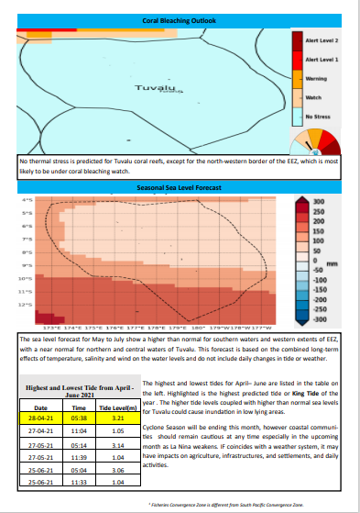
Tuvalu Ocean Outlook
Information in product:
SST Forecast Anomaly
Fisheries Convergence Zone
Coral Bleaching Outlook
Seasonal Sea Level Forecast
ENSO Scale
Tide Predictions - highest and lowest tides

Slide 8
Gaps & Recommendation
Translation into vernacular
Funds – to assist with awareness programs
Internet Connectivity
Capacity building
Monitoring and verification tools – SST & Coral bleaching.
Notes:
Radio programs are really expensive

Slide 9
Fakafetai lasi

