Slide 1
Shweta Shiwangni
climate@met.gov.fj

Slide 2
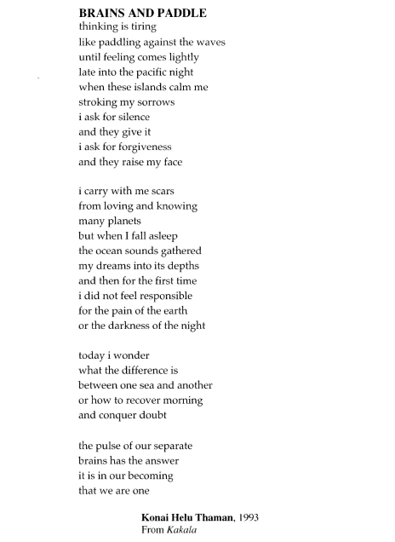
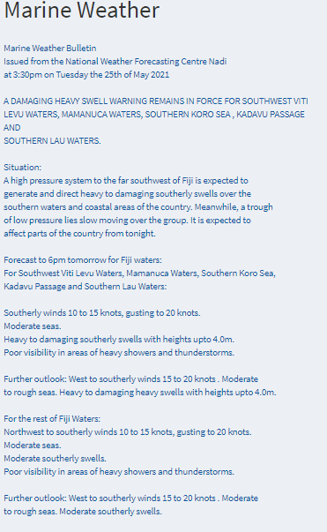
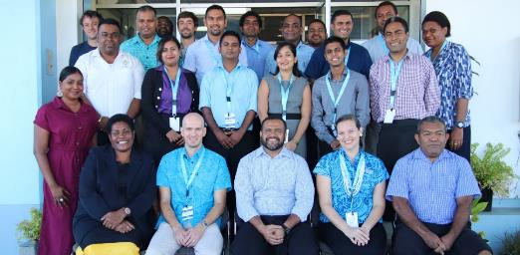
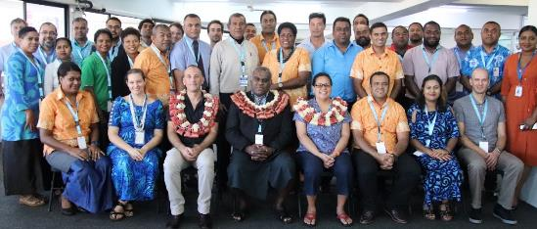
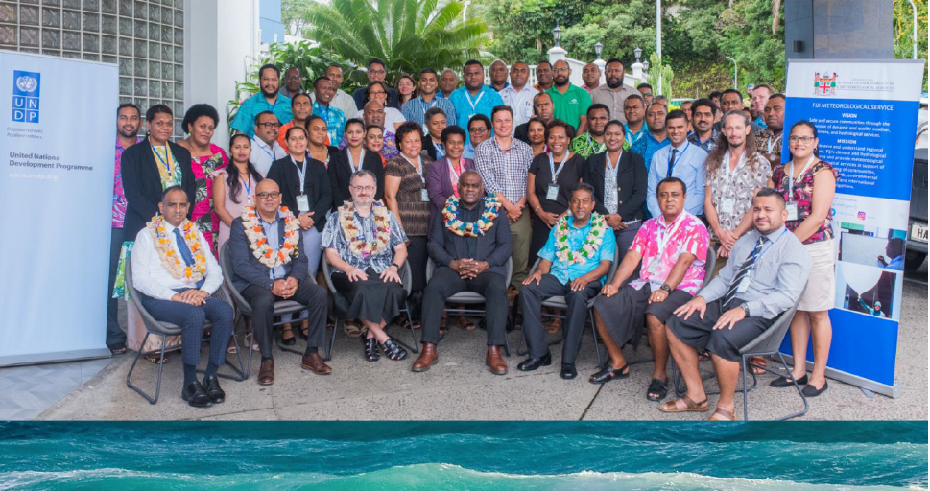
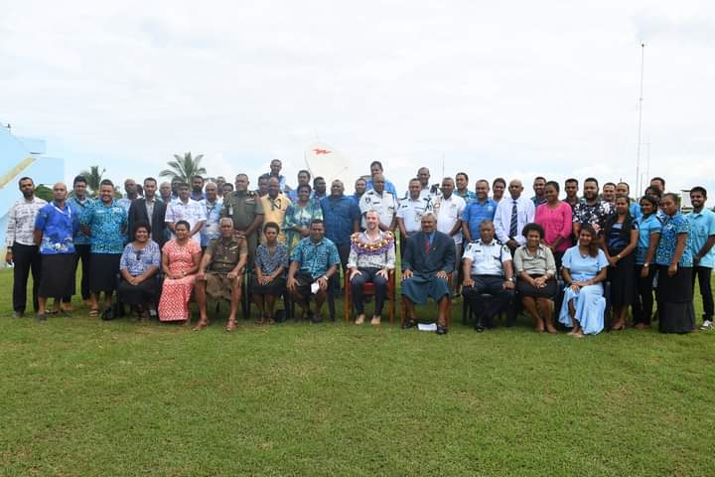
Journey with the Ocean: From Science to Service
Figure 1: Participants from different ocean capacity building phases.

Slide 3
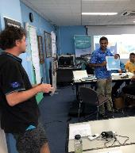
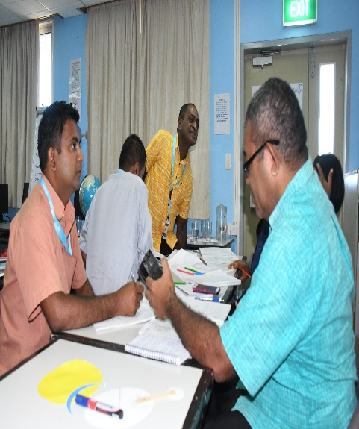
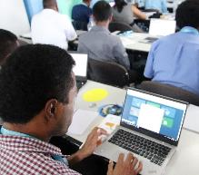
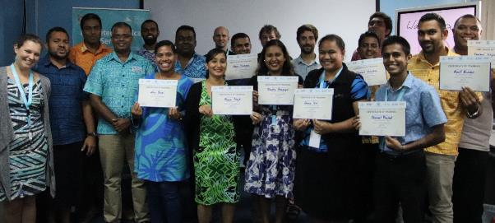
Training and Capacity Building
Introductory ocean science concepts delivered to develop FMS’s oceanographic capacity
Figure 2: Fiji Ocean Science to Service Workshop – Technical Training conducted in Nadi from 8-12 July 2019.

Slide 4
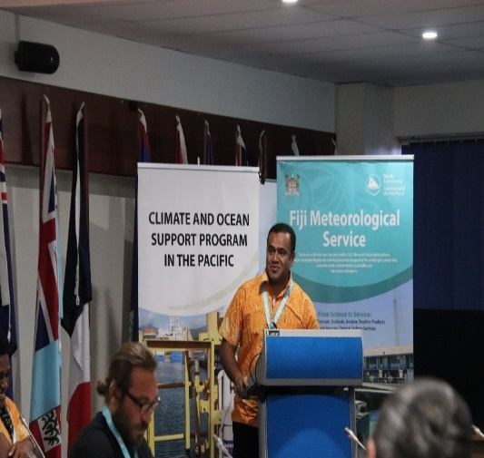
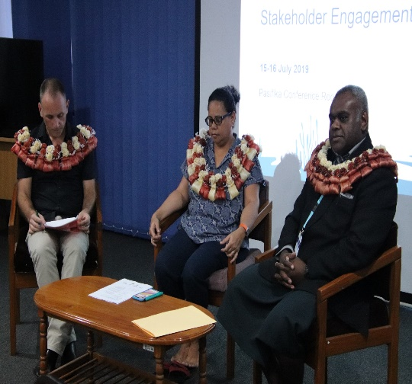
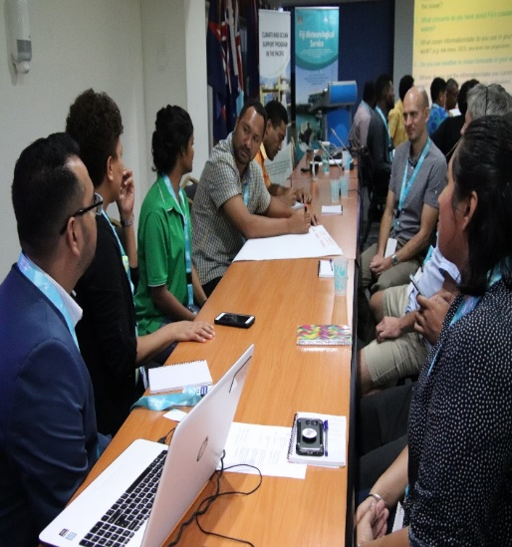
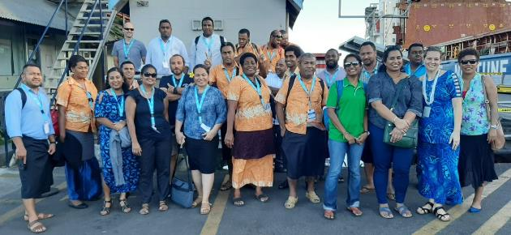
Stakeholder Engagement
Stakeholders from variety of organisations and agencies such as Fiji Navy, Fiji Ports, Government Shipping Service, Marine Search and Rescue, Fisheries, USP
Figure 3:Ocean Stakeholder Engagement held in Suva from 15-16 July 2019.

Slide 5
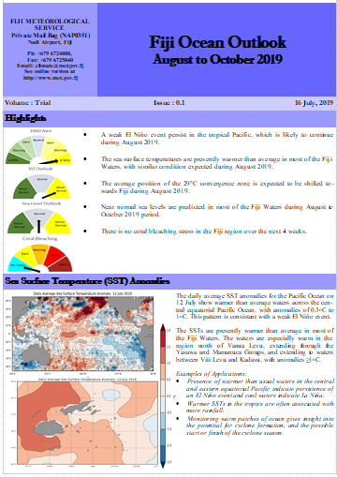
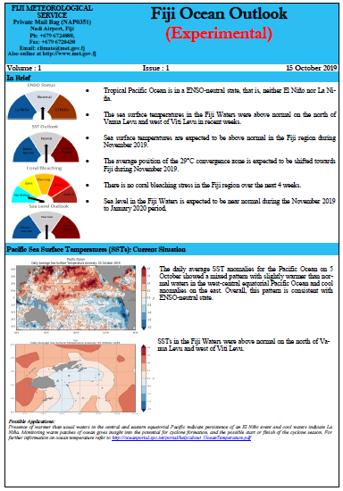
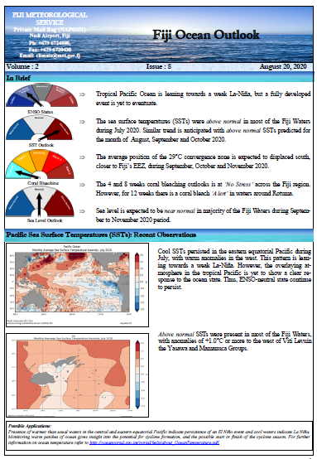
Development of Fiji Ocean Outlook Bulletin
Initial Stage Experimental Stage Fully Operational Stage
Figure 4: Initial to Fully Operational Development stages of Fiji Ocean Outlook.

Slide 6
Key Information Available – Monthly and Seasonal Timescale
Monthly Timescale – Observations
Pacific Sea Surface Temperature
Sea Surface Temperatures – Fiji
Chlorophyll Concentration
Seasonal Timescale - Predictions
Sea Surface Temperature Outlook
Fisheries Convergence Zone
Coral Bleaching Outlook
Sea Level Outlook
Tide Predictions
Moon Phases

Slide 7
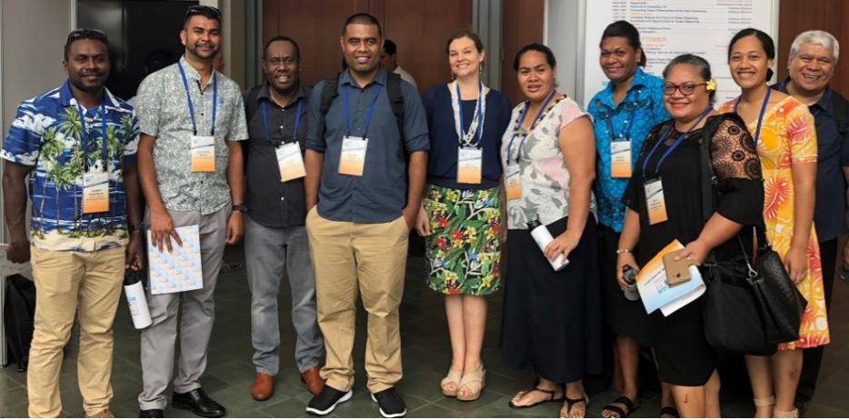
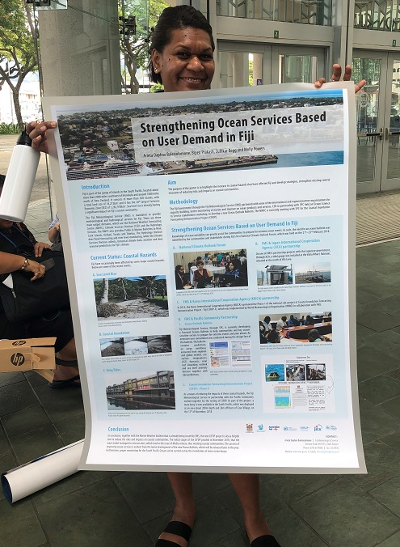
Steering the Paddle Towards Hawaii
Figure 5: Participants from Cook Islands, Fiji, Kiribati, Samoa, Solomon Islands, Tonga, Tuvalu, and Vanuatu Meteorological Services, together with SPC representatives attending the global ocean observing conference in Hawaii.
Figure 6: Scientific Officer (Climatology), Ms. Arieta Daphne, with Fiji's Ocean Poster containing information on the seasonal ocean bulletin which was developed using Ocean Data portal, in partnership with SPC.

Slide 8
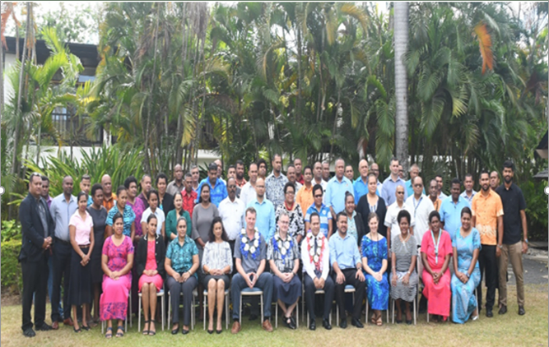
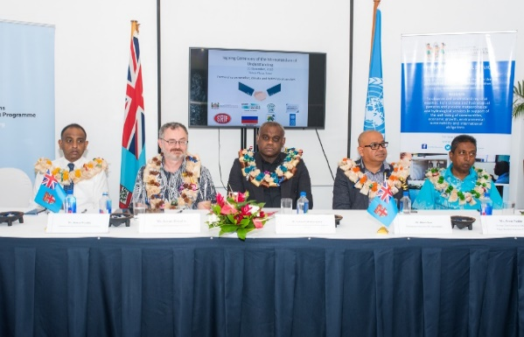
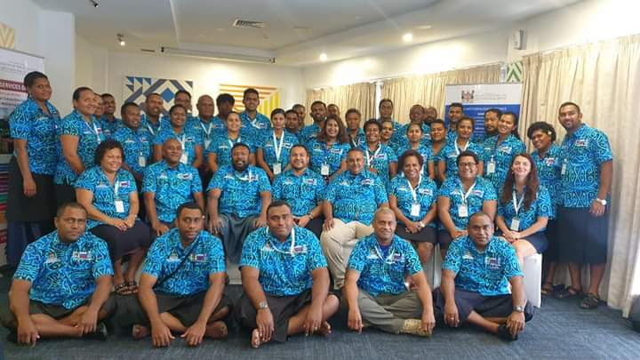
Continuous Steering Against the Waves
A number of ocean, fisheries and maritime stakeholders provided feedback on the Ocean Outlook
Focus was ocean and fisheries sector which generated attention from both mainstream and social media platforms
Figure 7: 2nd National Climate Outlook Forum held in Nadi from 2-6 December 2019
Figure 8: 3rd National Climate Outlook Forum held in Suva from 25-26 November 2020

Slide 9
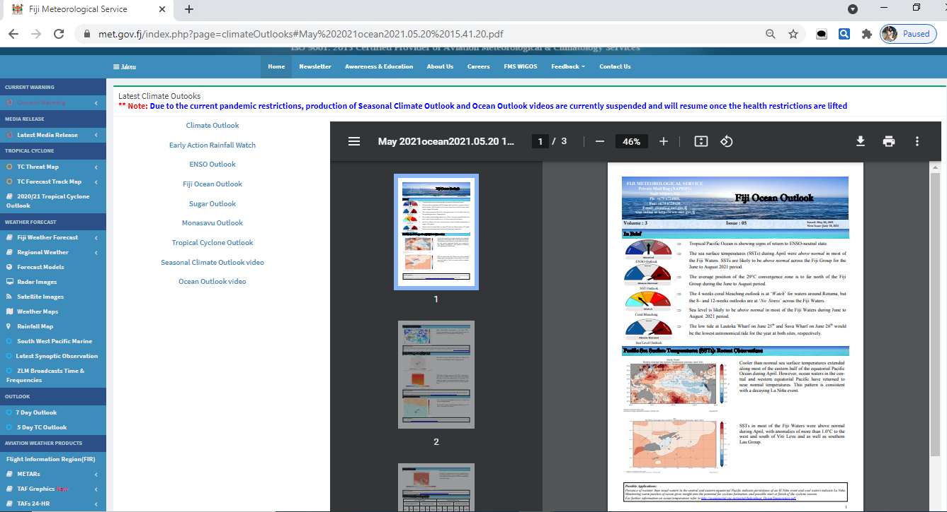
Disseminating Waves of Knowledge
Email – Internal and External Stakeholder mailing list
Website

Slide 10
FMS Social Media Platforms

Slide 11
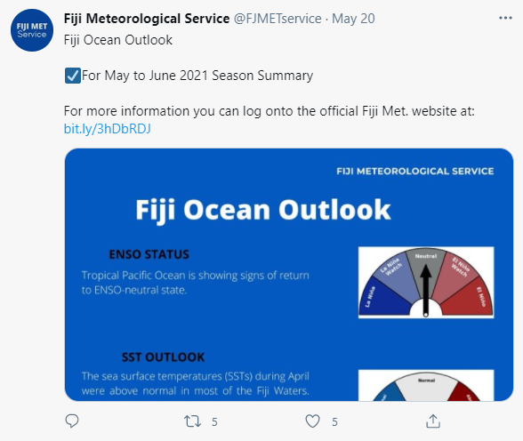
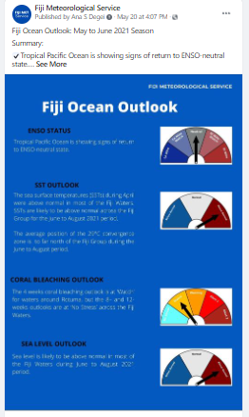
Twitter and Facebook Posts

Slide 12
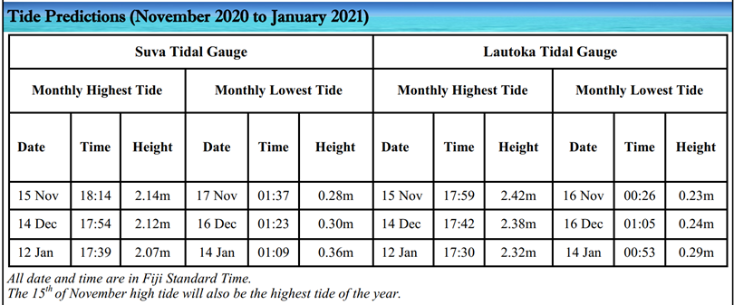
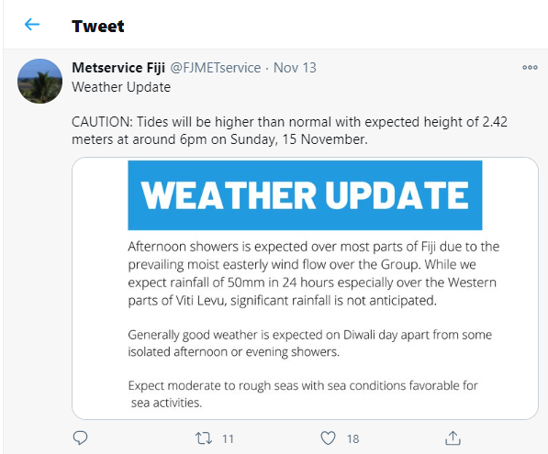
Tide Predictions

Slide 13
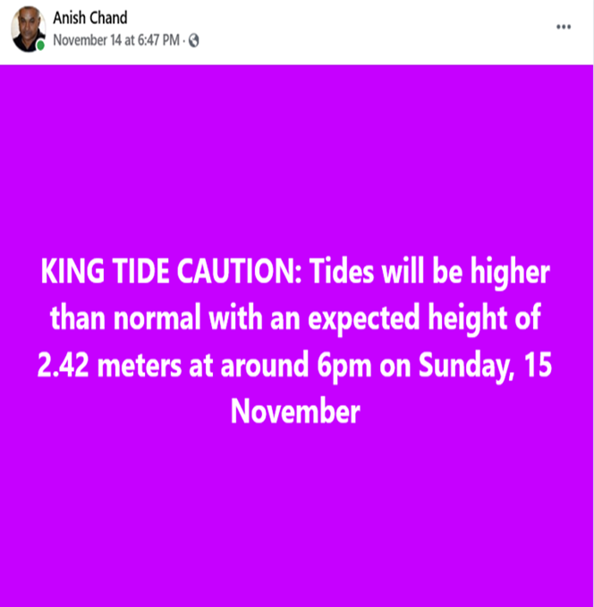
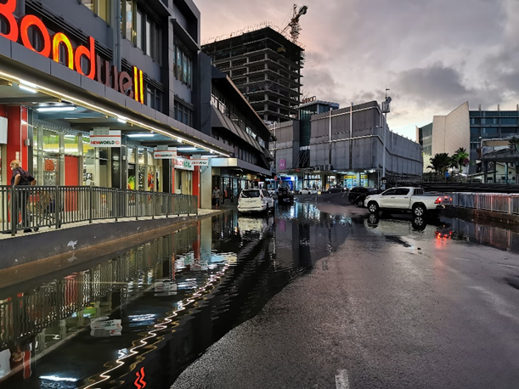
Figure 9: Different users benefit from Tide predictions. Source: Facebook
Figure 10: Impact of higher than normal tides. Picture Credit: Zulfikar Begg - SPC

Slide 14
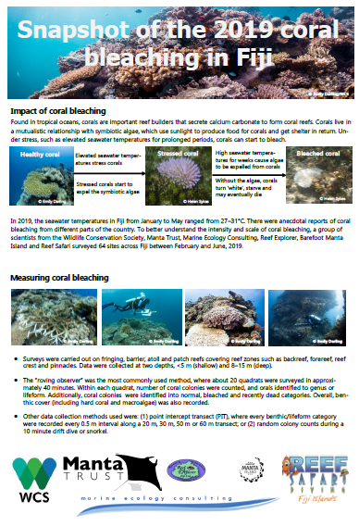
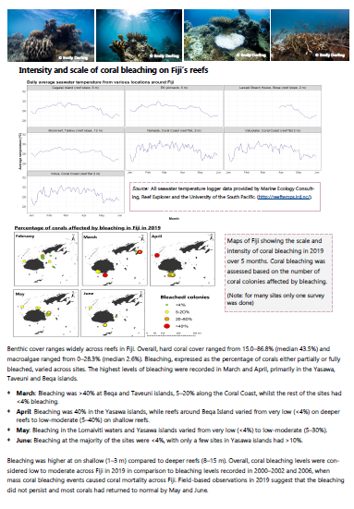
Waves Pave the Way: User Feedback

Slide 15
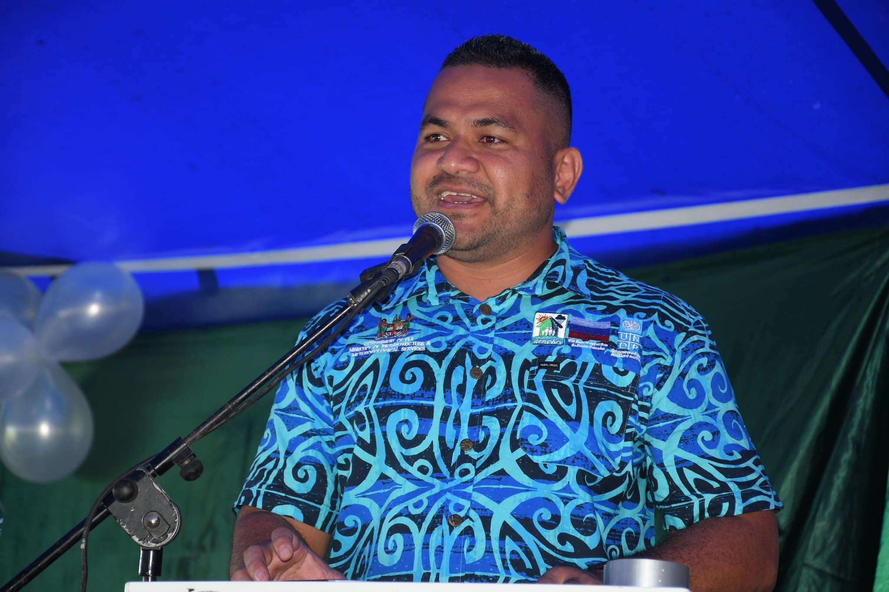
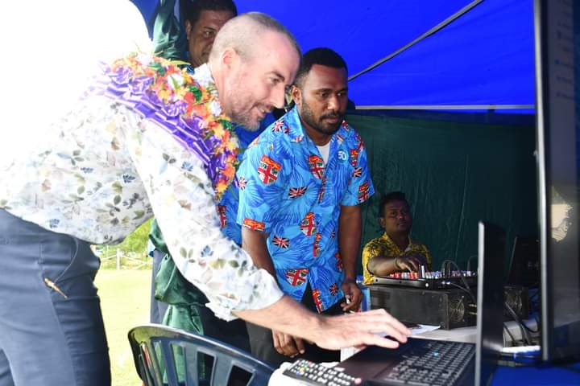
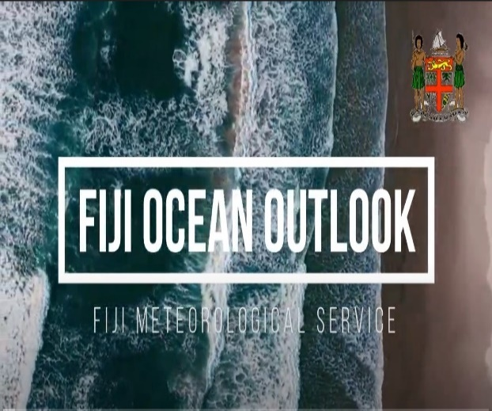
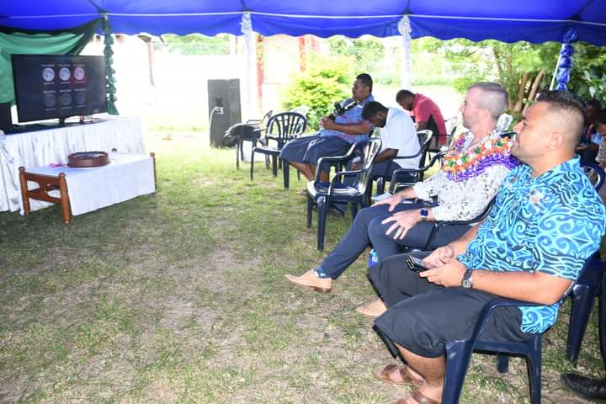
Paddling Against all Odds: Launch of Fiji Ocean Outlook Video (“First for the Pacific”)
World Meteorological Day 2021 Theme: The Ocean, Our Climate and Weather
UN Decade of Ocean Science for Sustainable Development (2021-2030)
Youtube Links- Ocean Outlook Video
https://www.youtube.com/watch?v=7LNTPYI7G9M
https://www.youtube.com/watch?v=6s-813U6vdE
Figure 11:Fiji Ocean Outlook Video gets launched during World Meteorological Day 2021

Slide 16
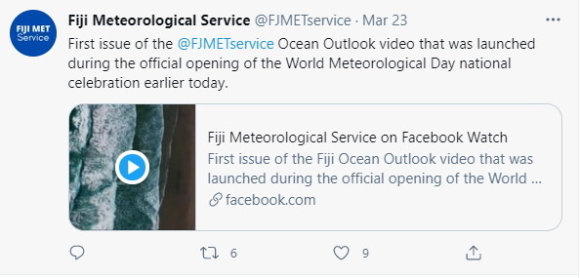
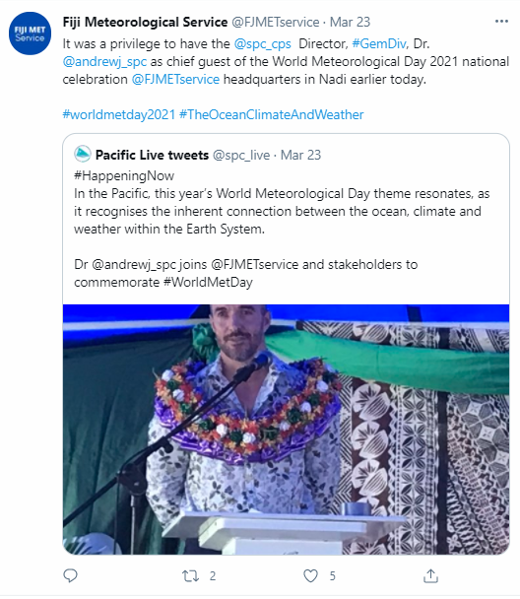
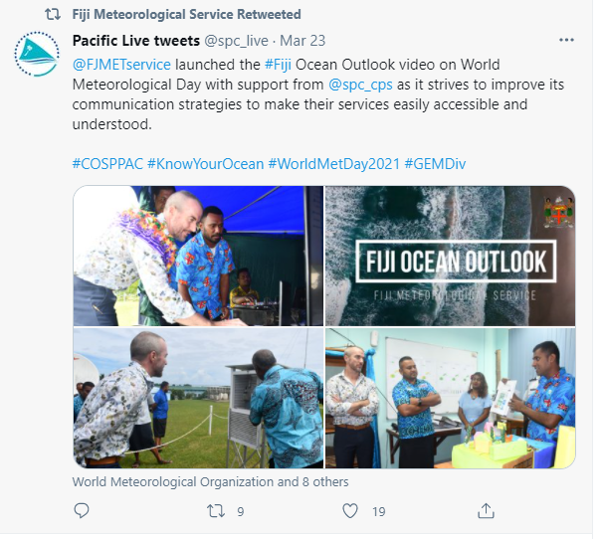
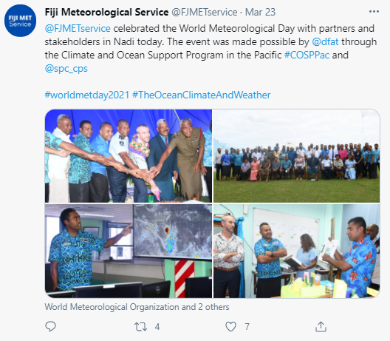
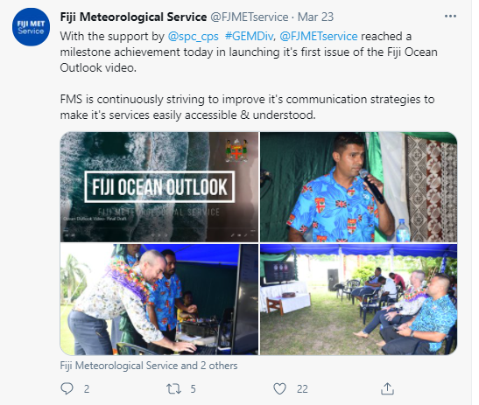
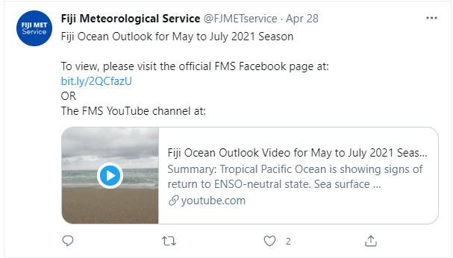
Interconnectedness of the Ocean
Figure 12: Media hype of Fiji Ocean Outlook Video Launch.

Slide 17
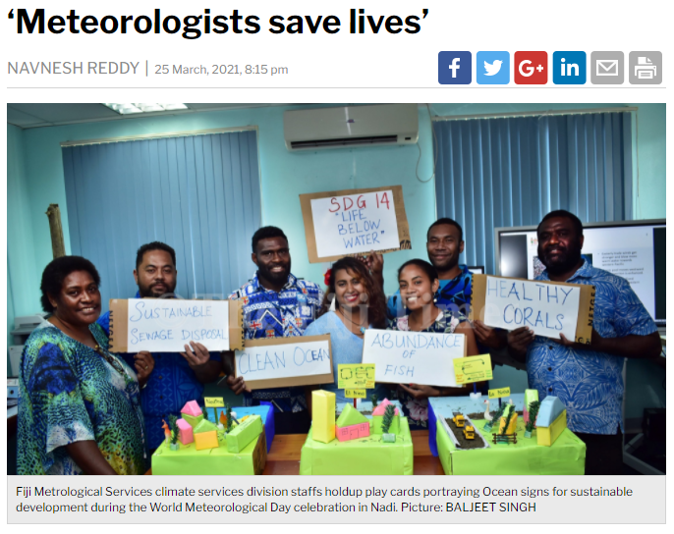
Journey of New Discoveries
Figure 13: CSD Staffs communicating science through models
https://www.fijitimes.com/meteorologists-save-lives/?fbclid=IwAR3E39QWdWJQxMRSKtPTWuP-my6d6ryk4jnbbpC2SvtOHfYxo-80uvk09Go

