Slide 1
Dart Buoy Data utilization in the republic of Marshall islands
5th Pacific Islands Workshop on Ocean Observations & Data Applications
Lee Jacklick Supervisory Weather Service Specialist WSO Majuro

Slide 2
Background
Since 2012, PacIOOS has offered a high sea-level forecast for Majuro to predict higher-than-normal sea levels that could result in potential coastal flooding.
On July 10, 2014, PacIOOS deployed a Datawell Directional Waverider buoy about 1 mile off the eastern shore of Majuro.
In October 2014, the Majuro Wave Run-Up forecast tool was launched. The tool updates hourly and provides a forecast of high sea level and potential wave run-up for ocean-facing shorelines for the upcoming six days.
In January 2015, the Majuro Wave Run-Up Forecast predicted a series of potential flooding events for the upcoming days. Ocean-facing shorelines of Majuro Atoll experienced wave inundation and houses were flooded.
RMI is almost entirely made up of low-lying atolls, making it extremely vulnerable to flooding. Majuro, with a population density of 7,413 people per square mile, is particularly vulnerable.

Slide 3
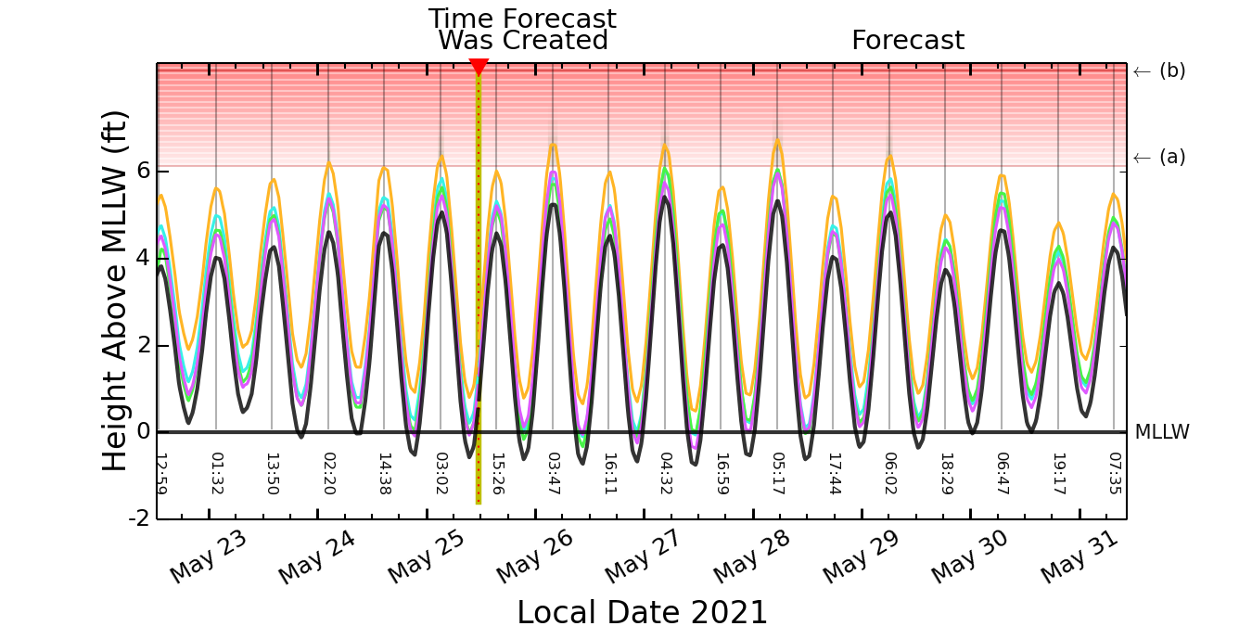
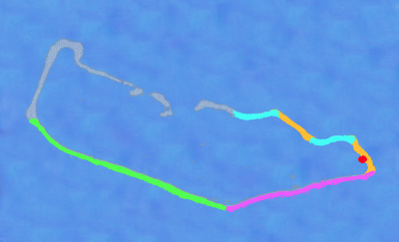
Majuro Atoll Wave Run-Up Forecast
Four separate color-coded Wave Run-Up Forecasts are provided for the ocean-facing shorelines (not lagoon side) of the most populous parts of Majuro atoll. The Cyan, Orange, Magenta, and Green curves show the potential Inundation Height for the respective unarmored shorelines due to high tides and/or wind-generated waves. If the forecasted inundation height extends into the red shaded area, inundation is likely in unprotected low-lying areas. The forecasts are updated hourly.
The Black Curve displays the Observed and Forecast Sea Level at Majuro Atoll (Uliga Dock) for the previous 3 days and the next 6 days, respectively, relative to Mean Lower Low Water (MLLW, a typical NOAA datum). Grey vertical lines show the associated times of the forecasted high sea level.

Slide 4
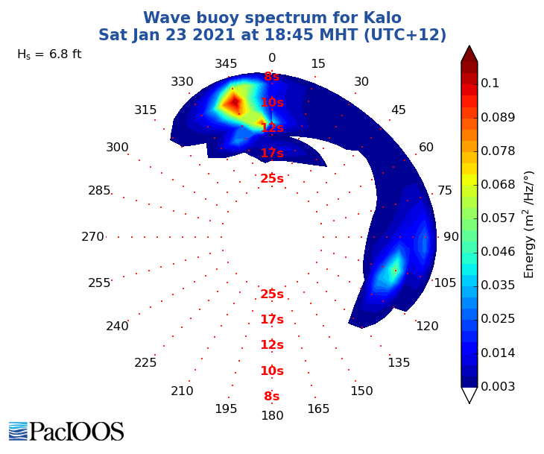
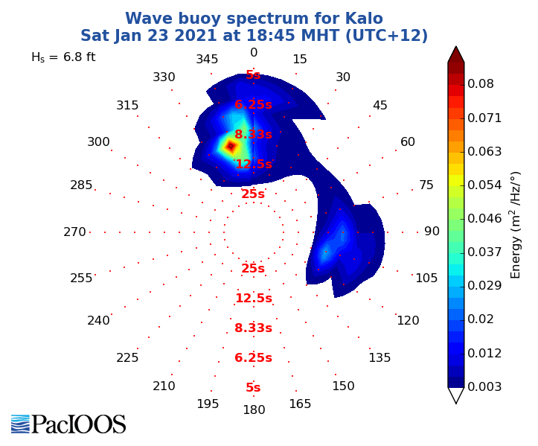
Swell spectrums
Full directional spectrum of the wave energy field
Swell directional spectrum

Slide 5
Data utilization
The Majuro Wave Run-up Forecast's ample lead time not only saved lives, but also allowed government agencies and residents to proactively build temporary berms to minimize damage to community infrastructure and personal property.
Wave rider buoys allowed NWS to produce accurate, high-surf forecasts and advisories that warned the public of the coming hazard.
Local fishermen, tour companies and other mariners all use the data provided by the wave buoys to routinely make informed decisions.
Government Search and Rescue efforts use the wave observations to locate drifting mariners.
In addition to providing critical safety data for the atoll and its residents, the buoy’s data will be used by weather forecasters and researchers working to develop flood forecasts for Majuro. It joins 11 other buoys in the PacIOOS network that monitor conditions in the Pacific Islands.

Slide 6
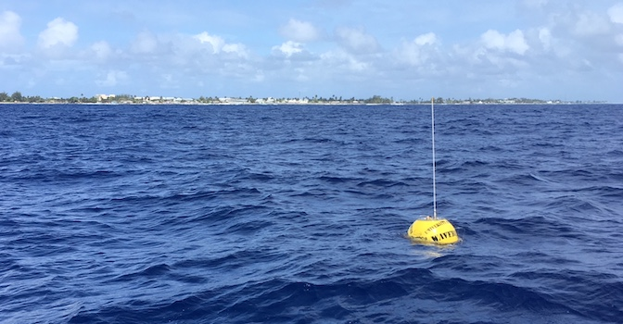
In Conclusion
“The Majuro wave buoy has revealed many of the unique characteristics of the potentially destructive waves that threaten the atoll from the east, south and west. It will reveal more secrets, and we will eventually solve the wave forecasting challenge at Majuro."
Chip Guard
Warning Coordination Meteorologist at WFO Guam (Ret.)
Source PacIOOS

