Slide 1
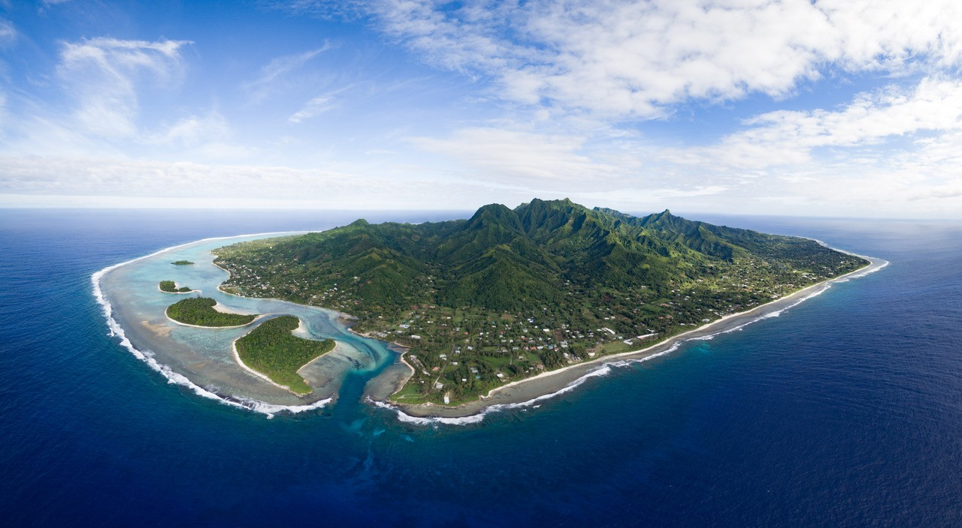

Water Research Laboratory | School of Civil & Environmental Engineering
Oceanographic investigations to support an
environmental risk assessment for ocean outfall disposal of wastewater

Slide 2
What do ocean observations have to do with wastewater?
Ocean outfalls are used in many countries within the region for disposal of treated (or not-so-treated) wastewater into the ocean. A quick search shows PNG, Fiji, FSM, American Samoa, Kiribati, RMI, Guam, Hawaii but likely others too.
Evaluation of risks (environmental, health, recreational) and design of the sewage treatment infrastructure (treatment plant and ocean outfall) requires detailed numerical modelling of:
      Outfall hydraulics within the ocean around the outfall (near field zone);
      Wastewater plume dynamics (far field zone):
        How the plume mixes and spreads;
        Where the plume moves under different met-ocean conditions (how far, how close to coast etc.);
        How much the wastewater is diluted within the surrounding ocean, and whether environmental receiving water quality targets are met;
  Numerical modelling of outfall & plume behavior is only as good as the calibration data behind it.

Slide 3
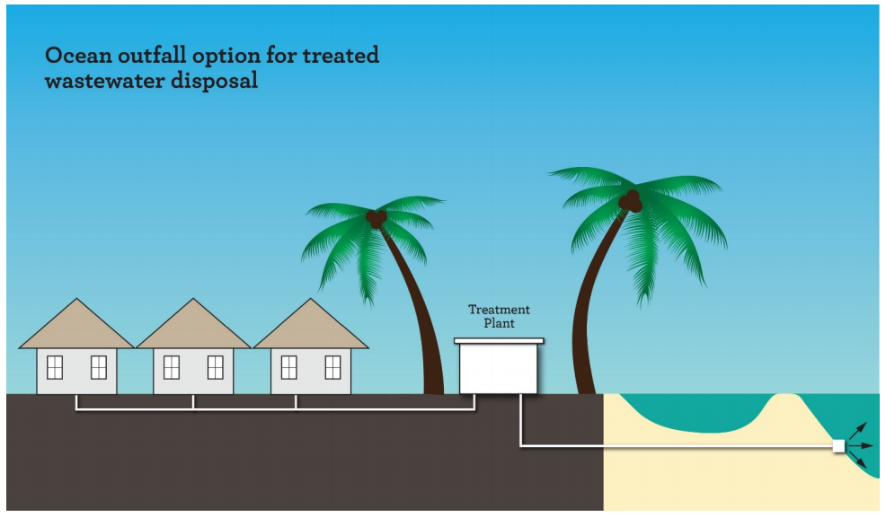
What do ocean observations have to do with wastewater?

Slide 4
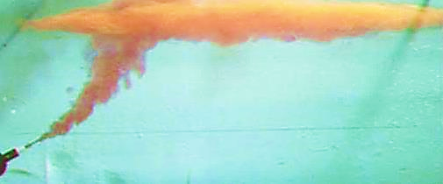
What do ocean observations have to do with wastewater?
Convection & Advection
Met-ocean parameters dictate outfall plume mixing and behavior:
Ocean currents and current profile;
Ocean temp and temp profile;
Salinity & density;
Waves;
Wind.
Diffusion & Dispersion
Buoyancy
Turbulence
Entrainment

Slide 5
Oceanographic investigations - Rarotonga
Reticulation and treatment of wastewater is needed for the Muri catchment in Rarotonga, to improve the health of Muri Lagoon which is currently impacted by excess nutrients, predominantly from onsite wastewater systems;
Disposal of treated wastewater via an ocean outfall is one of several options under consideration (though not the preferred option).

Slide 6
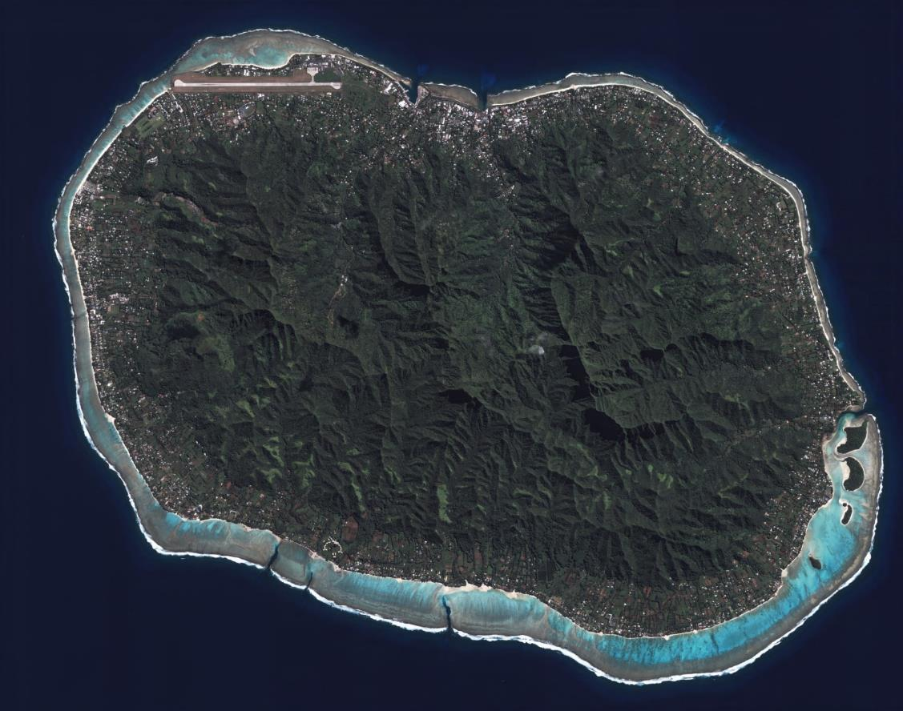
Oceanographic investigations were required to:
Assess the potential viability of the outfall wastewater disposal option;
Evaluate environmental, health and recreational risks;
Inform concept design of the treatment plant and outfall (location, size, treatment level etc.)
Two phases of oceanographic data collection have been undertaken so far:
Dye tracer and current profiling investigations for four locations (one-time deployment)
Monitoring of waves, current profile, temperature profile for potential outfall location (4-month deployment)

Slide 7
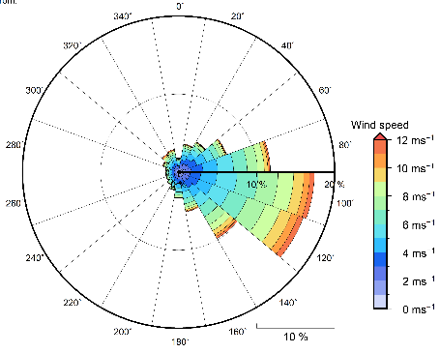
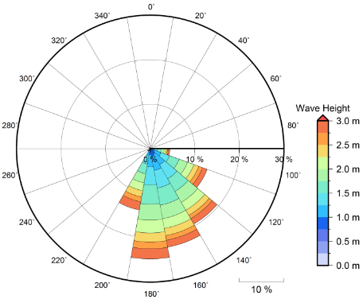
Annual Winds
Annual Waves

Slide 8
Phase 1 investigations – 4 locations:
Temperature – depth profiling;
Profiling of currents using vessel-mounted ADCP (acoustic doopler current profiler);
Deployment of GPS drifters;
Fluorometric dye tracer.

Slide 9
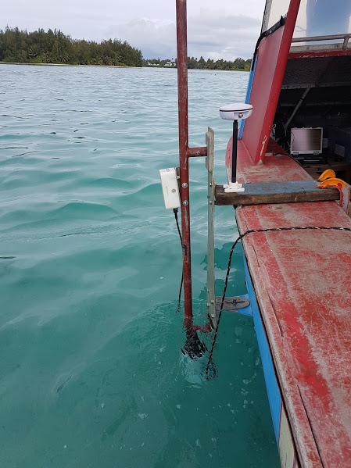
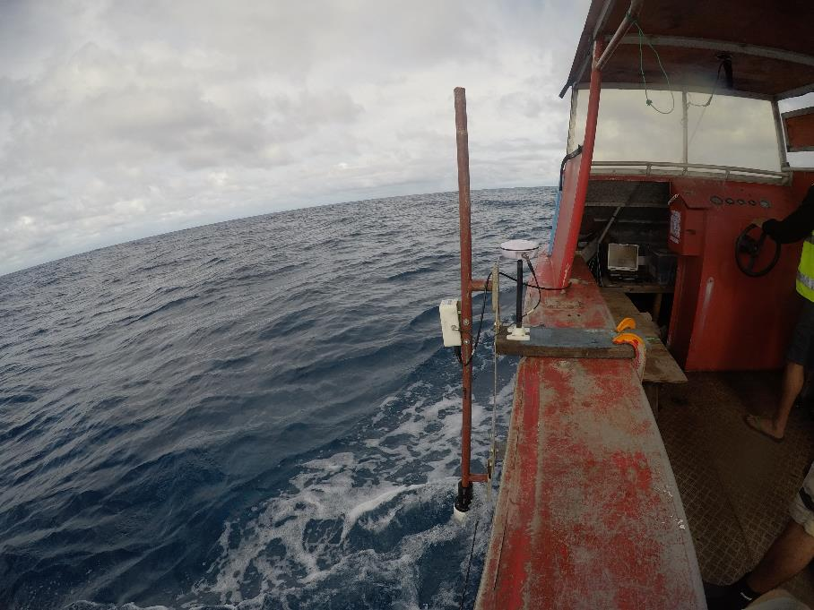
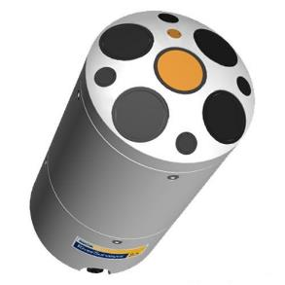
Measurements of ocean currents
Vessel-mounted Sontek M9 acoustic current meter for vertical current profiling;
Integrated GNSS for mapping position.

Slide 10
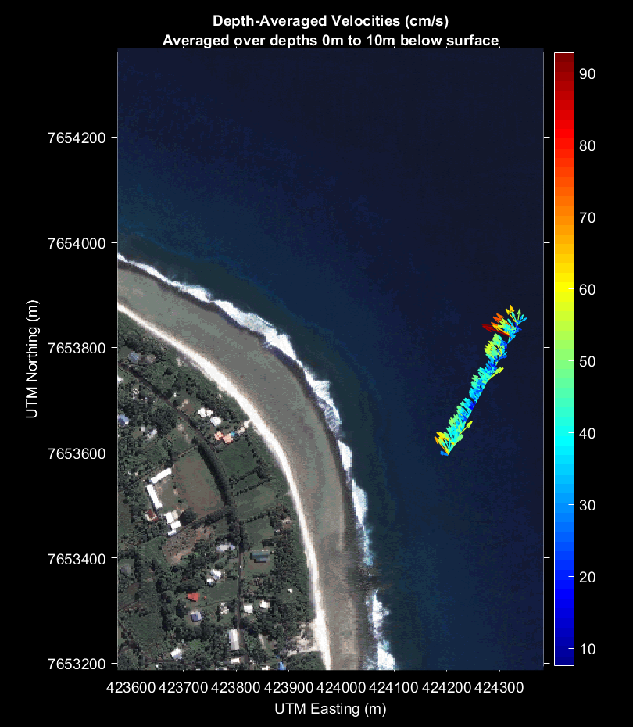
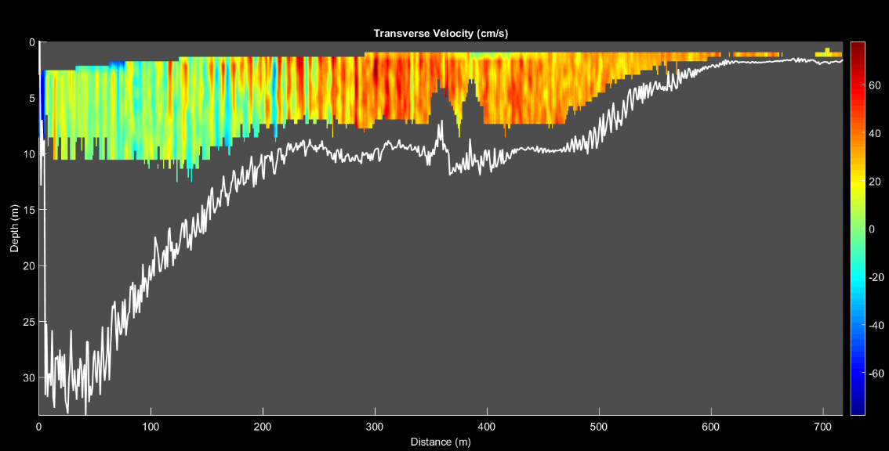
Measurements of ocean currents
Measurements of currents along cross-shore transects;
Vertical profile of current speed and direction.

Slide 11
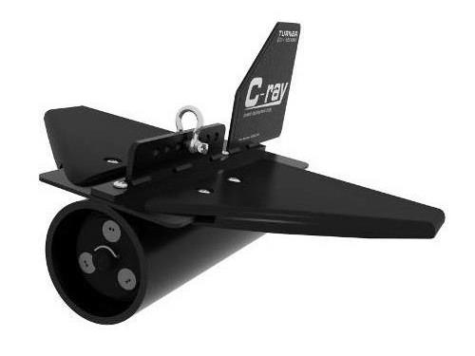
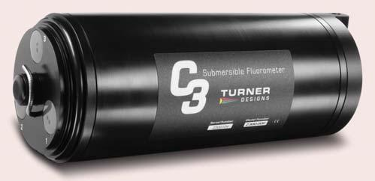
Measurements of ocean mixing, dispersion, advection
Specialist fluorometric dye tracer deployments (Rhodamine WT);
Measurement of dye concentration and movement through time using vessel-towed Turner Designs C3 Fluorometer;
      Dispersion, advection, dilution etc.
Measurement of surface currents using GPS drifters;
Post-processing of data to calculate site-specific ocean mixing characteristics, including dispersion coefficients for numerical modelling.

Slide 12
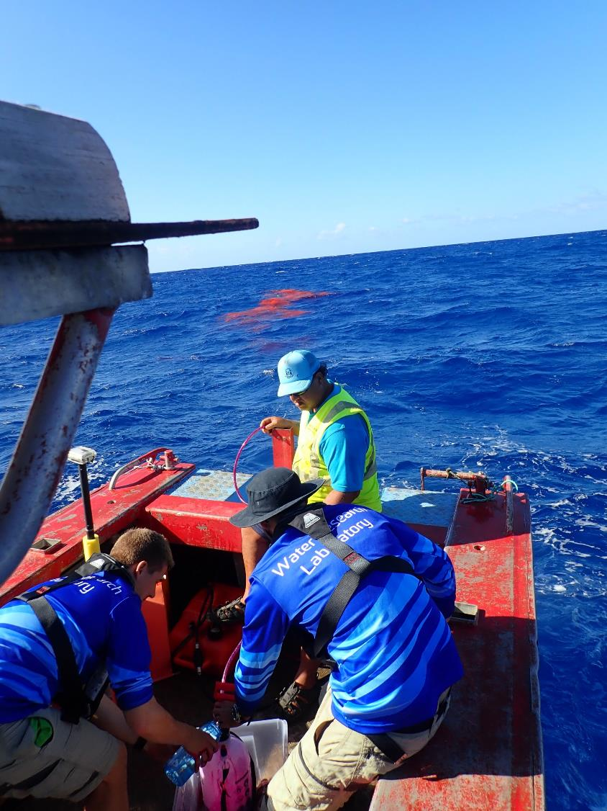
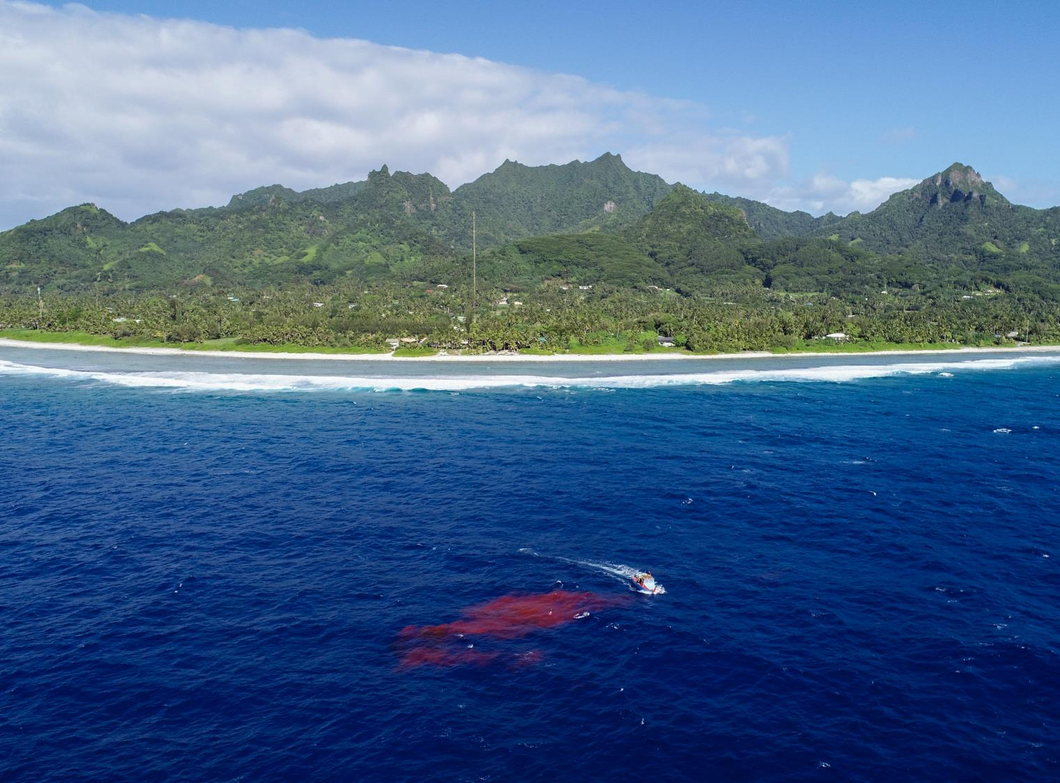

Slide 13
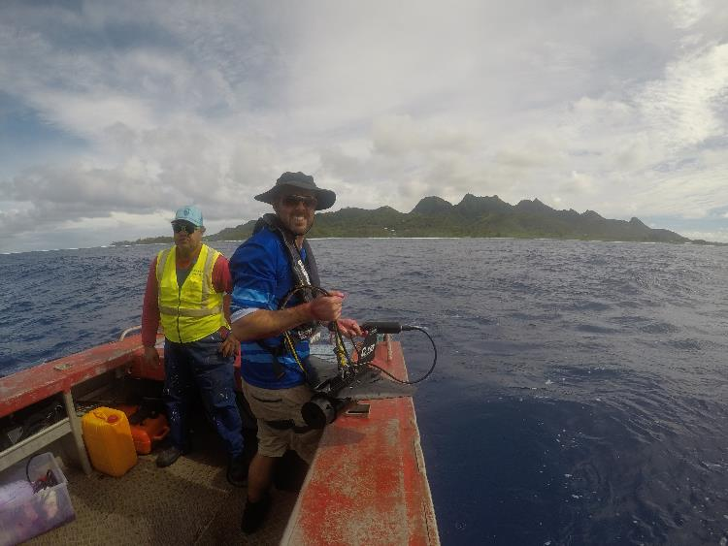
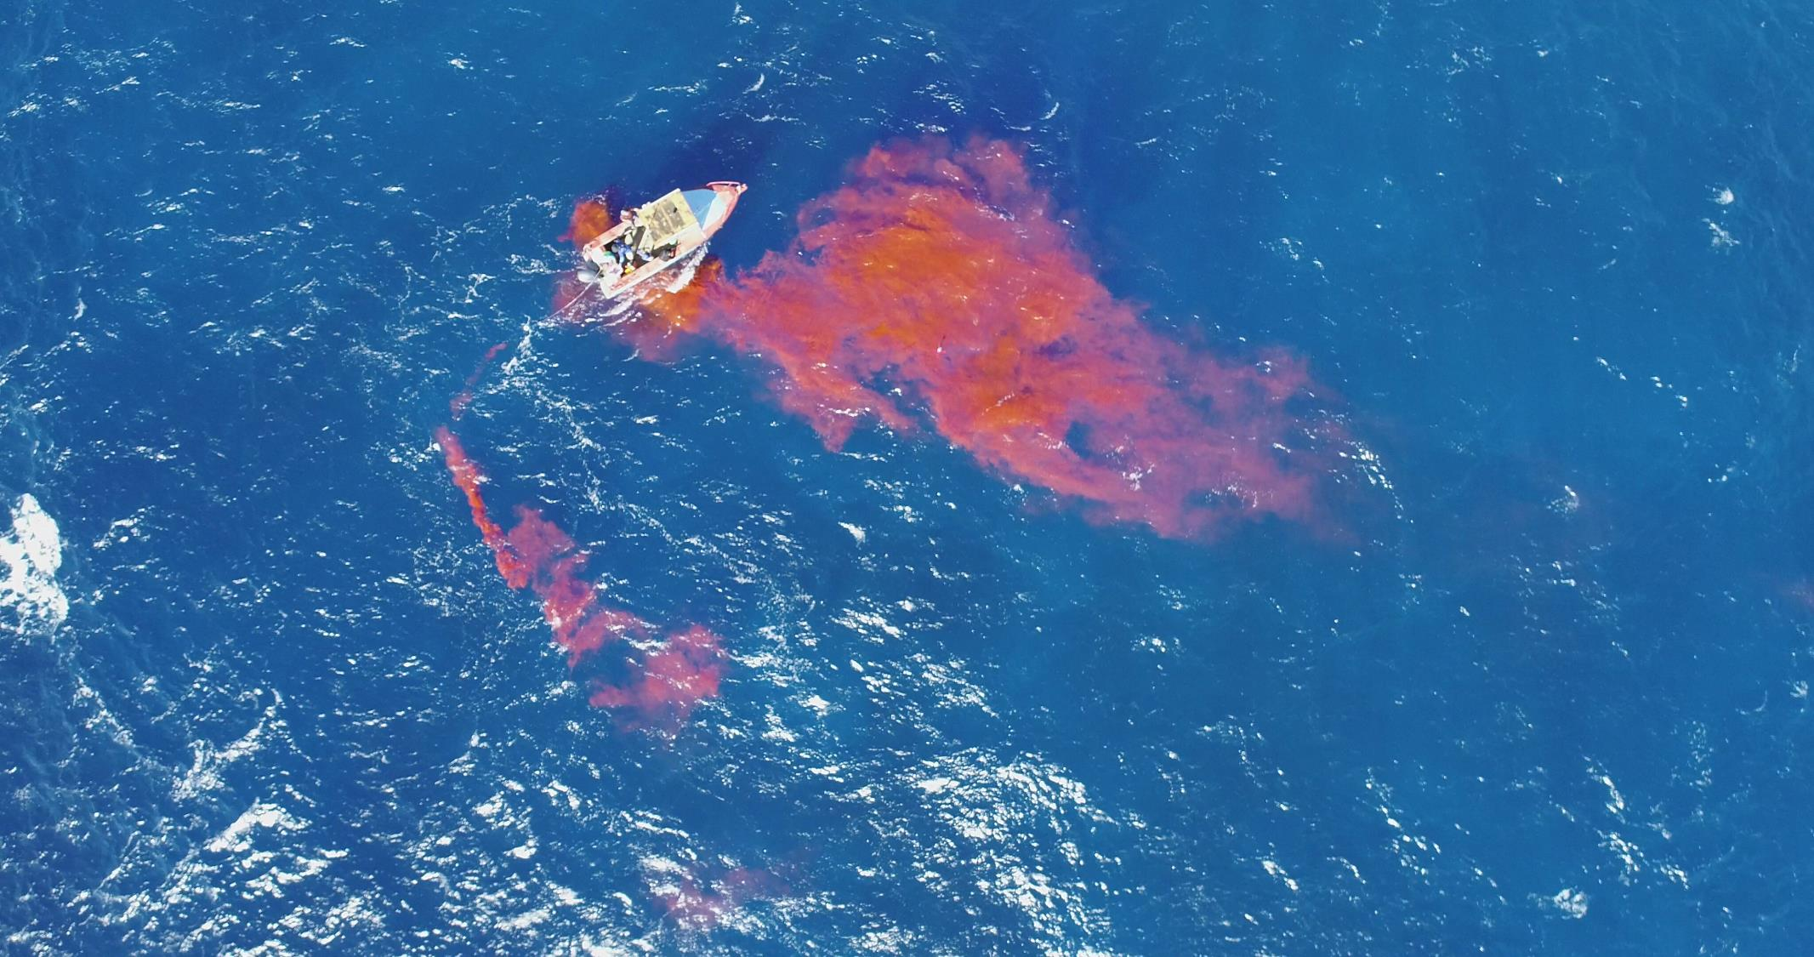
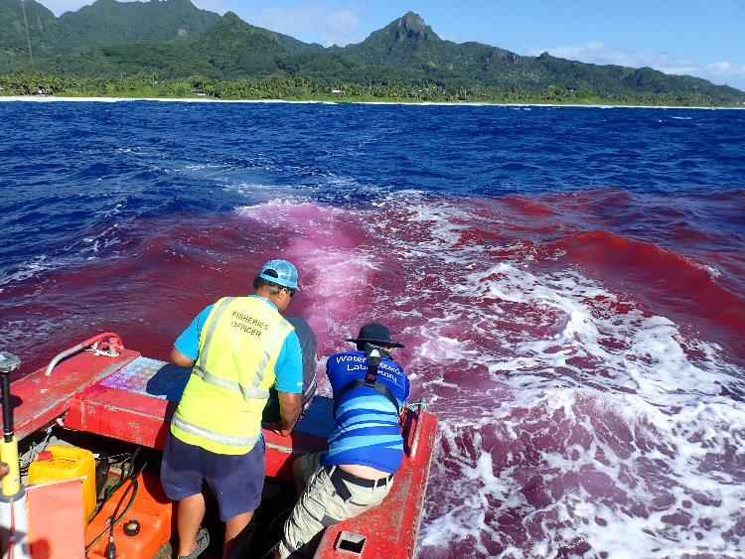

Slide 14
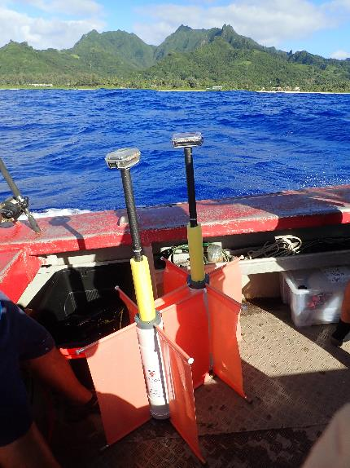
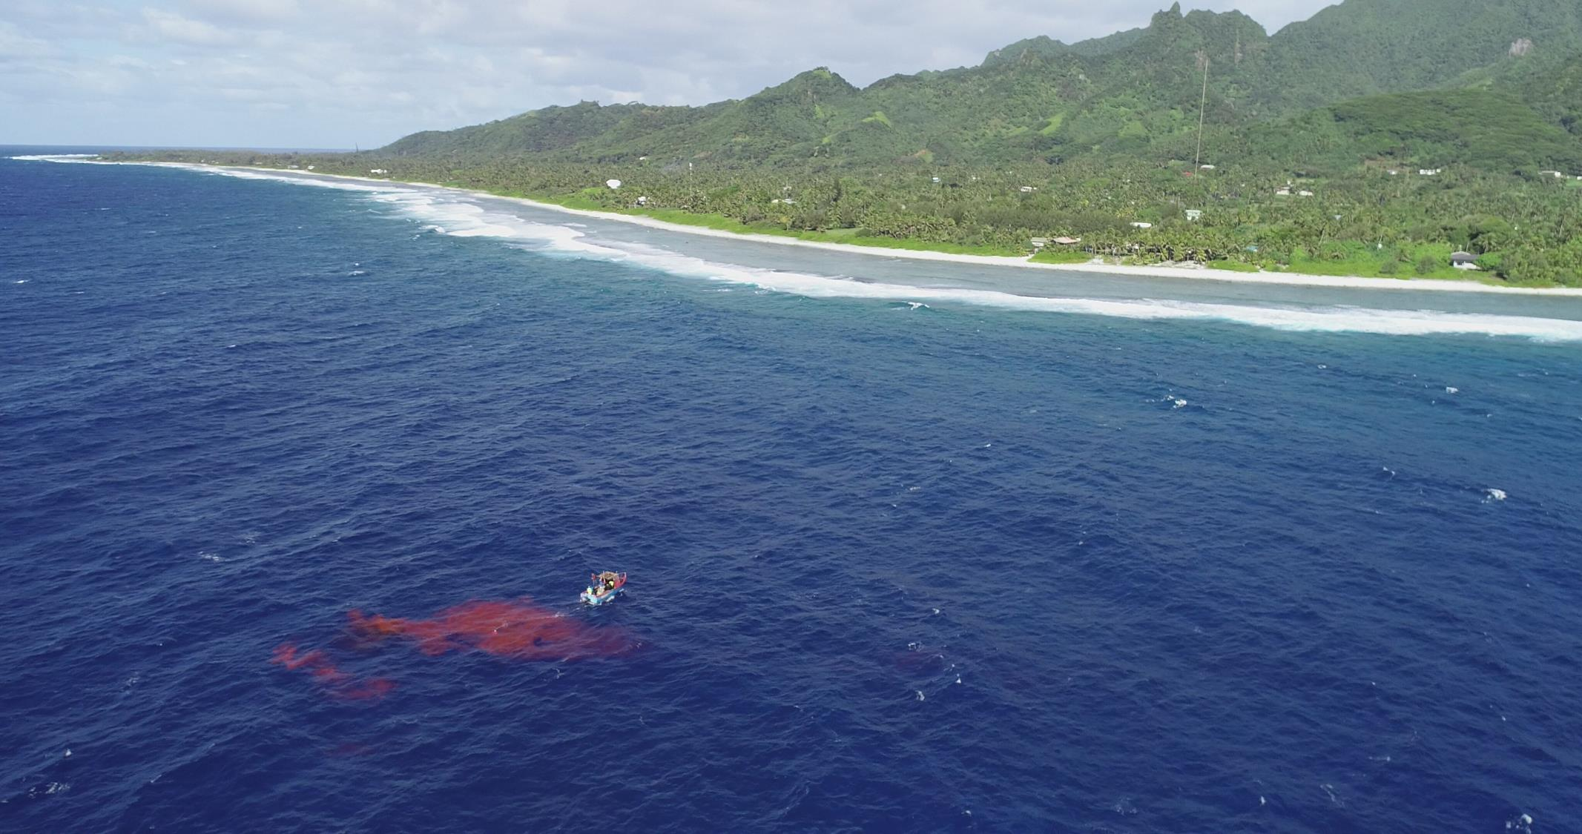
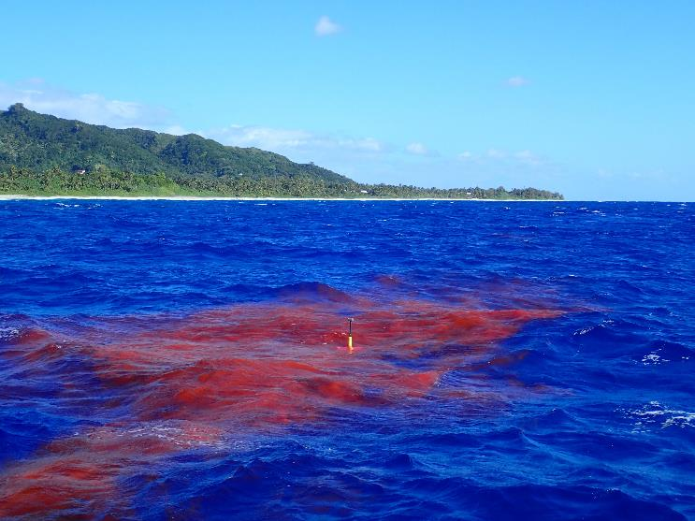

Slide 15
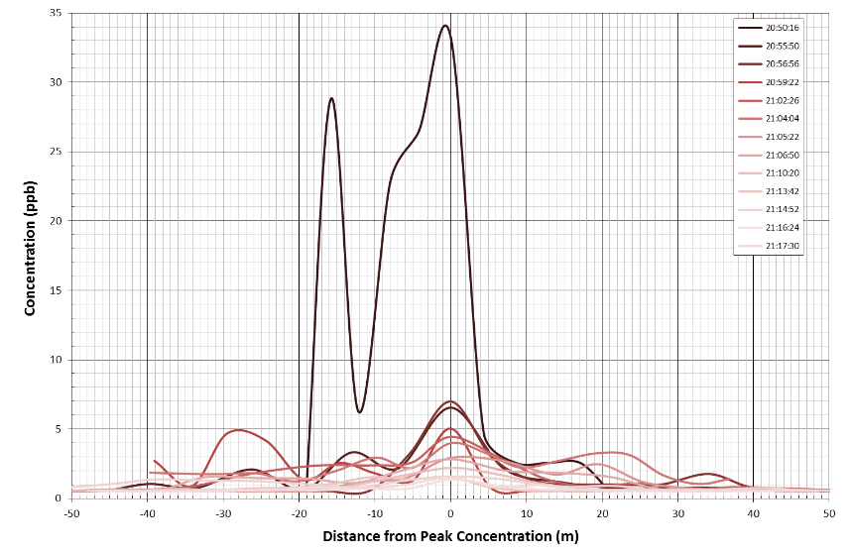
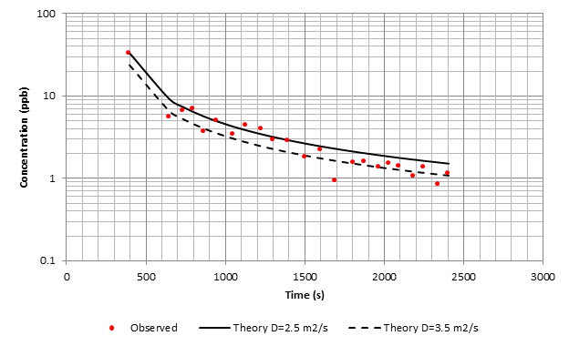
Dye tracer and GPS drifters
650 m
33 min
0.33 m/s

Slide 16
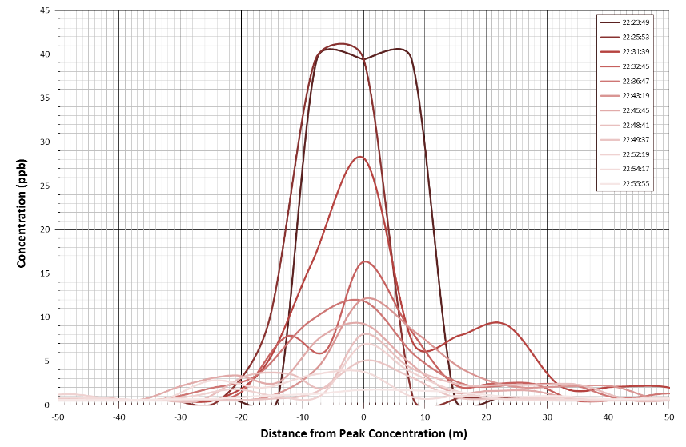
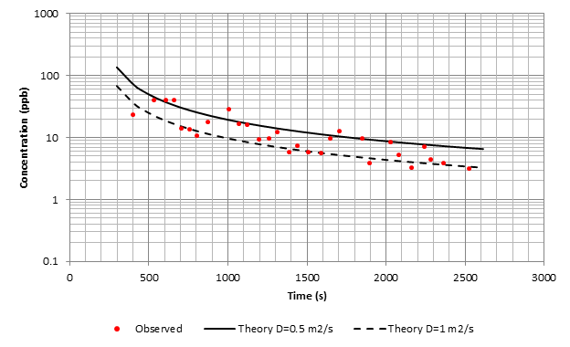
Dye tracer and GPS drifters
650 m
33 min
0.33 m/s

Slide 17
Phase 2 investigations – 1 location:
Bottom mounted acoustic current profiler:
      Nortek AWAC 1000 Khz;
      Teledyne RDI Workhorse Sentinel 600 Khz;
  Vertical array of temperature-pressure loggers:
      RBR Duo (temperature & waves);
      Heron Dipperlog Nano (temperature);

Slide 18
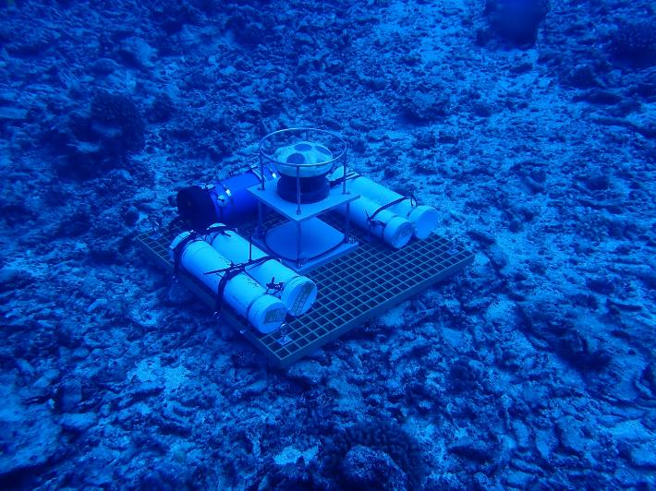
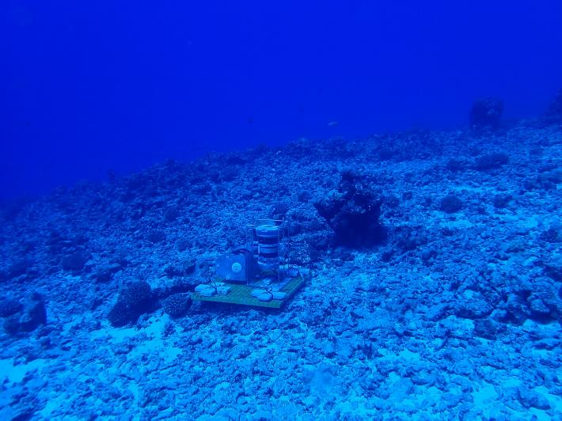
Battery canister
AWAC
Ballast weight
(4 x 25kg tubes)
Base mooring frame
Battery canister
ADCP
Base mooring frame
Ballast weight
(4 x 19kg blocks)

Slide 19
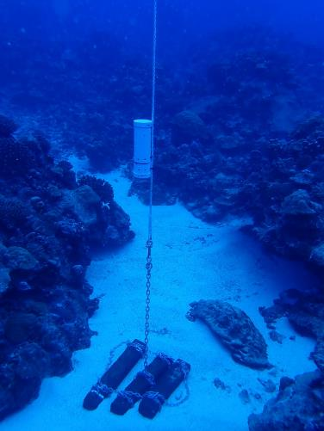
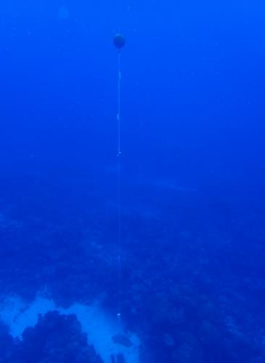
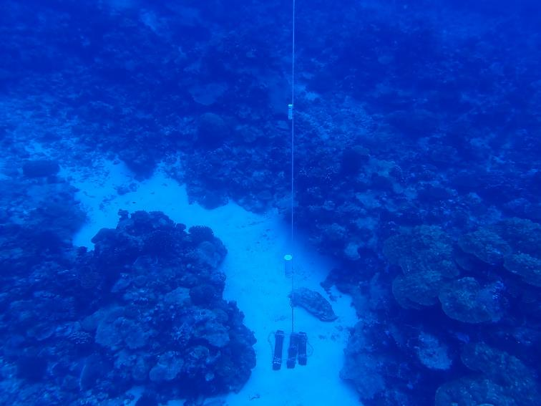
RBR Duo
Float buoy
Temp. loggers
Ballast weight
(3 x 60 kg)
RBR Duo

Slide 20
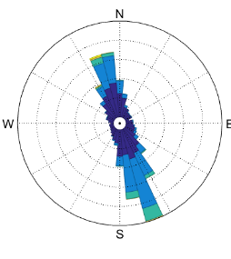
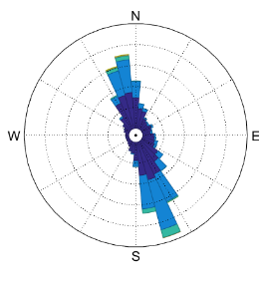
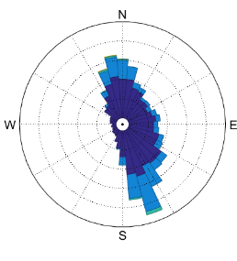
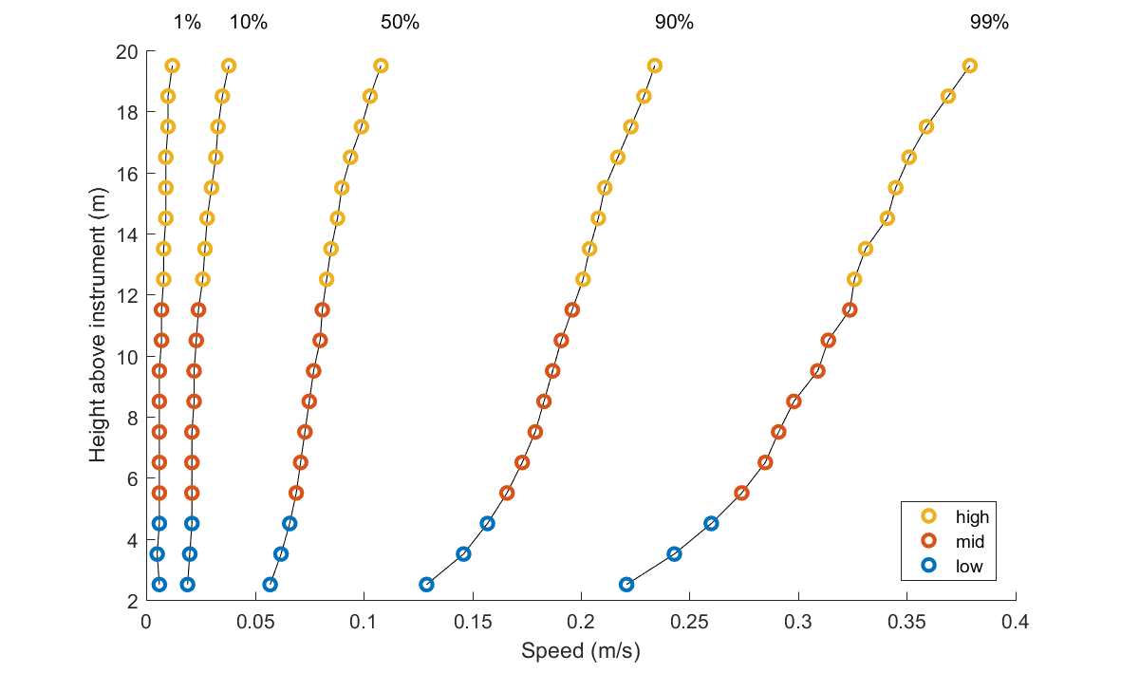
Current profiles through depth and current direction

Slide 21
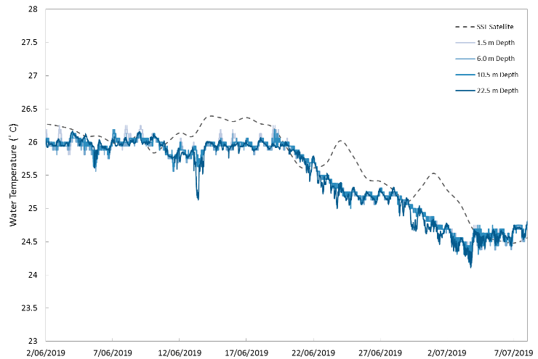
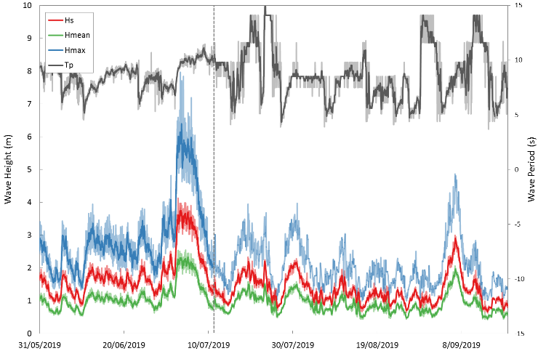
Water temp. profiles through depth and time
Wave height and period

Slide 22
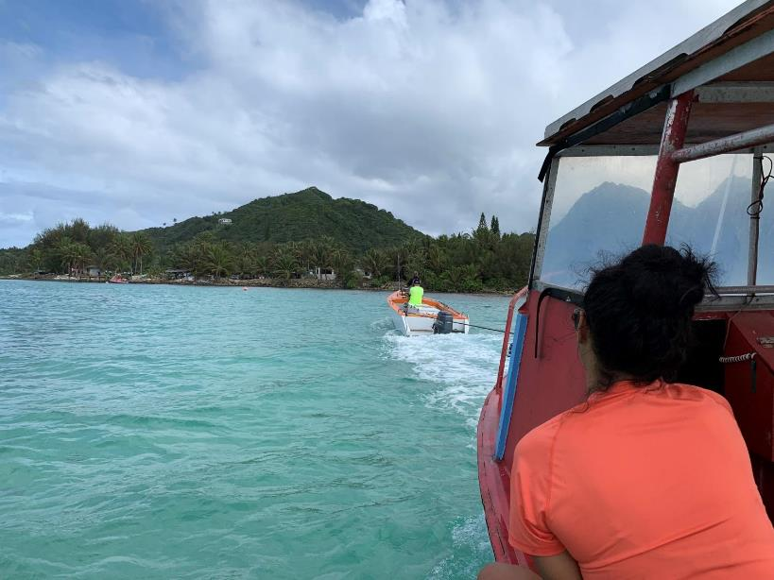
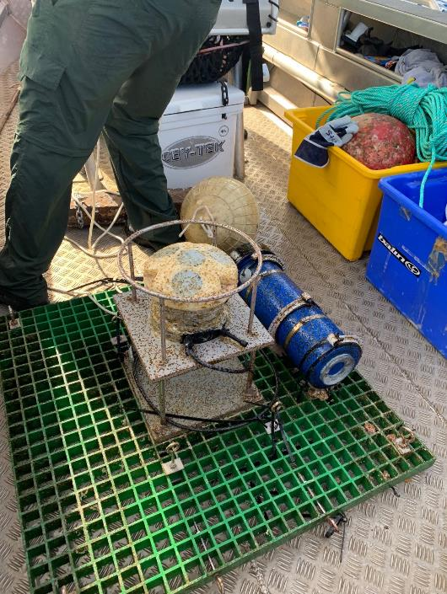
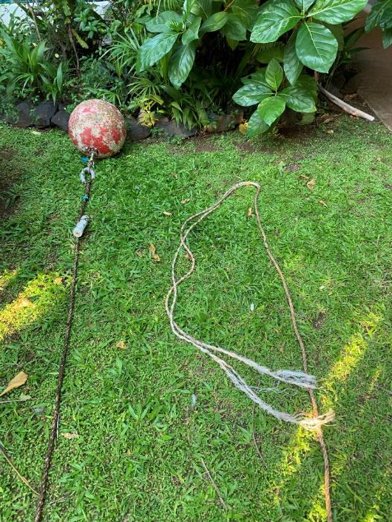
Challenges? There’s always a few ☺

Slide 23
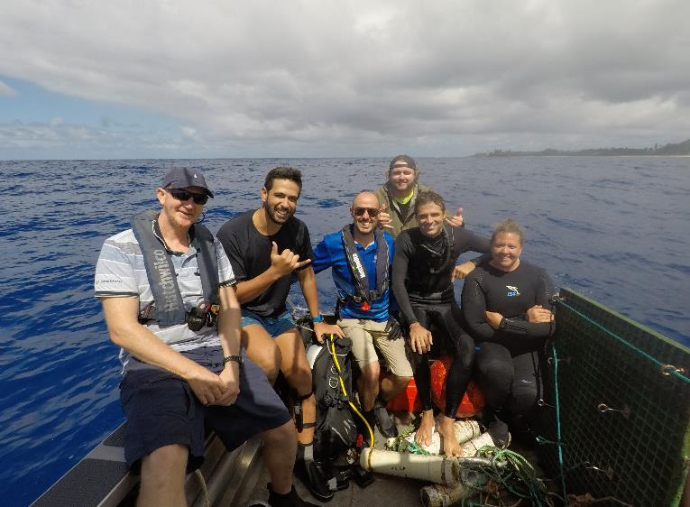
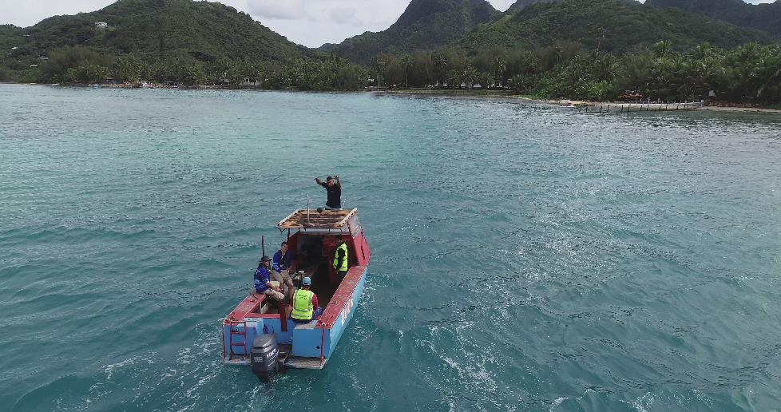
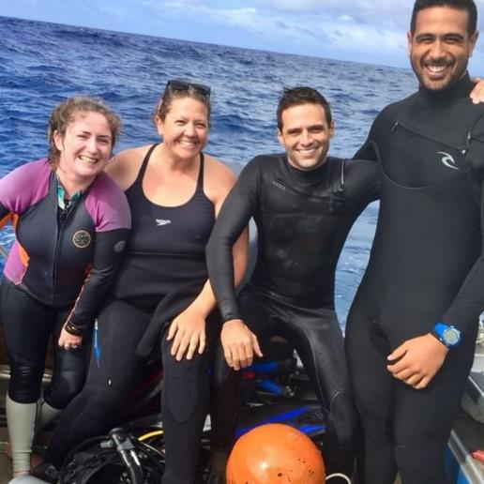
Acknowledgements
This work was undertaken under the Mei Te Vai Ki Te Vai project with the Cook Islands Government;
Fieldwork activities were supported by the awesome team at MMR;
Reelaxing Raro provided a fieldwork vessel and muscles to help with equipment deployment;
Oceanographic Field Services assisted for Phase 2 data collection;

Slide 24
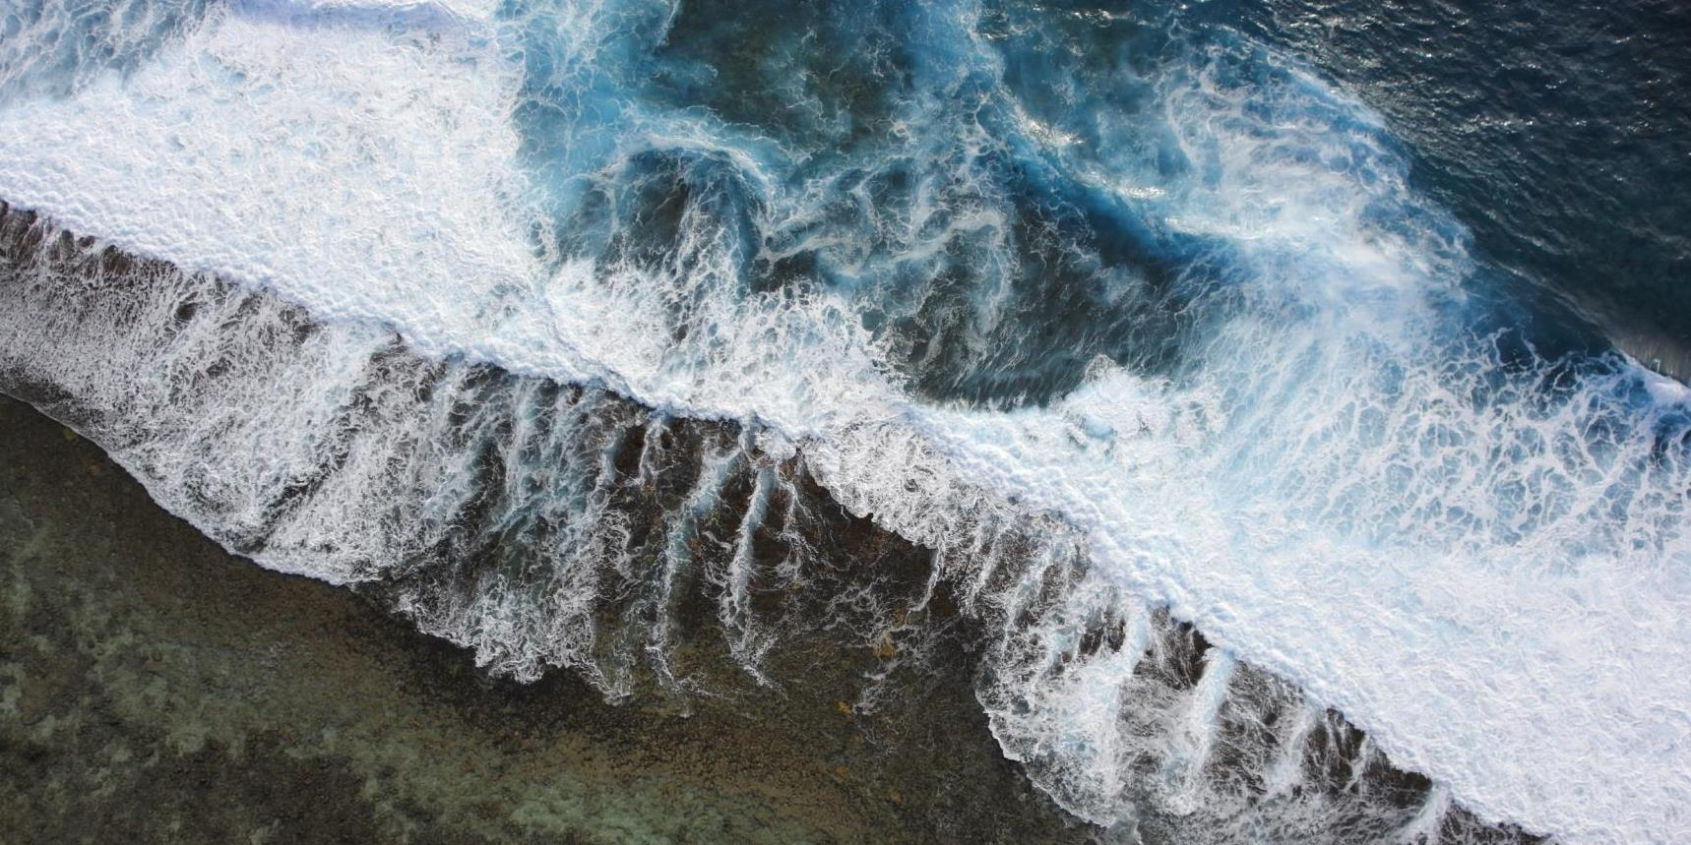
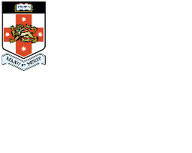
Thank you

