Slide 1
Ministry of Lands & Mineral Resources Mineral Resources Department Geological Surveys Division
Current profiler deployment and application
- MINERAL INVESTIGATION PROJECT 2020-2021
Sigatoka Waters Prospect

Slide 2
1.0 Introduction
1.1 Overview
The Mineral Investigation Project is formulated to enhance the mineral prospectivity of Fiji by raising the value of known prospects. This is to be achieved by conducting appropriate surveys on known prospects which have good potential, compiling the new data with the existing information and presenting this in an attractive package to would be investors.
The assessment and exploration of existing mineral prospects to facilitate growth in the exploration and mining industry to boost the mineral sector contribution towards the GDP and improving national economic growth.

Slide 3
2.0 Project Deliverables
(i) BATHYMETRY SURVEY AND GRAB SAMPLING SURVEY
Bathymetric data for the offshore areas were obtained from SPC and submitted to the Hydrographic Team on board the RV Volasiga. These dataset assisted the with the first two weeks of Garb sampling outside the reef edge with sampling depth of approximately 200 metres.
(ii) COASTAL SEDIMENT SAMPLING SURVEY
Geochemical sampling was carried out on coastal areas or the internal waters within the reef system. Initially a grid system was planned but due to the fringing nature of the reefs system much of the coastal areas are rocky or covered in sea grass, hence sediments were gathered where sufficient sediment deposits were identified and quantified as a minimum amount required for further Geochem analysis
(iii) STREAM SEDIMENT SAMPLING SURVEY
Geochemical sampling was carried out on creeks that flowed out into the coastal areas within the prospect area.
(iv) ACOUSTIC DOPPLER CURRENT PROFILER SURVEY
Two Acoustic Doppler Current Profilers were deployed with the assistance of SPC Divers and coordinated with the marine team one along the reef flat of Korotogo Village and the second on the reef edge in front of Yadua Village. The data will aim to provide insight on the longshore current in the vicinity of the river and support the interpretation of the Geochemical survey data.

Slide 4
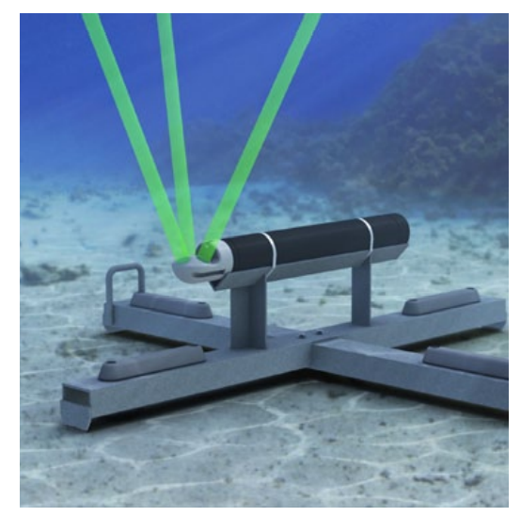
Acoustic Doppler Current Profiler
The instrument measures:
Current Speed through the water column
Current Direction through the water column
Wave
Water level (e.g. tide)
Water temperature

Slide 5
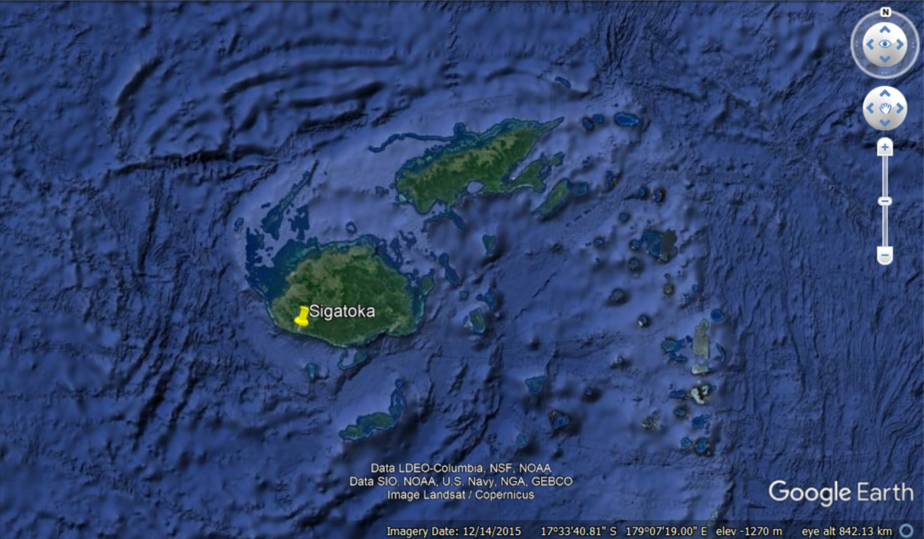
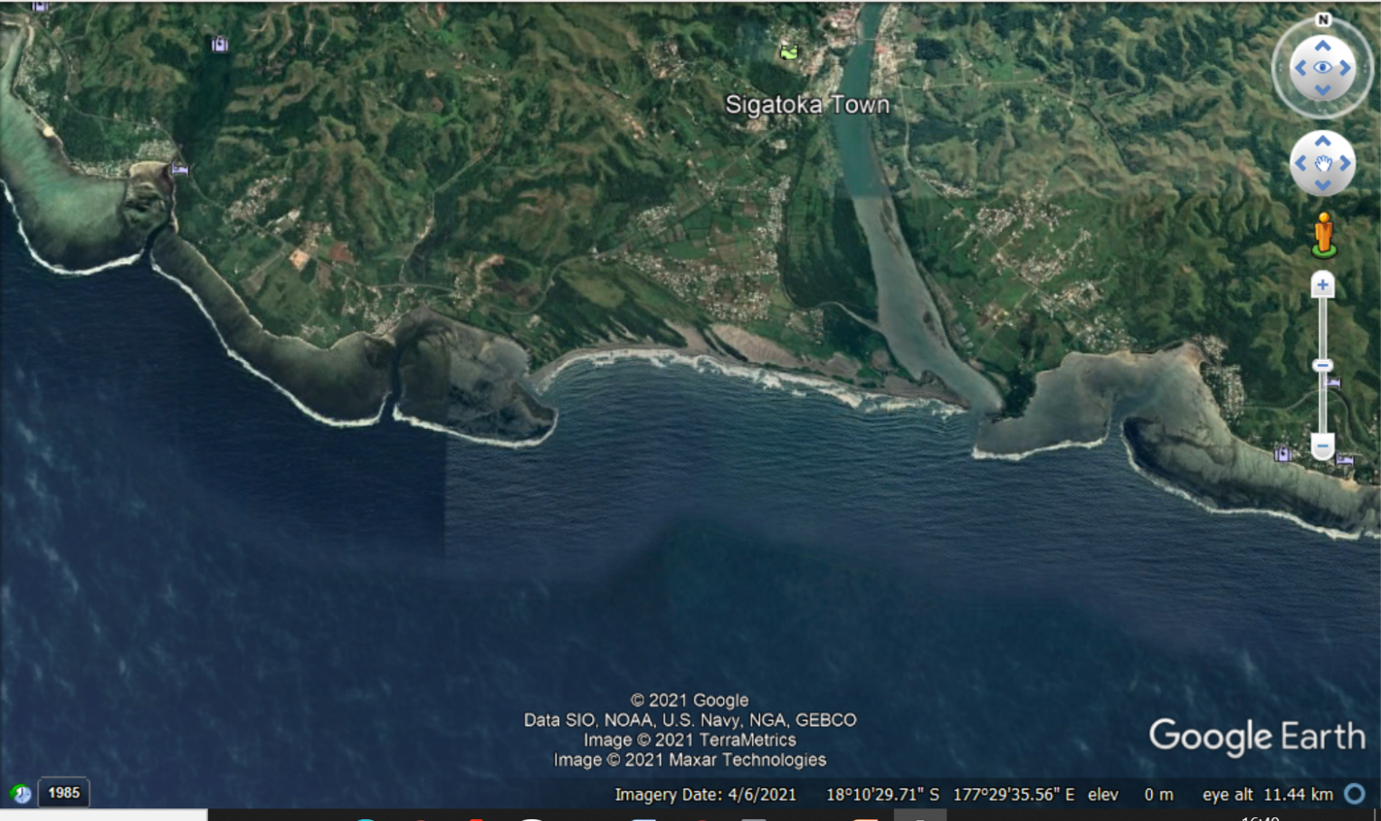
Project Site
3 month deployment
17/09/2020 - 15/12/2020
AQUADOPP 1 (Yadua)
Latitude: 18°10'15.80"S
Longitude: 177°27'2.18"E
Depth: approx. 15 m
AQUADOPP 2 (Korotogo)
Latitude: 18°10'35.78"S
Longitude: 177°31'23.49"E
Depth: approx. 2 m

Slide 6
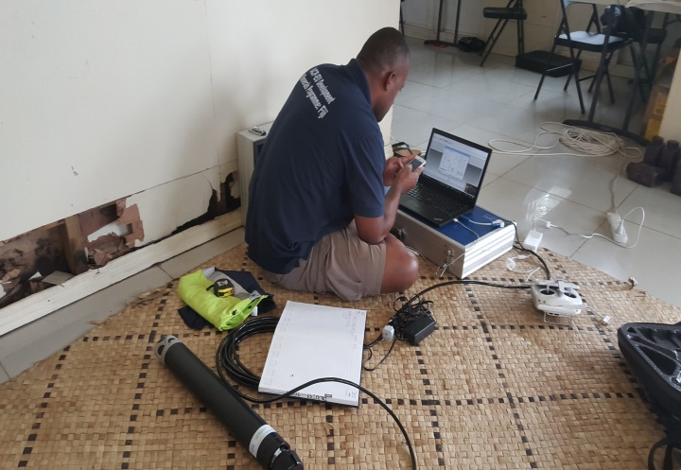
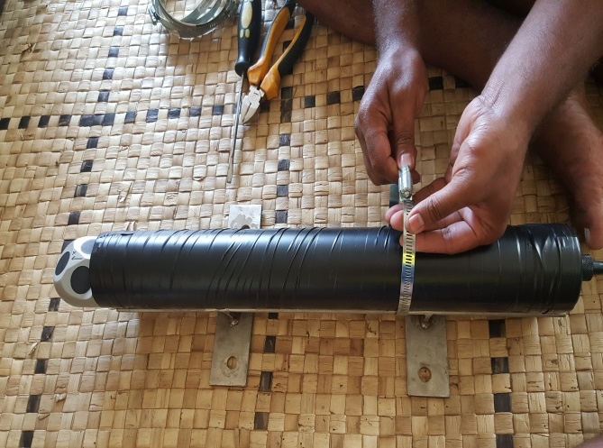
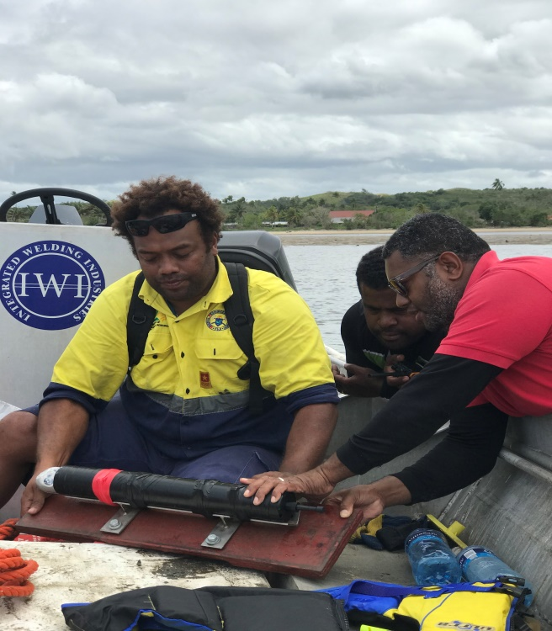
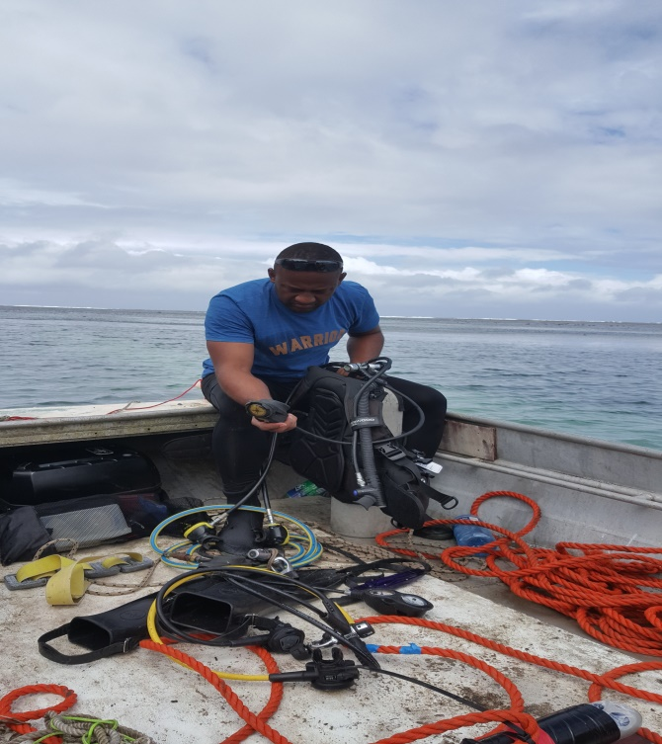
3.0 AQUADOPP Profiler programming and Setup
3a
Figure 3a: Programming the parameters into the Aquadopp.
3b
Figure 3 b & c: Encasing the Aquadopp and securing the Aquadopp on to its metal base
3c
3d
Figure 3d: Final check on the diving equipment and preparation for dive and Aquadopp deployment

Slide 7
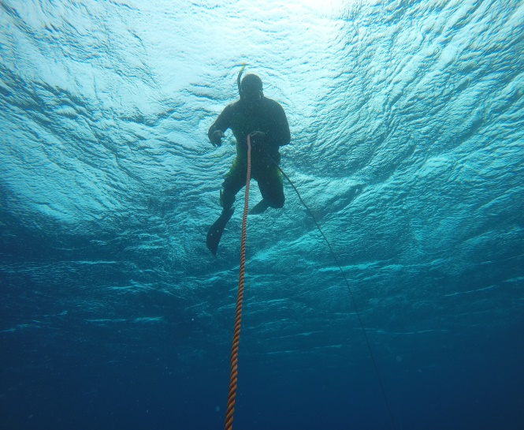
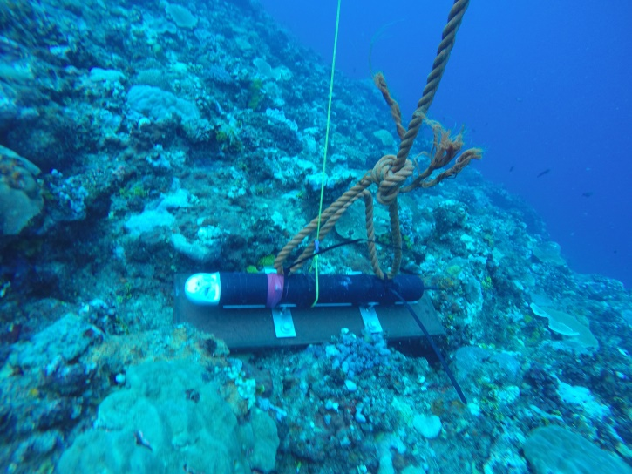
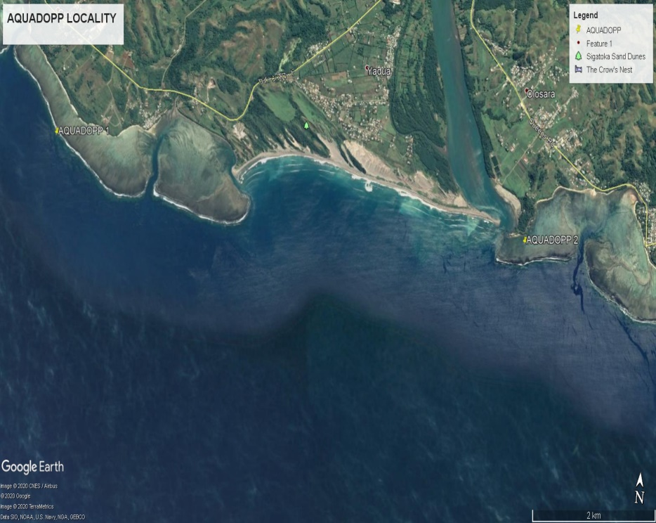
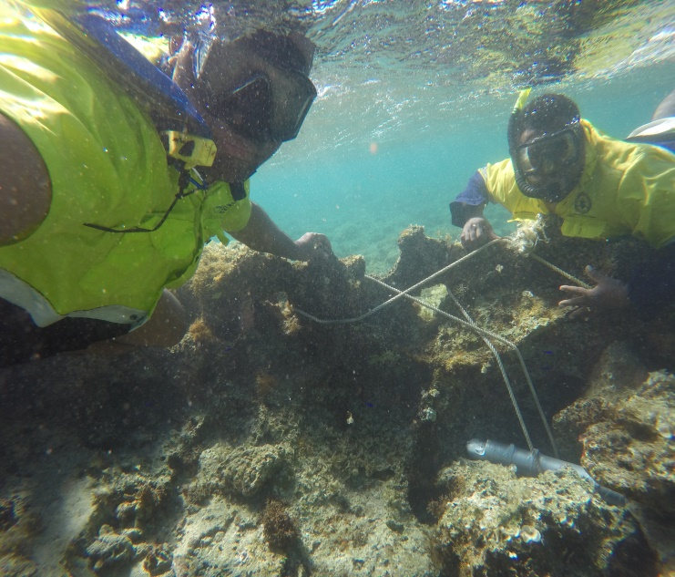
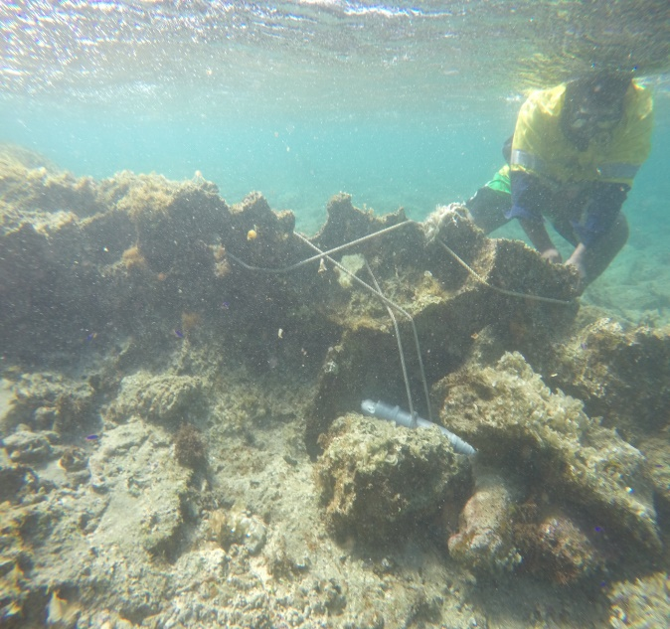
4.0 AQUADOPP Profiler Deployment
4a
4b
AQUADOPP 1 (Yadua)
Latitude: 18°10'15.80"S
Longitude: 177°27'2.18"E
Depth: approx. 15 m
AQUADOPP 2 (Korotogo)
Latitude: 18°10'35.78"S
Longitude: 177°31'23.49"E
Depth: approx. 2 m
4c
4d
Figure 4a: Support staff providing assistance and ensuring safety protocol are followed.
Figure 4b: Deploying the Aquadopp along the reef edge
Figure 4 c & d: Securing the 2nd Aquadopp along the reef flat at Korotogo

Slide 8
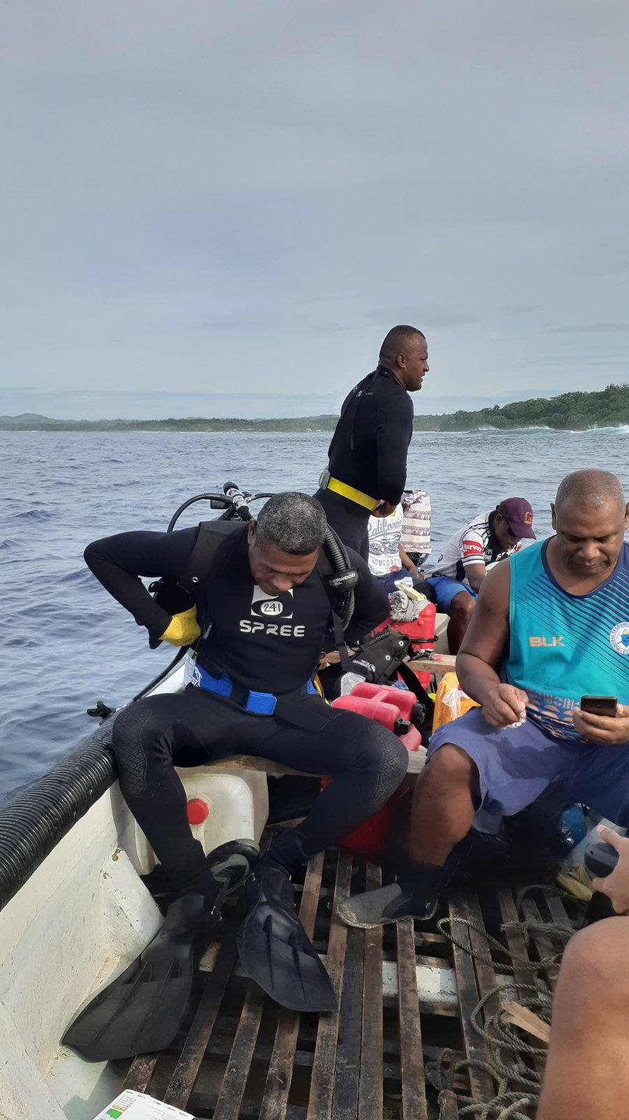
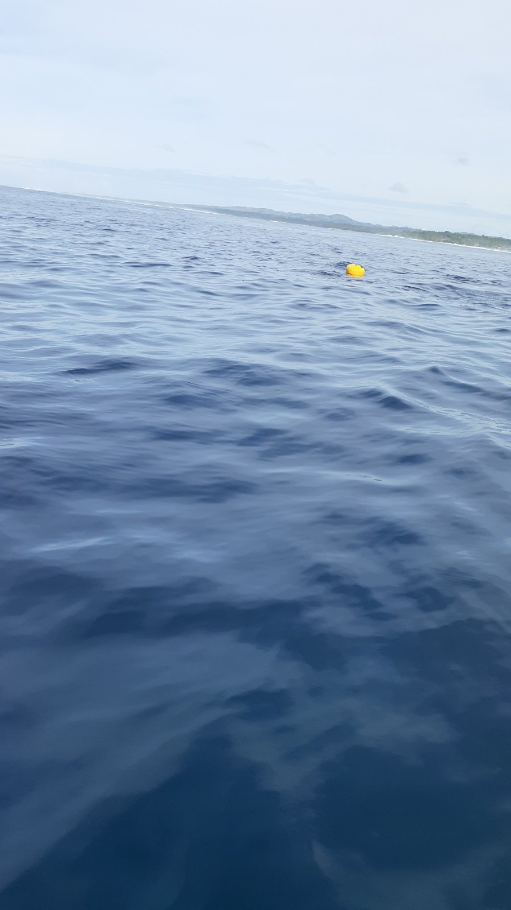
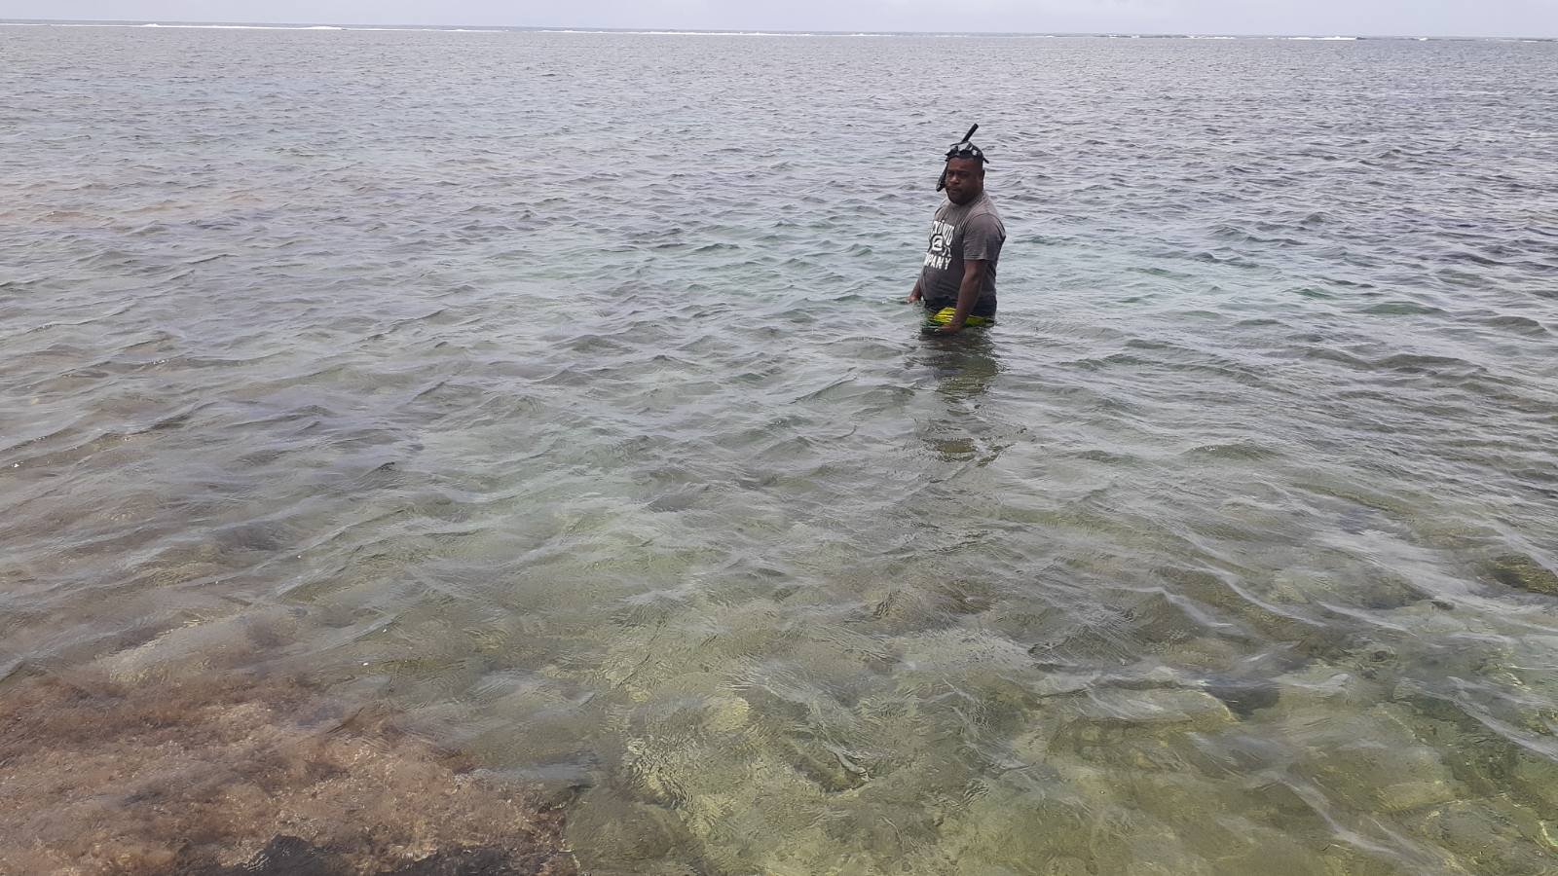
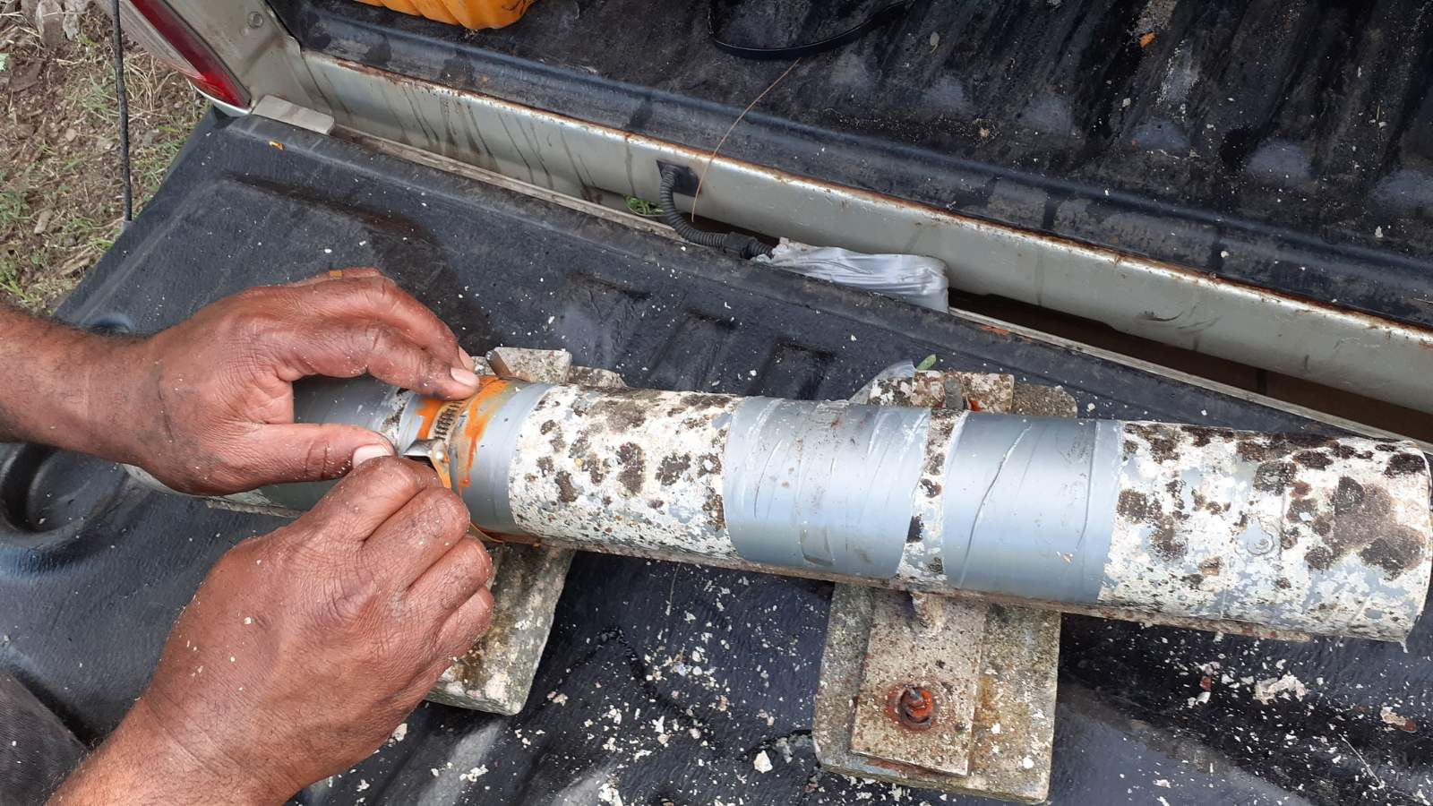
5.0 AQUADOPP Profiler Retrieval
5 a
5 b
Figure 5a: SPC divers preparing to retrieve the Aquadopp from site 1, 10b: Floating Balloon attached to the Aquadopp is seen floating on the surface
Figure 5c: Marine Section Staff preparing to retrieve the Aquadopp from site 2
Figure 5d: Cleaning of the Aquadopp Profiler back on land
5 c
5 d

Slide 9
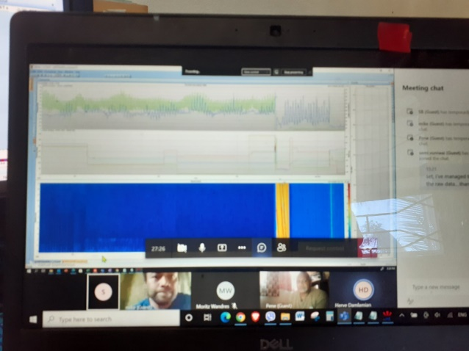
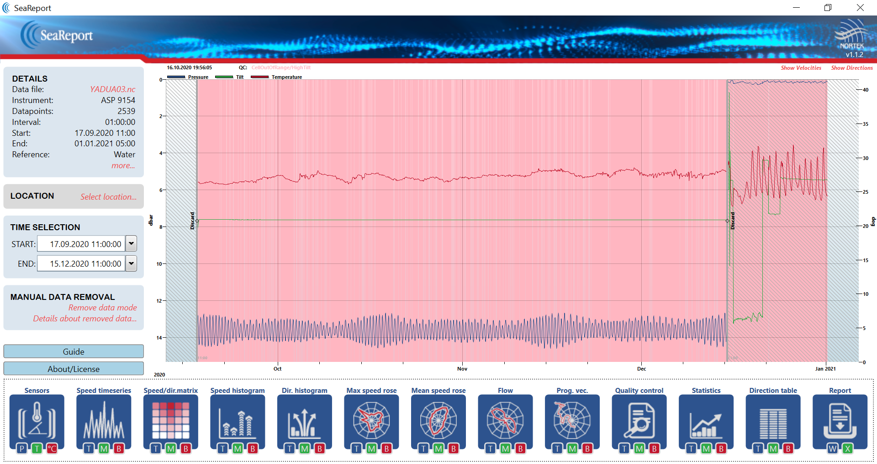
6.0 Aquadopp Profiler Data Processing
6 a
6 b
Parameters:
Current Speed Velocities (through out the water column)
Current Direction
Water level
Wave
Temperature

Slide 10
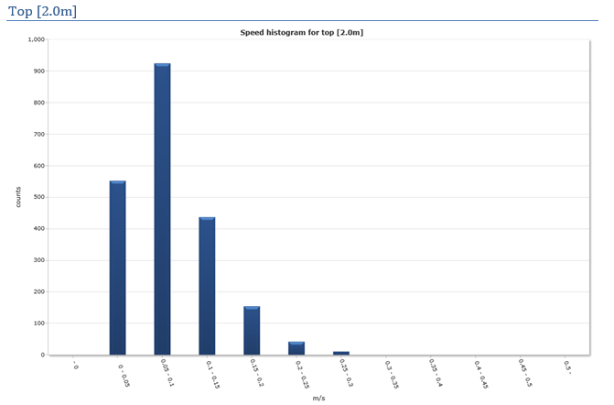
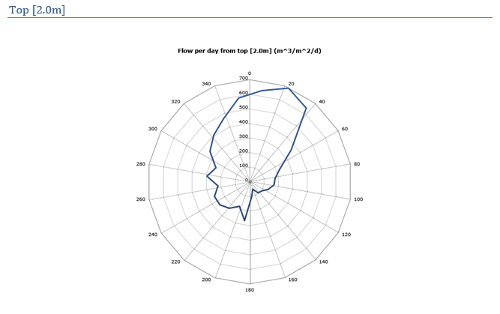
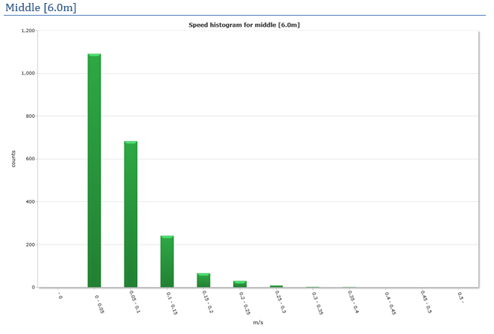
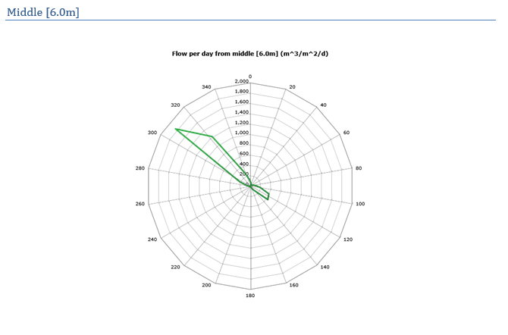
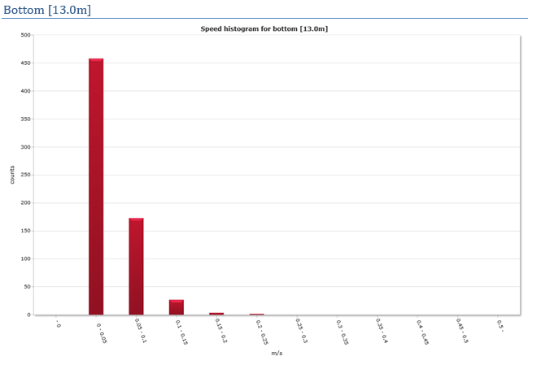
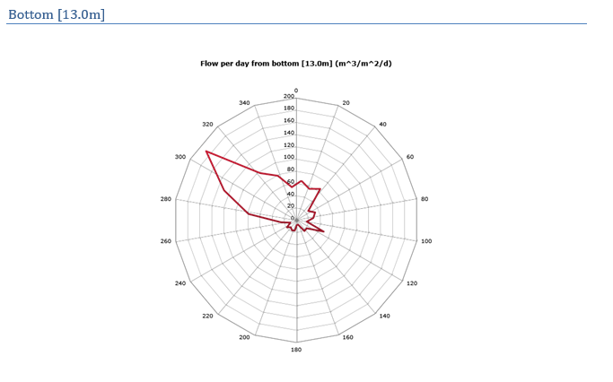
Preliminary information for Yadua Reef Slope Deployment (-15m depth)
Current speed decreases with water depth
At the Top layer, water flows towards the shore
Middle and Bottom layer water flow are mainly north westerly

Slide 11
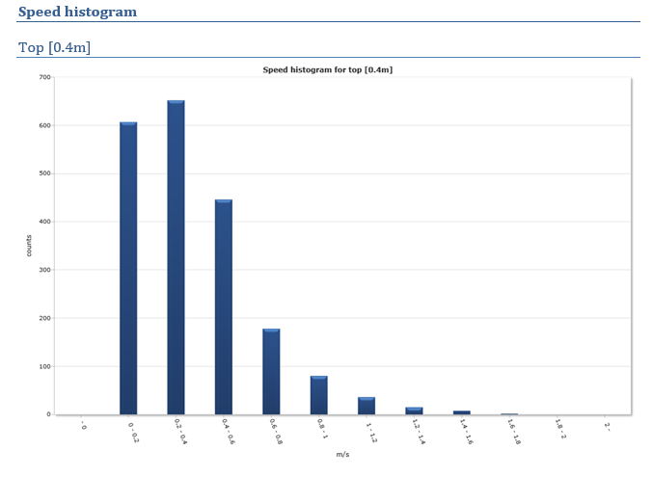
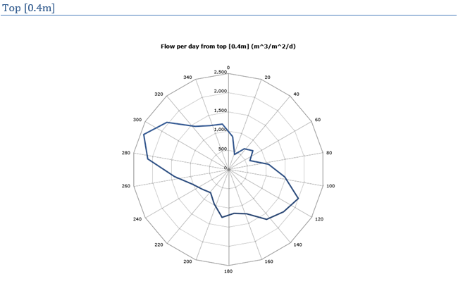
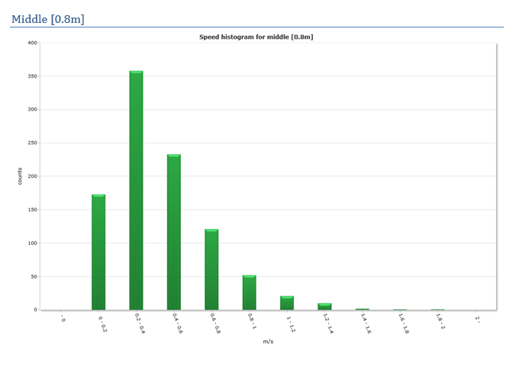
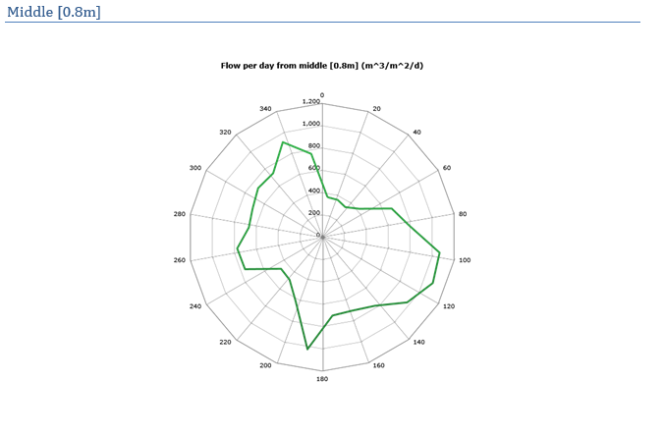
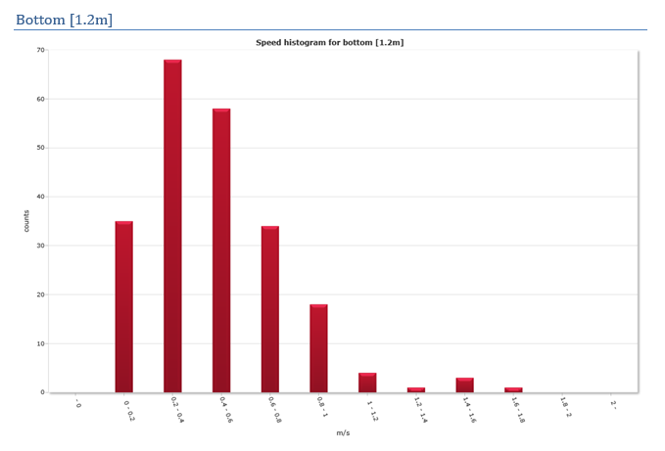
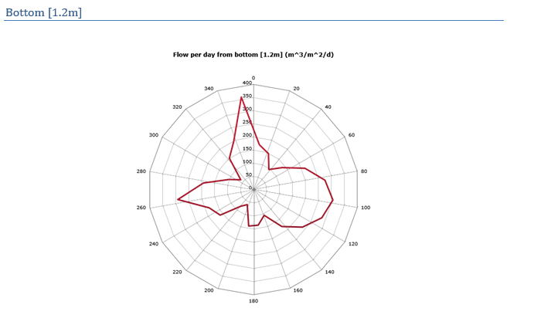
Preliminary information for Korotogo Reef Flat Deployment
Current speed is consistent across the water column
Complex flow pattern highlighting the competition between ocean forcing (wave, tide, wind), river discharge and geomorphological feature (channel)

Slide 12
Preliminary Findings
Sink?
Notes:
River carries down minerals and heavy metals
AQDP data shows that in and out lagoon flow compete near the river mouth. Outflow partly driven by the nearby channel acting as a sink for the minerals discharged by the river.
Based on the wave climate in the area (wave climate report) the area is exposed to southern swell
…Which would drive northward longshore current. As such, if minerals are entering the lagoon, they are likely to be either deposited in the korotogo lagoon area or thrown back at sea through the channel
As mineral is heavy and reef flat is high, it is most likely that most of the mineral would not end up on the reef flat near korotogo but travel north- westward as shown by bottom current data collected by the AQDP in Yadua.

Slide 13
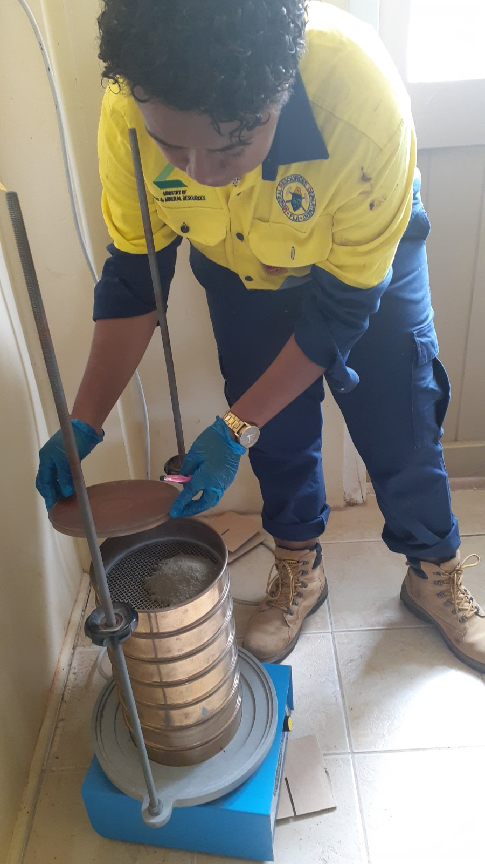
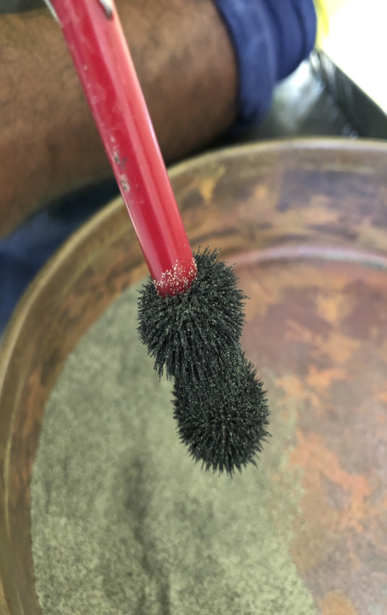
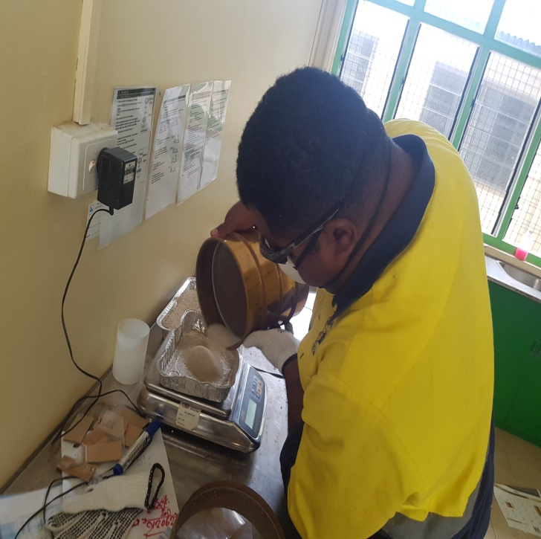
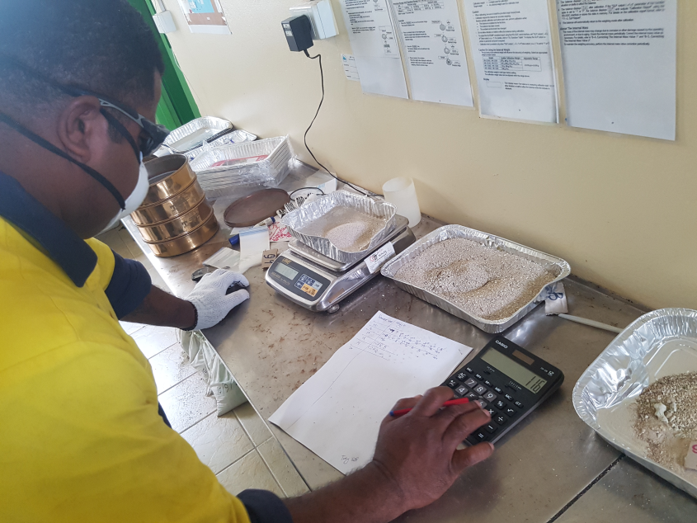
7.0 Geochemical Sample Preparation
Sieving, Magnetic test and weighing of Geochem Samples
7a
7b
7c
7d
Figure 8 a, b, c & d: Geochem sample sieving, magnetic analysis and weighing of the different sieved sizes per sample
Sieve Analysis (or Gradation Test) - to assess the particle size distribution (also called gradation) of a granular material

Slide 14
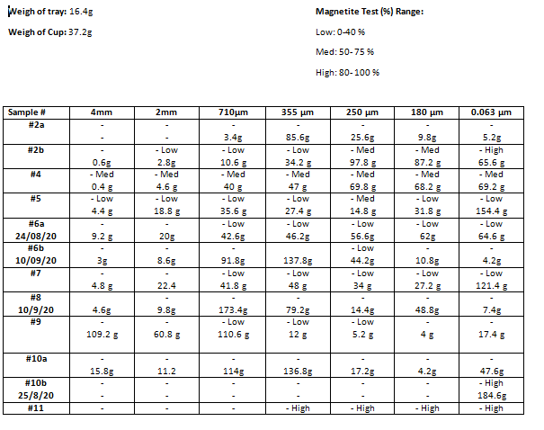
Preliminary Data Analysis

Slide 15
Way forward
Analysis through;
Atomic Absorption Spectroscopy
X-Ray Fluorescence Analyzer

