Slide 1
GOOS today, GOOS at the heart of the Ocean Decade
The Global Ocean Observing System
www.goosocean.org
A. Fischer, E. Heslop and the GOOS Team
Director, GOOS Office
DBCP PI-5, 27 May 2021

Slide 2
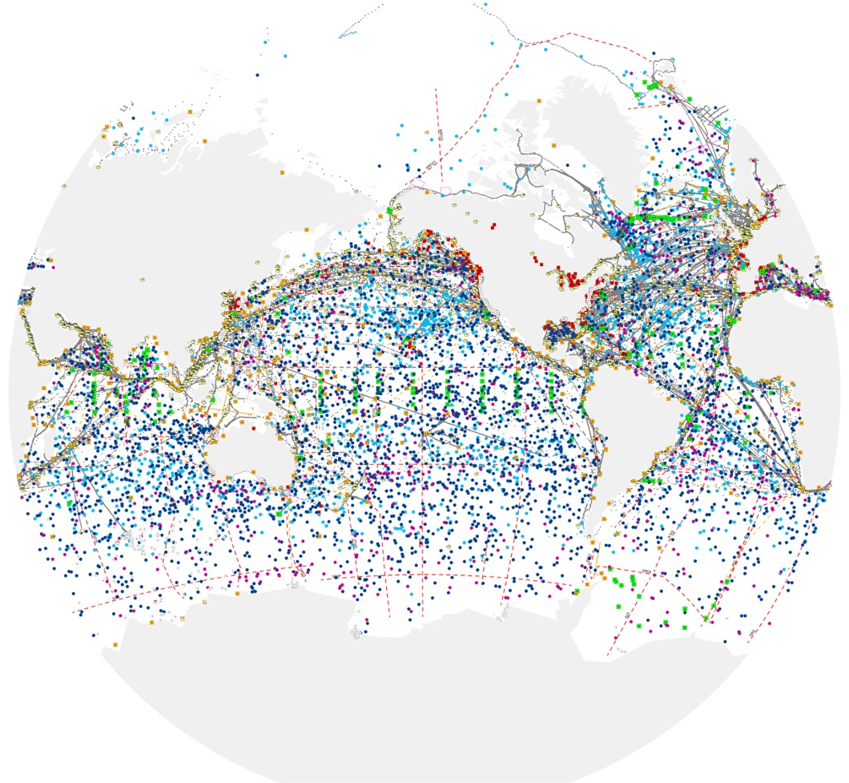
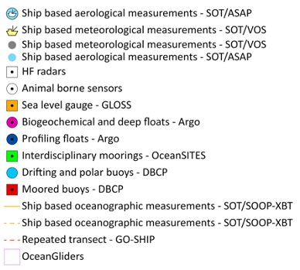
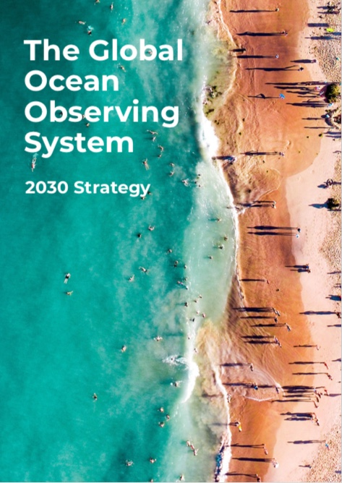
Ocean Observing in 2021
Established arrays (Argo, DBCP), new networks (gliders, HF Radar)
86 countries, 8,933 in situ observing platforms, 170 satellites
Early focus was on climate and operational services - increasing ocean health and human impacts
in situ ocean observations – 12 global ocean observing networks
Working towards the – GOOS Vision
www.ocean-ops.org/reportcard2020
Notes:
We have built tools to monitor and evaluate the system and centrally support implementation

Slide 3
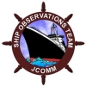
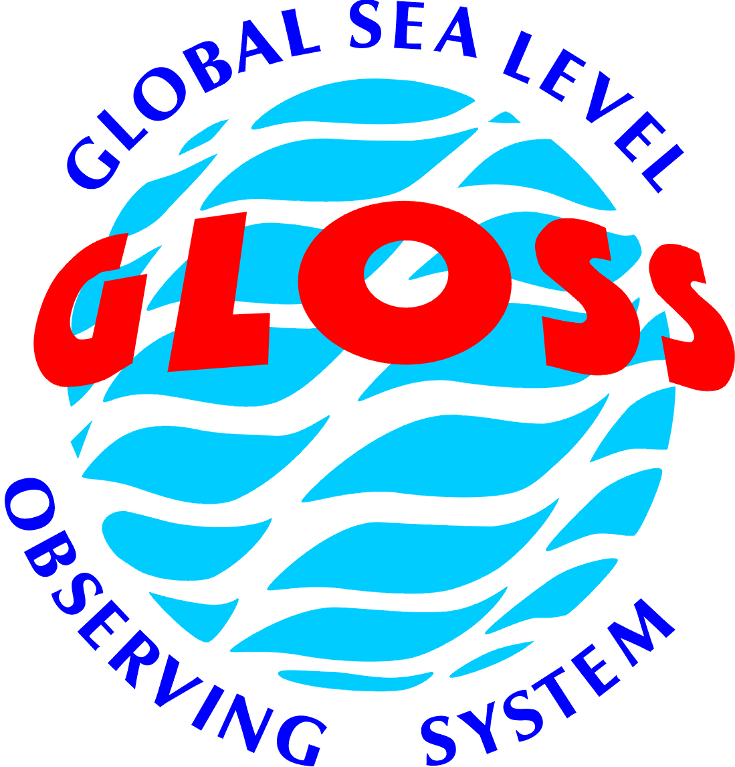
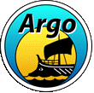
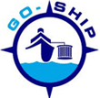
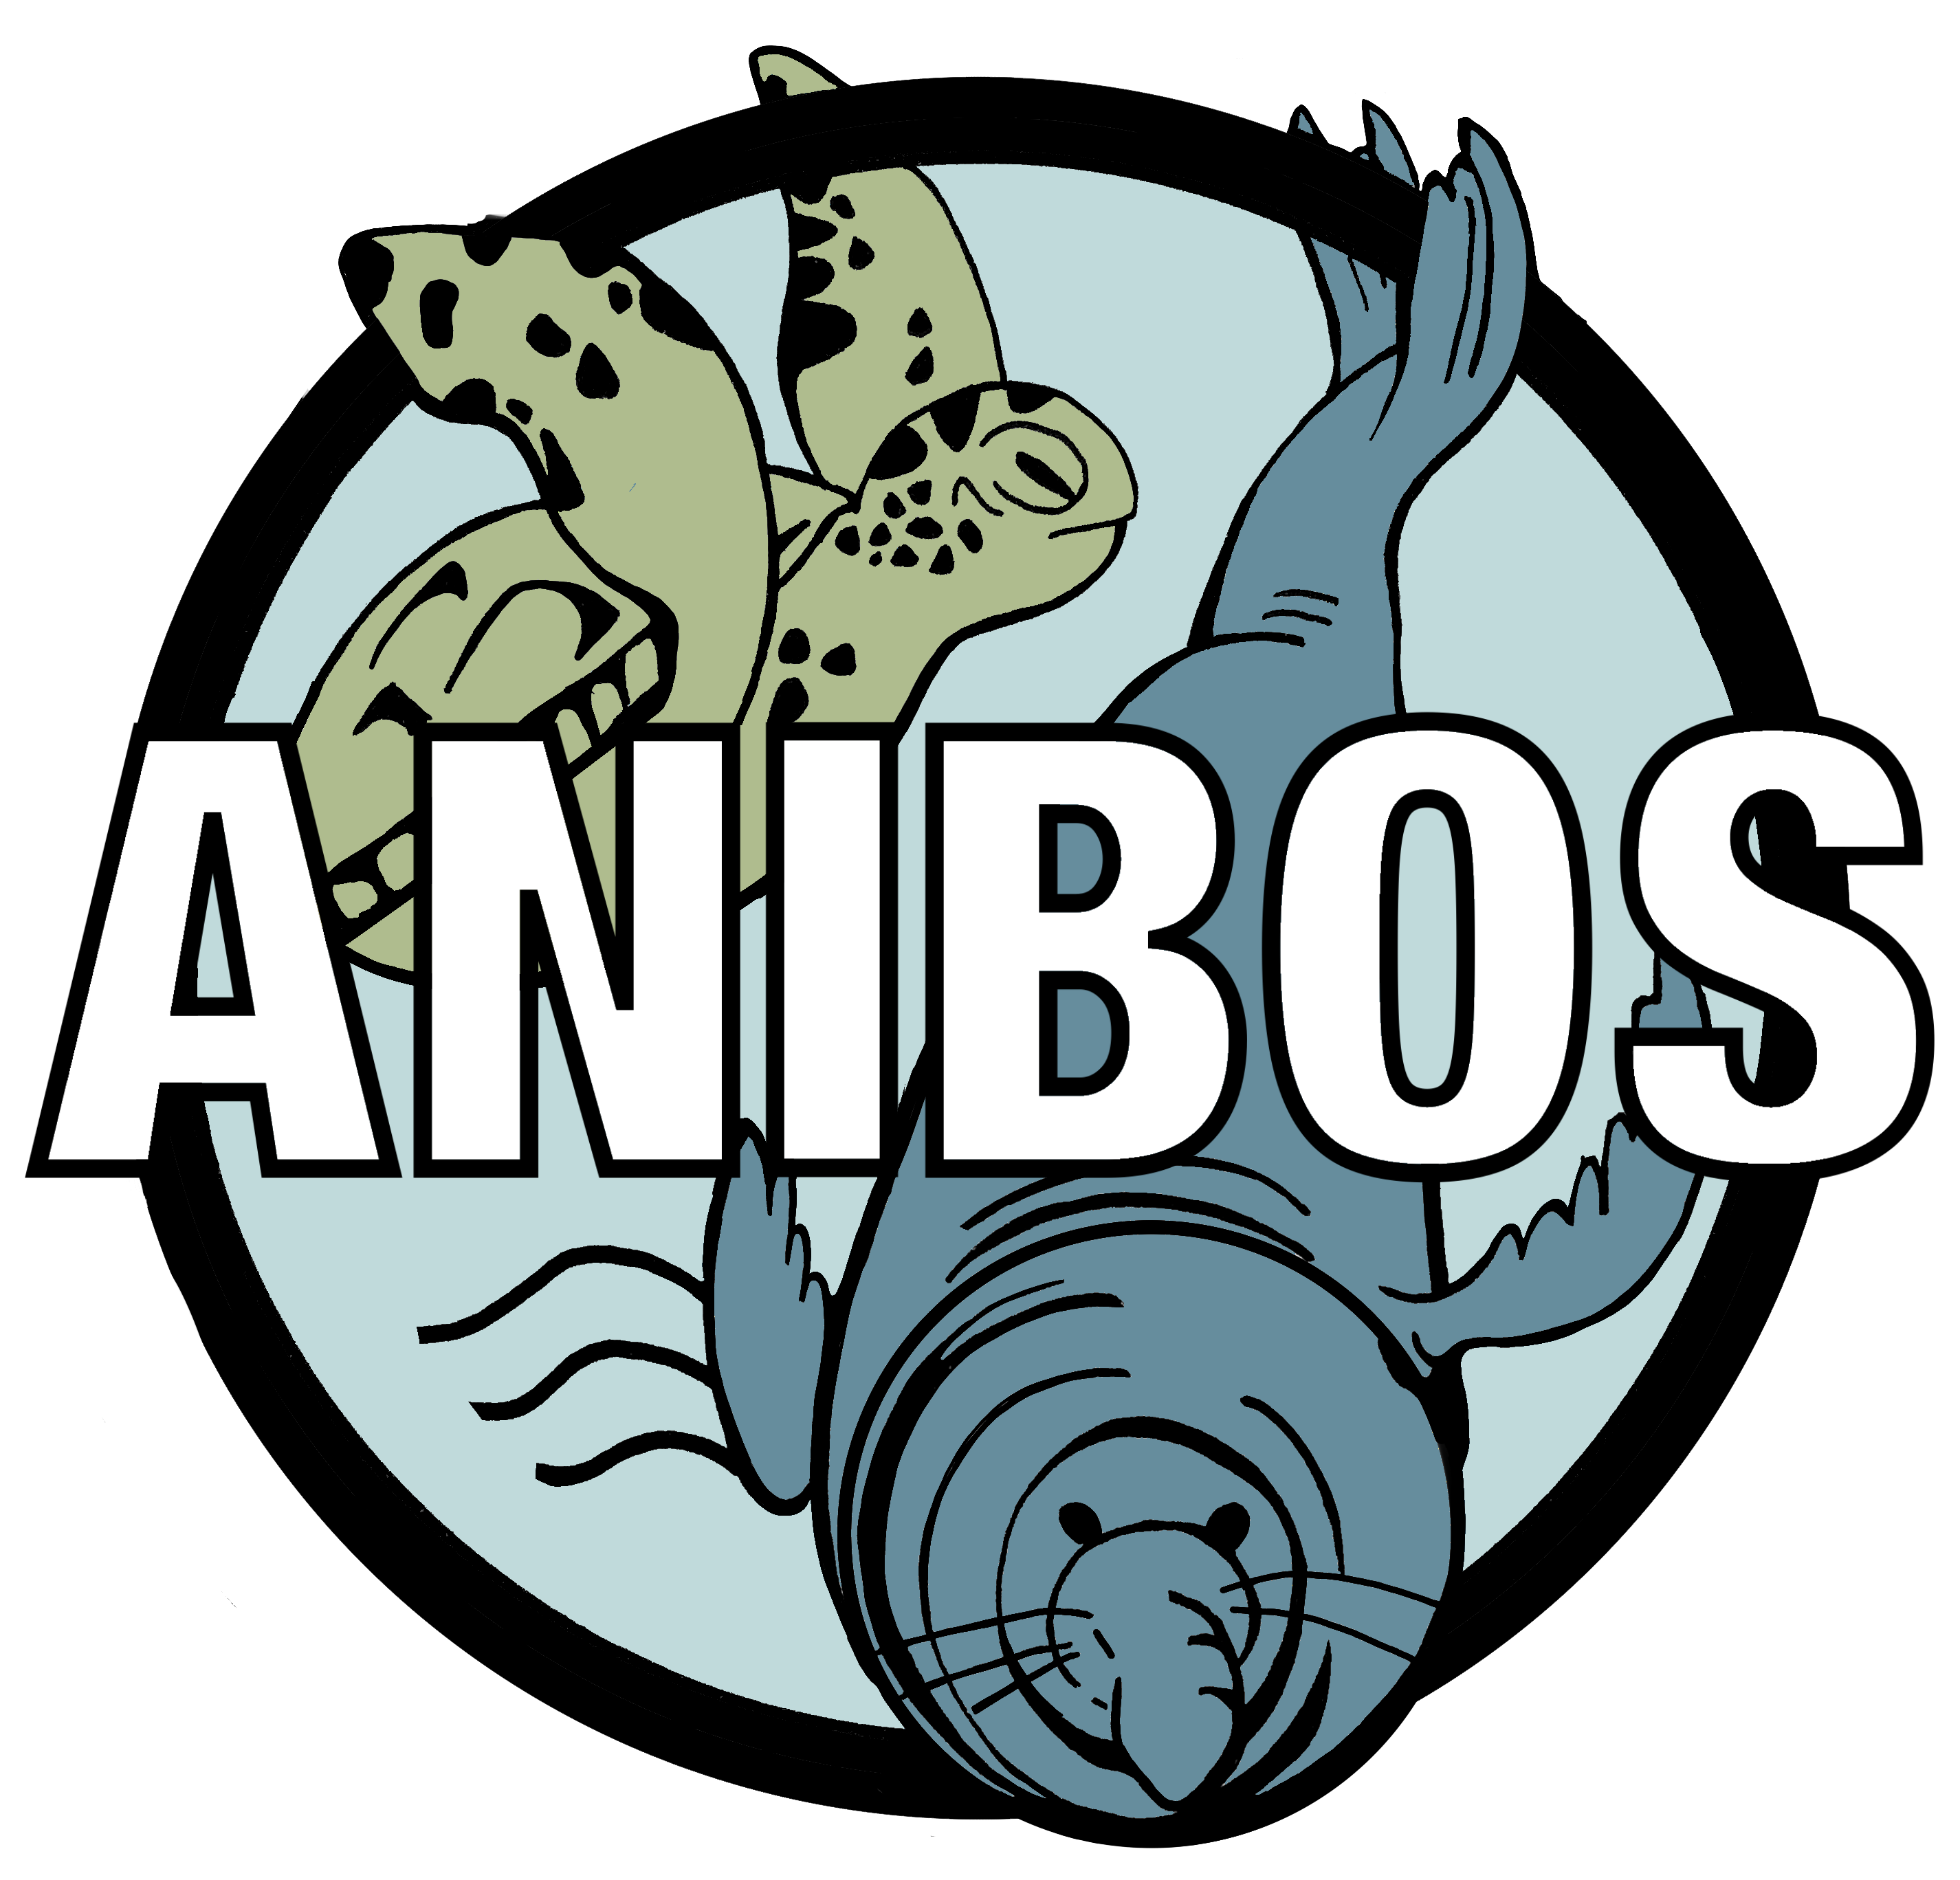
Ocean Observing Report Card 2020
Notes:
We have built tools to monitor and evaluate the system and centrally support implementation
annual reporting on the status

Slide 4
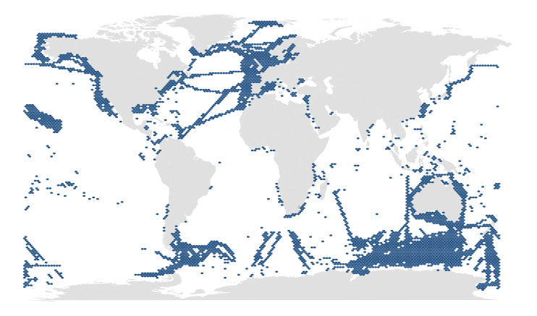
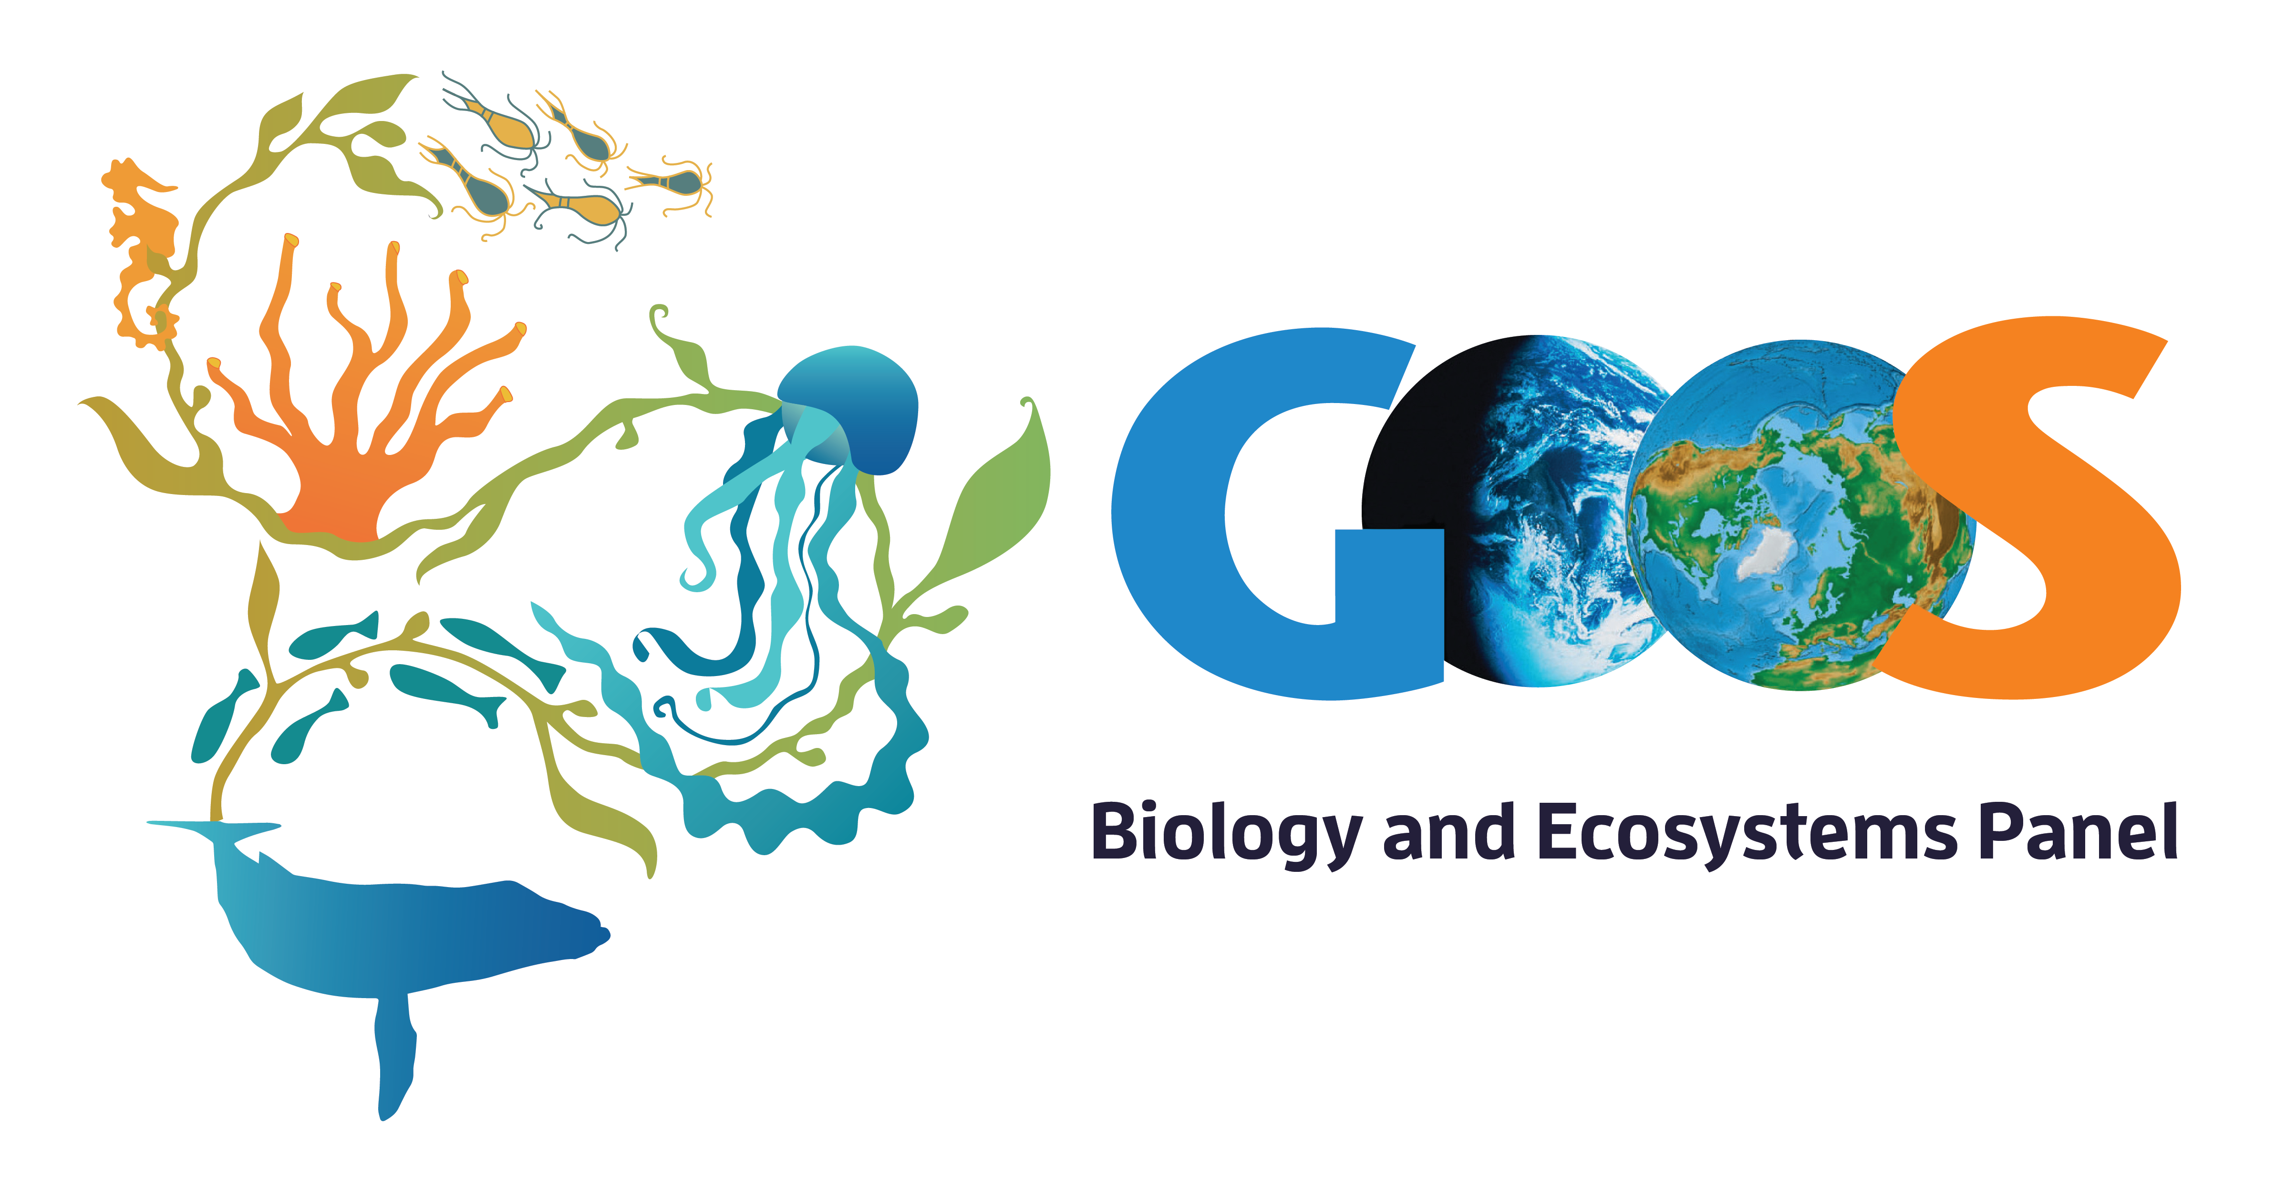
Ocean Observing in 2021
203 active long-term biological observing programs*
10 BioEco Essential Ocean Variable (EOV) based observing networks
Working towards the – GOOS Vision
Coverage 6 -7% of the global ocean, 93% without known sustained observations
* Survey 643 observing entities identified, 371 responded, 203 programs were active, long-term (5 years or more) and sampled at least EOVs systematically but spatial data were only available for 192 observing programs (Satterthwaite et al. 2020 in prep)
ocean-ops.org

Slide 5
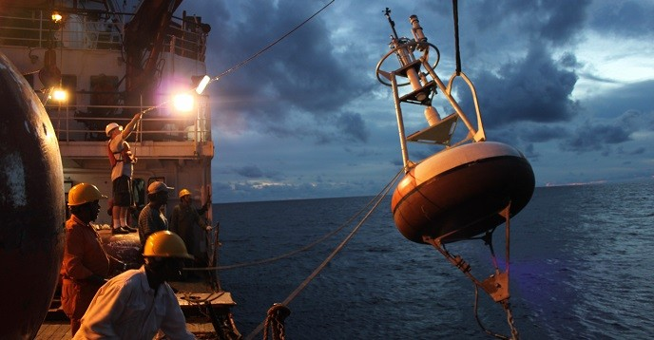
GOOS survey on Covid-19 Impacts April 2020 - across 12 global ocean observing networks - outlook updated during 2020
goosocean.org/covid-19

Slide 6
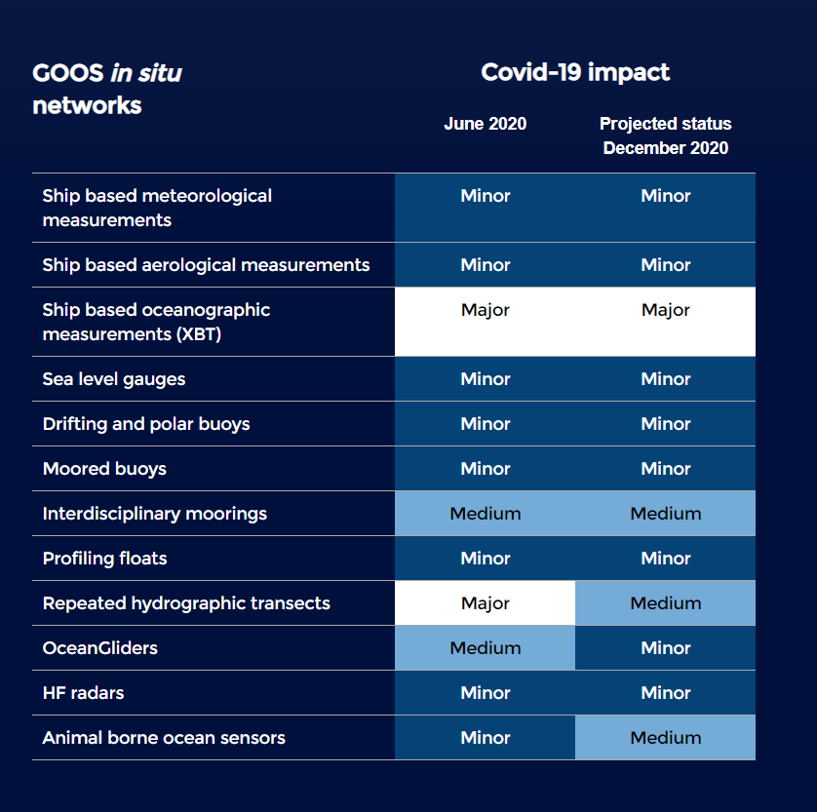
Evolution end 2020
Continue tracking:
Argo array down 10% to end 2020
Drifting buoys network back up to operational levels
50% fewer animals tagged Southern Ocean 2020/2021
Voluntary Observing Ships – approx. 5% reduction
Research vessels re-commenced with restricted operations
Locally and for specific datasets impacts can be higher
Observing system adaptation:
Ships of Opportunity Programme trained commercial shipping partners crew – now 5/32 lines operational - 15%
Use of charter vessels and local vessels for re-seeding and mooring turnaround
Increased cross-network cooperation for operations
Training of local operators to undertake calibration work
www.ocean-ops.org/reportcard2020
Notes:
major concerns for some networks. The system is reliant on ships and the impact of the epidemic is ongoing – concerned about:
Moorings – table shows, impact – nuanced with use commercial ship and working with ship operators
Go-SHIP – what used for and impact
DBCP/Argo – what used for and impact - nuanced with collaboration in charter, cross networks collaboration
SOOP – what they are trying but cannot go back full and will be impacted longer term
Southern Ocean - So a normal year ~ 115 tags normally/~ 50 tags Covid affected year. Emerging network so this is within interannual variability and more joining so at same time numbers ate rising - Korean seals deployments in the Ross Sea this year. I’m happy to update the number of tags that will be deployed on Weddell seals in the Ross for the 2020/2021 from 12 to 20 tag

Slide 7
Ocean Observing System System resilience
Use of autonomous instruments – delay in impact
Commercial ships remained operational
Strong effort by operators – working from home, monitoring data flow, work arounds for remote calibration, etc.
Community collaboration, with ship operators, across networks, sharing information
Identified as essential operations
Notes:
However the system showed resilience - in part due to increased automation – commercial vessesl VOS OK, arrays take time to decay, land based not maintained by functioning and gliders recovered quickly

Slide 8
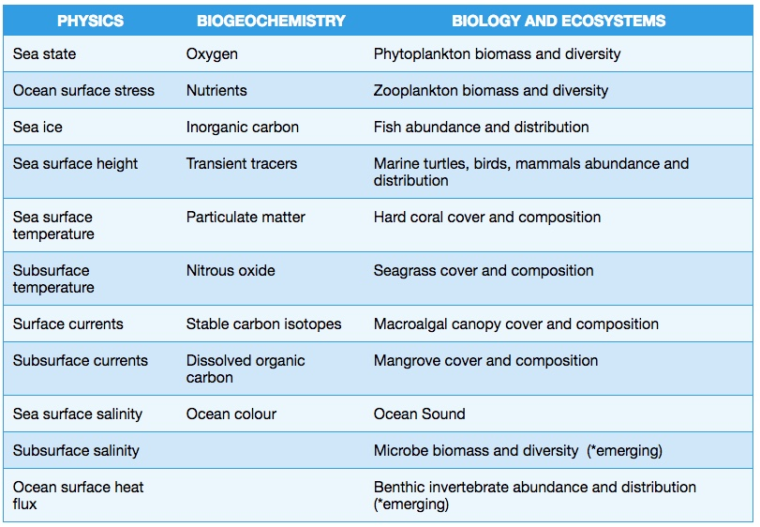
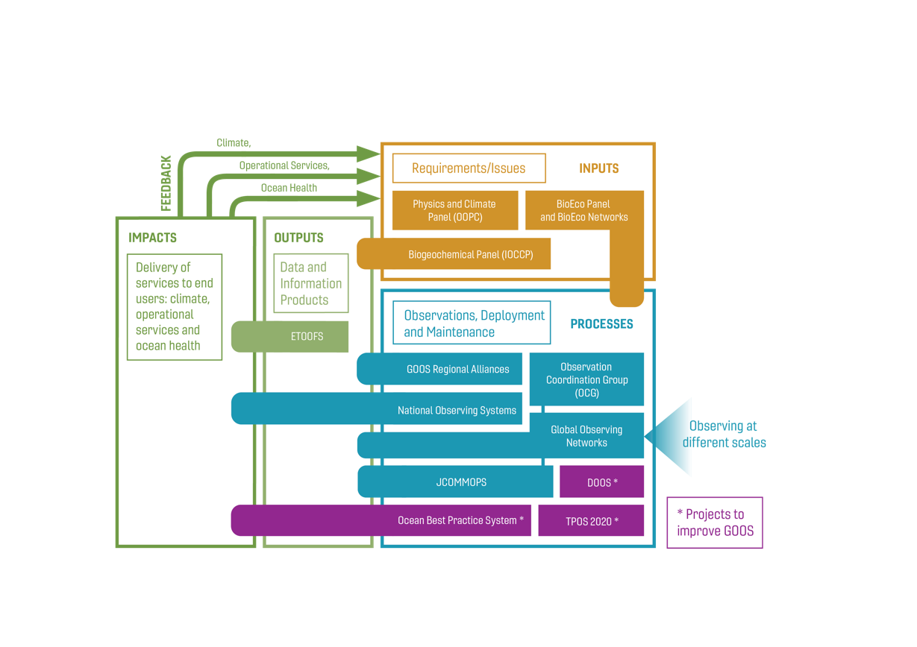
GOOS Today
Coordinates a system across ocean observing at many levels, institutional, national, regional, and global
31 Essential Ocean Variables to date through the GOOS Expert Panels, across physics, biogeochemistry, biology, ecosystems and human impacts
12 global ocean observing networks under the Observation Coordination Group (OCG), regional systems under the GOOS Regional Aliances
One system - delivery across Climate, Operational Services, Ocean Health
GOOS 2030 Strategy – strongly emphasises partnership to deliver services
Notes:
Relevant: The variable is effective in addressing the overall GOOS Themes – Climate, Operational Ocean Services, and Ocean Health.
Feasible: Observing or deriving the variable on a global scale is technically feasible using proven, scientifically understood methods
Cost effective
Majority observations funded oceanographic community,
Many and complex – many variables, spatial and temporal scales, phenomena to resolve – only getting more complex as approach coast – one system not many

Slide 9
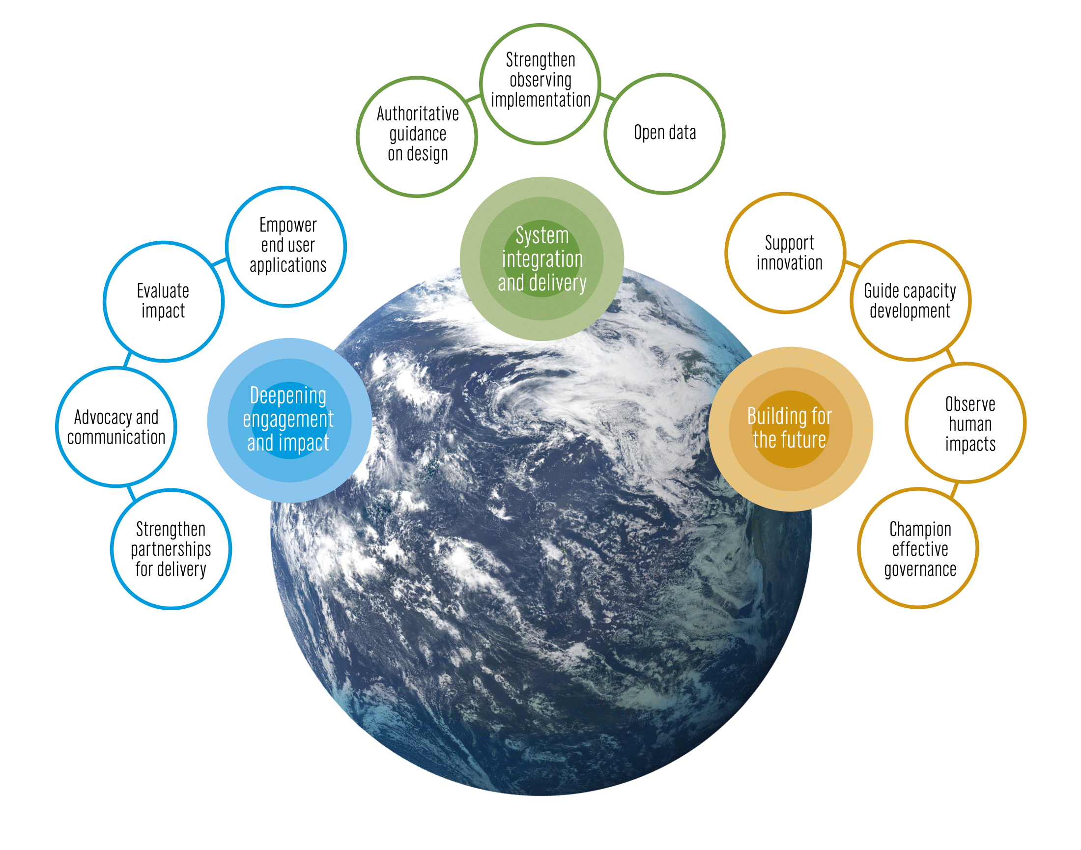
Vision
A truly global ocean observing system that delivers the essential information needed for our sustainable development, safety, wellbeing and prosperity
Mission
To lead the ocean observing community and create the partnerships to grow an integrated, responsive and sustained observing system
goosocean.org/2030strategy
Notes:
System integration and delivery are the ‘core’ of GOOS ‘business’ today
Deepening engagement and impact are key priority areas for work – including developing partnerships for delivery, advocacy and communications
Building for the future are about building the additional pieces we need for a fully integrated system, including capacity development and innovation, and leading the development of a governance system for the future system that includes say partners and other stakeholders
IT CAN BE VERY USEFUL TO HIGHLIGHT SOME OF THE STRATEGIC OBJECTIVES FOR SPECIFIC AUDIENCES OR TOPIC FOCUS – e.g. with a circle

Slide 10
Quote and Image Slide
Visual identity guidelines*
“
Vision
The science we need for the ocean we want
Mission
Transformative ocean science solutions for sustainable development, connecting people and our ocean
10

Slide 11
Overview of Submissions Received
214 program submissions and 27 contribution submissions:
Very robust and detailed submissions - high understanding of, and alignment with, Decade priorities
Diversity of proponents and themes
Wide diversity in scale of initiatives being proposed
OBS

Slide 12
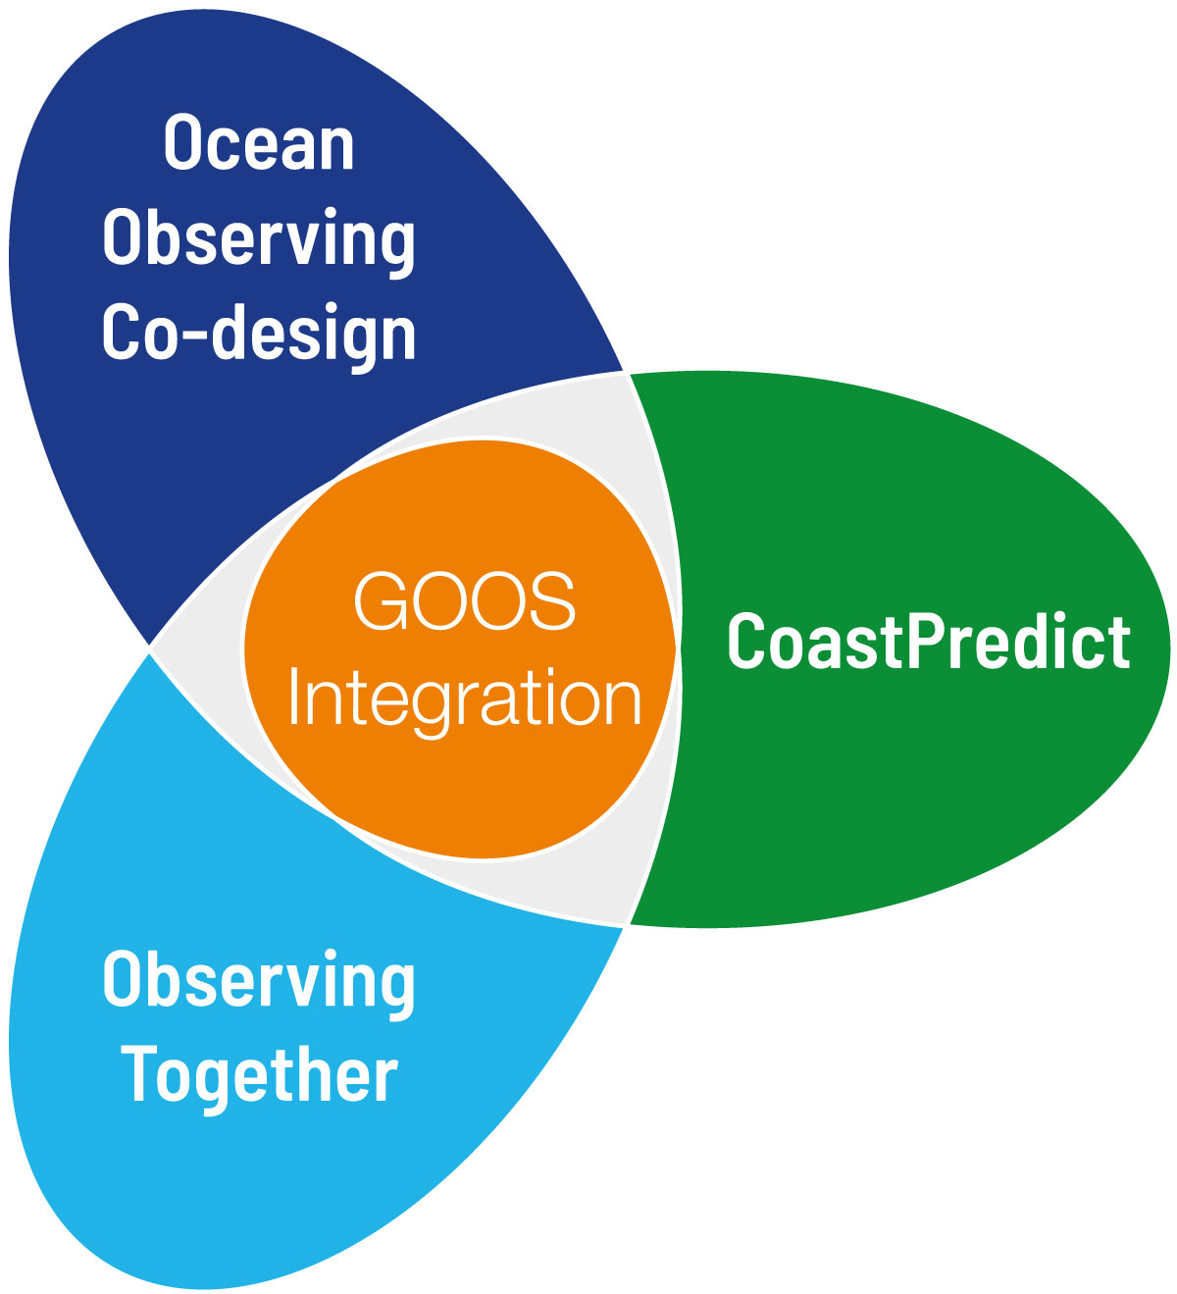
Ocean Observing Co-Design
Building the process, infrastructure and tools for co-design, creating an international capacity to evolve a truly integrated ocean observing system, matching agile observing and modelling capability with requirements.
leads: Sabrina Speich, David Legler,
Emma Heslop
CoastPredict
Redefining the concept of the global coastal ocean, transforming the science of observing and predicting the coast.
leads: Nadia Pinardi, Villy Kourafalou, Joaquín Tintoré
coastpredict.org
Observing Together
Transforming ocean data access and availability by connecting ocean observers and the communities they serve through enhanced support to both new and existing community-scale projects.
leads: Kim Currie and Molly Powers
Notes:
GOOS put substantial effort in planning and consulting the develop programme proposals for the Ocean Decade.
Three proposals have been submitted, and discussions on co-design continue and are expected to intensify.
The proposals are hinged around a common theme of integration of GOOS, with the open ocean and coast, with a broad set of stakeholder communities globally, and with infrastructure to test and sharpen delivery from observations through data and forecasting systems for end use across climate, early warnings and forecasts, and ocean health. The planning process has already deepened observing cooperation with the data system, forecasting systems, and stakeholders globally – all which help achieve both the vision and missions of GOOS, the Ocean Decade, and our implementers and Member States.

Slide 13
Transforming our ocean observing system assessment and design process.
Ocean Observing Co-Design will create a system co-designed with observing, modelling and key user stakeholders that will evolve ocean observing.
The challenge
Achieving the aims of the Ocean Decade demands readily available, fit for purpose ocean information. But much of the current ocean observing system has been built focusing on scientific and technical capability and attempting to join programmes together. Rather than setting priorities based on what will give the most benefit for cost, scientists have been encouraged to compete with each other.

Slide 14
The answer
Together, we will build the process, infrastructure and tools for ocean observing co-design necessary to support the Ocean Decade.
Objectives of Ocean Observing Co-Design
Integrate observing and modelling to support a sustainable ocean and society in ways that are measurably better
Make ocean observing and information appreciably more impactful through transformative co-design with the modelling community and key user stakeholders
Establish the international capacity and modular infrastructure to co-design and regularly evaluate the observing system
Entrain new observing and information technology across all elements of the programme.
Design and implementation through exemplars

Slide 15
Revolutionising Global Coastal Ocean observation and forecasting and offering open and free access to coastal information.
CoastPredict will redefine the science of observing and predicting the Global Coastal Ocean.
The challenge
Reducing risks and improving lives requires us to understand the coastal natural system as well as respond to ways in which climate change is affecting coastal populations.
With increasing coastal urbanisation, cities and megacities, there is greater need for advanced monitoring and predictions of extreme events such as flooding as well as pollution, habitat health and other hazards.

Slide 16
The answer
CoastPredict is a co-designed transformative response to science and societal needs. It is the result of significant input from young scientists, GOOS and global bodies active in international data modelling and best practice systems.
The Global Coastal Ocean concept at the centre of CoastPredict considers all coastal ocean regions as an interface area. Atmosphere, land, ice, hydrology, coastal ecosystems, open ocean and humans interact on a multiplicity of space and time scales that need to be resolved with proper scientific methods and consideration of uncertainties.
A coastal focus will engage island nations and indigenous or local people, inspire early career ocean professionals and be embraced by the general public.

Slide 17
Supporting the Decade of Ocean Science for Sustainable Development by connecting ocean observers and the communities they serve.
Observing Together will transform ocean data access and availability by connecting ocean observers and the communities they serve through enhanced support to both new and existing community-scale projects.
The challenge
Today, many communities around the world are unable to access ocean data in a way that is truly useful and enables them to make informed decisions. They often struggle to see the value of investing in ocean observation.

Slide 18
The answer
Observing Together aims to transform ocean data access and availability by connecting ocean observers and the communities they serve, through enhanced support to both new and existing community-scale projects.
Objectives of Observing Together
Equitable and practical access to ocean observations enabled by engagement and co-design with local observation and stakeholder communities.
A truly Global Ocean Observing System that makes a greater number of global and local observations available, integrated, interoperable and comparable.
Strengthened connections, mutual understanding, and improved knowledge sharing between ocean observers and the stakeholder communities they serve, globally and locally.
Increased evidence that ocean observations are applied to solve problems and inform decision-making at community, national, regional, and global levels.
Efficient design and use of ocean observations to maximise return on investment.
Design and implementation through community scale-projects

Slide 19
“Committed to change” - GOOS 10th Steering Committee 26-29 April 2021
Structural elements in place: 2030 Strategy, Implementation Plan that looks across the Core Team, stakeholder survey of support structures, Ocean Decade as vehicle for change
Improving governing and support structures
Design a process of change with stakeholders
Critically assessing internal architecture to be aligned with key functions
Asking co-sponsors (IOC, WMO, UNEP, ISC) to prepare for governance change

Slide 20
“Committed to change” - GOOS 10th Steering Committee 26-29 April 2021
Focus on regional support to GOOS: critically looking at GOOS Regional Alliances, GOOS Projects with a regional scope (TPOS, AtlantOS), and their connection to both global networks and national focal points and systems
principles of subsidiarity, resonance to identify best scales to effect change
connection to regional ocean management structures (LMEs, RFMOs, etc.)
Essential Ocean Variables EOVs
improving understanding and use of EOVs as a ‘strategic asset’ of GOOS
Understand and respond to how EOVs (and ECVs) are used
Make them (and connected applications-phenomena-EOV-observing network links) more useful for reviewing observing system development and gaps

Slide 21
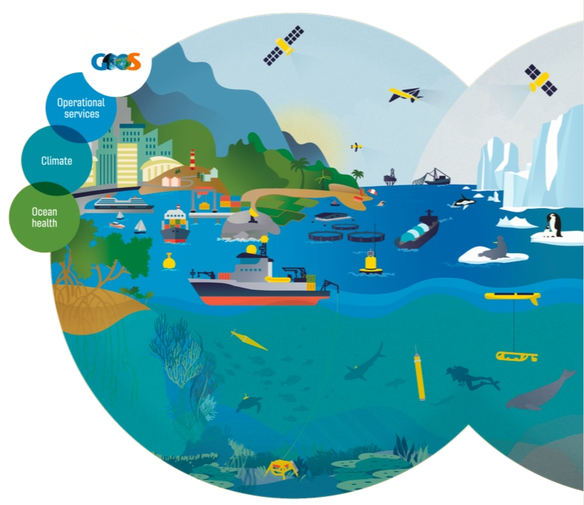
Thank you
goosocean.org

