Slide 1


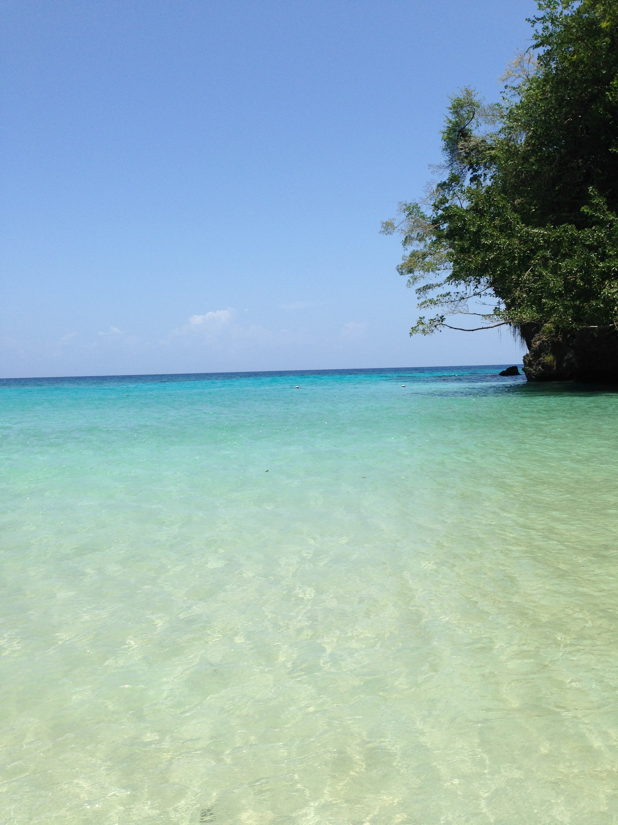
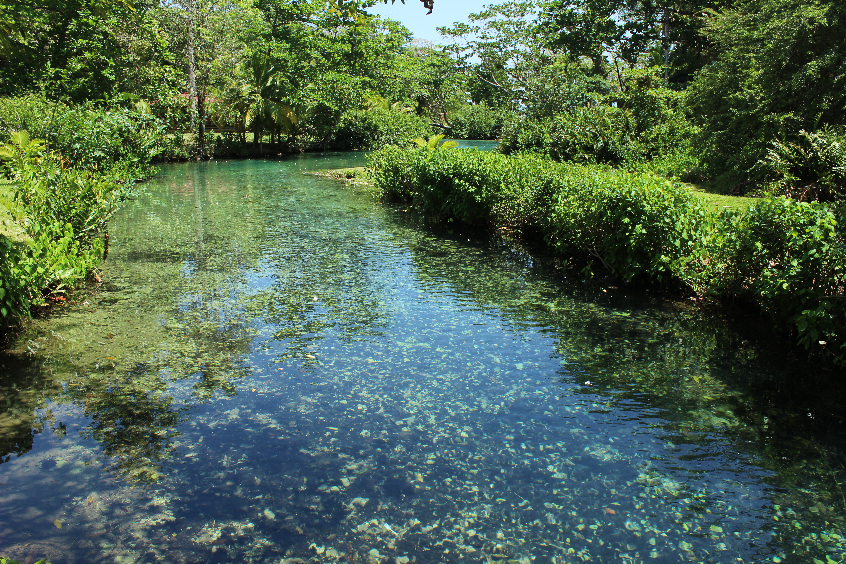
The IOC Ocean InfoHub Project
Lucy Scott
UNESCO/IOC Project Office for IODE
L.Scott@unesco.org

Slide 2
Introduction
The IOC Ocean InfoHub Project (OIH) is a global initiative to improve access to marine and coastal data and information.
It is a three year project that commenced in April 2020
The project is funded by the Government of Flanders (Kingdom of Belgium)
The objective of the project is to develop interoperability between existing information systems, thus improving the flow of information to end users.

Slide 3
OIH Objectives
1
The OIH/ODIS will link a network of hubs that will be able to exchange
data and information
Thus contributing to the transfer of marine technology, by enhancing shared scientific and technical capacities to render a wide range of data and information products and services available
The OIH will develop a proof-of-concept for an underlying Ocean Data and Information System (ODIS) architecture together with partners, in a co-design process.
The OIH will develop regional or thematic end user communities of practice
To promote and foster awareness and collaboration with established organizations and systems providing information, connecting contributors and users with the resources to support their efforts.
2
3

Slide 4
Three related initiatives
The Ocean InfoHub Project
IOC Ocean and Data information system Catalogue of data sources (ODISCAT), currently describes over 2000 online sources of marine & coastal data in 16 categories
The Ocean Data and Information System
The three projects are very closely linked.
The OIH Project has developed the first phase of the architecture underpinning ODIS, and is concerned with involving user communities and establishing proof-of-concept of ODIS.
OIH
ODIS-
CAT
ODIS

Slide 5
OIH links IOC databases
The OIH will first work with global IOC-associated online resources

Slide 6
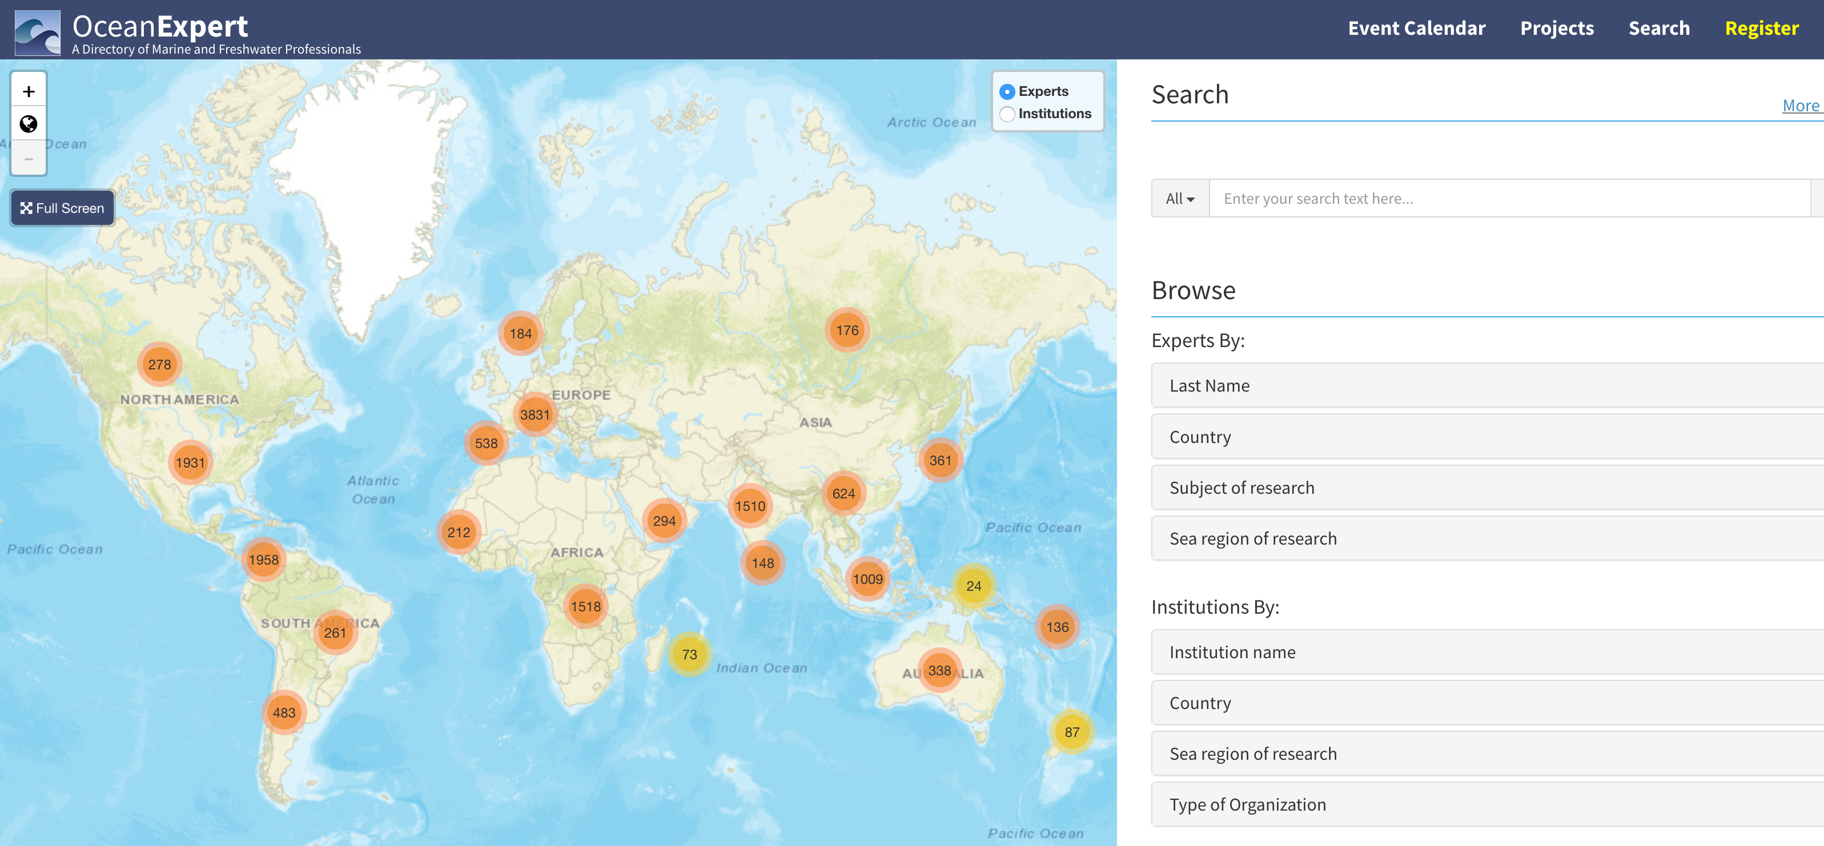
OIH links IOC databases
The OIH will first work with global IOC-associated online resources – including:
  OceanExpert : People

Slide 7
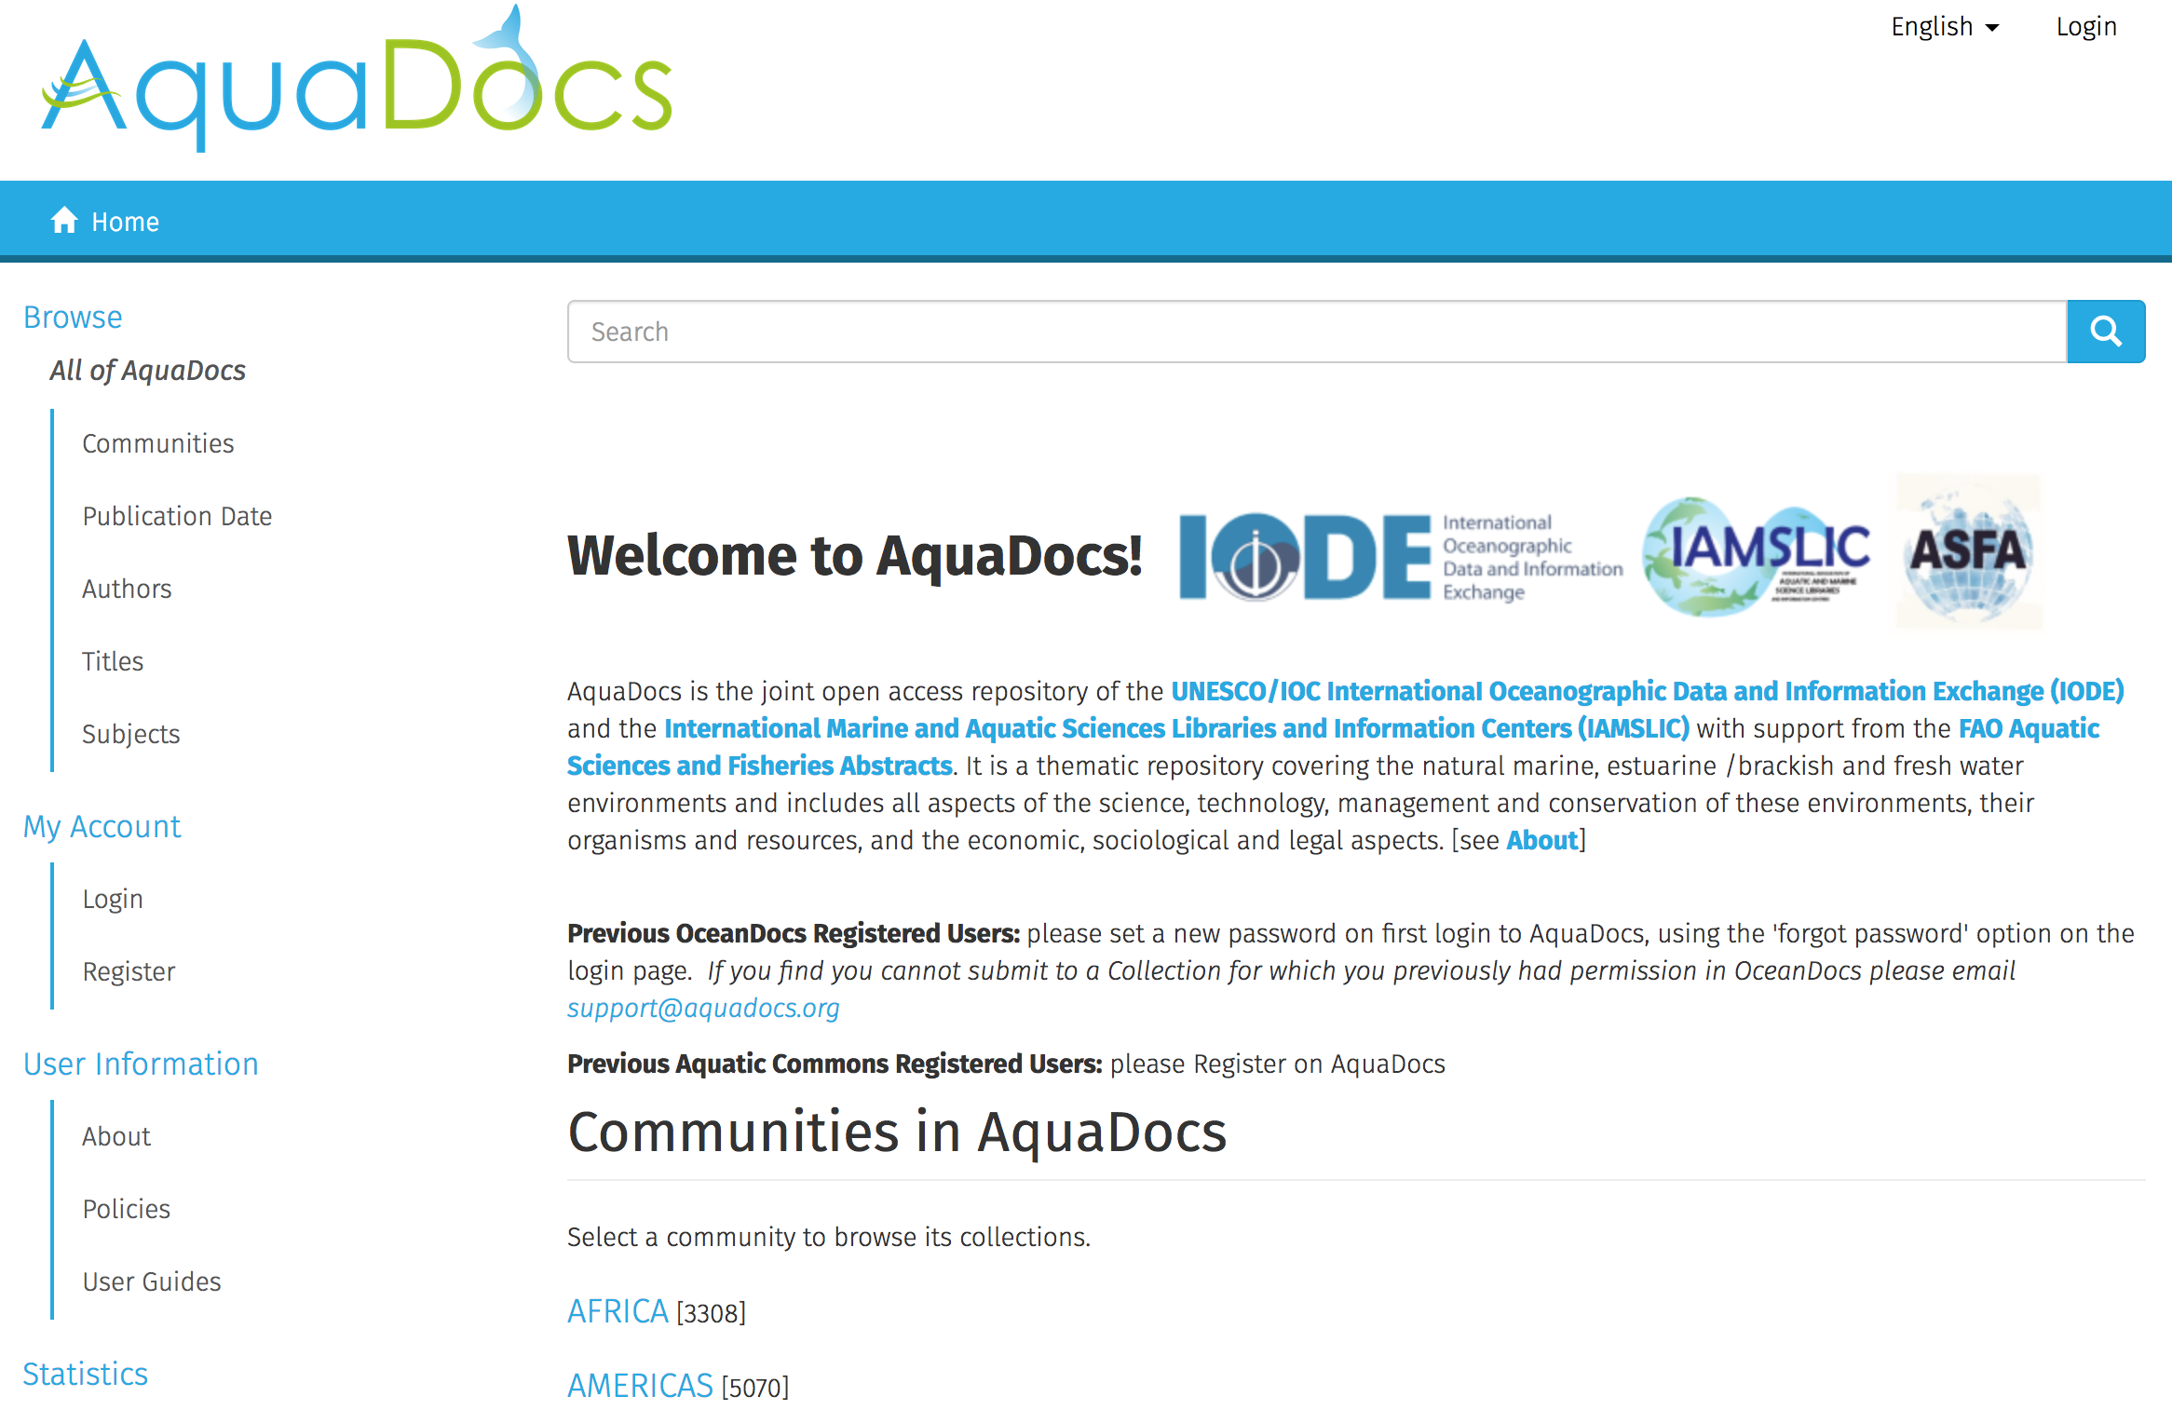
OIH links IOC databases
The OIH will first work with global IOC-associated online resources – including:
  OceanExpert : People
  AquaDocs : Documents and Publications

Slide 8
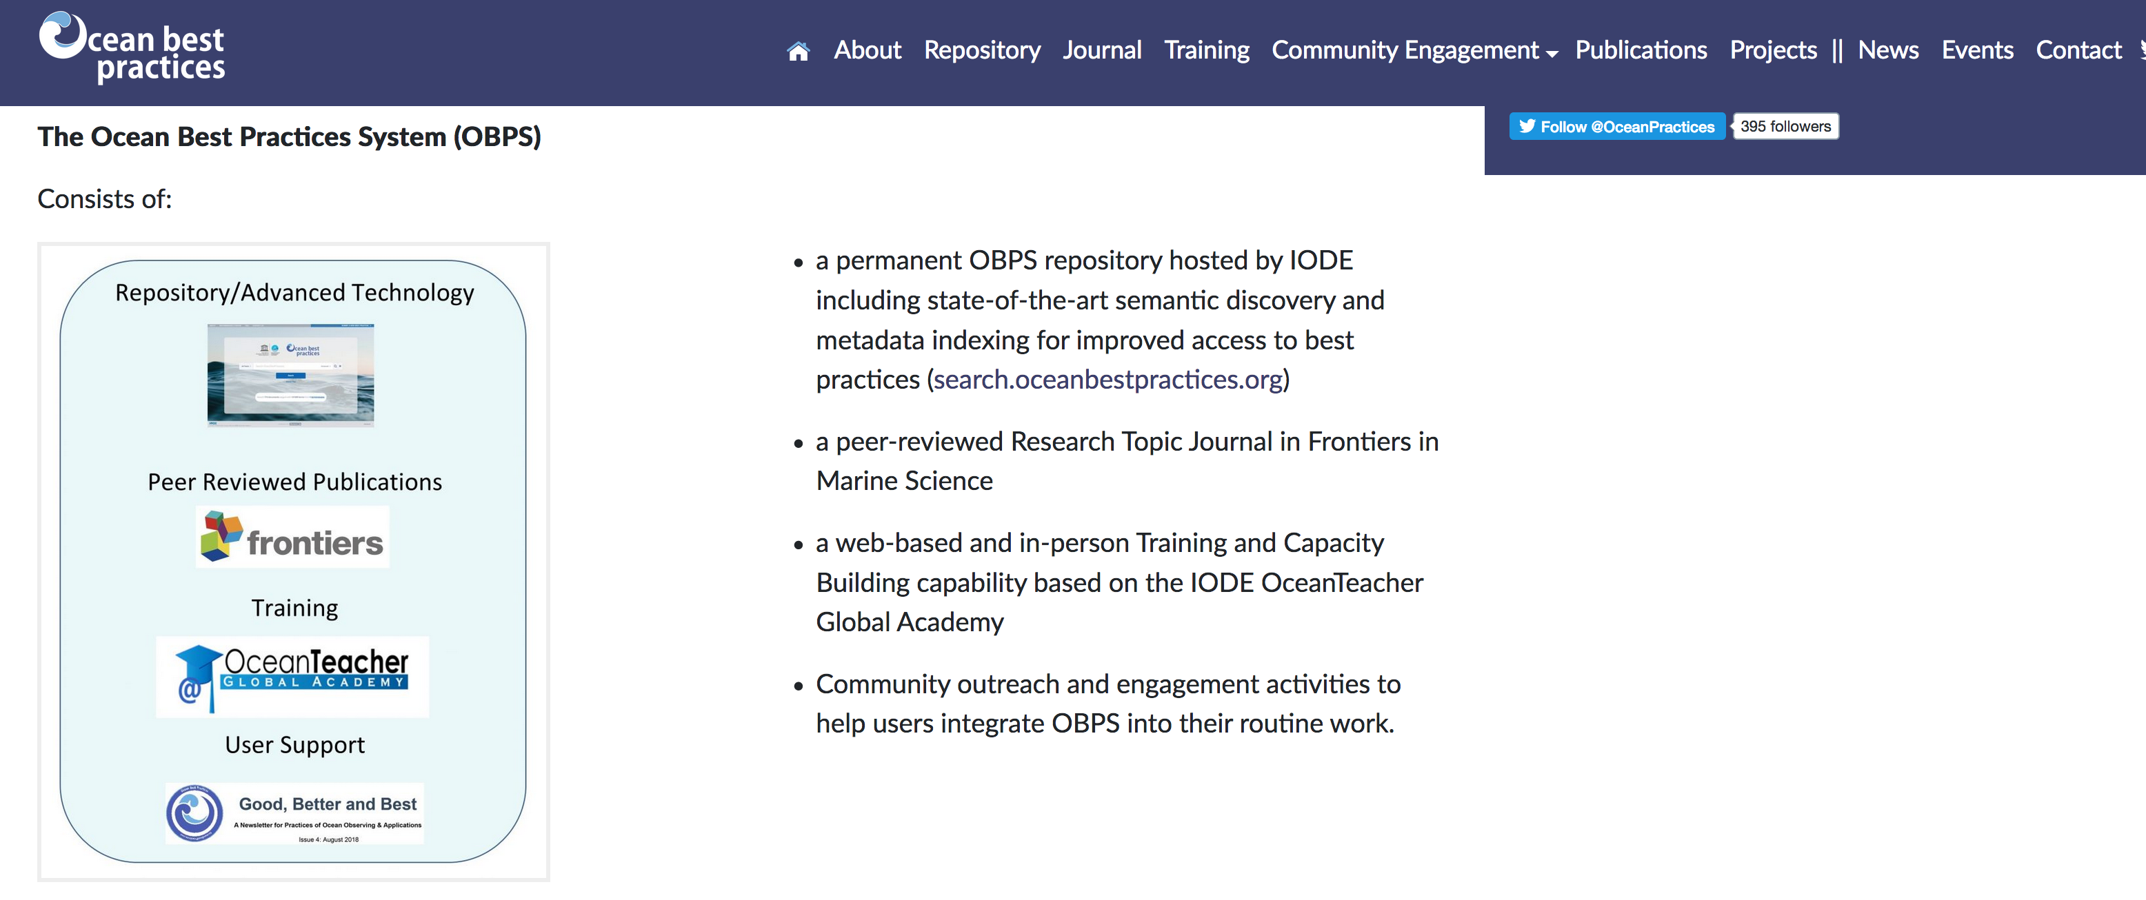
OIH links IOC databases
The OIH will first work with global IOC-associated online resources – including:
  OceanExpert : People
  AquaDocs : Documents and Publications
  The GOOS/IODE Ocean Best Practices System (OBPS)

Slide 9
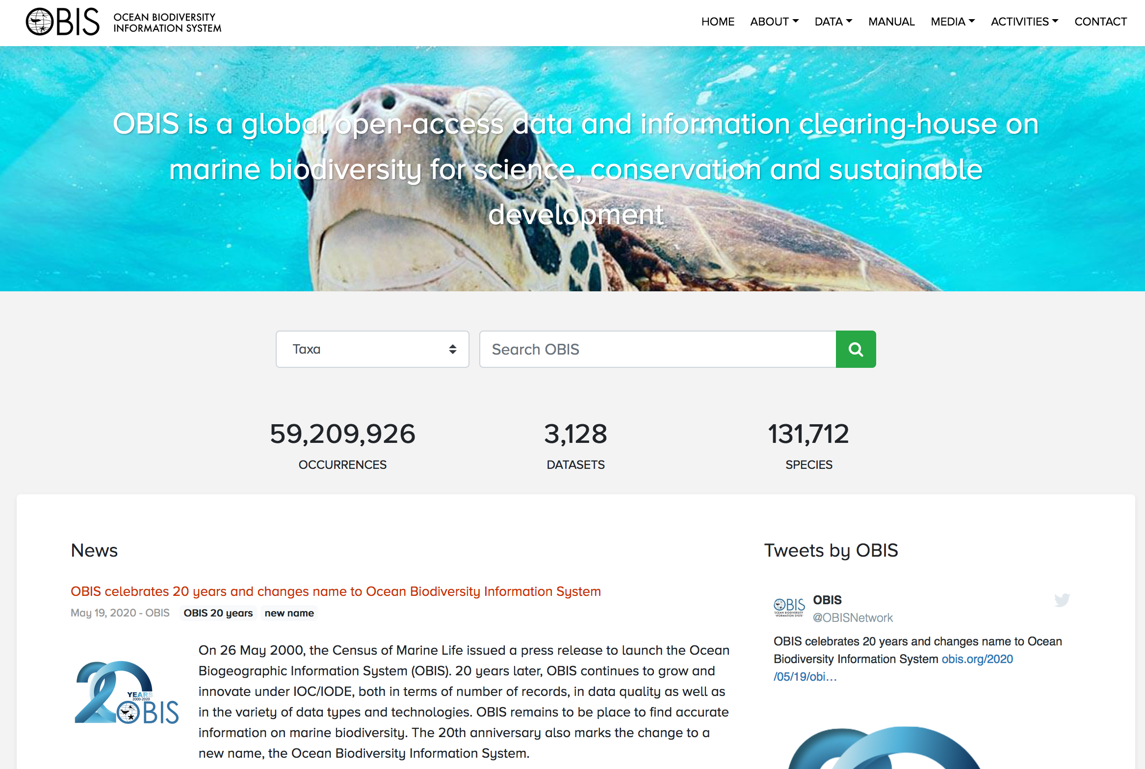
OIH links IOC databases
The OIH will first work with global IOC-associated online resources – including:
  OceanExpert : People
  AquaDocs : Documents and Publications
  The GOOS/IODE Ocean Best Practices System (OBPS)
  Data: the Ocean Biodiversity Information System (OBIS)

Slide 10
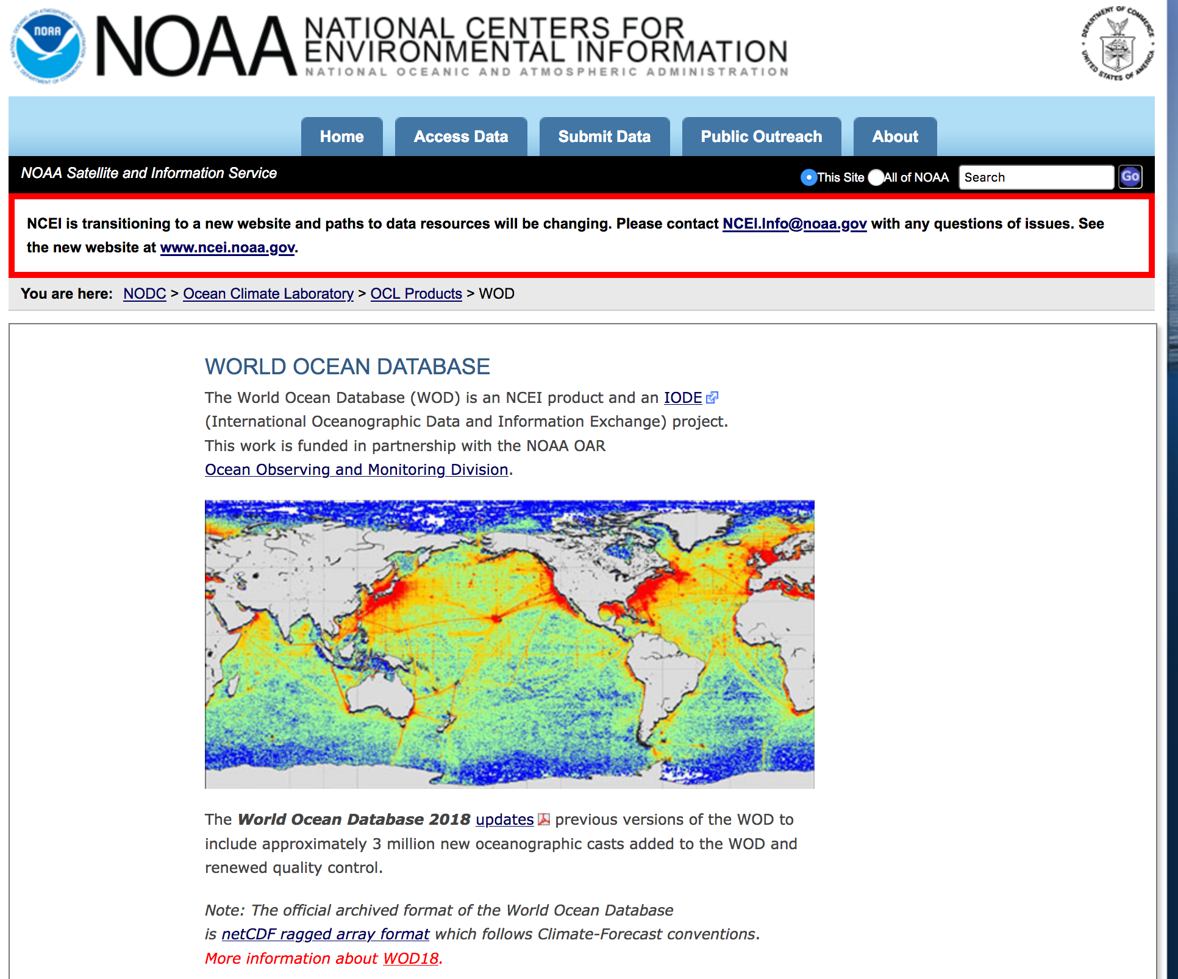
OIH links IOC databases
The OIH will first work with global IOC-associated online resources – including:
  OceanExpert : People
  AquaDocs : Documents and Publications
  The GOOS/IODE Ocean Best Practices System (OBPS)
  Data: the Ocean Biodiversity Information System (OBIS)
  Data: the World Ocean Database (WOD)

Slide 11
OIH links IOC databases
The OIH will first work with global IOC-associated online resources – including:
  OceanExpert : People
  AquaDocs : Documents and Publications
  The GOOS/IODE Ocean Best Practices System (OBPS)
  Data: the Ocean Biodiversity Information System (OBIS)
  Data: the World Ocean Database (WOD)
extended by partnerships with EurOcean, Marinetraining.eu, EMODNET, and other sources in the IOC ODIS Catalogue of Sources (ODIScat).

Slide 12
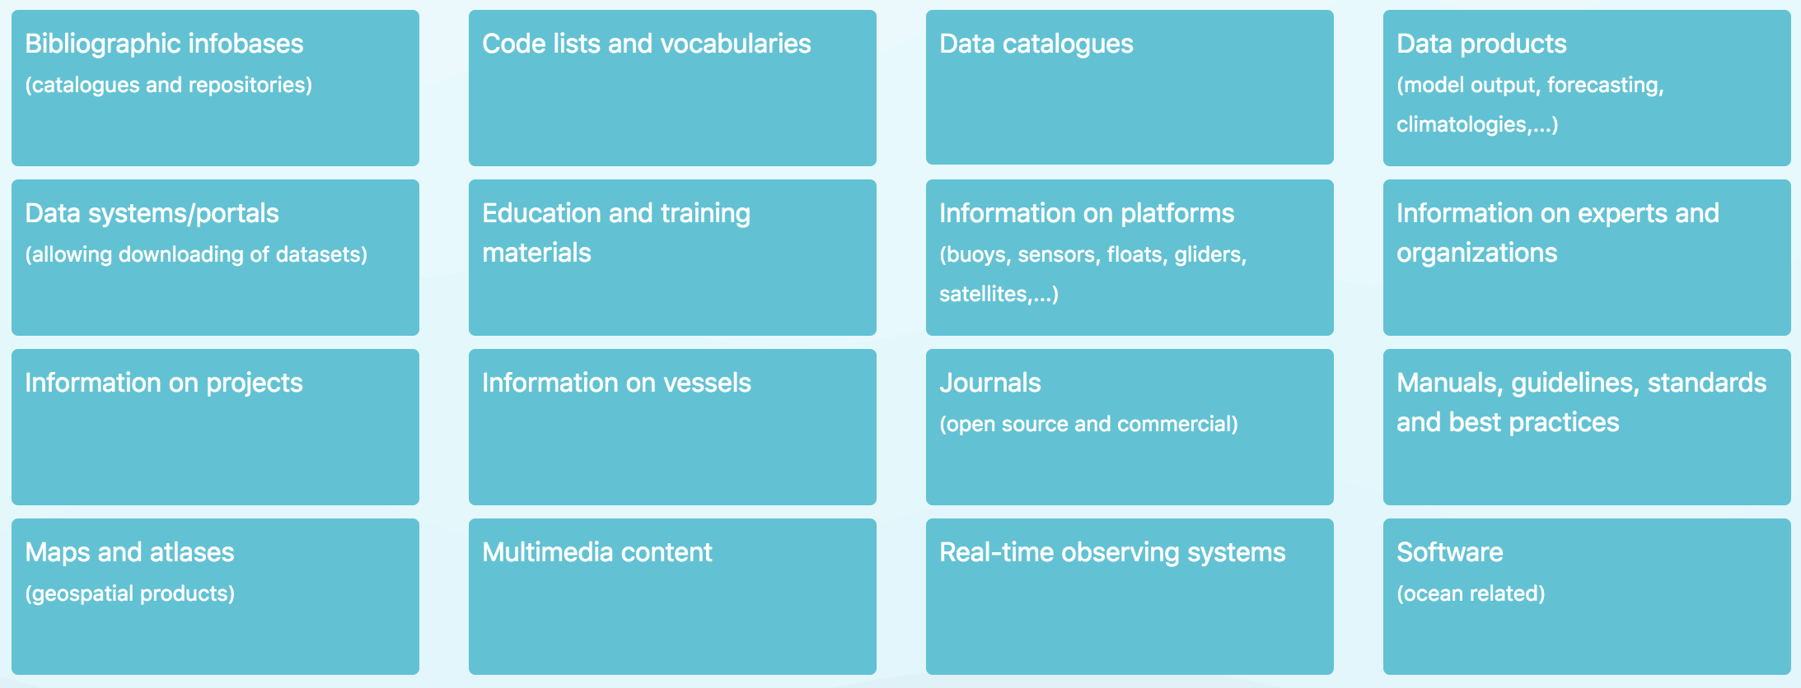
Initial data types
People and institutions/organizations
Documents
Spatial data/maps
Training opportunities
Vessels (research opportunities)
Projects
Data categories in ODIS-Cat

Slide 13
Three pilot regions
African region,
Latin America and Caribbean region, and the
Pacific Small Island Developing States
These three regions have participated in the development of the proposal for the Ocean InfoHub Project and will take a lead on pilot projects to test interoperability between existing information hubs.

Slide 14

Ocean
Data
Portal
ODIS-Architecture
Thematic Hub
Ocean
Best
Practices
OIH
Global Hub
World Ocean Database
OBIS
Ocean
Docs
Ocean
Expert
A global ODIS (Ocean Data and Information System) architecture will be developed to enable interoperability with local, regional and thematic infrastructures.
This will be developed with willing and able OceanInfoHub early adopters (co-design)
Lightweight schema.org based implementation patterns
Regional Hub
Regional Hub
Thematic Hub
Regional Hub
NationalHub
Thematic Hub
NationalHub
NationalHub
NationalHub

Slide 15
Ocean
Data
Portal
OIH SERVICES – global demonstration
Thematic Hub
Ocean
Best
Practices
OIH
Global Hub
World Ocean Database
OBIS
Ocean
Docs
Ocean
Expert
Finding specific expertise
Finding vessel based training opportunities
Regional Hub
Regional Hub
Thematic Hub
Regional Hub
Peer-to-peer collaboration
NationalHub
Finding data / information
Thematic Hub
NationalHub
NationalHub
NationalHub
Finding spatial data / metadata

Slide 16
OIH support for the IOC’s CD Strategy
These services would all be in support of the IOC Capacity Development strategy.
The project will also focus on the transfer of local knowledge,
on supporting early career scientists,
and on remedying gender disparity by increasing access to information, technologies and opportunities.

Slide 17
OIH support for global reporting
The OIH will assist countries in their reporting requirements for the Sustainable Development Goals (particularly goals 4,9, 14 and 17), contribute to key aims of the UN Decade of Ocean Science for Sustainable Development, the Paris Agreement, the Sendai Framework for disaster Risk Reduction and Marine Biological Diversity of Areas Beyond National Jurisdiction. The OIH will also assist IOC member states to report on ocean science capacities through the Global Ocean Science Report (GOSR).

Slide 18
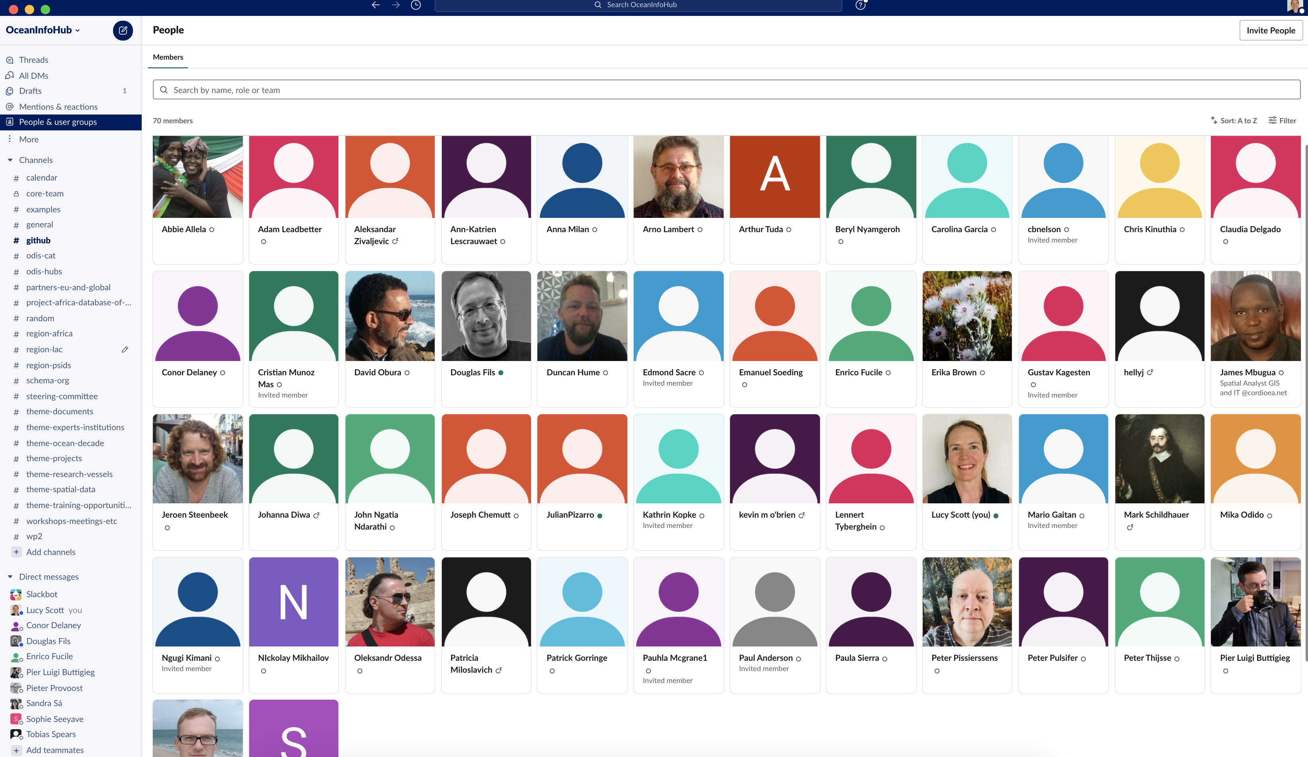
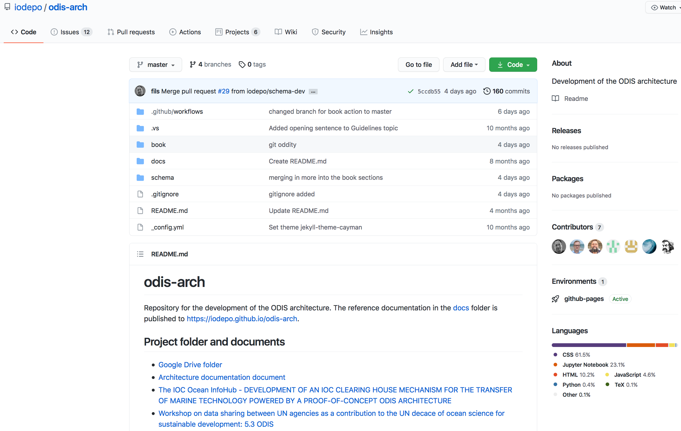
Achievements to date
Active Technical Working Group (GitHub, Slack and meetings) 70 members from all over the world, over 2600 posts in the Slack forum.

Slide 19
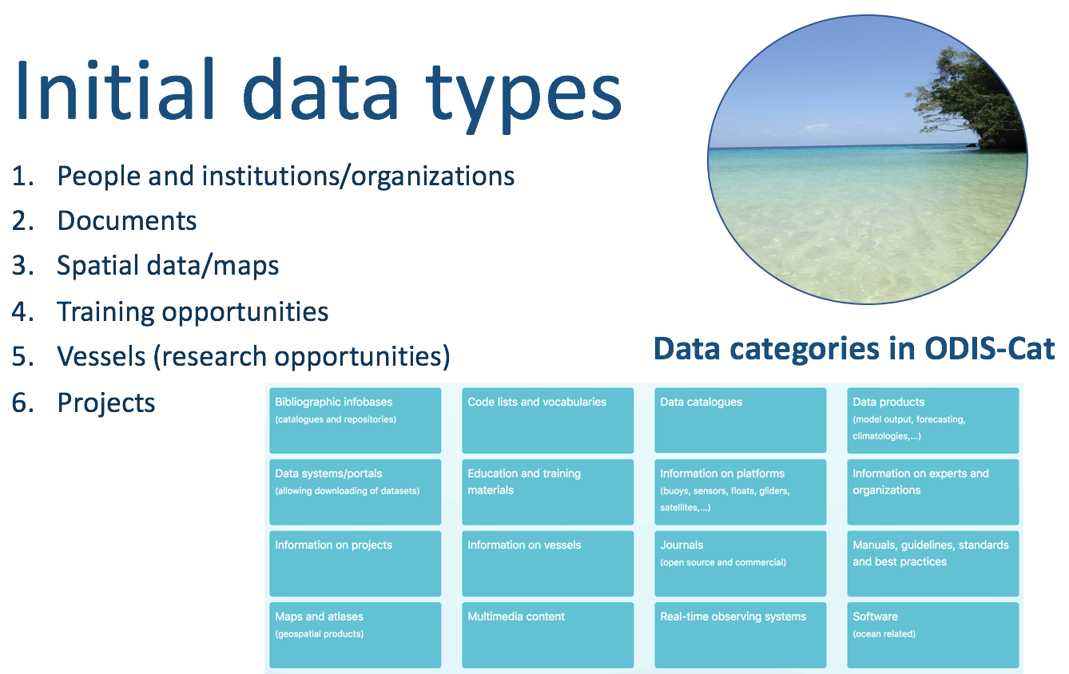
Achievements to date
Active Technical Working Group (GitHub, Slack and meetings)
Developed documentation for the ODIS-architecture, for all six priority themes

Slide 20
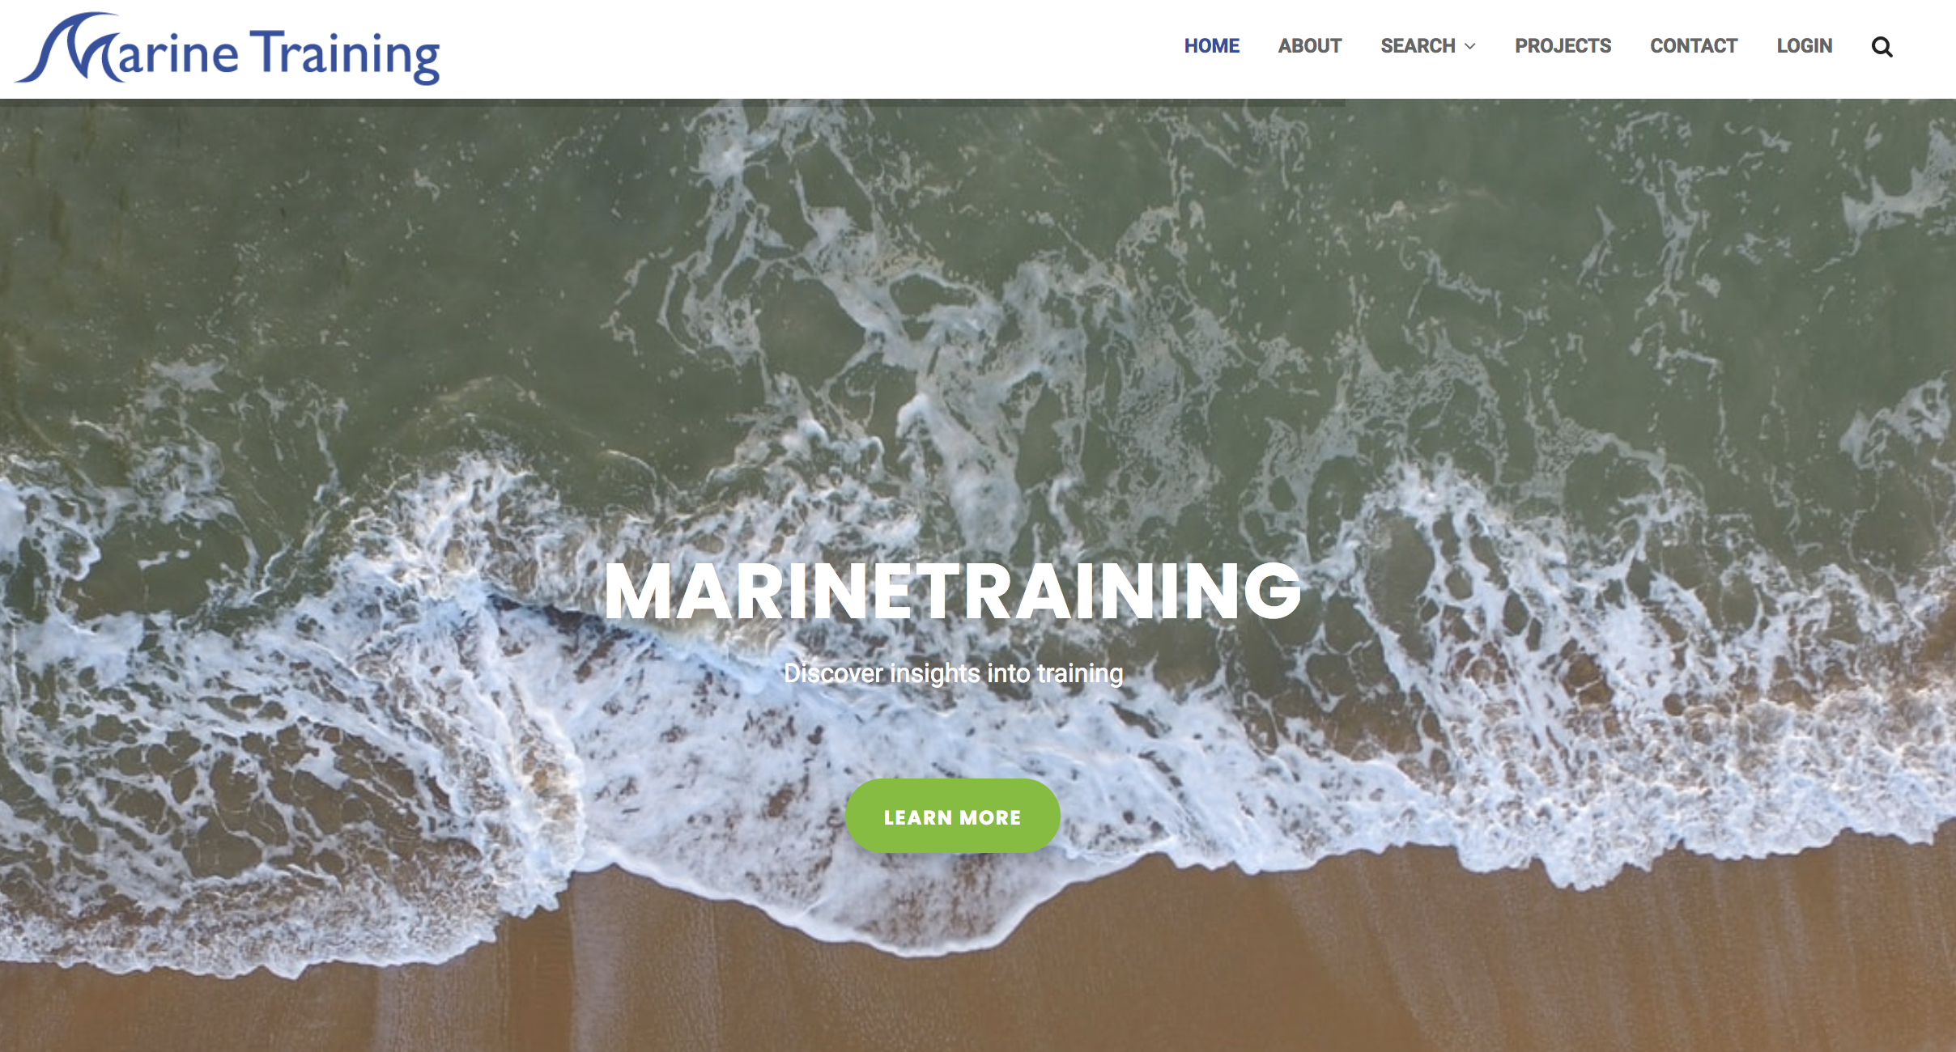
Achievements to date
Active Technical Working Group (GitHub, Slack and meetings)
Developed documentation for the ODIS-architecture, for all six priority themes
Proof-of concept for the ODIS-architecture
Marinetraining.eu
OceanExpert
OBIS
One search returns results from all 3 systems

Slide 21



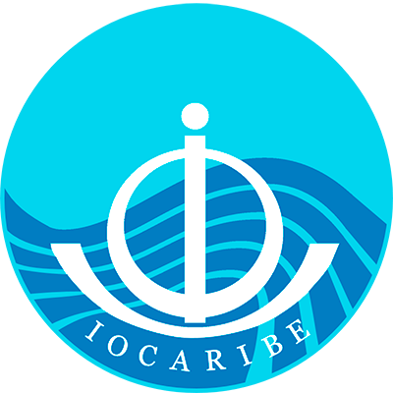

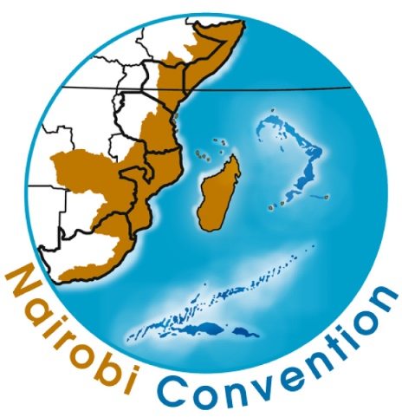

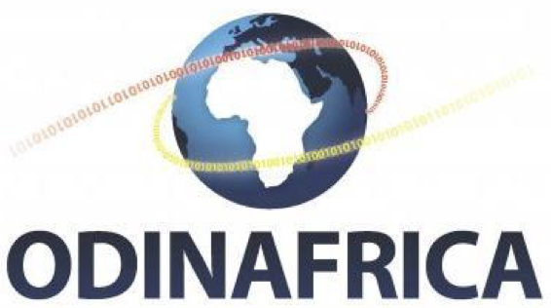


Achievements to date
Active Technical Working Group (GitHub, Slack and meetings)
Developed documentation for the ODIS-architecture, for all six priority themes
Proof-of concept for the ODIS-architecture
Three regional communities of practice implementing one or more of the patterns

Slide 22
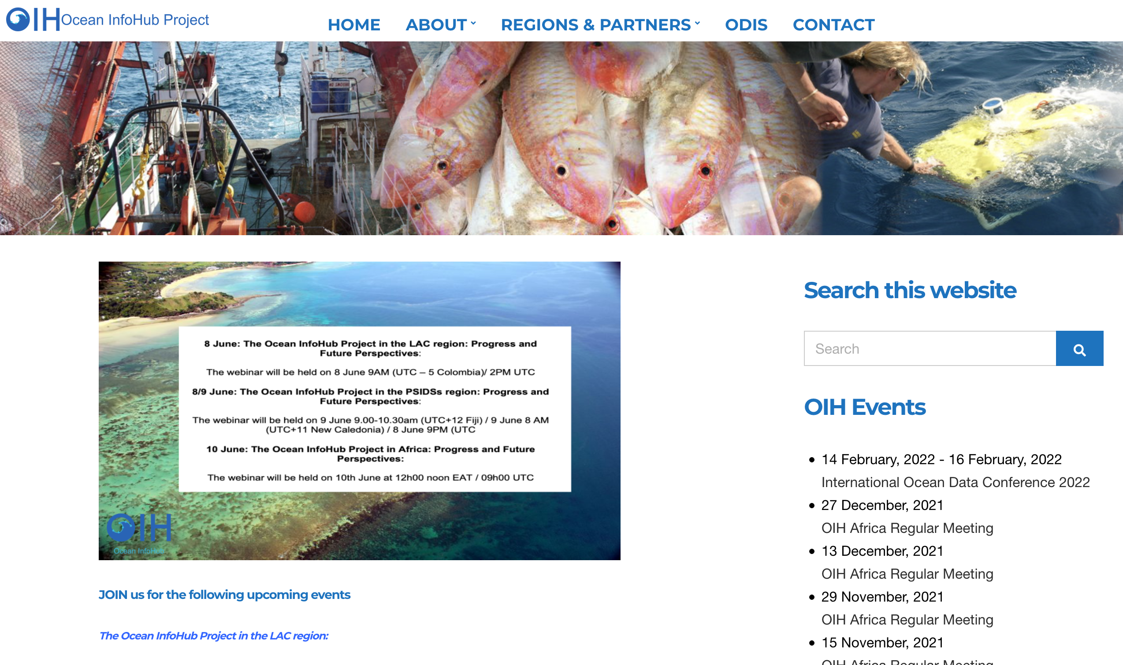
Achievements to date
Active Technical Working Group (GitHub, Slack and meetings)
Developed documentation for the ODIS-architecture, for all six priority themes
Proof-of concept for the ODIS-architecture
Three regional communities of practice implementing one or more of the patterns
Increasing visibility and interest from around the world

Slide 23
In conclusion
The OIH will facilitate better access to global databases, but also better visibility of national and regional data holdings.
Regions and countries can learn from each other; Africa, Pacific and LAC regions all have success stories that will be useful to share.
The OIH development and implementation principles will be fully based on co-design: the project seeks the participation of a wide range of partners and end user communities that are involved in the sustainable use and management of marine areas.
We welcome involvement from additional partners.

Slide 24
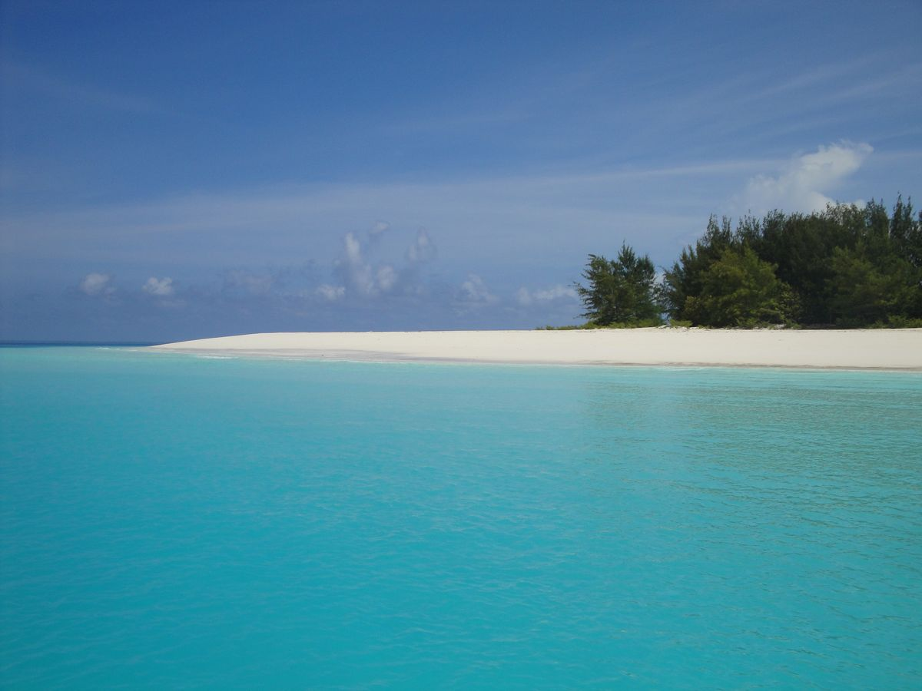
Thank you
https://oceaninfohub.org

