Slide 1
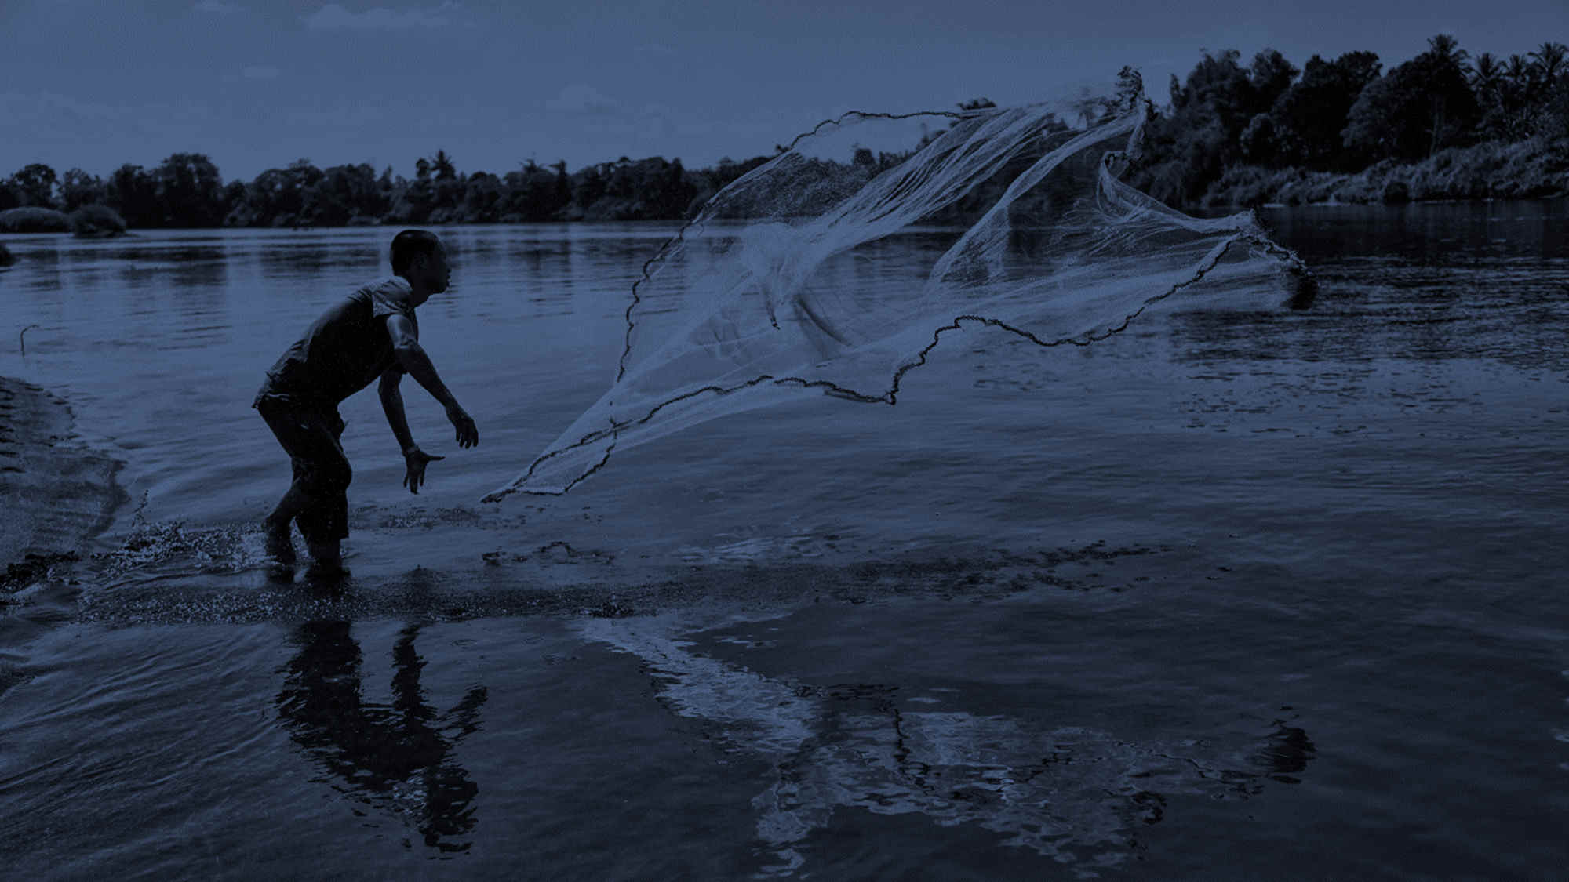
Ocean InfoHub
Presented by Zulfikar Begg and Sioeli Tonga
Email: zulfikarb@spc.int & sioelit@spc.int
www.spc.int

Slide 2
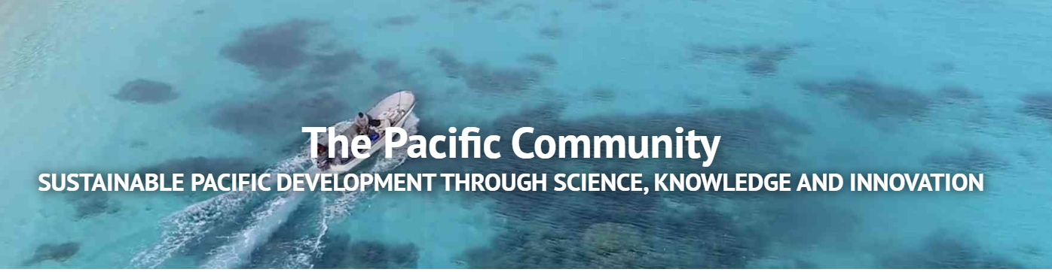
SPC - The Pacific Community - is the principal scientific and technical organisation supporting sustainable development in the Pacific region, serving 26 member countries.
www.spc.int
GEM - SPC Geoscience Energy and Maritime Division - seeks to maintain a reputation for excellence as the region’s principal provider of geoscientific services, in work areas such as Ocean and Coastal Geoscience, Disaster Risk Reduction, Climate Change, Water and Sanitation, Geothermal Energy, Geological Resources and Surveys, etc. http://gem.spc.int/
Organisational Background
Notes:
The Pacific Community was established by a treaty, the Canberra Agreement, in 1947, by the six ‘participating governments’ that then administered territories in the Pacific Islands region: Australia, France, New Zealand, the Netherlands, the United Kingdom and the United States of America. Our organisation’s governing body is the Conference of the Pacific Community, which meets every two years. Each member country and territory is entitled to one vote on decisions. In this way we are an organisation owned and governed by our 26 country and territory members. 4 regional offices and 600 staffs.

Slide 3





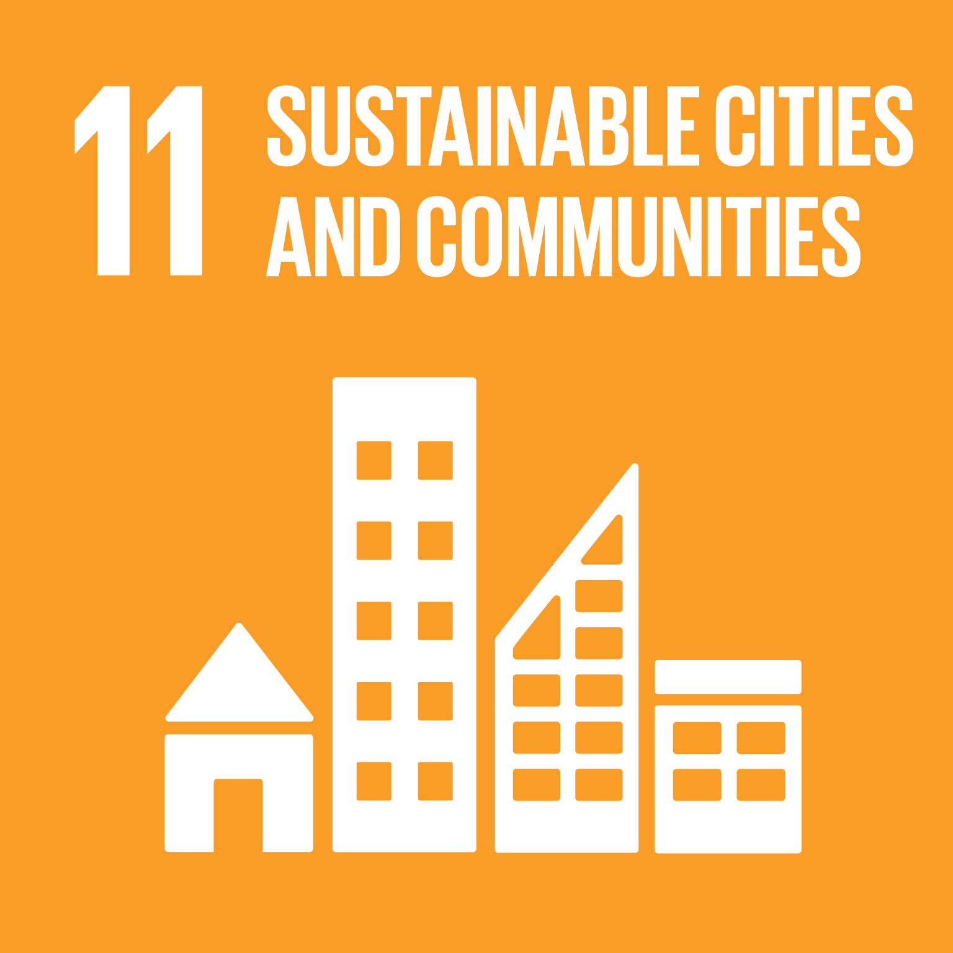
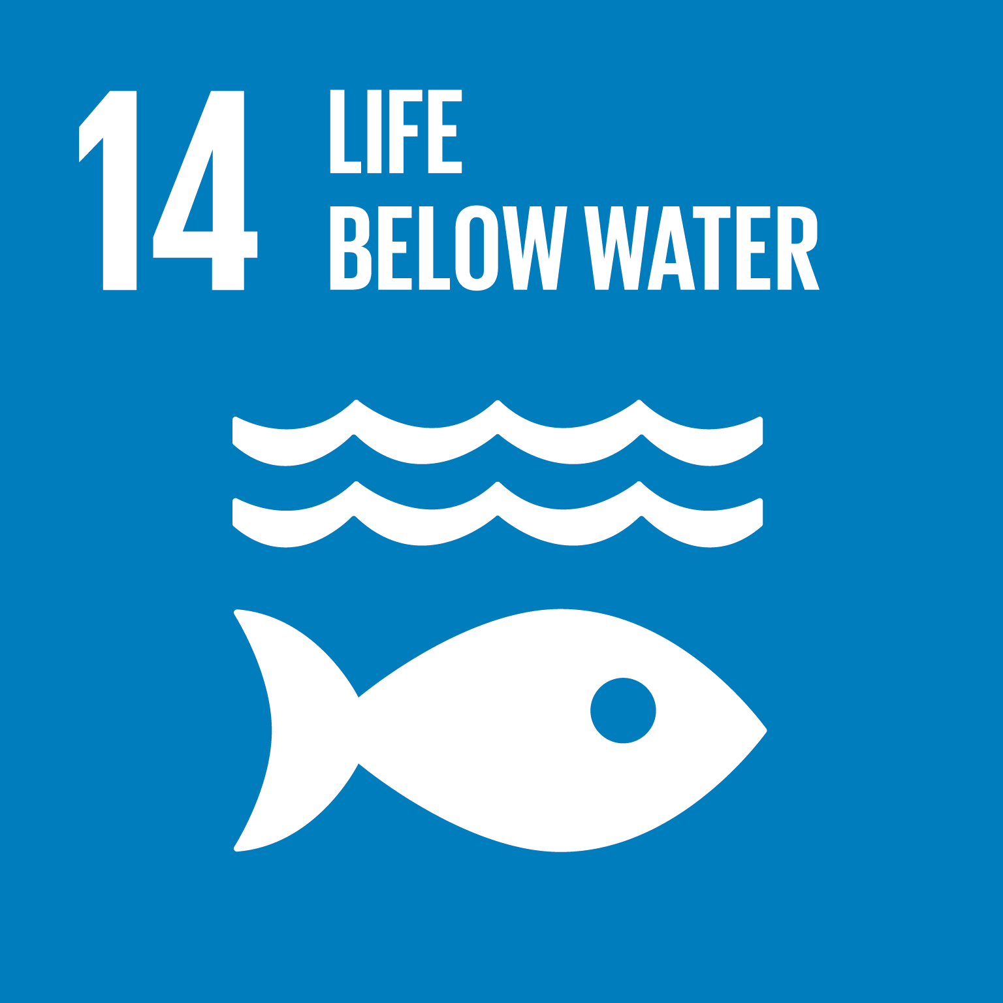

What is ?
Ocean and maritime governance, policies and laws
Maritime boundaries & marine spatial planning
Coastal hazard assessment & early warning systems
Sustainable sea transportation and ports
Ocean literacy and maritime capacity development
Enhance data collection and provide data management services for fisheries & marine ecosystems, ocean observation and predictions.
People
72 scientists & other experts

Slide 4
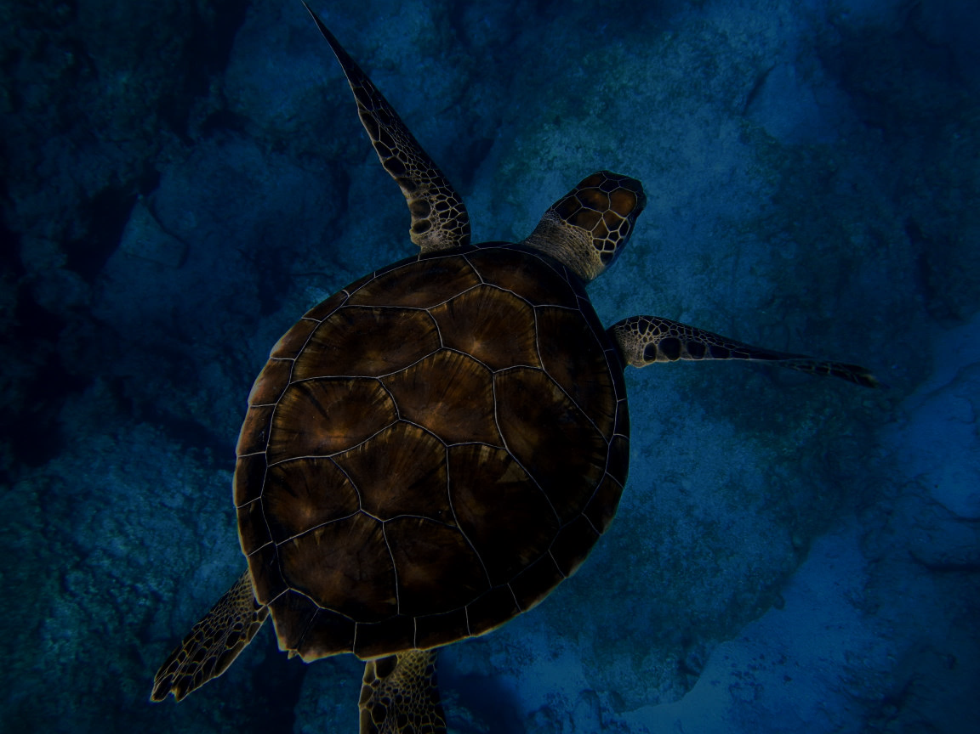
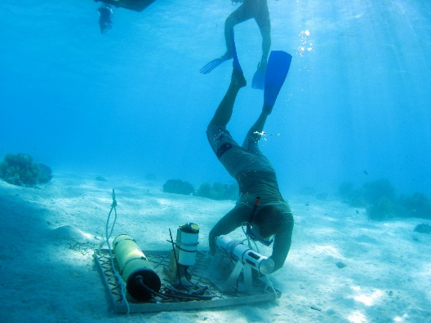
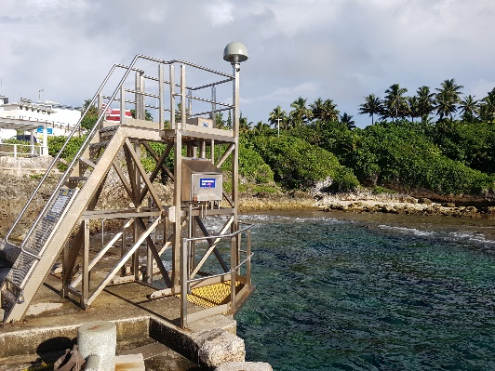
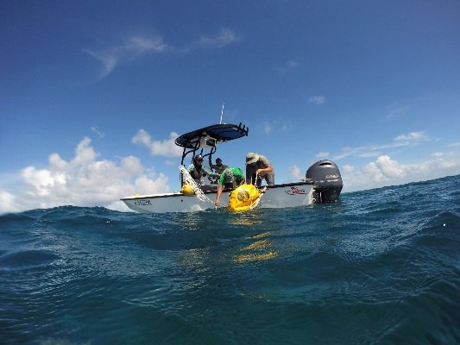
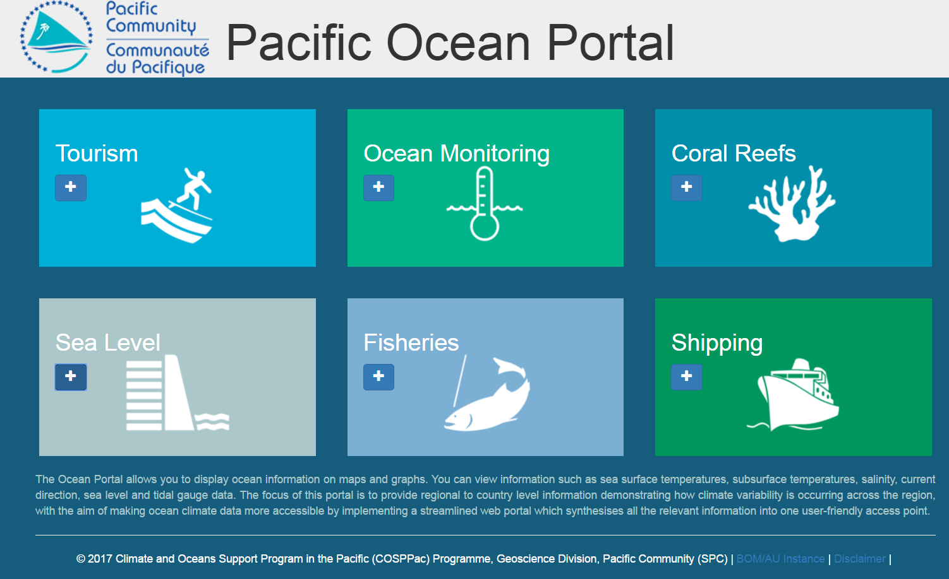
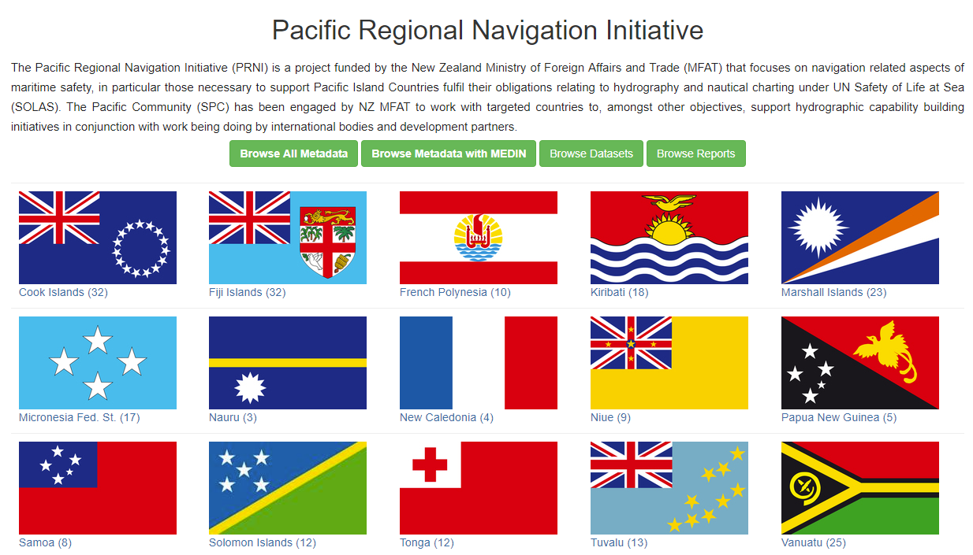
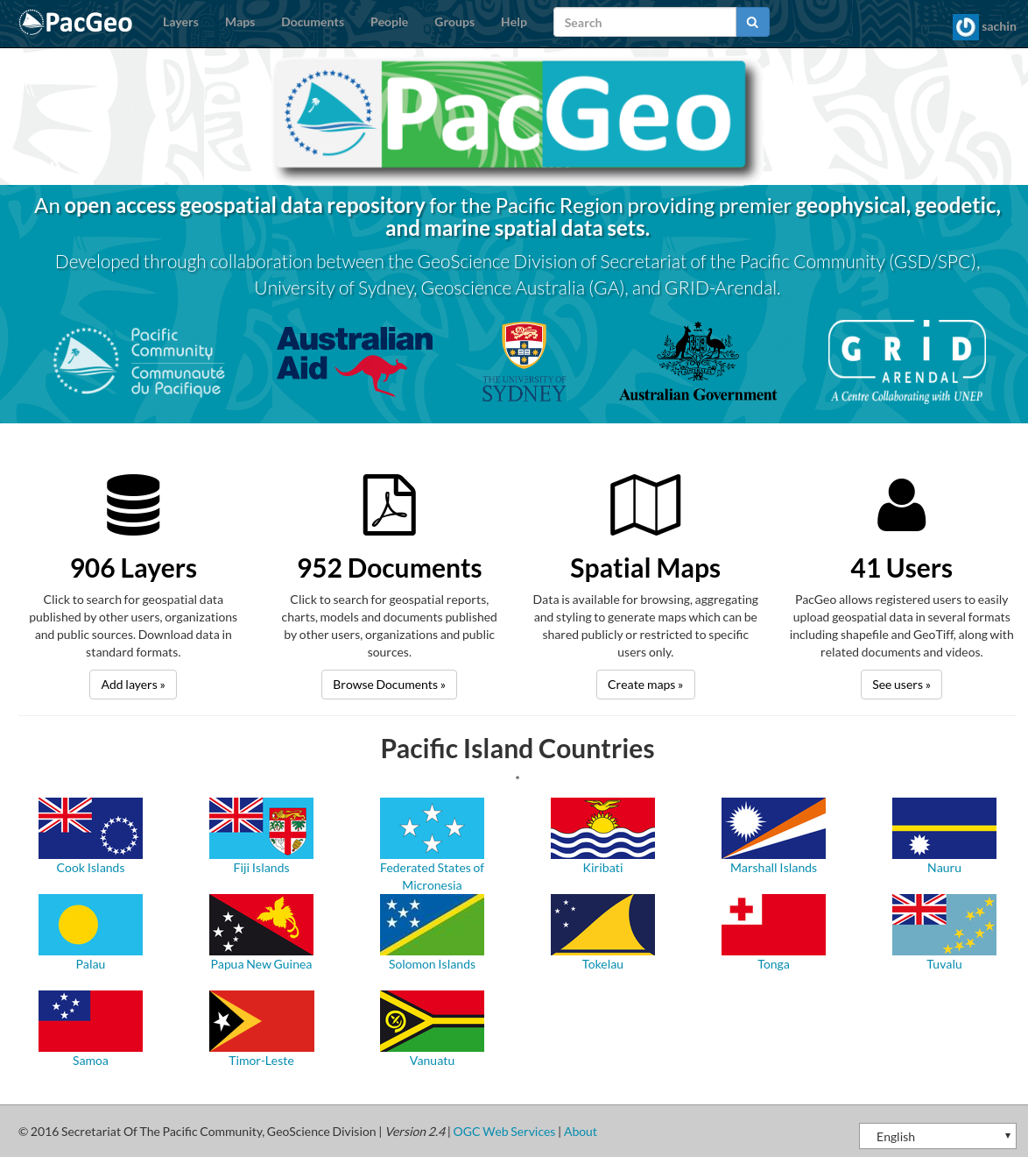
Marine Observations and Data Management
Oceanographic Campaigns
COSPPac Tide gauges
Wave Buoy
oceanportal.spc.int
http://www.pacgeo.org/prni/
http://www.pacgeo.org/

Slide 5
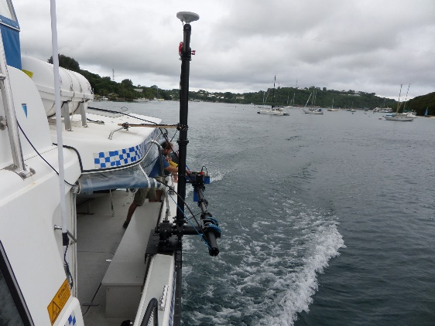
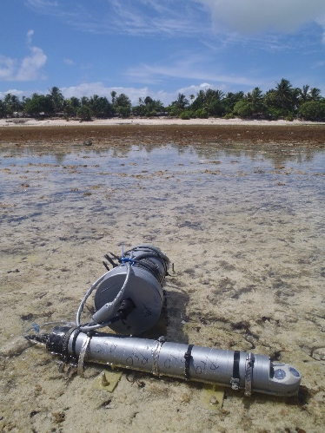
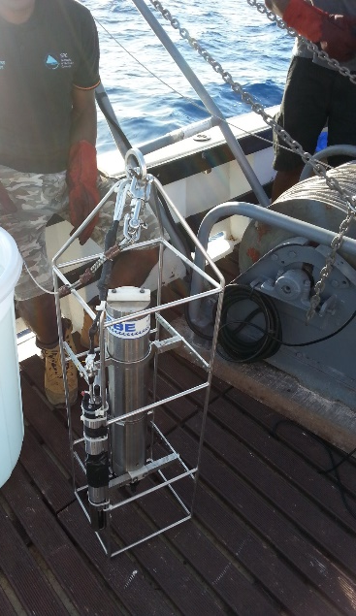
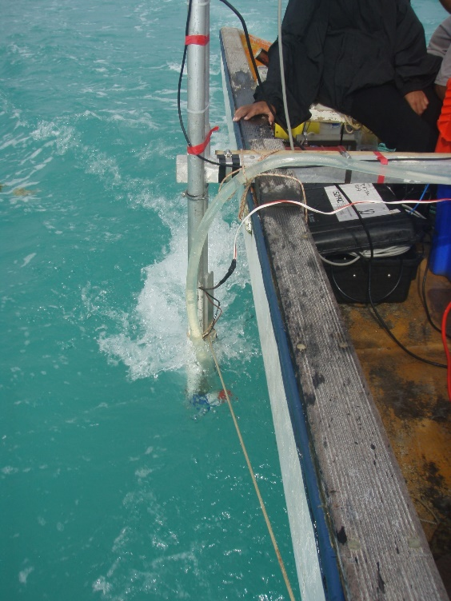
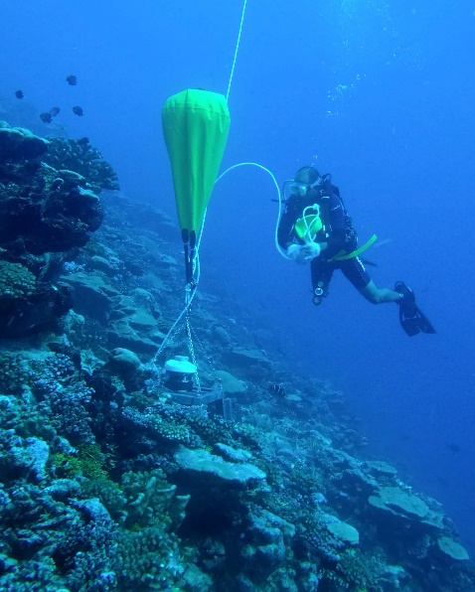
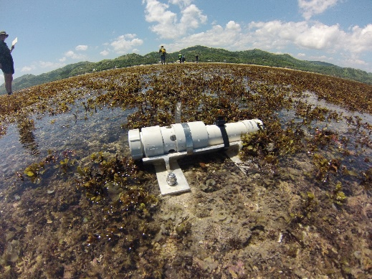
Observing Instrumentation

Slide 6
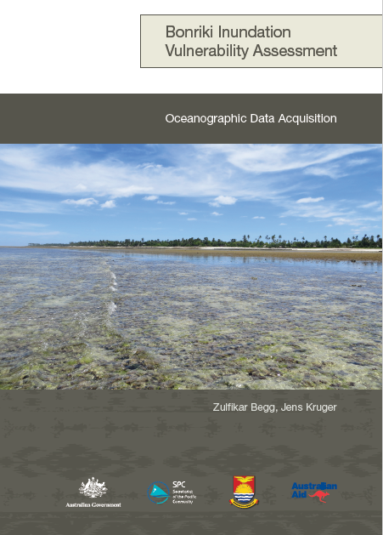
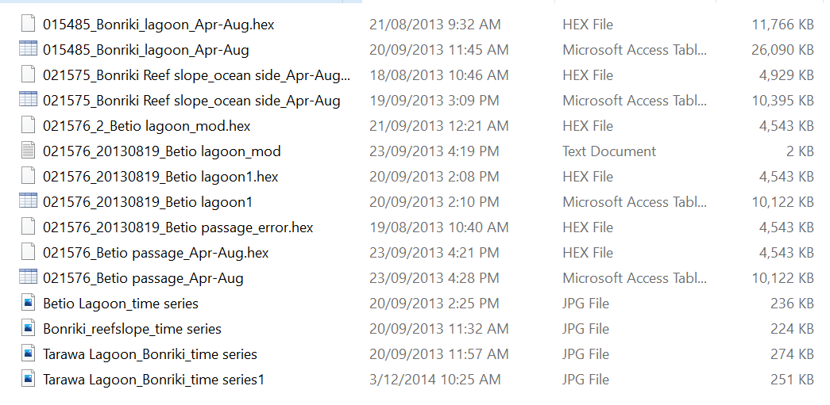
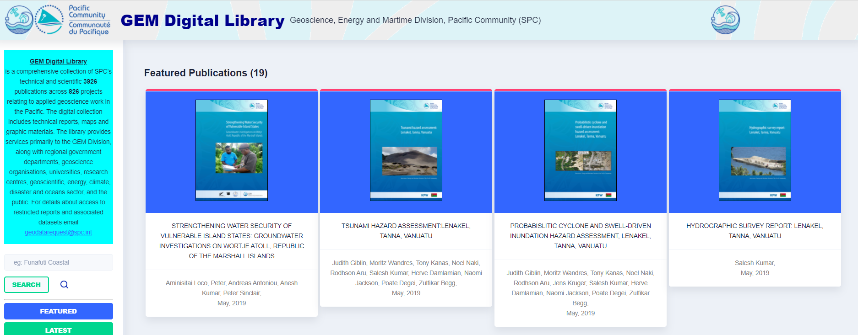
Data?

Slide 7




PACIFIC DATA HUB
Harnessing the power of data and knowledge for sustainable development
https://pacificdata.org/
datahub@spc.int

Slide 8




Uptake and Impact
Data Management Capability
Data Platforms

Slide 9

PACIFIC DATA HUB |Challenges
Coordination
Capacity, capability and maturity
Sustainability
Access
Notes:
Highlighting some of the challenges we face in managing data as a valuable resource in the Pacific

Slide 10
PACIFIC DATA HUB | Data Journey
COLLECTION
UPTAKE
IMPACT
PUBLICATION
Identify
Collect
Process
Analyse
Release
Disseminate
Connect
Incentivise
Influence
Use
Change
Reuse
PRODUCTION
USE
Increasing value of data

Slide 11
Promote data use culture
Encourage data use for decisions
Build community of practise
Improve data literacy
COLLECTION
UPTAKE
IMPACT
PUBLICATION
Identify
Collect
Process
Analyse
Release
Disseminate
Connect
Incentivise
Influence
Use
Change
Reuse
Data success stories
Data-driven policies
User feedback
Provide a sustainable shared data infrastructure
Reduce time-cost to publish and use data
Partner with other producers
Harness new data sources
Facilitate reuse
Increase interest in data production
Ensure data are interoperable
Data quality frameworks
Protect privacy
PRODUCTION
USE
Track behaviour changes
Strengthen M&E
Increasing value of data
Provide machine-readable data
Project data is accessible online through the PDH
Notes:
Touch-points along the data value chain where the Pacific Data Hub can add value for Pacific Island Countries and Territories:
A sustainable data infrastructure
access to shared tools and capabilities
a regional public good
Facilitate sharing of private and restricted data between government agencies
Data exchange and interoperability with SPREP and other development partners
Strengthening the Pacific data ecosystem operating within the regional development architecture
Strengthening data literacy and empowering civil servants with data and tools to derive insights and value from our data resources

Slide 12




PACIFIC DATA HUB |Platforms
Dashboards
Tools
DATA VISUALISATION
DATA EXPLORATION
SDG Dashboard
MANA Dashboard
PDH.stat Data Explorer
PacificMap
Front-end
Data stories and insights
Maritime Boundaries
Education Dashboard
PORTALS
PDH Home
Project Portals
Policy Bank
Skills Portal
Search
Harvesters
Data store
Linked data
DATA CATALOGUE
Metadata
Search
Statistical& scientific data
Indicators
Geospatial data
DATA LAYER
Statistical Datasets
Scientific Datasets
Microdata
Geospatial Data
Notes:
Contact Sio:
Platform components
A sustainable and durable data infrastructure for the Pacific
A vehicle for coordinated and sustainable investment in technology to support data management needs and enhance utility of data

Slide 13
PACIFIC DATA HUB |Technology
Dashboards
Tools
DATA VISUALISATION
DATA EXPLORATION
Power BI
Highcharts
D3
.Stat Data Explorer
TerriaJS
Front-end
Data stories and insights
Tableau
R Shiny
ArcGIS Story Maps
PORTALS
Drupal
WordPress
Search
Harvesters
Data store
Linked data
DATA CATALOGUE
CKAN
SOLR
Statistical data
Indicators
Geospatial data
DATA LAYER
.Stat Suite
THREDDS
NADA
Geoserver
Notes:
Technology components

Slide 14
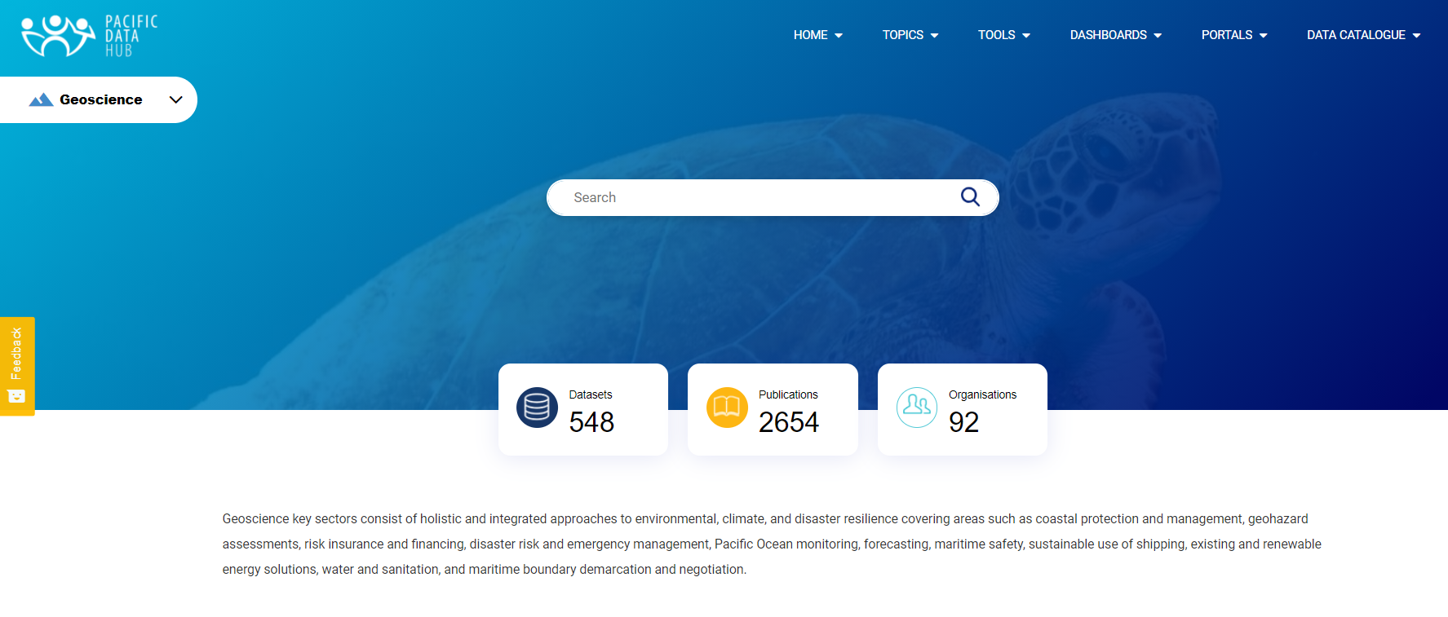
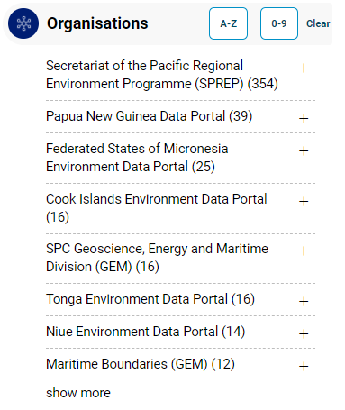
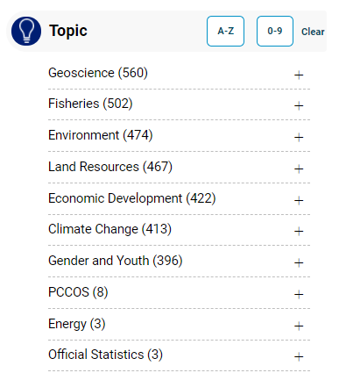

Slide 15
Possible Linkages/Trials
OBPS/Documents: Feature already in PDH (CKAN)
Experts and Institutions: two separate directory type lists shown on a Drupal add-on (there are hundreds of these)
Maps – PDH stack has Geoserver as a back engine and the TerriaJS (Pacific Map) that is front end for this. CKAN holds metadata and search function
Vessels – If this is a list of vessels and their characteristics, this can be accomplished with a directory type add-on for Drupal, with metadata in CKAN, so the search can find a vessel. A click on a vessel can take users to the position of the vessel on the Pacific Map or can show the latest route or any other information that can be purchased as a live service
OIH Capacity Building/resourcing

Slide 16
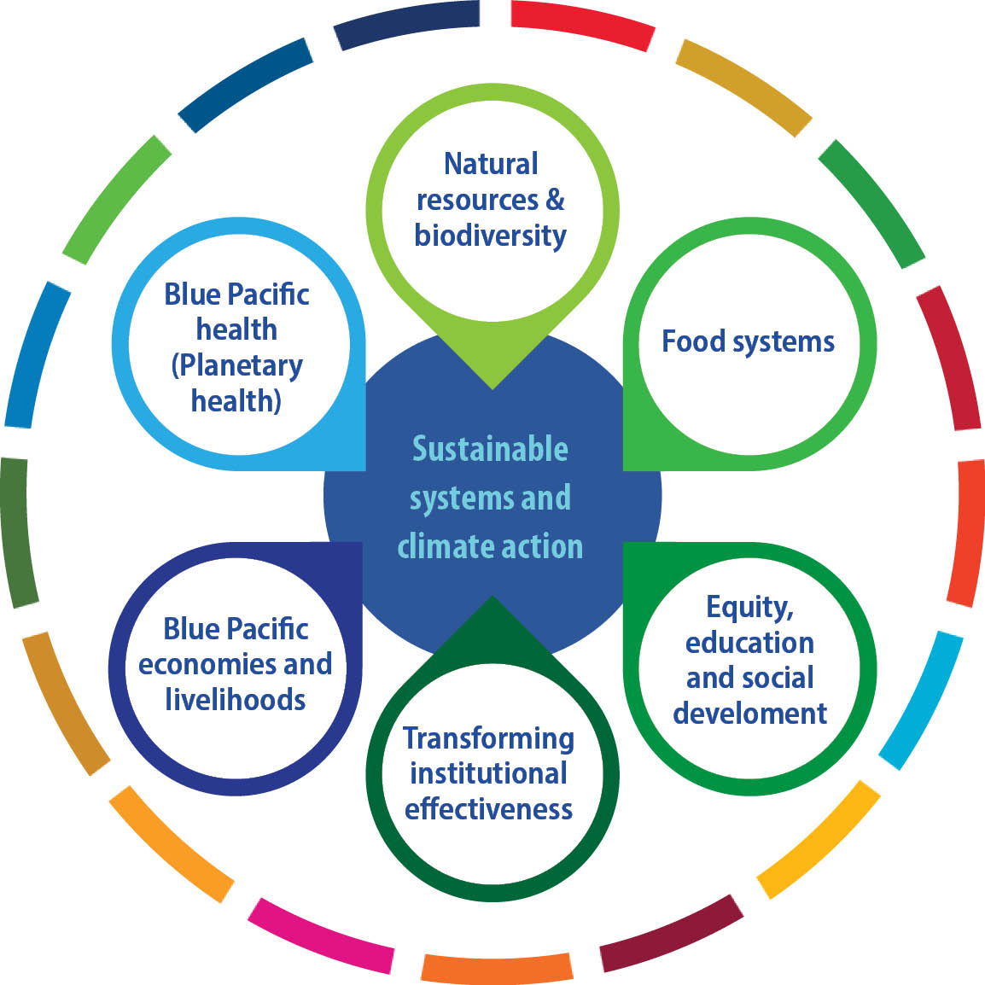
Goal 1: Pacific people benefit from sustainable economic development | Goal 2: Pacific communities are empowered and resilient | Goal 3: Pacific people reach their potential and live long and healthy lives | Goal 4: One SPC delivering integrated programmes through streamlined services
Our Key Focus Areas have been shaped by the analysis of member plans and priorities, COVID 19 assessments, SPC mandate, capabilities, regional commitments and the SDGs.
Culture and human rights are an integral part of environmental, economic and social dimensions of sustainable development.
Notes:
Links to SPC organisational strategy:
Supporting program design
Step back and look at the broader strategic context that this fits into
SPC is currently in the process of developing a new, 10 year strategic plan in consultation with our members, our partners and other staff
It goes for a longer time horizon, and has been developed using futures thinking principles.
In the interim, our governning body last year approved a 2021 transition plan, to see us through this consultation process and set the agenda for this important year for COVID response and recovery
7 key focus areas
Underpinning all of these are the use of scientific and technical expertise to use strong evidence for decision making . This means that the Pacific Data hub plays a central role in making data discoverable and accessible for decision making
It is also a shared resource and a means for driving integration within SPC – and supporting a focus with our members

Slide 17

PACIFIC DATA HUB
Harnessing the power of data and knowledge for sustainable development
https://pacificdata.org/
datahub@spc.int
Notes:
Questions

