Slide 1


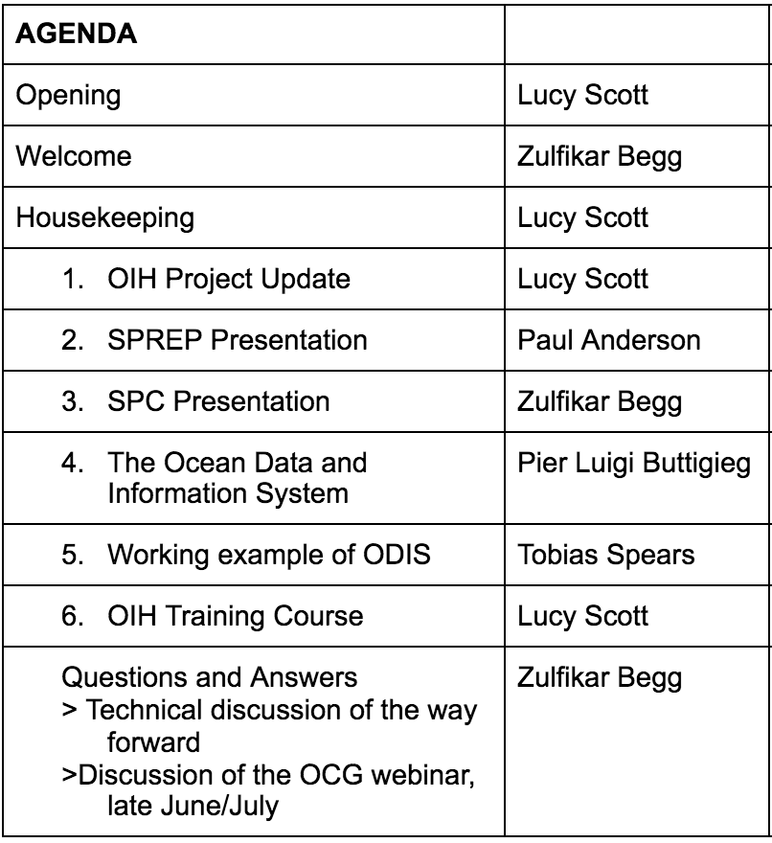


The Ocean InfoHub Project in the Pacific Small Island Developing States region: Progress and Future Perspectives

