Slide 1


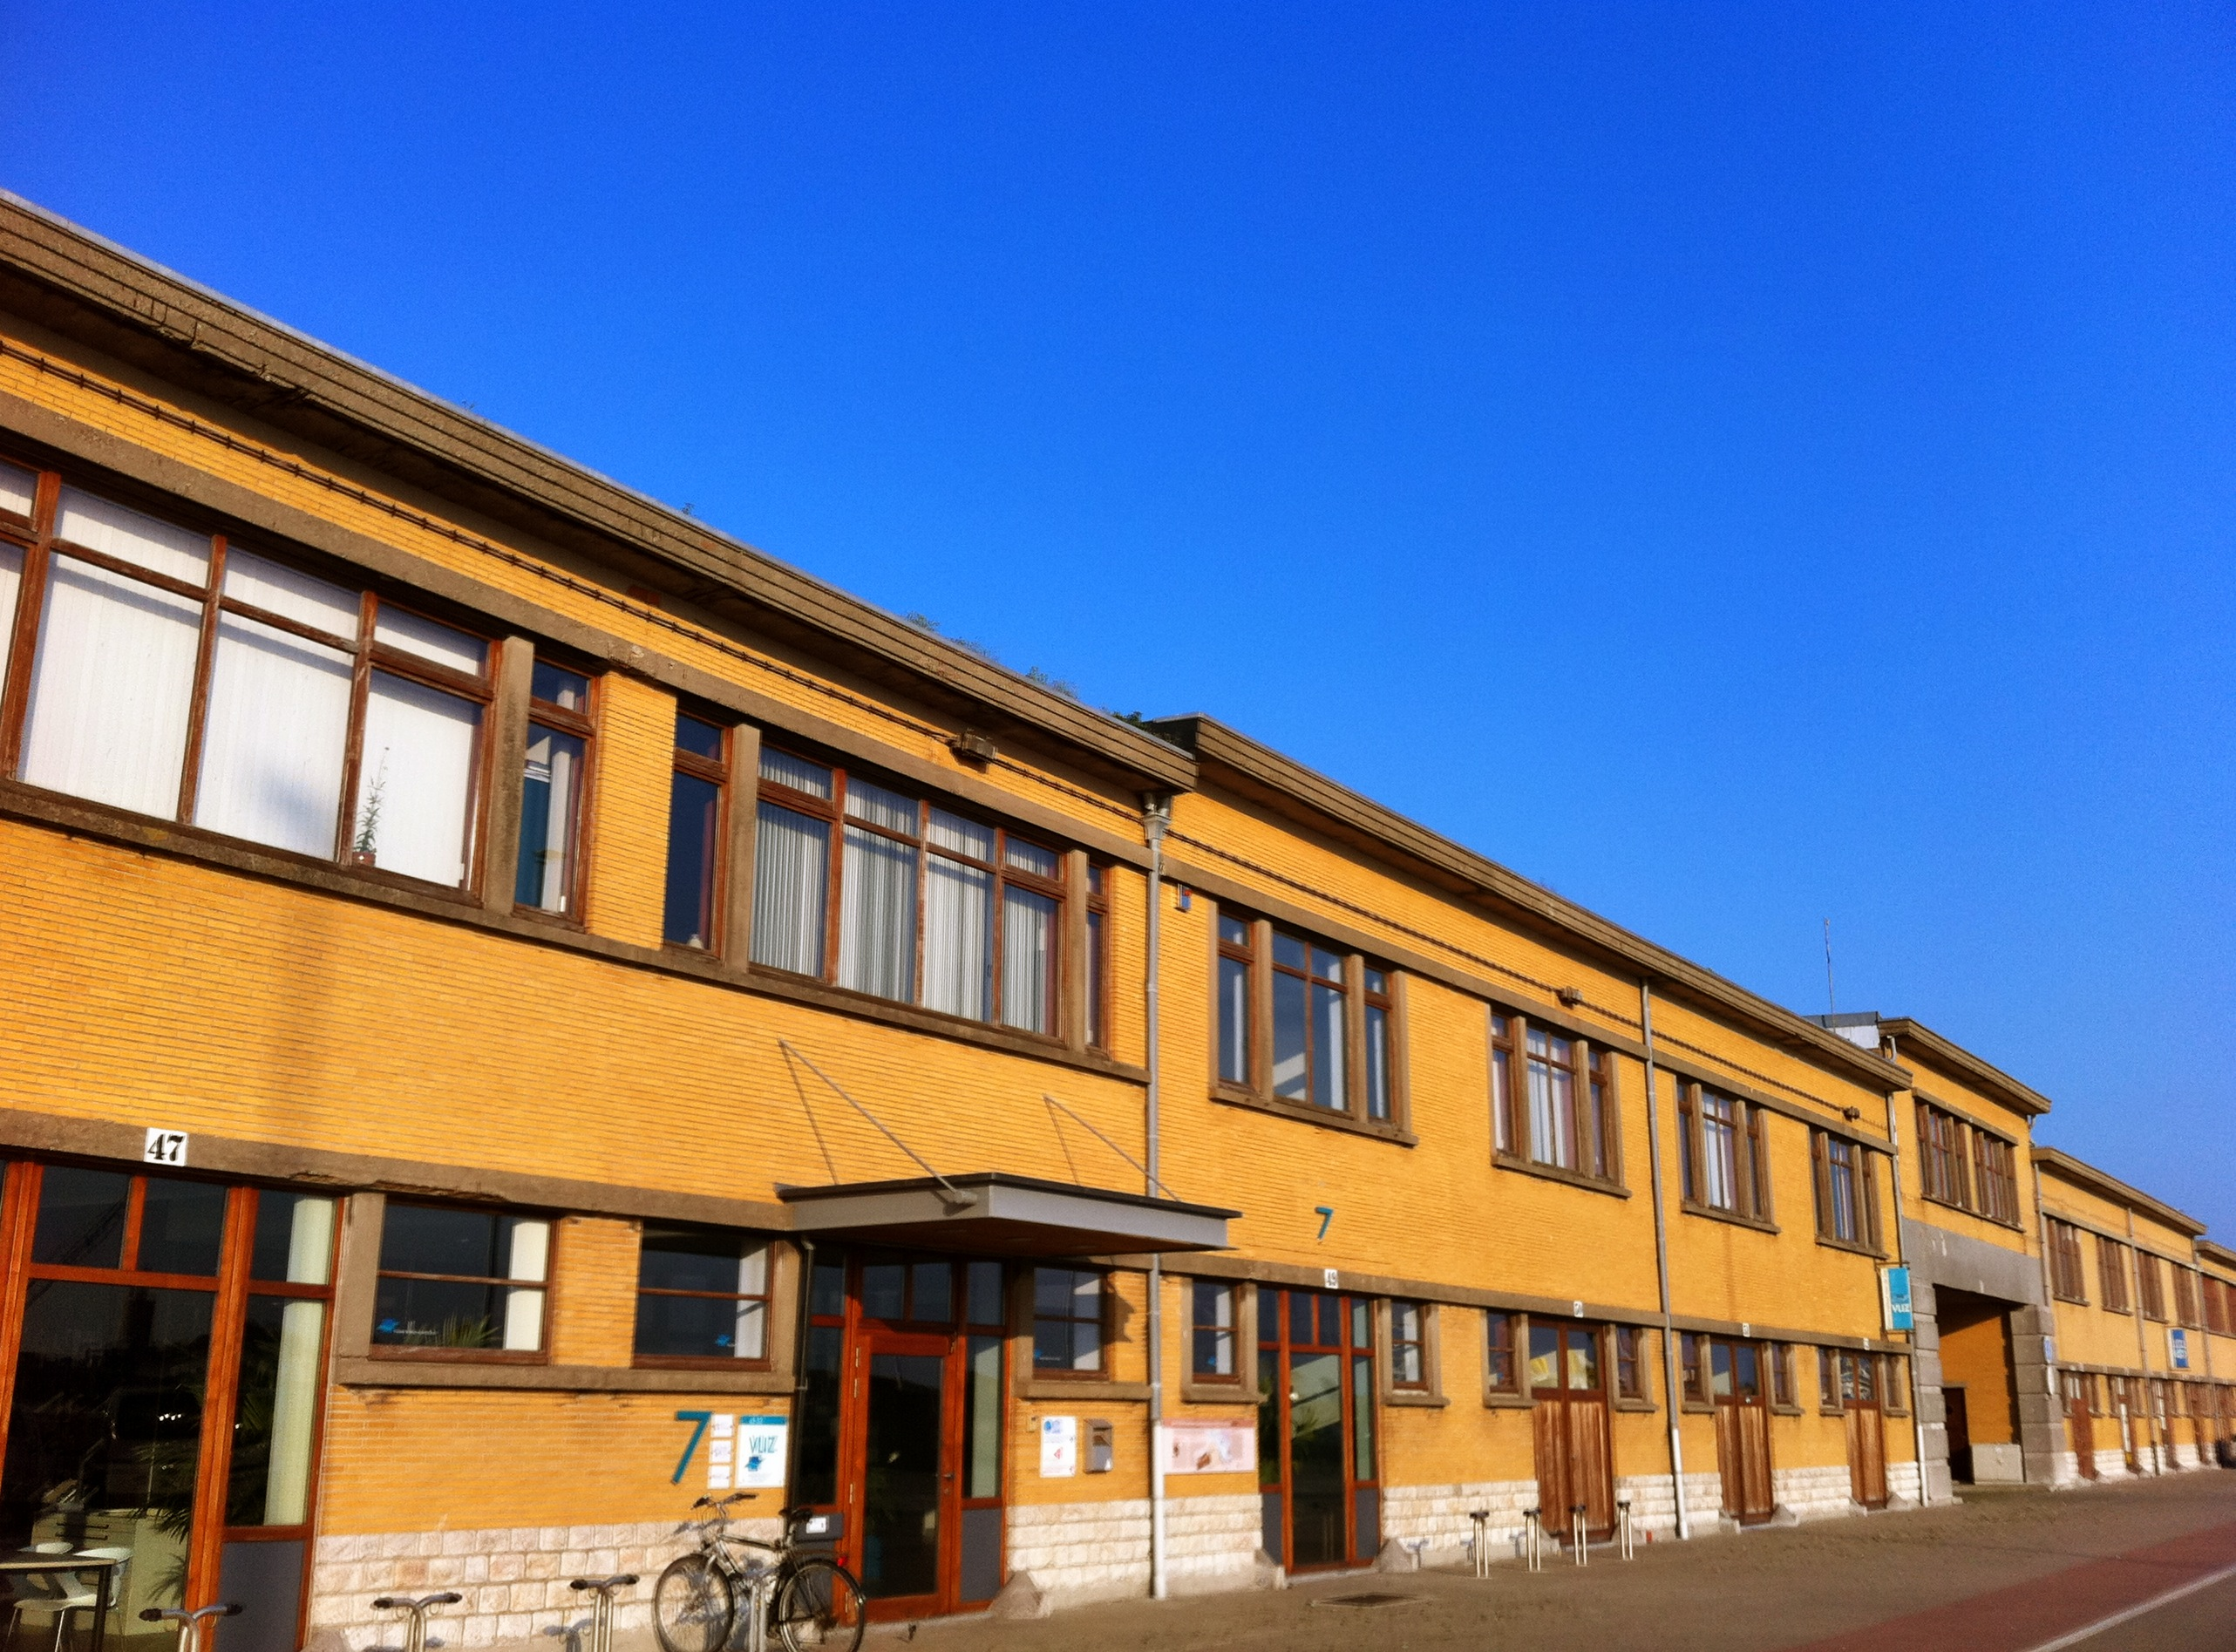
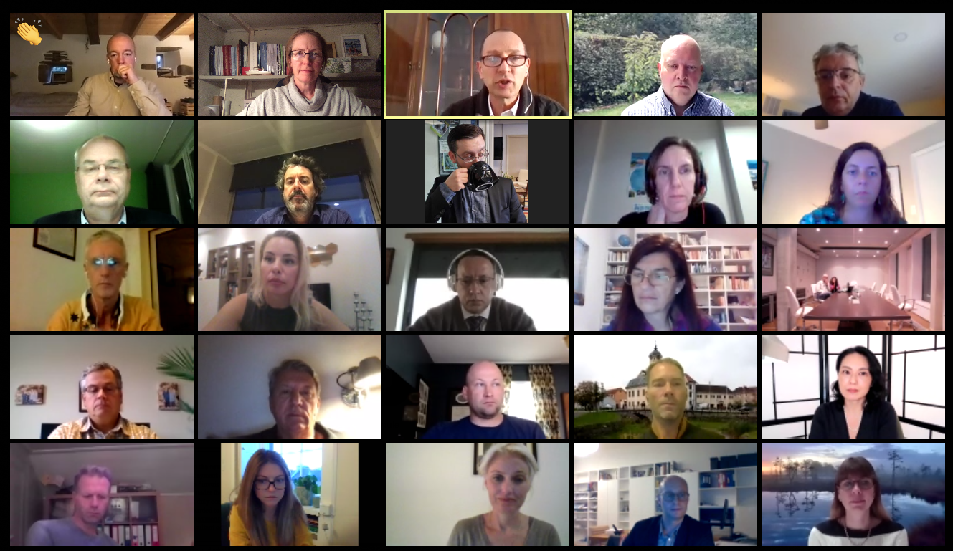
The IOC Ocean InfoHub Project: Training courses 2021
Lucy Scott
UNESCO/IOC Project Office for IODE
L.Scott@unesco.org

Slide 2
Introduction
The Ocean InfoHub, together with the OceanTeacher Global Academy and other partners, is developing a training course (2021)
Online
First course in English, thereafter Spanish and French language versions.
Between September and December 2021, repeated / extended in 2022.

Slide 3
Training course details
Title: Implementing the Ocean Data and Information System (ODIS) architecture
Objectives: The course’s central aims are to:
Equip participants with a conceptual understanding of what ODIS is, why it has been created, and how it works
Equip participants with conceptual and practical understandings of the technical components of ODIS, including its use of schema.org patterns and web-based publishing and harvesting
Provide participants with the tools they need to describe their (meta)data and publish it

Slide 4
Training course details
Expected learning outcomes:
An understanding of the Ocean InfoHub project
An understanding of the Ocean Data and Information System
An understanding of how to incorporate ODIS schema.org patterns into existing online databases or websites.
Target audience and prerequisites (Who should attend? What prerequisite knowledge is required)
The target audience should have an understanding of:
JSON and the HTML Document Object Model
How to configure extensions to their web framework (DKAN, CKAN, geonetwork or others), if a framework is being used.

Slide 5
Training course details
Course content:
1. High-level concepts of OIH/ODIS
2. General introduction to our use of schema.org
3. ODIS schema.org patterns
4. Setting up the standard publishing/contribution environment
5. Harvesting patterns in JSON/RDF
6. Querying harvested material

Slide 6
For more information
Subscribe to our mailing list
OR
Send me an email (L.Scott@unesco.org) to be informed personally, when the course is announced.
https://oceaninfohub.org

