Slide 1
IOC Capacity Development
Needs Assessment Survey Outcomes
Johanna Diwa - 7 June 2021

Slide 2
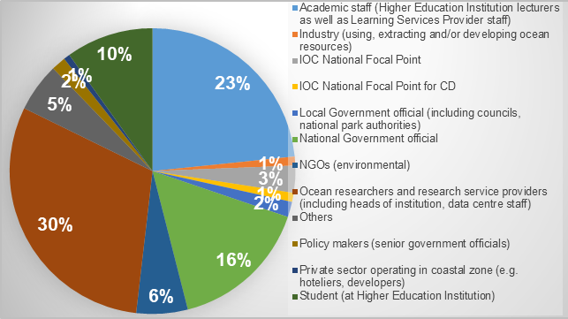
2020 Capacity Development Needs Assessment Survey
2nd CD Needs Assessment
Launched 1 September 2020, closed 2 February 2021
RESPONSES: 1005 from 118 countries received
FOCUS:
115 developing country MS
25 IOC Focal Points, 10 IOC CD Focal Points
Stakeholder groups breakdown:
Section 1:
Respondent’s profile: to be filled by all
Sections 2-5:
Capacity development needs assessment: for each stakeholder group
Notes:
Large group of responses from practitioners group, such as ocean researchers, academic staff, students (63%)
Small response size from national coordinated authorities through focal points

Slide 3
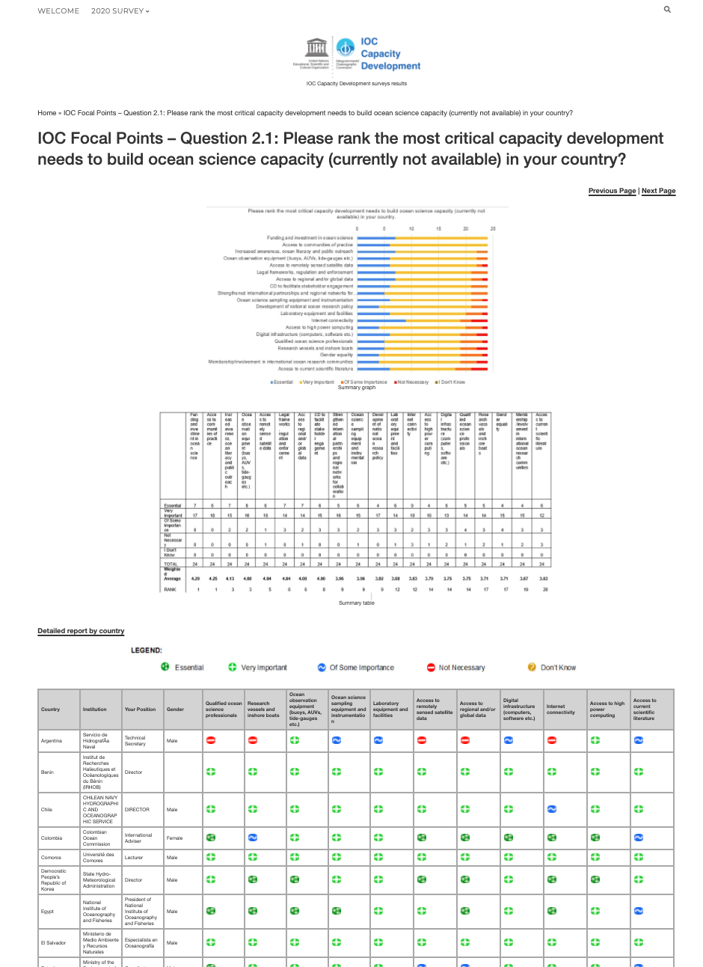
Outcomes
FULL RESULTS available online: https://surveys.ioc-cd.org/
Detailed responses, individual and per stakeholder groups uploaded in the site
Results presented based on:
Overall analysis (all stakeholder groups)
Regional analysis (all regions + all capacities)
Country reports (summary of responses from focal points + practitioners group per country)
Initial results presented at various GE-CD meetings:
1st Task Team Meeting on IOC CD Strategy - October 2020
2nd Task Team Meeting on IOC CD Strategy - February 2021
IOCARIBE Meeting - May 2021
Notes:
Some observations from the survey based on the overall analysis and regional reporting highlights
Due to the relatively small size of responses, care must be taken when interpreting the results and making assumptions based on the data presented

Slide 4
Overall Analysis: MOST CRITICAL CAPACITY DEVELOPMENT NEEDS
TOP CRITICAL CD NEEDS
Funding and investment
Access to communities of practice
Increased awareness, ocean literacy and public outreach
Ocean observation equipment
Access to remotely sensed satellite data

Slide 5
On the UN Decade of Ocean Science
In the context of the UN Decade of Ocean Science for Sustainable Development for which of the following Ocean Decade Challenges are capacity development needs greatest in your country?
In the context of the UN Decade of Ocean Science for Sustainable Development for which of the following Ocean Decade objectives are capacity development needs greatest in your country?
Notes:
Challenge 7: Ensure a sustainable ocean observing system across all ocean basins that delivers accessible, timely, and actionable data and information to all users as the Ocean Decade Challenges where capacity development needs were identified greatest, the practitioners group consistently ranked Challenge 2: Understand the effects of multiple stressors on ocean ecosystems, and develop solutions to monitor, protect, manage and restore ecosystems and their biodiversity under changing environmental, social and climate conditions where CD needs were greatest. As for the Ocean Decade objectives, all the objectives were considered highly relevant, most especially Objective 3: Increase the use of ocean knowledge and understanding, and develop capacity to contribute to sustainable development solutions which was ranked consistently as greatest capacity development needs across regions and groups.

Slide 6
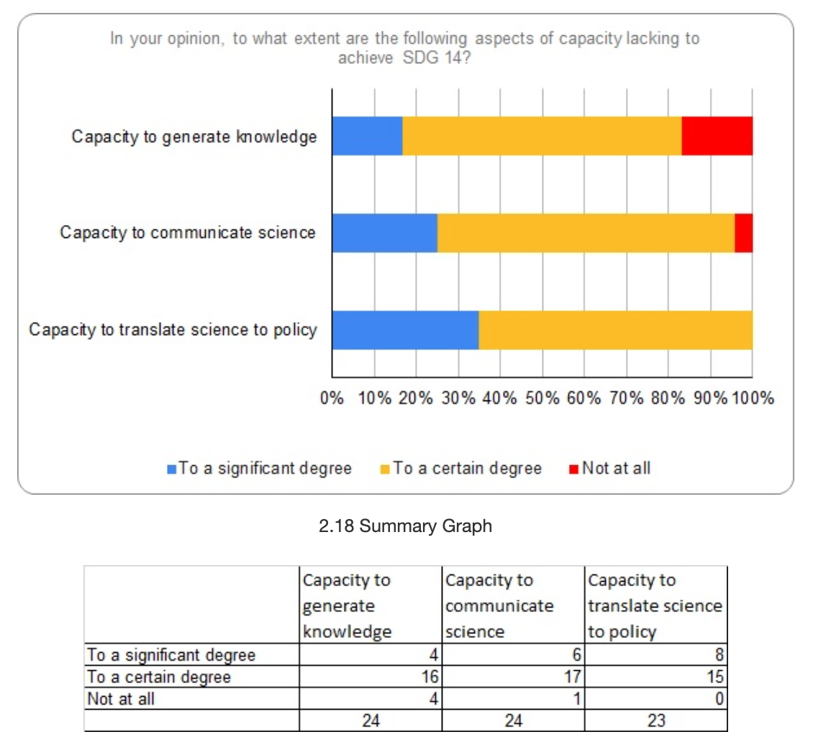
On SDG14
Is Sustainable Development Goal 14 considered as a national priority in your country?
How would you rate the level of capacity available right now in your country to achieve SDG 14?
In your opinion, to what extent are the following aspects of capacity lacking to achieve SDG 14?
Notes:
Almost all the focal points (96%) who responded to
questions related to SDG14 in Subset 2A of the questionnaire confirmed that
SDG14 is a national priority in their countries. More than half believed that their
countries and institutions have significant and partial capacity to achieve SDG
14. As to capacity lacking to achieve SDG 14, the respondents consistently
answered ‘capacity to translate science to policy’ as most lacking.

Slide 7
On National CD Strategy and Needs Assessment
Q2.19: Does your country or institution have a national ocean science strategy?
Has your country carried out an ocean science capacity needs assessment?
Notes:
More than half (54%) of the focal points respondents indicated the absence of a national ocean science capacity development strategy. More than half (63%) of the focal points respondents answered that there has not been any capacity needs assessment conducted in their country.

Slide 8
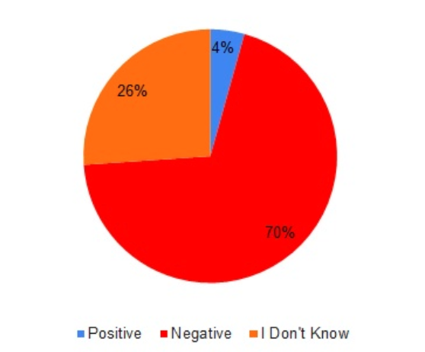
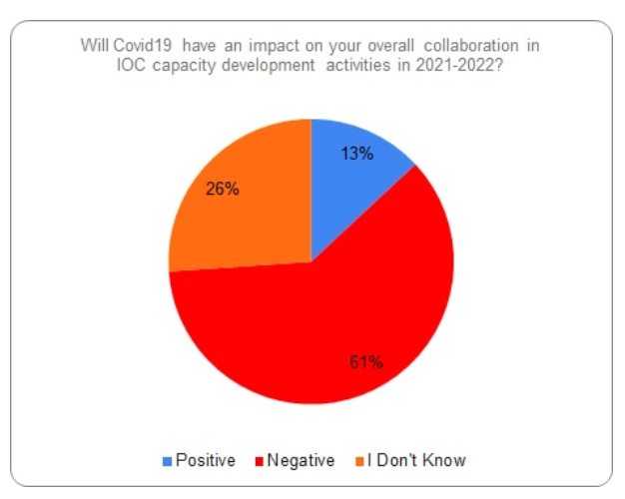
On Covid19 Impact
Will Covid19 have an impact on your overall collaboration in IOC capacity development activities in 2021-2022
Will Covid19 have an impact on your support (financial, in-kind) to IOC capacity development activities in 2021-2022
Notes:
Two questions regarding the impact of Covid19 to the implementation and support to IOC CD activities yielded negative impact among the majority of the respondents, as expected.

Slide 9
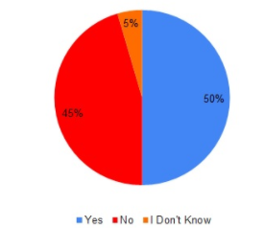
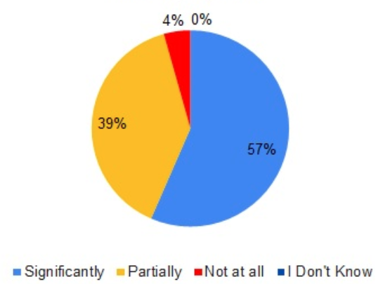
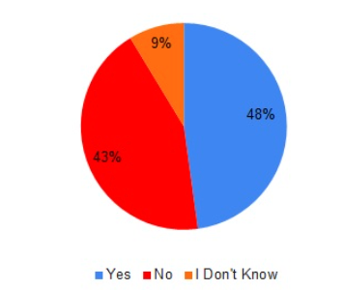
On Marine Science Research
Is HEI output of graduates linked to human resources needs of the national research institutions?
How do you rate national coordination on marine research in your country?
Is there an active policy to promote the use of local marine research/monitoring/management expertise in the private sector?
Is marine scientific research in your country linked to policy needs?
Notes:
More than half (54%) of the focal points respondents indicated the absence of a national ocean science capacity development strategy. More than half (63%) of the focal points respondents answered that there has not been any capacity needs assessment conducted in their country.

Slide 10
Are the following non-governmental stakeholders involved in decision- making processes to come up with action plans to implement their ocean policies?
On Ocean Policies
Are there national plans or institutional mechanisms in place to support the development of ocean science capacity in your country?
At national level, what are the most frequent obstacles to implementing ocean related policy?
Limited financial resources
Lack of technical capacities
Lack of access to data and information
Notes:
Challenge 7: Ensure a sustainable ocean observing system across all ocean basins that delivers accessible, timely, and actionable data and information to all users as the Ocean Decade Challenges where capacity development needs were identified greatest, the practitioners group consistently ranked Challenge 2: Understand the effects of multiple stressors on ocean ecosystems, and develop solutions to monitor, protect, manage and restore ecosystems and their biodiversity under changing environmental, social and climate conditions where CD needs were greatest. As for the Ocean Decade objectives, all the objectives were considered highly relevant, most especially Objective 3: Increase the use of ocean knowledge and understanding, and develop capacity to contribute to sustainable development solutions which was ranked consistently as greatest capacity development needs across regions and groups.

Slide 11
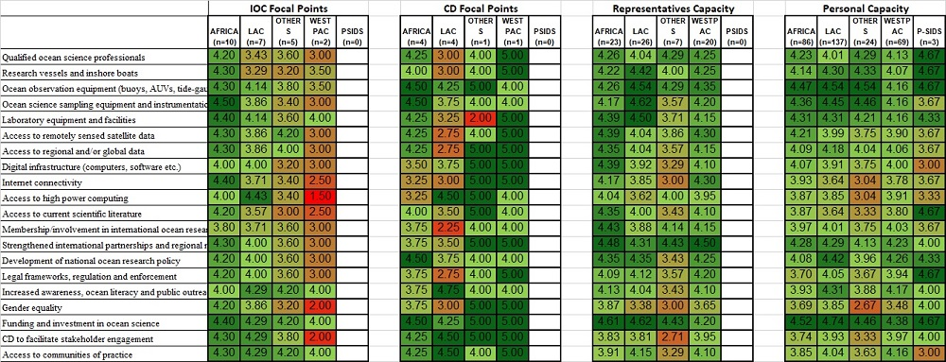
Regional analysis: Critical CD needs
Access to high power computing
Ocean observation equipment
Ocean science sampling equipment and instrumentation
strengthened international partnerships and regional networks for collaboration
Funding and investment
Notes:
Regional analysis
Across the board - funding and investment
In Africa, ocean science sampling
In LAC, access to higher power computing for both focal points- but if we look at the rep and personal group, it’s one of the least ranked CD items for them
Across regions, rep responses point to strengthened international partnerships and regional networks for collaboration
For personal responses, ocean observation equipment

Slide 12
Regional results: Human Resources
Advanced professional development training
Increased collaboration with UNESCO Chairs
Continuous professional development
Establishment of a visiting lecturer program
Establishment of internship/fellowship

Slide 13
Regional results: Infrastructure
Training on the use and maintenance of
physical infrastructure
Access to best practices on use and maintenance
Notes:
Contrasting access to best

Slide 14
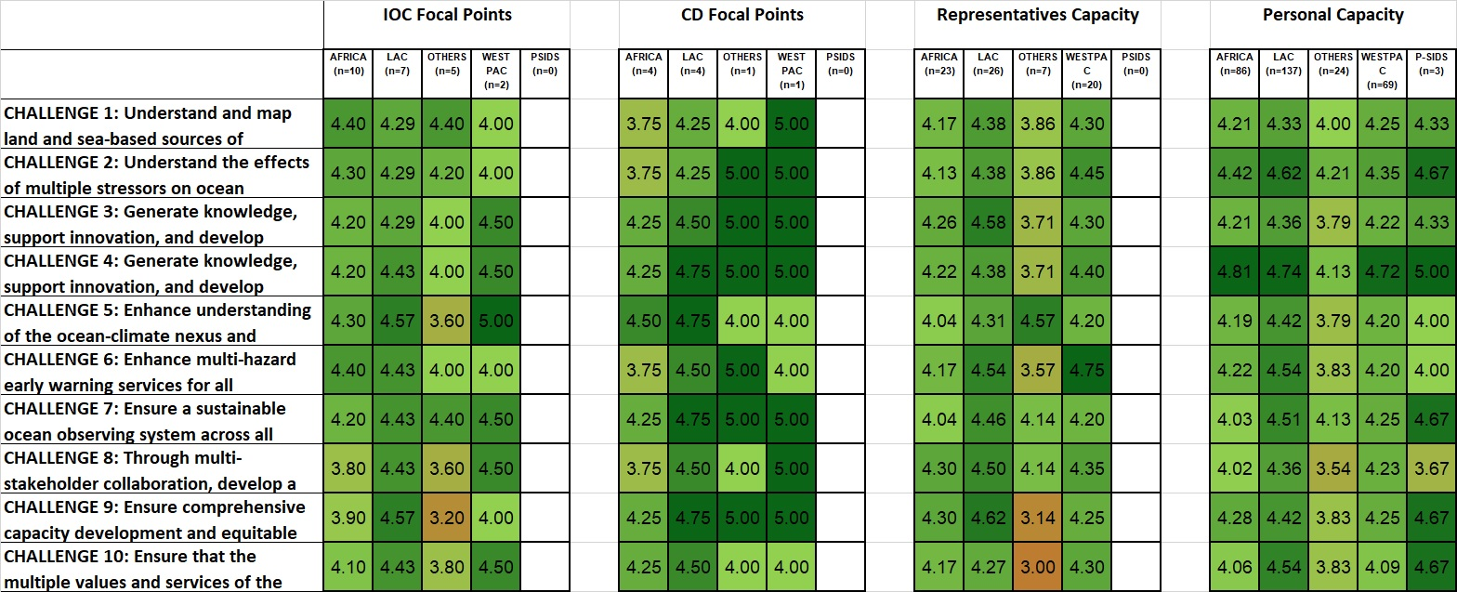
Regional results: Ocean Decade Challenges
Challenge 7
Challenge 4
Notes:
Challenge 4 - highest for personal group

Slide 15
Regional results: Ocean Decade Objectives

Slide 16
Highlights
Though limited, these survey outcomes revealed some important observations:
Strong expression of a need for capacity enhancement across the board;
Funding and investment as one of the top CD needs identified; gender equality among least ranked;
Regional priorities and CD requirements identified expected to contribute to regional work planning and interventions;
Decade Challenges and Decade Objectives where CD needs were greatest;
Capacity to translate science into policies identified as most lacking capacity;
Inputs for potential revision of the IOC CD strategy and its implementation plan;
Poor linkage between focal points and target communities, e.g. disconnect between the views of practitioners and national officials;

Slide 17
Recommendations
Nominating CD focal points is vital to facilitate efforts in coordination of CD needs assessment surveys in the future;
Involvement and representation of stakeholder groups are crucial for the Decade;
National efforts to institutionalize CD programs are critical but may get overshadowed if needs are not made clear;
More active engagement and direct reach with national networks of relevant stakeholder groups involved in ocean-related activities;
Continuous efforts are needed to reach out to countries for more responses and representation in the results;
Address communication impediments caused by outdated contact information of focal points;
Regular assessments are important to address gaps (next survey scheduled in 2022)

