Slide 1
Revision of IOC Capacity Development Strategy
Luis Menezes Pinheiro, 7 June 2021

Slide 2
GE-CD Task Team related to revision of IOC CD Strategy
Objective
“…to analyze the reasons for and develop the rationale supporting a revision of the IOC Capacity Development Strategy (2015-2021)…”
Chair: Luis Pinheiro
Members:
Aidy Muslim; Nic Bax; Bradford Brown; Xuan Zhu; Gen Totani; Andi E Sakya; Rafael González-Quirós; Suzan Kholeif; Luis Menezes Pinheiro; Zacharie Sohou; Koffi Marcellin Yao; Frederico Antonio Saraiva Nogueira; Carlos Rodolfo Torres Navarrete; Bernardo Aliaga; Johanna Diwa; Peter Pissierssens
Actions
First meeting held on 7 December 2020, reviewed and finalized terms of reference and work plan
Second meeting held on 12 February 2021, discussed inputs and summarized results of consultations
Final task team report submitted as IOC/INF-1396, published at UNESDOC

Slide 3
Report Highlights
Review of main elements justifying revision of the current strategy:
Outcomes of the 2nd IOC Capacity Development Survey;
Capacity development Chapter of the Implementation Plan (IP) of the UN Decade of Ocean Science for Sustainable Development (2021–2030);
Feedback from consultations with IOC global and regional programmes related to Capacity Development; and
Feedback from consultations with UN specialized agencies, non-UN IGOs, Global and Regional organizations, programmes and projects, NGOs and private sector partners.

Slide 4
2. CD Chapter of the Ocean Decade IP vis-a-vis IOC CD Strategy

Slide 5
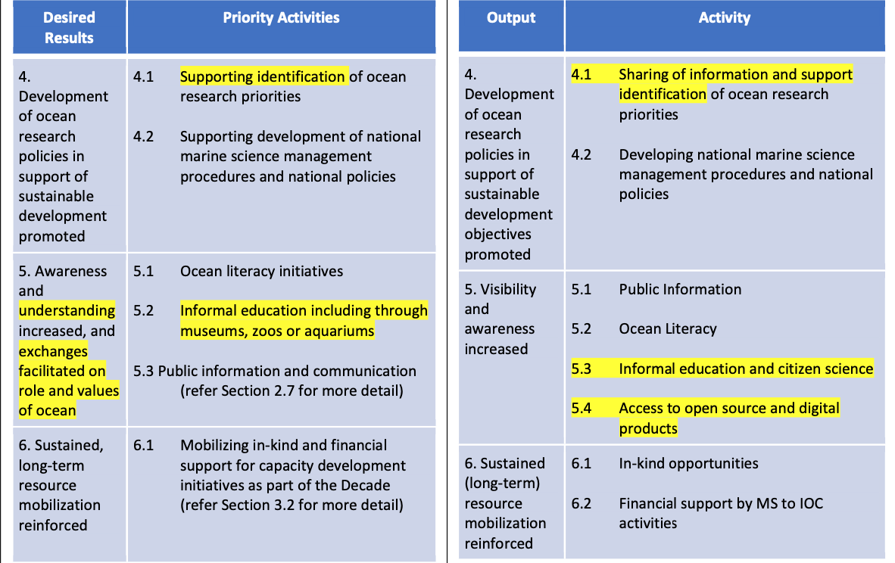
2. CD Chapter of the Ocean Decade IP vis-a-vis IOC CD Strategy

Slide 6
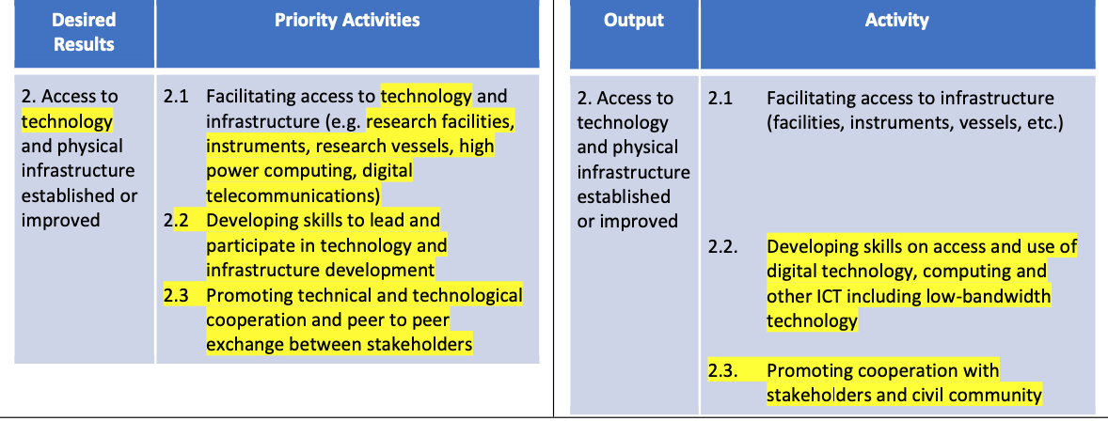
2. CD Chapter of the Ocean Decade IP vis-a-vis IOC CD Strategy

Slide 7
3-4. Consultations with Global and Regional Programmes, UN specialized agencies, non-UN IGOs, global and regional projects, etc.
Email requests were sent, with a set of questions that may inform the GE-CD Task Team of the possible gaps, potential addition/removal of elements and other considerations in the revision of the IOC CD strategy.
General comments and suggestions received emphasized the following;
Importance of highlighting long-term CD sustained strategies;
Need to develop mechanisms for monitoring, evaluation and learning to assess the quality and impact of the capacity development activities;
Capacity development will be better achieved through partnerships between developed countries and SIDS and LDCs;
Integration of natural sciences and societal disciplines into a holistic assessment of the marine environment must also be a general principle in CD strategies and initiatives;
Global challenges such as climate change, biodiversity and habitat loss, and their impact on marine resources and ecosystem services need to be central in CD strategies and initiatives;
Remove barriers to full gender and geographic diversity, and guarantee equitable access to ocean knowledge, ocean-related education, training, and transfer of marine technology

Slide 8
3-4. Consultations with Global and Regional Programmes, UN specialized agencies, non-UN IGOs, global and regional projects, etc.
Other Emerging Issues:
CD in policies and decision making
CD oriented towards policy makers is critical, to help support Member States in the implementation of SDGs and other key UN processes
Science-policy interface is essential for the development and implementation of legal and institutional ocean governance frameworks
SIDS, LDCs and LLDCs as priority
Role of CD has to be more specific and reinforced in making them priority in the IOC CD Strategy
CD plan for communities to develop productive capacities for successful structural transformation, better and more resilient and inclusive future
Cooperation and merging with CD strategies in other UN organizations, regional and national institutions, and the private sector
Establish a high degree of coordination between CD strategies of UN organizations, supported by broader participation of Member States
Cross-cutting aspects in the coordination of CD strategies should include (i) connection with the private sector on partnering training opportunities; (ii) enable multi-donor arrangements

Slide 9
3-4. Consultations with Global and Regional Programmes, UN specialized agencies, non-UN IGOs, global and regional projects, etc.
Other Emerging Issues:
Gender, traditional activities and indigenous heritage
Reinforce the role of gender, of traditional and indigenous knowledge and social inclusion in the IOC CD Strategy
Removing barriers to full gender, generational, and geographic diversity, and ensure an equitable and accessible ocean for all
Data storage, management and access
More support for the creation and maintenance of interoperable ocean datasets at national level and their interoperability at the national context
SIDS and LDCs have open access to data generated by developed countries, but it is as crucial that they can appropriately manage the data they produce
Further a common and standardized international approach to the sustainable knowledge of the oceans as part of CD strategies

Slide 10
Global Ocean Science Report (GOSR)
Enhance the current level of funding for ocean science.
Establish continuous collection of internationally comparable data on investments in ocean science.
Facilitate co-design of ocean science by involving ocean science information users and producers.
Promote multistakeholder partnerships in ocean science and operationalize transfer of marine technology.
Move towards ocean science capacity development with the equal participation of all countries, genders and ages, embracing local and indigenous knowledge.
Develop strategies and implementation plans to support the career needs of women and young scientists.
Find solutions to remove barriers for open access to ocean data.
Foster education and training in professions related to ocean sciences.
Assess the impact of the COVID-19 pandemic on human and technical capacity in ocean science.

Slide 11
Key Recommendations
Revise GE-CD’s ToR to allow continuation of its work on revising the IOC CD Strategy for 2023-2030
GE-CD to prepare a proposal for submission to the 32nd Session of the IOC Assembly in June 2023
Consider appropriate form and structure with an ideal length to entice target audience to read through the Strategy
Promote visibility and reach of the revised CD Strategy to utilize it as a guide in implementation of CD activities
Incorporate key messages in a short policy brief for a wider outreach

