Slide 1

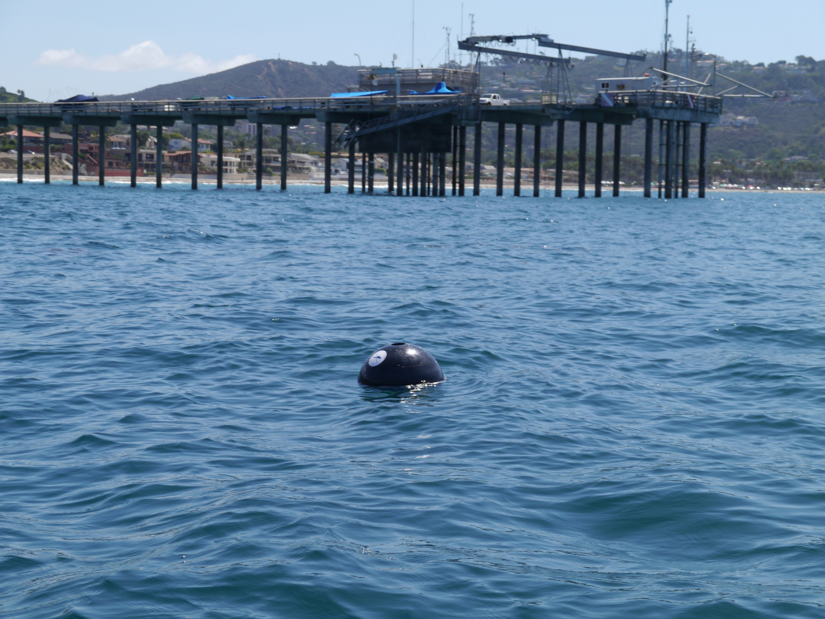
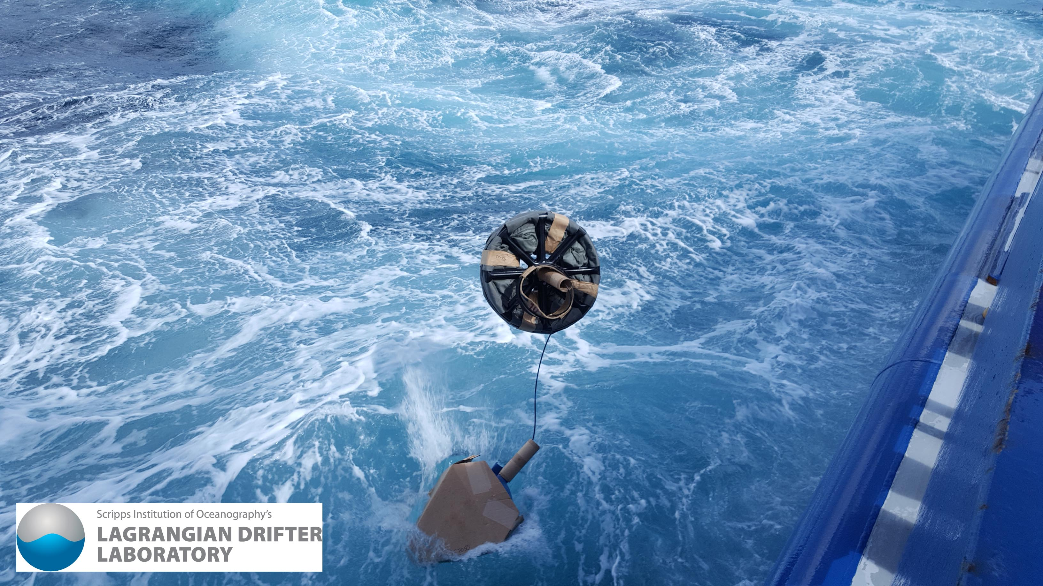
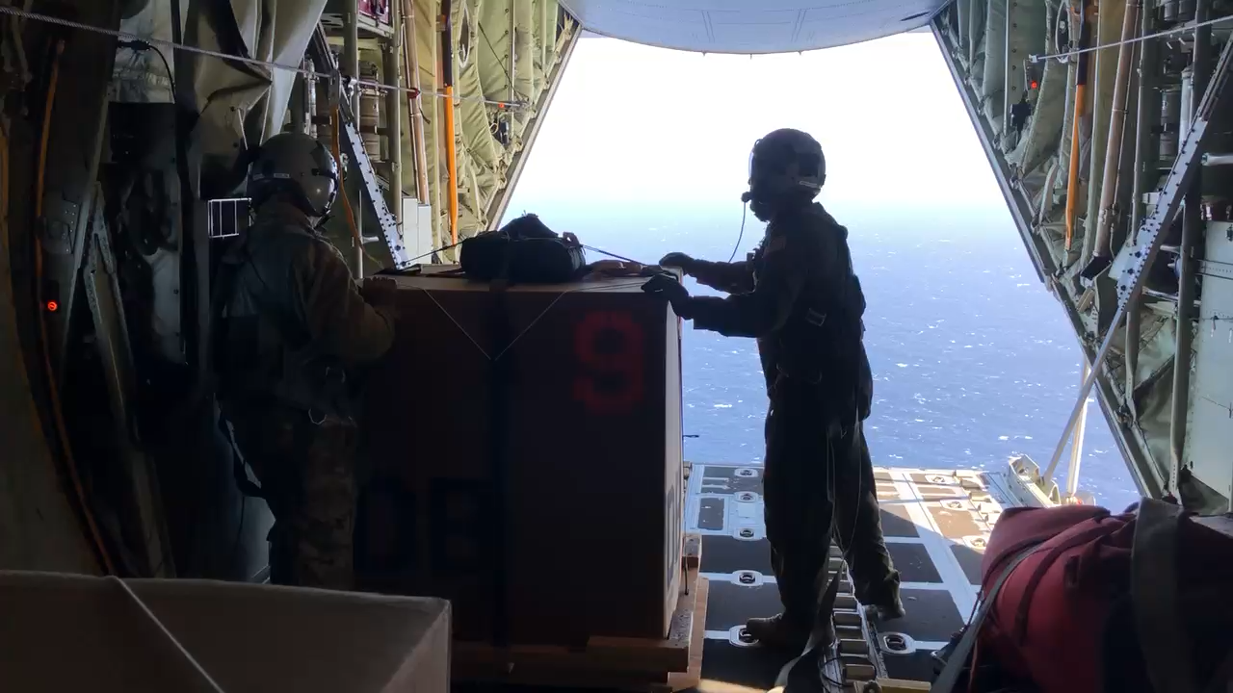

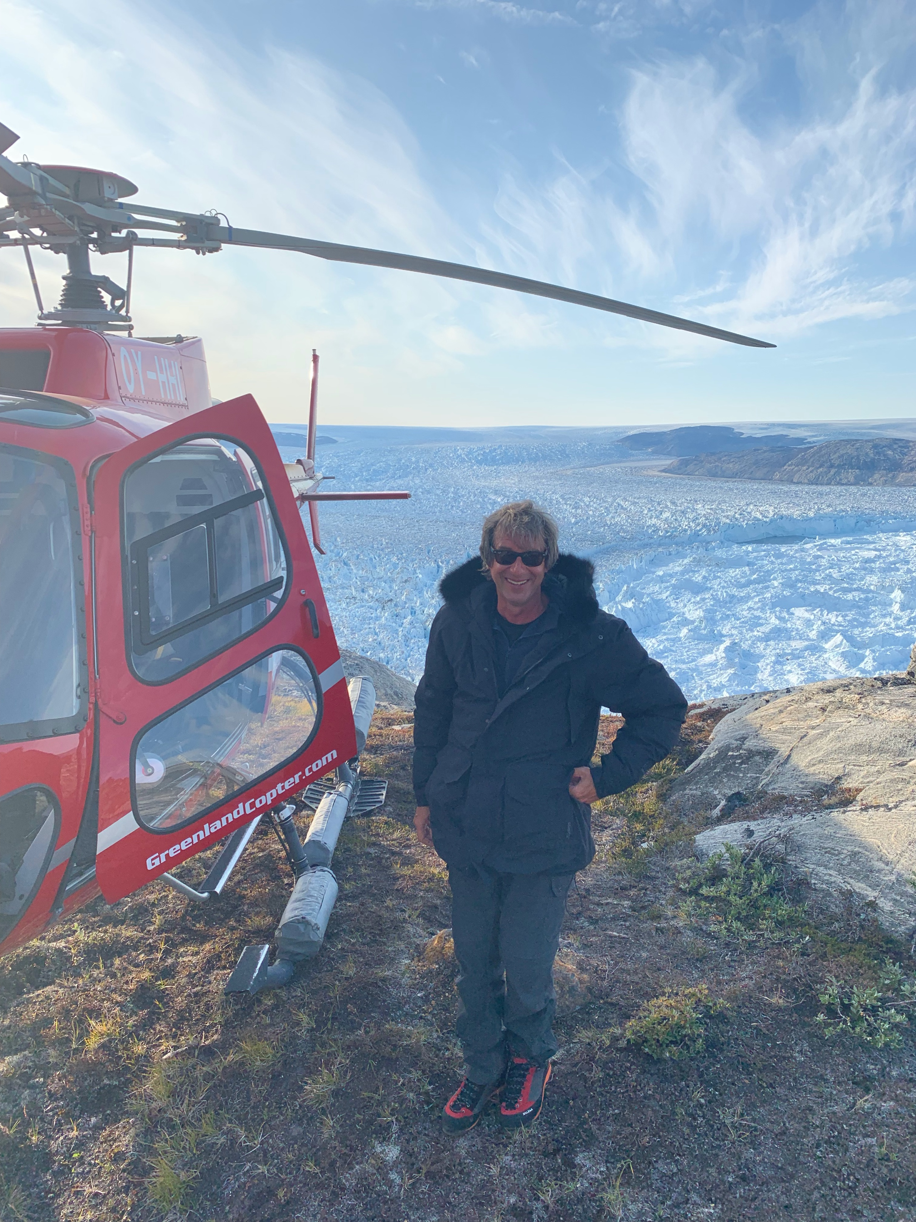
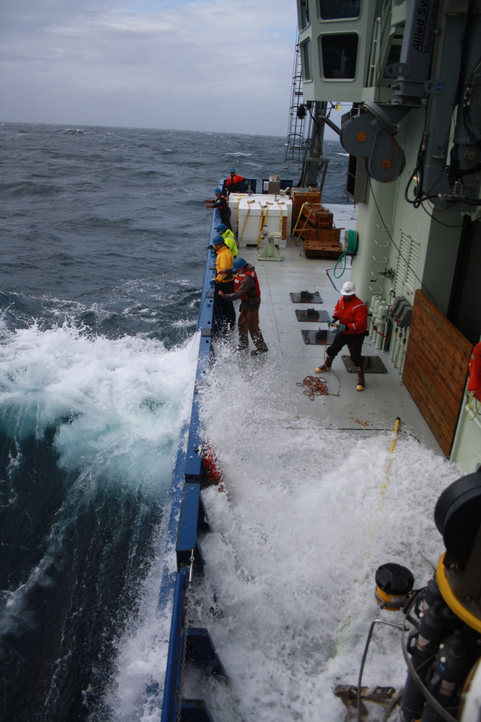
Global Observations of Open Ocean Waves with Drifters
Credit: USAF 53rd WRS
Luca Centurioni, PhD
Director, Lagrangian Drifter Laboratory
Principal Investigator, Global Drifter Program
Cooperative Institute for Marine, Earth, and Atmospheric Systems (CIMEAS)
Climate, Atmospheric Sciences, and Physical Oceanography
Scripps Institution of Oceanography
La Jolla, California, USA
lcenturioni@ucsd.edu, http://gdp.ucsd.edu/
Copyright 2021 Lagrangian Drifter Laboratory. All materials on this presentation are the property of Lagrangian Drifter Laboratory, unless otherwise specified. If you would like to use any LDL materials, please seek permission by sending an email to lcenturioni@ucsd.edu
PI-5 Workshop, June 10, 2021, Virtual
Notes:
The purpose of this chat is to illustrate some of the motivations to start a career in ocean sciences

Slide 2
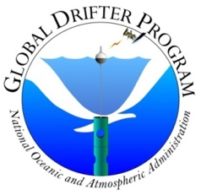
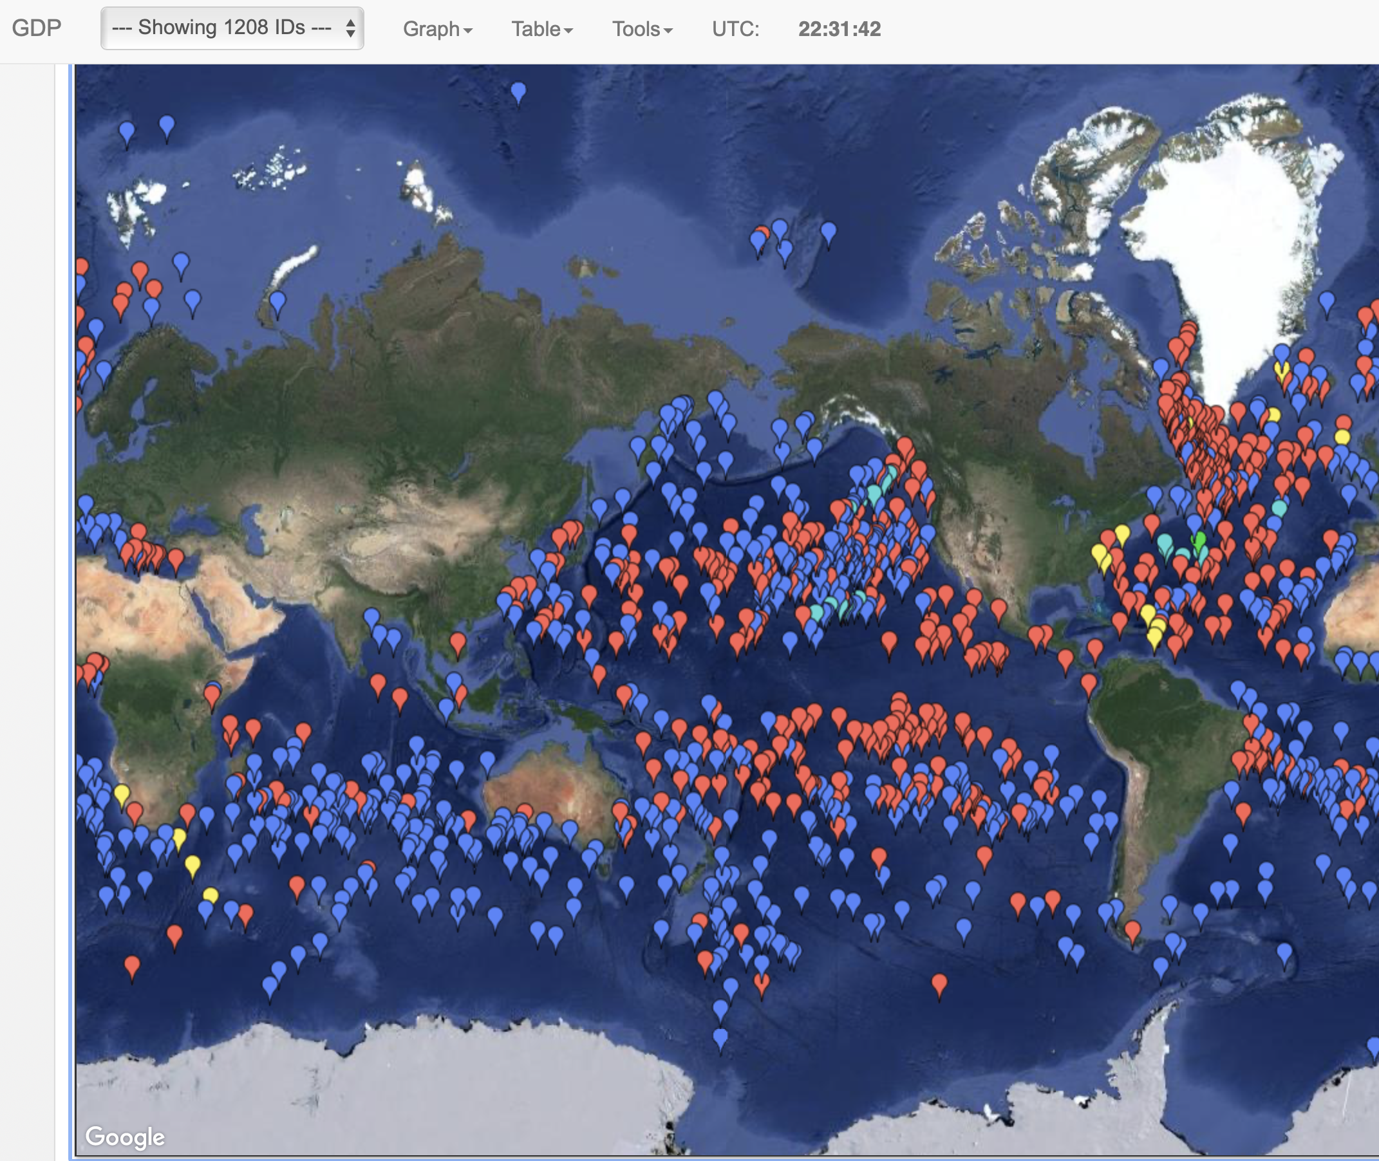

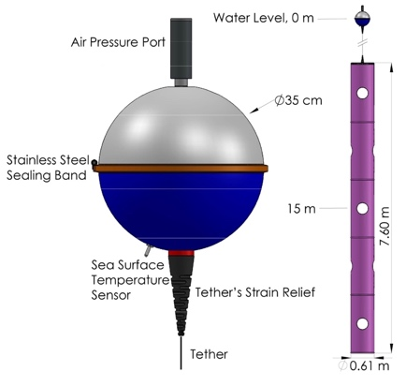
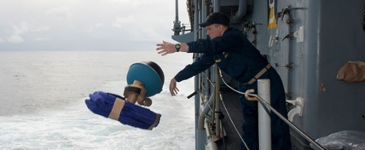
The Global Drifter Program in a Nutshell
The Only Global Scientific Project for In-Situ Ocean Observing at the Air-Sea Interface
Overarching Goals:
Maintain a global 5ºx5º array of surface drifting buoys to meet the needs for an accurate and globally dense set of in-situ observations: mixed layer currents, SST, atmospheric pressure, winds, and salinity.
Build a collaboration with the international community to maintain the array.
The GDP provides publicly available observational baselines in the upper-ocean mixed-layer and fills a unique role in the Global Ocean and Climate Observing System. The positive impacts of the GDP data are large and well documented
Credit: LT Grabon, US NAvy

Slide 3

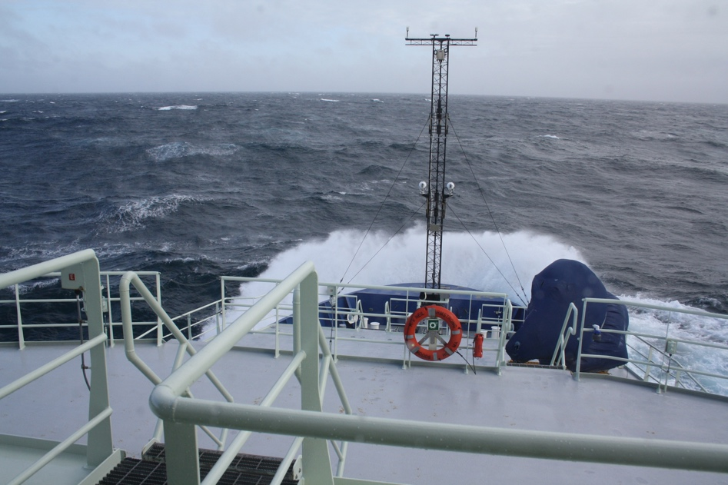
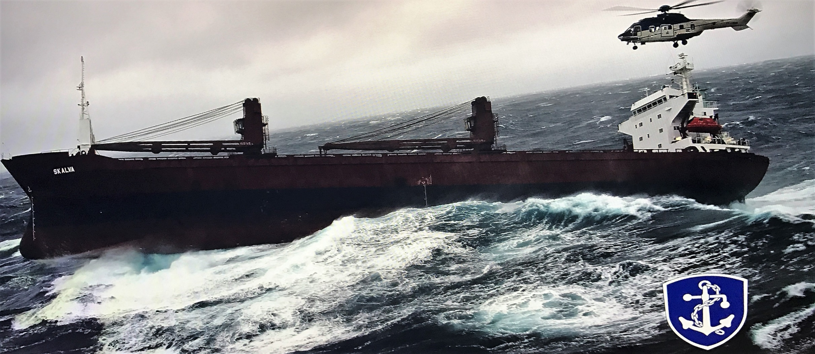
Motivations for in-situ
Open Ocean Wave Observations
Science: Wave propagation (trans-basin/local), air-sea interaction (e.g. momentum and gas fluxes), wave/current interaction (e.g. wave modulation by strong currents), wave/wave interaction, wave/internal wave interaction (implications for diapycnal mixing), engineering of offshore structures, climate assessment, risk assessment and planning
Validation and forecasting: Real-time validation of wave forecasting products, assimilation of wave data into wave forecasting models, open ocean in-situ Boundary conditions to improve coastal wave forecasts where people live and work
Societal: Navigation efficiency and safety (wave/Gulf Stream interactions), SOLAS, marine insurers, Lloyd's ship hull strength metric, wave inundation warnings (e.g. India, Sri Lanka, West Africa)
Satellite missions: Calibration and validation of remotely sensed significant wave height and spectral characteristics retrievals of the surface wave field
Photo credit: Icelandic Coast Guard
Waves and their interaction with currents have caused serious ship accidents. In-situ data are needed to constrain/validate models and notify mariners of hazardous conditions
In-situ wave observations in the open ocean are very sparse.
Outer-shelf, inner-shelf and the coastal wave measuring installations combined outnumber the offshore installations by a 4:1 ratio.
A sustained open ocean network of wave sensors is virtually non-existent

Slide 4
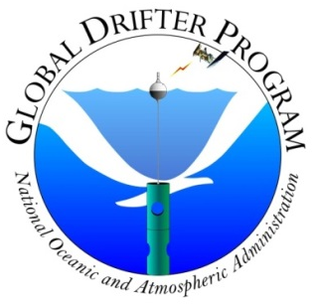
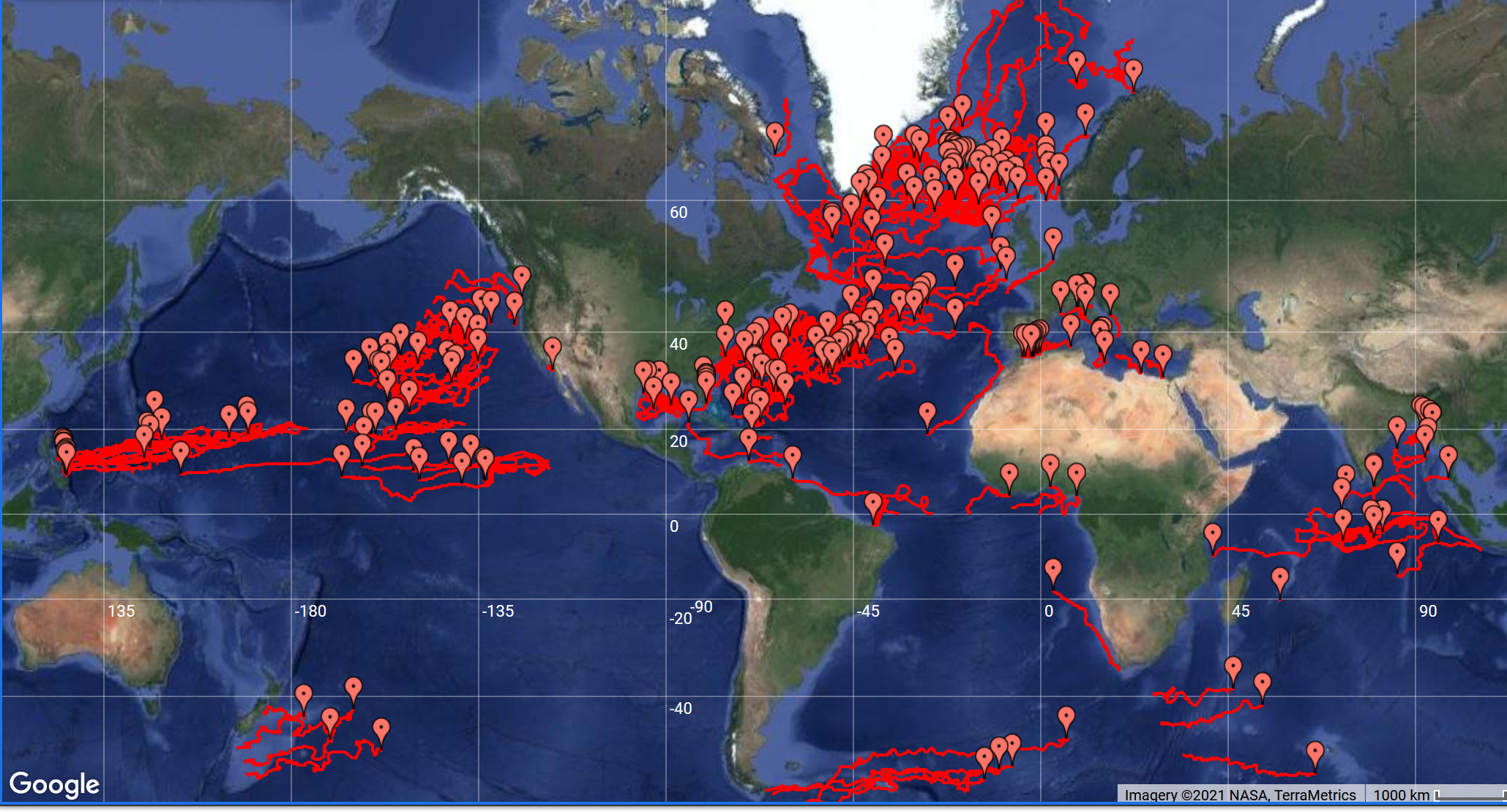
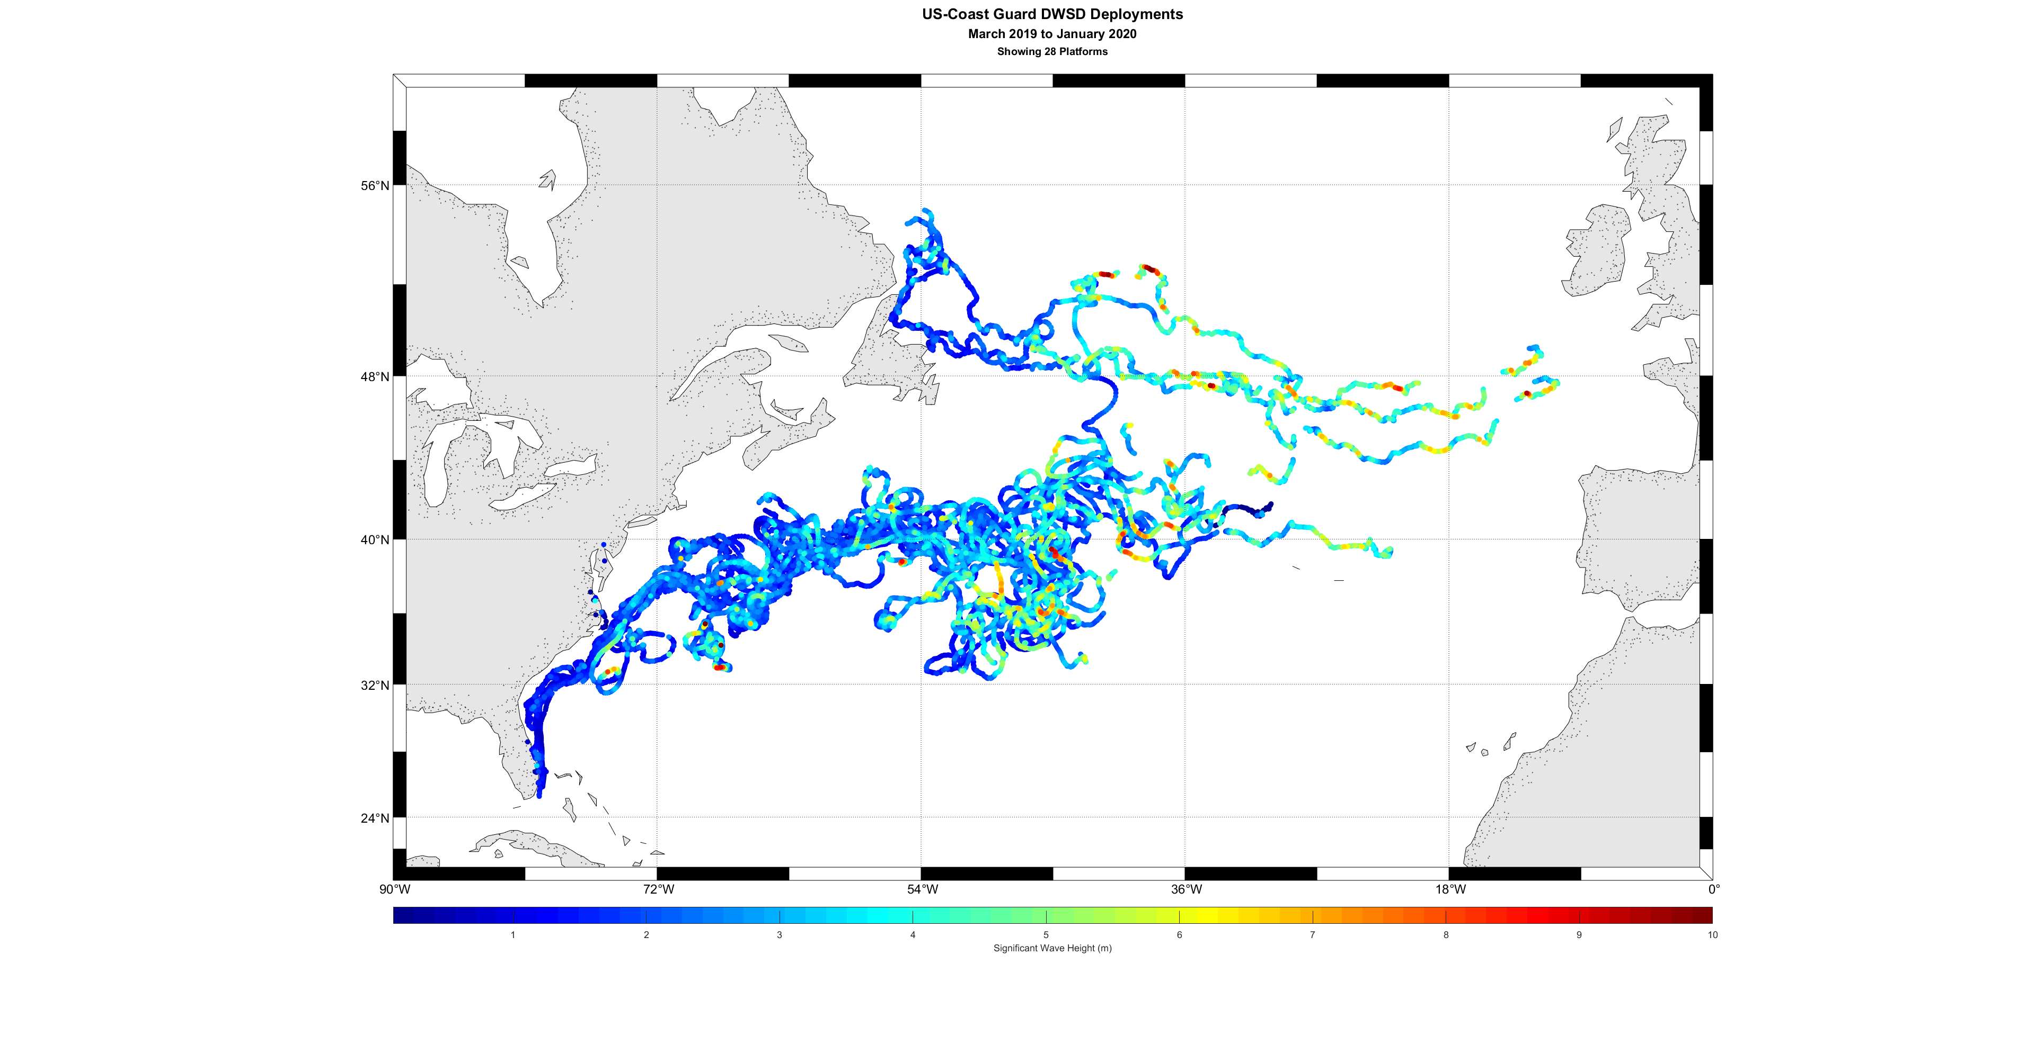
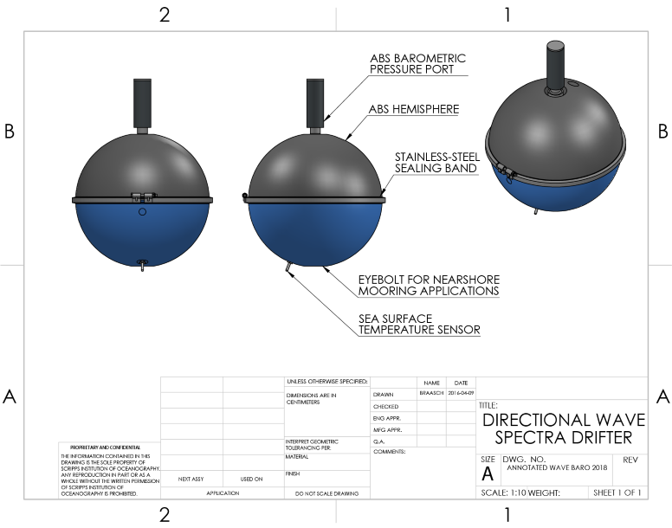
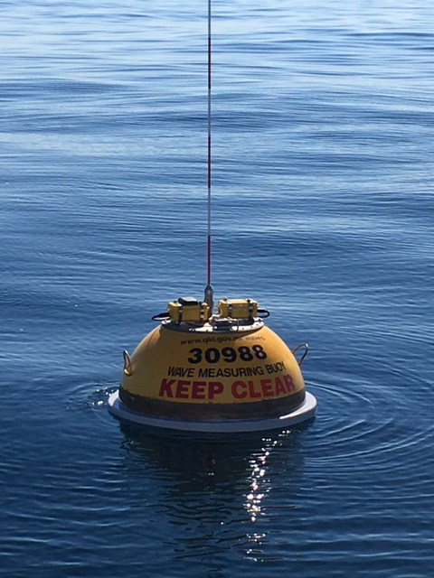
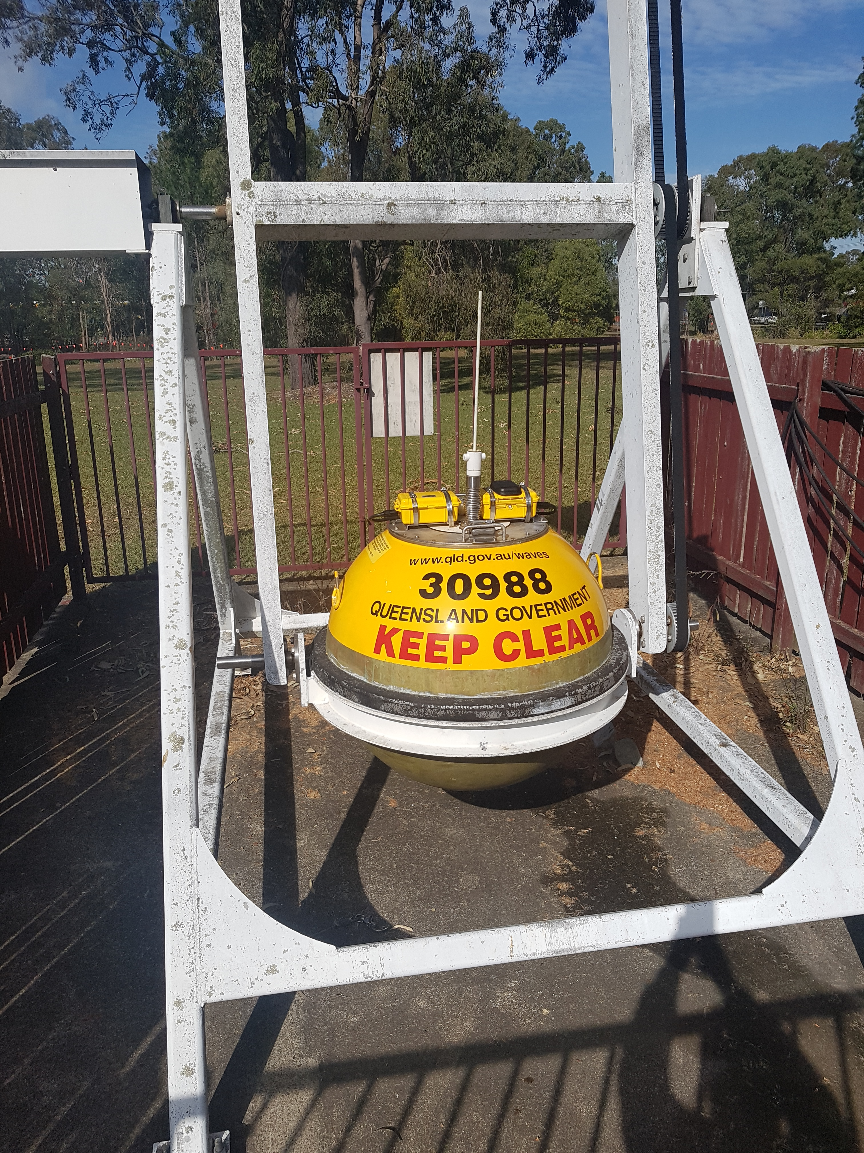
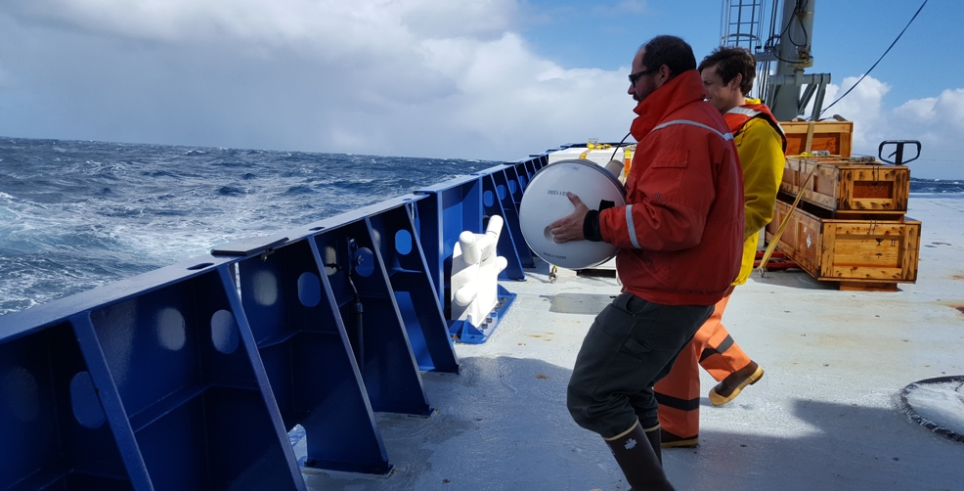
The Global Drifter Program Wave Component
“Innovating for Even Bigger Impacts: Directional Wave Observations”
The Technology
Directional Drifters, developed by the GDP@Scripps since 2005 was designed to sustain global arrays of wave sensors.
Global DWS drifter deployments
Southern Ocean: Significant Wave Height of 9.2 m recorded
23% smaller than WW3 (NCEP run)
Construction:
Most cost-effective wave buoy equipment
Same components and hardware construction as the SVPB family instrument
Biodegradable or recycled plastic
Extension of existing platform => SVPB drifter with less hardware but more software
Sensors:
GPS localization
SST (
SLP
Directional Wave Sensor
Telemetry:
2-way Iridium telemetry for fast data relay (< 1 min) and over-the-air mission control
Test of the LDL DWS sensor against DWR by Datawell
Waves, SST and Air Pressure from the same instrument (NOAA funded in 2018)
Wave Observations/Forecasting
DWSBD data (waves, SST, SLP) are already on the GTS. The GDP is actively engaged with NOAA Labs and international partners on assimilation/validation
Tracks of DWSBD (waves, SST, air pressure) drifters deployed by the GDP in 2019 in the Gulf Stream in collaboration with USCg)
Link to Real-Time Wave Data

Slide 5
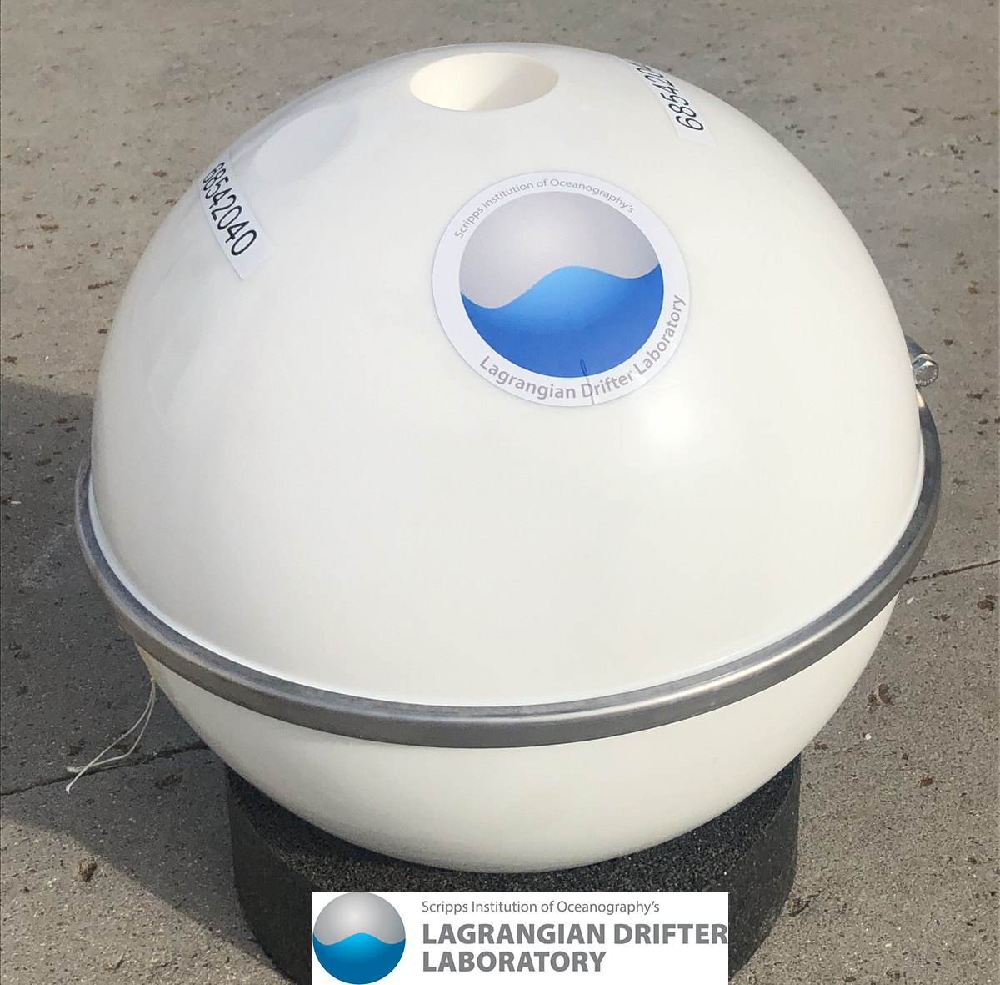
The Biodegradable Wave Drifter
In recent months the GDP has deployed several prototypes of wave buoys made of bio-degradable, non-toxic and compostable components (79% renewable resources); While all the LDL made drifters have used recycled materials for years, our goal is to improve our efforts to minimize the impact of our critical observations on the environment.
Our interest in the recent deployments of biodegradable drifters is into determining if this new material is suitable for long term applications, in other words, we want to see how long they will survive in a real application.
The preliminary data on the performance of the biodegradable drifters indicate that they are a viable alternative to petroleum based plastic
The biodegradable DWSTM

Slide 6
The GDP DWSDTM/DWSBDTM pilot array (241 wave riders deployed to date)

Slide 7
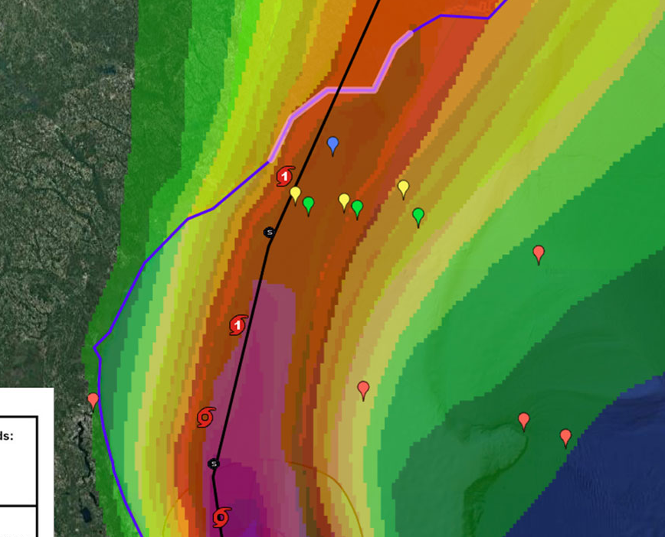
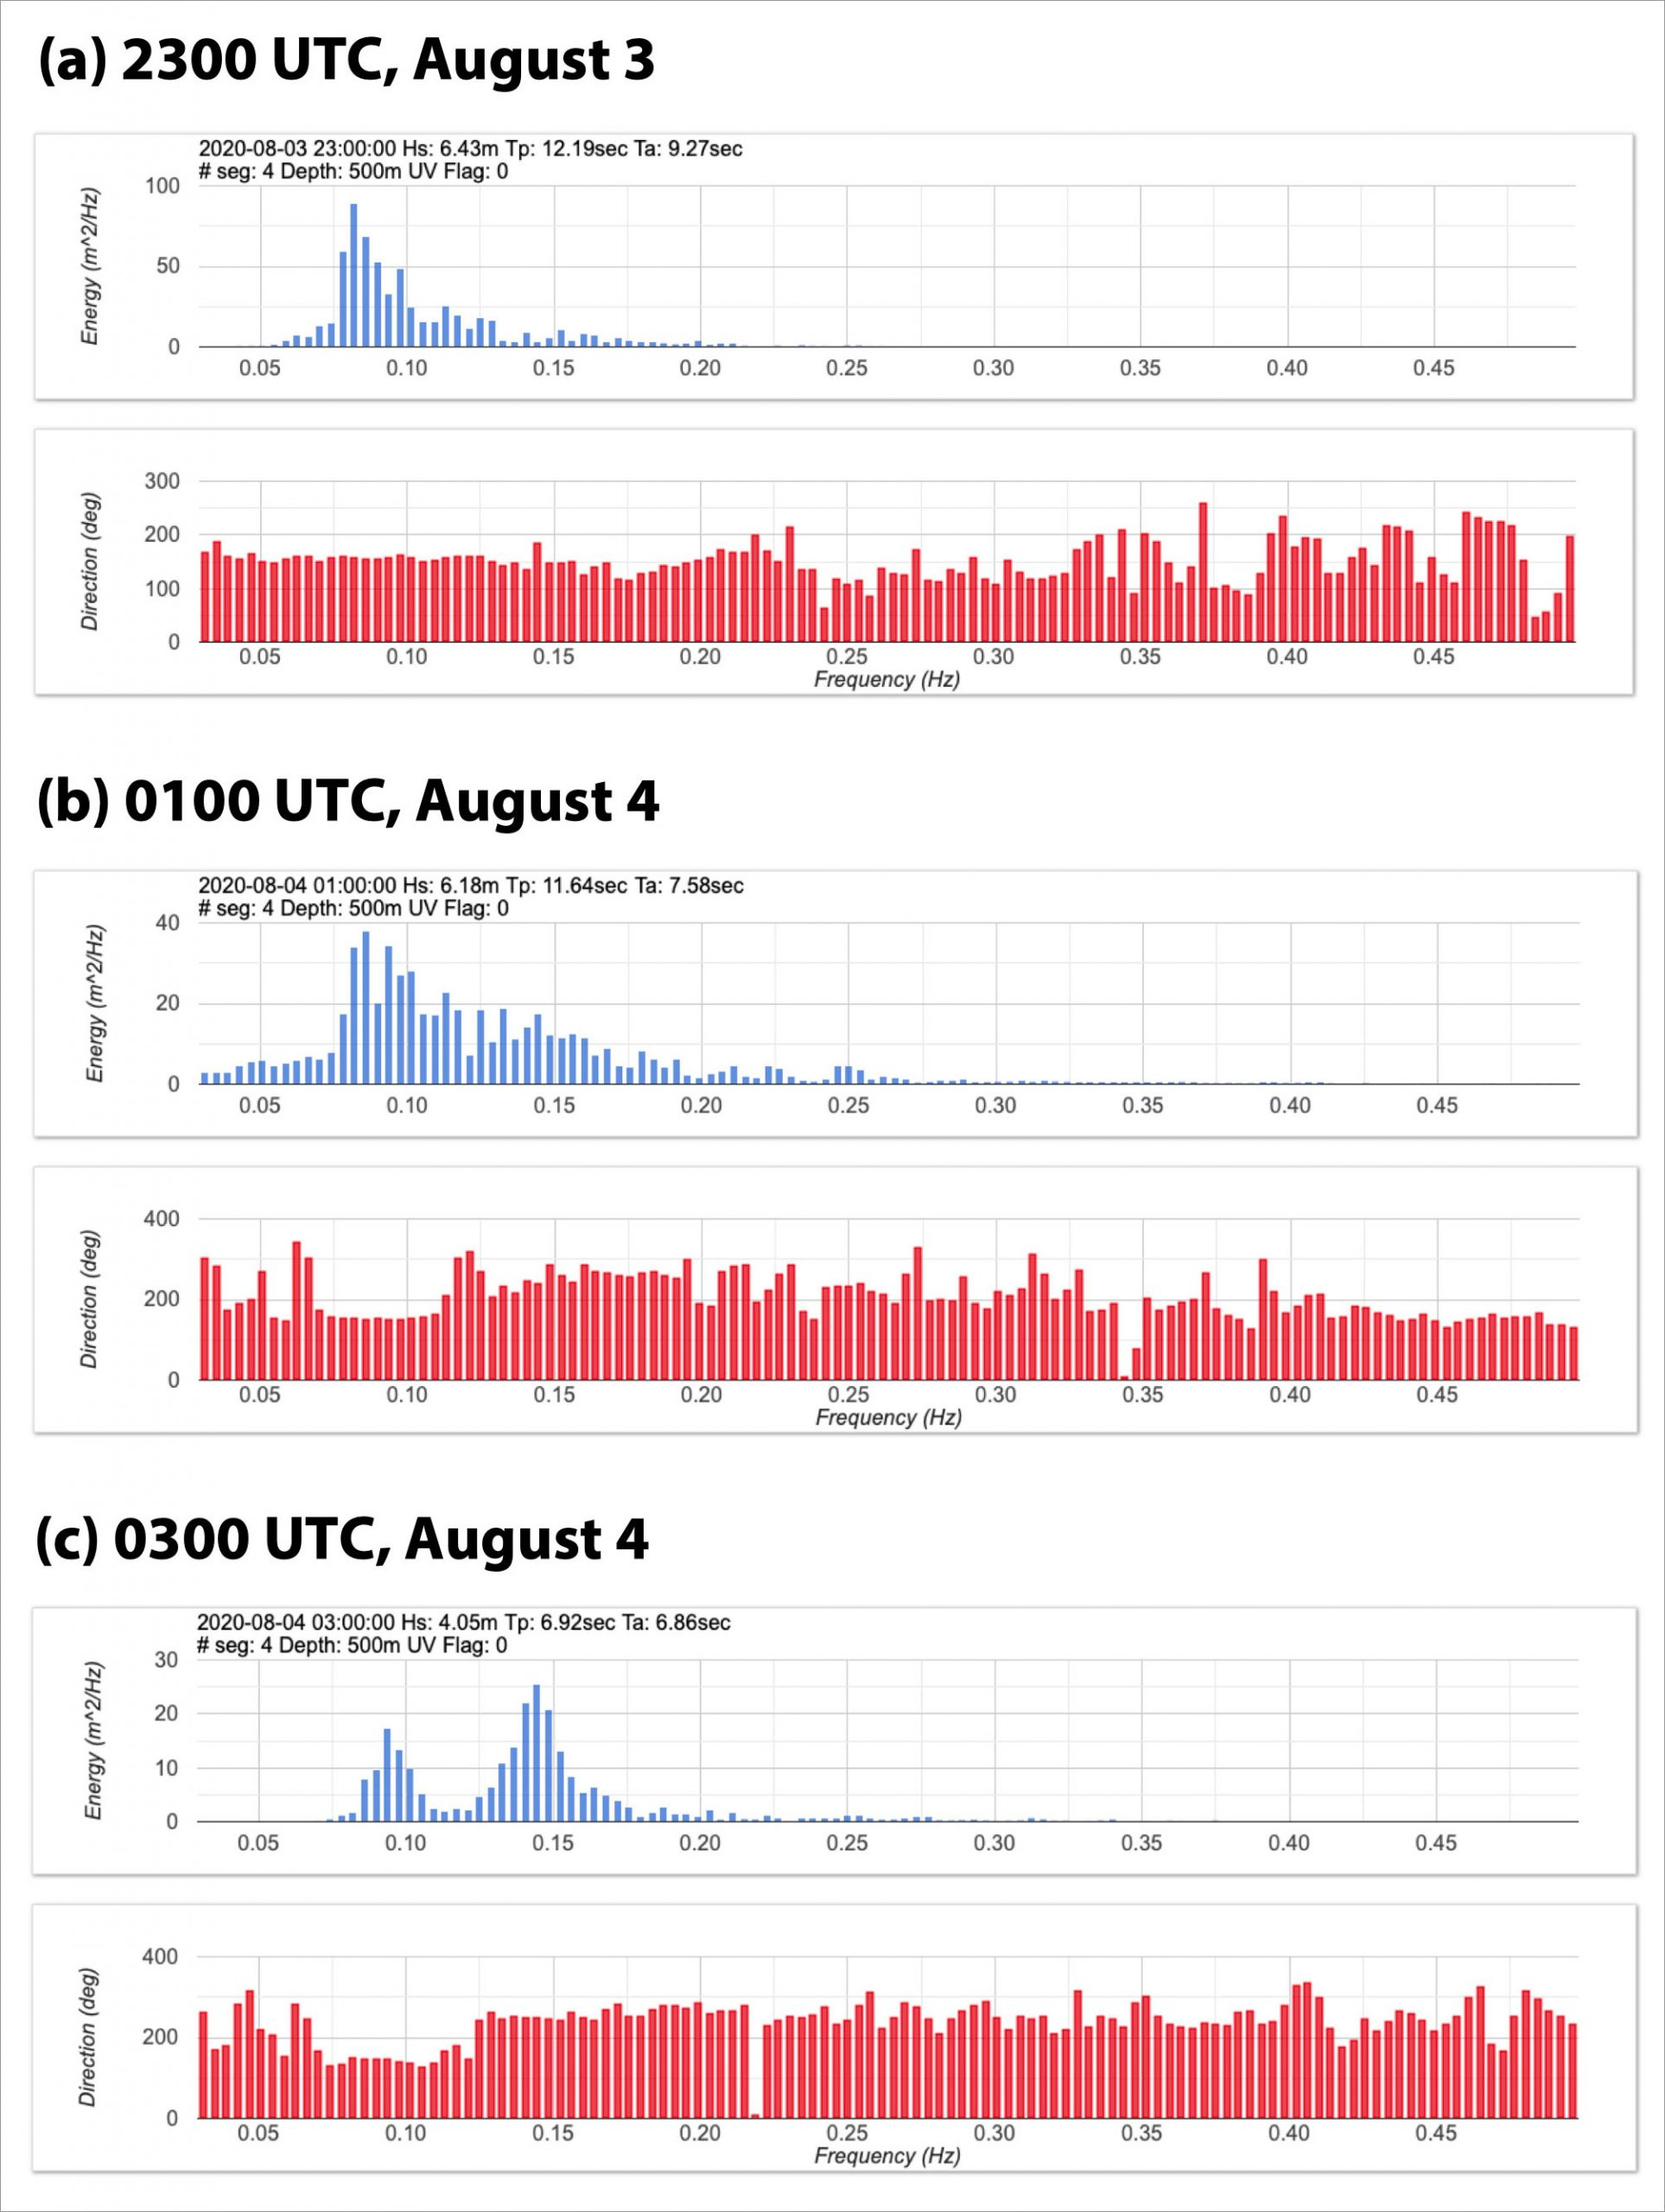
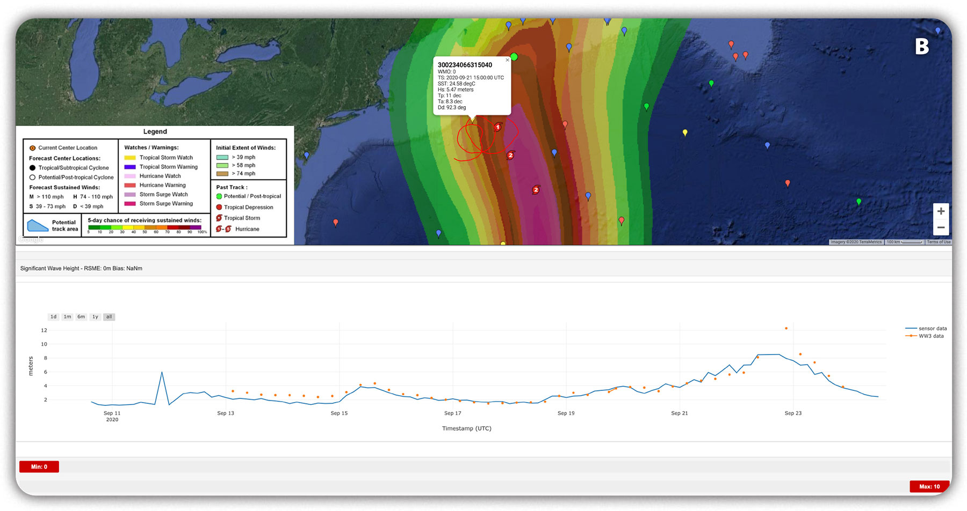
Examples of 2020 DWSD Observations in Hurricanes
Hurricane Isaias
Hurricane Teddy
The drifter array was deployed very close to the coast
The significant wave height from the drifter shows the increase in swell from Hurricane Teddy and the mismatch with the WaveWatch III model prediction at the height of the storm passage. See full story at: https://gdp.ucsd.edu/ldl/news-hurricane-teddy/
Transition of swell and locally generated wind waves under different parts of the hurricane. Normally in a large storm away from the coast, the large swell will move ahead of the storm. Isaias was atypical because of its proximity to land. There are indications of inbound swell even during opposing winds. After the passage of the storm, there is a return to locally generated wind waves.
Why is important to measure waves:
Drag Coefficient (ocean-atmosphere coupling)
Storm surges
Model assimilation, forecast validation
See full story here: https://gdp.ucsd.edu/ldl/news-hurricane-isaias/

Slide 8
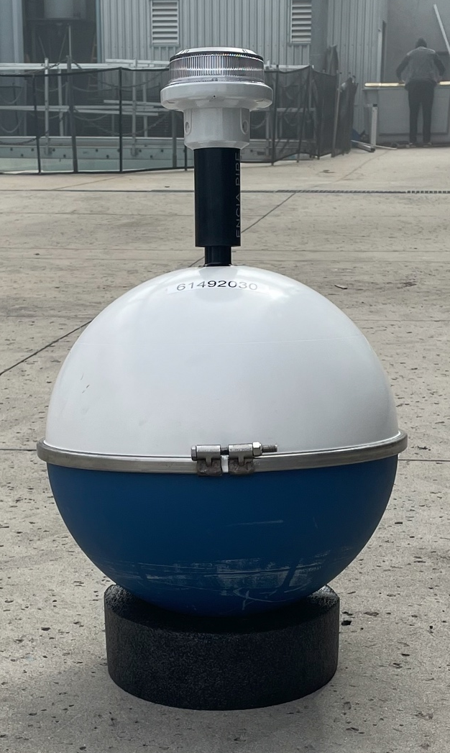
Summary of GDP’s DWSTM and DWSBTM Capabilities
Publicly available data, FAIR/O standards, for international cooperation
Proven GPS technology based on GDP drifter design
Measures the directional wave spectra
Measures scientific grade sea surface temperature and atmospheric pressure
Suitable for global applications due to Iridium telemetry
One year endurance at 3 hours reporting
GTS enabled
Suitable for coastal applications when moored
Lantern for mooring applications

Slide 9
An Opportunity for the Pacific Island Community
”Call for Expression of Interest in Deployment of Wave Drifters”
Supported by WMO and by the GDP
More details can be found at this link, or you can contact directly lcenturioni@ucsd.edu or LJiang@wmo.int
Successful candidates will receive a DWSBTM drifter, with mooring line
The GDP will support the iridium transmission for the first year
The GDP will decode the data and will provide a web-based viewer as well as direct data transfer
The GDP will post the data to the GTS
The GDP/LDL personnel will travel to the site for the mooring installation
Dr. Centurioni, PI of the GDP, will provide training on the analysis and scientific interpretation of the wave data

Slide 10
Conclusions
Global wave data are needed for ocean and atmosphere science and for risk evaluations such as the exposure of coastal communities to inundations caused by extreme events and regional coastal changes in a changing climate scenario.
The DWSD technology developed by the Lagrangian Drifter Laboratory at Scripps Institution of Oceanography has been demonstrated and can support a sustainable global array of directional wave sensors
Our decades-long open data policy supports basic science and forecasting around the globe and encourages participation of both private and public sectors. GDP scientists will continue to promote the use of drifter data and the new wave observations to train the next generation of ocean and climate scientists. Note that over 1,200 peer-reviewed publications using traditional drifter data exist.
A WMO funded opportunity exist to engage with the GDP on the use of this new technology

Slide 11
Thank you for your attention!
Please email questions to:
lcenturioni@ucsd.edu

