Slide 1
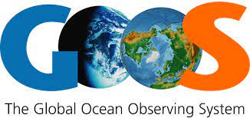
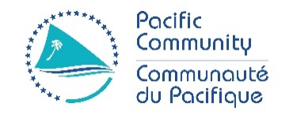
Fifth Pacific Islands Training Workshop on
Ocean Observations and Data Applications (PI-5)
27-28 May and 10-11 June 2021 (Fiji Time, UTC+12)
Technology and application of petrel gliders
Presented by: Liu Ma (Tianjin University, China)
Email: wei.ma@tju.edu.cn

Slide 2
Outline
1
Petrel Underwater Glider
2
Application in environmental observation (network)

Slide 3
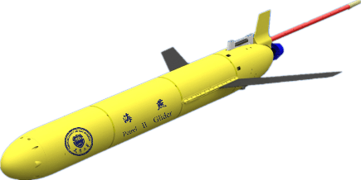
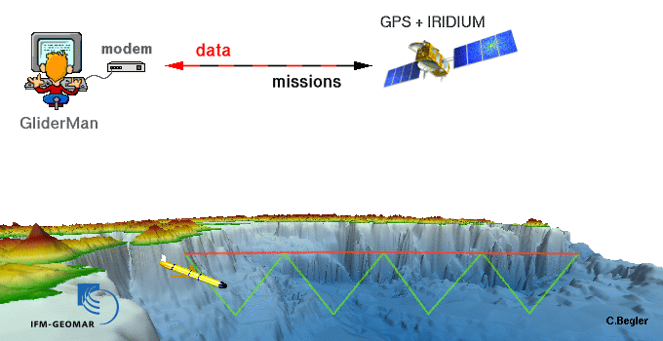
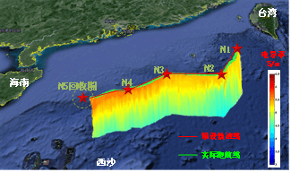
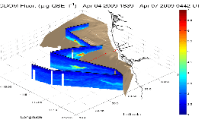
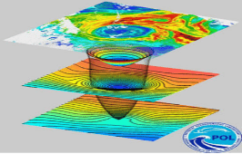
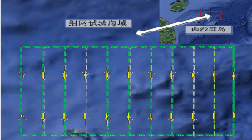
1
Petrel Underwater Glider
Research Field: Underwater Glider
Operating principle
Unmanned Autonomous
Buoyancy-Driven
Observation Platform
Cited from: www.geomar.de
Observational Sea Trail
Material and data

Slide 4
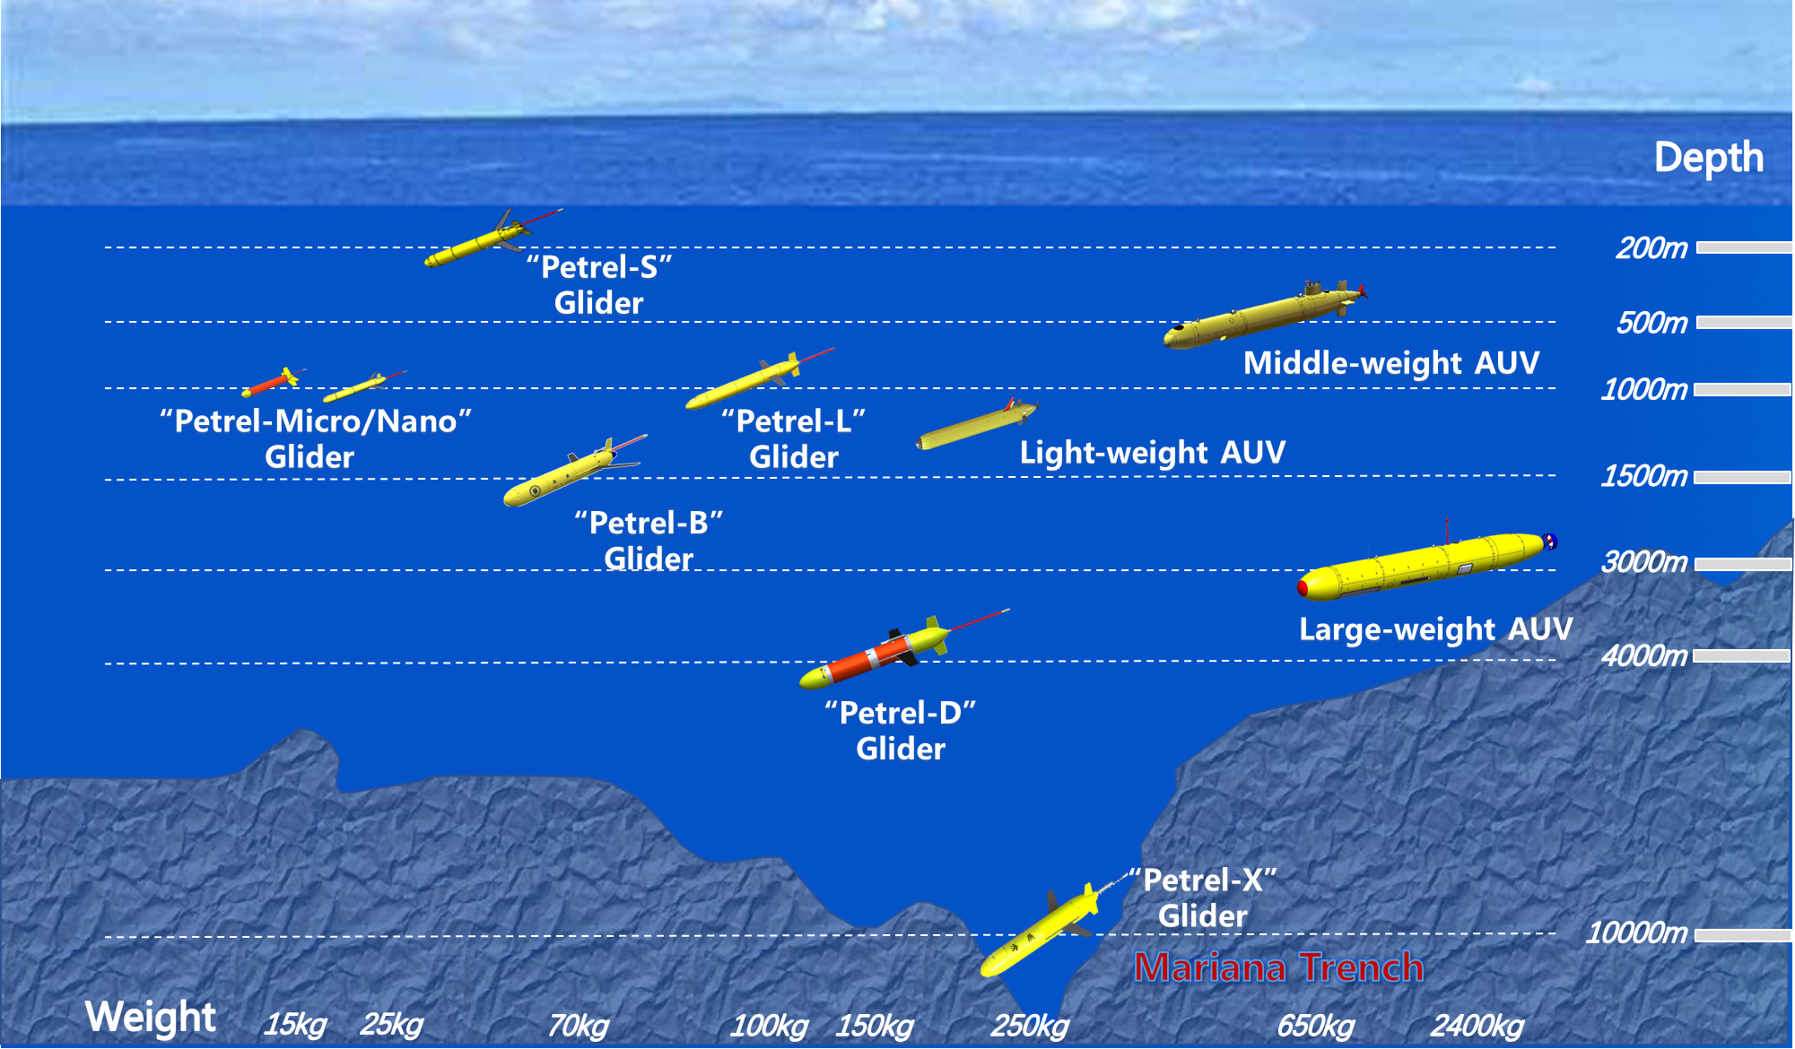
1
Petrel Underwater Glider
Pedigree Development
Underwater Glider Pedigree
Working depth: 200m/1000m/1500m
4000m/10000m
Weight: 15kg/25kg/ 70kg/100kg/150kg
250kg
AUV
Light-weight AUV
Middle-sized AUV
Large-scale AUV

Slide 5
1
Petrel Underwater Glider
Pedigree Development
At present, we have realized the pedigree development of Petrel Underwater Glider in terms of working depth, endurance and task sensor payload. The Group has gained the capabilities of developing, manufacturing, and supporting underwater gliders with a working depth within 200-11000m.

Slide 6
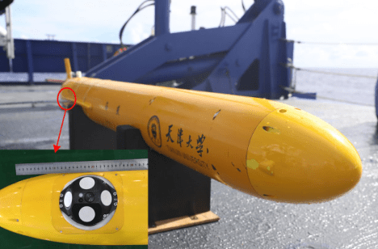
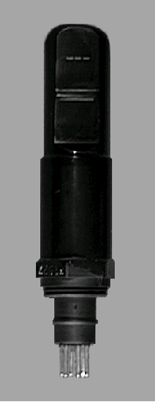
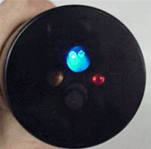
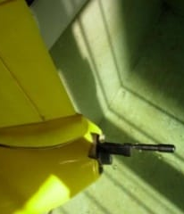
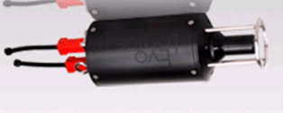
1
Petrel Underwater Glider
Integrated application of sensors
Application Field
CTD/Dissolved oxygen
Microstructure turbulence profiler
ADCPr
Hydrophone
Underwater acoustic communication set
Turbidity meter
Chlorophyll fluorimeter
γ-ray sensor/radiometer
Optical backscatter sensor
Phycobilin sensor
Electromagnetic sensor
……
Marine dynamic environmental parameter observation
Marine acoustic parameter observation
Marine ecological and biochemical parameter observation

Slide 7
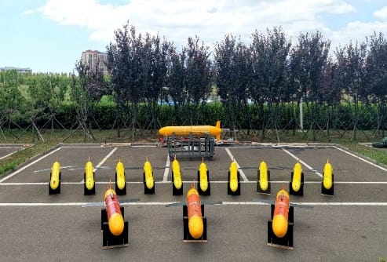
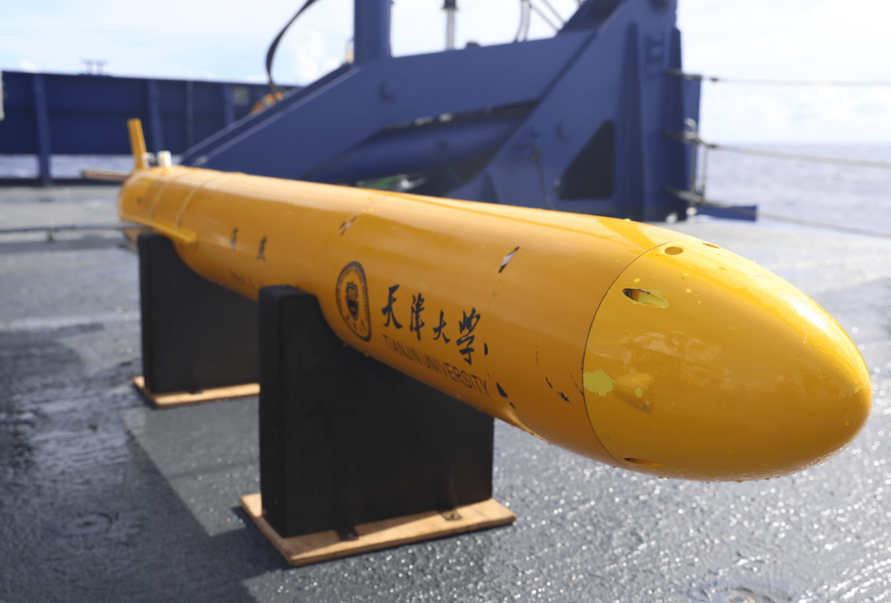
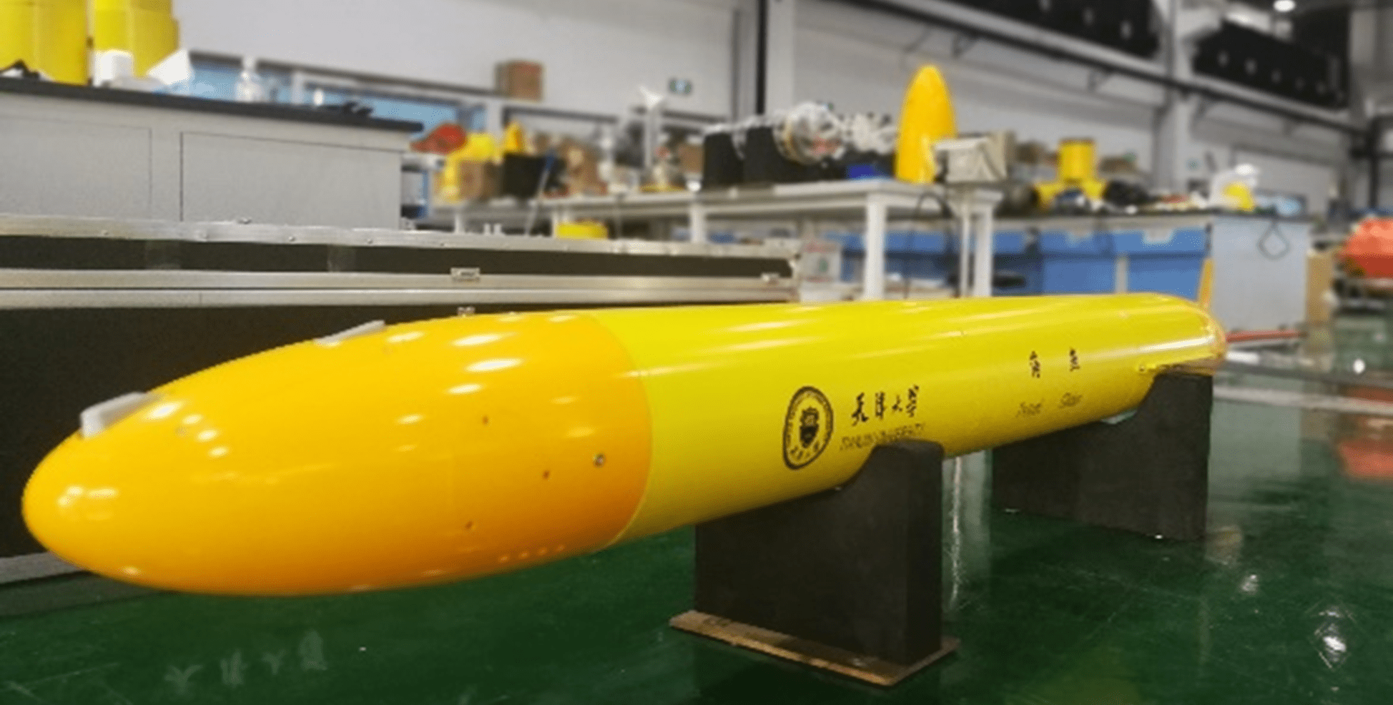
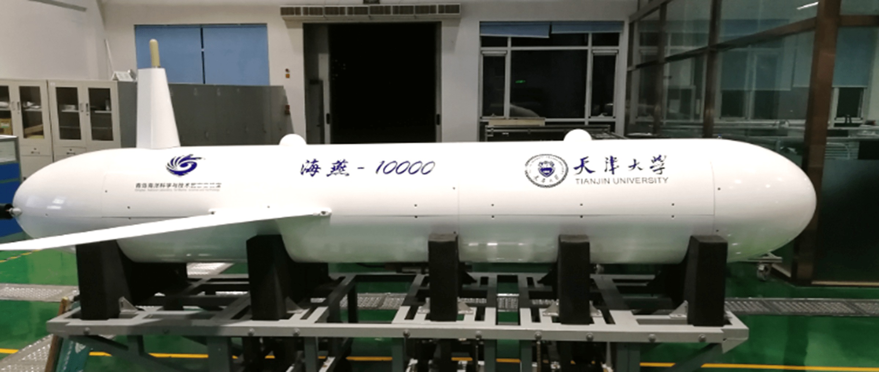
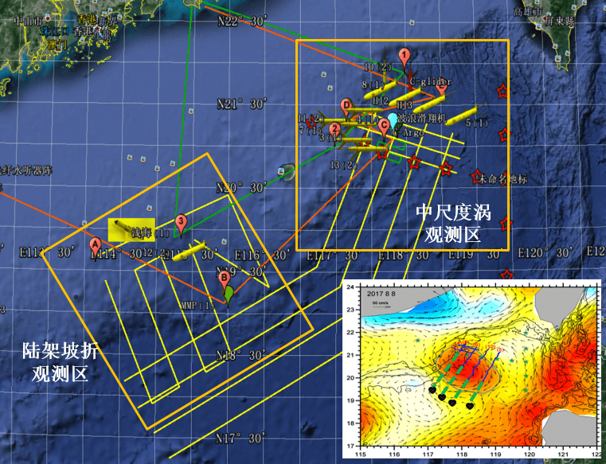
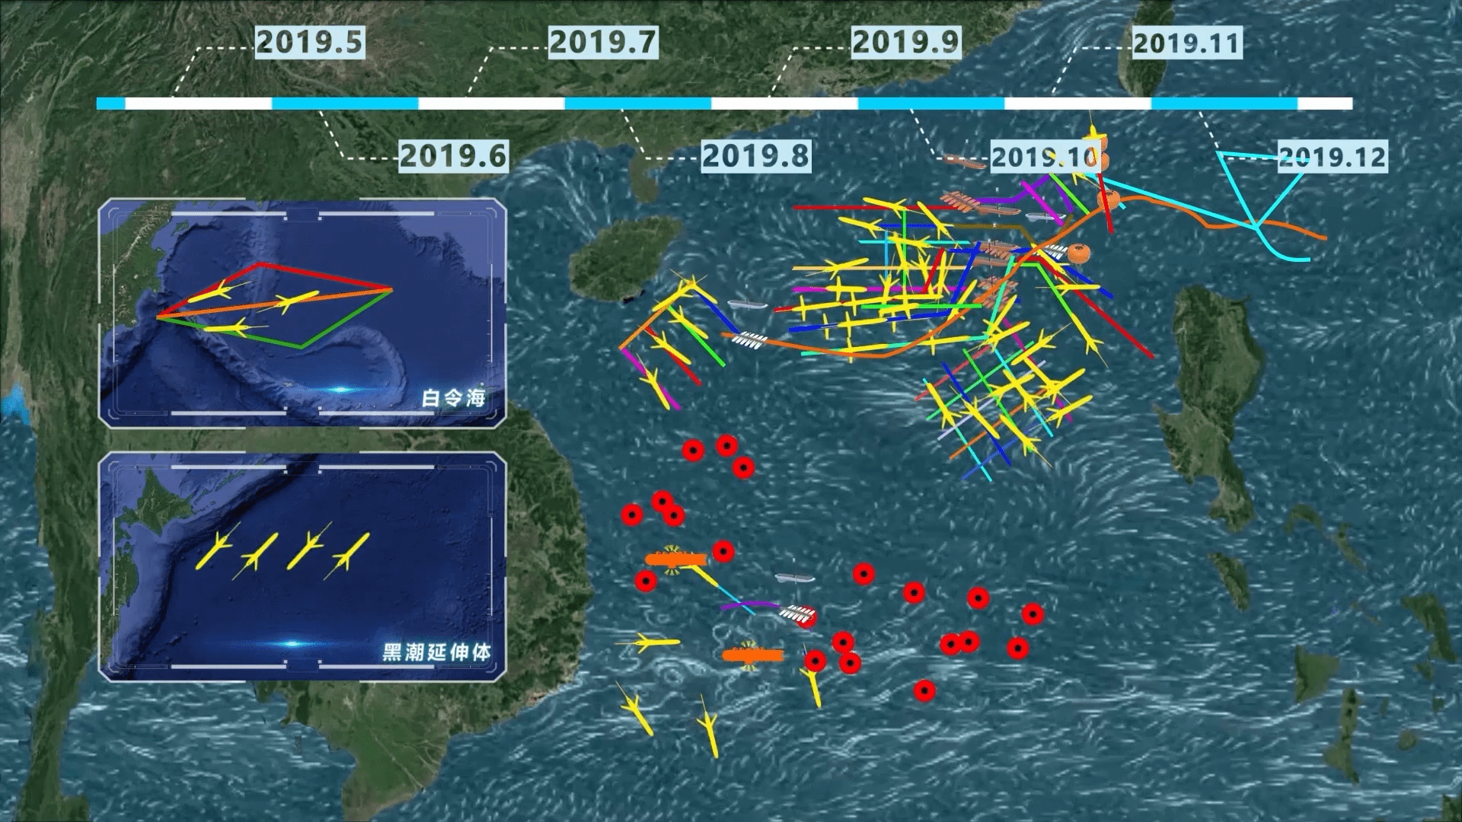
1
Petrel Underwater Glider
Data Highlights
Currently, Petrel gliders have completed more than 50,000 task profiles in total, with a total voyage of more than 150,000 km.
In July 2020, Petrel-X ^{PLUS} glider dove to 10,619m and created a new world record;
Till May 2020, Petrel-L long-endurance underwater glider had operated for duration of more than 300 days and endurance of more than 4,000km ；
Since May 2019, Petrel gliders have performed large-scale network observation of the ocean phenomena in South China Sea, including mesoscale eddies and typhoons;
During June-July 2017, 7 Petrel gliders formed a network and completed the world’s first underwater-glider-based typhoon observation.

Slide 8
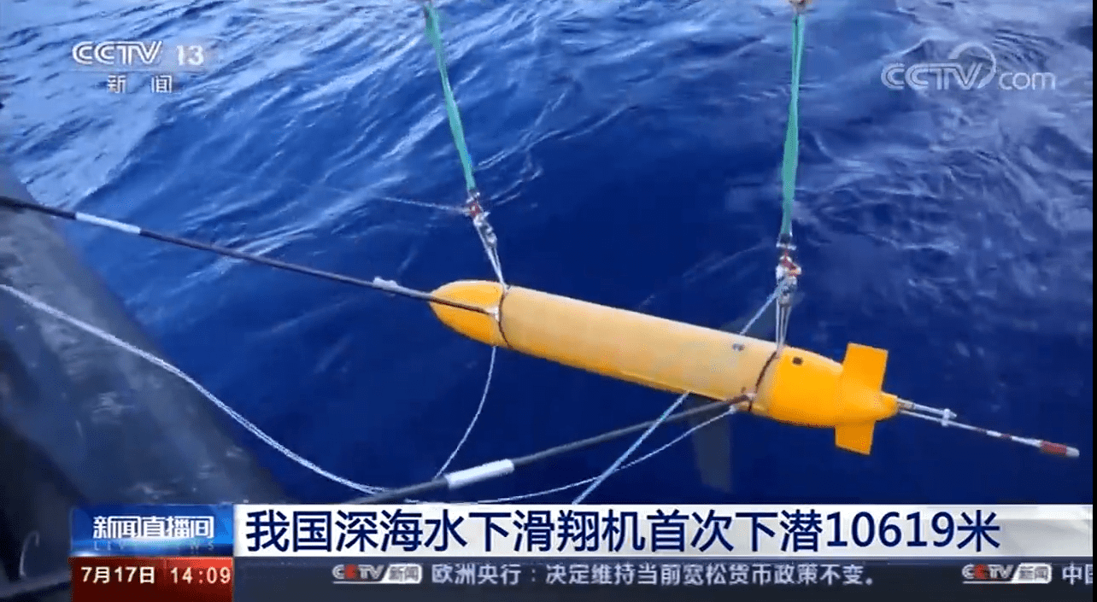
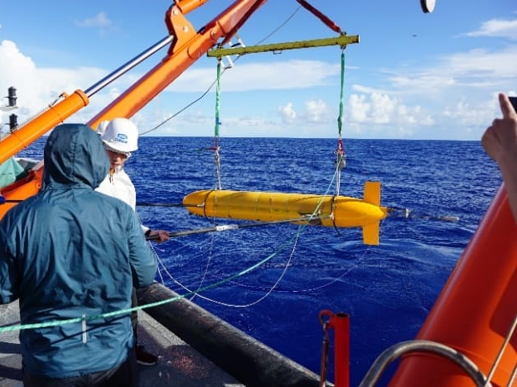
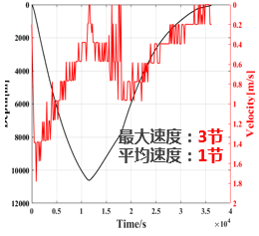
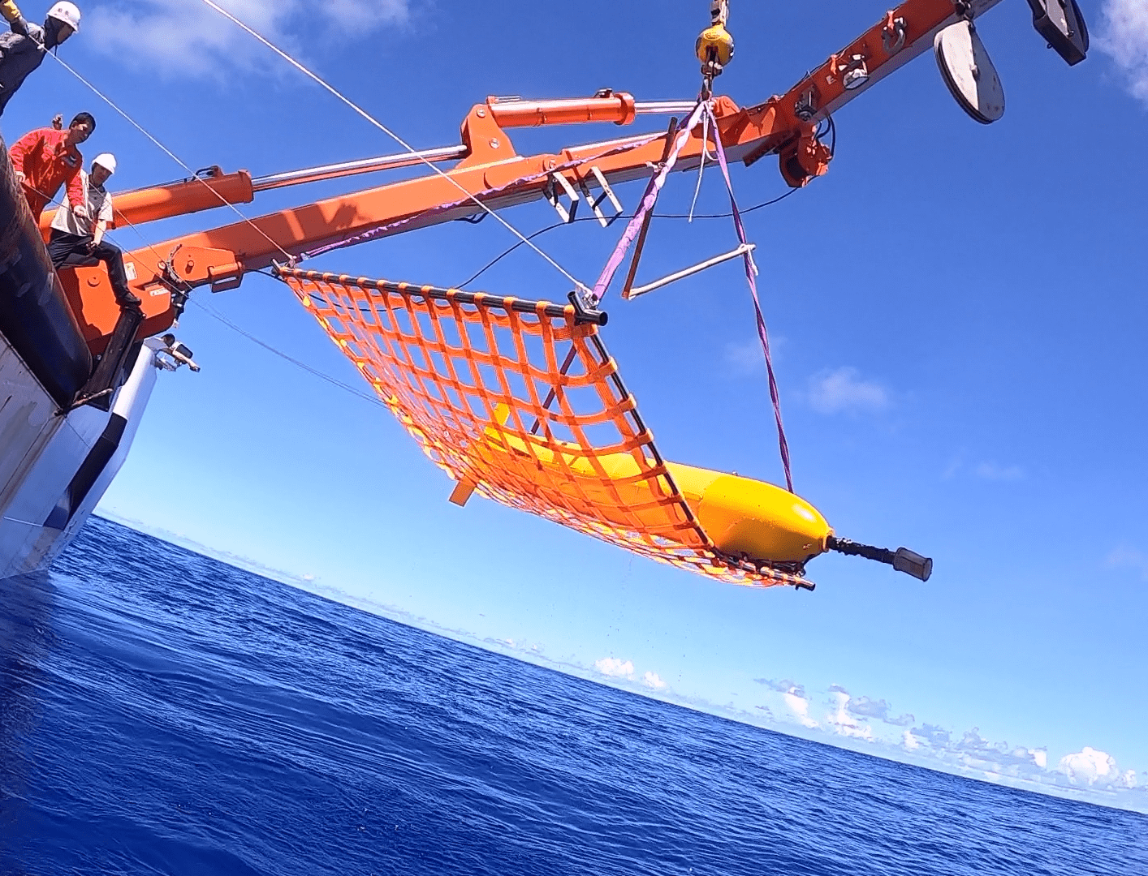
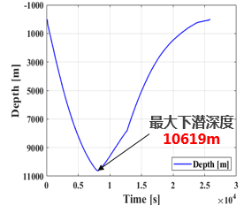
1
Petrel Underwater Glider
New World Record (2020)
“Petrel-X ^{PLUS}” Glider
Glider-1
Glider-2
Deployment
Recovery
In July 2020,“Petrel-X ^{PLUS}” glider performed a comprehensive survey for 5 continuous days, obtaining 45 observation profiles, including each of 3000m-level, 6000m-level, and 7000m-level, as well as 3 profiles of 10000m-level, which dove to 10,245m, 10,347m, and 10,619m respectively, breaking the world record for deepest dive by underwater glider again.

Slide 9
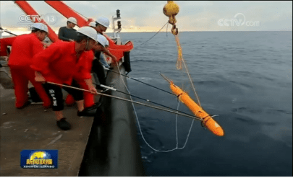
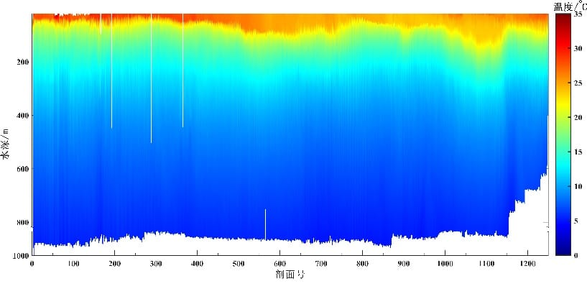
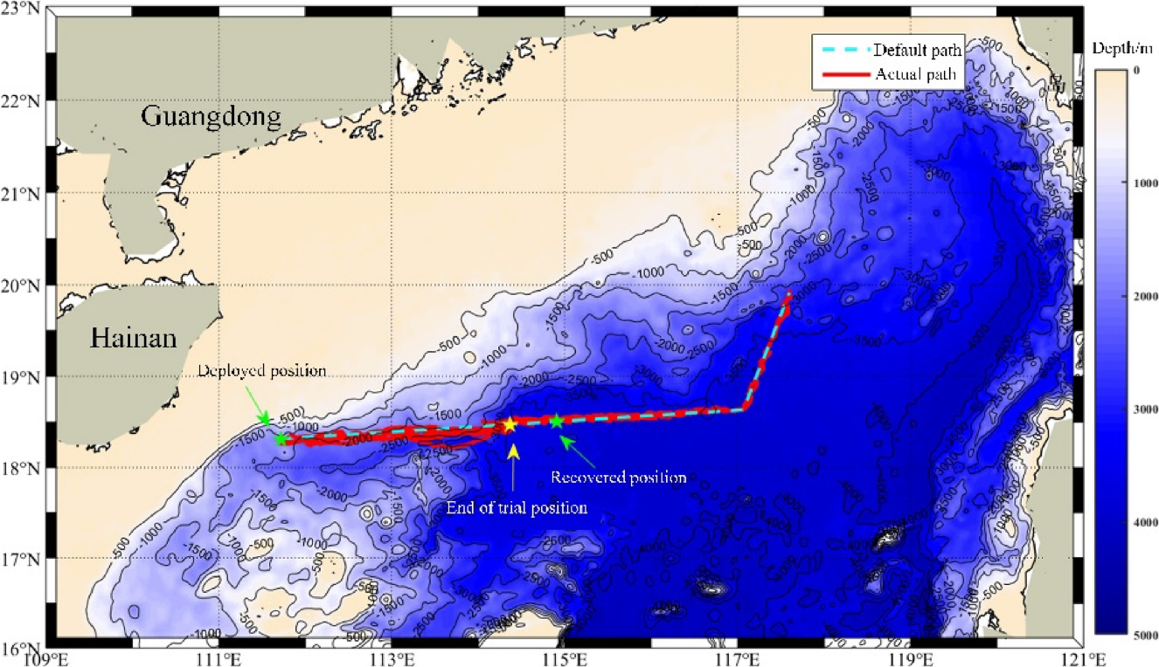
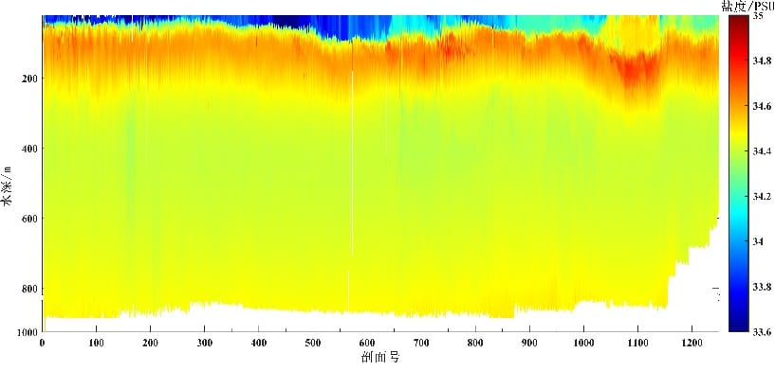
1
Petrel Underwater Glider
Petrel-L long-endurance glider
Temperature
Salinity
In 2020, Petrel-l travelled in South China Sea for 301 continuous days, completing1250 profiles and a voyage of 4435 km.

Slide 10
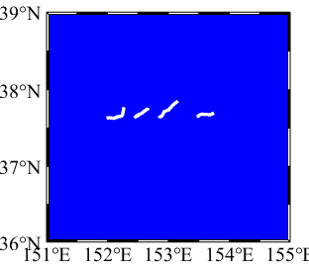
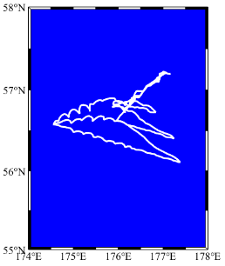
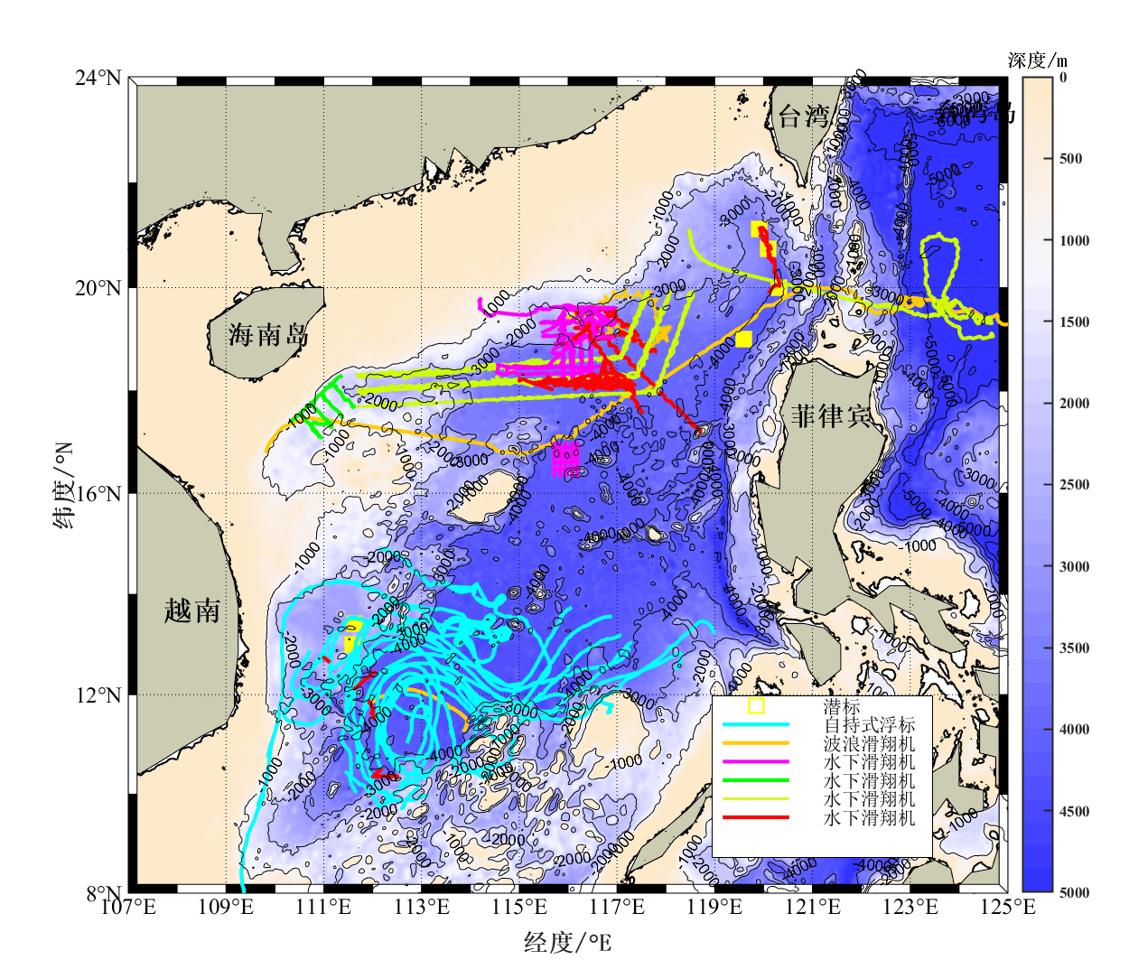
1
Petrel Underwater Glider
The largest
network in China
Petrel leads the establishment and running of national observation network with unmanned systems.
89 vehicle participation times (74 vehicles)
The maximum number of vehicles in the same network is 45.
Operating for 379 days (till 2020. 05.22)
More than 24,000 profiles in total
Total distance of 125,000 km travelled by the mobile platform
Covering more than 1050,000 square kilometers
Trajectories of the participating vehicles
Kuroshio Extension
Bering Sea
Northern SCS
Luzon Strait
Bering Sea
Middle SCS
Kuroshio Extension

Slide 11
1
Petrel Underwater Glider
Statistical Data
Application data of Petrel underwater glider pedigree
>150000 km
>50000
10619 m
＞5000 km
1250
301 days
28 vehicles
Maximum number of vehicles in the same network
Maximum duration
Largest profile number
Largest endurance
Largest diving depth
Total number of profiles
Total endurance
Dada updated by April 2021

Slide 12
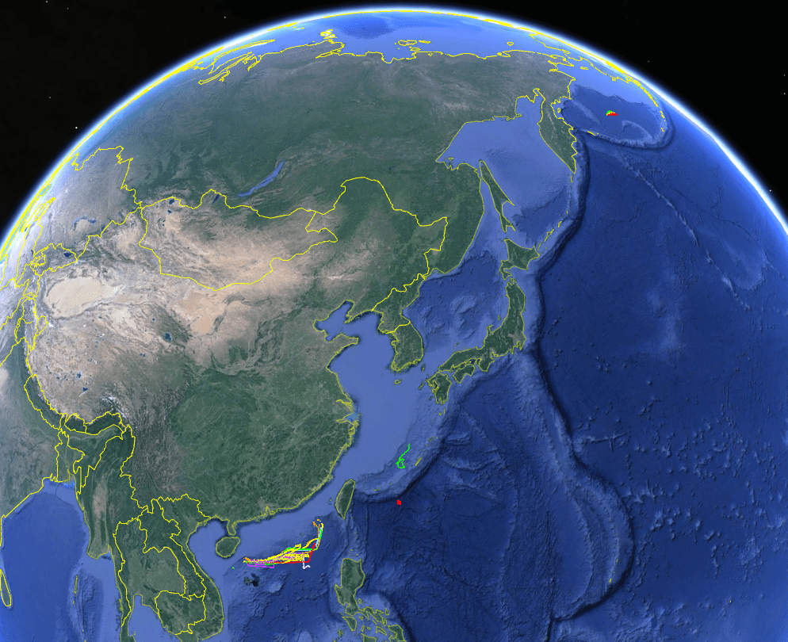
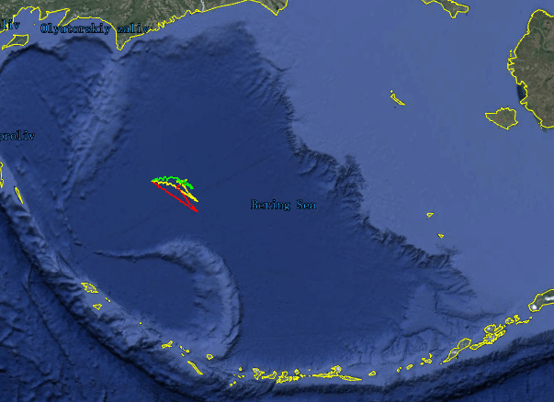
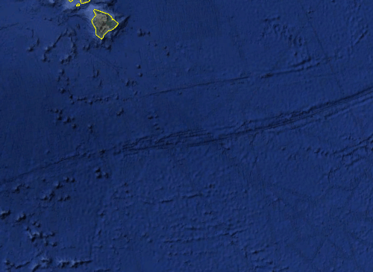
1
Petrel Underwater Glider
Application areas
A total endurance of more than 15,000 km
More than 50,000 profiles in total
Bering Sea
Established and run the observation network with unmanned systems.
The expedition on“global climate change and the interaction between air and sea”
Water source of South-North Water Diversion Project
Bohai Sea
Bering Sea
The 10th Chinese National Arctic Research Expedition
Huanghai Sea
The IODP Expeditions 45/46
Fuxian Lake
East China Sea
Miyako Strait and Kuroshio Area investigation
Hawaii
Pacific Ocean
First marine network observation of a passing-by typhoon
South China Sea
……
Indian Ocean
马里亚纳海沟
Petrel gliders have been successfully applied in South China Sea, the Pacific Ocean, the Indian Ocean, the Bering Sea, etc., completing more than 50 major expeditions.

Slide 13
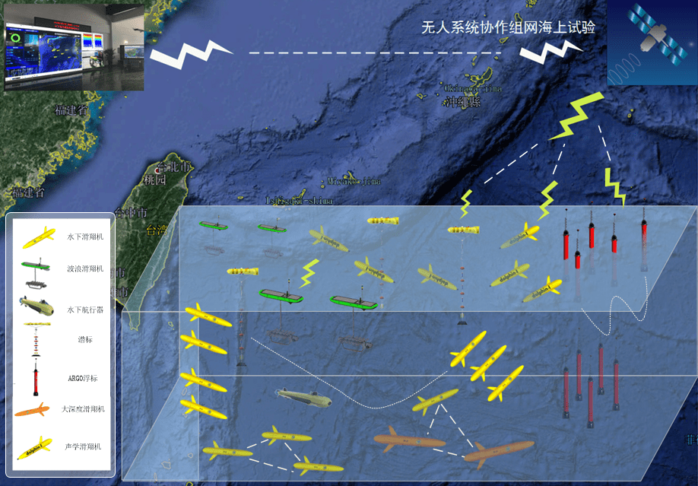
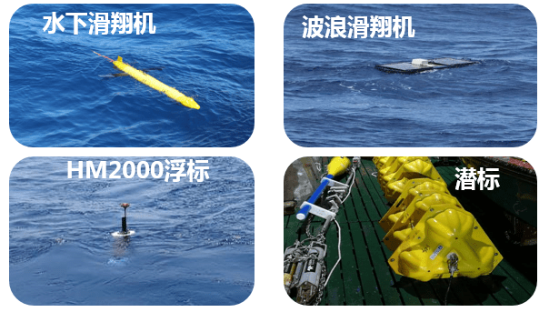
2
Application in environmental observation (network)
Petrel leads the establishment and running of
national observation network with unmanned systems.
Overview
Since May 2019, using the Petrel pedigree, our group has led multiple types of unmanned observation equipment, and smoothly carried out cooperation observation tests with a heterogeneous fleet，which improves the observation capability in extreme environments such as multi-scale ocean dynamic process and typhoon, establishes a bi-directional communication link connecting real-time marine observation data, shore-based supercomputing center, and scientific research vehicles，and thus lays the foundation for large-scale application of unmanned underwater platforms.
Sea trail by cooperation network of
unmanned systems

Slide 14
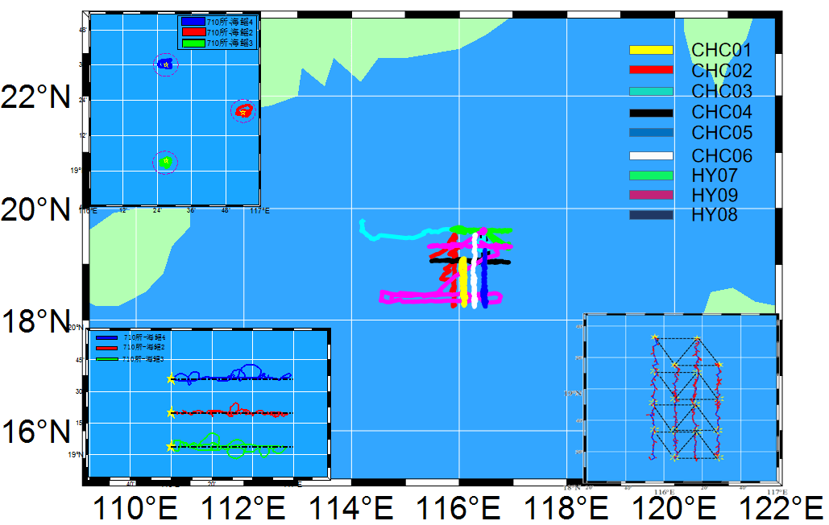
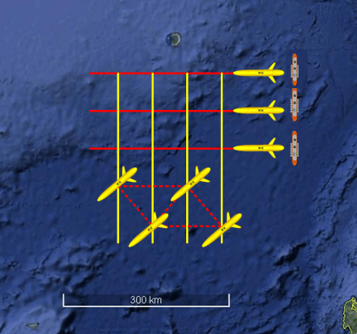
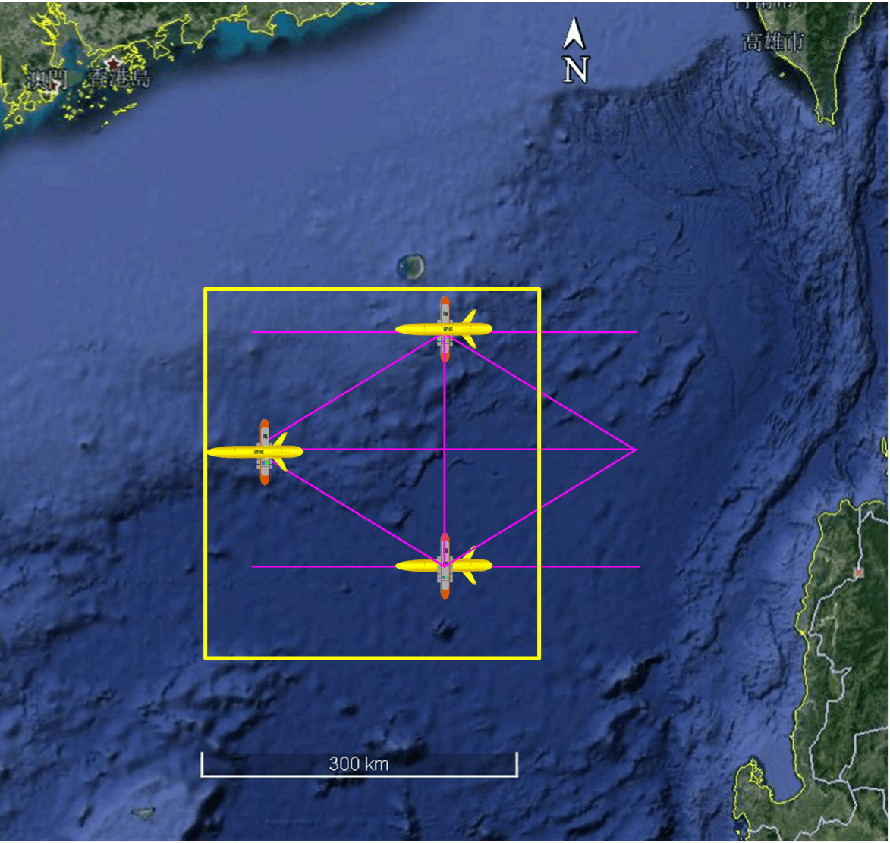
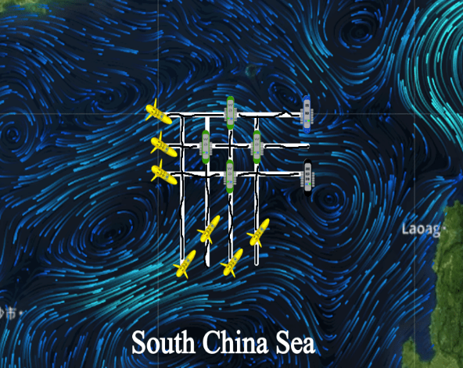
2
Application in environmental observation (network)
Petrel leads the establishment and running of
national observation network with unmanned systems.
Fully verifying the formation and cooperation techniques of the heterogeneous fleet
Realizing cooperation observation with surface and underwater heterogeneous unmanned platforms;
Verifying the motion patterns and collaborative control mechanisms of the heterogeneous glider fleet;
Joint navigation trail of sea gliders
Joint fixed-point observation of sea gliders
Testing of trajectory-keeping ability against currents

Slide 15
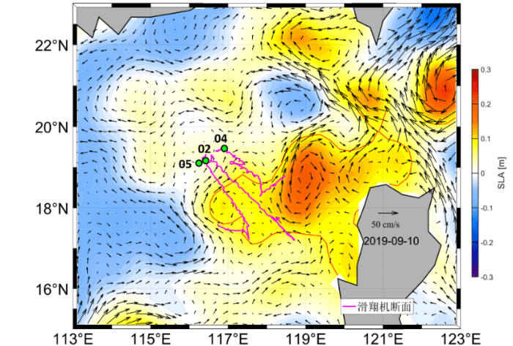
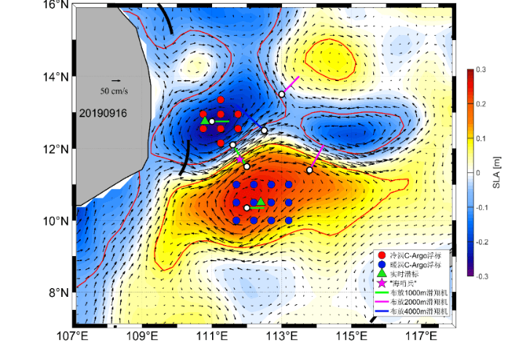
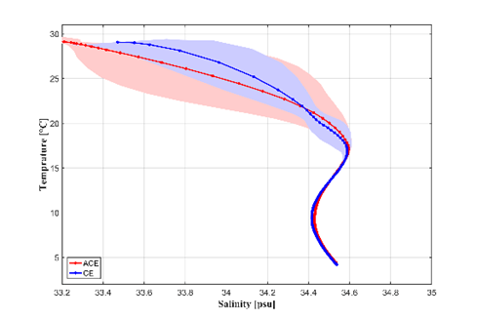
2
Application in environmental observation (network)
Petrel leads the establishment and running of
national observation network with unmanned systems.
Successful cooperation observation of multi-scale dynamic process
Multiple vehicles of different types observed the warm mesoscale eddy at Luzon Strait and the meososcale eddy pair to the east of Vietnam in cooperation, obtaining partial structural features and thermohaline properties of mesoscale eddies
Warm mesoscale eddy
Eddy pair off Vietnam
The observation data indicate that the warm eddy pushes down the thermocline and the cold eddy lifts the thermocline, which shows a declining trend from the warm eddy center to the cold eddy center.
Thermohaline properties of the eddy pair
Position and density anomaly of the eddy pair

Slide 16
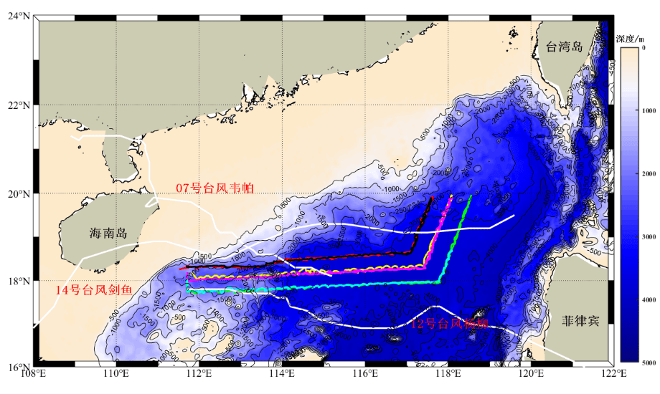
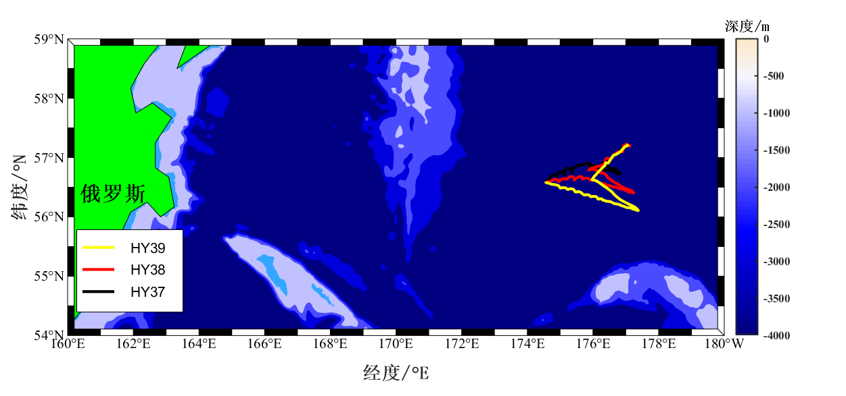
2
Application in environmental observation (network)
Petrel leads the establishment and running of
national observation network with unmanned systems.
Successful cooperation observation in the extreme marine environment (typhoon)
During their reciprocating network navigation in the typhoon observation area, South China Sea, 10 Petrel-L underwater gliders realized on-site cooperation observation of the marine environment when typhoons “Wipha”, “Podul” and “Kajiki” are passing by.
The Group initially applied a fleet of 3 Petrel underwater gliders for observation in the Bering Sea, obtained continuous high-density hydrological and biochemical data, and recorded how powerful cyclone process affected the marine environment.

Slide 17
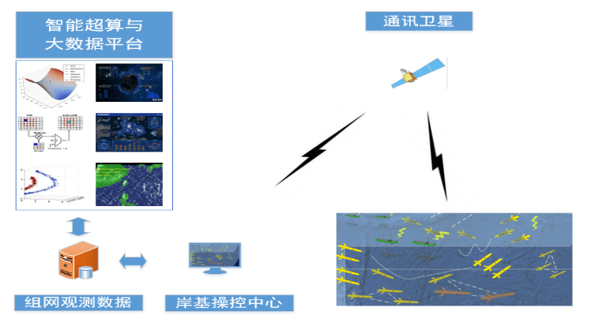
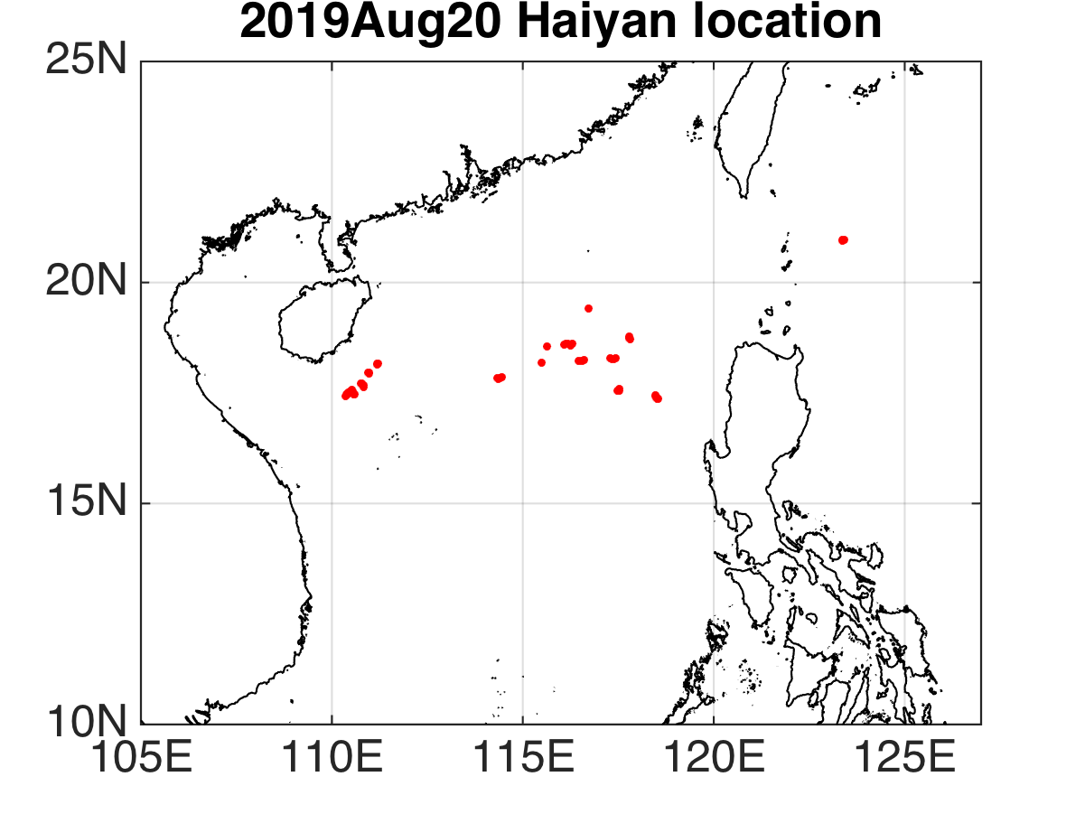
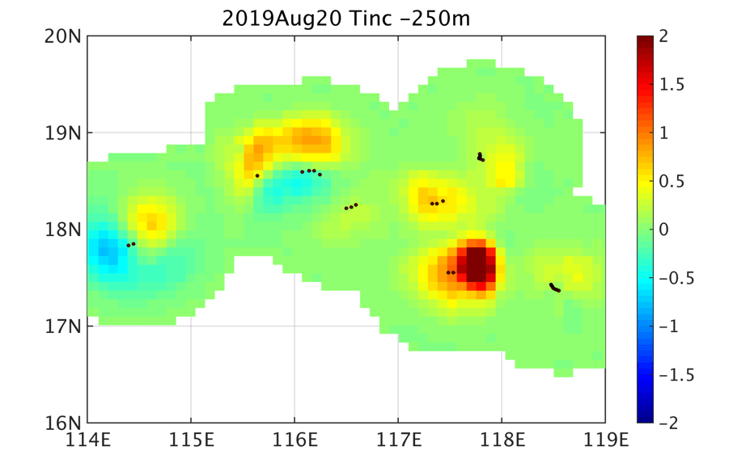
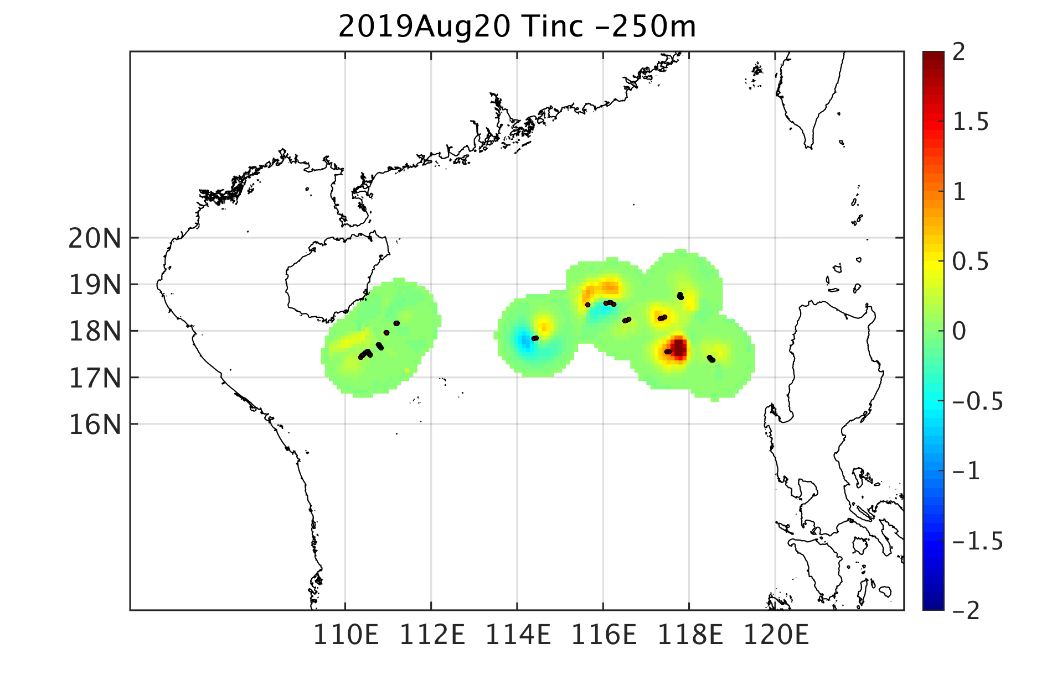
2
Application in environmental observation (network)
Petrel leads the establishment and running of
national observation network with unmanned systems
Smoothly completed the observation task of marine safety and mode verification
The Group completed sea trials in the area centered by middle and northern South China Sea, and initially established a bi-directional communication link connecting real-time marine observation data, shore-based supercomputing center, and scientific research vehicles, which helps send back real-time observation date for mode assimilation.
The real-time data of 17 underwater gliders were sent back, and the assimilation results indicate: the simulation accuracy for temperature above the thermocline at South China Sea in August is 91% higher than that obtained without data constraint.

Slide 18
2
Application in environmental observation (network)
Petrel leads the establishment and running of
national observation network with unmanned systems.
Smoothly completed the observation task of marine safety and mode verification
Through quality control processing of the data sent back to the shore by 5 underwater gliders off east Hainan, the assimilation of regional multi-layer temperature filed and whole range temperature field performed.
The results indicate: the temperature in the depth range from the surface layer to 200m deep increases by 0.5℃; the relative error decreases by 0.2% after the assimilation of whole range temperature field.
Surface layer
100m
200m
Before assimilation
Surface layer
100m
200m
After assimilation
Moving trajectory of the equipment
Whole range SST assimilation

Slide 19
2
Application in environmental observation (network)
Petrel leads the establishment and running of
national observation network with unmanned systems.
Smoothly observed the flow characteristic and surface-layer vortex properties of the water mass in Luzon Strait.
To carry out scientific research on dynamic process of bottom boundary layer in Manila trench and turbidity current, Petrel-4000 underwater glider, in cooperation with the turbidity current observation subsurface buoys, completed the large-depth sampling of the observation cross section in Manila trench, and flow characteristic and surface-layer vortex properties of the water mass in Luzon Strait were obtained by data analysis.
Distribution property of vortexes in Manila trench.

Slide 20
2
Application in environmental observation (network)
The 10th Chinese National Arctic Research Expedition
First network observation of the Bering Sea
On August 25, 2019, the Group adopted the Petrel gliders with CTD and dissolved oxygen sensor, carried out network observation of the water body and biomedical factors in the Arctic Ocean, and obtained continuous and high-density hydrological and biochemical data of the east-west cross section in high seas of the Bering Sea, completing the observation mission successfully.

Slide 21
2
Application in environmental observation (network)
Sixth segment of China's first global ocean comprehensive scientific expedition, IODP Expedition 46
First ocean turbulence observation with underwater gliders
In April 2018, the Petrel gliders followed the scientific research vessel “Xiangyanghong 01” developed by the First Institute of Oceanography (SOA) and performed mission of the Sixth segment of China's first global ocean comprehensive scientific expedition. This is the first time that China uses its self-developed underwater gliders for ocean turbulence observation, which has a great scientific significance for marine forecasting, environment protection and climate change prediction.

Slide 22
2
Application in environmental observation (network)
The IODP (International Ocean Discovery Program) Expedition 45
Successful observation of the Clarion-Clipperton zone in Pacific Ocean with rich Polymetallic Nodules
During August-September, 2017, Petrel gliders participated in the IODP Expedition 45, traveled a voyage of 220 km, and made an all-around, stereoscopic observation of the marine environment surrounding the zone with Polymetallic Nodules.

Slide 23
2
Application in environmental observation (network)
First SCS comprehensive network observation in 2017
Application: mesoscale eddy observation
Three-dimensional analysis result of mesoscale eddy based on network observation data by underwater gliders
(a) Potential temperature anomaly above 900 m; (b) Potential temperature anomaly above 350 m; (c) Density anomaly above 900 m; (d) Density anomaly above 300 m

Slide 24
2
Application in environmental observation (network)
First SCS comprehensive network observation in 2017
Application: observation of seawater biomedical factors
Vertical distribution of chlorophyll, colored dissolved organic matter, and dissolved oxygen concentration
Chlorophyll concentration;
(b) Chlorophyll concentration above 200m;
(c) Colored dissolved organic matter concentration;
(d) Dissolved oxygen concentration。
The black and grey contour lines denote the potential and density respectively.

Slide 25
2
Application in environmental observation (network)
First SCS comprehensive network observation in 2017
Application: observation of typical internal waves
Glider-13 started the 31st profile (Profile-31) at 14:00, August 20, from the location of (20.98ºN/117.82ºE)
Fluctuations of temperature, potential and density fields observed by underwater gliders

Slide 26
2
Application in environmental observation (network)
First SCS comprehensive network observation in 2017
Application: the first typhoon observation
A fleet of five underwater gliders performed the network observation of typhoons “Hato” and “Pakhar” in Northern South China Sea, and obtained continuous observation data of the sea area they passed by, which validated the reliability of Petrel glider in extreme conditions.

Slide 27
2
Application in environmental observation (network)
Integrated observation based on holographic imaging
Application: Observation on spatial and temporal distribution of marine planktons
During January 10-11, 2020, the Peter-II glider integrated with underwater holographic imaging system operated 600 meters continuously in South China Sea, and observed the plankton distribution and biochemical parameters. This is the first integration of underwater glider and underwater holographic imaging system. The platform can analyze the density of marine suspended particles and estimate spatial and temporal distribution of planktons of 0.01mm-35mm scale in the depth range of 0–1000m.
Holographic images of planktons
The deployment, operation and recovery of Petrel-ll carrying Seascan holographic imaging system

Slide 28
2
Application in environmental observation (network)
Winter observation at Luzon Strait
Application: seawater biochemical element observation in Kuroshio Area
During January 15-22, 2018, a customized underwater glider for Xiamen University operated for 900 continuous meters in Luzon Strait and observed conductivity, temperature, depth and biochemical parameters such as chlorophyll of the section.

Slide 29
Thank you！
Welcome to cooperation and exchange
Email: wei.ma@tju.edu.cn

