Slide 1

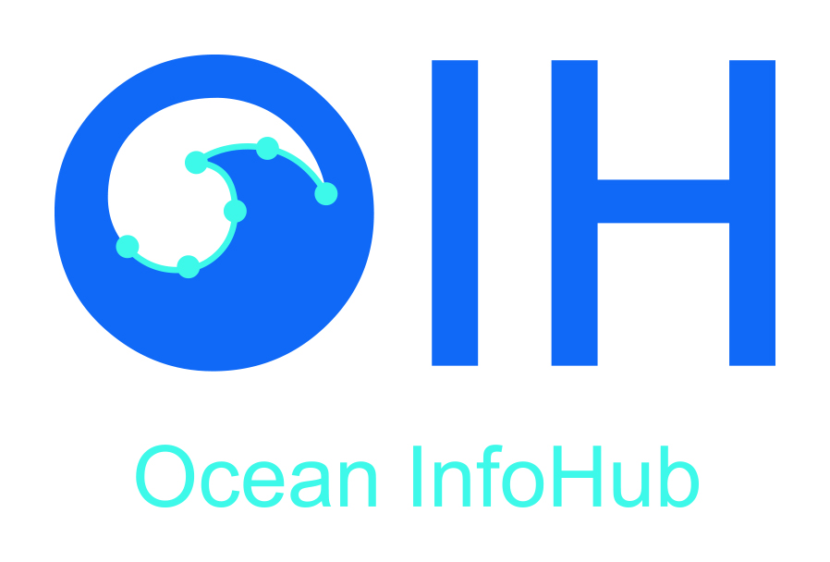

The Ocean Data and Information System (ODIS)
Creating an inclusive digital commons for ocean science & sustainable development
OIH/ODIS Webinar for the IOC | 2021-05-31
Pier Luigi Buttigieg (pier.buttigieg@awi.de)

Slide 2
Background in brief
Ocean data and other digital resources are dramatically increasing, both in their volume and variety
But local, national, and regional digital systems and infrastructures are still not interlinked in a sustainable manner
Currently, there is no “digital glue” to help ocean data stakeholders connect to each other and UN data systems
We urgently need to align and connect independent digital initiatives to form a diverse – but interoperating –
Ocean Data and Information System
No single digital solution can address all the ocean challenges we face
We must sustainably link existing and emerging systems together to coordinate action and capacity

Slide 3
The ODIS Mission
To build a sustainable, interoperable, and inclusive digital ecosystem for all ocean stakeholders
This will be accomplished by
providing robust, easily-implementable, and neutral IODE-moderated technologies and digital cultures to persistently interconnect stakeholders
co-creating the digital architecture (ODIS-Arch) to maximize diversity while protecting interoperability
providing diagnostics on the sustained interoperability and health of the ocean digital ecosystem

Slide 4
digital ecosystem
A digital ecosystem is a distributed, adaptive, open socio-technical system with properties of self-organisation, scalability and sustainability inspired from natural ecosystems.

Slide 5
The ODIS Concept
“The IOC Ocean Data and Information System (ODIS) will be an e-environment where users can discover and access data, information and associated products or services, provided by Member States, projects and other partners associated with IOC”.
Components in ODIS
  should be free to run internal operations independently
  can use ODIS-Arch to exchange information and increase interoperability and common awareness

Slide 6
Each custom exchange incurs more set-up and maintenance cost
Node
Node
Node
HUB
Single hub systems can be brittle, and very hard/slow to change and respond to new needs
Node
Node
Node

Slide 7


Node
The Web is our collective Hub
Each component/node is in charge of their own contribution
Linked Open Data and Semantic Web technologies will bridge nodes
A set of minimal interoperability and exchange standards will allow any node to continuously communicate to any other (ODIS-Arch)
Anyone can create solutions like portals & hub(lets) using the interoperability architecture → greater inclusivity
Node
Node
WWW
Node
Node
Node

Slide 8
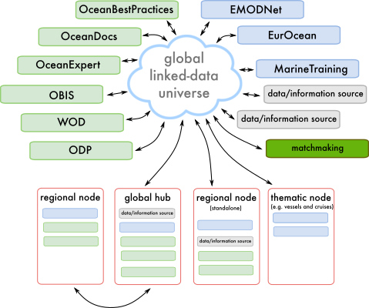

UN Systems
(some) partners

Slide 9
A living digital ecosystem
All stakeholders can have one or more “niches”, which can change over time
  Producers of digital products
  [1°, 2°, 3°, …] consumers of digital products
  Regulators of the ecosystem
  Recyclers and de/recomposers (no data should be wasted!)
1°
2°
3°
P
2°
4°
1°
2°
∞

Slide 10
From digital ecosystems to the digital biosphere
ODIS will be one of many digital ecosystems in the “digital biosphere”
needed to address the SDGs and their successors
Oceans (ODIS)
Resilient food
system
Atmosphere
Planetary
Access to
education
Mariculture
Ocean literacy
Cities
Terrestrial
Healthy oceans

