Slide 1





Fifth Pacific Islands Training Workshop on
Ocean Observations and Data Applications (PI-5)
27-28 May and 10-11 June 2021 (Fiji Time, UTC+12)
CMOC/China and its Data & Information Service
Dr. Yu Ting (Julia) and Wan Fangfang, NMDIS, MNR, China
julia_yu_nmdis@163.com

Slide 2



The Commission agreed that a limited number (less than ten) of WMO-IOC Centres for Marine Meteorological and Oceanographic Climate Data (CMOCs) covering specific JCOMM data domains, will form a key component of the Marine Climate Data System (MCDS), and will further facilitate interoperability with, and seek to internationally formalize the International Comprehensive Ocean-Atmosphere Data Set (ICOADS) and eventual similar existing domain-specific international archives, within the remit of JCOMM.
BACKGROUND
MCDS
CMOC a
CMOC b
CMOC …
CMOC c

Slide 3
DAC
Simplified MCDS Structure
GDAC
DAC
Three main components
Data Acquisition Center (DAC): first line data receiver – directly from measurement source
Global Data Assembly Center (GDAC): world-wide aggregation for specific observation system
Center for Marine Meteorology and Oceanographic Climate Data (CMOC): Aggregates all relevant data types for a specific set of environmental variables
DAC
GDAC
CMOC
Users
DAC
DAC
GDAC
DAC

Slide 4
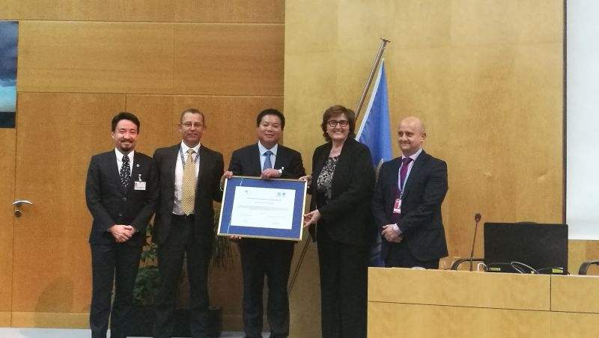
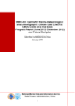


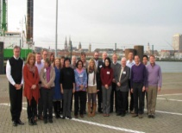

2013.03 IODE-22
submit progress
report
2013.06 submit feedback
on accreditation
criteria
2011.11 MCDS1
raise intention
2015.01 Complete
work plan for
2015-2016
2015.05 WMO cg-17 2015.06 IOC-XXVI
2017.10
JCOMM-5
awarded CMOC Certificate of Recognition to NMDIS
MCDS workshop
CMOC/China History
ETMC-4
2019.05 Participate in ETMC-7
2016.08
First CMOC/China Workshop
2014.01 DMCG-5
2014.02 Submit self-evaluation
2014.03 1st ODINWESTPAC planning
workshop
2014.06 JCOMM expert group visiting NMDIS
2012.02 Submit Statement
of Commitment
2012.05 JCOMM-4
operate on a trail
basis

Slide 5
7X24 operation website to provide free services to users (www.cmoc-china.cn), mirroring with other CMOCs when possible
Integrate marine-meteorological and oceanographic climate data, metadata, and actively conduct HLQC and produce specialized datasets of ECVs and EOVs
Tasks of
CMOC/China
Provide technical training, and carry out capacity building activities for countries in the region.
Actively participate in the research and development of oceanographic and marine-meteorological products, and their related services: climate statistical products and reanalysis products

Slide 6
Data and Metadata Collection
and Management
Data integration
CMOC/China focusing on the Asian Pacific Region
Data and Metadata—Collection, Management and Exchange
High level QC
Integrate global drifting buoy observations and metadata
Product R&D
Historical metadata and data rescue
Capacity Building
Improve existing metadata standards
Develop metadata schema for integrated and specialized datasets

Slide 7
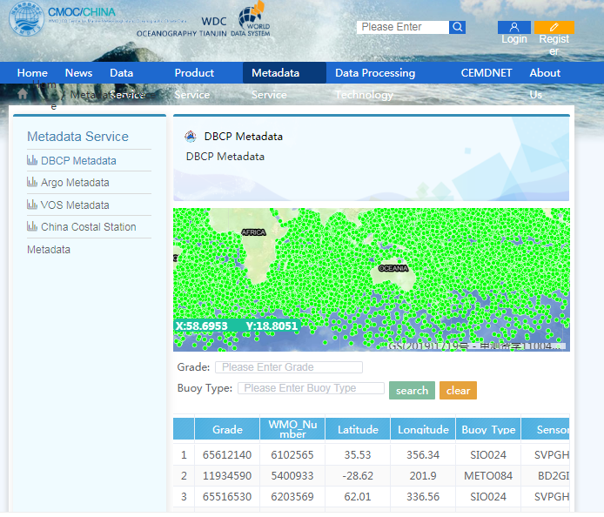
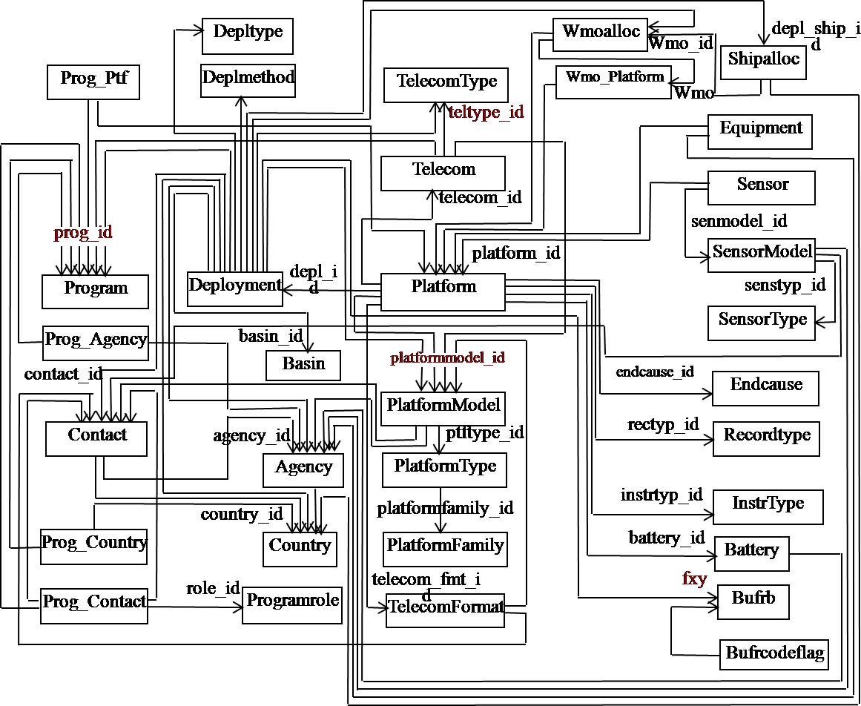
Drifter data integration study
Integrate the data of each drifter from deployment to end-of-operation with corresponding metadata.
To facilitate the
Further quality control of the observations
Tracing of a single drifter
Ocean current study
Preserve of buoy metadata
…
Up to November 2020, 4.6GB integration dataset which includes 25,036 drifters (from 1970 to 2020) was processed, among which 1006 were newly deployed in 2020.

Slide 8
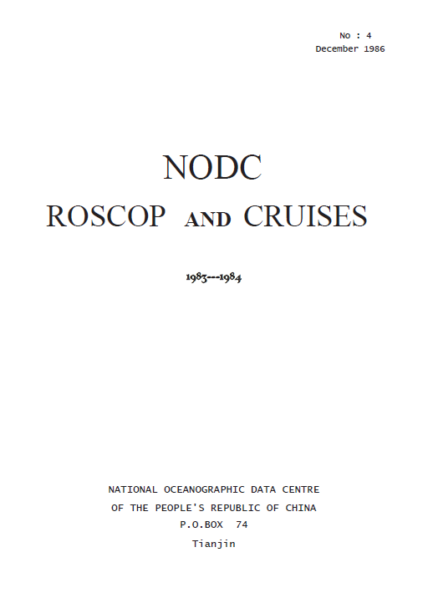
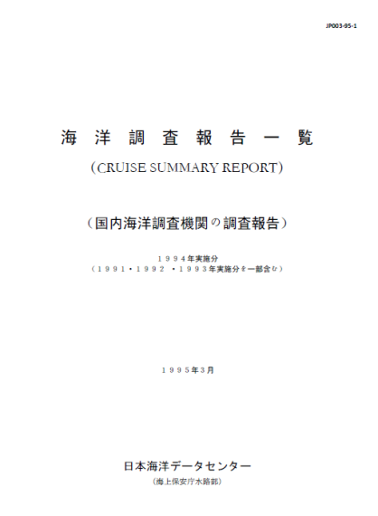
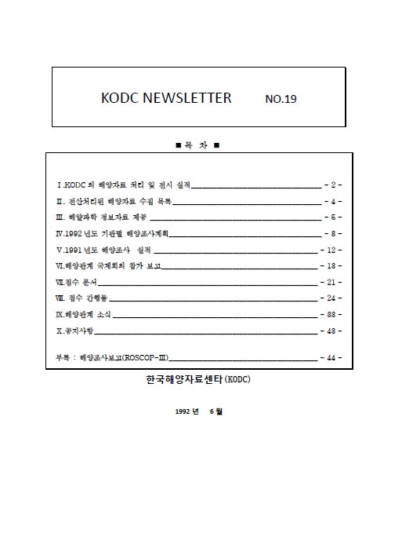
Data rescue
Three cruise summary reports have been digitized and made available online. The integration of rescued ROSCOP metadata with their corresponding observational data was initialized in earlier 2016.
(Japan) Cruise Summary Report JP003‐95‐1;
KODC Newsletter No.19;
(China) NODC ROSCOP and Cruises 1983‐1984.
Cooperation with Hong Kong Observatory on the historical meteorological data rescue initiated in 2016
  Ship observations in Director’s Report for 1892, 1894, 1895
  Observatory publication “Weather Observations From Ships (Appendix to Hong Kong Observations, 1931), by C.W. Jeffries, F.R.A.S., Director, 1932
  Ship observations listed in Daily Weather Charts

Slide 9
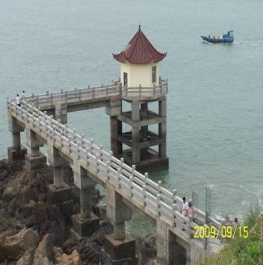
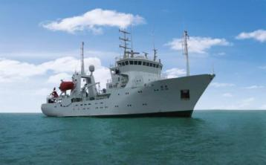
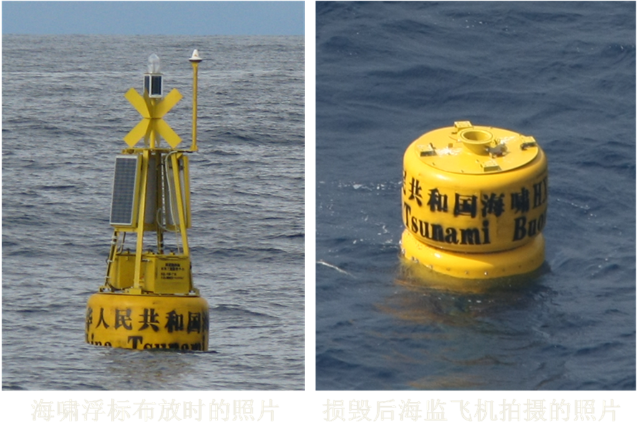
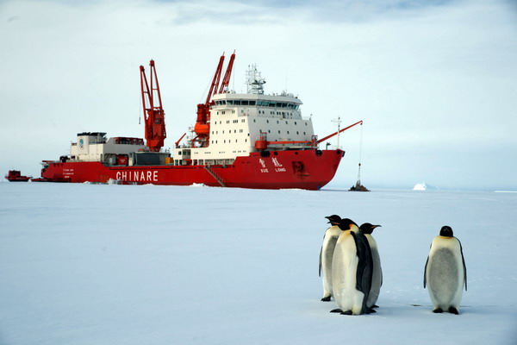
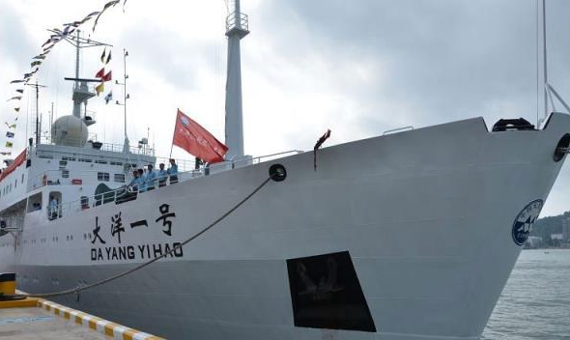
Progress towards making more marine meteorological (and oceanographic) data from China publicly available
Observations
Oceanographic station
VOS
Polar investigation
Tsunami buoy
China Ocean Survey

Slide 10
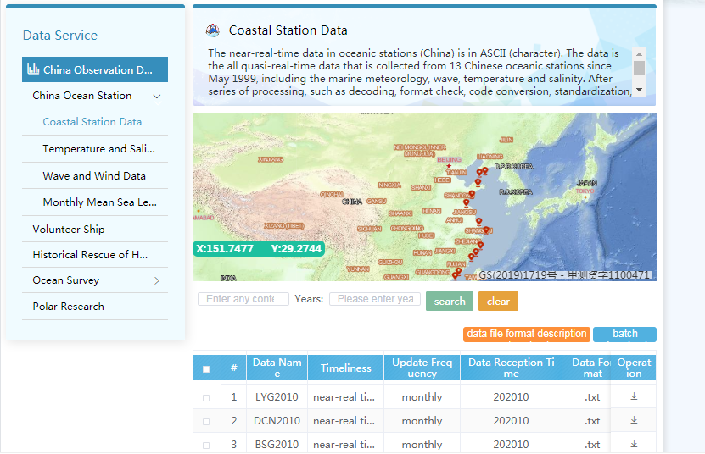
Observation Data of China
Observation data of the Chinese Oceanographic Stations
No. | Name of the dataset | Temporal coverage | Total amount of data |  | Data update in 2020
 |  |  | Data volume (MB) | Number of files | Data volume (MB) | Number of files
1 | Delayed mode surface temperature and salinity, wind-wave data from 3 COSs: Shidao, Xiaomaidao and Lianyungang | 1996.01- 2020.10 | 48.9 | 1921 | 3.18 | 72
2 | Monthly mean sea level data from 6 COSs: Dalian, Lvsi, Kanmen, Zhapo, Xisha and Nansha | 2011.04- 2020.10 | 24.2KB | 115 | 2.5KB | 12
3 | Marine meteorological, wave, sea surface temperature and salinity data from 13 COSs: Xiaochangshan, Dalian, Yantai, Xiaomaidao, Lianyungang, Lvsi, Shengshan, Zhelang, Zhenhai, Dachen, Nanji, Beishuang and Dongshan | 1999.05- 2020.10 | 108.0 | 2029 | 11.82 | 156
Total |  |  | 156.92 | 4065 | 15.00 | 240
In 2020, data, metadata and product published at CMOC/China were about 16.7GB..

Slide 11
Observation Data of China
China VOS Observation Data Sharing
Basic information of China ocean survey data
Ship Name | Call sign | Affiliation | Type of ship | Tonnage | Sailing route
He Chen | BKWD6 | Zhoushan Hefeng Shipping Co., LTD | Merchant ship | 4,422 | Southeast Asia
Xin Xiamen | BPBB | CHINA COSCO Shipping Group | Container Ship | 30,000 | China - Australia
XinYantian | BPBA | CHINA COSCO Shipping Group | Container Ship | 30,000 | Domestic routes
Xin Fuzhou | BPBE | CHINA COSCO Shipping Group | Container Ship | 30,000 | China - Europe
Xin Chiwan | BPBC | CHINA COSCO Shipping Group | Container Ship | 30,000 | China - North America
Xue Long | BNSK | State Oceanic Administration | Research vessel | 15,000 | North and South Pole
No. | Name | Voyage | Temporal coverage | Record
1 | Temperature and Salinity Data | 26 | 1992-2017 | 521
2 | Current Data | 14 | 2003-2017 | 281891
3 | Meteoroidal Data | 11 | 1995-2017 | 433786
Total |  | 51 | 1992-2017 | 716198
In 2020, China ocean survey data were released on CMOC/China website for the first time, including temperature and salinity data from 26 voyages, current data from 14 voyages, meteorological data from 11 voyages, time ranging from 1992 to 2017, totally 702,043 records.

Slide 12
Global Oceanographic and Marine Climate Data
-Conduct the quality control and duplicate elimination of observation data of GLOSS and COSs, and prepare and release the integrated global sea level dataset;
-Carry out the quality control and duplicate elimination of Argo and GTSPP data, and prepare and release the integrated global and regional T&S datasets;
-Conduct the duplicate elimination of sea surface meteorological data in ICOADS, VOS, DBCP and GTS datasets, and prepare and release the integrated global sea surface meteorological dataset and China VOS dataset.
-Carry out DBCP drifter data and metadata integration
No. | Name of the dataset | Temporal coverage | Data volume (GB) | Number of files
1 | Integrated global ocean current data | 1994-2020 | 0.93 | 146
2 | Integrated global temperature and salinity data | 1773-2020 | 73.7 | 37,795
3 | Integrated global meteorological data | 1662-2020 | 102 | 83,570
4 | Integrated global sea level data | 1984-2020 | 2.10 | 31,440
5 | Integrated global buoy data | 1979-2020 | 4.6 | 25,036
Total |  | 1662-2020 | 183.33 | 177,987

Slide 13
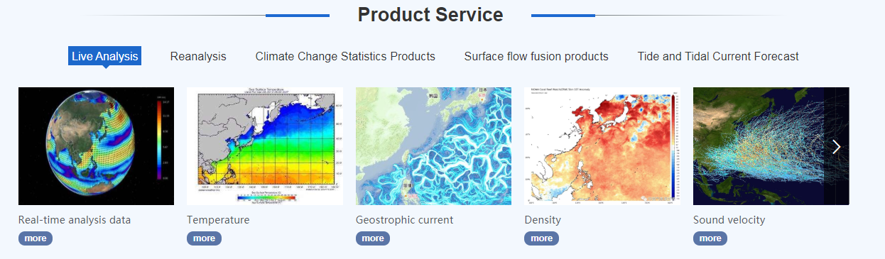
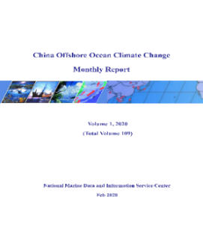
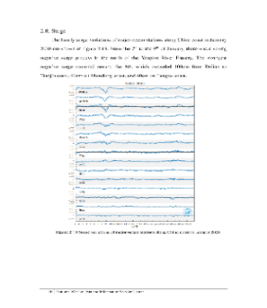
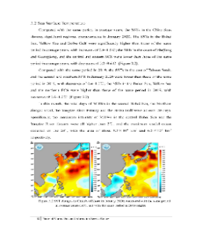
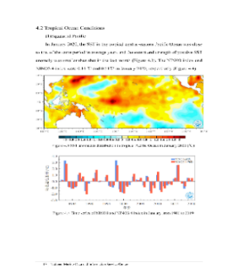
Climate Statistical Products
Climate Statistical Products
Monthly Report of Sea Level and Climate Change of China
Graphic products of temperature and salinity in Northwest Pacific

Slide 14
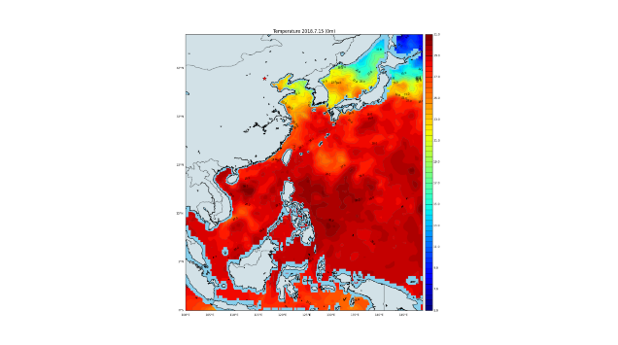
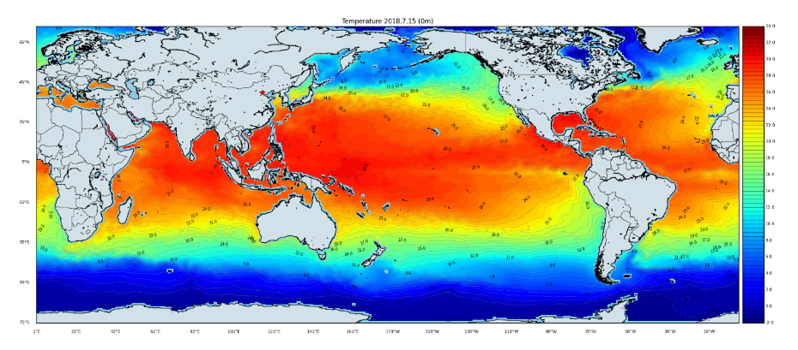
Improve the reanalysis ocean dynamic model
  turbulent mixing parameterization schemes
  turbulent flux parameterization schemes at the air-sea interface
Improve the ocean data assimilation algorithms
  T-S relationship,
  the water column adjustment algorithm
  a fully conserved minimal adjustment algorithm with (T, S) coherency for stabilization of thermohaline profiles
Regional and global ocean reanalysis datasets R&D
  Global ocean reanalysis datasets from 2008 to 2019
  Regional ocean reanalysis datasets from 1958 to 2019
Evaluation of the regional and global ocean reanalysis dataset
Regional reanalysis product
Ocean Reanalysis Products
Global reanalysis product

Slide 15
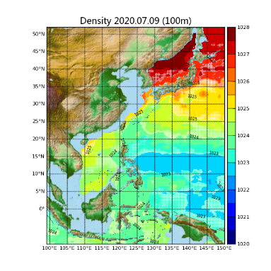
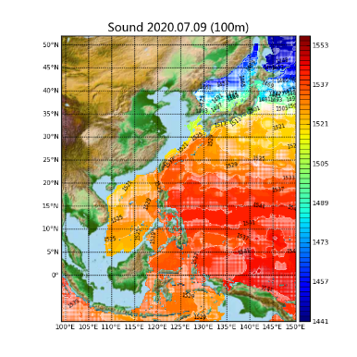
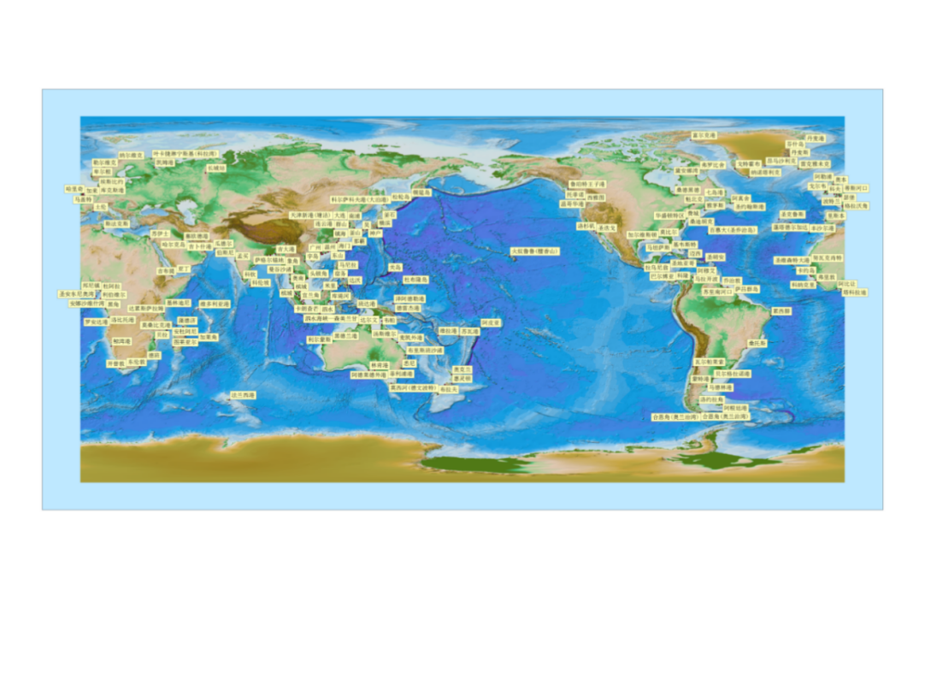
PRODUCTS
SERVICE
Real-time analysis on sound velocity at the depth of 100m
Real-time analysis on density
at the depth of 100m
Sea surface current fusion products in August 2018
Real-time analysis data
Argo trajectory inversion of global ocean surface current
Global tidal forecasting stations in 2020

Slide 16
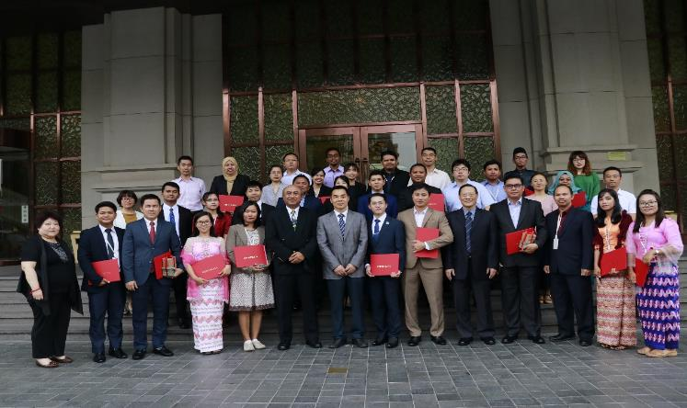
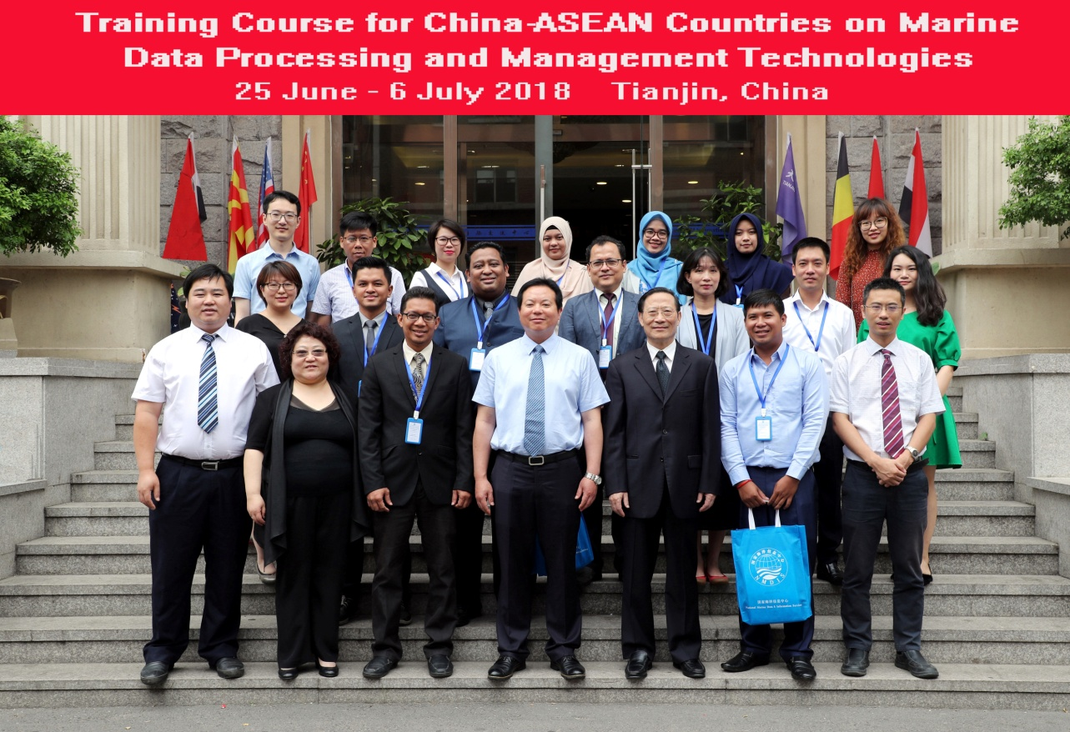
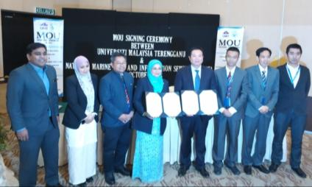
Training Course for China-ASEAN Countries on Marine information Technologies
Capacity
Building
Tianjin, China, May 27 – June 14, 2019
Training Course for China-ASEAN Countries on Marine Data Processing and Management Technologies
Tianjin, China, June 25 - July 6, 2018
Signing of MOU between NMDIS/China and UMT /Malaysia in October 2018

Slide 17
Fifth Pacific Islands Training Workshop on Ocean Observations and Data Applications (PI-5)
Thank you for your attention!

