Slide 1
The Ocean is the solution

Slide 2
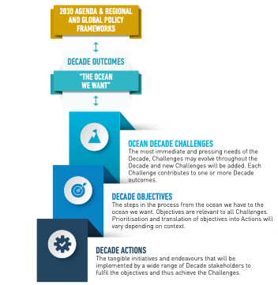
Decade Vision & Mission
Decade Action Framework
Vision
The science we need for the ocean we want
***
Mission
Transformative ocean science solutions for sustainable development, connecting people and our ocean.
Go to oceandecade.org
for the Implementation Plan

Slide 3
Where we are Where we would like to be
Science based on curiosity & competent for problem diagnostic
Science providing solutions and motivation for action
Observing system for climate and emerging data service
Application ready products and information system
Major knowledge gaps, weak ocean literacy
Ocean literate society and well-informed decisions
Funding base mostly in research mode
Demonstrated value chain, resources and commitment
Hugely uneven capacity, especially low in developing countries/SIDS
CD/ transfer of technology: no one is left behind

Slide 4
National Ocean Policies: timeline
2005
Pacific Islands Regional Ocean Policy PIROP
2010
Framework for a Pacific Oceanscape
FPO
1982
UNCLOS
2016
SDGs
Pathway to the ocean we want
2016 Cook Islands Marae Moana Policy
2016 Vanuatu’s National Ocean Policy
2018 Solomon Islands National Ocean Policy
2020 Samoa Ocean Strategy
2020 PNG National Ocean Policy
2020 Niue Moana Mahu regs.
(2021) Fiji’s National Ocean Policy
FPO, 2010:
little progress on ocean governance
no national ocean policies
no dedicated national institutions
Analysis of NOPs shows that all include the principles of, and aspire to the implementation of, Integrated Ocean Management

Slide 5
Pacific solutions to save our ocean
“we seek to save our Blue Pacific and provide solutions to our existential challenges
Focus:
Support the implementation of national ocean policies and a joined-up approach to Integrated Ocean Management (IOM) across the Pacific
Objective:
Harnessing science and knowledge (including Traditional Knowledge) for IOM
Outcomes:
Policy
Science
Culture
Robust legal instruments and policy frameworks
Officially Endorsed Action
Actions are inclusive of traditional knowledge
Improved decision support systems

Slide 6
We are all part of the solution
Get involved and join the oceandecade.org

Slide 7
Clean
Healthy and resilient
Productive
Predicted
Safe
Accessible
Inspiring and engaging

Slide 8
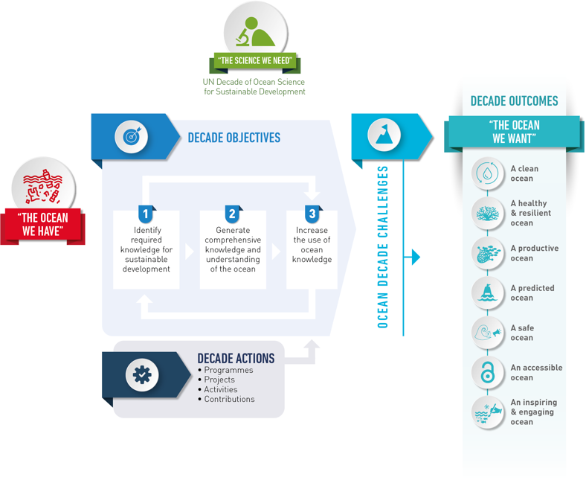
The Ocean Decade in a nutshell
Notes:
Objectives: identifying, generating and using knowledge

