Slide 1
establishing
real-time wave ocean monitoring system
Some lessons learned
Prepared by Herve Damlamian
herveda@spc.int
Notes:
Need logos

Slide 2
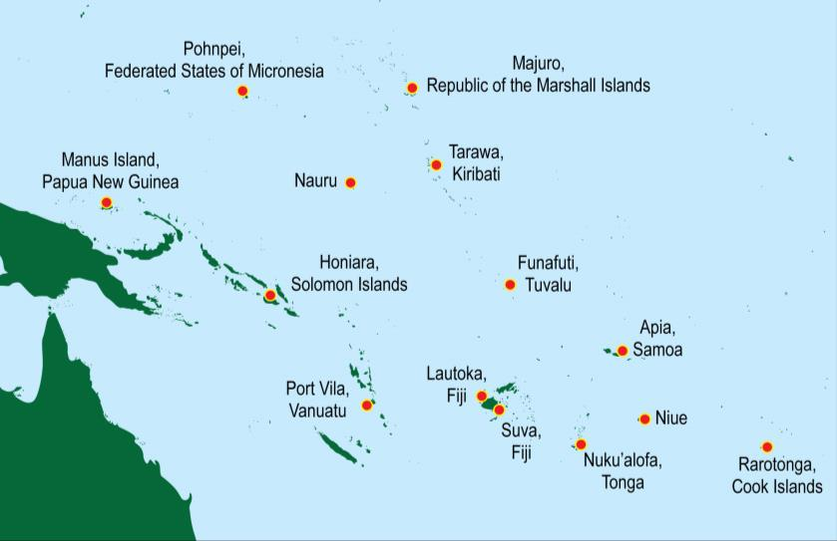
The COSPPAC Tide Gauge Network
A sustainable real-time ocean monitoring network
Since 1993

Slide 3
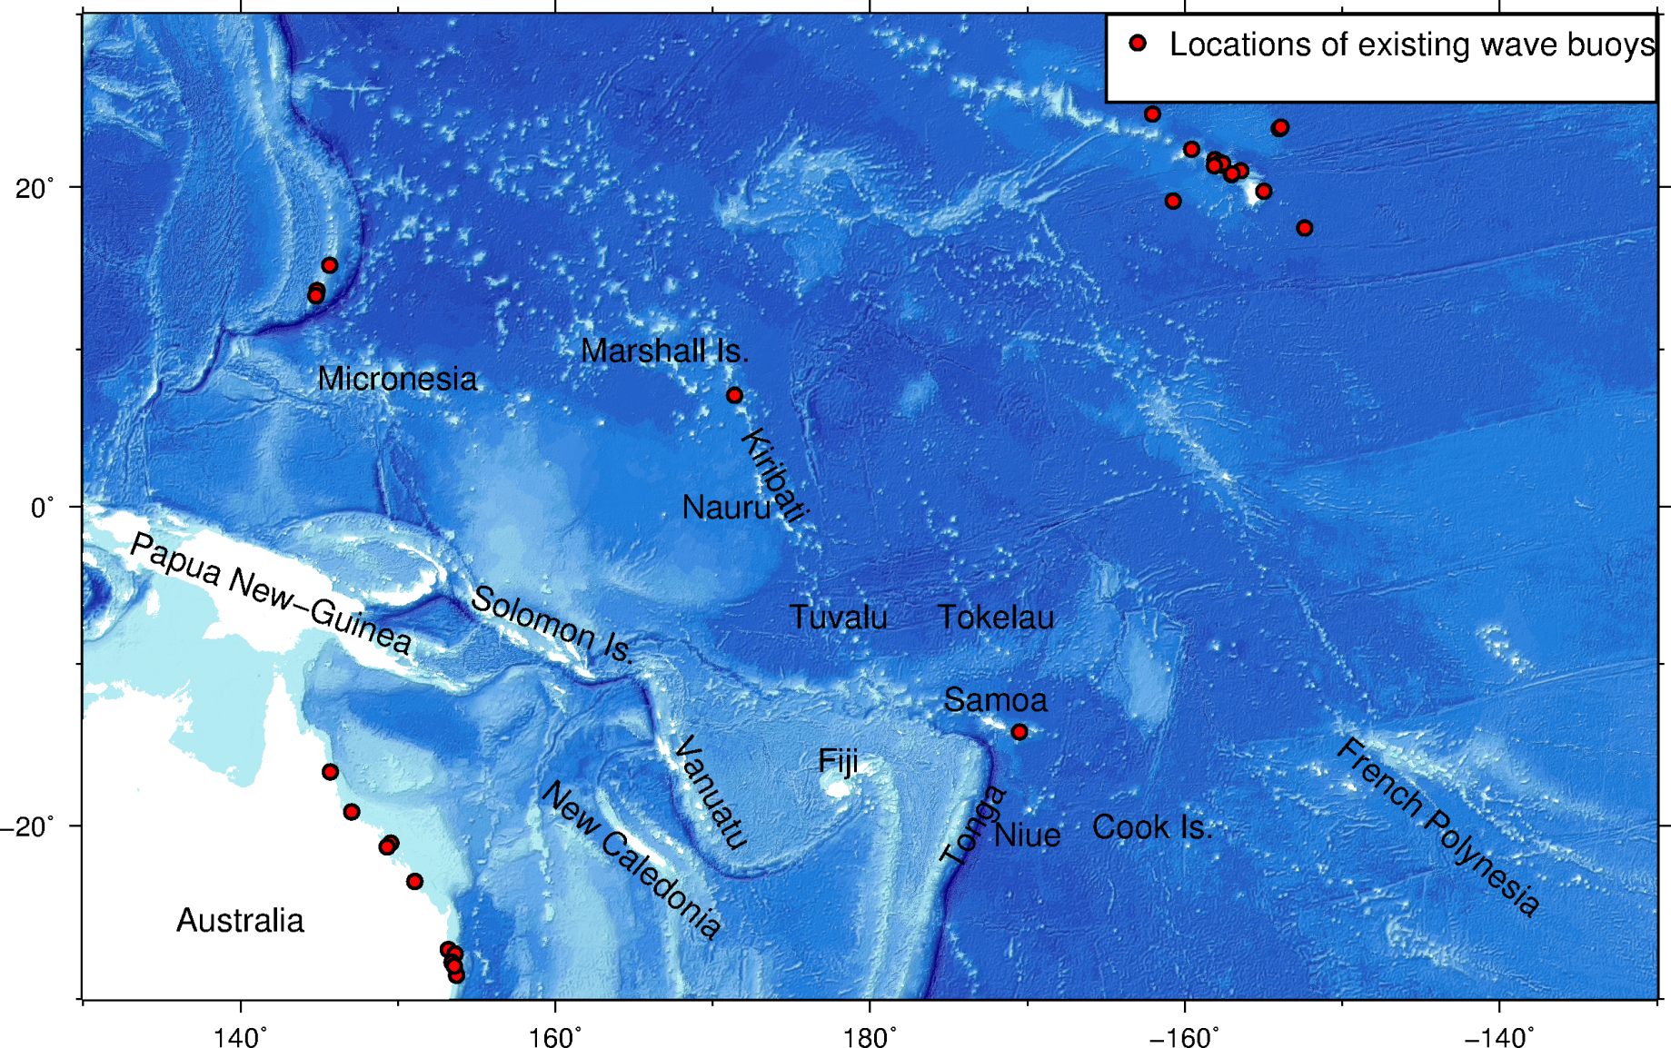
SPC’s current and upcoming wave buoy deployment
REGION: 20% of ocean EEZ and <1% of buoys
Existing wave buoy
Wave buoy deployed since 2019
Wave buoy to be deployed
CREWS
CIFDP
R2BAC
PREP
UNEP-GCF

Slide 4
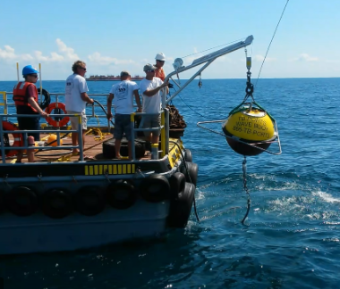
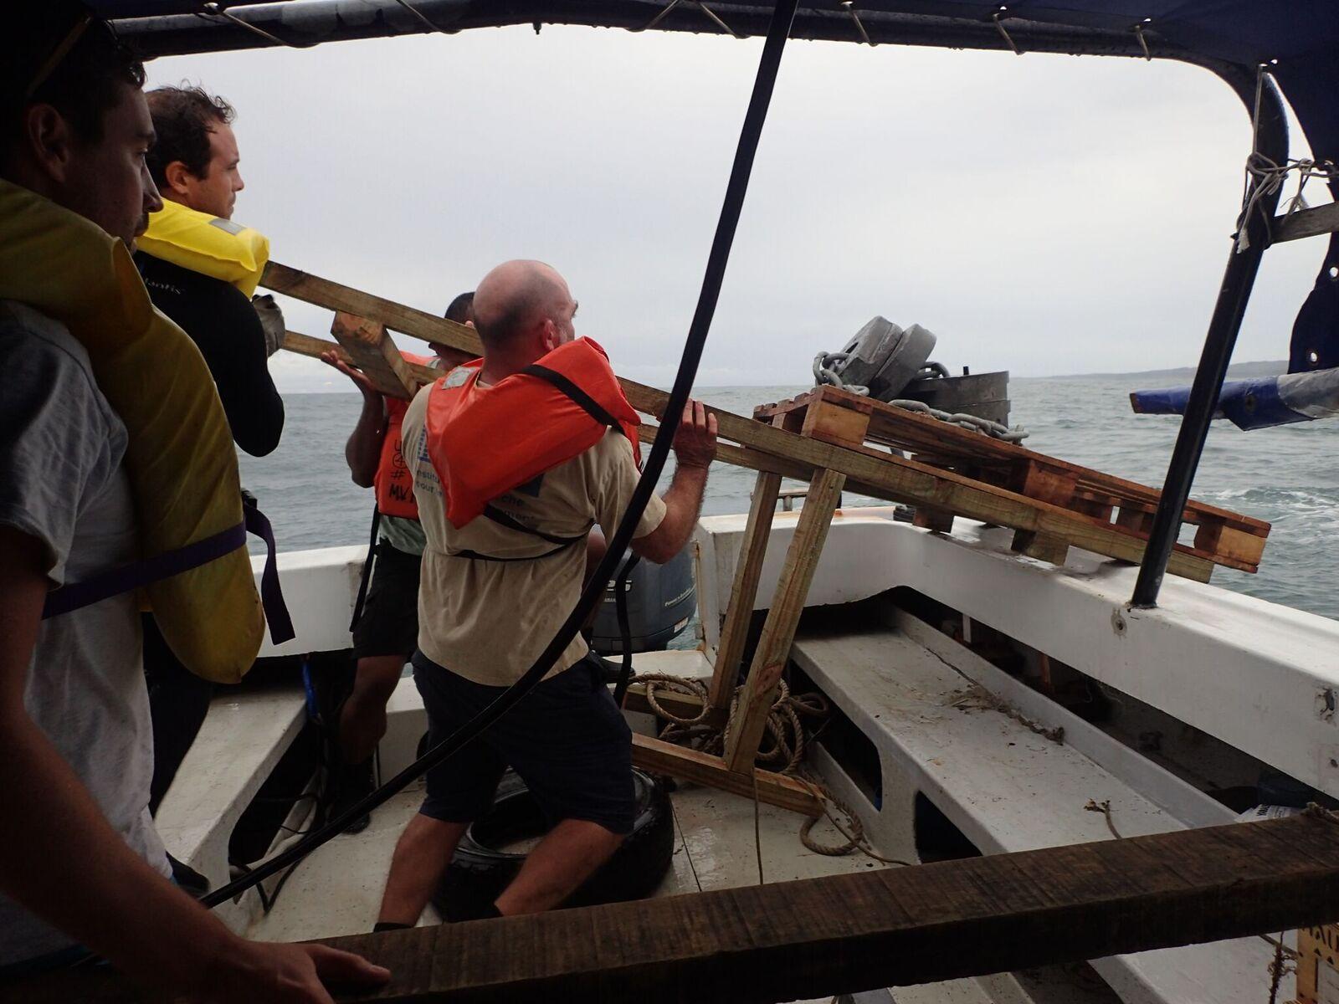
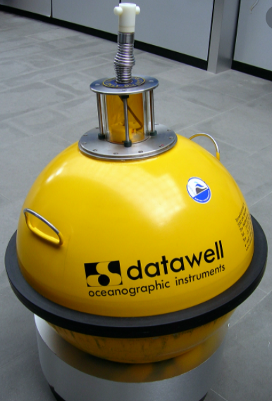
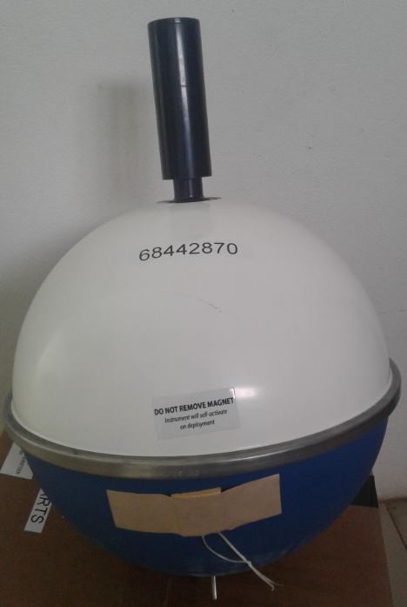
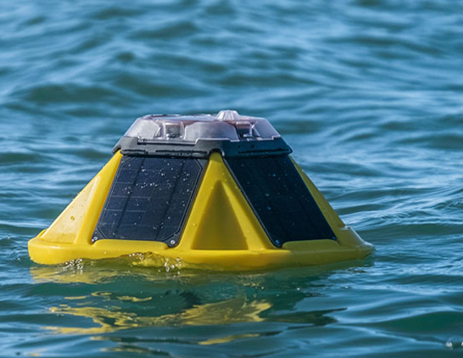
2 existing wave buoy systems in PICTS
Heavy Duty
Light Weight
Notes:
2 systems heavy duty versus light weight
- Datawell 100-250Kg versus 5Kg
50K versus 5-10k
Mobilisation and deployment : Crane
More robust though / high quality data / Widely used for decades
We also have a SCRIPPS buoy - (Luca) that we are deploying soon off Suva #excited

Slide 5
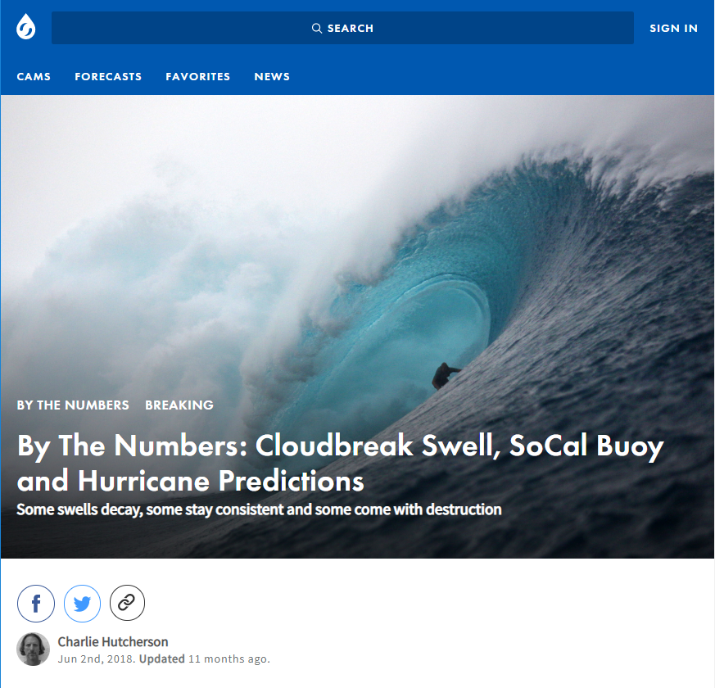
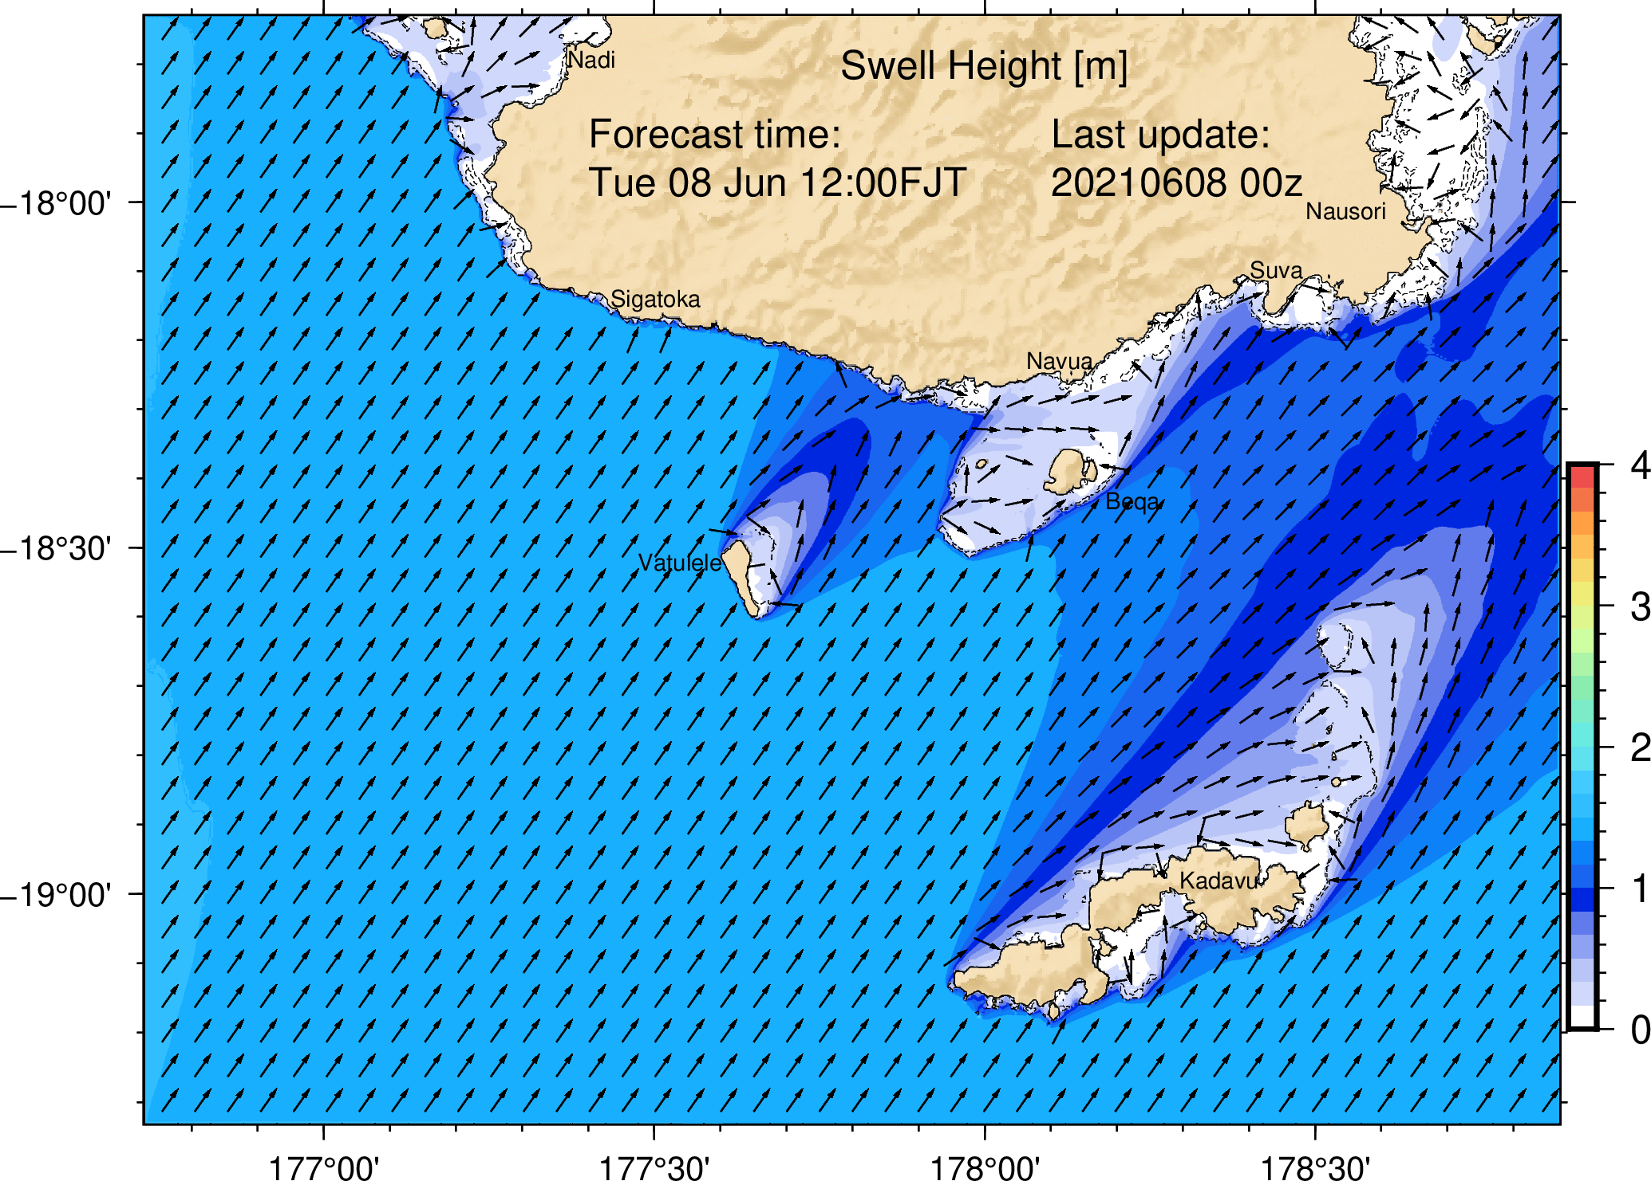
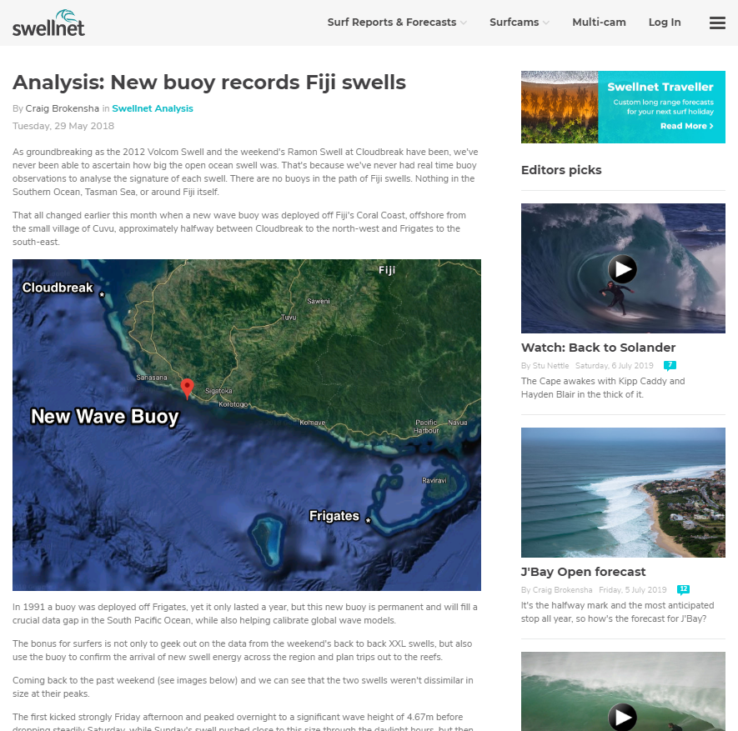
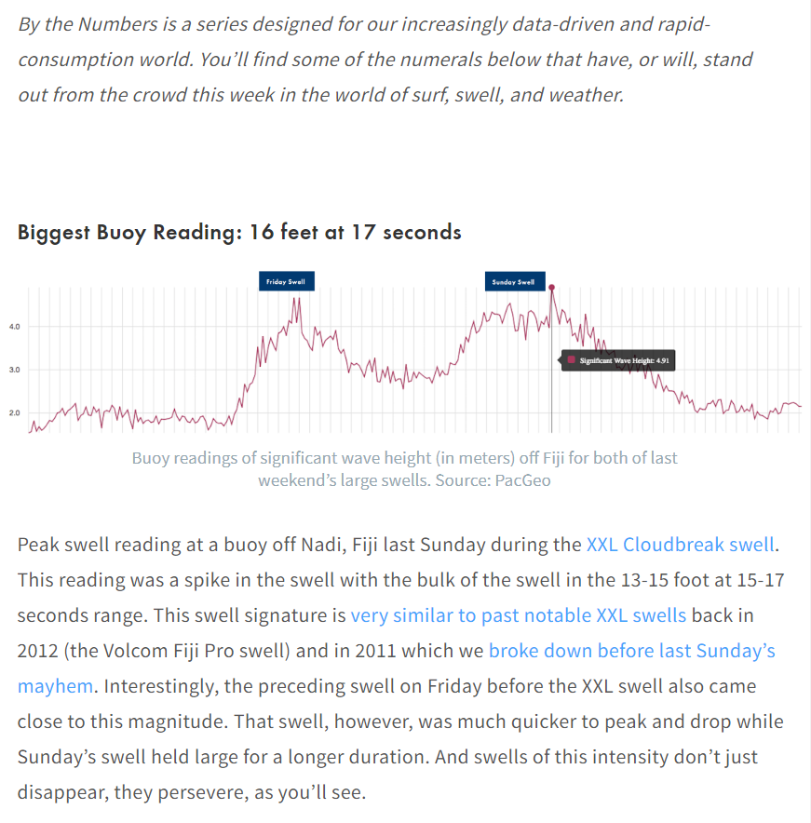
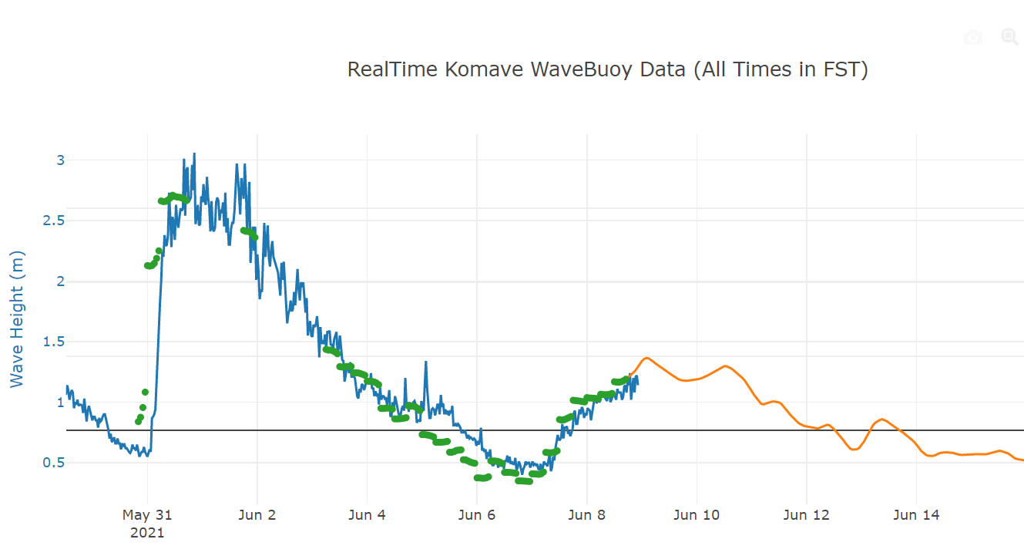
A Wide range of local benefit
Improved Ocean Service: real-time validation
Increased visibility
Real-time wave height buoy data
Past nowcasted wave height
Forecasted wave height
Notes:
But also:
- Post TC forecast analysis ( TC Harold, TC Yasa)
Navigational safety
Support planning for mariners, fishermen, etc…
For early warning (but will talk more about that in few slides

Slide 6
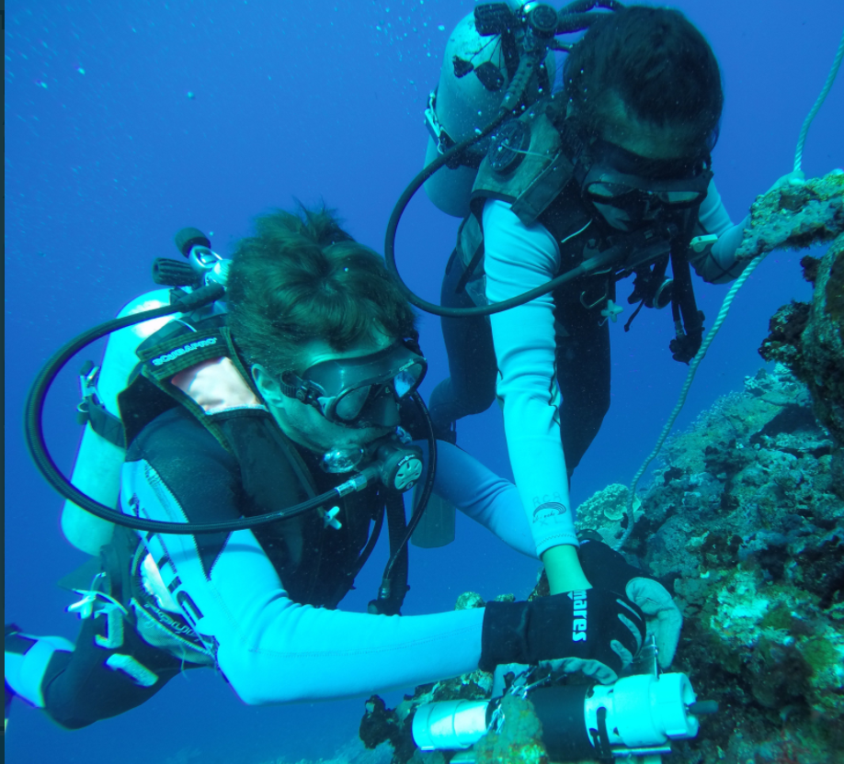
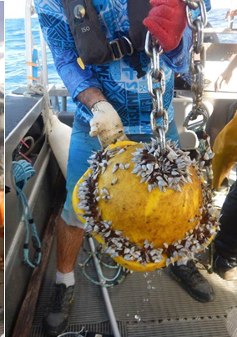
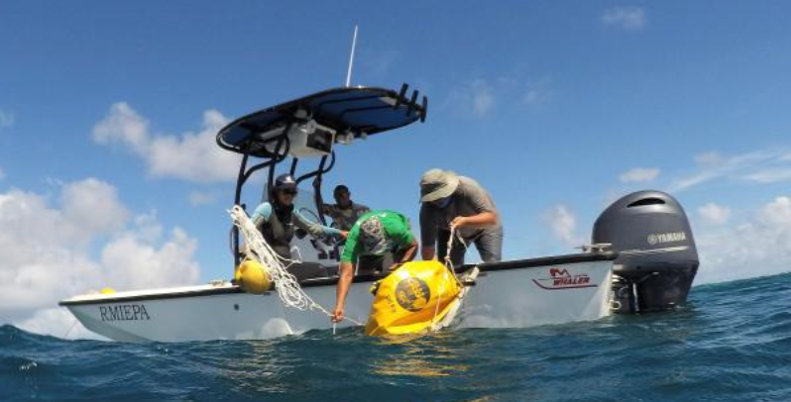
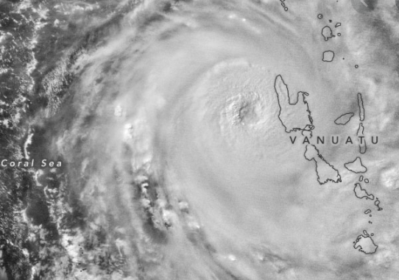
Challenges
Ocean Survey Capacity at NMHS
Operational Cost
3month after deployment, NC
Extreme Ocean Conditions
Human Interaction
vtwctr.org

Slide 7
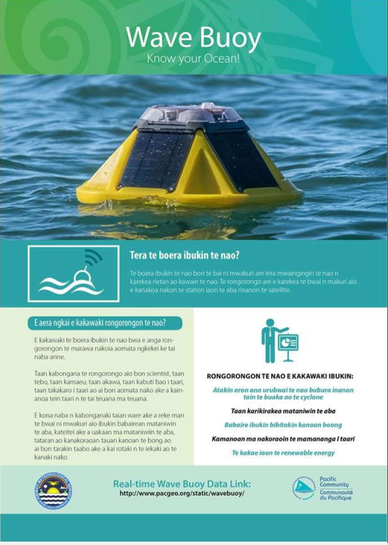
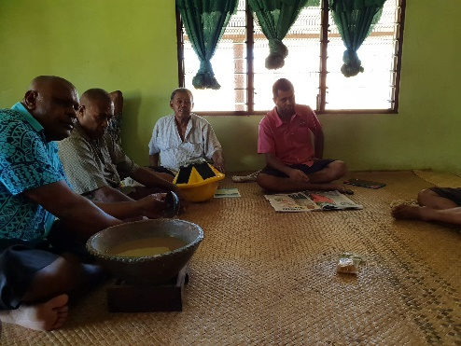
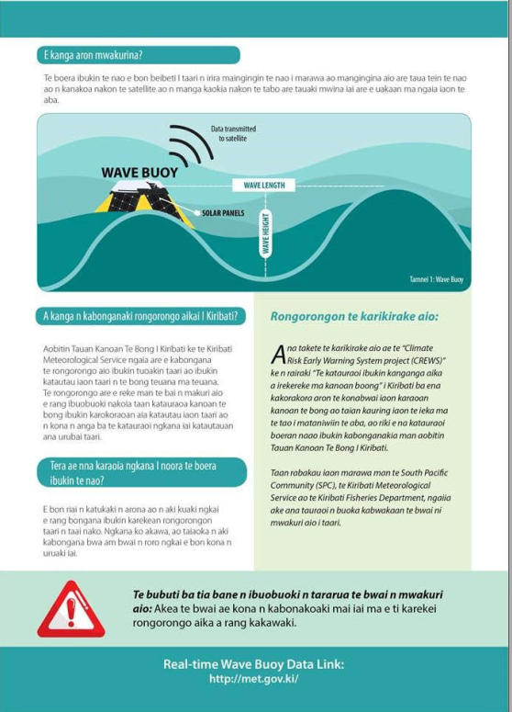
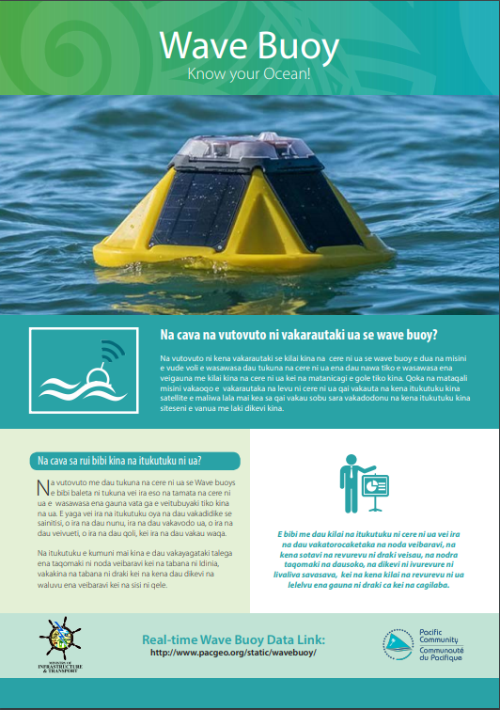
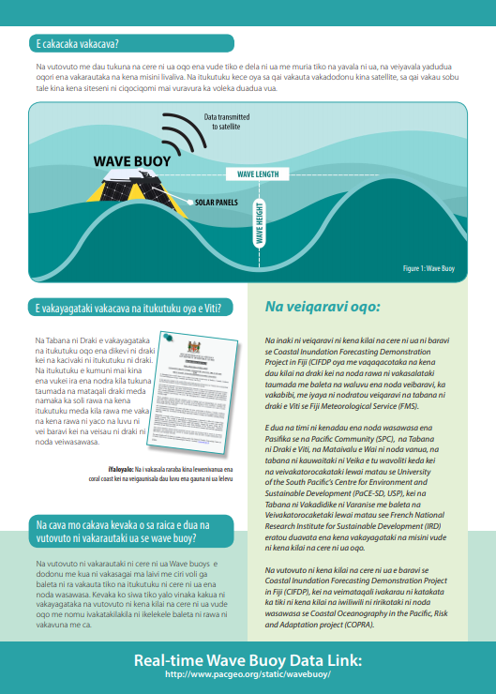
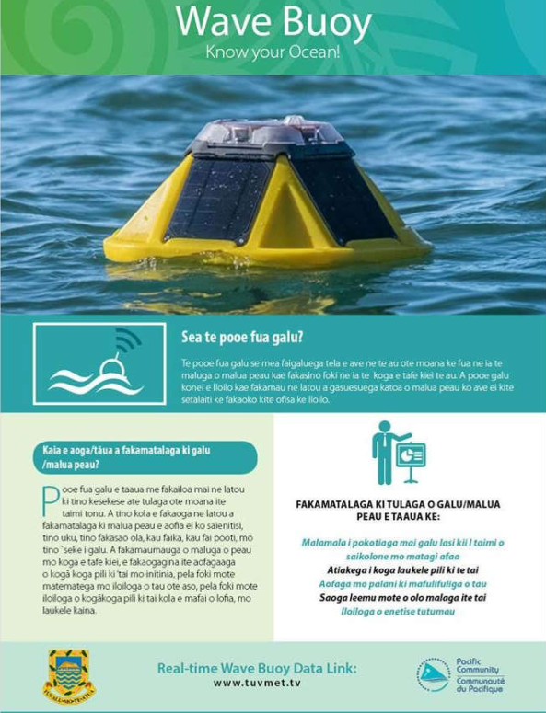
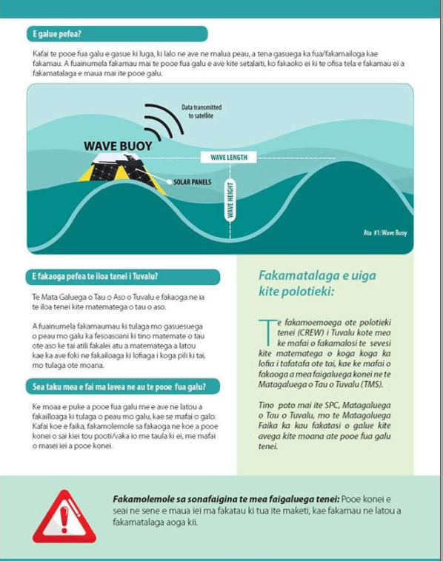
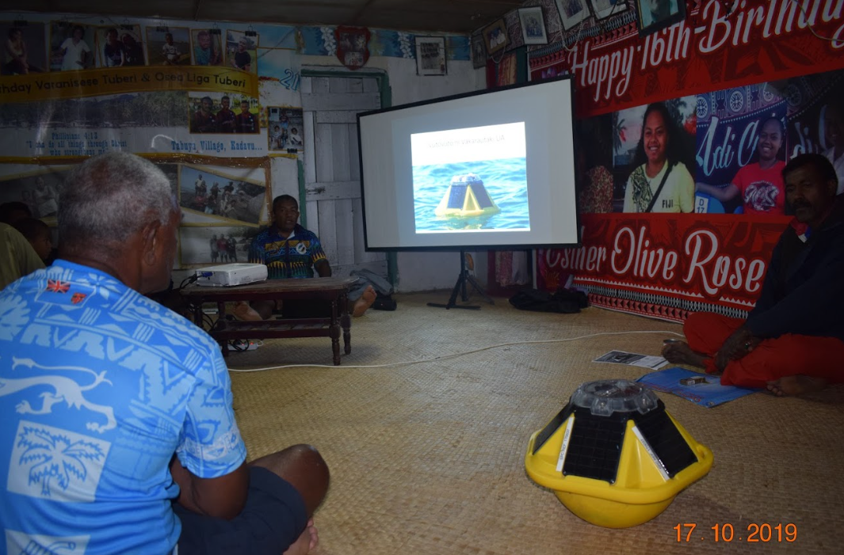
Partnership with communities
Notes:
Not to ask people not to interfere with the wave buoy but to create a meaniful partnership
- ownership of the equipment / tangible benefit
- Actors (could potentially do some maintenance / or provide feedbacks on inundation event during big wave)

Slide 8
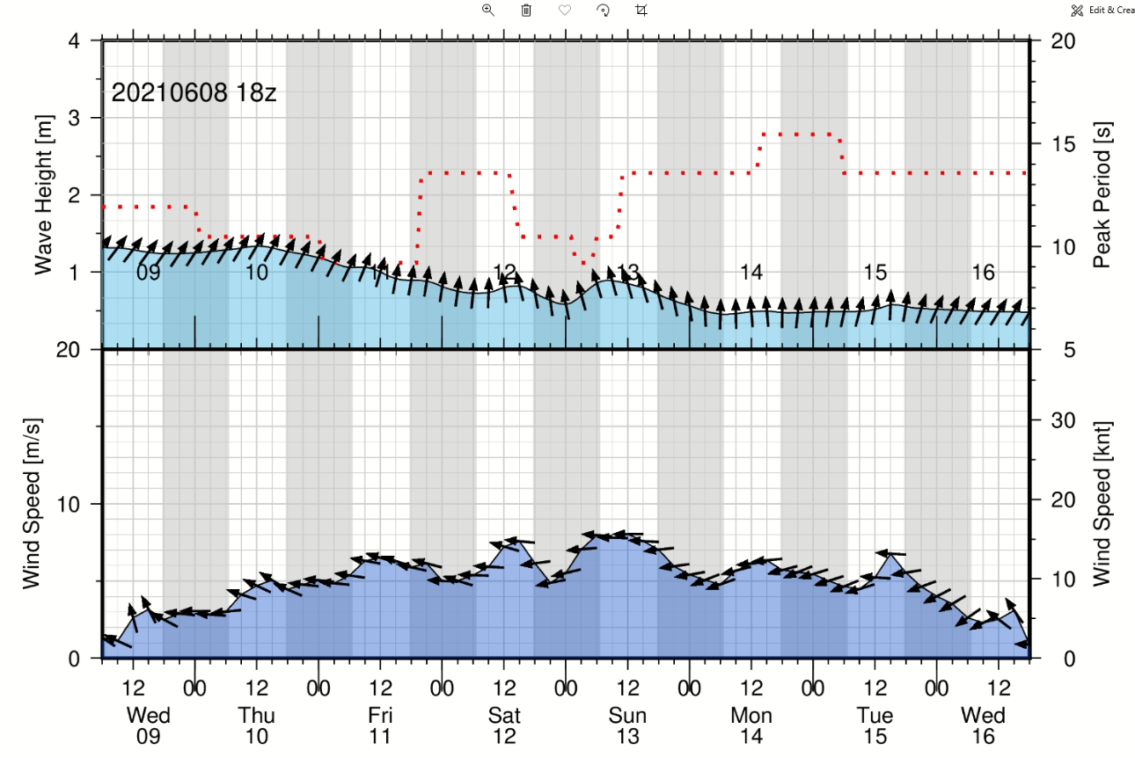
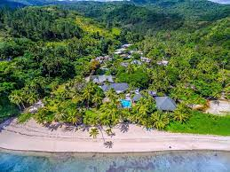
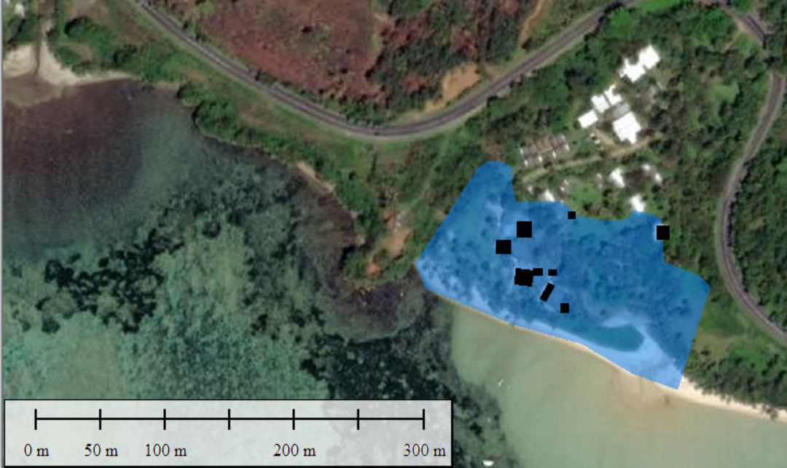
Public/private partnership
Tourism industry
Tailored products
Increased visibility
and popularity
Wave forecast
Wind forecast
Inundation forecast
Beachhouse, Coral Coast
Notes:
Tailored product: Increase customer feeling of safety / tailor to surfers
Visibility - naming?

Slide 9
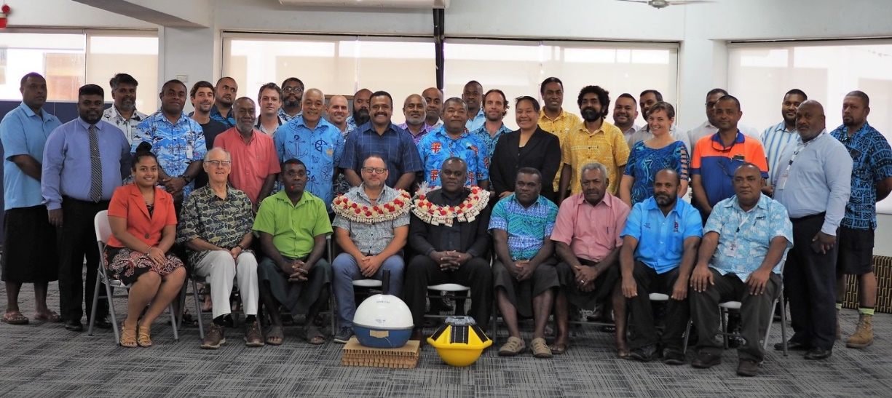
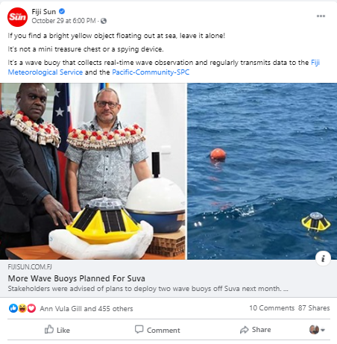
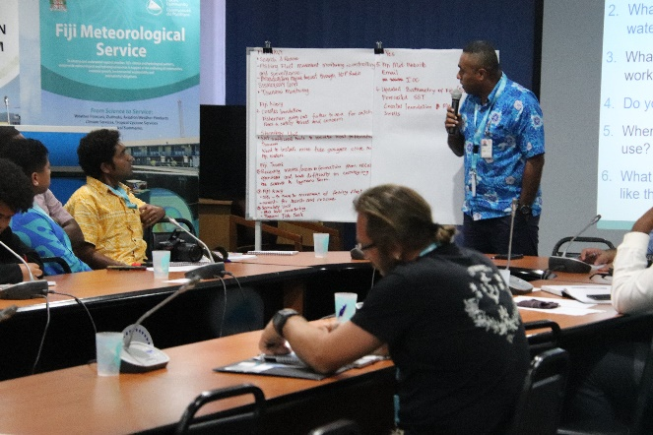
Partnership with Maritime sector
Suva Maritime Stakeholder Engagement
Site selection
Mooring design
Risk reduction strategy
SOP
Notes:
Maritime Authority, Port Authority, Navy, Surfer Association, Water Police, etc…

Slide 10
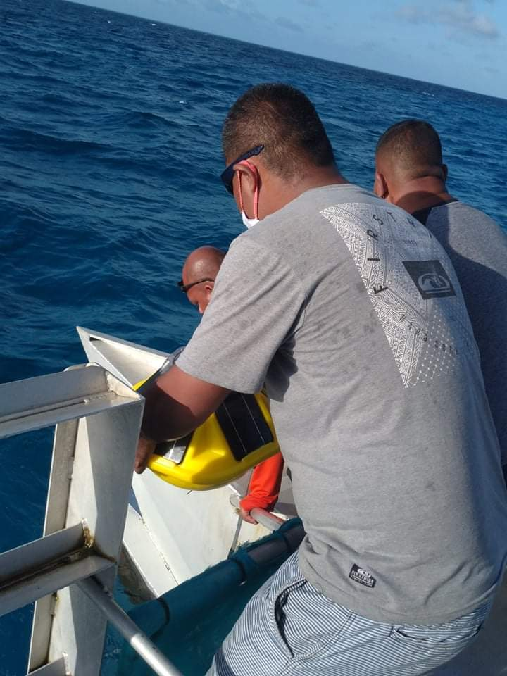
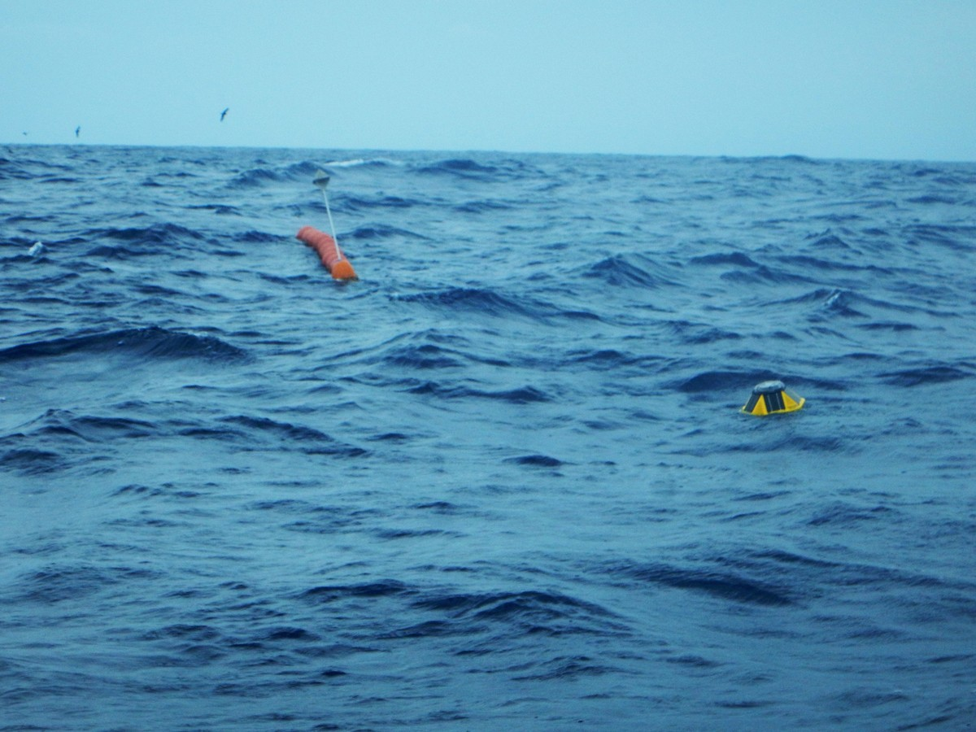
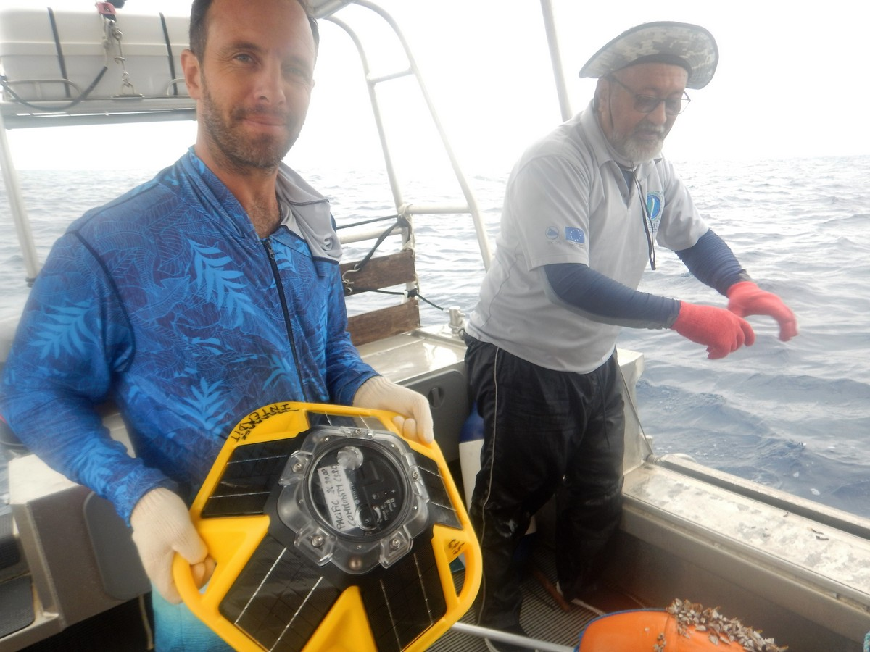
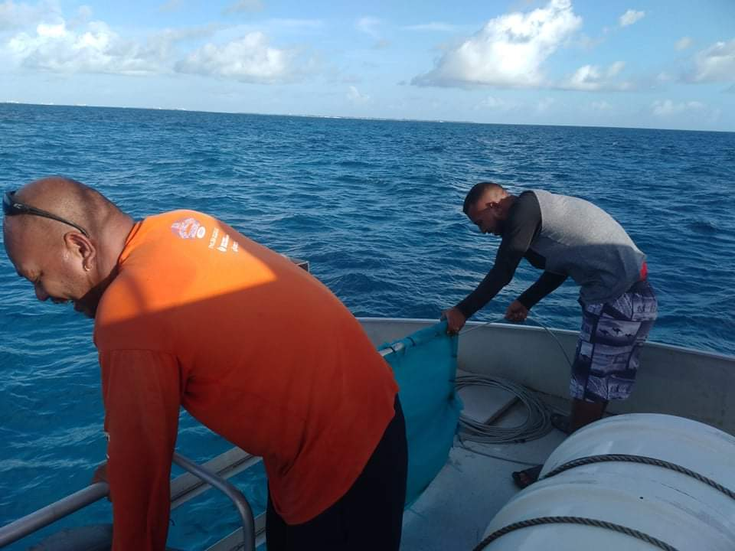
Partnership with FISHERIES sector
KMS partnership with Kiribati Fisheries
Exciting partnership prospect capitalising on FADs
REAL-TIME WAVE BUOY DATA DURING TC NIRAN, NC
Notes:
KMS led the development of a partnership with KI Fisheries
Captialising on their expertise and ressources (boat, etc…) to successfully deploy the wave buoy
Adrien led the development of a partnership with our FAME division in NC to investigate the possibility to capitlise on FAD infrastructure for wave buoy deployment.
Provide FAD with GPS tracker - receive an alert if FAD is drifting
Inform fisherman on actual wave/wind at the site / increased planning and safety
Remove logistical issue and cost of wave buoy deployment
Fisheries to support maintenance and rescue operation
Provide ideal platform for meaningful partnership
Survived Cyclone Nyran

Slide 11
Wave buoy network: Early detection Warning system

Slide 12
Conclusion
Ocean wave monitoring service is expected to be significantly strengthened over the coming years.
It is expected to play a major role in improving ocean prediction services (EWS, navigational safety etc..)
However there is a need to overcome the various challenges that would impede the sustainability of these systems.
It also offers an opportunity for NMHS to strengthen their partnerships with communities, maritime sector, fisheries and private sector (e.g. tourism).
If sustained, the wave buoys could also be used as a regional early detection warning system

