Slide 1



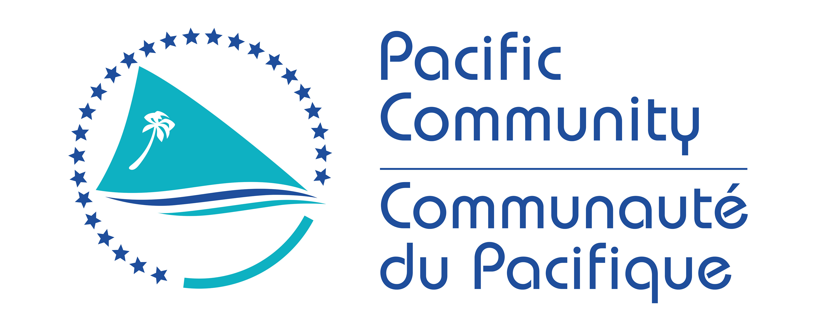

Fifth Pacific Islands Training Workshop on
Ocean Observations and Data Applications (PI-5)
27-28 May and 10-11 June 2021 (Fiji Time, UTC+12)
Seafloor measurements :
Examples from Reef TEMPS and SMART cables
Presented by: Jérome Aucan, SPC/PCCOS
Email:jeromea@spc.int

Slide 2
Seafloor measurements :
-Mounted on the seafloor (from reef-flat to abyssal plains)
-Autonomous or wired.
-Multiple variables measured (Most common are temperature and pressure)
Benefits : | Drawbacks
-High resilience in exposed area. -Multiple parameters possible. -High frequency data possible. -Relative cost. -Relative ease of deployment. -Relative protection against vandalism. | -Not real-time (unless cabled to shore) -Scuba operations can be required.

Slide 3
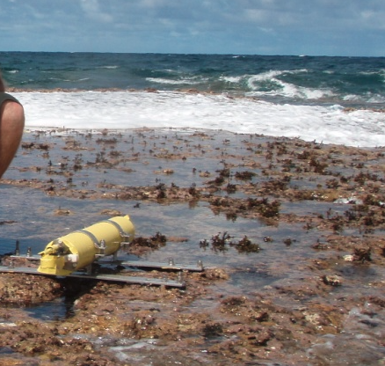
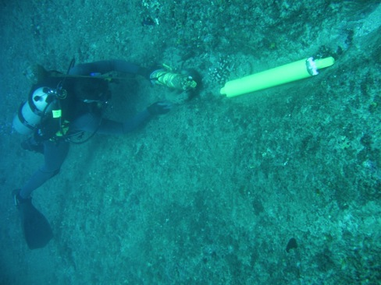
Low tide deployment in the inter-tidal area
Scuba deployment in the surf zone area

Slide 4
-Pressure :
Able to measure both swell and wind waves, infragravity waves, tsunamis and tides…
In exposed areas (compared to tide gauges), in the surf (compared to wave buoys). In many case, the only way to capture these processes.
-Temperature : more relevant than SST. More continuous than ship based. In area where moored buoys would not survive.

Slide 5
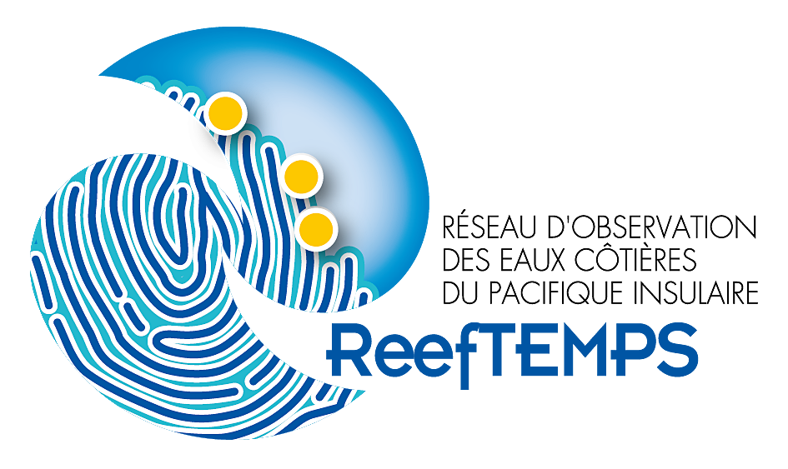
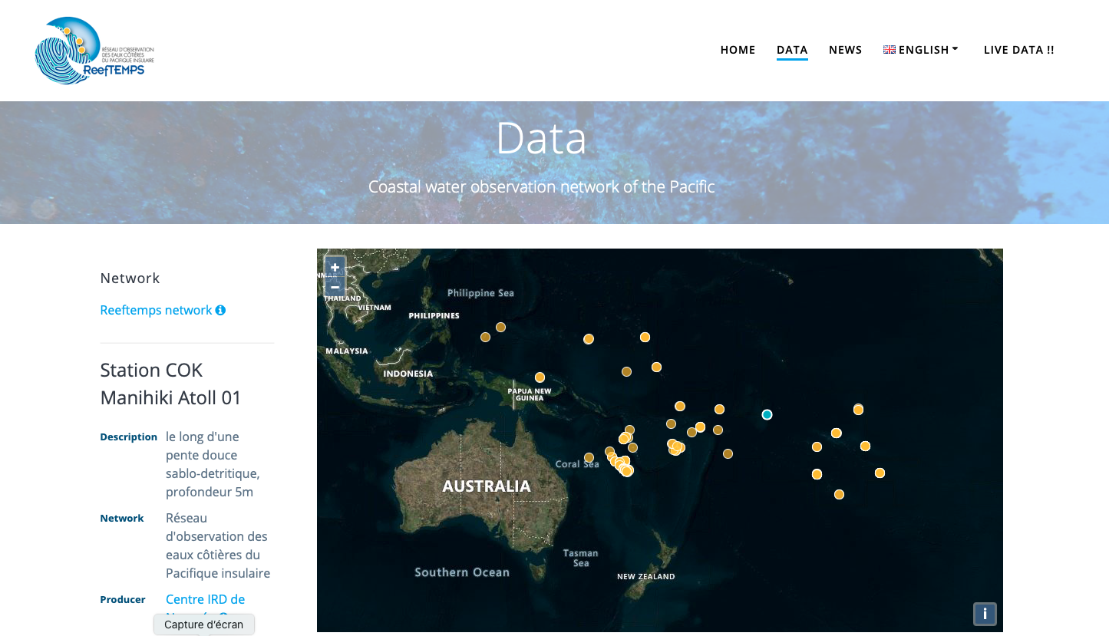
http://reeftemps.science
-FAIR data principles
-Oceansites Netcdf convention.
-OGC SOS (Sensor Observation Service) Standard.
-Inclusion into OIH in discussion.

Slide 6
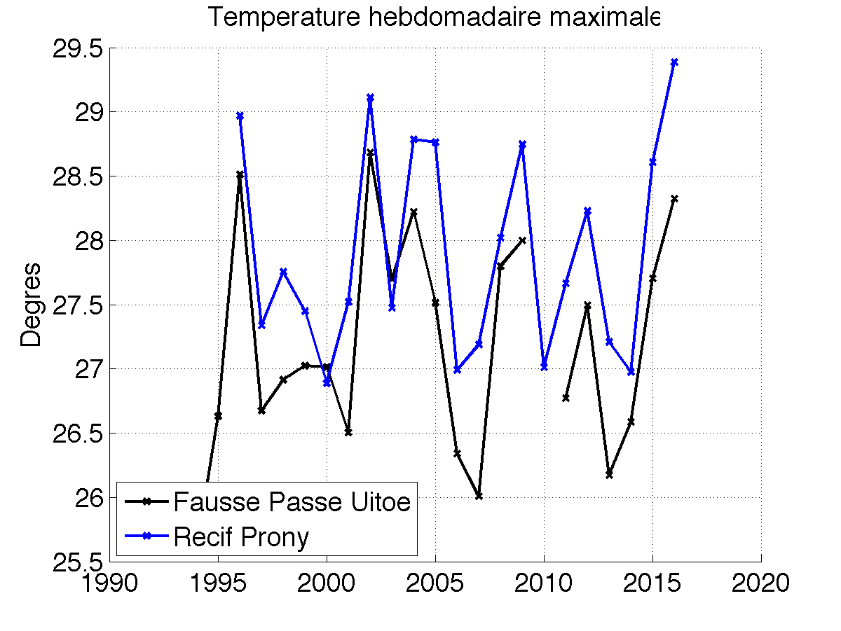
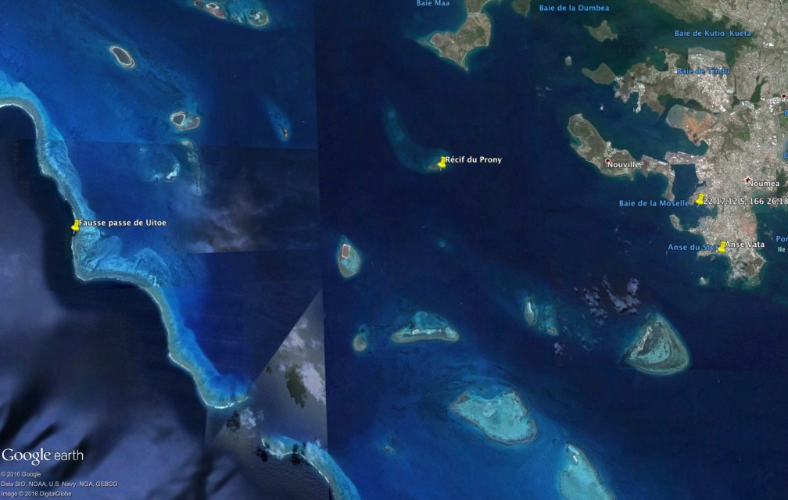
No bleaching
bleaching
La Nina
El Nino
Bleaching observed in New Caledonia

Slide 7
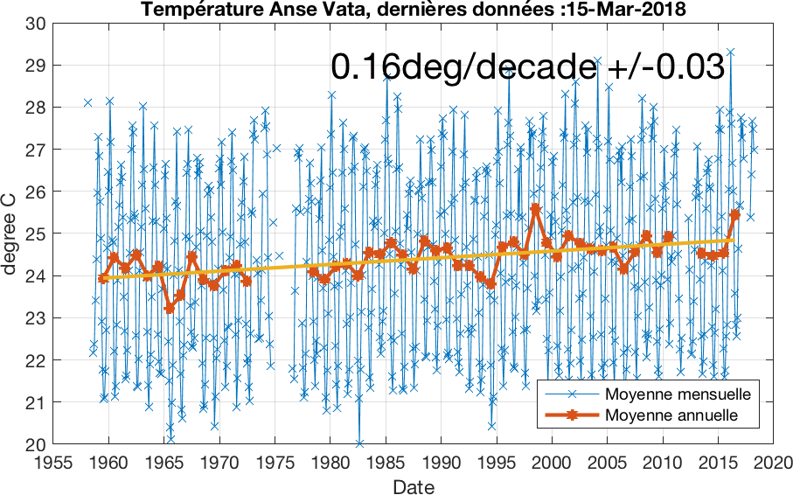

Slide 8
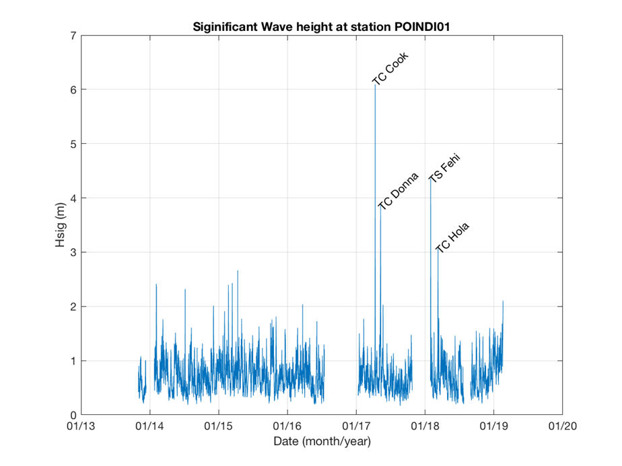

Slide 9
Recall First DBCP PI workshop in Palau in May 2015 :
A plan for multihazard coastal vulnerability monitoring system for the Pacific Islands.
Requirements for observations are :
-Tide gauges
-Wave buoy
-Seafloor pressure sensors

Slide 10
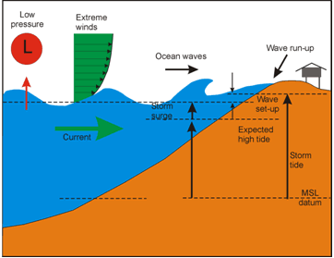
Measured by the wave buoy
Measured by the pressure sensor
Measured by the tide gauge

Slide 11
Basic idea :
Telecom + Science
Cable repeaters host sensors
Potential: 20,000 repeaters, typical separation of 50-200km.
Initial sensors : Pressure, temperature and acceleration.

Slide 12
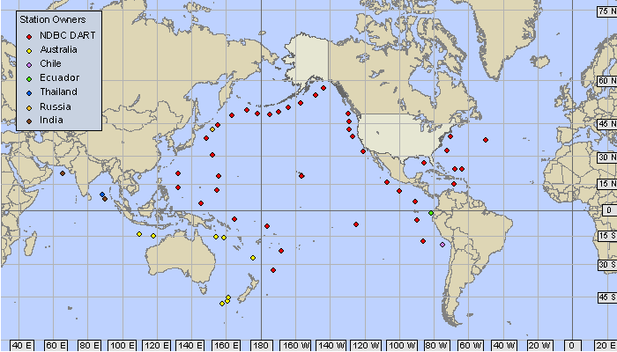
Improvement of tsunami warning and detection systems.
Lack of Observations
High currents
Lack of Observations
High threat
Expensive O&M and
High Vandalism

Slide 13

SMART Cables Facilitation by ITU-WMO-UNESCO/IOC
Joint Task Force (JTF)
JTF, 120 Members from 80 organizations, and 3 UN sponsoring agencies
Helping raise awareness and advocate for the SMART subsea cable systems.
Linking key stakeholders: ocean observing community, disaster management organisations, cable owners, operators and suppliers…
Working with scientific observatories, industry, countries and sponsors to deploy a SMART Cable Wet Demonstrator.

Slide 14
Thank you

Slide 15
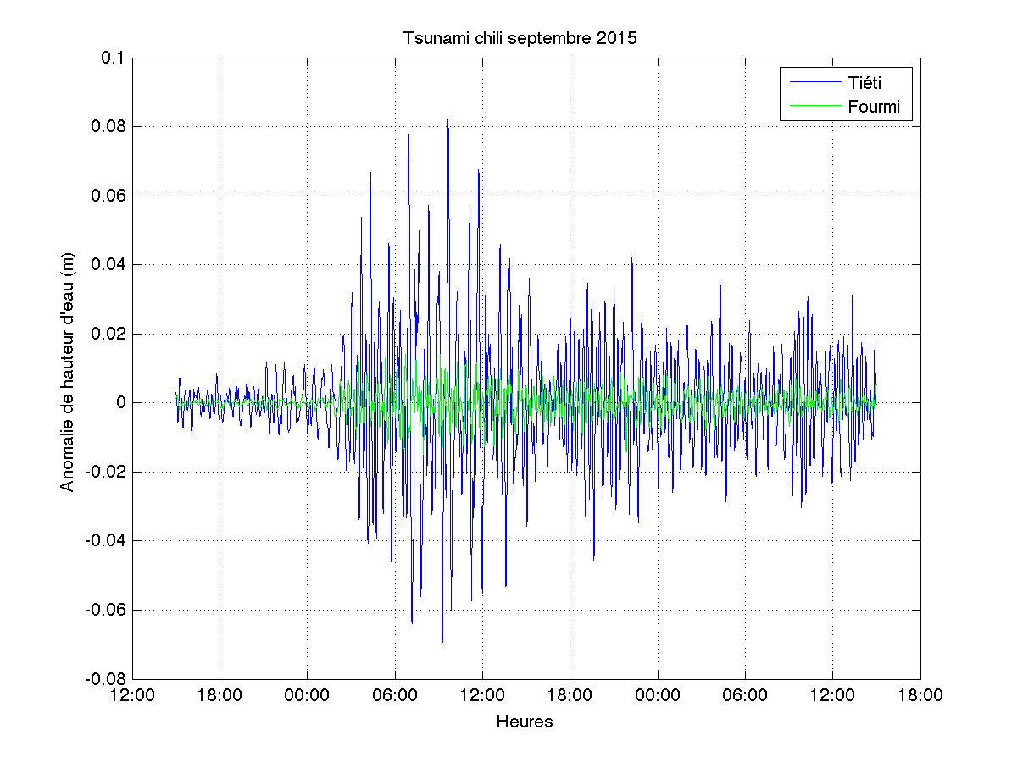

Slide 18
Notes:
When it comes to tsunami detection in the open ocean, we rely today on costly seafloor system, that transmit acoustically to a nearby buoy that can then relay the data to shore via a satelite.
These systems are very expensive to maintain in remote areas of the ocean, and are also very prone to vandalism.
This maps show all the stations that exist today, as little diamonds where the color

