Slide 1
Tide Gauges and GNSS Observations within Climate and Oceans Support Program in the Pacific (COSPPac)
Jeff Aquilina
jeff.aquilina@bom.gov.au

Slide 2
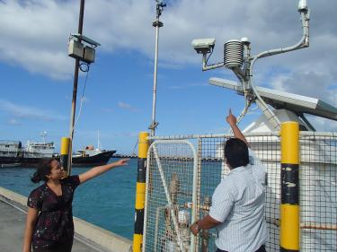
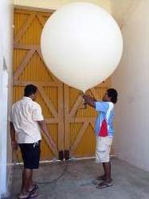
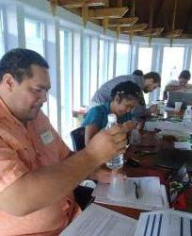
COSPPac overview
Continuation of DFAT funded Pacific Islands Climate Prediction Project from 2004 and South Pacific Sea Level and Climate Monitoring Project since the early 1990s
COSPPac 4-year program (July 2012 – June 2016), 2-year extension to June 2018
$39.3M over 6 years
COSPPac Phase II July 2018 to June 2022
$22.6 M over 4 years
Current Delivery partners:
Bureau of Meteorology (BoM), Aust
Geosciences Australia (GA), Aust
Pacific Community (SPC), Suva, Fiji
Secretariat of the Pacific Environmental Programme, (SPREP) Apia, Samoa
Notes:
Australia funds a range of climate related programs through the Department of Foreign Affairs and Trade's (DFAT), bilateral and regional programs and through other agencies including the Department of Industry, Innovation and Science, The Bureau of Meteorology (BoM) and Geoscience Australia (GA).
COSPPac is a major component of Australia's contribution to minimising the impacts of climate variability and change in the Pacific and to meeting the Australian Government's climate change aid objectives.
Program budget: AU$39.3 Million over 6 years: June 2012- June 2018
The priority leading to the close of the Program is the transition of COSPPac’s products and services to the Pacific regional partners where appropriate.
Current DELIVERY PARTNERS ARE:
Bureau of Meteorology (BoM) Aust
Geoscience Australia (GA)
Pacific Community (SPC)
Secretariat of the Pacific Regional Environment Programme (SPREP)

Slide 3
PSLGM overview
South Pacific Sea Level and Climate Monitoring Project (SPSLCMP) started in the early 1990's in response to concerns of global warning on climate and sea levels in the Pacfic.
In 2012, The Pacific Sea Level and Geodetic Monitoring (PSLGM) continued under the wider Climate and Oceans Support Program in the Pacific (COSPPac).
There are 14 sea level monitoring stations, which are datum controlled to a dedicated GNSS station.
Notes:
The Pacific Sea Level Monitoring Project (PSLMP) continues the work of the
South Pacific Sea Level and Climate Monitoring Project (SPSLCMP), which started in the early 1990's and operates under the wider Climate and Oceans Support Program in the Pacific (COSPPac) initiative which began in 2012 by the Australian Government.
The Project was originally developed as a Australian response to concerns raised by the member countries of the South Pacific Forum over the potential impacts of global warming on climate and sea levels in the Pacific with the principal objective of ‘the provision of an accurate long term record of sea level in the South Pacific for partner countries and the international scientific community which enables them to respond to and manage related impacts’.
Australia funds a range of climate related programs through the Department of Foreign Affairs and Trade's (DFAT), bilateral and regional programs and through other agencies including the Department of Industry, Innovation and Science, The Bureau of Meteorology (BoM) and Geoscience Australia (GA).

Slide 4
PSLGM overview
Cook Islands
Federated States of Micronesia
Fiji – Lautoka
Fiji - Suva
Kiribati
Marshall Islands
Niue
Nauru
Papua New Guinea
Samoa
Solomon Islands
Tonga
Tuvalu
Vanuatu
Notes:
The Pacific Sea Level Monitoring Project (PSLMP) continues the work of the
South Pacific Sea Level and Climate Monitoring Project (SPSLCMP), which started in the early 1990's and operates under the wider Climate and Oceans Support Program in the Pacific (COSPPac) initiative which began in 2012 by the Australian Government.
The Project was originally developed as a Australian response to concerns raised by the member countries of the South Pacific Forum over the potential impacts of global warming on climate and sea levels in the Pacific with the principal objective of ‘the provision of an accurate long term record of sea level in the South Pacific for partner countries and the international scientific community which enables them to respond to and manage related impacts’.
Australia funds a range of climate related programs through the Department of Foreign Affairs and Trade's (DFAT), bilateral and regional programs and through other agencies including the Department of Industry, Innovation and Science, The Bureau of Meteorology (BoM) and Geoscience Australia (GA).

Slide 5
Supports the Australian & Pacific Tsunami Network
Notes:
After the Indonesian Tsunami in 2004, the Australian Government invested in a Tsunami Warning Network covering Australia and the South Pacific region. As a result of these measures and due to the age of the existing Pacific network approaching nearly twenty years, an upgraded project in 2010 was started to improve communications to real-time satellite communications, new data-loggers and additional Vega radar sea level sensors added to the suite of sensors.
The Australian Tsunami network has a total of 45 stations, where 28 are datum controlled every 18 months. The other 17 are currently only used for monitoring tsunami's and storm surges and have not been designed to have efficient datum controls established, but in saying that, we are working to remedy this. The 14 Pacific Sea Level Monitoring stations are combined with 14 Australian Sea Level Monitoring stations, to make-up this Australian Tsunami Network.
So, my team maintains 28 Sea Level Monitoring stations, with a further 4 early warning tsunami tide gauges located in pacific that have a radar as the primary sensor.

Slide 6
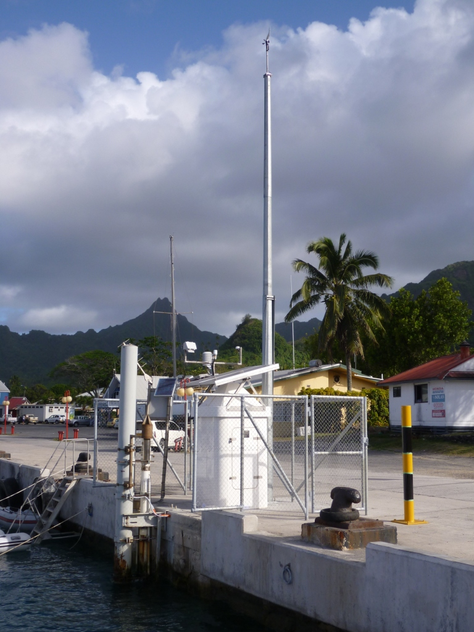
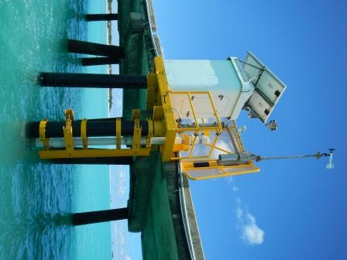
Pacific Tide Stations
Cook Islands
Kiribati
Notes:
In 2012 the equipment hut at Cook Is tide station had to be relocated and a security fence installed, due to the local development on the wharf area.
In 2014, we completed a major infrastructure upgrade at our Kiribati tide station. Costing around $200K

Slide 7
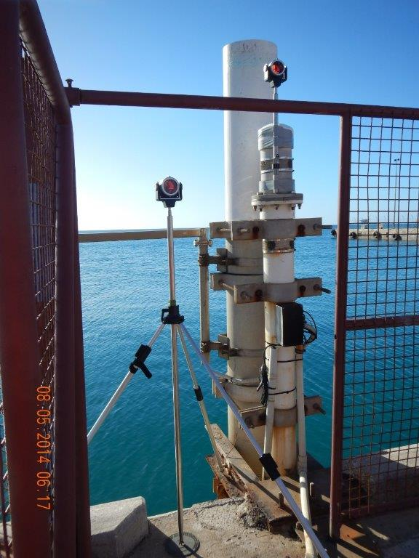
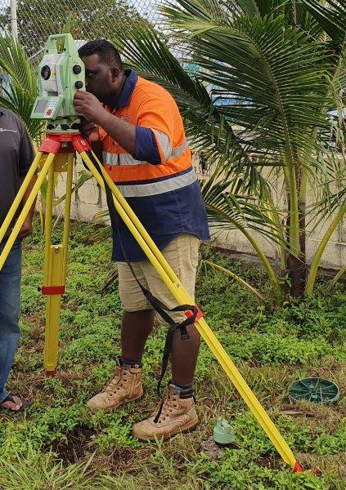
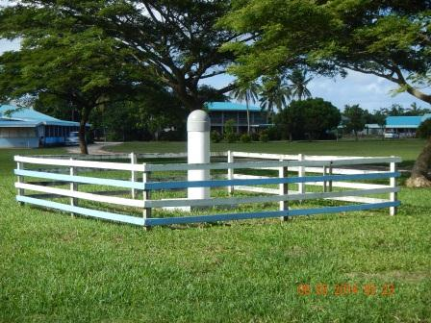
Pacific GNSS Stations
Tonga

Slide 8
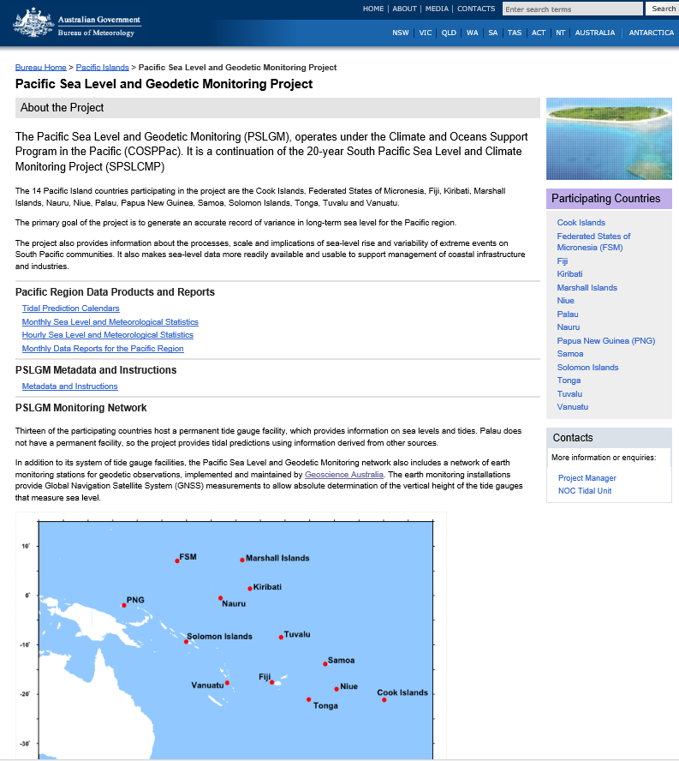
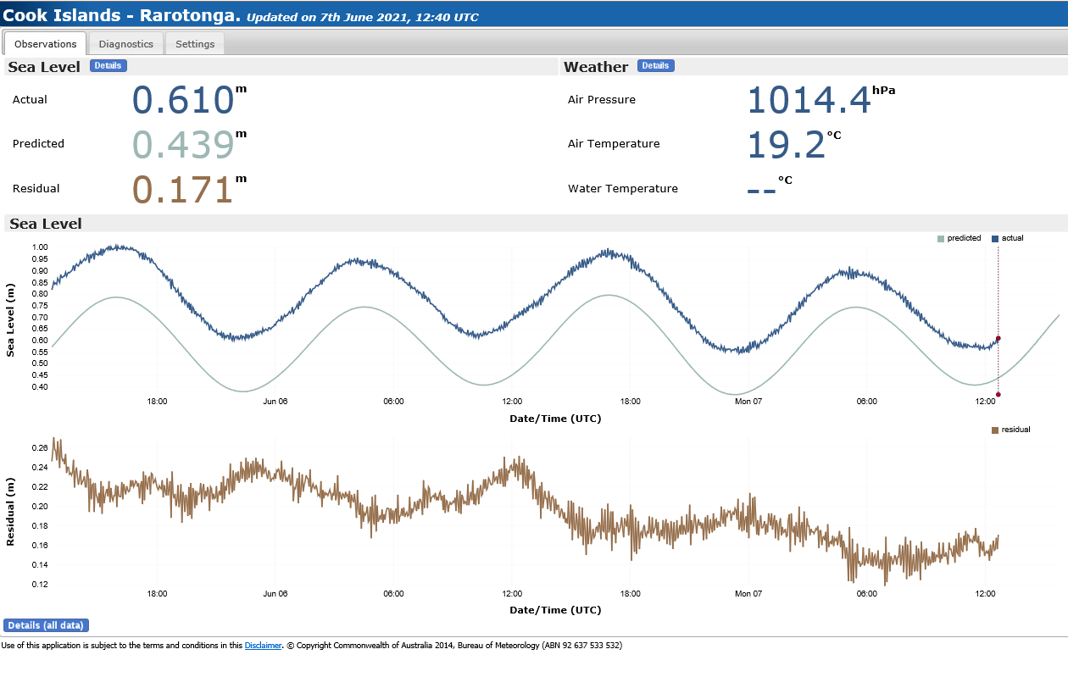
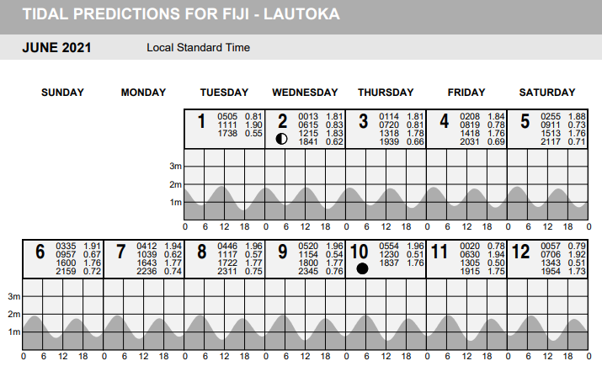
Australian
Bureau of Meteorology
Web Details:-
www.bom.gov.au/pacific/projects/pslm/index.shtml
Products and Reports
Tidal Prediction Calendars
Monthly Sea Level & Meteorological Statistics
Hourly Sea Level & Meteorological Statistics
Monthly Data Reports for the Pacific Region
Real Time Data Display
http://www.bom.gov.au/cosppac/rtdd/q1c7o0hj48yu/?station_number=200855

Slide 9
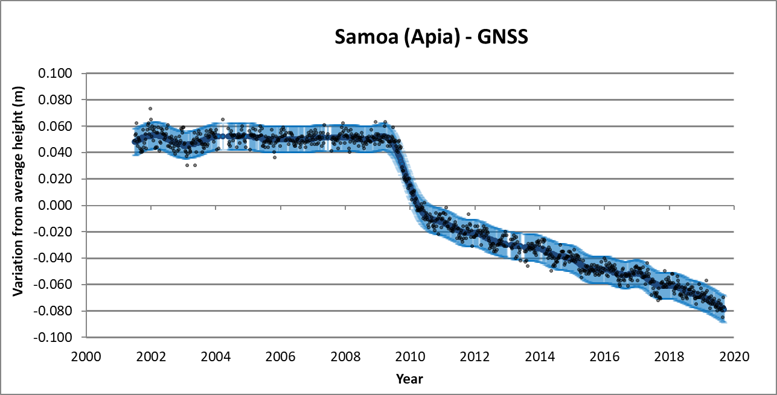
Geoscience Australia
Web Details:-
www.ga.gov.au/scientific-topics/positioning-navigation/geodesy/pacificsealevel

Slide 10
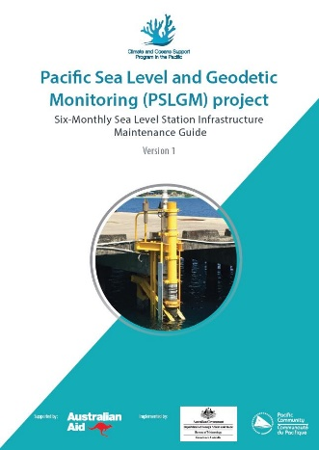
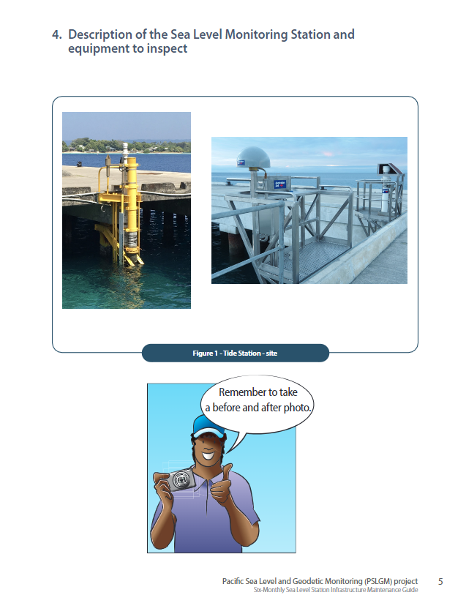
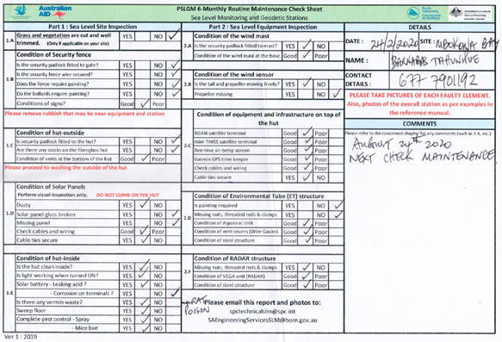
Network collaborations between
Project, Met Services and Lands Departments.

Slide 11
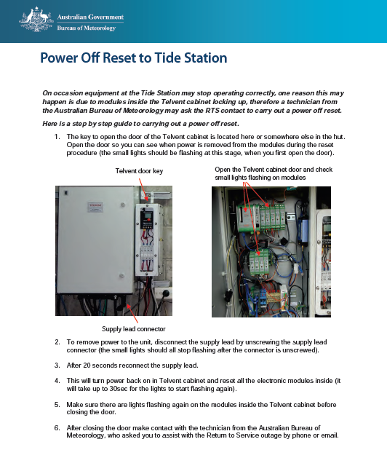
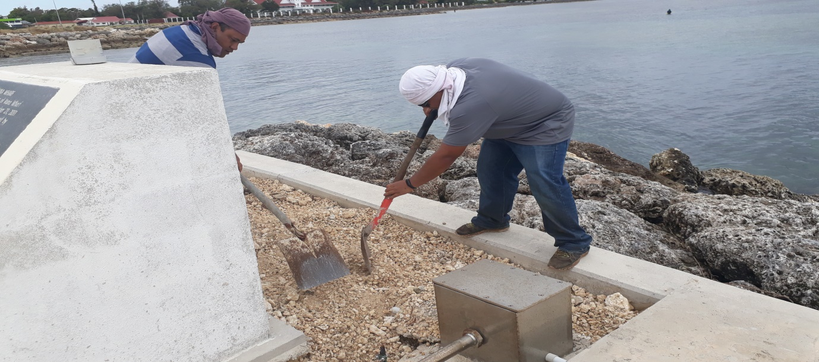
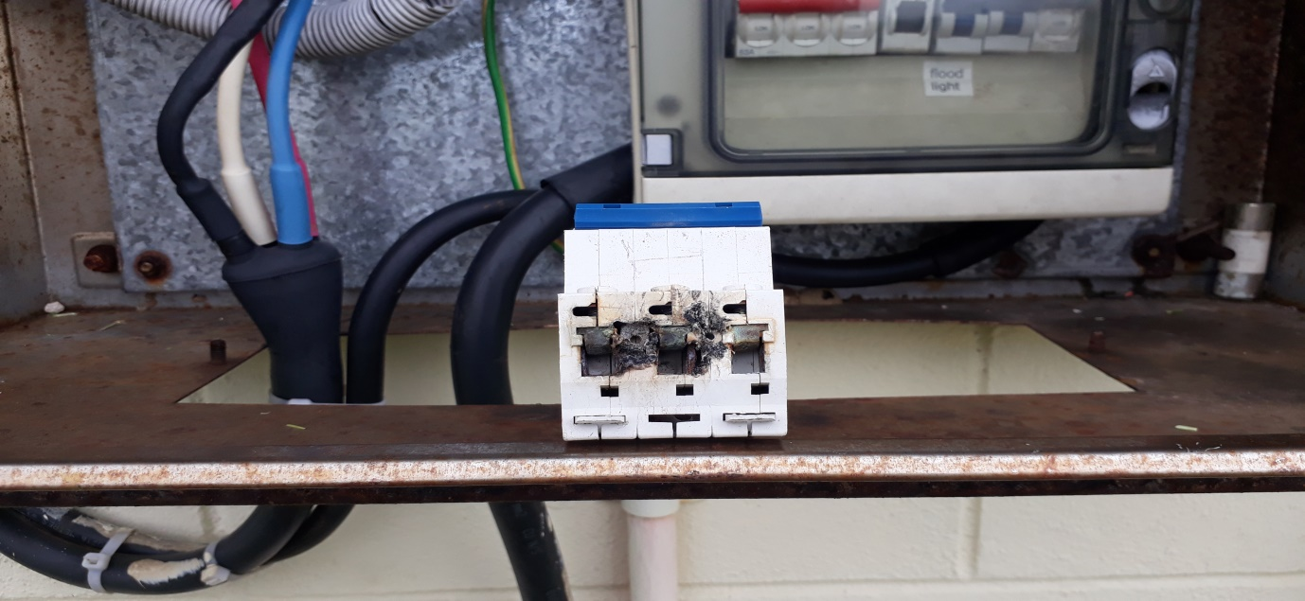
Network collaborations between
Project, Met Services and Lands Departments.

Slide 12
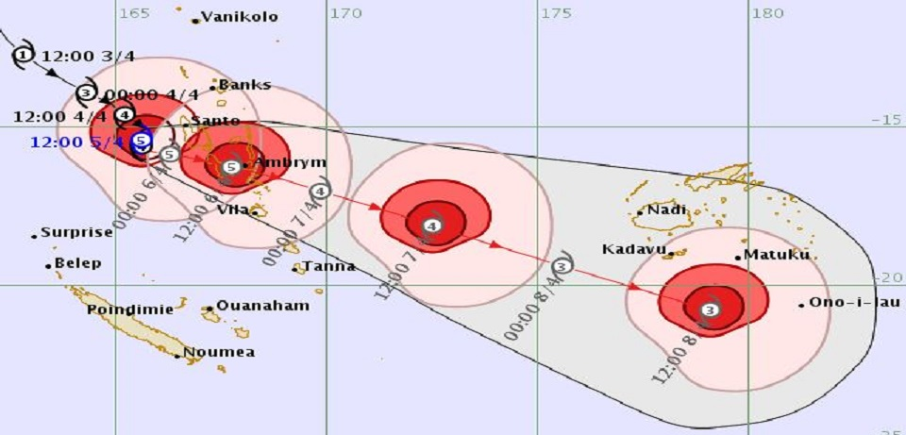
TC Harold April 2020

Slide 13
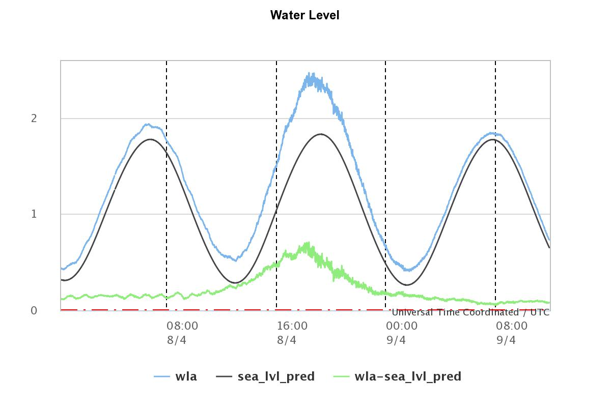
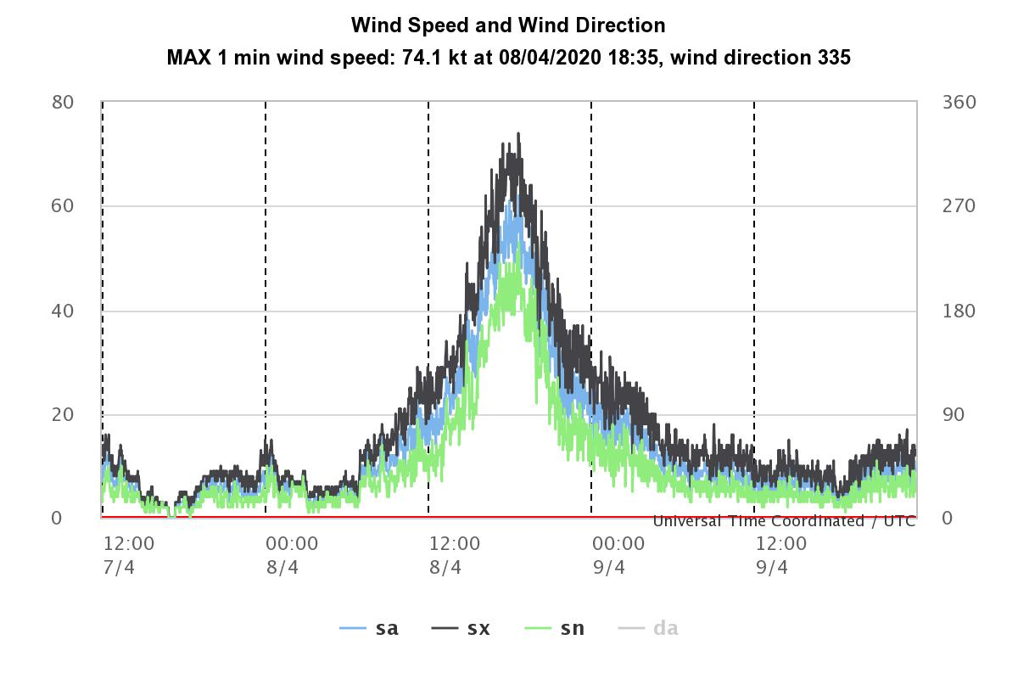
TC Harold April 2020

Slide 14
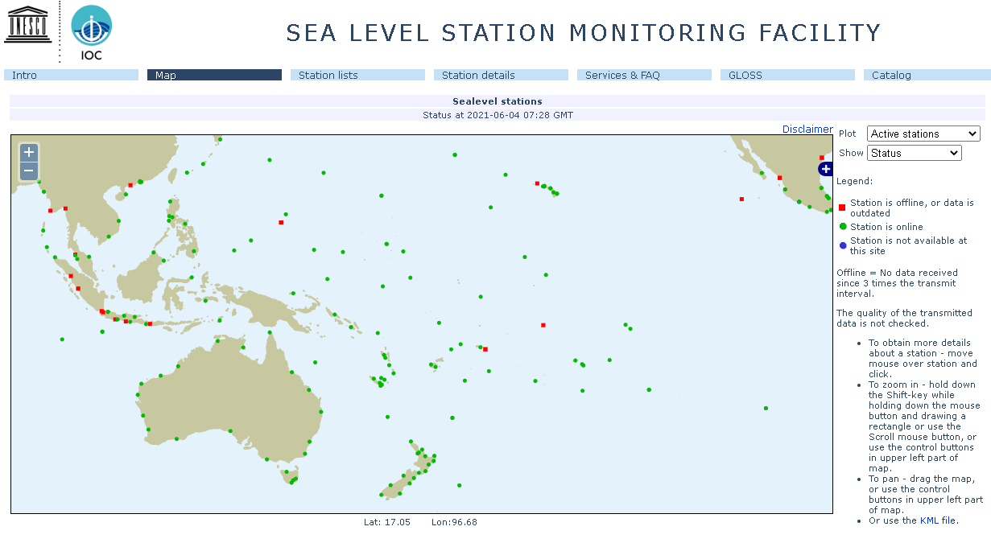
GLOSS Network via the GTS system
http://www.ioc-sealevelmonitoring.org/map.php

Slide 15
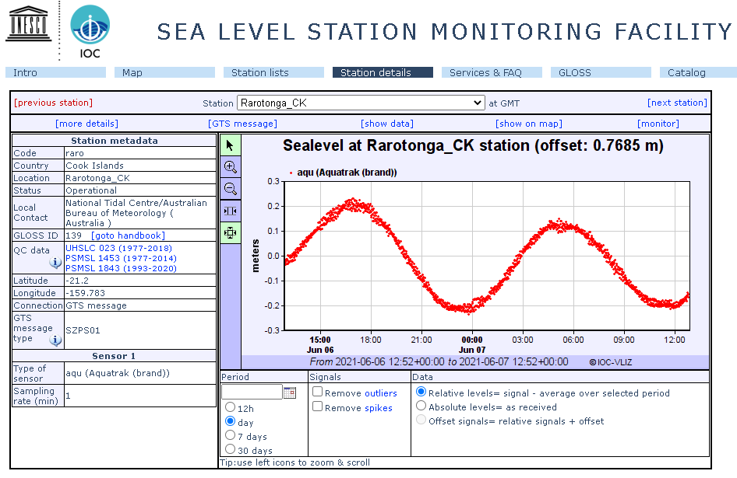
GLOSS Network via the GTS system
http://www.ioc-sealevelmonitoring.org/station.php?code=raro

Slide 16
Thank You
Jeff Aquilina
jeff.aquilina@bom.gov.au

