Slide 1
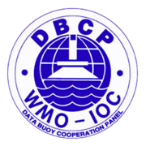
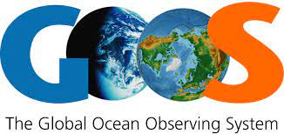
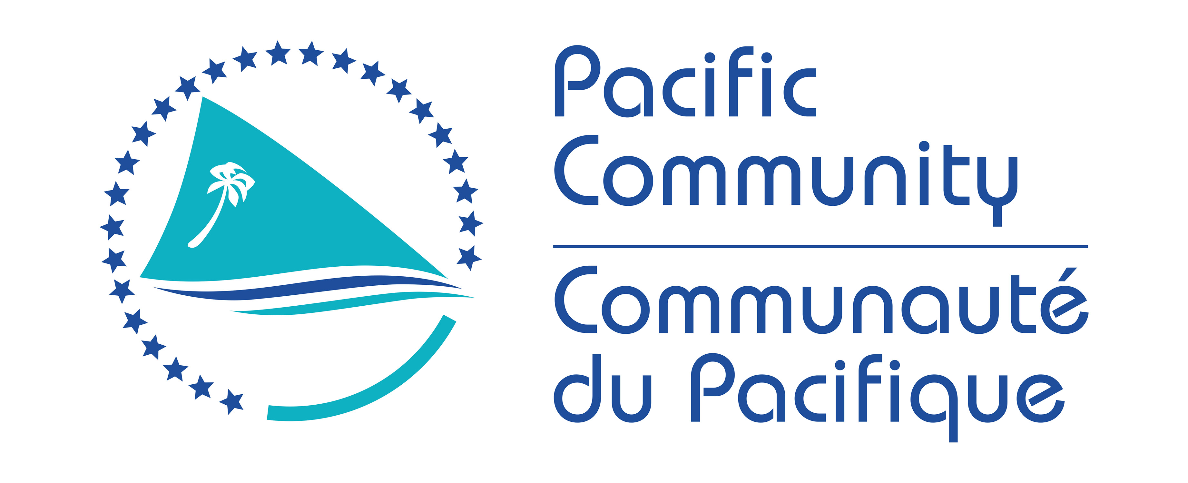
Fifth Pacific Islands Training Workshop on
Ocean Observations and Data Applications (PI-5)
27-28 May and 10-11 June 2021 (Fiji Time, UTC+12)
Country Report: Papua New Guinea
Presented by: Kisolel Posanau
Email: solel.posanau@gmail.com

Slide 2
Ocean Stakeholder Engagement: National Maritime Safety Authority (NMSA)
What have you learnt:
1. What ocean data they regularly use and how they get that information?
NMSA regularly utilizes:
Tide Data from the Australian Government Bureau of Meteorology, AusTides by the Australian Hydrographic Office and the NMSA Geonica Tide Gauge System.
Bathymetric Data from Hydrographic Surveys conducted by the Royal Australian Navy
Shipwreck Data from NMSA Hydrography Department
Offshore Aids to Navigations from NMSA Hydrography Department
Ocean Wind Velocity from the Australian Government Bureau of Meteorology
Ocean Currents from the Australian Government Bureau of Meteorology
Oil spill and other Pollutions from NMSA Marine Environment Protection Department

Slide 3
2. What ocean data they need that they don’t have and what would be the ideal format/ frequency for getting this information?
NMSA needs Sea Level, Sea Surface Temperature (SST), Sea Surface Salinity (SSS) and Wave Height and Velocity Data. Ideal formats would be in CSV, MS Excel and NETCDF.
3. If private sector, would they be willing to pay for that information?
Not Applicable.
4. To what extent do they rely on traditional knowledge? Could they provide a few examples of times when they have used complementary scientific knowledge and traditional knowledge to support a decision?
NMSA Field Engineers and Technicians rely on traditional knowledge especially with the weather and climate and ocean currents to assist with their operations. E.g. using scientific combined with traditional knowledge of how ocean winds are generated in particular areas to assist in positioning vessels and boats for offshore works and to avoid wind generated currents and waves. Another example is to cause little to no disturbance in Sacred Masalai (Totem) areas of the sea while carrying out offshore operations or to avoid operations in such areas.

Slide 4
Next Steps/Future Plans
National Weather Service to create a product that can provide NMSA with their needs as per question 2 on ocean data and more research to question 4.
To provide regular meetings or updates especially when there are severe weather warnings out at sea.

