Slide 1

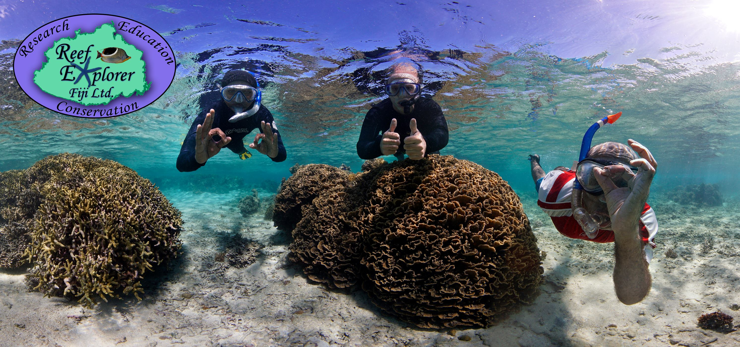




Fifth Pacific Islands Training Workshop on
Ocean Observations and Data Applications (PI-5)
27-28 May and 10-11 June 2021 (Fiji Time, UTC+12)
Country Report: Fiji
Presented by: Shweta Shiwangni
Email: climate@met.gov.fj

Slide 2
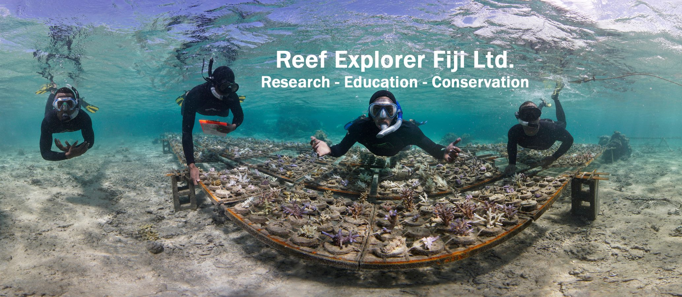
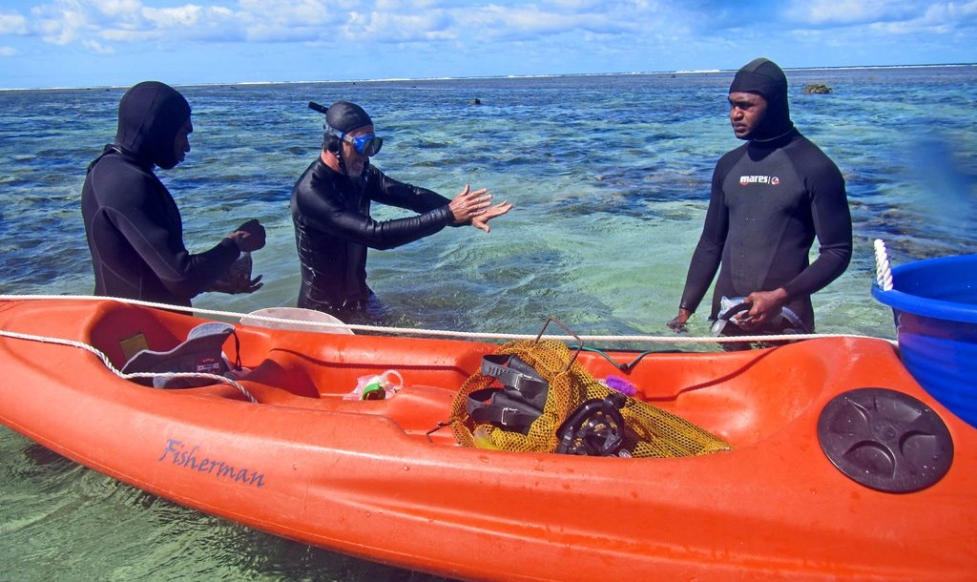
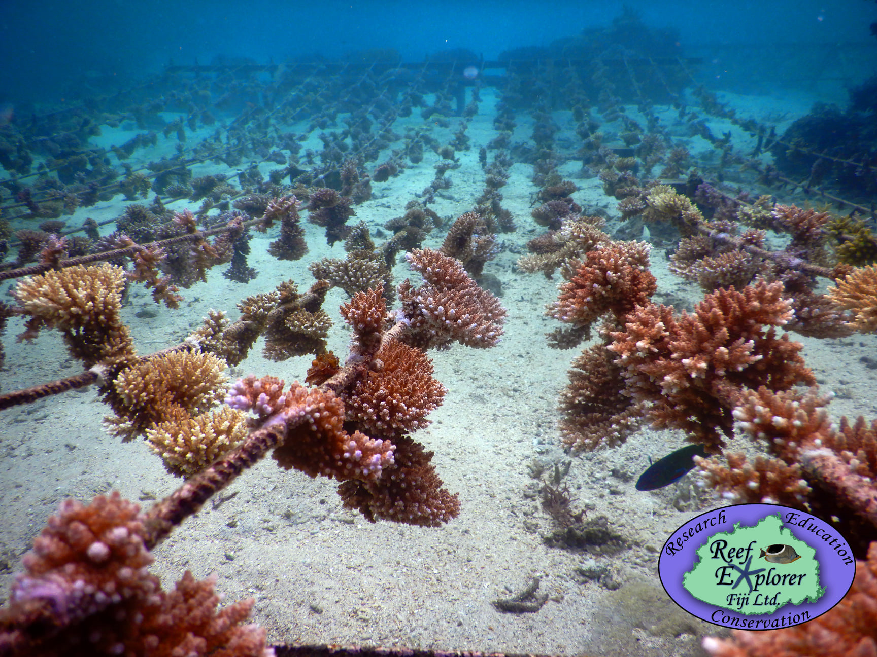
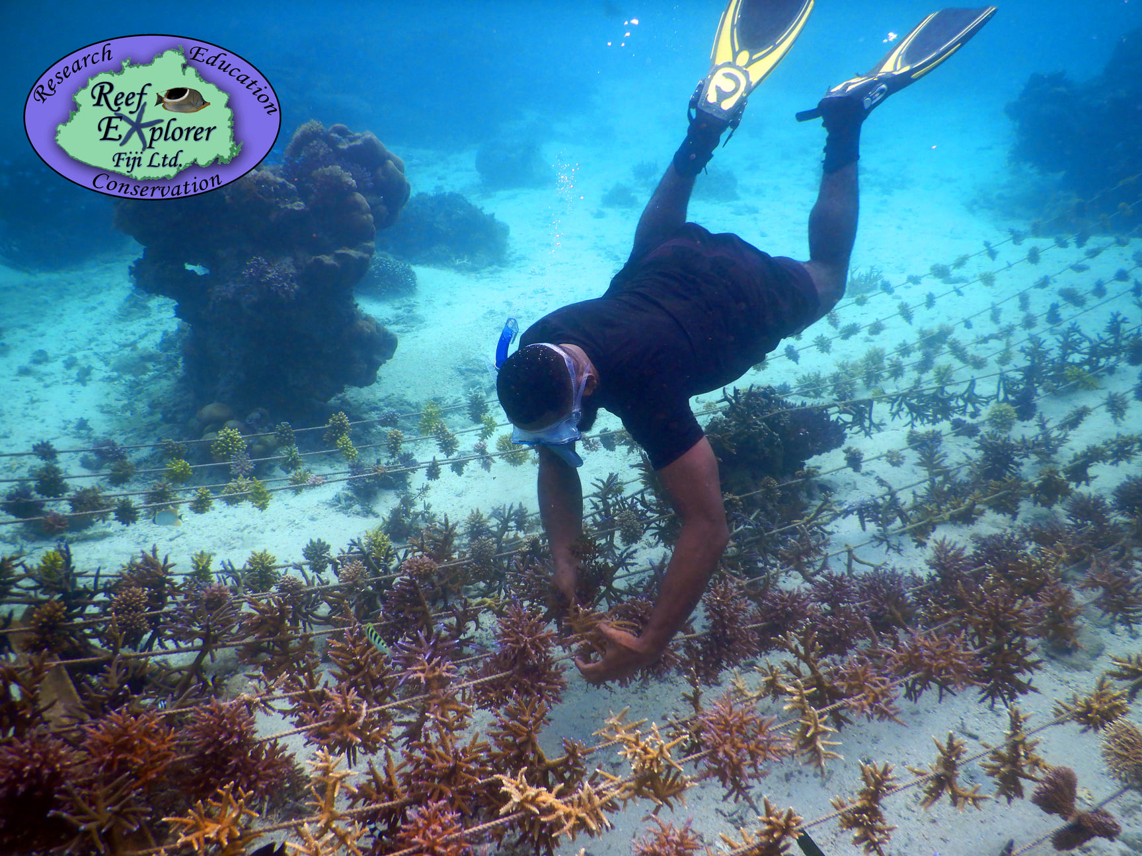
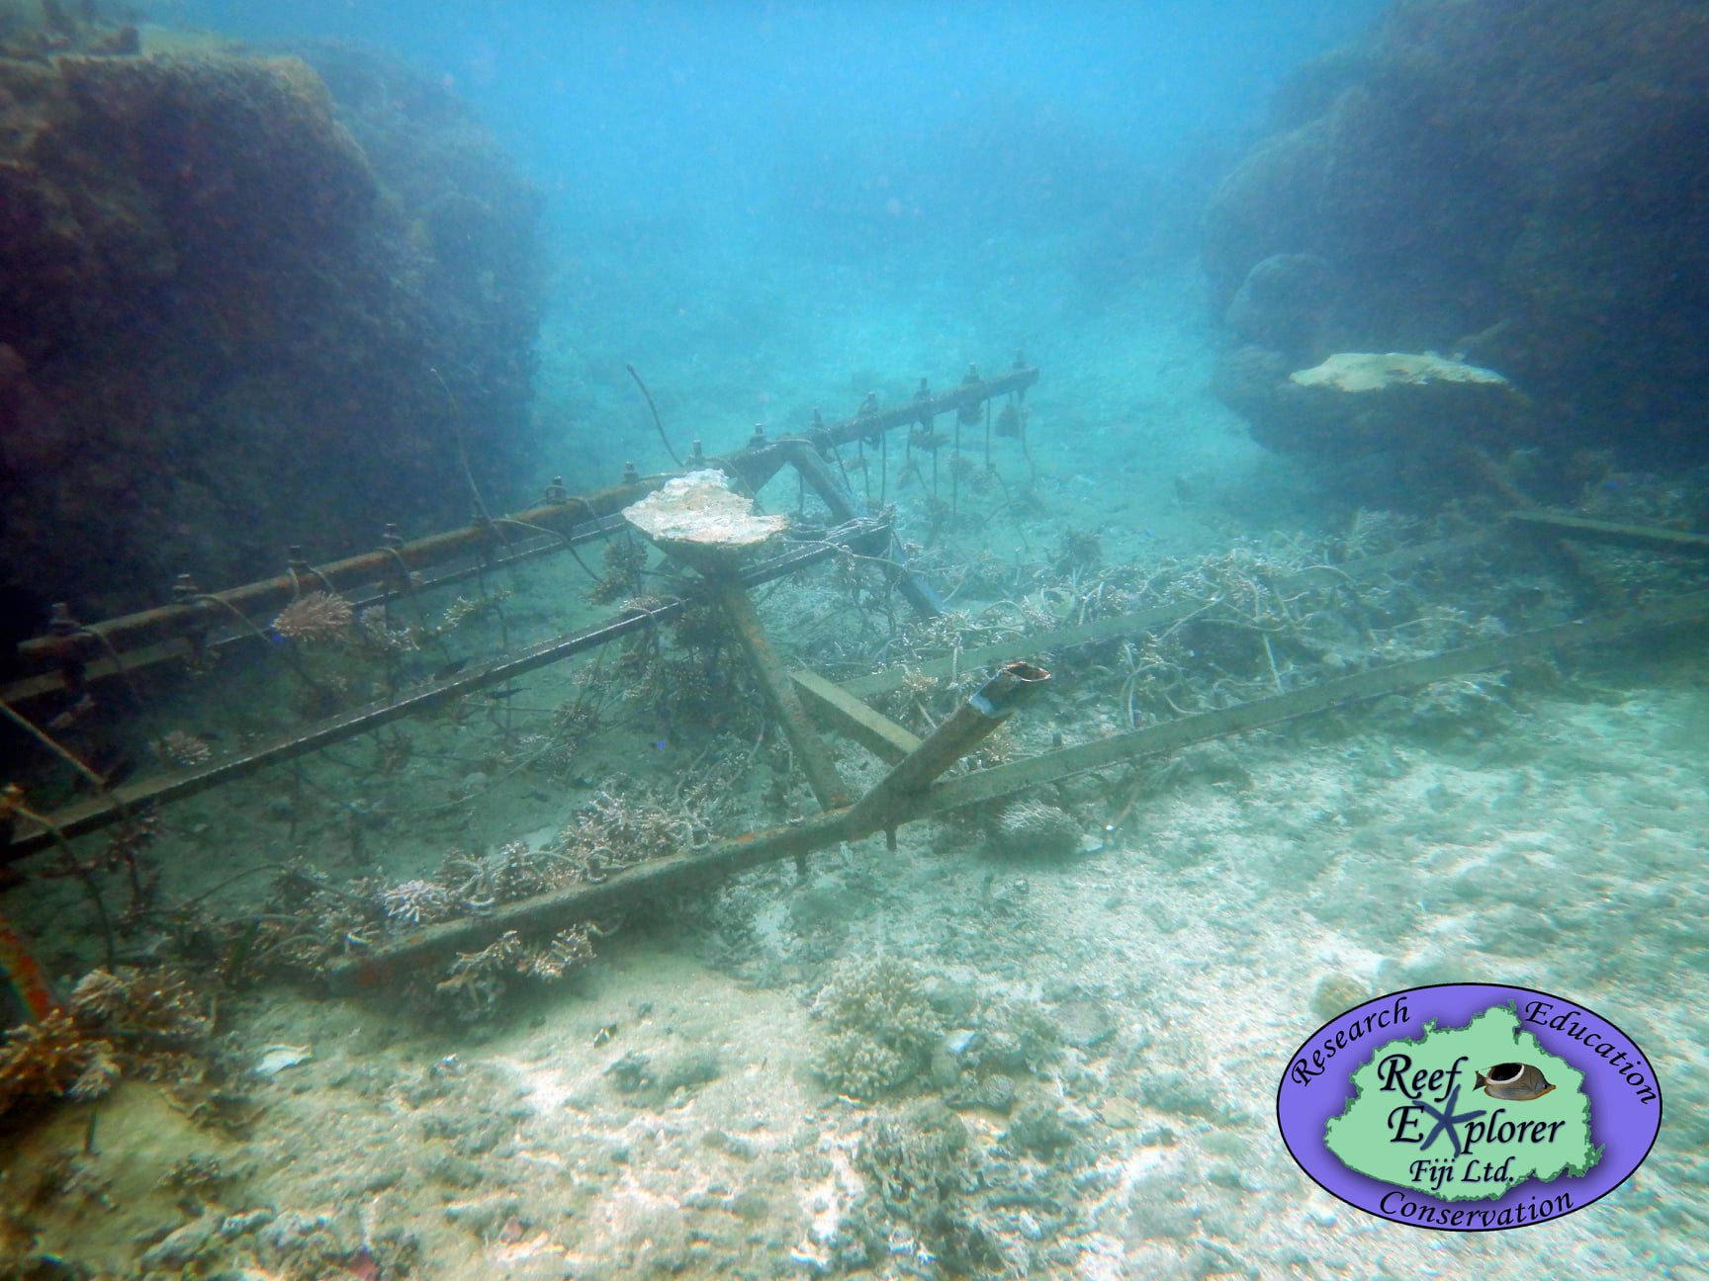
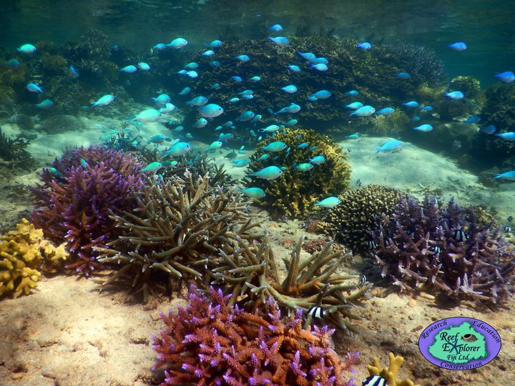
Ocean Stakeholder Engagement
Figure 1: Reef Explorer Fiji promoting the management, conservation, & sustainable development of Fiji’s natural resources. Source: Reef Explorer Fiji Ltd. Facebook Page

Slide 3
What have you learnt
What ocean data they regularly use and how they get that information?
remotely acquired sea surface temperature data acquired free from NOAA’s Coral Reef Watch Program
sea water temperature data acquired from their in situ loggers
wave/swell height and direction forecast for free from Magicseaweed.com surf forecast

Slide 4
2. What ocean data they need that they don’t have and what would be the ideal format/ frequency for getting this information?
Dissolved oxygen, solar irradiance, and wave height data (hourly) would be helpful from sites where they work, though those data are not things that could be obtained without in situ equipment.
3. If private sector, would they be willing to pay for that information?
No – they are looking to cover the costs of the equipment required to obtain those data into a research grant.

Slide 5
4. To what extent do they rely on traditional knowledge? Could they provide a few examples of times when they have used complementary scientific knowledge and traditional knowledge to support a decision?
They use traditional knowledge in many facets of their work, but not for ocean data – they require quantitative data for those parameters of interest.

Slide 6
Next Steps/Future Plans
Reef Explorer Fiji are working to establish a seawater temperature monitoring program across reef habitats at various sites around the Fiji archipelago as they have established on the Coral Coast. These data will be used to model bleaching predictions based on remotely acquired SST data, among other things. Currently they are collaborating with FNU on parts of this effort. Once their modelling is done, they will be able to share this information with other stakeholders.

