Slide 1
Tsunami Service Provider Interoperability Tool (TSP-IOT)
Software architecture

Slide 2
Two main entities have been introduced as components of the TSP-IOT, at high level of abstraction:
Repository: collects all the resources
Operator: catches (or puts) resources from the Repository
While Thinking to a software architecture that implements this model, one realization can be the following:
Repository
DBMS (DataBase Management System)
Operator
WEB GUI (Graphical User Interface)
In modern distributed architectures, another component is introduced:
RESTful WEB Service Provider: provides resources to any implementation of the Operator. Restful WEB services, as well as web APP GUIs need to be exploited by a Web Server.
The word RESTful indicates a standard style of architecture on which the Services are based. Each request to a Web Server is made by an URI (Uniform Resource Identify)

Slide 3
The prototype of TSP-IOT is based on a distribute software architecture
WEB Browser (any)
SHELL cmd (curl, wget)
App (python, java …)
WEB GUI Angular
WEB SERVER Nginx
TSUNAPI RESTfull WEB Services Python Flask
Tsunami DATABASE Mysql
At the top level there is any type of realization of the Operator, that ask for services to the Web Server.
Depending of these requests, the web server responds either, by providing its web app or by forwarding the request to TSUNAPI. Only the browser needs to requests the web GUI. The web GUI contains some javascript code that will do further requests for TSUNAPI to get data to fill in its widgets (tables, graphs etc…).
TSUNAPI Services gets from the database the data to fill its response.

Slide 4
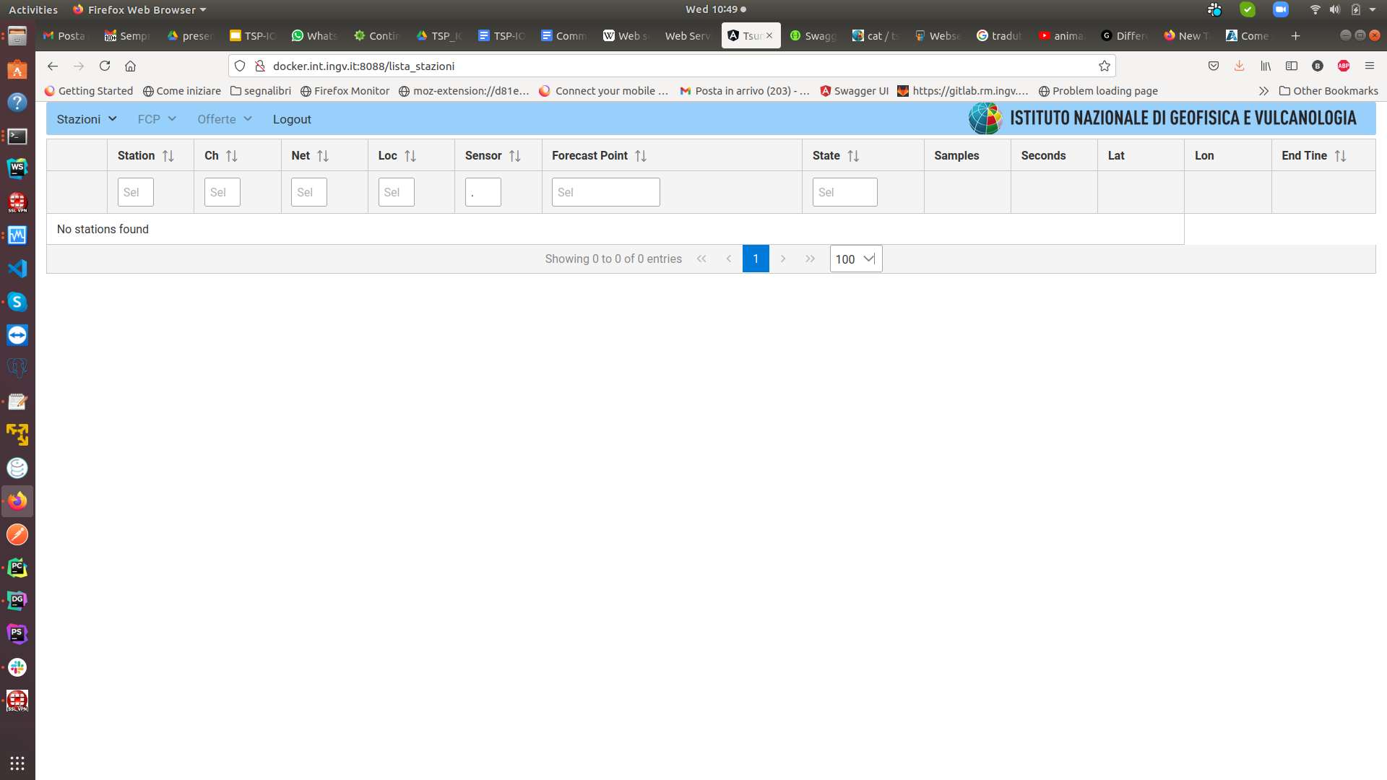
Using the GUI in a web browser
Web Server responds, providing the browser wiith the WEB APP, that is a mix oh HTML and javascript code
BROWSER
The browser requests for the web GUI with the URI
http://docker.int.ing.it:8088/
WEB
SERVER
TSUNAP I
DATABASE
App
The javascript running in the browser requests the list of all stations, with the URI:
http://docker.int.ingv.it:8088/api/scnls
The browse Runs the received WEB App. It consists on Visualize an empty html table whose scope is to list all stations. At this point the WEB app running inside the browser, needs the data to fill in the empty table. This is what the javascript code will do ...
The Web Server forward this request to the TSUNAPI server
TSUNAPI server, query the database to get the data
The javascript code fill the received data into the table
The Database responds to the query providing the query result
The TSUNAPI responds to the WEB Server providing the data in json format
The WEB Server forward the response to the Browser

