Slide 1

The UN Decade of Ocean Science for Sustainable Development 2021-2030:
Tropical Americas Transparent and Accessible Ocean Co-Design Workshop
“DEEP SEA CAPACITY DEVELOPMENT NEEDS IN THE WTA AND THE ETP FOR THE OCEAN WE WANT”
Thursday, 19 August, 2021 at 10:00 Colombia time (UTC-5)

Slide 2
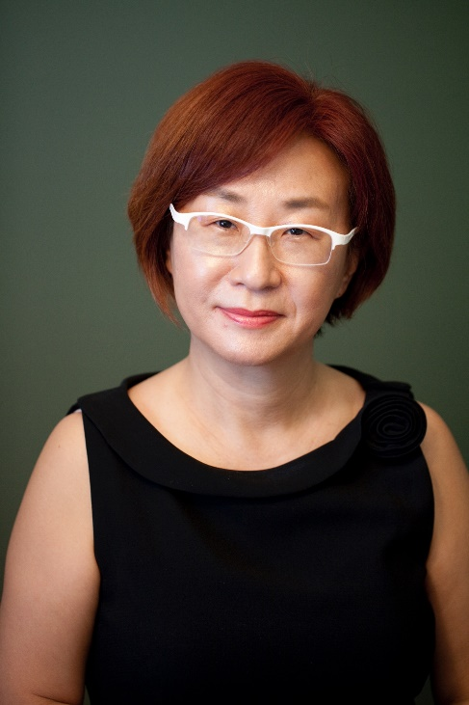
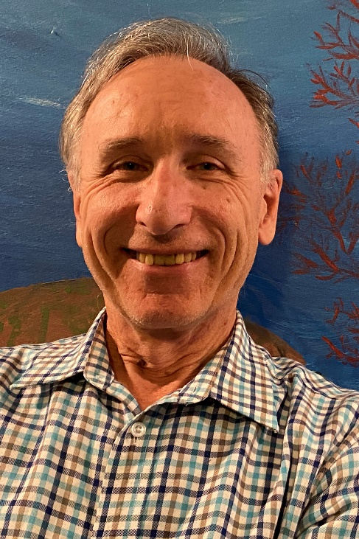
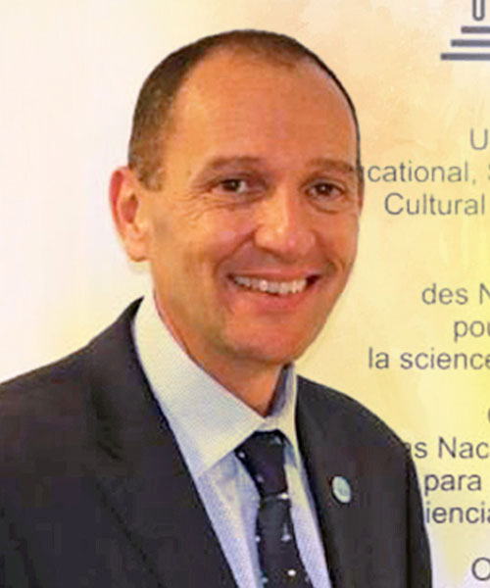
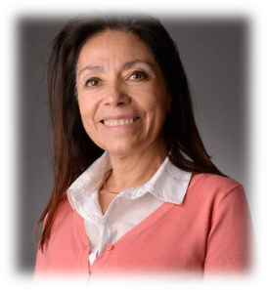

Part 1 Welcome / Overview
Jihyun Lee
Director of Office of Environmental Management and Mineral Resources, International Seabed Authority ISA
Arthur E. Paterson
Program Manager, Office of International Activities, Office of Oceanic and
Atmospheric Research, NOAA
Ariel Troisi
Intergovernmental Oceanographic Commission (IOC) Chair Co-Chair WTA Capacity Development Working Group
Elva Escobar Briones
Co-Chair WTA Capacity Development WG, Institute of Marine Sciences and Limnology, UNAM, México

Slide 3
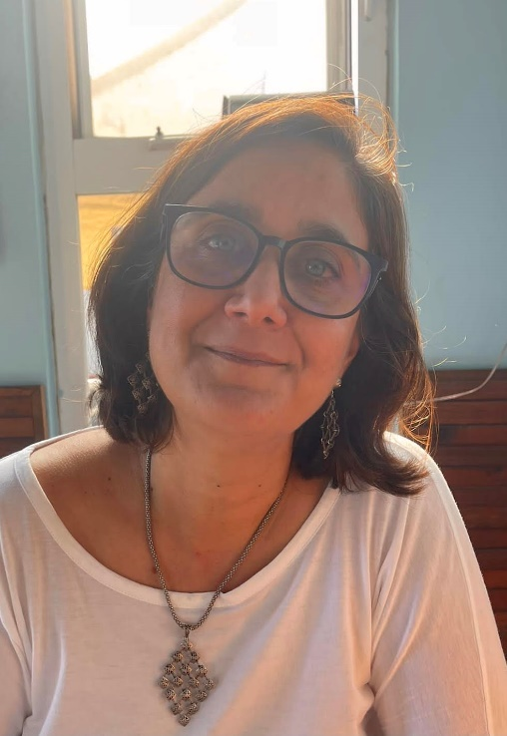
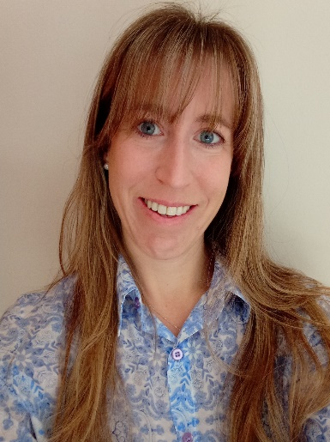
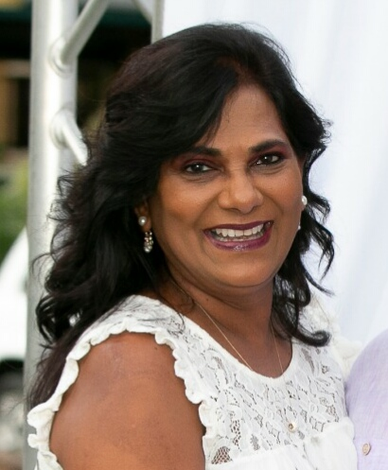
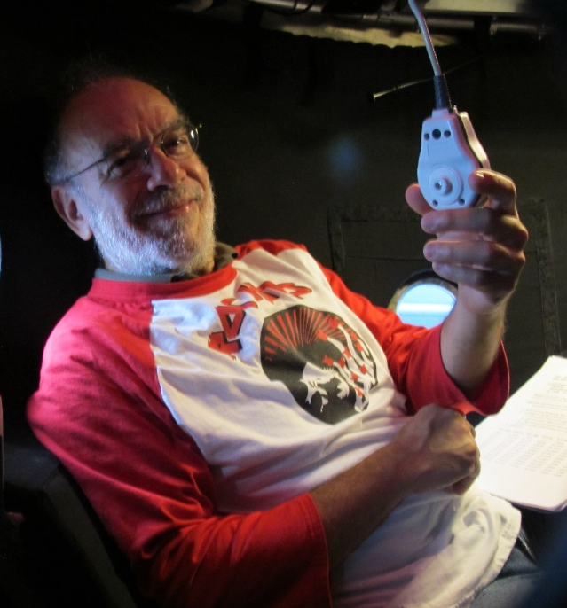
Part 2 Panel: Ongoing CD Programs in the WTA and the ETP regions
Moderator Dr. Sharon Z. Herzka
Department of Biological Oceanography at the Center for Scientific Research and Higher Education of Ensenada (CICESE) , Mexico
Ana Carolina Ronda
Investigadora Adjunta, CONICET-Instituto Argentino de Oceanografía (IADO/UNS)
Judith Gobin
Professor of Marine Biology
University of West Indies UWI – Trinidad & Tobago
Jorge Cortés
Researcher at the Center for Research in Marine Science and Limnology (CIMAR), Professor at UCR, Costa Rica

Slide 4
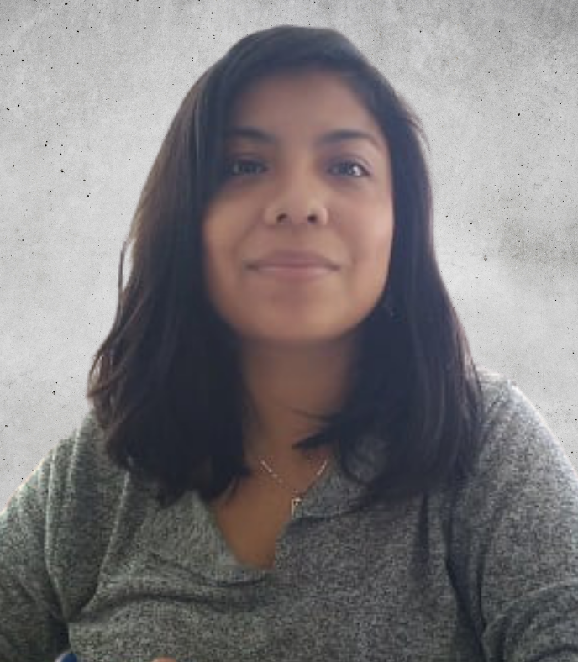
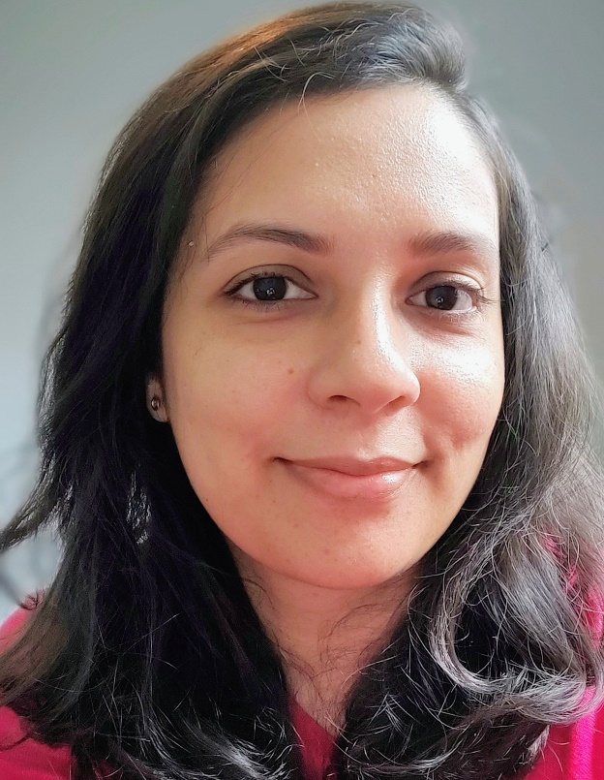
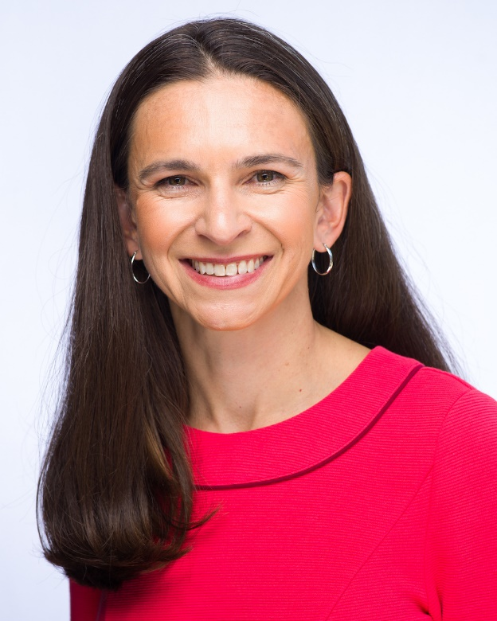
Part 3 Panel: Ocean Decade Endorsed Programs
Moderator Denisse Flores
Coordinadora de la Oficina de
Comunicación y Difusión del Instituto de Ciencias del Mar y Limnología de la
UNAM, México
Katy Croff Bell
President Ocean Discovery League, National Geographic Explorer
Sonakshi Mishra
ECOP, Programme Management Officer, International Seabed Authority ISA

Slide 5
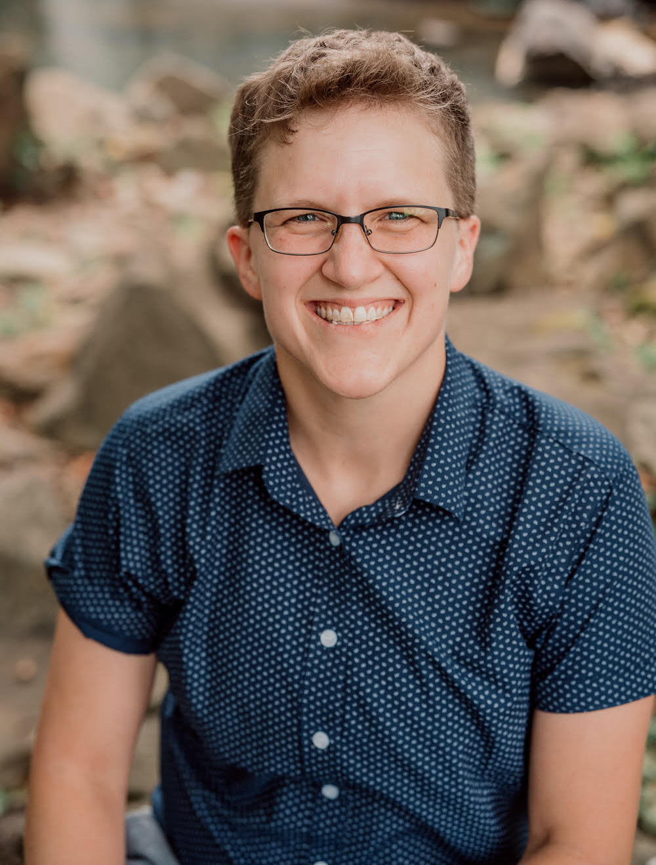
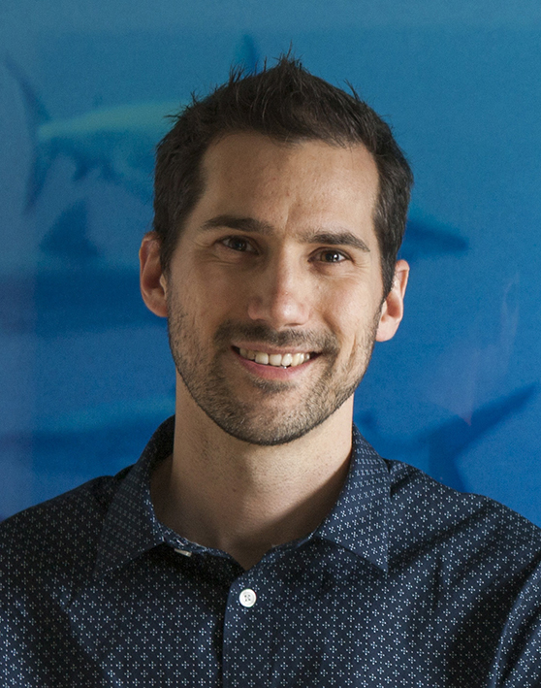
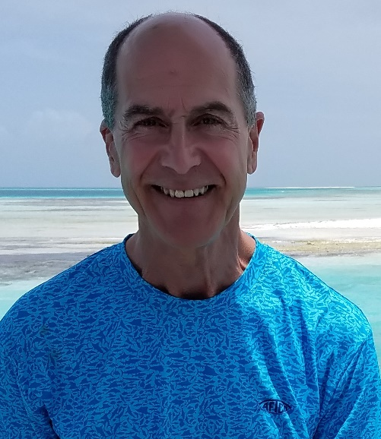
Part 3 Panel: Ocean Decade Endorsed Programs
Frank Müller
Professor, College of Marine Science
University of South Florida, USA, USF, Marine Life 2030, Ocean Decade
Nick Higgs
ECOP, Director Cape Eleuthera Institute, Bahamas
Leslie Smith
Project Director, Deep Ocean Observing Strategy, IGOOS, UN

Slide 6
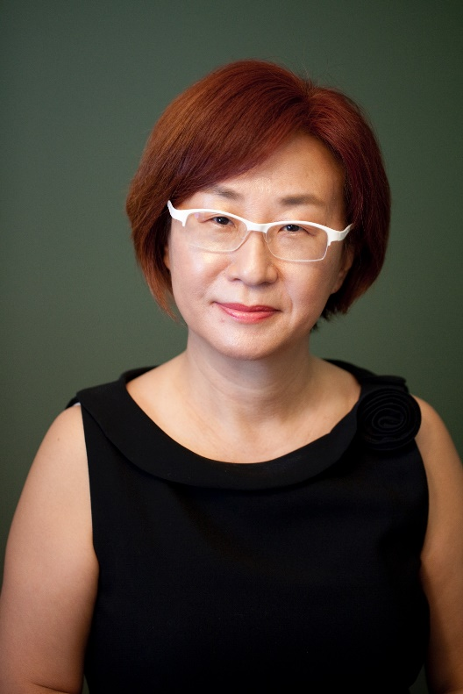
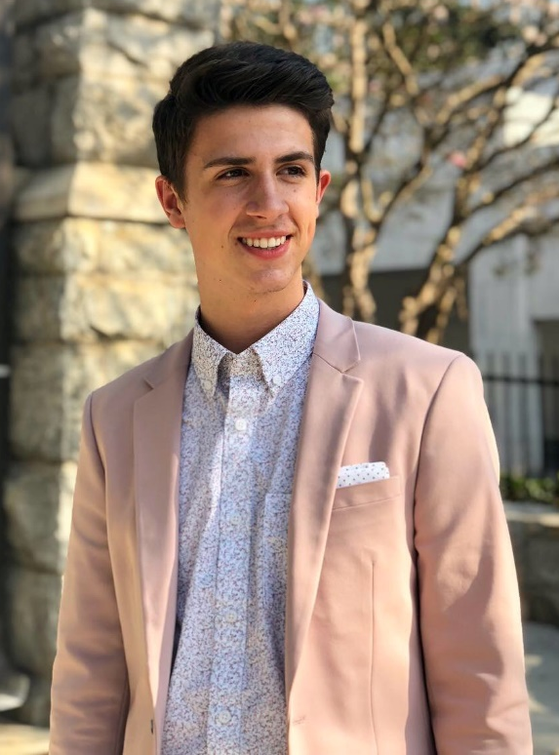
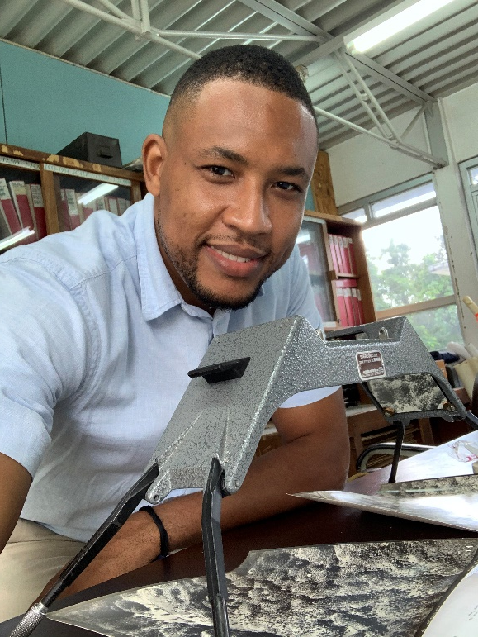
Part 4 Panel: What is needed? Next steps
Moderator Jihyun Lee
Director of Office of Environmental Management and Mineral Resources, ISA
Hank Hedge
ECOP, Ministry of Transport and Mining, Jamaica
Mark Haver
ECOP, Chair of the Sustainable Ocean Alliance Youth Policy Advisory Council, USA

Slide 7
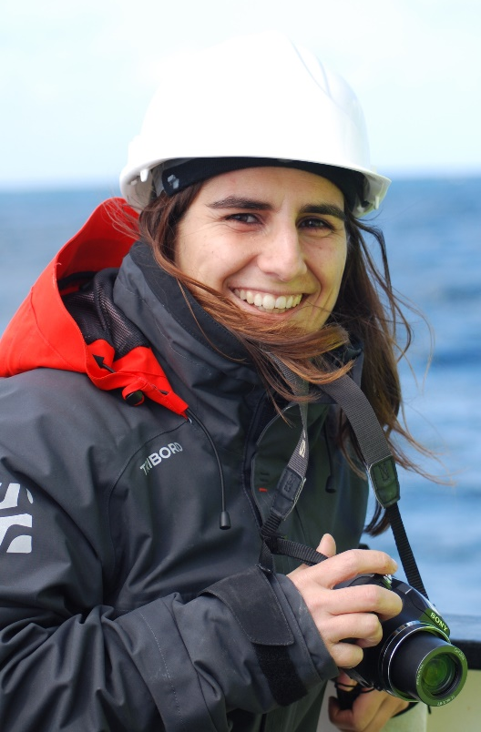
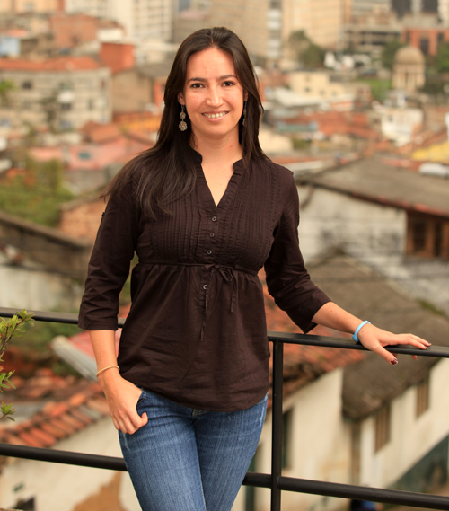
Part 4 Panel: What is needed? Next steps
Luisa Fernanda Dueñas Montalvo
ECOP, Assistant Professor, Universidad Nacional de Colombia, Facultad de Ciencias
Luciana De Melo Santos Genio
Environmental Analyst, International Seabed Authority ISA

Slide 8

Part 5 Closing Session, Summary and call to action
Elva Escobar Briones
Co-Chair WTA Capacity Development WG, Institute of Marine Sciences and Limnology, UNAM, México
Jihyun Lee
Director of Office of Environmental Management and Mineral Resources, ISA
Arthur E. Paterson
Program Manager, Office of International Activities, Office of Oceanic and
Atmospheric Research, NOAA

