Slide 1
Australia
Joel Cabrie
Manager Marine Networks
Bureau of Meteorology
joel.cabrie@bom.gov.au

Slide 2
About Organisation (Met-Ocean Structure)
VOS responsibilities:
Manage a fleet of 43 x manual observing ships, 5 x APTR ships & 1 x ShipAWS
SOOP responsibilities:
BoM manages a fleet of 4 x XBT SOOP ships performing FRX sampling of IX01, PX02 & PX11
CSIRO perform HDX sampling on IX28, PX30 & PX32
RAN perform ad-hoc sampling
Institute/staff (PMOs):
The Marine Networks team
Manager Marine Networks: Joel Cabrie (Melbourne, VIC)
XBT/Argo Data Manager: Lisa Krummel (Melbourne, VIC)
XBT/Argo Data Manager: Mike Funnell (Sydney, NSW)
Senior PMO: Ian Charlesworth (Perth, WA)
National PMO Network
We have trained PMOs operating out of various national ports, including Melbourne, Sydney, Fremantle, Brisbane, Adelaide, Cairns & Hobart

Slide 3
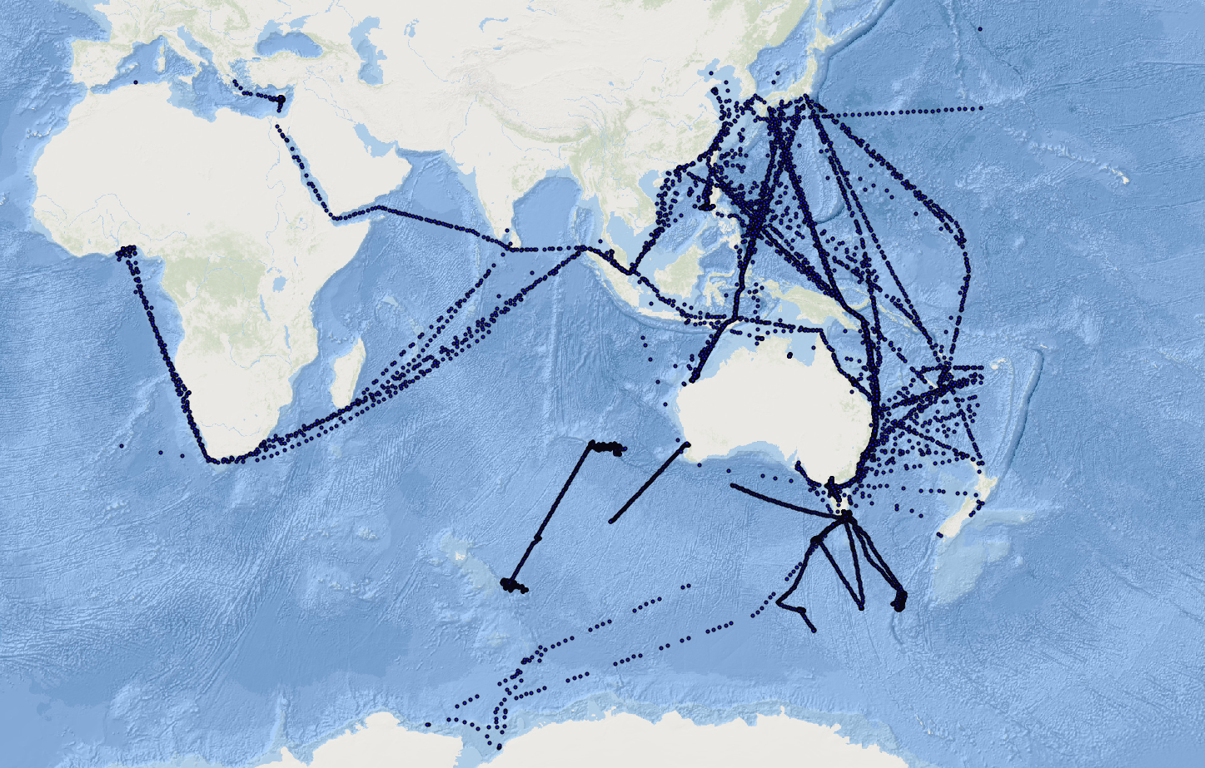
VOS 2020
Only 23,000 Observations received in real-time during 2020. Significant decrease from previous years (~40,000) due to COVID-19 restrictions.

Slide 4
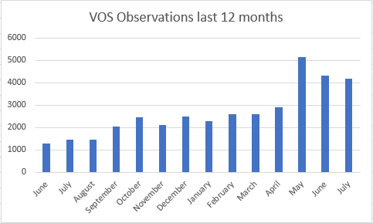
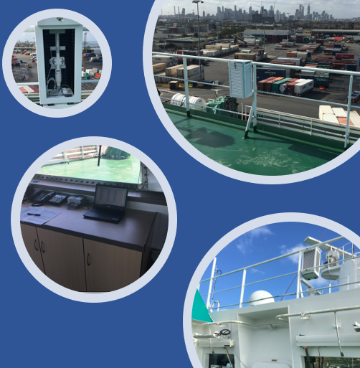
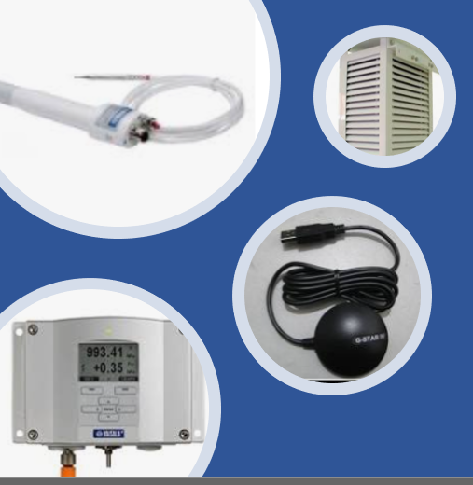
VOS 2021
So far in 2021:
Observation improving significantly in 2021.
Already exceeded last year's total observations.
APTR rolled out to 5 ships in 2021.
Looking forward:
Planning to go to tender for a new ShipAWS this year.
Continue to roll-out APTR to any coastal vessels with adequate internet/email.
Continue to replace mercury thermometers with Vaisala HMP155.
Recruitments and ship visits limited to Australian coastal vessels due to COVID-19 restrictions.

Slide 5
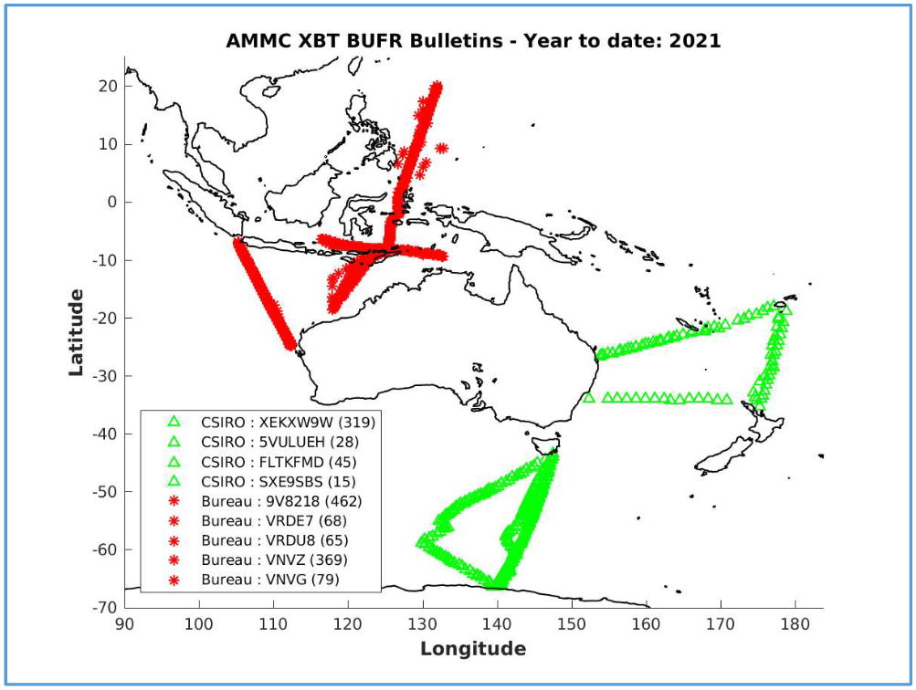
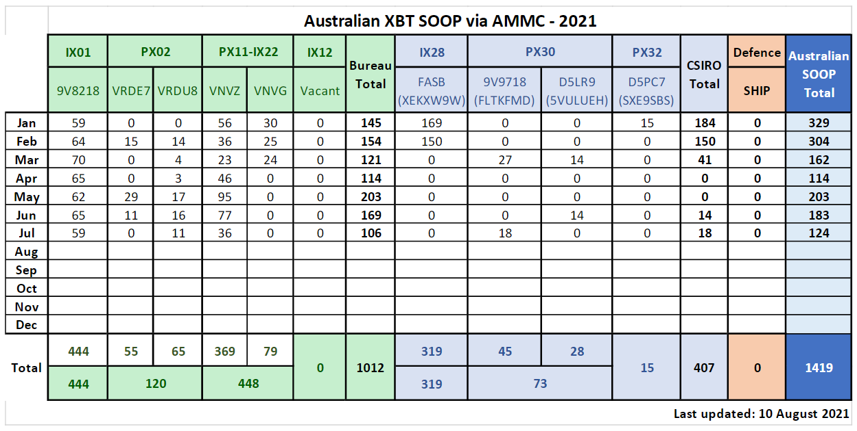
XBT SOOP
Network Overview:
XBT sampling is a joint effort between the Bureau of Meteorology, CSIRO and the Australian Navy.
Requirements for permits for XBT sampling within marine parks.
CSIRO temporarily changed from HDX sampling to FRX sampling by ship's officers on PX30 & PX32 due to COVID-19 restrictions.
HDX sampling continues on IX28.
RAN does not send real-time XBT data to the GTS (classified).

Slide 6
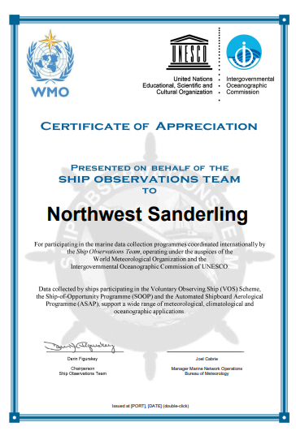
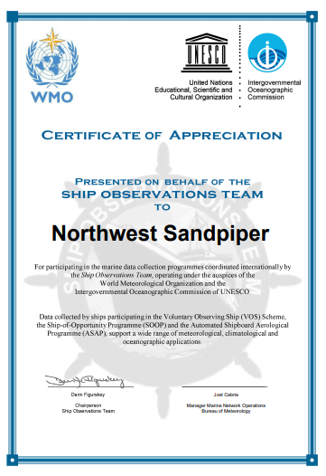
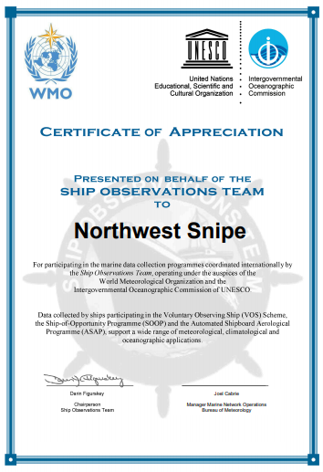
Other initiatives/resources: Met and ocean network
32 x Drifting Buoys deployed by ships participating in the Australian VOS fleet
New Antarctic re-supply vessel, RSV Nuyina, on track for delivery this year. Observations to be shared via the GTS.
3 x VOS ships presented with SOT certificates in recognition of 30 years of voluntary service:
Northwest Sanderling
Northwest Snipe
Northwest Sandpiper
Working with Lisa Blair to setup VOS reporting and buoy deployments during her circumnavigation of Antarctica later this year.

Slide 7
Gaps and Requirements, and Covid-19 Impact
Fleet size has decrease significantly. Target fleet of 70 ships reduced to 49.
Several cruise ships have been sold or are being scrapped.
Unable to visit any ships that have come from a foreign port within the past 14 days.
Ship visits limited to Australian coastal vessels only.
Trans-Tasman bubble with New Zealand since May 2021.
Unable to complete mercury replacement by the end of 2020 due to COVID-19 restrictions on ship visits.
Existing (legacy) ShipAWS network reduced to only 1 ship.

