Slide 1
CHINA
Presented by YANG Jinkun
Co-author: SHANG Wenyan, MA Jing
Ministry of Natural Resources, P.R. China

Slide 2
About Organisation (Met-Ocean Structure)
MNR
construction and operation of the national integrated global ocean observation network
China VOS management, operation and maintenance
VOS real-time data reception
redistribution and marine forecasting service
Three branches of MNR: East, North, South
VOS recruitment
observation instruments installation
data reception from vessels
real-time data uploading to NMEFC
NMEFC
China VOS data (real-time, delayed mode data) management and service
NMDIS

Slide 3
China VOS Activities
SOverview of the Chinese ship observation network observation
Ship Observation
Operational ship observation
Voluntary observation ships
Marine Section Observation
Scientific expedition
-World ocean investigation
-Polar exploration
3

Slide 4
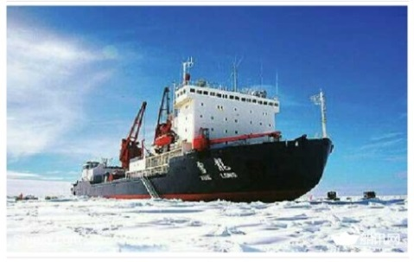
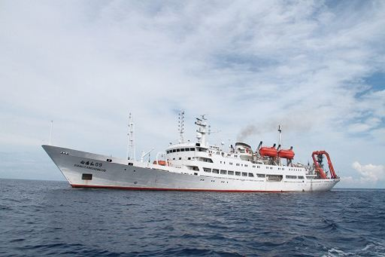
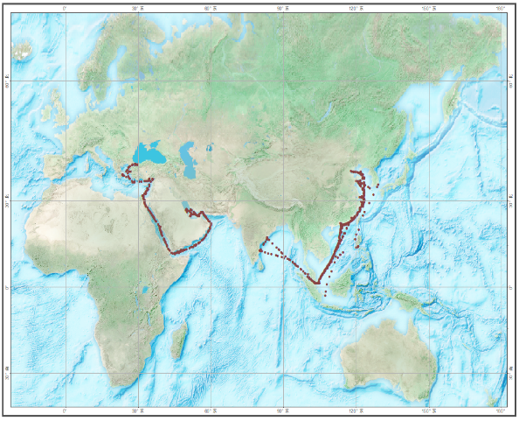
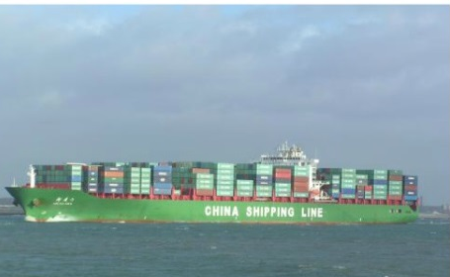
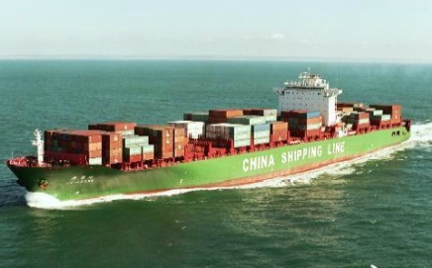
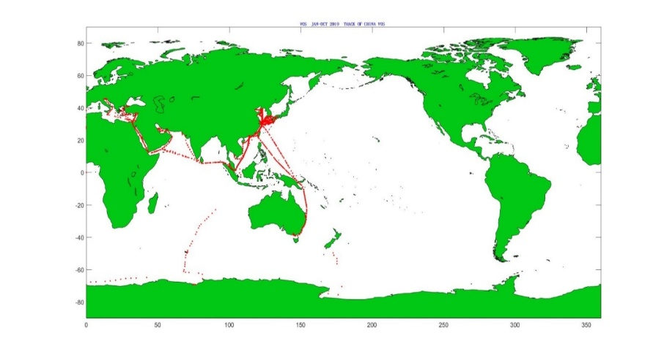
China VOS Activities
VOS Status
Category | No. of ships at 31 Dec 2020 | Recruitments in 2020 | De-recruitments In 2020
Selected AWS | 115 | 29 | 0
VOSClim AWS | 0 | 0 | 0
R/V XUE LONG
R/V XIANG YANG HONG 09
Trajectory chart of China VOS in 2020
XIN XIA MEN
XIN YAN TIAN
Trajectory chart of China VOS in 2019
4

Slide 5
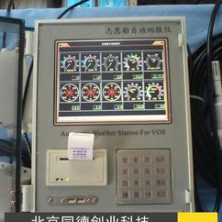
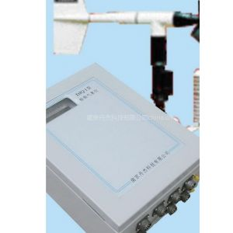
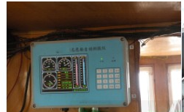
China VOS Activities
Shipboard Automatic Weather System
Type | No. of ships at 31 Dec 2020 | Manual Input Yes / No | Method of Comms
XZC2-2SA | 95 | Yes | Inmarsat-C or Beidou Navigation Satellite
XZC2-2SC | 5 | No | Beidou Navigation Satellite
XZC6 | 11 | No | Inmarsat-C or Beidou Navigation Satellite
DJQ-1 | 4 | No | CDMA, Beidou Navigation Satellite
XZC2-2SC
HYY-XZC2-2SA
DJQ-1

Slide 6
China VOS Activities
PMO ship visit activities
Activity | Manual Ship | AWS Ship
Routine VOS inspections |  | 11
VOS recruitment visits
VOS de-recruitment visits
Total visits by national PMOs | 11
Total number of PMOs | 3
6

Slide 7
China VOS Activities
Data collection and management
From April 2017, efforts were made to share China VOS data to GTS. 8 well operated VOS ships were selected.
No | English Name | Call sing | Owner | Type
1 | XIANG YANG HONG 09 | BNPC | SOA | Research Vessel
2 | HE CHEN | BKWD6 | Zhoushan Hefeng Shipping Co., LTD | Merchant Ship
3 | YU KUN | BQHZ | Dalian Maritime University | Training Ship
4 | XIN CHI WAN | BPBC | CHINA COSCO Shipping Group | Container Ship
5 | XIN XIA MEN | BPBB | CHINA COSCO Shipping Group | Container Ship
6 | XIN FU ZHOU | BPBE | CHINA COSCO Shipping Group | Container Ship
7 | XUE LONG | BNSK | SOA | Research Vessel
8 | XIN YAN TIAN | BPBA | CHINA COSCO Shipping Group | Container Ship
7

Slide 8
China VOS Activities
Contributions and data collected for SOT
In 2019: 7 Chinese VOS ships were in place and data from them were transmitted to GTS operationally.
In 2020: 4 Chinese VOS ships were in place and data from them were transmitted to GTS operationally
Chinese voluntary ship observation data in 2019
Ship name | Cast | Starting time | End Time | South border | North border | East border | West border
Xin Xia Men | 428 | 2019010106 | 2019102806 | 1.2000 | 38.9000 | 0.0000 | 123.6830
Xin Yan Tian | 668 | 2019010106 | 2019103018 | 1.1000 | 45.7000 | 0.0000 | 128.8000
Xin Chi Wang | 434 | 2019032705 | 2019103006 | -39.2830 | 31.3830 | 0.0000 | 154.1830
Yu Kun | 328 | 2019031900 | 2019102806 | 8.3000 | 39.4000 | 103.5000 | 123.4000
Hechen | 1512 | 2019050507 | 2019103011 | 29.1000 | 35.0830 | 121.0000 | 133.8830
XiangYangHong 09 | 290 | 2019031818 | 2019102806 | 35.4000 | 36.0830 | 119.5000 | 120.3000
Xue Long | 459 | 2019010106 | 2019073018 | -75.6830 | 31.3830 | 3.0830 | 359.4000
Total | 4119
Chinese voluntary ship observation data in 2020
Ship name | Cast | Starting time | End Time | South border | North border | East border | West border
Xin Xia Men | 363 | 2020011412 | 2020123018 | -3.2830 | 39.0000 | 0.0000 | 123.4000
Xin Yan Tian | 417 | 2020011412 | 2020123012 | 11.8830 | 41.0000 | 23.6000 | 60.0830
Xin Chi Wan | 173 | 2020011518 | 2020122812 | 1.2000 | 36.0000 | 80.3000 | 129.1000
Xue Long | 47 | 2020120812 | 2020123112 | 31.2830 | 31.2830 | 121.6830 | 121.6830
Total | 1000
8

Slide 9
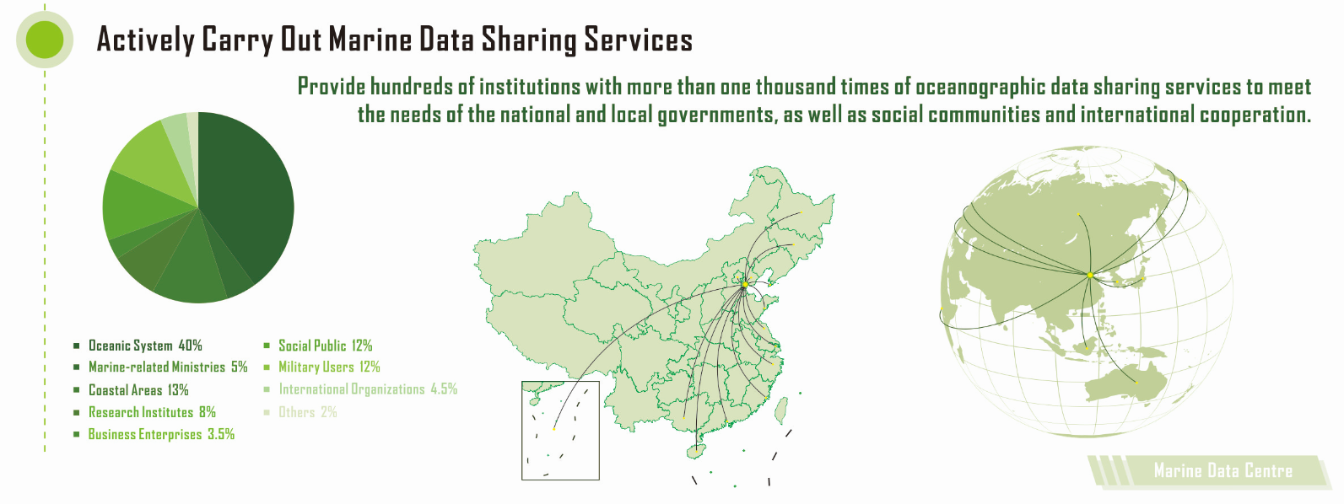
Other initiatives/resources: Met and ocean network
Data sharing and service
Notes:
重点讲CMOC

Slide 10
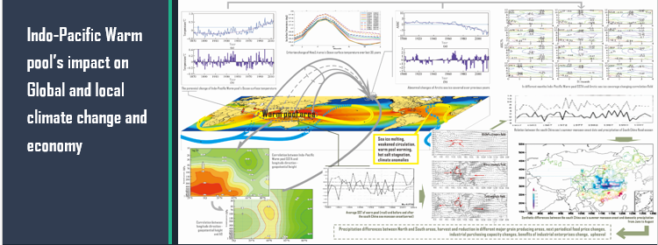
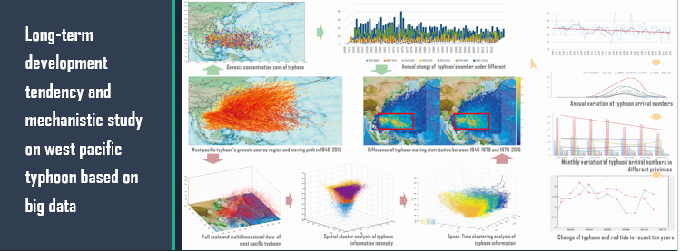
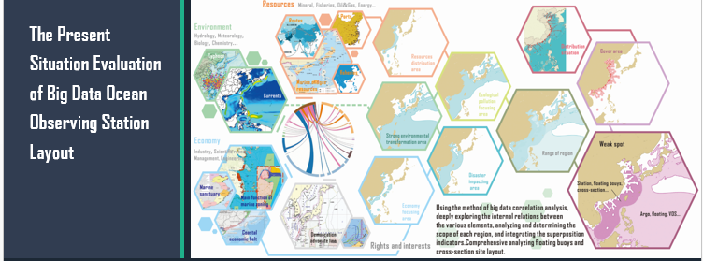
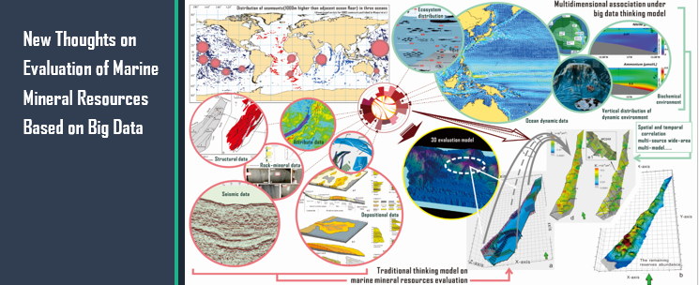
Other initiatives/resources: Met and ocean network

Slide 11
Gaps and Requirements, and Covid-19 Impact
Gaps and Requirements
-Replacement of AWS
-Instruments purchase and ships recruitment
-Boarding visit and AWS maintenance
Covid-19 Impact
-Less voyages, less data
-Less international exchange
-Poorer communication

Slide 12
Future Plans
1. More VOSs
National Marine Observation Network Planning
- stressing on the VOS observation
- target: over 400 Voluntary Observing Ships in position
- gradually enlarge the team of Chinese VOS for data sharing
2.Fit in with the VOS standards
- better coordination and cooperation among multi-departments in China
- adjustment of the VOS specifications, data transmission format, data manage policy, software (and/or hardware) in China to fit for the international standards
3. Marine big data study
- study on marine big data methodology and practice
- aiming at marine disaster early warning and forecasting, global climate change
4. Calibrate instrument regularly, continuously improve data quality
5. International exchange and cooperation

Slide 13
THANK YOU ! QUESTIONS? IN CASE I AM NOT ABLE TO ANSWER IT RIGHT NOW OR I DIDN’T UNDERSTAND YOU QUITE WELL, PLEASE FEEL FREE TO E-MAIL ME. I WILL REPLY AS SOON AS POSSIBLE. newyjk@126.com

