Slide 1
Germany Deutscher Wetterdienst (DWD)
Henry Kleta (henry.kleta@dwd.de)
Marine Network Manager, NFP for SOT, VOS, ASAP
with contributions from various german agencies / organizations

Slide 2
About Organisation (Met-Ocean Structure)
Deutscher Wetterdienst (DWD)
SOT, VOS, ASAP, E-Surfmar, E-ASAP
responsible for GTS data (meteorology)
Bundesamt für Seeschifffahrt und Hydrographie (BSH)
SOOP, ARGO, DBCP
responsible for GTS data (oceanography)
Alfred Wegener Institute (AWI) and Max Planck Institute for Meteorology (MPI)
ASAP
GEOMAR and IOW
SOOP (SOCONET - ICOS)

Slide 3
SOT Activities
ASAP
DWD stations integrated in E-ASAP
AWI (RV Polarstern): ASAP profiles in GTS
MPI (on RV Sonne): ASAP profiles in GTS
SOOP
No XBT lines
BSH: 9 fixed stations in german waters
GEOMAR, AWI, IOW: ICOS pCO2 measurements (not yet in GTS)

Slide 4
SOT Activities
PMO Network
Hamburg Marine Network Manager Henry Kleta
3 PMOs Steffen Steinmöller
Susanne Ripke
Matthias Hoigt
1 ASAP PMO Harald Budweg
3 AWS Technicians Jens Mehlinger
Florian Göhring
Markus Trommer
Bremerhaven 2 PMOs Cord Grimmert
Ortrun Arth
central address: PMO@DWD.DE

Slide 5
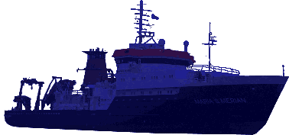
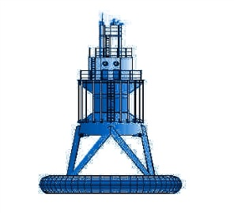
SOT Activities
DWD VOS fleet (12/2020), number of VOS stations
NMHS Operated 456
NMHS Cooperative 95
Other 5
Total: 556 (103 AWS)
Maersk: 170 (on 128 vessels, 43 AWS)

Slide 6
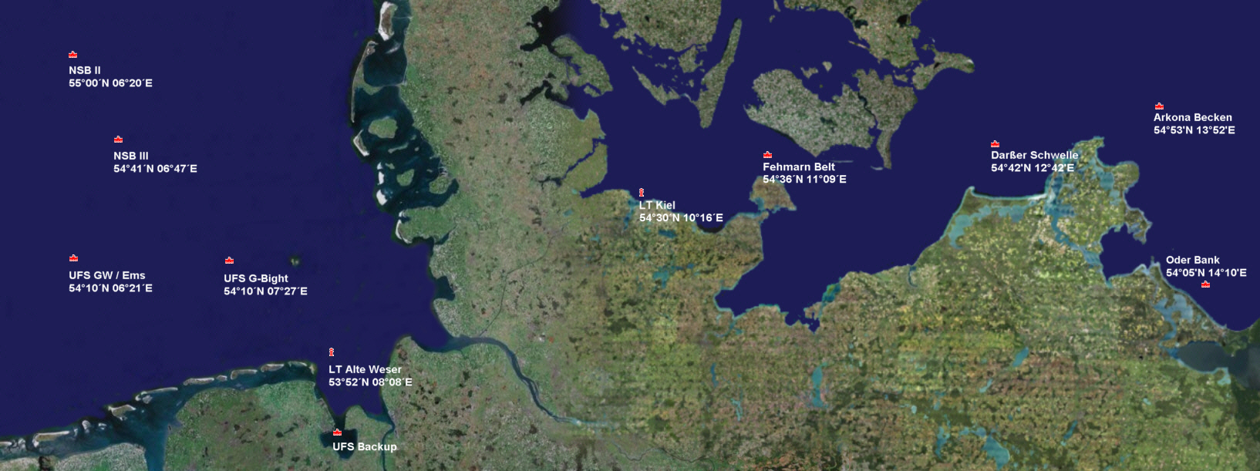
SOT Activities
Other (stations on fixed positions)

Slide 7
SOT Activities

Slide 8
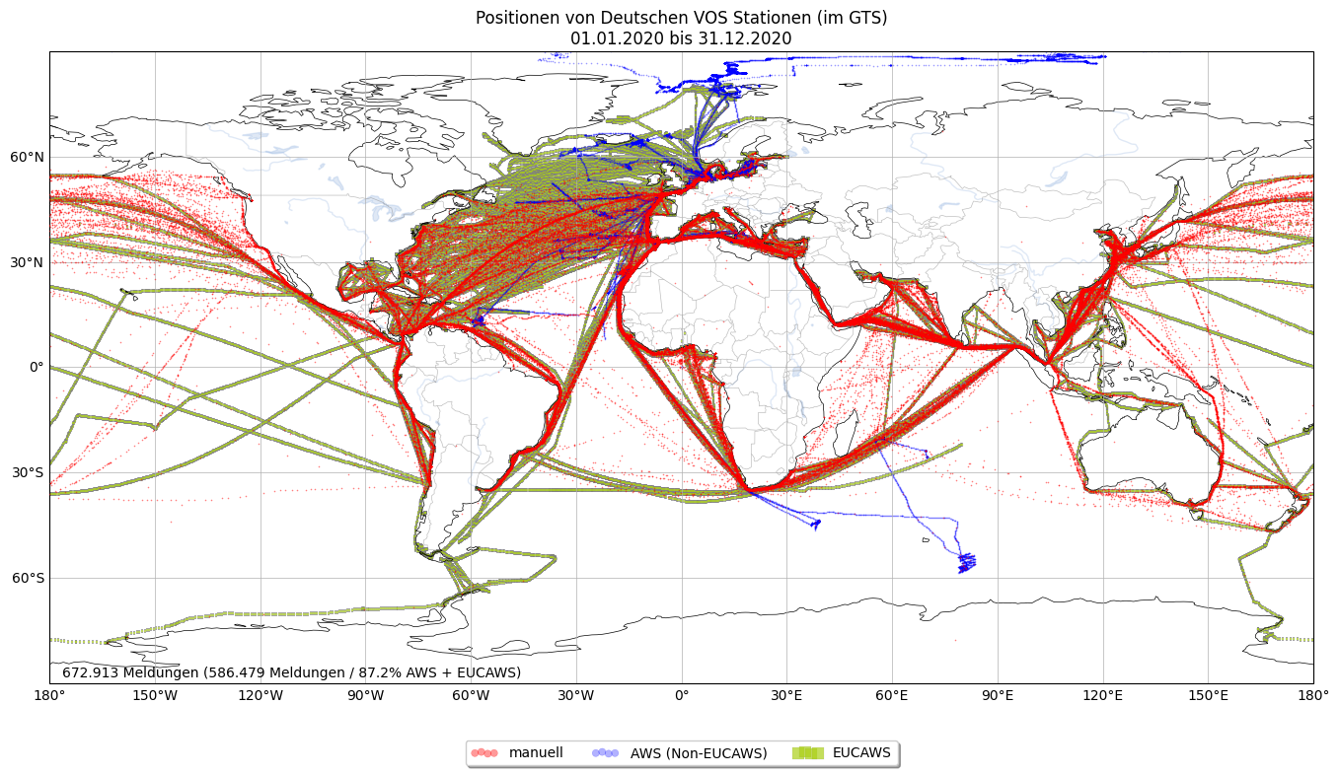
SOT Activities

Slide 9
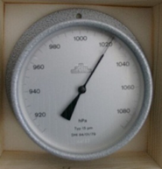
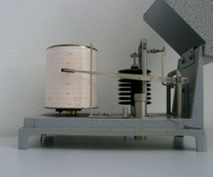
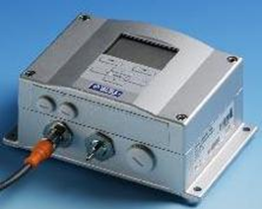
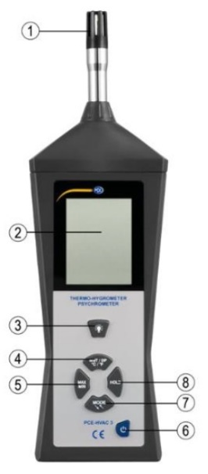
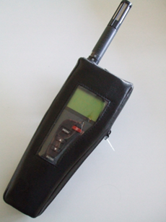
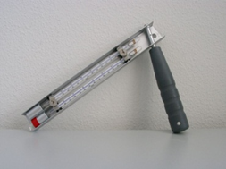
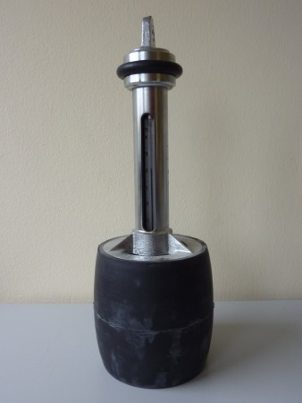
SOT Activities
Conventional VOS – sensors
+ ->
-> ->
PCE HVAC 3

Slide 10
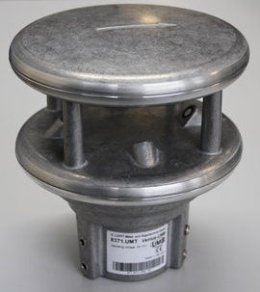
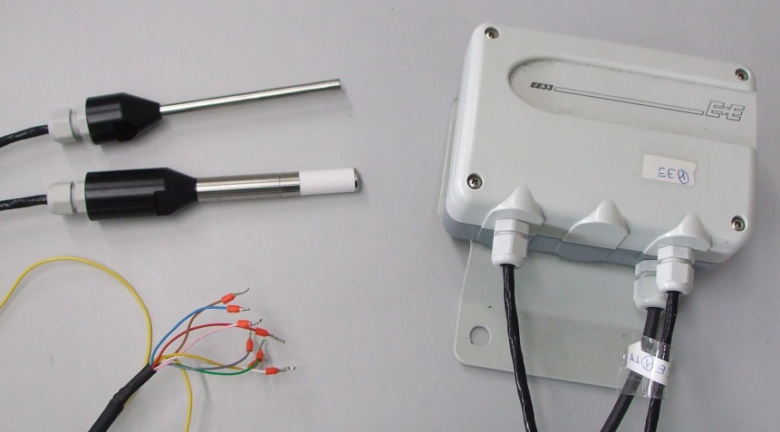
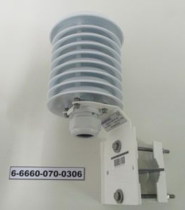
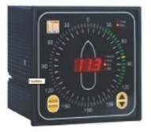
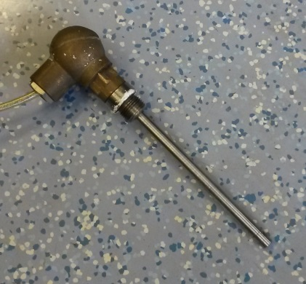
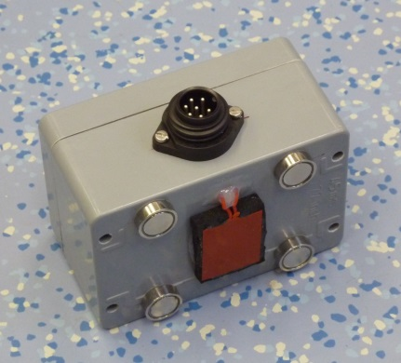
SOT Activities
Automatic VOS – sensors

Slide 11
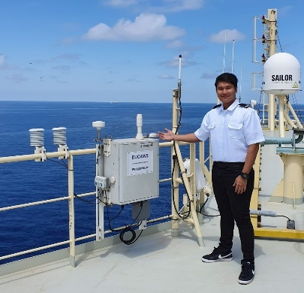
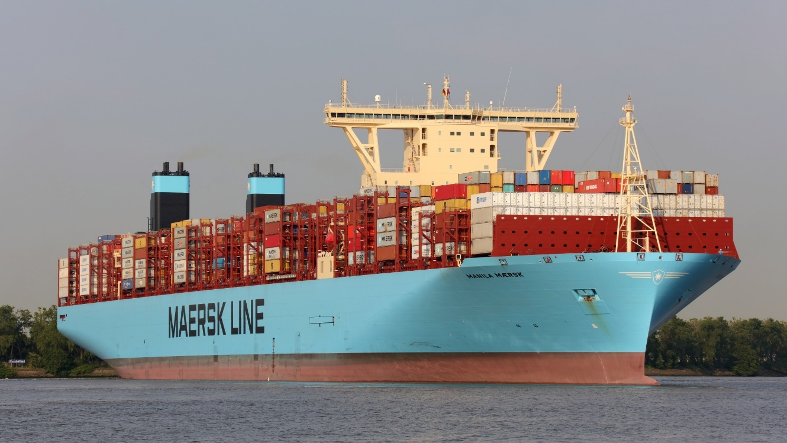
SOT Activities
EUCAWS @ Maersk – now 50 AWS active

Slide 12
Other initiatives/resources: Met and ocean network
Coordination with german navy
deployment of 15 drifting buoys (provided by NOAA/GDP) in indian ocean later this year from FGS Bayern
Coordination with scientific community
ongoing discussions to integrate scientific systems into VOS dataflow
ISO committee "marine technology"
german delegate to ISO/TC 8/SC 13

Slide 13
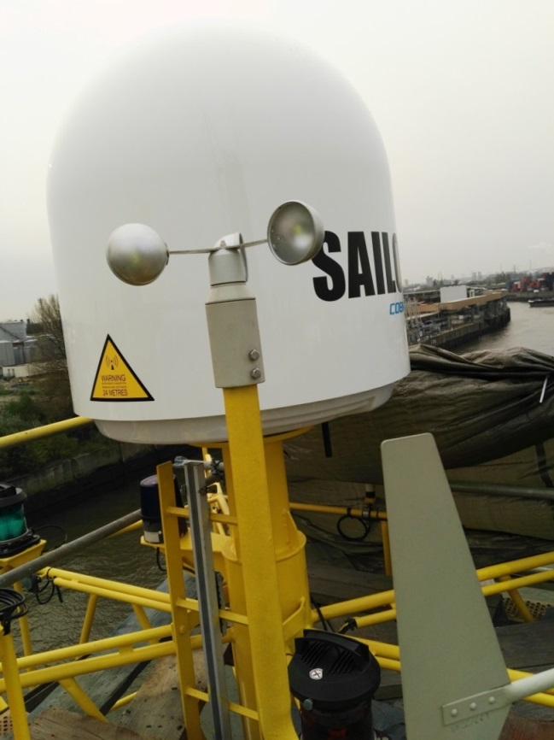
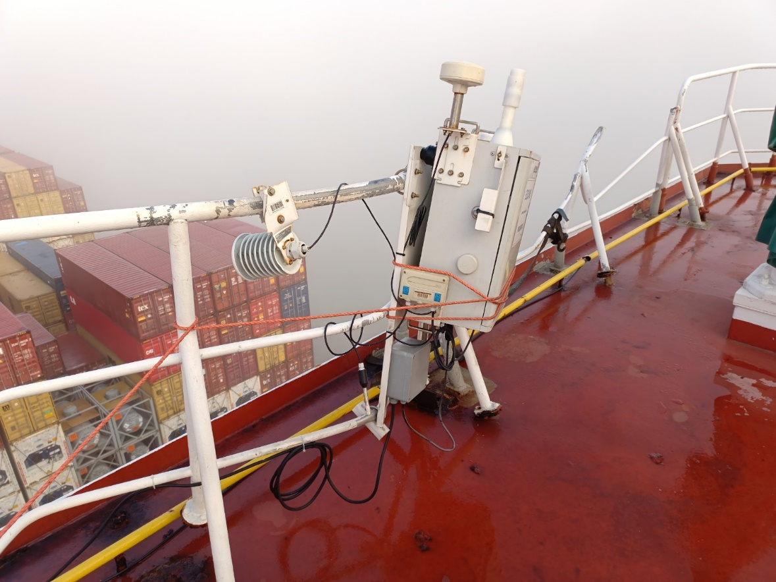
Gaps and Requirements, and Covid-19 Impact
Challenges...

Slide 14
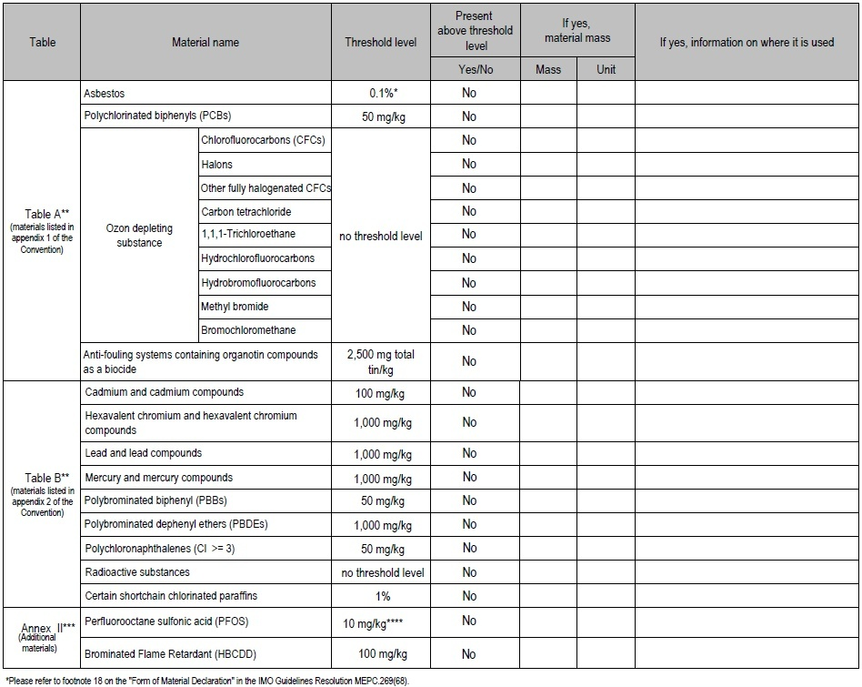
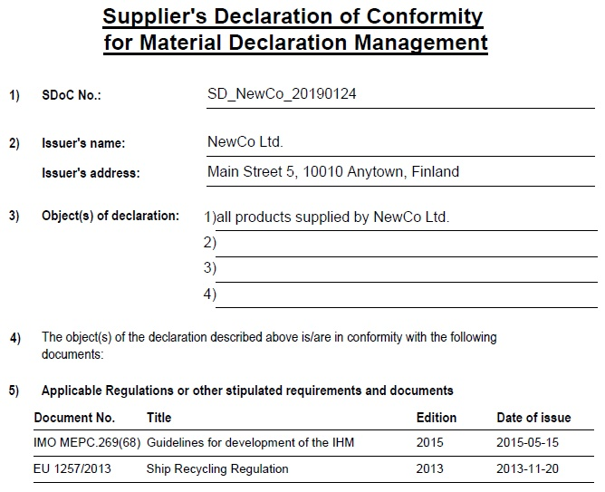
Challenges
IMO
Material Declaration / Declaration of Conformity

Slide 15
Discussion

