Slide 1
Hong Kong, China
Chow Chi Kin
( ckchow@hko.gov.hk )
Port Meteorological Officer
Hong Kong Observatory (HKO)

Slide 2
About Organisation
(Met-Ocean Structure)
VOS responsibilities: HKO participated in the VOS Scheme in 1949. First visit to ships made as early as in 1892
SOOP responsibilities: Nil
ASAP responsibilities: Nil
Institute/staff (PMOs): One part-time PMO

Slide 3
SOT Activities (1): VOS
2020 Statistics
78 VOS in 2020 (1 more VOS was recruited in May 2021)
2 Automatic Ships installed with AWS
(i) AMOS (UKMet Office)
(ii) Modified drifting buoy
17,332 ship observations (BBXX) distributed on the GTS
10,401 automatic observations distributed on the GTS
12,001 delayed mode data files in IMMT submitted to GCC

Slide 4
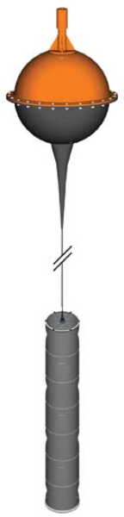
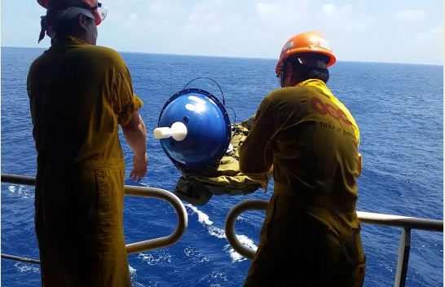
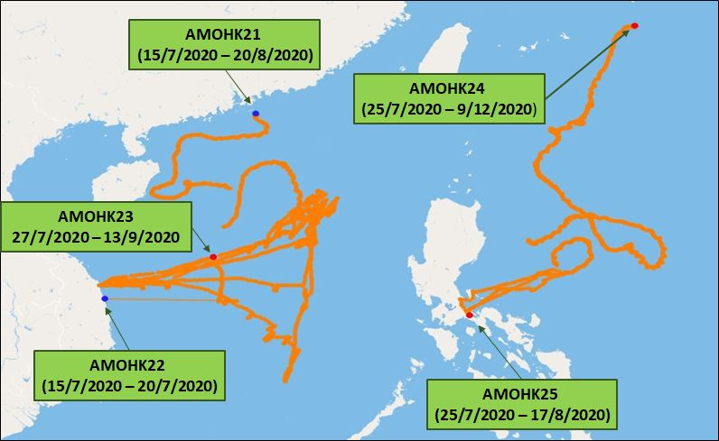
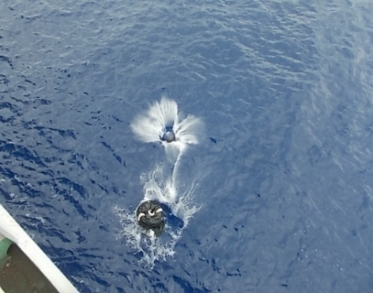
SOT Activities (2):
Drifting Buoy Deployment
MetOcean Surface Velocity Program (SVP) drifting buoy attached with a holey sock drogue
With the help of HKVOS, 3 buoys were deployed in the South China Sea and 2 in the western North Pacific between July and August 2020. (5 more buoys were deployed in the same areas between June and July 2021)
SVP drifting buoy

Slide 5
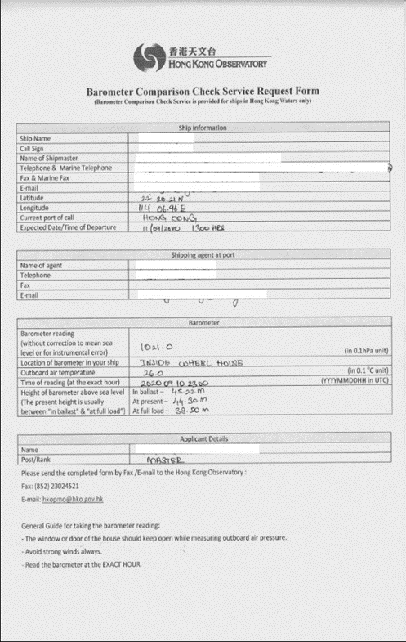
PMO Activities (1)
Number of VOS visits by PMO: 3
(only in Jan 2020)
Ship visits suspended following outbreak of COVID-19
Shipmasters requesting for barometer calibration are invited to send “Barometer Comparison Check Service Request Form” to HKO with pressure reading, barometer height & temperature information via email or fax when the ship is berthing at HK
Information on the correction indexes sent back to shipmasters
Totally 30 requests for barometer calibration in 2020 (15 requests up to July 2021)

Slide 6
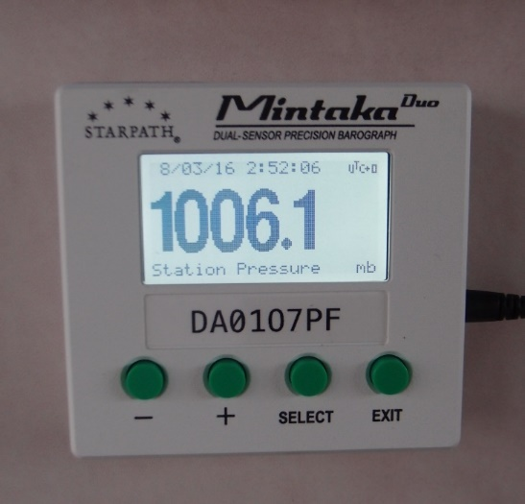
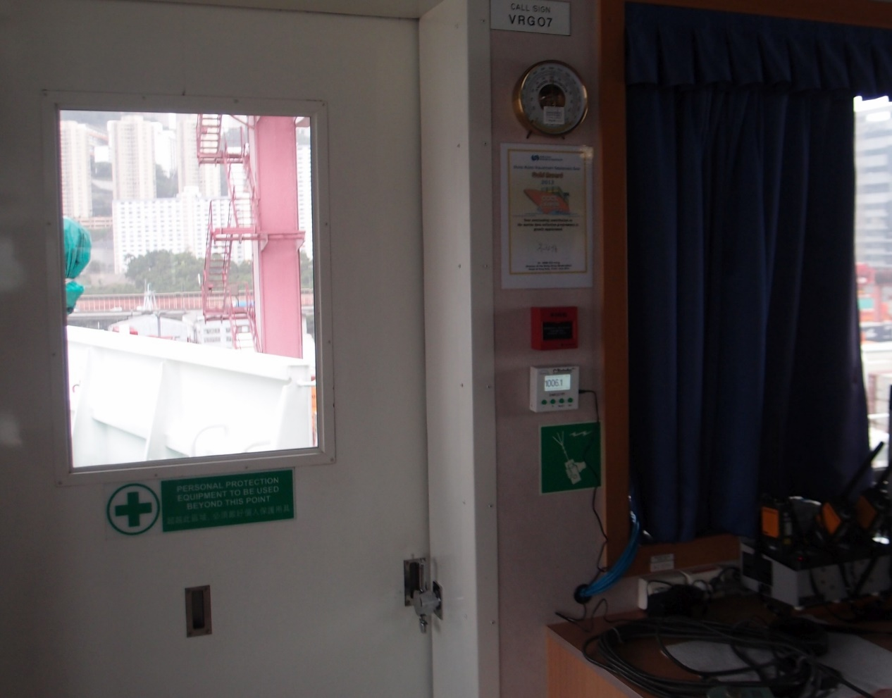
PMO Activities (2)
46 VOS have installed digital barograph onboard (up to July 2021)
(58 % of total number of ships in the HKVOS fleet)

Slide 7
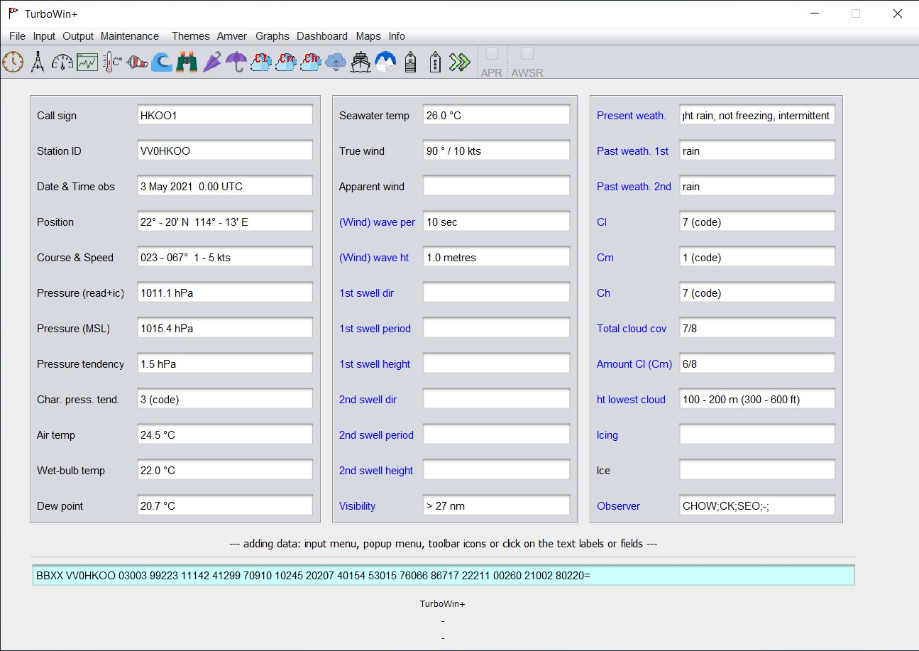
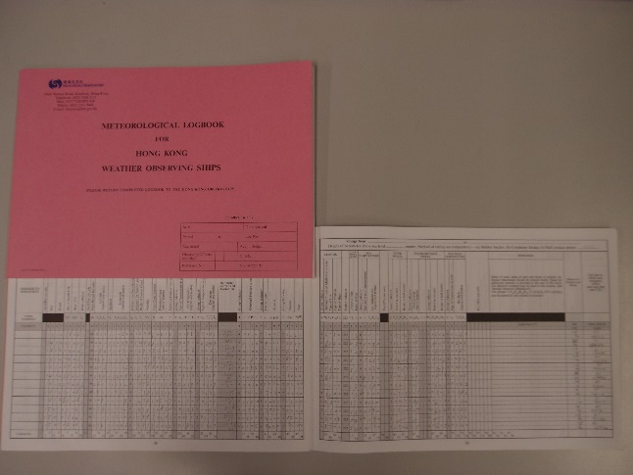
PMO Activities (3)
76 VOS (out of 79) are using electronic logbooks
(TurboWin / TurboWin+)
Paper logbook
Electronic logbook

Slide 8
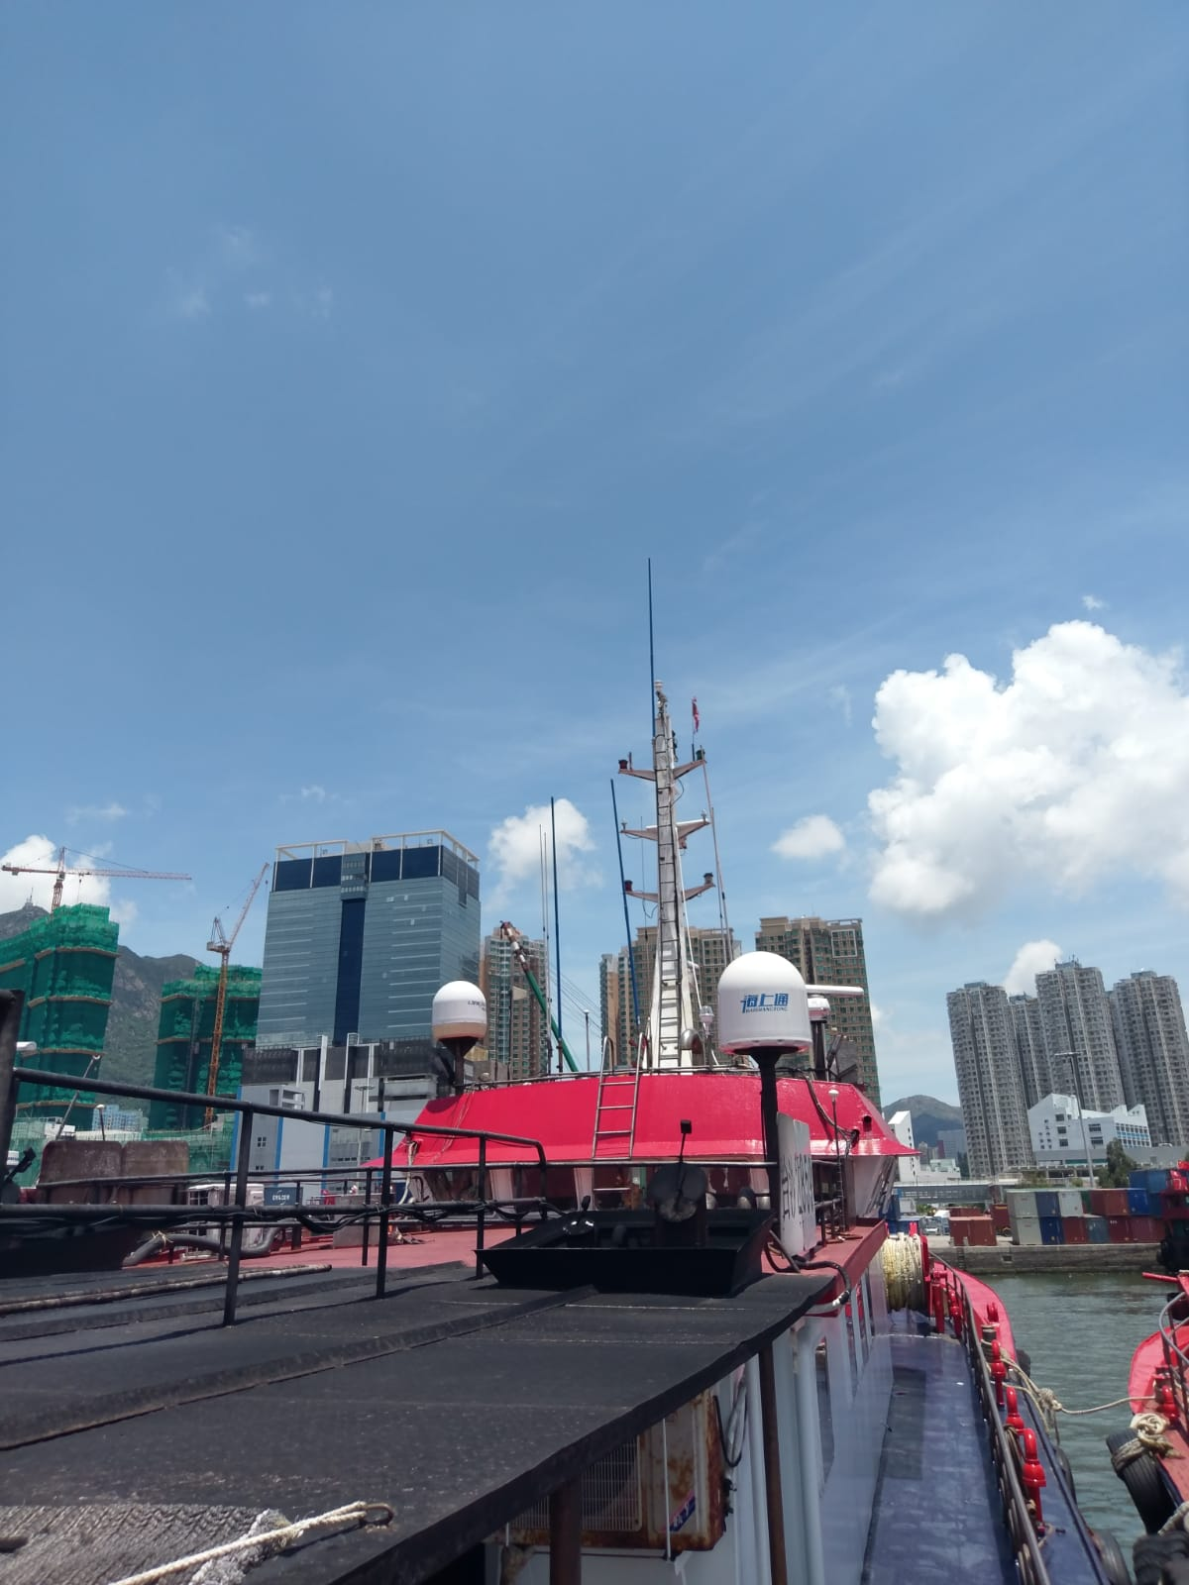
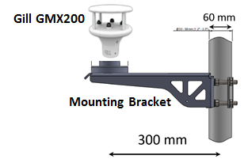
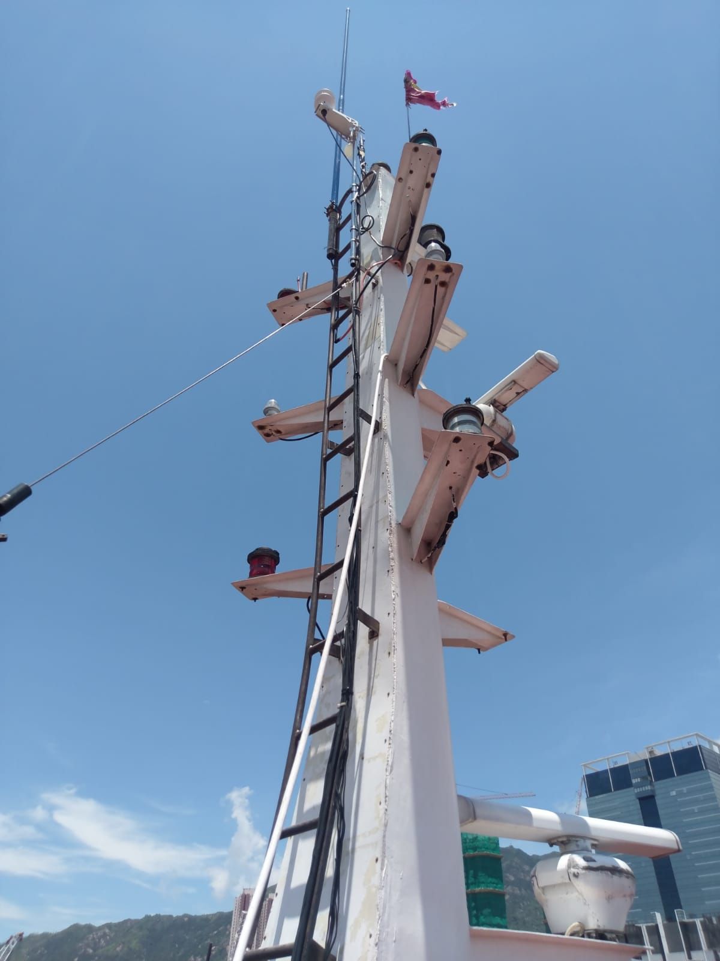
Other initiatives/resources:
Met and ocean network
Trial operation of ultrasonic anemometer on fishing vessel
An ultrasonic anemometer (Gill GMX200) was installed on a fishing vessel
The anemometer is equipped with GPS and outputs both apparent and true wind
26 Jul 2019 – FV1 installed on the top of mast of a fishing vessel
FV1
(Beidou satellite)

Slide 9
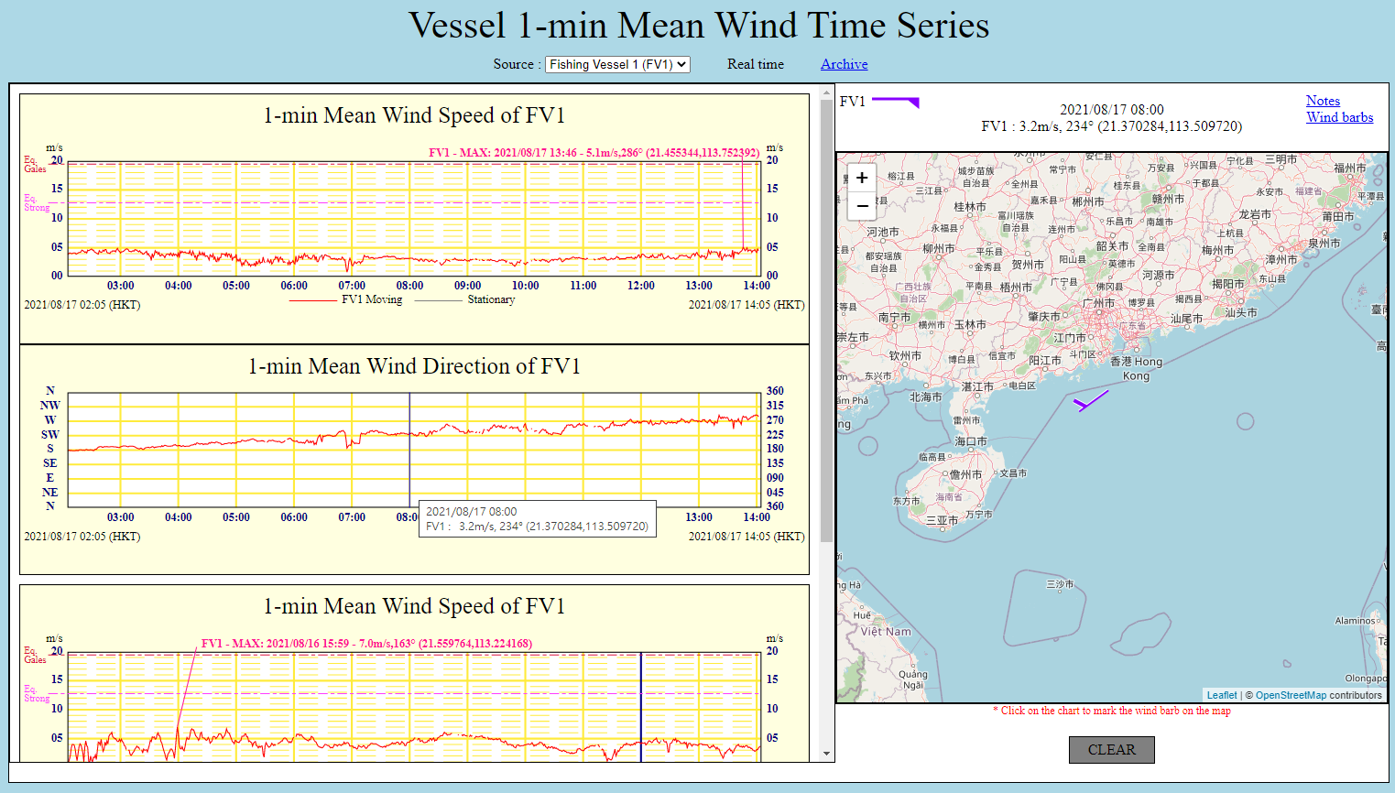
1-min mean wind data collected & transmitted in real-time via Beidou back to HKO

Slide 10
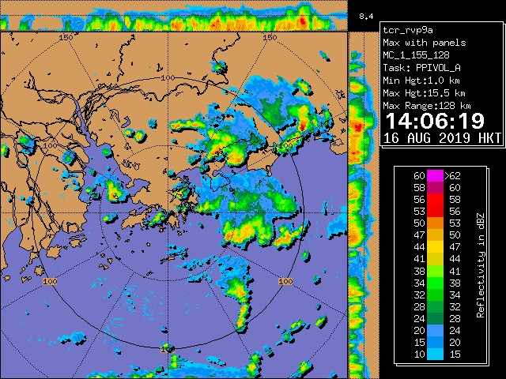
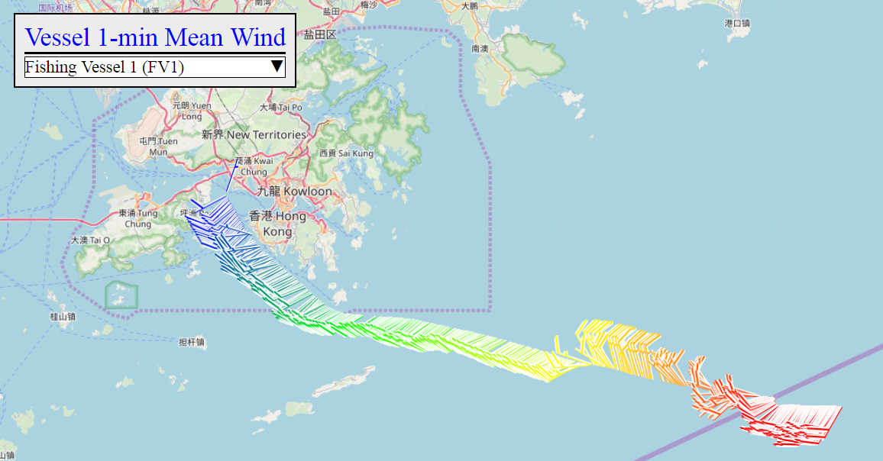

FV1 encountered downbursts from a squall line on 16 Aug 2019
14:06H
14:01H

Slide 11
Gaps and Requirements, and Covid-19 Impact
HKVOS visits have been suspended since early 2020 due to outbreak of COVID-19. On-site calibration of ship barometers became impracticable
A few vessels were moored at ports for a long time following the pandemic and were unable to report marine observations (e.g. cruise ships)
Automatic transmission of weather observations still not feasible for some VOS with older version TurboWin and limited internet access onboard

Slide 12
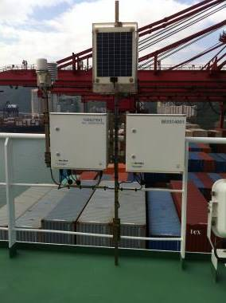
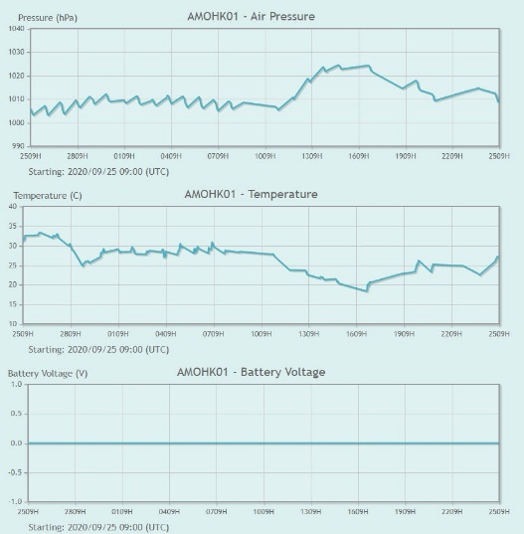
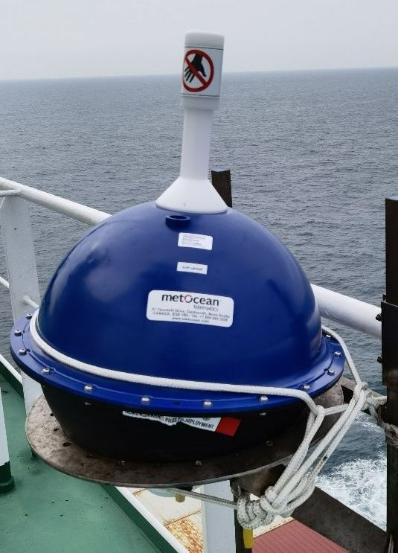
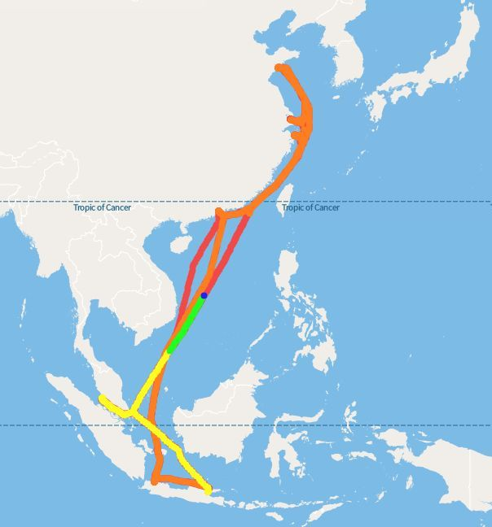
Gaps and Requirements, and Covid-19 Impact
Two AWS onboard HKVOS have run out of battery with no data transmission since Jul/Oct 2020 respectively
Delay of maintenance due to suspension of ship visit
Battery for UK AMOS (AMOHK01 on OOCL Bangkok) was acquired. The vessel does not plan to return to HK in 2021. Battery replacement pending
A new drifter was acquired in Jan 2021 and re-mounted onboard “OOCL Savannah”. Dissemination to GTS by AMOHK02 resumed since April 2021
Voltage = 0
AMOHK01 remained unserviceable
AMOHK02 remounted, dissemination of weather information resumed

Slide 13
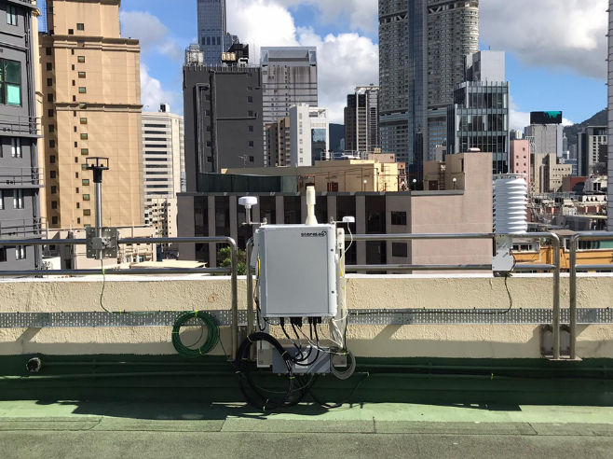
Future Plans
To install a set of European Common Automatic Weather System (EUCAWS) onboard one selected HKVOS as pilot project to collect weather observation data over the sea
Liaison with shipping company in progress in order to identify a suitable vessel
System has been installed at the rooftop of HKO Headquarters for testing

Slide 14
Thank You !

Slide 15
Supplementary Slides

Slide 16
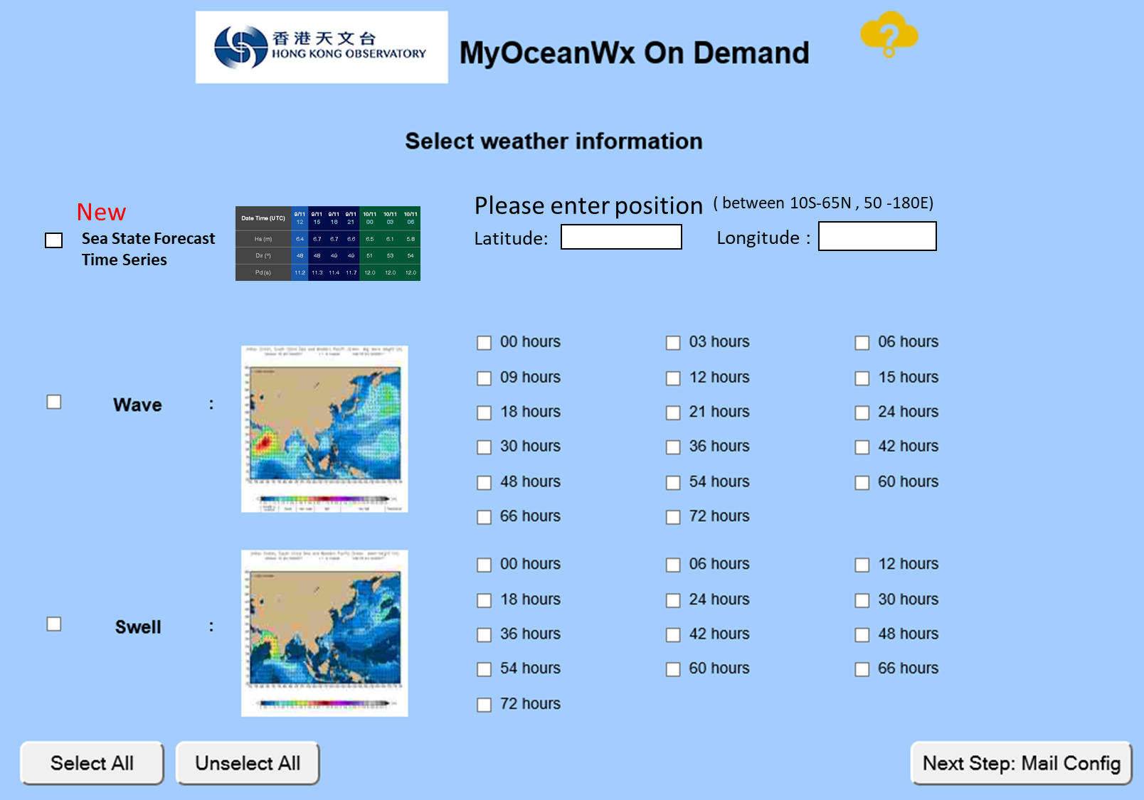
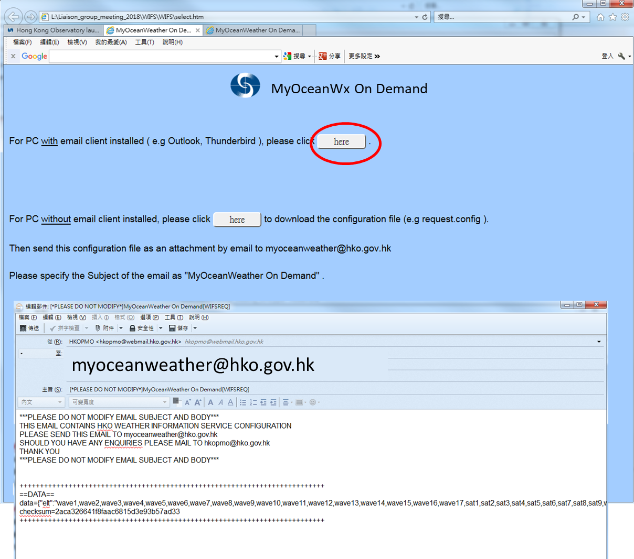
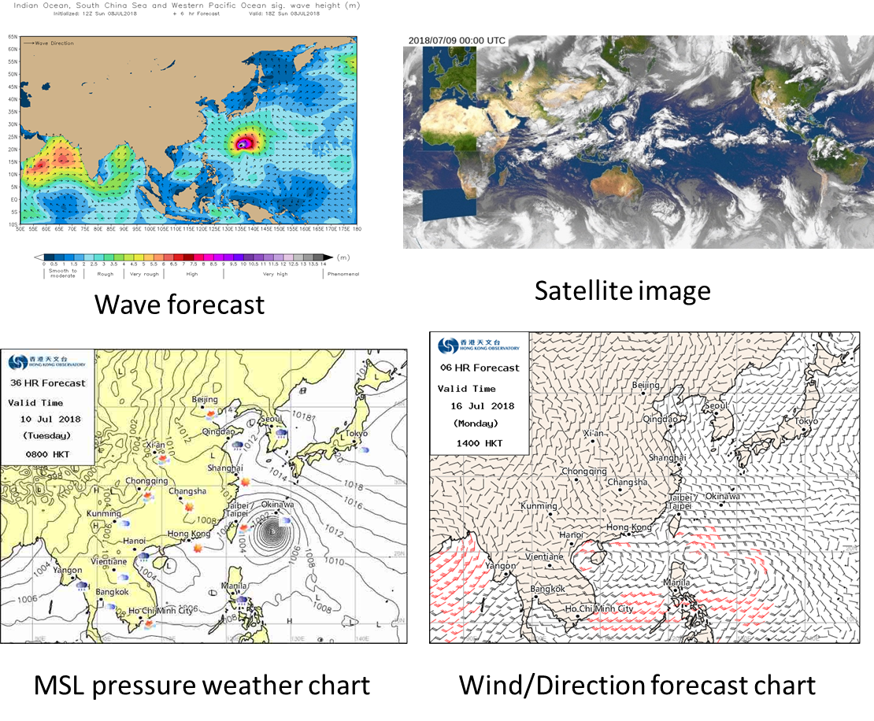
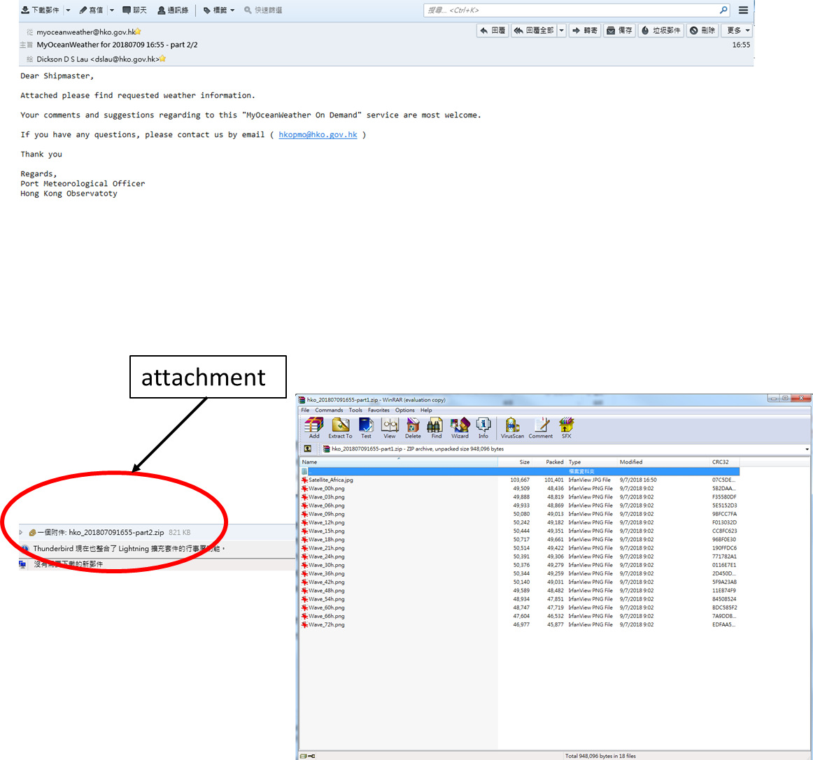
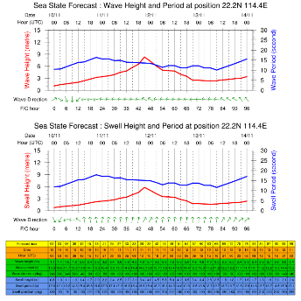
Other initiatives/resources:
MyOceanWx On Demand Service
On-demand weather services via email
An off-line system (no internet access is required onboard)
Weather information include
1. Wave / swell height forecast charts
and time series.
2. Satellite imageries
3. NWP MSLP charts
4. NWP temperature forecast charts
5. NWP wind forecast charts
6. NWP weather forecast charts
7. Weather bulletins of HK (9 days weather forecast, local weather forecast, tide information, TC warning)
a mail with attachment for the requested products will be sent to the shipmaster within 30 minutes
Time series of wave, wind and swell

Slide 17
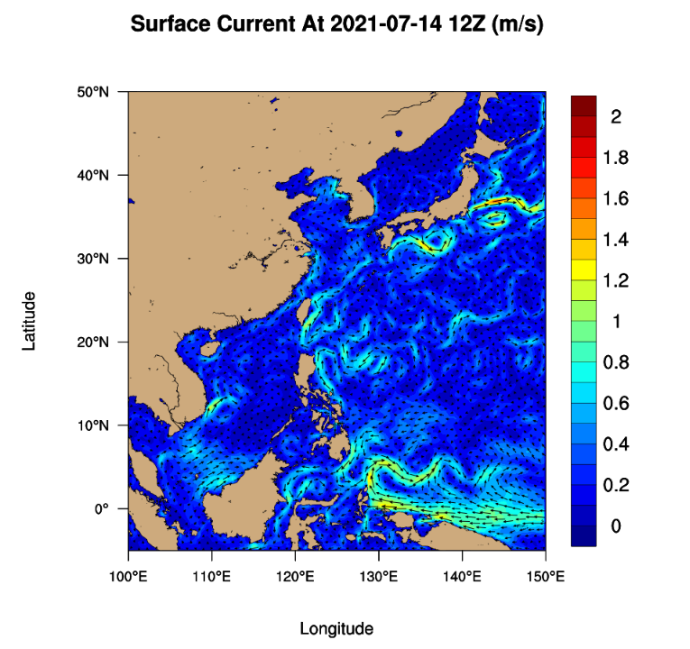
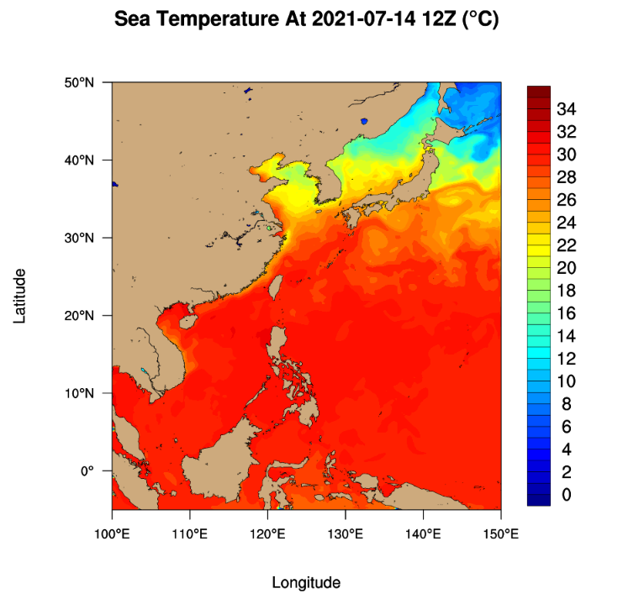
Future Plans (2)
Deploy drifting buoys under the DBCP Barometer Upgrade Program in the South China Sea and western North Pacific ( & probably add a wave drifter)
Replace all aneroid barographs with high precision digital barographs onboard HKVOS
Provision of ocean forecast to shipping community
Ocean modelling forecast covering the western Pacific Ocean and the South China (5S - 55N, 100 - 150E )
144-hour (6 days) forecast of sea surface current, temperature, salinity, etc. in 3-hourly intervals
Forecast updated twice daily
Sea Current
Sea Temperature

Slide 18
Network diagram (Fishing Vessel)
Wind Sensor
King’s Park
Data pushing
Beidou Receiver
Device Server
To HKO
Beidou Transmitter
LP3500
(SBC)
Device Server
HKO
Tablet
(display, serialization and data logging)
Virtual network
4G router
Polling Program
4G router
Data server for radiation data
Radiation Sensor

