Slide 1
Japan Meteorological Agency (JMA)
YAMAMOTO Mayu
Scientific Officer
vos-office@climar.kishou.go.jp

Slide 2
About Organisation (Met-Ocean Structure)
Japan Meteorological Agency (JMA)

Slide 3
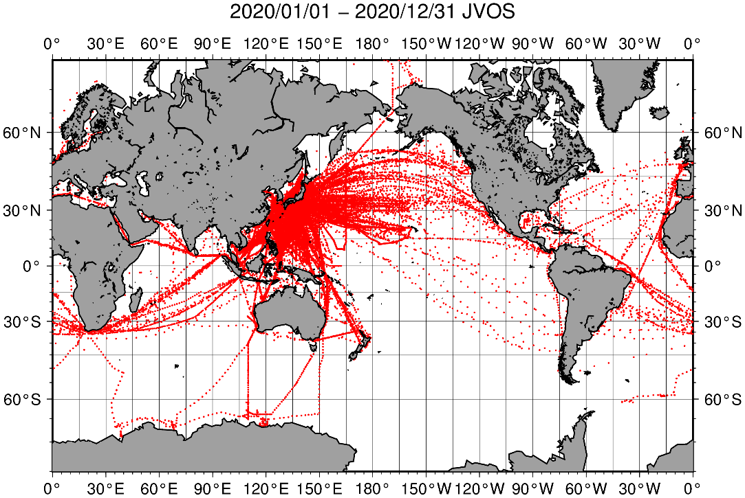
SOT Activities (VOS)
Japanese VOSs are about 600 vessels as of Dec. 2020
Most of Japan VOSs use their own instruments（Manual）
SHIP Reports from Japan VOSs amount about 41,000 messages
JMA recommends to use Turbowin
Inmarsat-C (SAC-41) / email is used for data transmission
SHIP Reports from Japan VOSs in 2020

Slide 4
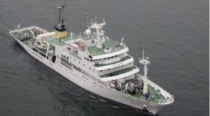
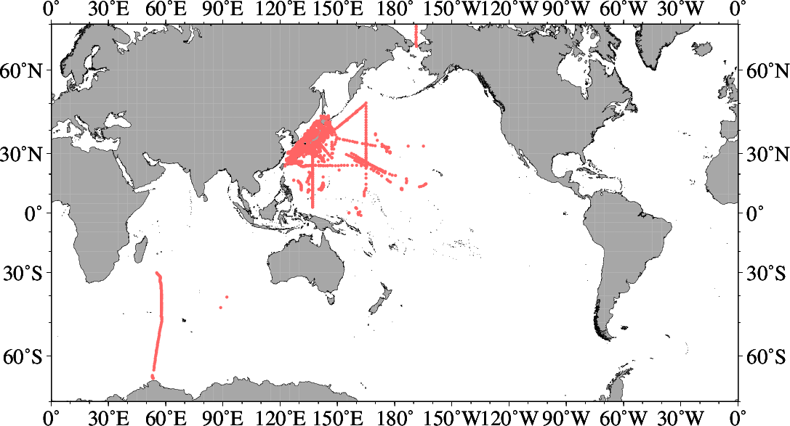
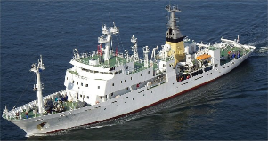
SOT Activities (SOOP)
JMA operates 2 research vessels (Ryofu Maru / Keifu Maru) and samples CTD profiles regularly on PX45 / PX46 line
These reports amount 121 messages
Reports from Japanese research / fishery training vessels amount 595 BATHY messages and 6,022 TESAC messages
Inmarsat-C (SAC-41) / email is used for data transmission
JMA’s research vessels
BATHY/TESAC messages in 2020
Ryofu Maru
Keifu Maru

Slide 5
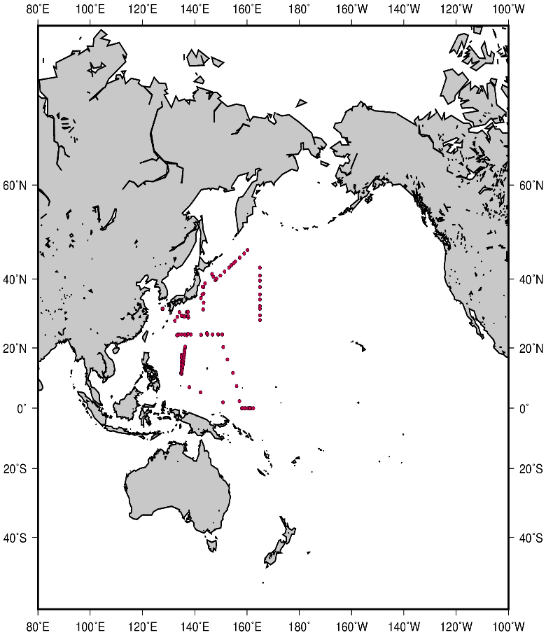
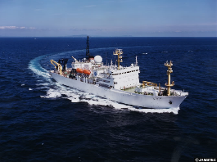
SOT Activities (ASAP)
Vessels operated by JMA (Ryofu Maru) and JAMSTEC (Mirai) provide upper air soundings on the GTS
TEMP-SHIP Reports from Japan amount 417 messages (Ryofu Maru : 84 , Mirai : 333)
Inmarsat-C (SAC-41) / email is used for data transmission
Vessels providing upper air soundings on the GTS in 2020
TEMP-SHIP messages in 2020
Ryofu Maru
Mirai
(JAMSTEC)

Slide 6
Gaps and Requirements, and Covid-19 Impact
JMA quit PMO visits in April 2021.
Now we only provide barometer checking services via e-mail for ships calling at Japanese ports.
Online service for barometer checking
(https://marine.kishou.go.jp/baro-chk/index.html)

Slide 7
Future Plans
JMA is now working on discontinuing the callsign masking scheme.
It is expected to be ended by March 2022.
Some vessels have already decided to quit the masking scheme, and the number of reports with callsign is gradually increasing.
Keifu Maru, a research vessel by JMA will contribute to "ASAP" from March 2022.

