Slide 1


Russian Federation,
Federal Service on Hydrometeorology and Monitoring of Environment (ROSHYDROMET),
N.N. Zubov State Oceanographic Institute,
Moscow
RF National VOS coordinator
Vasiliy A. Melnikov
" Vasiliy Melnikov" <vmelnikov@ocean.ru>

Slide 2

About Organisation
ROSHYDROMET https://www.meteorf.ru
NATIONAL OBSERVATION NETWORKS
Meteorological stations and observation sites, including AMS (of which 204 are hard-to-reach-stations)
Hydrological stations and sites
Agrometeorological stations
Upper-air stations
Doppler radars (ДМРЛ-С)
About Organisation
Sites of land surface water quality monitoring in terms of hydrochemical indicators
Radiation monitoring stations
Air quality monitoring sites
Sites of marine environment quality monitoring in terms of hydrochemical indicators
Sites of land surface water quality monitoring in terms of hydrobiological indicators
MORE THAN 30 TYPES OF OBSERVATIONS
Notes:
Meteorological stations and sites, including AMS (of which 204 are hard-to-reach-stations)
Hydrological stations and sites
Agrometeorological stations
Upper-air stations
Doppler radar stations (ДМРЛ-С)
Sites of land surface water quality monitoring by hydrochemical indicators
Radiation monitoring stations
Air quality monitoring sites
Sites of marine environment quality monitoring by hydrochemical indicators
Sites of land surface water quality monitoring by hydrobiological indicators

Slide 3
About Organisation
Research institutions:
N.N. Zubov State Oceanographic Institute ROSHYDROMET (Moscow)
Shirshov Institute of Oceanology Russian Academy of Sciences (Moscow)
Etc. https://www.meteorf.ru/about/structure/
ROSHYDROMET Data centers :
All-Russian Research Institute of Hydrometeorological Information - World Data Center https://www.meteorf.ru/about/structure/niu/354/
Etc. https://www.meteorf.ru/about/structure/

Slide 4
About Organisation
ROSHYDROMET
Management on hydrometeorology and monitoring environment (UGMS), UGMS branches –centers (CGMS)
Bashkir
Verkhne-Volzhskoe (marine)
Far East ( marine)
Zabaikalskoe
West Siberian
Irkutsk
Kamchatka ( marine)
Kolymskoe
Crimean ( marine)
Murmansk ( marine)
Ob-Irtysh
Privolzhskoe
Primorskoe( marine)
Republic of Tatarstan
Sakhalin (marine)
North (marine)
North-West ( marine)
North Caucasian ( marine)
Central Siberian
SCHMS CHAM
Chukotka (marine)
Ural
Central
Central Black Earth
Yakutsk

Slide 5
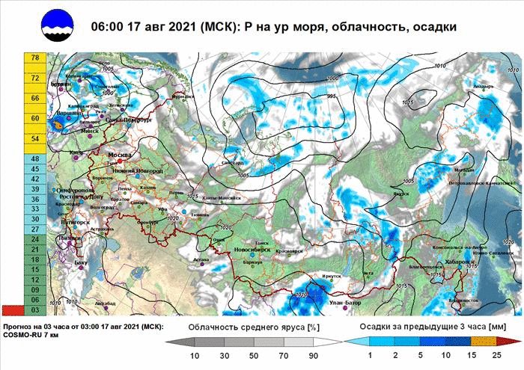
Use: Met and ocean network,
COSMO Model Forecast Maps-sea level pressure, cloudiness, precipitation.

Slide 6
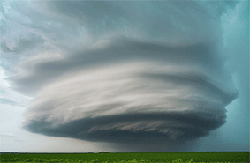
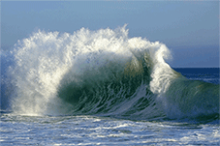
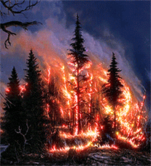
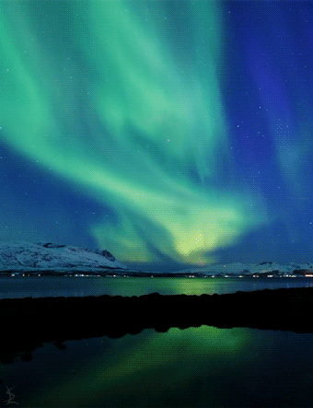
FOCUSING ON HAZARDOUS HYDROMETEOROLOGICAL EVENTS
ON THE TERRITORY OF THE RUSSIAN FEDERATION
METEOROLOGICAL
HYDROLOGICAL
Hurricanes
Tornados
Hail
Icing rains
Mudflows
Floods
Storm surges
1% GDP
Annual damage
Droughts
Heat and cold waves
Wild fires
Tsunami
Magnetic storms
CLIMATE
GEOPHYSICAL

Slide 7
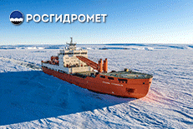
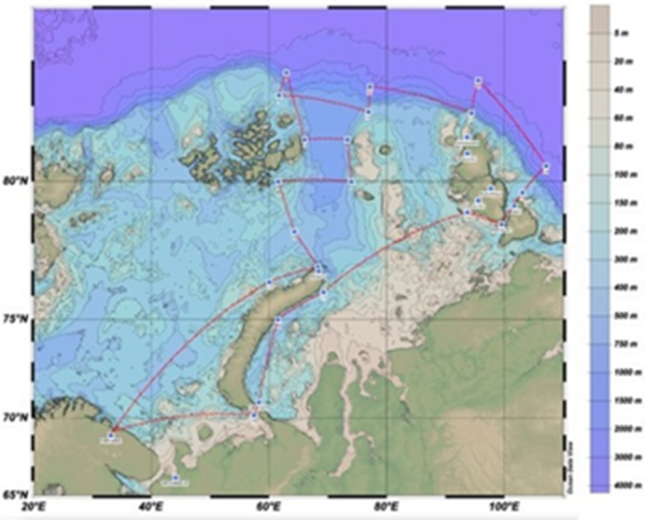
Arctic Region and Northern Sea Route

Slide 8
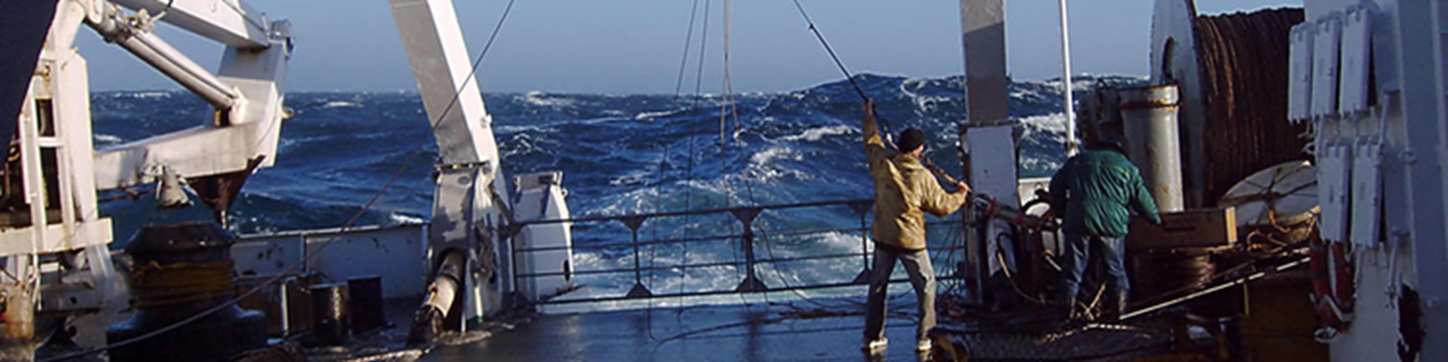
SOT Activities: Contributions and data
Numbers of vessels under Russian Federation flag that participated in the WMO VOS in 2017-2020 according to marine UGMS Roshydromet - VOS; Numbers of Automatic Weather Stations - AWS; Numbers of contributed observations by year.
Year UGMS | 2017 |  |  | 2018 |  |  | 2019 |  |  | 2020
 | VOS | AWS | Obs. | VOS | AWS | Obs. | VOS | AWS | Obs. | VOS | AWS | Obs.
Murmansk | 53 | 2 | 5120 |  |  |  |  |  |  | 38 | 7 | 4110
Primorsk | 21 | 1 | 1012 |  |  |  |  |  |  | 13 | 1 | 412
Sahalinsk | 14 | 0 | 3122 |  |  |  |  |  |  | 13 | 0 | 2495
North | 23 | 2 | 4120 |  |  |  |  |  |  | 15 | 3 | 3438
Total: | 111 | 5 | 13374 | 111 |  |  | 111 |  | 7.186 | 79 | 11 | 10455

Slide 9
Future Plans
It’s time to …
Roshydromet – supervision of the management infrastructure development;
Shirshov institute of Oceanology RAS (& several other RAS Institutes with research fleets) - Involvement to the VOS activity.
Goal and project: to equip most of available ships and research vessels with AWS.

Slide 10
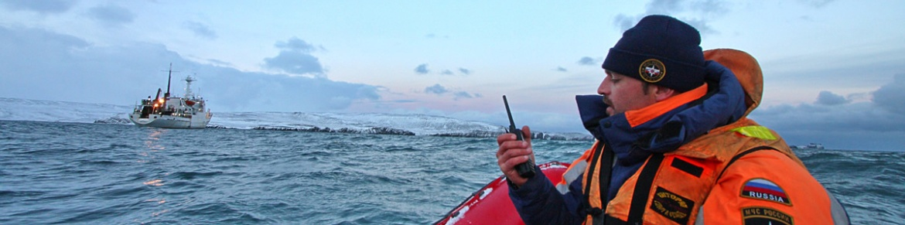
Thank you
for attention!

