Slide 1
Met Office (UK)
Fraser Cunningham fraser.Cunningham@metoffice.gov.uk
Marine Networks Manager

Slide 2
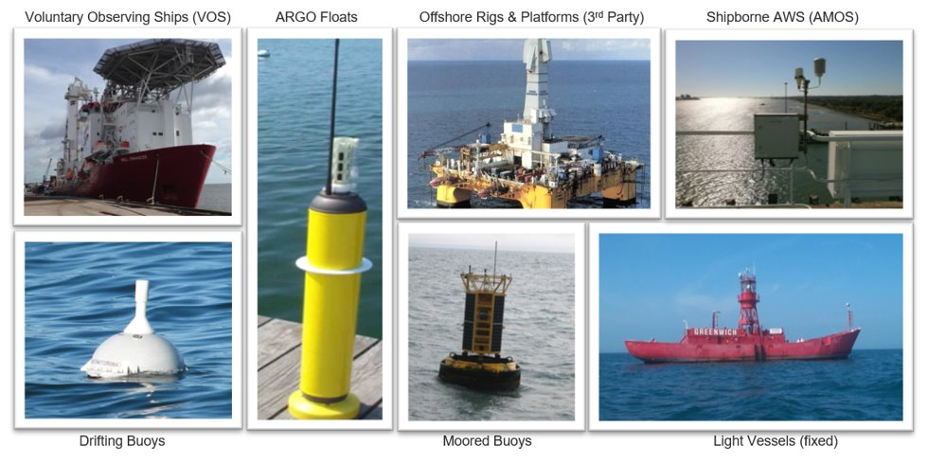
Met Office Marine Observing Networks

Slide 3
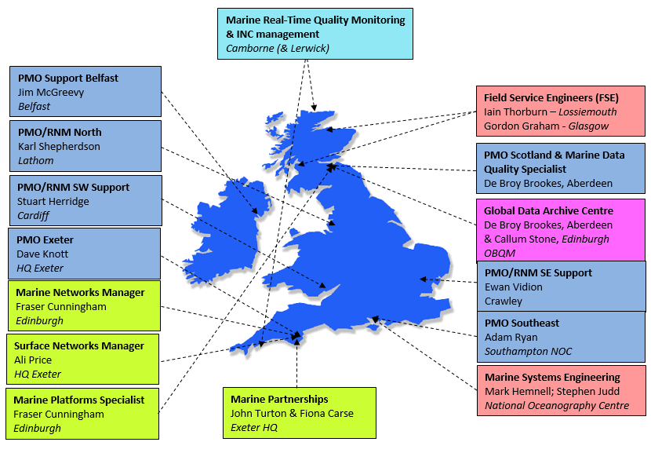
Met Office Marine Observing Networks
=~2.7 FTE PMO resource

Slide 4
UK VOS Fleet
Category​ | Number of Ships (July 2021)​ | Recruitments​ (2020- July 2021) | De-recruitments​ (2020 – July 2021)
NMHS Operated | 228 | 7 | 40
Conventional | 175 | 7 | 35
AMOS/2X | 53 | 0 | 5
Observation numbers (on-time)
PMO Activity 2020-21
 | 2020 | 2021 to end July
Manual (by HH+120) | 80K | 41K
AMOS (by HH+20) | 364K | 190K
3rd Party | 550K* | 320K*
2020 – 42 Inspections
2021 – 5 Inspections
3 recruitments

Slide 5
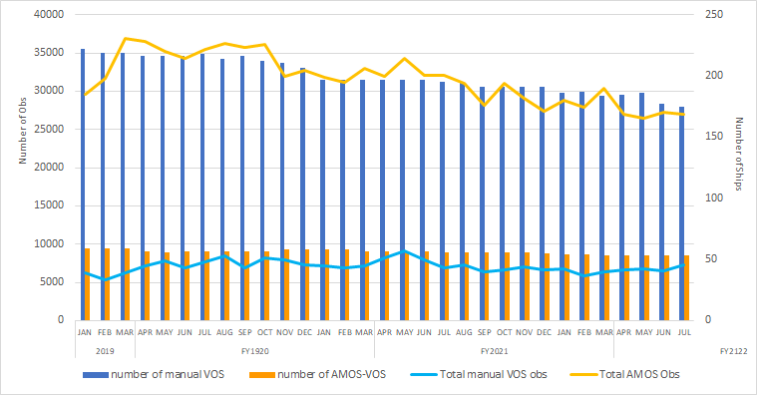
Observation Numbers

Slide 6
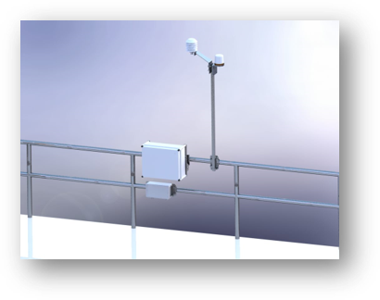
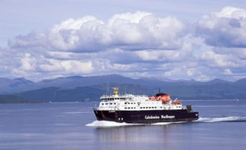
Other initiatives/resources: Met and ocean network
AMOS2X rollout – CE marking challenge
SurfaceNet marine pilots
AWS IMMT submission
VOS Automation - Mintaka
Wider NetZero plans impact on future travel

Slide 7
Covid-19 Impact
Training two new PMOs in lockdown
All training carried out remotely
No ship visits
Lack of maintenance on AWS
Unable to restore failed systems to working order
Cruise industry suspension
Ships stopped sailing, obs numbers strong but geographical spread poor
Oil industry fleets
Fleets shrinking as ships have been sold on e.g our BP fleet shrunk from 37 to 14
Notes:
COVID-19
Training two new PMOs
Two new PMO’s joined the team one week before the first UK national lockdown, which meant that all training had to be carried out remotely.
Cruise Industry suspension
All our cruise ship VOS stopped sailing due to COVID-19 and have been largely stationary around the UK ever since. Whilst we haven’t had the geographical spread of data, the officers on board have been very dedicated and vastly increased the number of obs they’ve been sending.
Oil Industry – shrinking of fleet
Due to changes in the direction of many of the major oil companies (Shell/BP etc), many of their ships were sold. In 2020 our BP fleet shrunk from 37 to 14 which had a big impact on our total fleet numbers and targets.

Slide 8
Future Plans
Get back on track after a tough year
Start rolling out AMOS2X again
Migrate all automatic sites to SurfaceNet and report in BUFR
Continue VOS automation trials
Improve metadata with WIGOS compliant database

