Slide 1
Joel Cabrie
Manager Marine Networks
Bureau of Meteorology
joel.cabrie@bom.gov.au

Slide 2
Overview
During the last intersessional period, the TT-RPT implemented two major capacity development initiatives:
the Sixth International Port Meteorological Officers Workshop (PMO-6)
The VOS Donation Program.
In addition to these, the following resources were also provided to aid with capacity development:
Updated VOS website
Comprehensive Turbowin+ User Guide
PMO Best Practices Guide

Slide 3
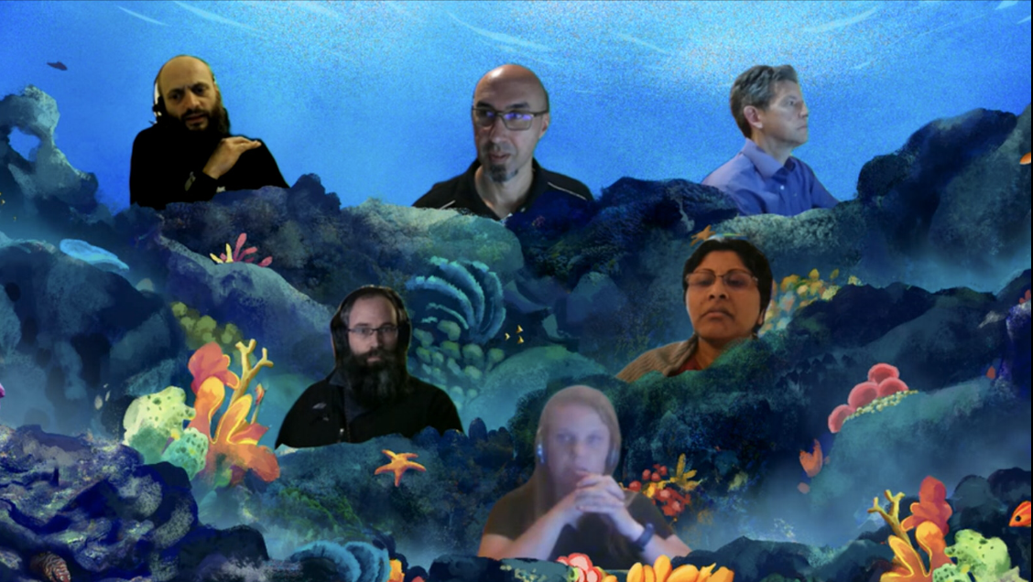
PMO-6 Workshop
Major aims of the PMO-6 were to get more countries involved in PMO activities, update the PMOs with recent developments in Turbowin+, WIGOS metadata requirements, SOT-IDs and resources available on the VOS website.
PMO-6 workshop was attended by about 110 participants from 57 countries.
This workshop was a great success with broader participation made possible due to the virtual nature of the workshop. Future workshops will be organized in a hybrid mode with in-person and virtual sessions.
Link to video Day 1 and Day 2 :
https://drive.google.com/drive/folders/1cBHM-8-2LwL6_6Tzs-vaRpxWC-I57w8U
Links to the PMO-6 documents:
https://www.goosocean.org/index.php?option=com_oe&task=viewEventDocs&eventID=2610

Slide 4
PMO-6 Actions
PMO-6 New Actions
No. | Action Item | By whom | Deadline
1 | Develop a user manual on VOS metadata submission to OceanOPS websystem | VOS Task Team on Metadata | SOT-12
2 | Create short youtube videos demonstrating metadata submission and obtaining Ship Observations Team (SOT) unique Identifications (IDs) through the OceanOPS web system | SOT Task Team on Recruitment, Promotion and Training | SOT-12
3 | Arrange focused session on PMO activities in a more frequent basis for the PMO community | SOT Task Team on Recruitment, Promotion and Training | end of 2021
4 | Continue efforts in harmonizing and collaborating efforts on sea ice observations with Global Cryosphere Watch (GCW) programme | VOS chair and Other SOT members as appropriate | On-going

Slide 5
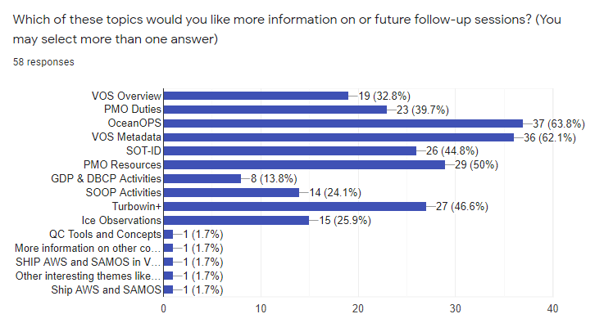
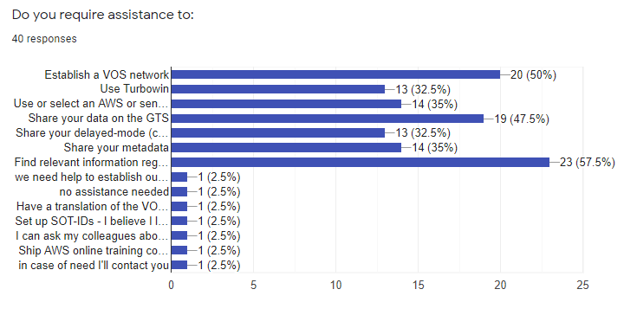
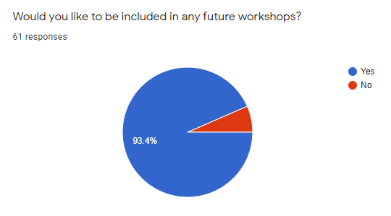
Workshop Feedback

Slide 6
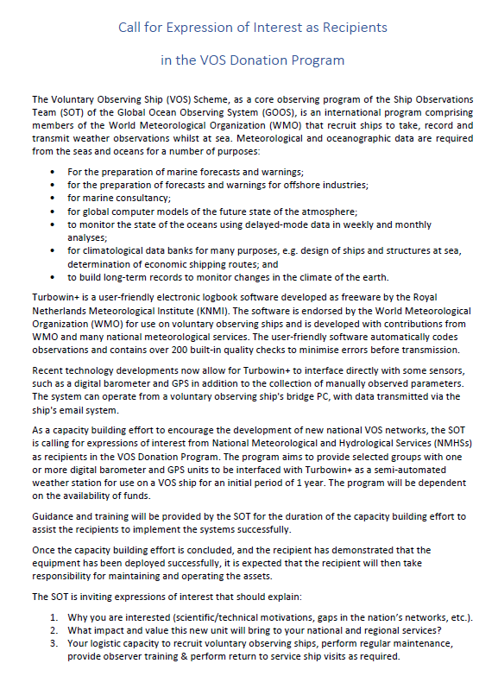
VOS Donation Program
A call for expression of interest as recipients in the VOS Donation Program was issued on the 10th August 2021:
The program aims to provide selected groups with one or more digital barometer and GPS units to be interfaced with Turbowin+ as a semi-automated weather station for use on a VOS ship for an initial period of 1 year.
Guidance and training will be provided by the SOT for the duration of the capacity building effort to assist the recipients to implement the systems successfully.
Once the capacity building effort is concluded, and the recipient has demonstrated that the equipment has been deployed successfully, it is expected that the recipient will then take responsibility for maintaining and operating the assets.
Submissions due by 15th September 2021

Slide 7
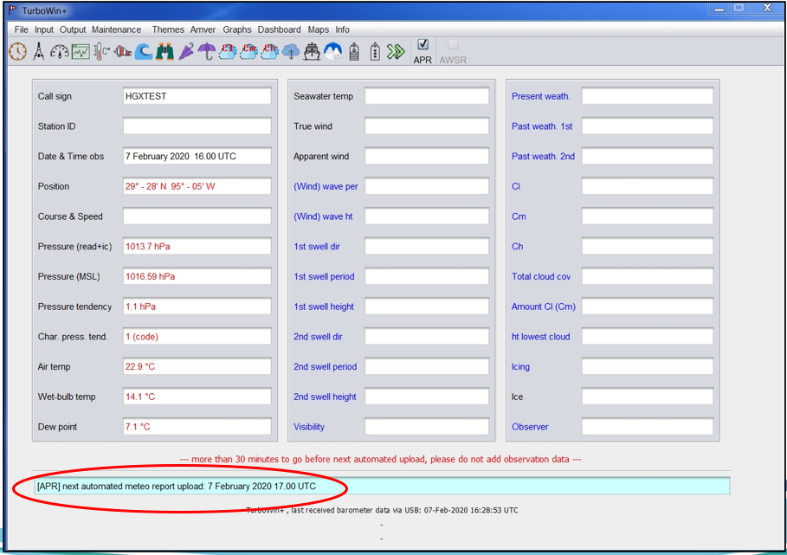
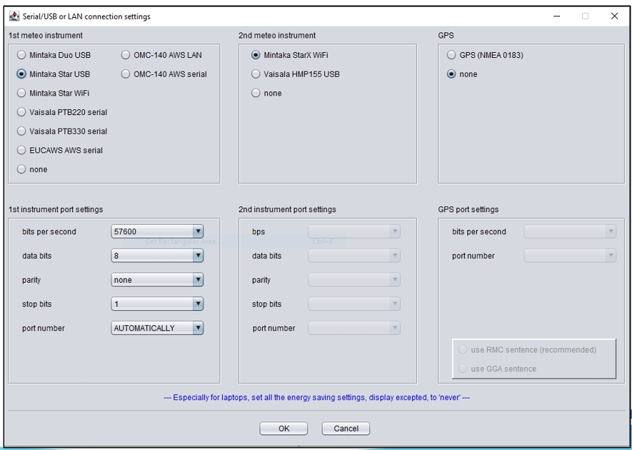
VOS Donation Program (cont.)
Turbowin+ APTR function will allow for automated air pressure, latitude and longitude to be output via the ship's email every hour.

Slide 8
VOS Website
The VOS website was updated at the end of January 2021: https://www.ocean-ops.org/sot/vos/
New VOS classes
VOSClim and Pub47 references
SOT certificate
Best Practices
PMO Buddy List
Turbowin+ User Guides
Various other links
The PMO quick reference document was used as the foundation for a PMO Best Practice guide:
Outlines standard PMO duties
Provides guidance on avoiding duplicate recruitments

Slide 9
Recommendations/Actions
Identify successful candidates for the VOS Donation Program (early-November 2021)
Begin procurement of equipment for the VOS Donation Program (mid-November 2021)
Prepare supporting documentation for roll-out of the VOS Donation Program (early-2022)
Commence implementation of the VOS Donation Program with successful candidates (mid-2022)
Create YouTube videos for the following:
Common Turbowin+ configurations
Requesting an SOT-ID
Submitting metadata to OceanOPS
Plan 6-monthly PMO workshops targeted at specific topics of interest
WIGOS metadata format
SOT-IDs
Turbowin+

