Slide 1
9.1.1: VOS Panel activity report
Henry Kleta, Chair VOSP

Slide 2
VOS Panel Activities
VOS Panel - Terms of References
The Voluntary Observing Ship (VOS) Panel shall:
Review, recommend and coordinate the implementation of new and improved specialized shipboard meteorological instrumentation, siting and observing practices, as well as of associated software;
Support the development and maintenance of new pilot projects;
Oversee and encourage members to upgrade their VOS to report according to standards meeting climate user requirements, including reporting the required climate and ship parameters in both real time (GTS) and in delayed mode (via VOS GDAC);
Develop and implement activities to optimize ship inspections and recruitment, including promotional material;
Prepare annually a report on the status of VOS operations, data availability and data quality.
Action: Secretariats to ensure that the ToRs are listed correctly on all relevant websites and are kept up to date. (Secretariats, asap and ongoing)

Slide 3
VOS Panel Activities
Activities of chairperson in intersessional period:
Attended various meetings and Tele-Conferences
SOT (EB, EC, TTs), is attending SOT-11
OCG (OCG-11, Roundtable, Report Card,...)
CLIMAR-5
PMO-6 Workshop
E-Surfmar ET meetings (VOS as chair)
Maersk / VOS discussions
Global Cryosphere Watch (GCW) / VOS discussions
meetings of the WMO SG-GBON
SOT metadata internship at OceanOPS in 09/2020

Slide 4
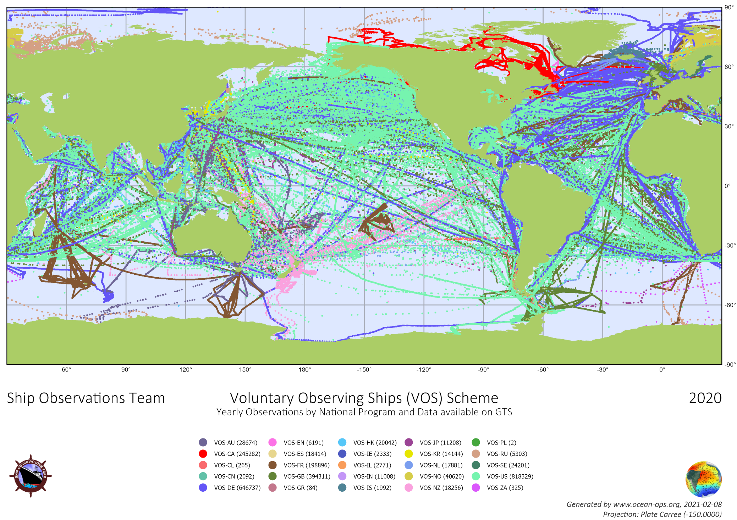
VOS Panel Activities

Slide 5
VOS Panel Activities
VOS network status (2020)
Action: OceanOPS to implement functionality to allow output of information on number of observations (observation counters per selected station / stations / fleet) for a specified period of time (month / year). Furthermore implement functionality to generate maps with only those observations on the map using VOS terminology. (OceanOPS, asap)

Slide 6
VOS Panel Activities
VOS network status (2020), realtime (GTS) and delayed mode data (IMMT)
~ 4200 stations registered in Pub47 database
~ 2750 stations provided ~2.5 mill. (@OceanOPS, ~2.8 mill. @E-Surfmar) real-time observations in 2020 (~ +4% station, ~ +10% observations)
~ 10% of VOS fleet is automated
25 active VOS programmes (23 in 2019)
only 14 national programmes provided delayed mode data (~ 1.6 million IMMT observations) to VOS GDACs in 2020
Action: All VOS operators are requested to keep their metadata up-to-date (VOS operators, ongoing)
Action: All VOS operators are requested to provide quarterly delayed mode data to the VOS GDACs (VOS operators, ongoing)

Slide 7
VOS Panel Activities
VOS network status – conclusions
Not all observations are pushed onto the GTS or are not found in the GTS
Due to i.e. re-ingestion (i.e. after conversion of formats) duplicates are very likely to be counted on either side too
Recommendation: All VOS operators are invited to compare their observation counts with those from OceanOPS to find missing data and / or duplicates.
Recommendation: If data is drawn from GTS and re-ingested, the usage of special headers (making clear that these are duplicates or compilations) should be considered to allow easier identification of duplicates and / or original format / or conversions made from the original observations.

Slide 8
VOS Panel Activities
PMO network status (2020)
~ 45 PMOs were reported in 17 annual reports
a record low number of ship visits (~1000) were reported due to Covid19
~ 160 Port Meteorological Offices and Officers, providing service in 47 countries / territories, are listed in WMO No.9, Volume D, Part B
https://community.wmo.int/activity-areas/operational-information-service/volume-d-information-shipping
Action: All VOS operators and / or PMOs are requested to arrange provision of SOT annual reports via National Focal Point. (VOS operators, annually)
Action: Secretariats to provide easy access to NFP and PMO lists (with input from IOC and WMO members) and keep them up-to-date, and link to them from relevant websites. (Secretariats, asap and ongoing)

Slide 9
VOS Panel Activities
VOS / Maersk
Maersk decided in 2019 to participate in teh VOS network with all company owned vessels (approx. 300)
VOSP chair acts as central focal point for Maersk
50 AWS (EUCAWS provided by DWD) are now active onboard Maersk vessels
Maersk is investigating in full integration of AWS into ship systems (NMEA feed, e-Logbook)
Ongoing discussion to have all Maersk vessels equipped with an AWS
Additional discussions between DWD and Maersk concerning provision of historic data from ship systems to DWD VOS-GDAC
Potential to receive near realtime data feeds from Maersk vessels for GTS ingestion under investigation

Slide 10
VOS Panel Activities
SOT / VOS relevant websites
VOS website
http://sot.jcommops.org/vos/
Pub47 metadata database
http://www.jcommops.org/sot/vos_esurfmar/vosmetadata_v6/
OceanOPS
https://www.ocean-ops.org/board?t=sot
GOOS / SOT landing page
https://goosocean.org/sot
jcomm.info sites / documents linked from archived sites / documents must be kept accessible
goosocean / oceanexpert has to be kept up-to-date and functional

Slide 11
VOS Panel Activities
ISO committee ISO/TC 8/SC 13 "marine technology"
ISO Project 23745 "General specification for shipboard meteorological instrument"
approved in 2020 as new project in work programme of working group 2 "Ocean hydrometeorological observation"
VOSP chair is german delegate to ISO/TC 8/SC 13
TT-ISSC chair and VOSP VC are involved in WG 2 as "contributor"
no further progress to be reported
Action: Secretariat(s) to organize replacement of outgoing VOSP VC as contributor to ISO/TC 8/SC 13/WG 2 (Secretariats, asap)

Slide 12
VOS Panel Activities
Development of the VOS network:
Following SOT-9 the IMO MSC circular 1293 “Participation in the WMO Voluntary Observing Ships’ (VOS) Scheme” was updated:
New circular: MSC.1/Circ.1293/Rev.1 – 25 May 2018
(can be found in on VOS website)
Draft Rev. MSC/Circ. 803 “Participation of NON-SOLAS Ships in the Global Maritime and Safety System (GMDSS)”:
(9) Non SOLAS ships operating in high sea areas are invited to participate in the WMO Voluntary Observing Ships (VOS) Scheme. […]

Slide 13
VOS Panel Activities
Actions (from SOT-10)
Ref. Item | Action Item | By | Deadline | Update
A8.1/1 | Further explore and promote the possibility to auto-generate annual reports. | SOT-TC & VOS Chair | SOT-11 | ongoing
A8.1/2 | Develop documents on how to replace Call sign with SOT-ID and make it available for Ship operators. | VOS Chair & SOT-TC | August 2019 | pending
A10.1.2/2 | VOS chair to further revise the SOT ID allocation and come up with a revised version based on the ideas presented at the SOT-10. | VOS Chair & SOT-TC | Aug 2019 | pending
A10.1.2/3 | Prepare documentation on SOT ID transition and make them available on a central location for SOT community. | VOS Chair & SOT-TC | Dec 2019 | pending
A12.1.5/1 | Interested VOS operators to liaise with VOS chair to discuss participation/further steps of batch recruitment of Maersk ship. | VOS Operators | ASAP | ongoing

Slide 14
Discussion

