Slide 1
Joel Cabrie
Manager Marine Networks
Bureau of Meteorology
joel.cabrie@bom.gov.au

Slide 2
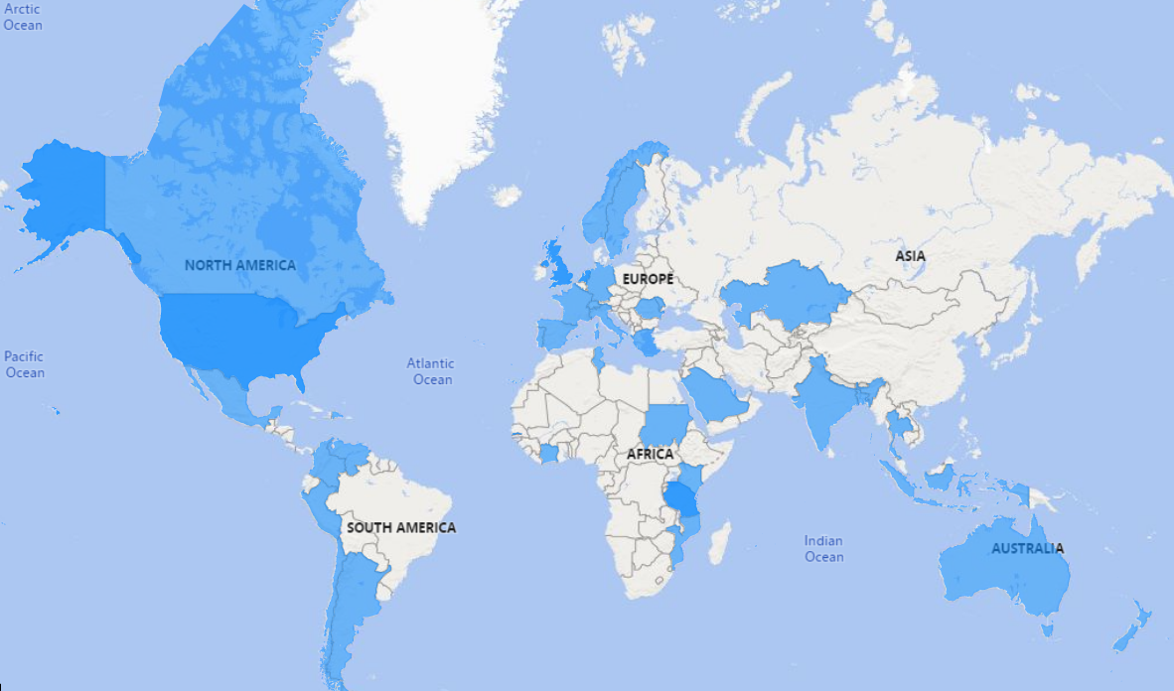
Participation
109 Participants
47 Countries

Slide 3
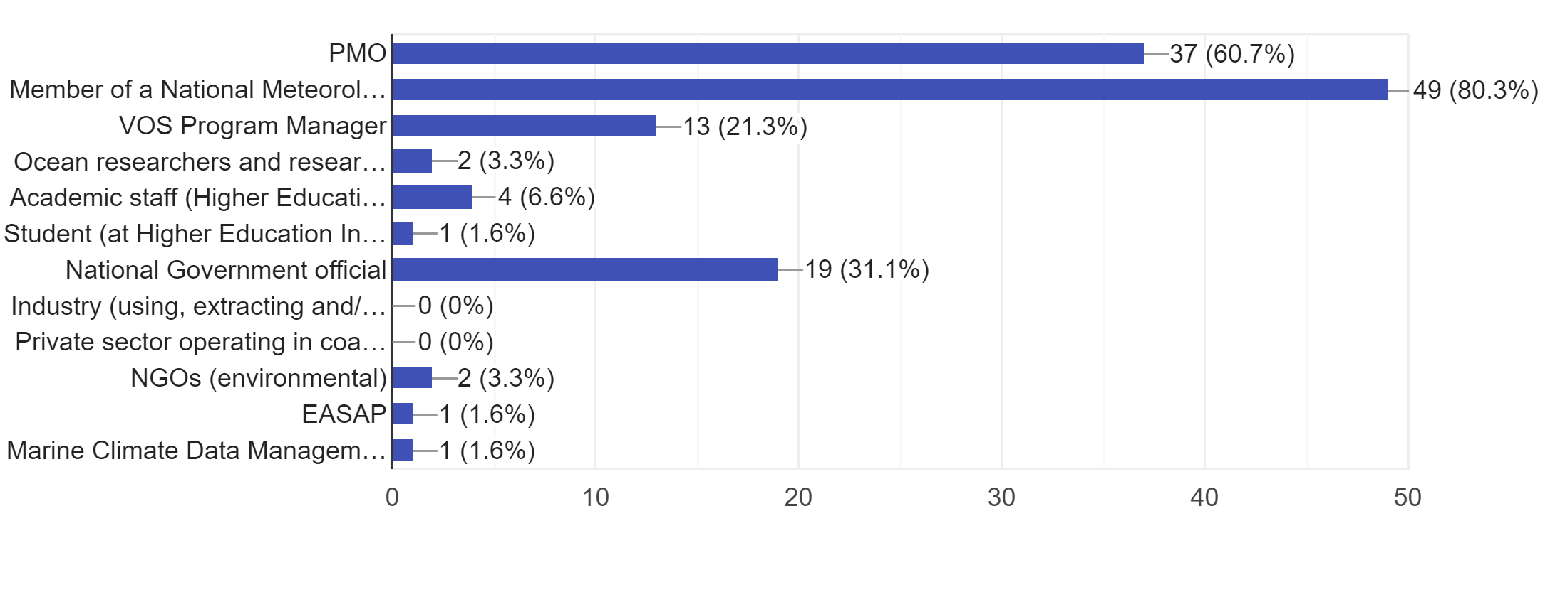
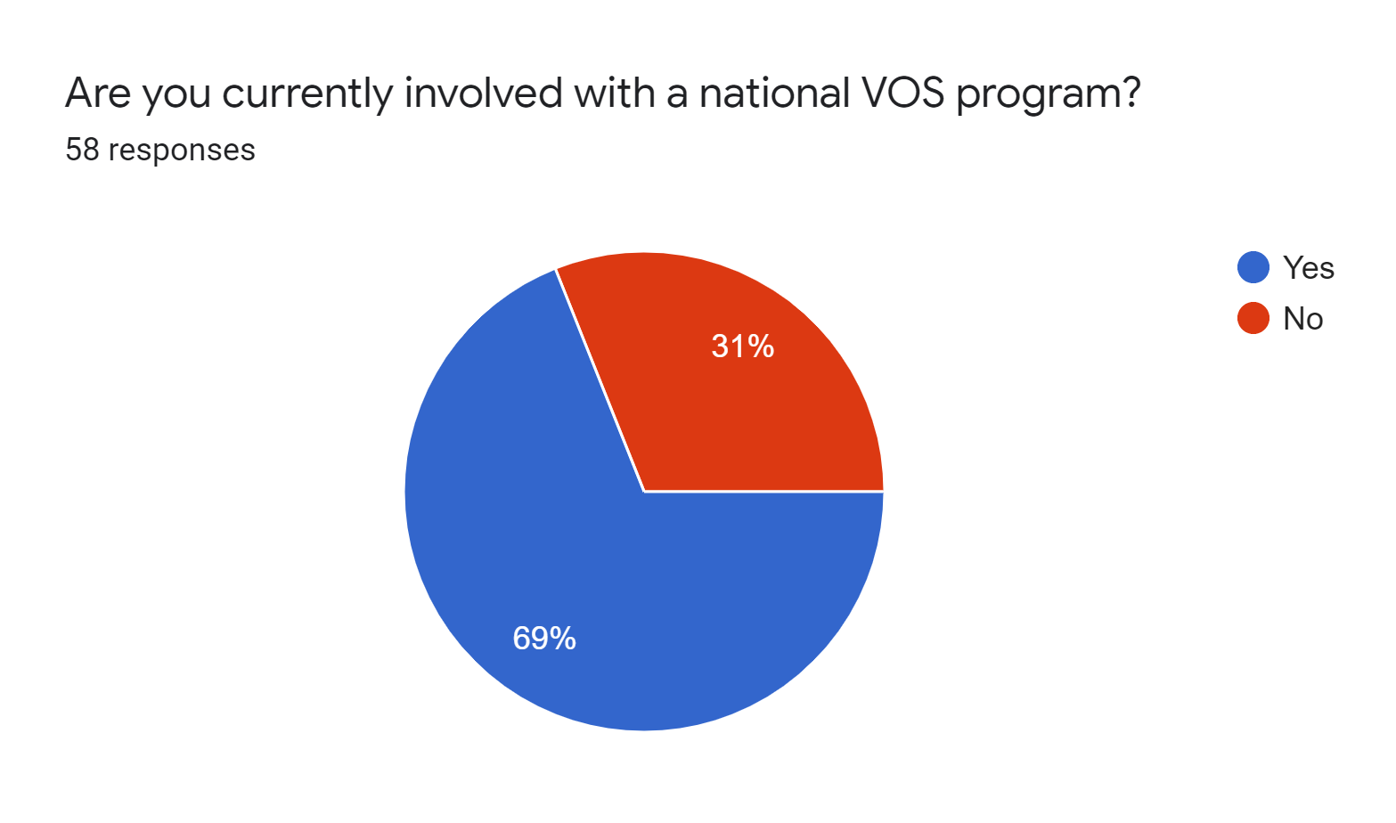
Experience/Background

Slide 4
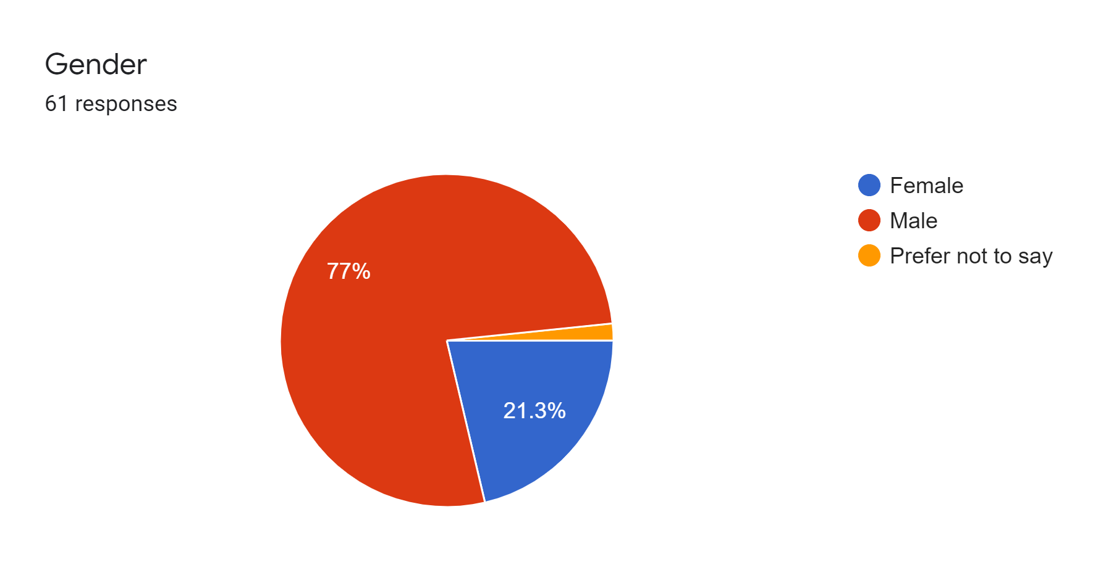
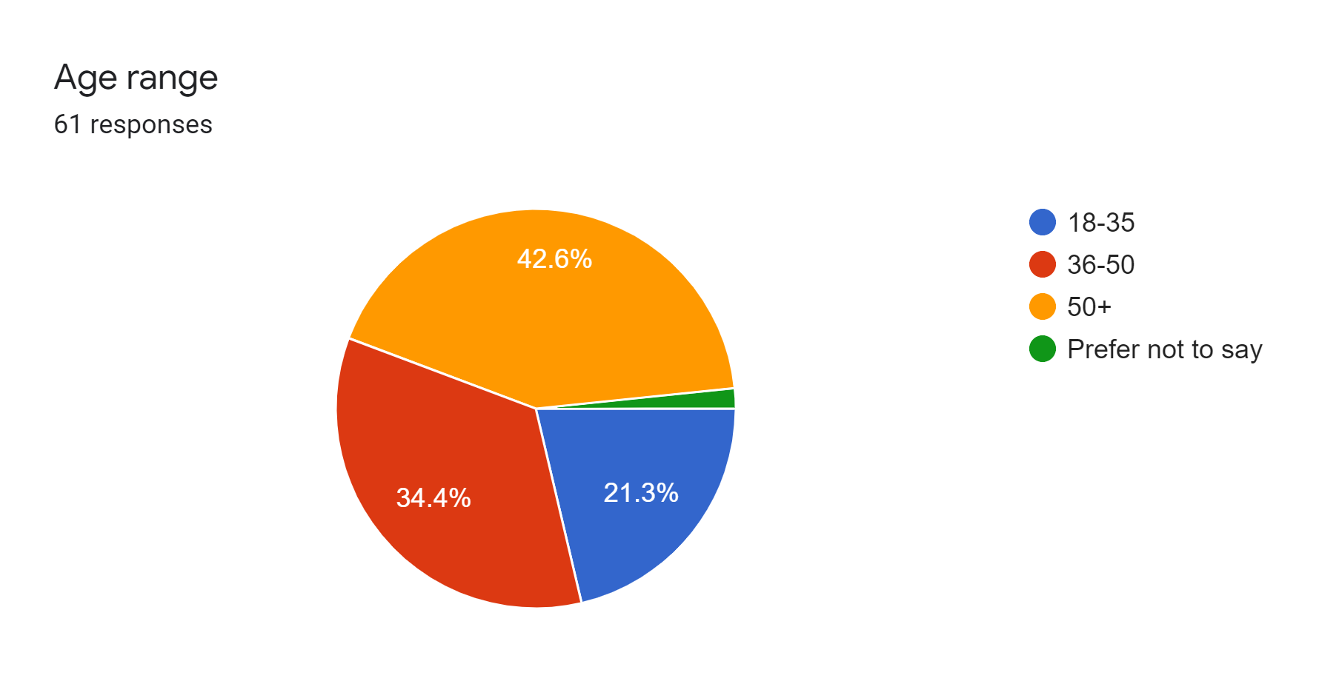
Demographics

Slide 5
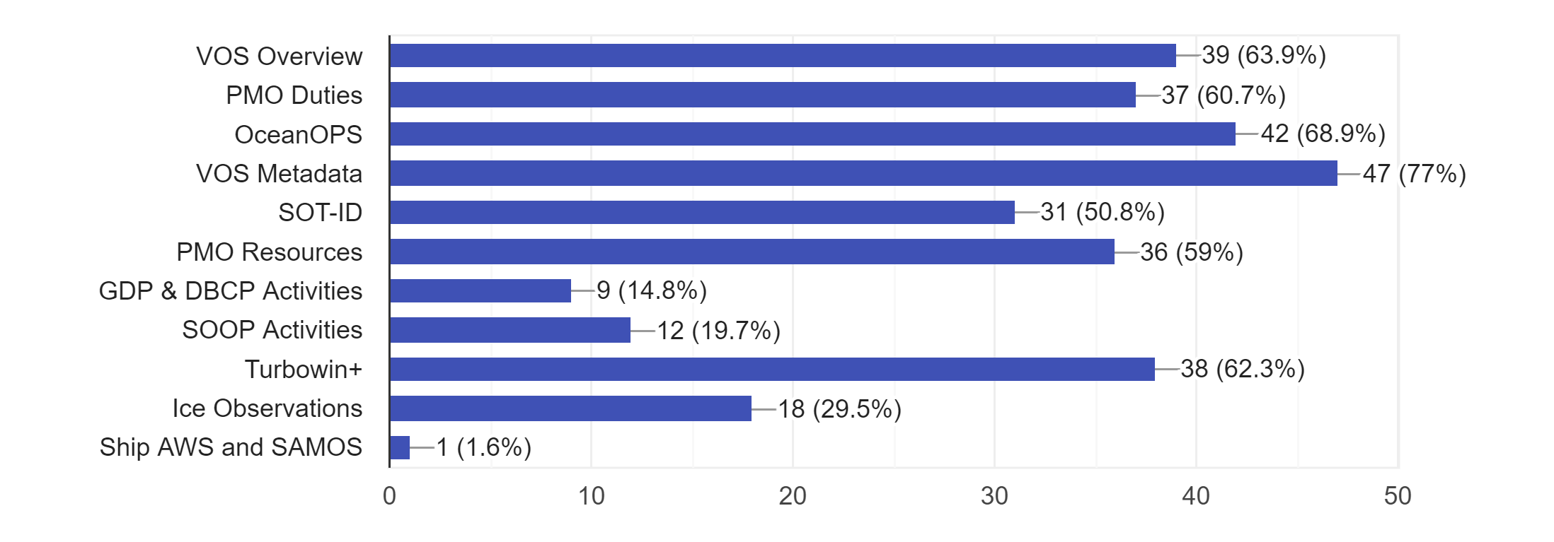
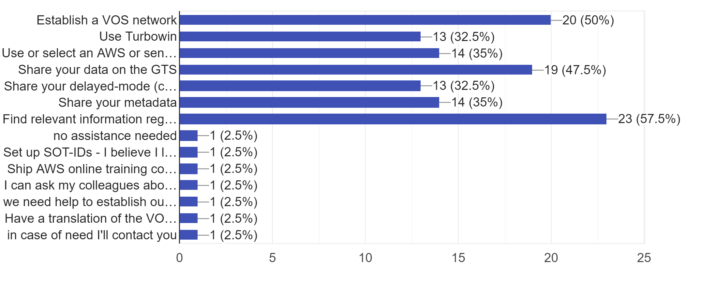
Feedback
What were the most important topics for you in the workshop?
Do you require assistance to:

Slide 6
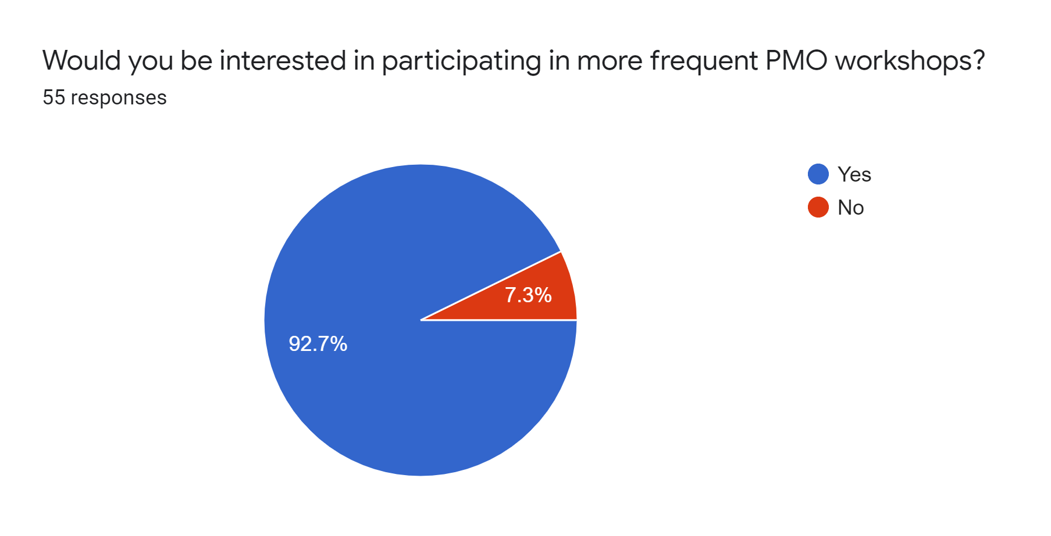
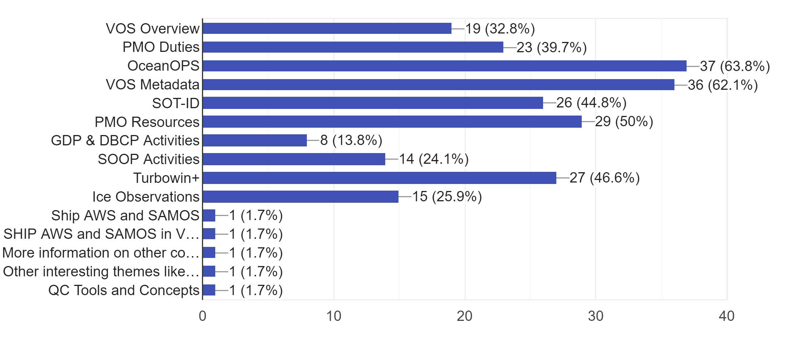
Future Workshops
Which of these topics would you like more information on or future follow-up sessions?
Priority topics for future webinars based on participant feedback:
How to use OceanOPS
Changes to VOS Metadata requirements
Requesting an SOT-ID
How to use Turbowin+
Using QC Tools & recognising error patterns
How to recruit ships and keep voluntary ships motivated
Sharing data via the GTS
Increased frequency of webinars for PMO capacity development
6 monthly
Virtual format

Slide 7
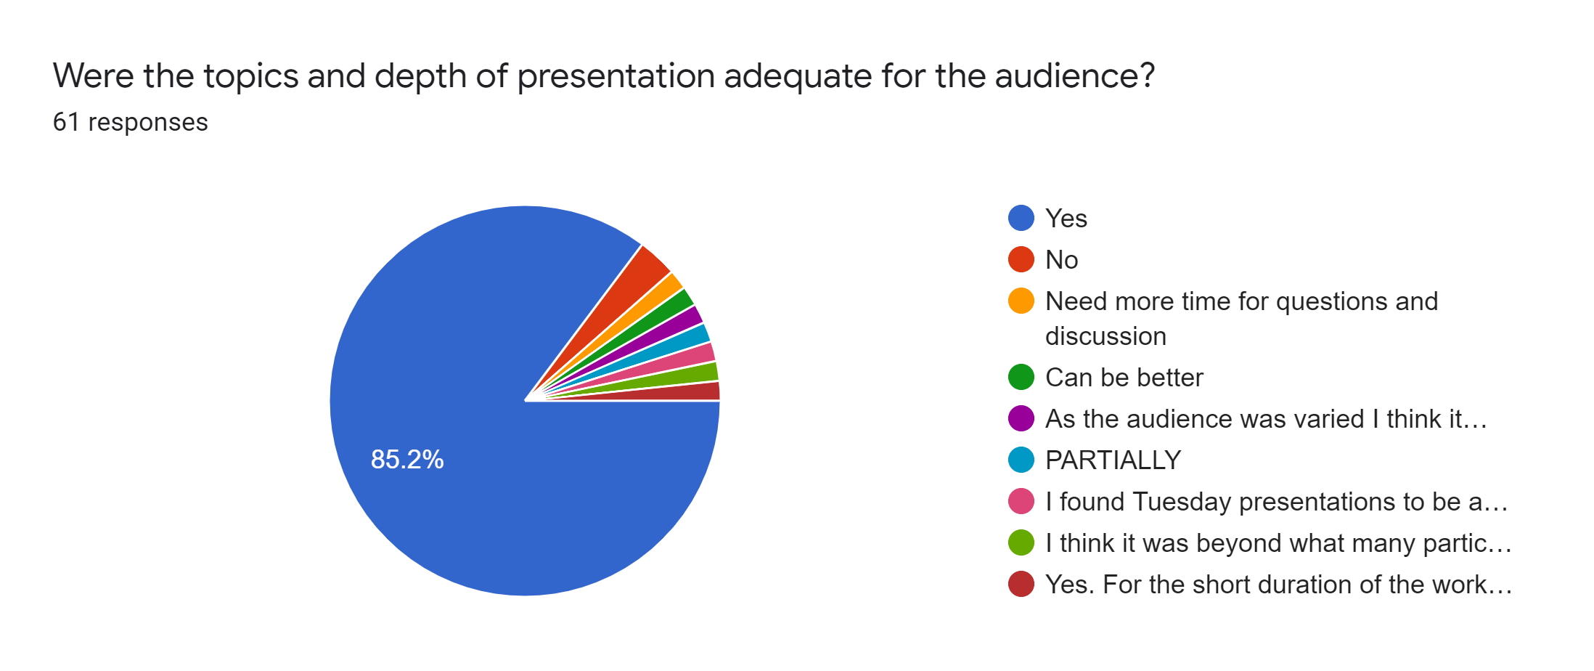
Topics
As the audience was varied I think it may be better to split the sessions up into a basic session with the aim of recruiting new countries to the VOS program and a more advanced technical session for existing participants.
Need more time for questions and discussion
Yes. For the short duration of the workshop, there were good introductions. Longer follow-ups on the new WIGOS metadata format and training/demo opportunities may be useful.
I found Tuesday presentations to be a bit too basic at times but appreciate not everyone there was a PMO so would not have the same knowledge as me. Thursday was very interesting though and at the right level.
I think it was beyond what many participants could take in and process.

Slide 8
General Comments
Online training course for PMOs might be valuable
Virtual workshop was more accessible, but limits practical sessions and networking opportunities
Sessions were informative for beginners
Recorded sessions will be helpful as a future resource
Sharing of different Turbowin+ setups by different countries was a good way to demonstrate capabilities of the software
With such large numbers of participants, a virtual session becomes more like a series of lectures than a workshop
Topics felt rushed to stick within set times
Using the chat function for questions is not as useful as having proper dialogue and interactions with other PMOs
Look forward to future opportunities for face to face workshops

