Slide 1
Agenda item 13.2
Task-Team on Instrument Standards and Satellite Communications
J.B Cohuet
Météo-France

Slide 2
Membership
Jean-Baptiste COHUET (TT Chairperson, France)
Ross BANNISTER (TT ViceChair, New Zealand)
Martin KRAMP (ex officio, SOT TC)
David BERRY (United Kingdom)
Christophe BILLON (France)
Francis BRINGAS (United States)
Joel CABRIE (Australia)
Mardene DE VILLIERS
Darin FIGURSKEY (United States)
Henry KLETA (Germany)
Massaya KONISHI (Japan)
Rudolf KROCKAUER (Germany)
James LUCIANI (United States)
Balakrishnan NAIR (India)
Damian NAPOLES (Netherlands)
Emma STEVENTON (United Kingdom)
Michael POTOCHNEY (United States)
Peter ROUX (South Africa)
Rene ROZEBOOM (Netherlands)
Adam RYAN (new member, United Kingdom)
Shawn SMITH (United States)
Joaquin TRINANES (United States)
Mayu YAMAMOTO (new member, Japan)
2

Slide 3
Terms of reference
Compile information and provide guidance on existing activities, procedures and practices within SOT relating to instrument testing, standardization and intercalibration, as well as the standardization of observation practices and procedures;
Using guidance contained in existing guides including the WMO Guides on Instruments and Methods of Observation (WMO-No.8) communicate with manufactures regarding new technologies and recognized equipment problems when requested;
Prepare dedicated Webpages containing this information, to be made widely available through the SOT web site and linked from other relevant websites;
Organise inter-comparisons as required by SOT sessions;
Review and comment relevant WMO Publications when requested to make sure they are kept up to date;
Evaluate the operational and cost-effective use of satellite data telecommunication systems for the real-time collection of VOS and SOOP data in support of the World Weather Watch, GOOS, and GCOS;
Evaluate and propose new communication systems for conventional VOS to substitute Code 41 and continue to monitor the cost implications of Code 41;
Liaise with international organizations (IMO, IMSO) and with telecom providers to take into account expected evolutions relevant to SOT.
3

Slide 4
Activities
1- Collection of technical information
Instrumentation for VOS, SOOP, ASAP
Instrument standards guidelines
Dataflows
GTS headers
On SOT Website
2- AWS standards
TT-ISSC was asked to document minimal standards for Ship-borne Automatic Weather Stations (S-AWS).
Draft document is available here
4

Slide 5
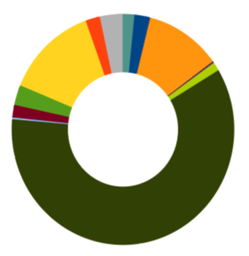
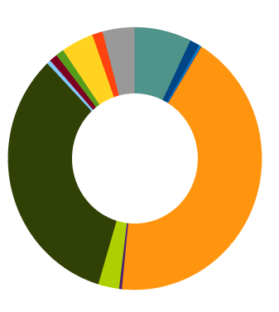
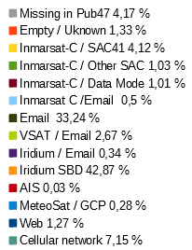
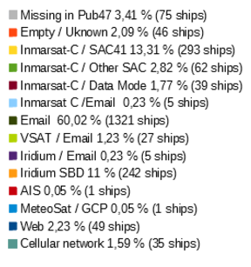
Activities
3- Monitoring of Telecommunication Systems used for VOS
For 2020
Telecoms per VOS
Telecoms per observations
5

Slide 6
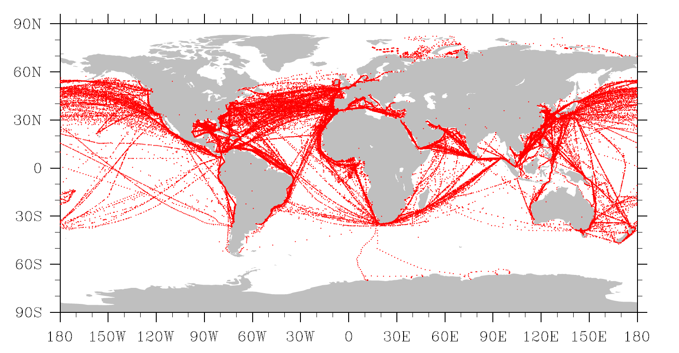
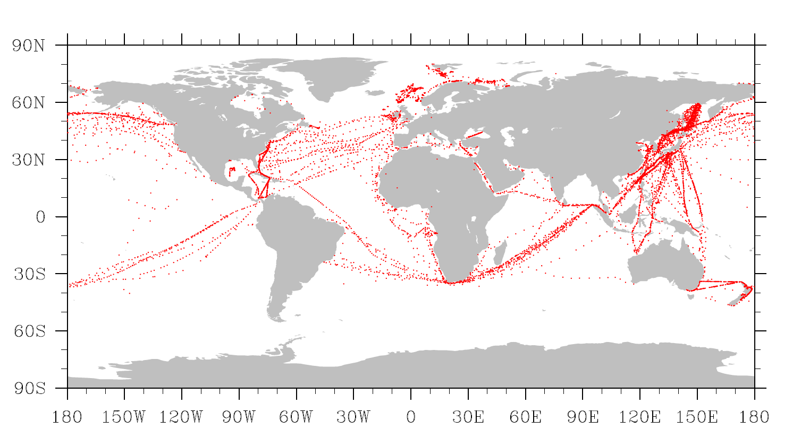
Activities
3- Monitoring of Telecommunication Systems used for VOS
Email is now the system of transmission the most used by VOS (60% of active ships), in particular for manual ships and that part is still increasing at it was 45% of the VOS two years ago. In total 33% of the observations are sent by Email.
For AWS, Iridium SBD is the most used system. It represents only 11% of the active ships but producing 42% of the messages sent to the GTS.
The proportion of ships sending messages to the GTS which are not registered in pub47 is decreasing. It was 25% of the active ships in 2018, and they are now only 5% of the ships.
Code41 is still used by many ships (14% to 19% of the VOS considering that the non-registered ships are usually sending their messages in code41). It represents 4% to 8% of the messages distributed on the GTS.

Slide 7
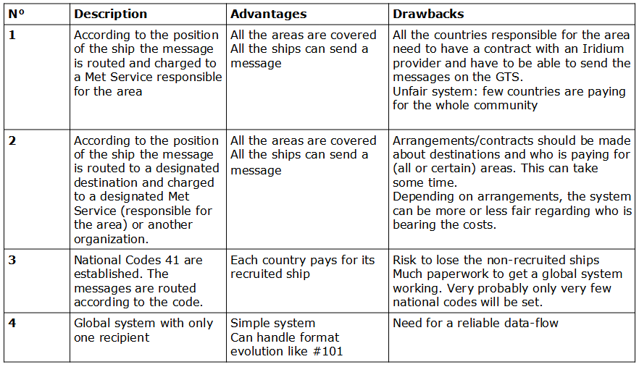
Activities
4- Iridium for GMDSS
Early 2020, Iridium was successfully certified by the IMO to offer GMDSS
October 2020 Iridium contacted WMO to know how to implement the Code41
December 2020 : Iridium announced that their GMDSS services became operational without SAC41 service implemented.
A need for a transmission system with Iridium free of charge for the ships is still needed
Implementation for dataflows and paiements has to be discussed with Iridium. Options :

Slide 8
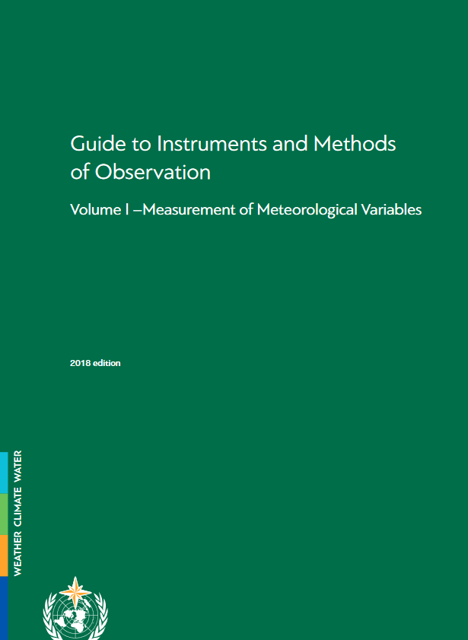
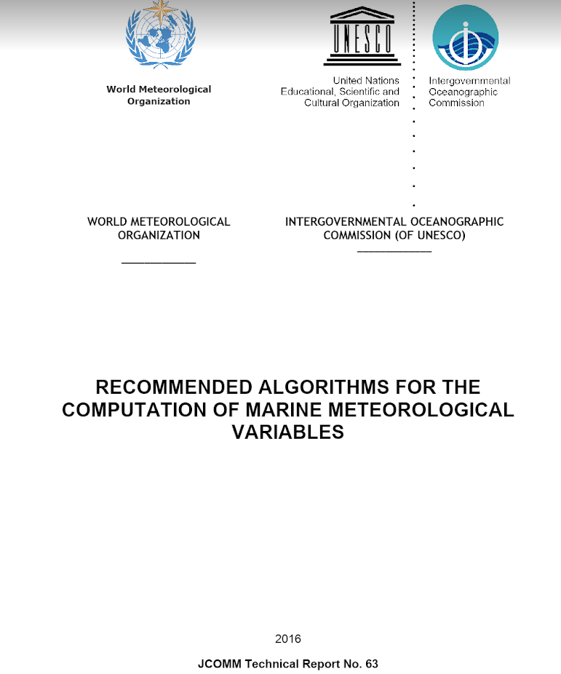
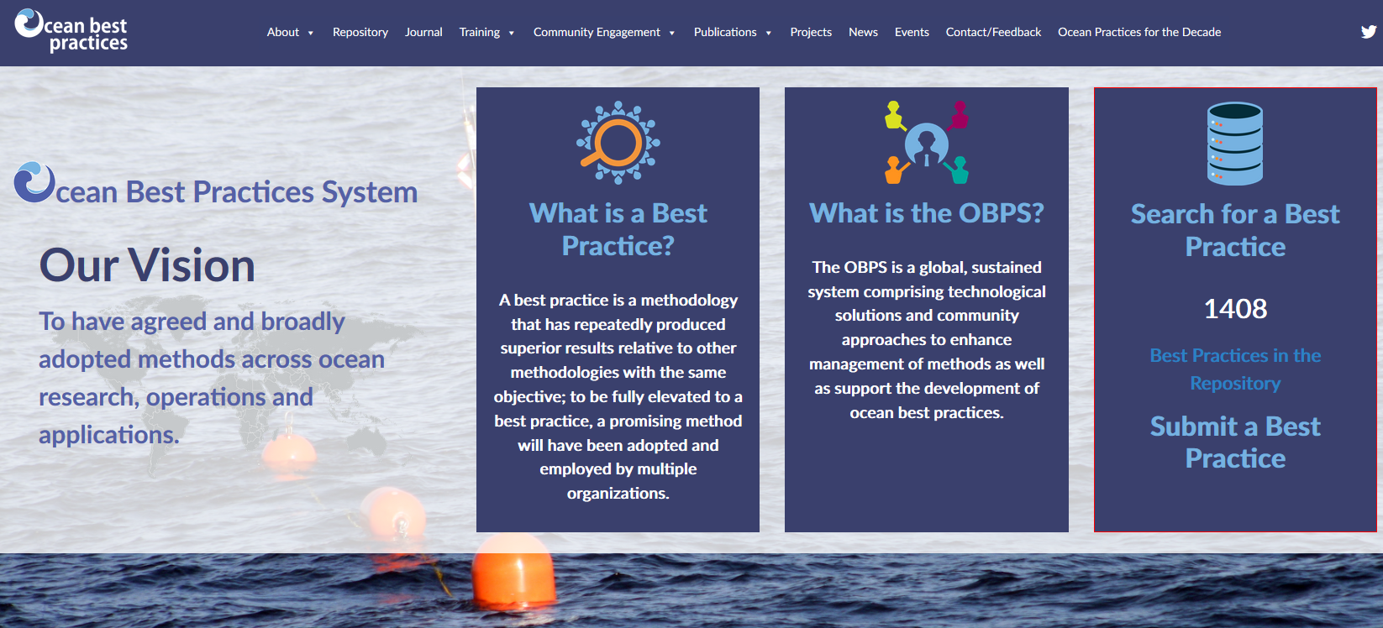
Activities
5 - WMO n°8
The ocean observing community proposes the development of a new Volume to the Guide to Instruments and Methods of Observation (WMO No. 8).
Volume III (Observing Systems),
Chapter 4: Marine Observation
JCOMM63 : recommended algorithm for the computation meteorological variables
Ocean best practice portal
Measurement of Marine
Meteorological
and Oceanographic
Variables.
New volume of WMO n°8

Slide 9
Questions
Thank you for your attention
Any questions
Contact : jean-baptiste.cohuet@meteo.fr
sot-tt-iss@jcommops.org

