Slide 1
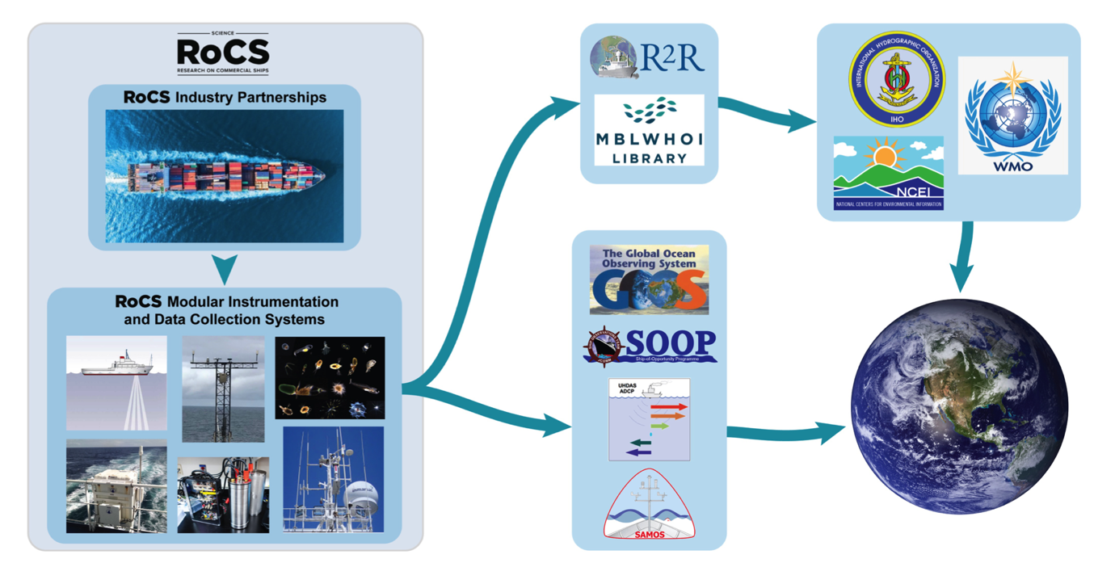
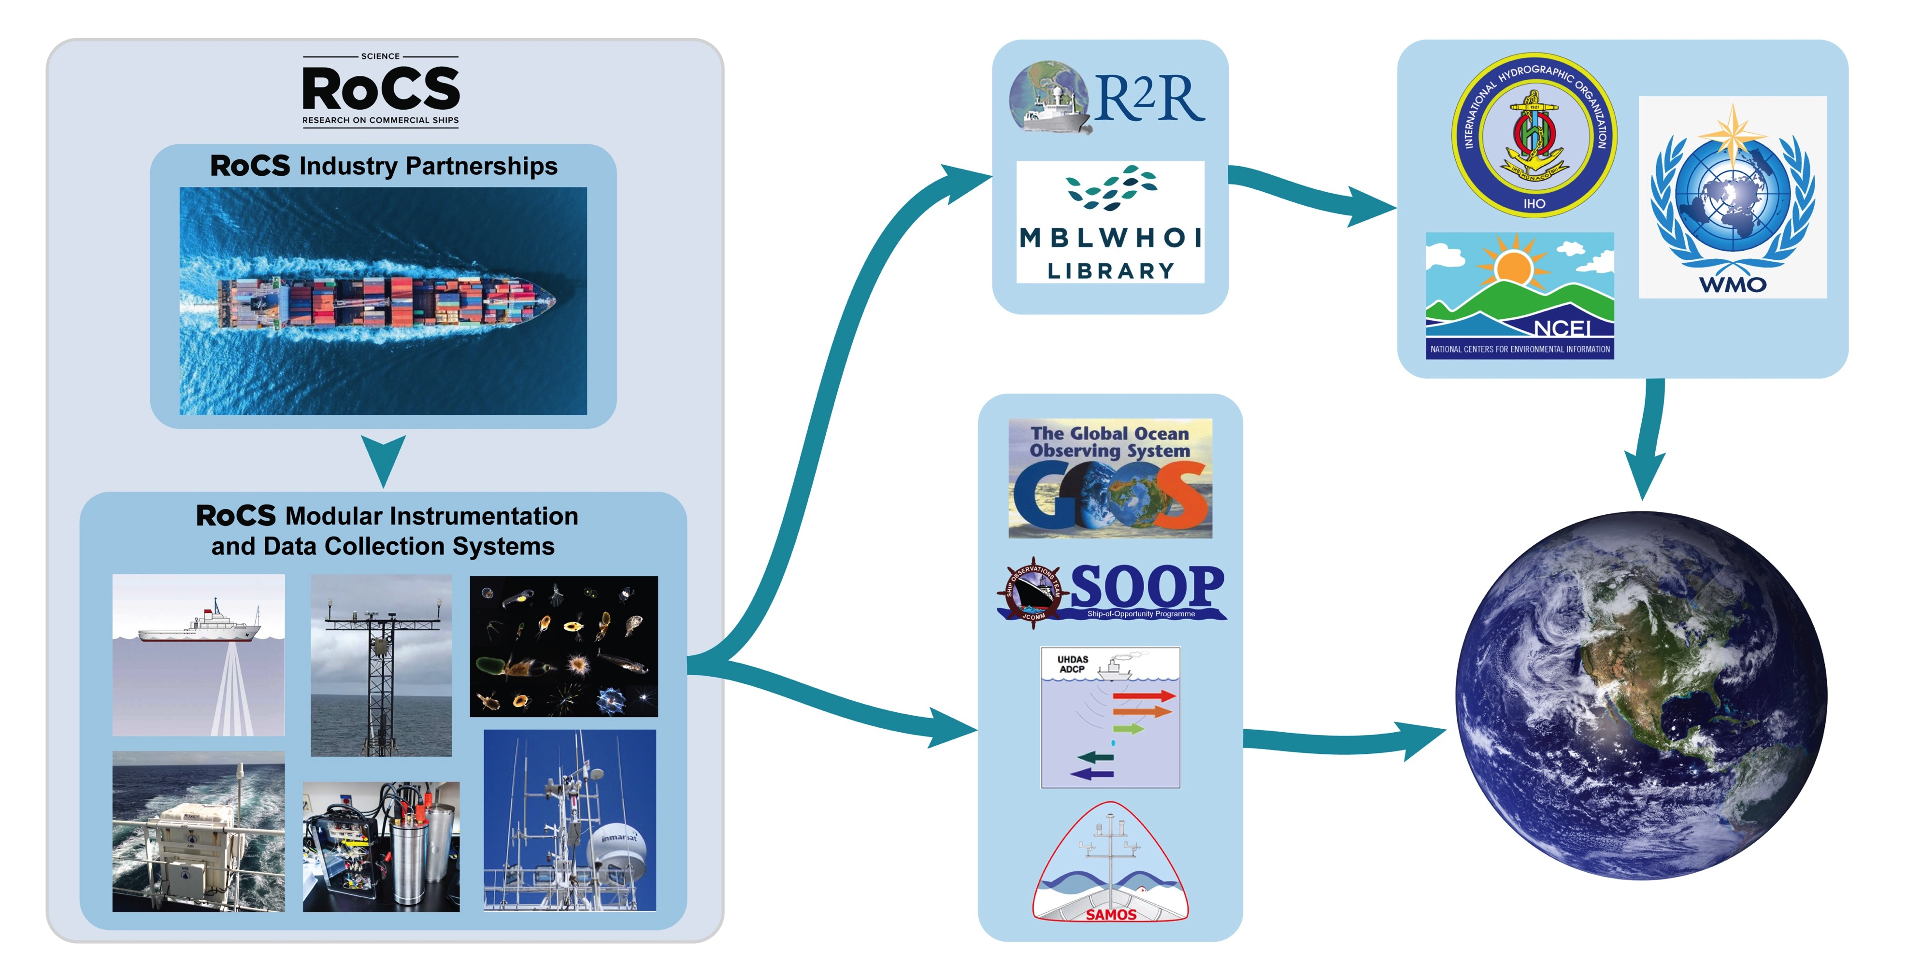
Science Research on Commercial Ships (Science RoCS)
Presented by Shawn R. Smith
RoCS Team: M. Andres, A. Macdonald, K. Strom, L. Stolp, R. Hudak (WHOI); S. Smith, M. Bourassa (FSU) in collaboration with many others at URI, Stony Brook, U Hawaii, UNH, BIOS, UW, LDEO, Scripps.
SOT-11, 13 September 2021

Slide 2
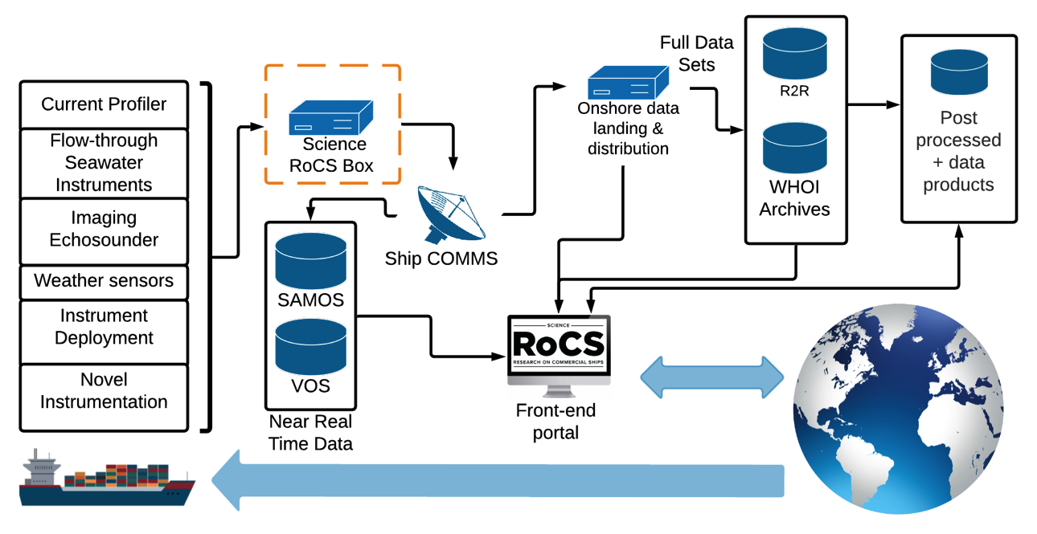
What is Science RoCS?
An ad hoc group of like-minded scientists, data managers, technicians, engineers and marine operators …
Science RoCS envisions a future where scientific data collection on commercial ships is the new industry standard, providing regular and repeat measurements across oceans, including remote regions, on scales not otherwise accessible to the scientific community and society at large.

Slide 3
What is Science RoCS?
Design a framework that, when fully-implemented across a fleet of vessels & routes, will make scientific observations on commercial ships the new industry standard​.
Foster mutually beneficial relationships between ship owners and the scientific community.
Create a culture that encourages development of sensors and technologies optimized for use on vessels in regular traffic.
Promote cross-disciplinary ocean science by simultaneously collecting multiple data streams.
Notes:
One proposal to NSF, MI-DP, sought to instrument 10 ships, with two flagships having the full suite of sensors including ADCP.

Slide 4
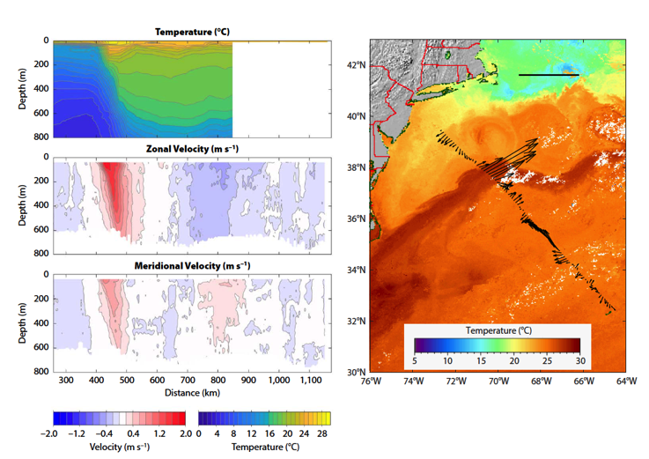
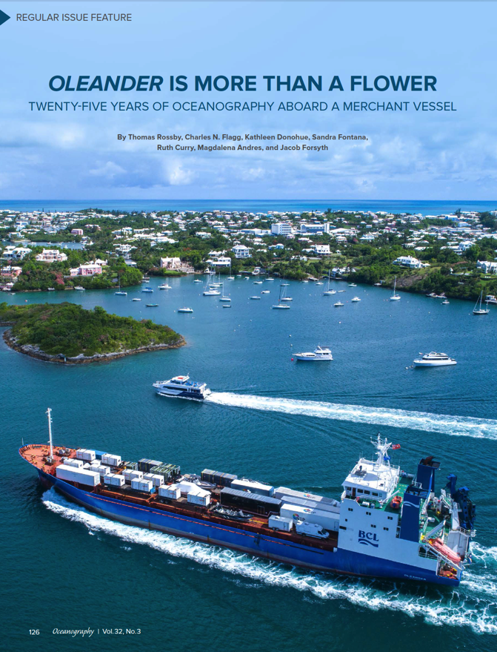
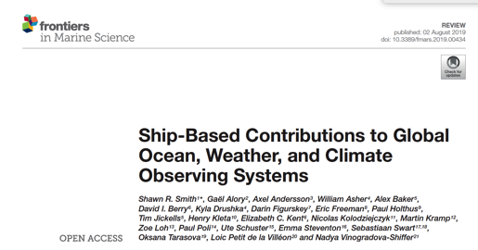
Build on success and vision of OceanObs ‘09 & ’19,
and SCOR Working Group 133
Notes:
Multiple OO’19 papers recommended expansion of multi-variate observations from ships
These recommendations would support VOS via NWP, SOOP for fluxes, pCO2, etc.
SCOR WG 133 – Developed the OceanScope concept for commercial ships.

Slide 5
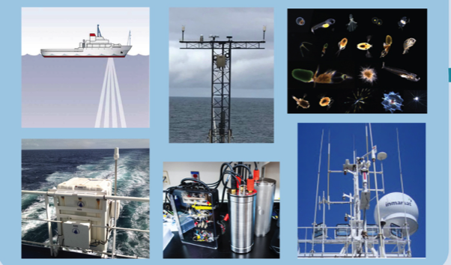
Science RoCS Objectives:
Develop a global program to continually scan the ocean’s sub-surface velocities at high horizontal resolution.
Collect multiple data streams, including ocean currents and weather, with “Integrated Observing Platforms” hosted on commercial ships.
Partner with existing global programs to provide (a) deployment opportunities and (b) a portal to connect to Industry for easier access to remote regions and routes of high scientific value.
Notes:
The portal is called, “Marine Facilities Planning.” A Dutch designed software system used by UNOLS, EU, AUS, U.A.E., & Japanese research vessel operators. NOAA is considering it as well. It’s here that scientists, researchers & engineers will be guided to a ship/ operator to host their needs.

Slide 6
Science RoCS: Facilitating Sensor Deployment
Notes:
This is where RoCS needs to connect with OCG, SOT, VOS, and SOOP. Need to coordinate this U.S. effort with GOOS activities.
MFP – NSF Marine Facilities Planning tool – used by U.S. to schedule/plan academic research cruises
AXIS auto XBT launcher on left – talks through Iridium now. Calls home every now and then for a new mission (adaptive sampling possible).

Slide 7
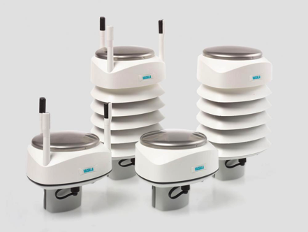
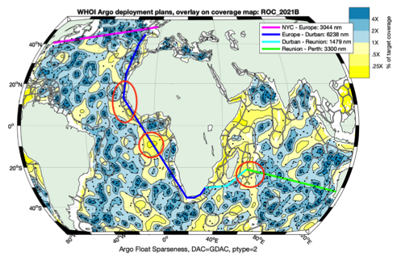
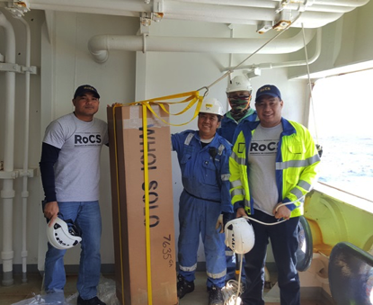
Ongoing Science RoCS efforts….
Although still pursuing significant funding in the via U.S. Federal and other sources, the RoCS team is pushing forward with several initiatives:
Fostering relationships: between ship owners with global, Arctic or regional routes (Wallenius Wilhemsen, Stena Line, Pangaea) and the Scientific Community.
Initial sensor deployments: Argo deployments by crew of WW vessel, Deploying Vaisala WXT weather sensors on Pangaea vessel, PCO2 system on WW ship.
Partnering with existing global programs: Argo, pCO₂ to find suitable routes, train crew in deployments, and assist with clearances. Ongoing discussions with NOAA’s Global XBT and Drifter programs.
Argo density (yellow=low, blue – high)
Notes:
What are the red circles highlighting in the middle figure.
Density of Argo floats. Yellow areas need more floats.
Track is a WW line. Red circles are key deployment areas.
Need to assess EEZs and work on clearances for deployments.
Right figure – Captain and crew trained to do deployment of Argo, no rider needed.

Slide 8
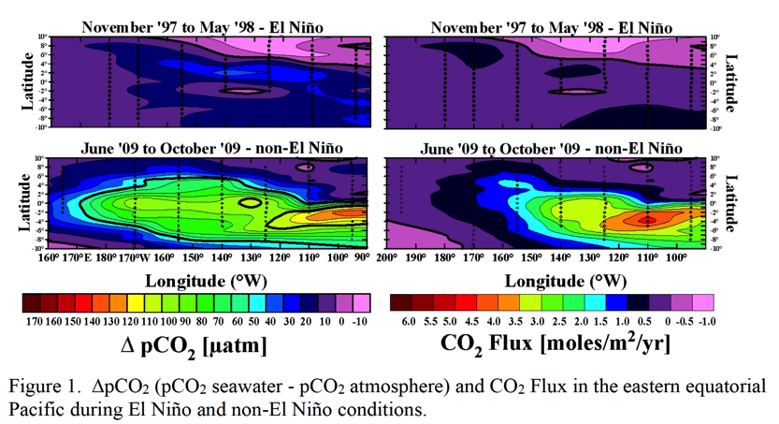
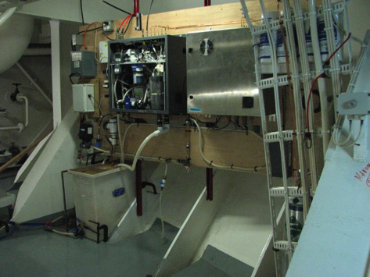
Ongoing Science RoCS efforts….
Working with NOAA-PMEL Carbon Group to have a PCO₂ system installed on a WW ship.
Figures courtesy of J. Herndon, NOAA-PMEL
Notes:
There are many routes to choose from, the “Schedule Liaison” through the MFP portal will help you find the right ship, route, speed, bandwidth, clearance, site visits, dry dock installation etc.
Looks like this install will happen in September 2021.

Slide 9
A few potential end-uses of Science RoCS data streams
Weather forecasts – e.g., predicting hurricane tracks and intensity.
By tracking ocean eddies, upper ocean heat content ahead of a storm
Ocean forecasts – e.g., predicting ocean conditions for the Energy Industry
Feature locations, vertical structure, eddy shedding events important for offshore energy platform design and operation.
Science – e.g., AMOC, carbon cycle, shelf and slope exchange processes, air/sea interactions, bio/physical interactions, model validation and assimilation, satellite ground-truth (SST, SSS, SSH).
Model currents (color) vs. float trajectory (black)
Vessel ADCP (22 July 2006 0259-0954)
Surface Drifter Trajectories: 25 April 2016
-50
-150
-250
-350
-450
1.4
1.2
1.0
0.8
0.6
0.4
0.2
Elevation (m)
Current Speed (m/s)
-10 -5 0 5 10 15
0 1 1.5 m/s
Distance from Maximum Velocity (km)
0 1 2 3
Image credits: M. Bruce, Woods Hole Group
Surface Current Speed (knots)
Notes:
Left - Loop current ring – current speed in m/s – Model in color, black lines are actual drifter trajectories – good model resolution, still not good enough, Industry needs to know the long-term variability (Stars are industry assets).
Center – gives you what ADCPs can show – depth of currents in loop
Right – Extent of currents and loops that are critical for industry to know about (also ocean/atmosphere forecasting).

Slide 10
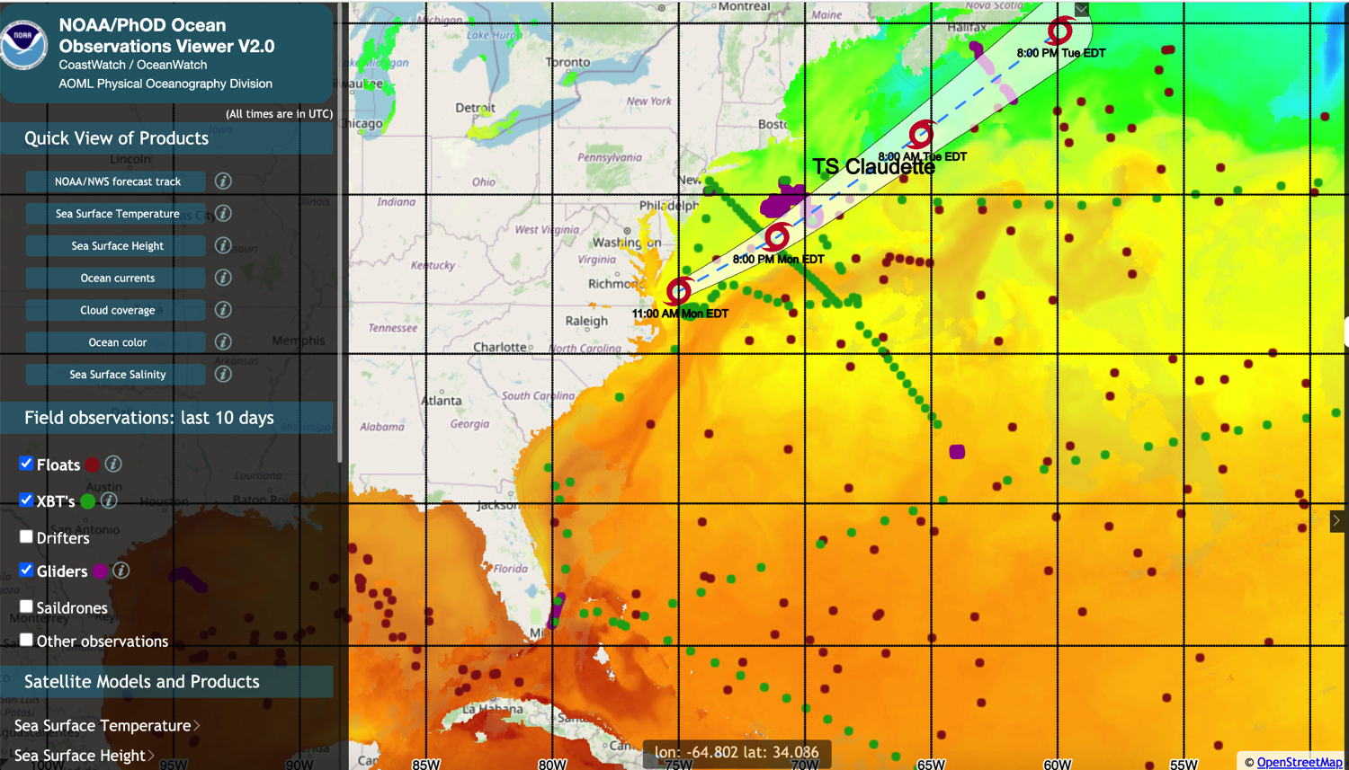
Profile data are assimilated into the Global Real-Time Ocean Forecast System (RTOFS) at Environmental Monitoring Center (EMC) for ocean and hurricane forecasts.
A next step could be assimilation of sub-surface velocity data (e.g., Levin et al., 2020 & 2021 discuss impacts of subsurface velocities on 4D-Var ocean state estimates).
Figure shared June 22, 2021 by Gustavo Goni, NOAA; created by AOML OceanObsViewer
Notes:
Levin, J., H. Arango, B. Laughlin, E. Hunter, J. Wilkin and A. Moore, (2020), Observation impacts on the Mid-Atlantic Bight front and cross-shelf transport in 4D-Var ocean state estimates, Part I – Multiplatform Analysis, Ocean Modelling, 156, 101721, doi: 10.1016/j.ocemod.2020.101721
Levin, J., H. Arango, B. Laughlin, E. Hunter, J. Wilkin and A. Moore, (2021), Observation Impacts on the Mid-Atlantic Bight Front and Cross-Shelf Transport in 4D-Var Ocean State Estimates, Part II – The Pioneer Array, Ocean Modelling, 157, 101731, doi: 10.1016/j.ocemod.2020.101731
Shows that models are capable of assimilating XBT, glider and other data. Would be interested in ADCP down the road.

Slide 11
RoCS Collaboration with SOT
Many planned RoCS observations fit existing SOT, or broader OCG, activities.
Marine Meteorology, XBT, thermosalinograph, PCO₂
Bathymetry
Currents (an EOV, but not a present focus of SOT)
How can RoCS ensure observations are distributed in real-time using VOS and SOOP protocols?
RoCS interested in getting observations to the GTS, but how to do this?
Via NMHS? OpenGTS initiative?
Connect OceanOPS with RoCS on several fronts
Metadata for RoCS vessels, including supporting existing VOS, SOOP standards
Identifying deployment opportunities to achieve GOOS mission
Can SOT/OCG help RoCS to develop a unified global shipboard ADCP program?
Leverage work by JASADCP, University of Hawaii
Notes:
SOT – GOOS Ship Observation Team
OCG – GOOS Observation Coordination Group
VOS – Voluntary Observing Ship Scheme
SOOP – Ship Of Opportunity Program
GTS – Global Telecommunications Network
NMHS – National Meteorological and Hydrographic Service
OceanOPS – Coordination center for GOOS, assesses status of ocean observing system - https://www.ocean-ops.org/board

Slide 12
Questions?

