Slide 1
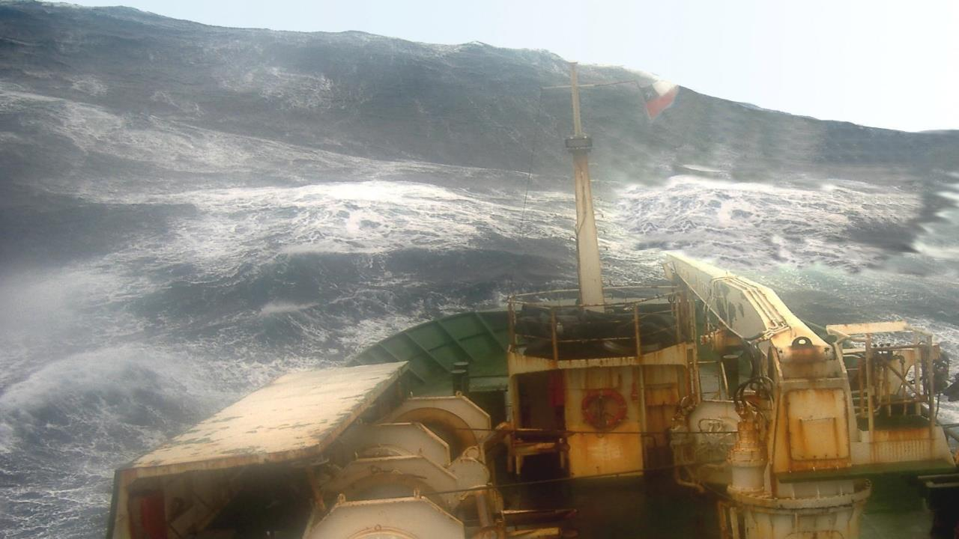
x-Cdr. Alejandro de la Maza
S.O.T. – V.O.S. National Report
CHILE NAVY WEATHER SERVICE
PATRIOTISMO
HONOR LEALTAD VALENTÍA INTEGRIDAD DEBER

Slide 2
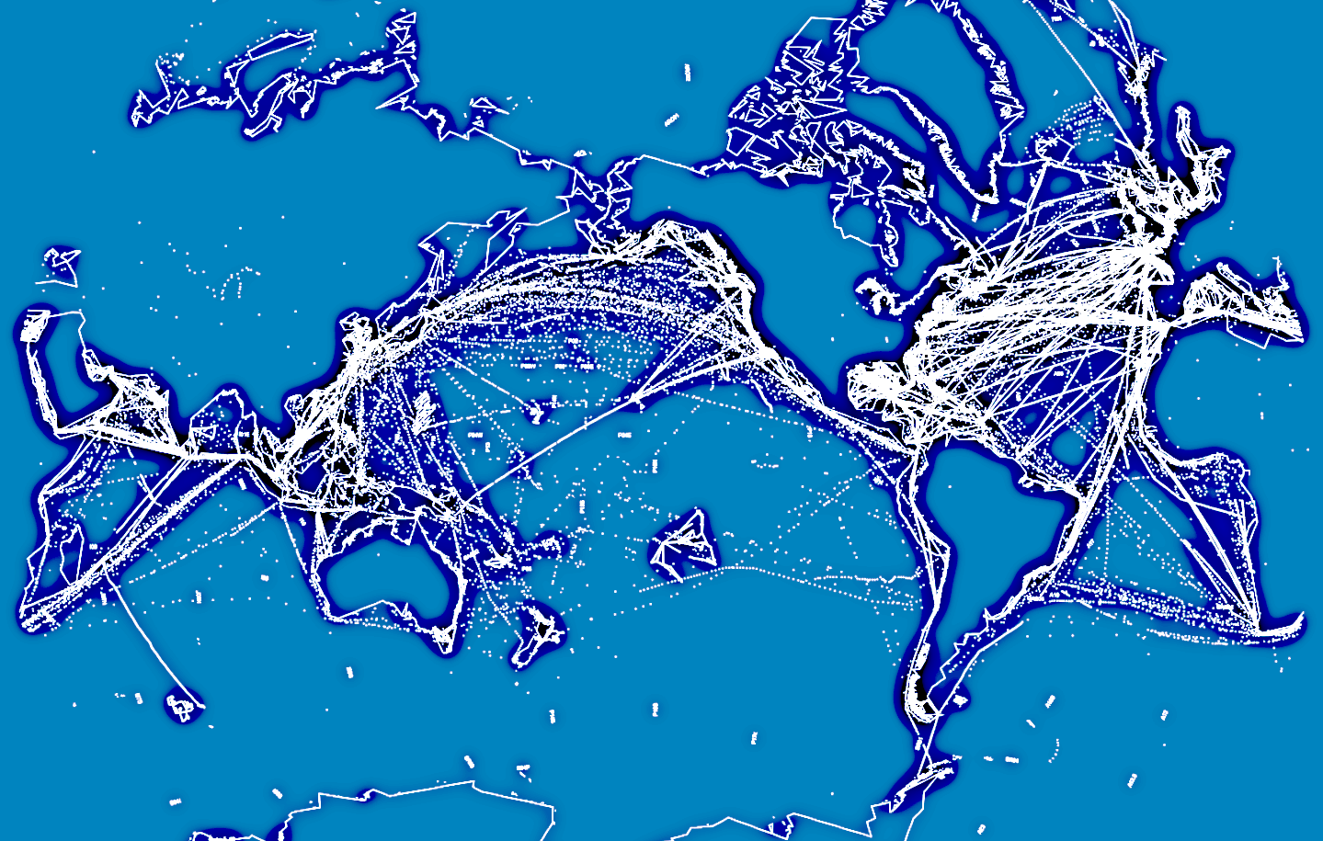

Slide 3
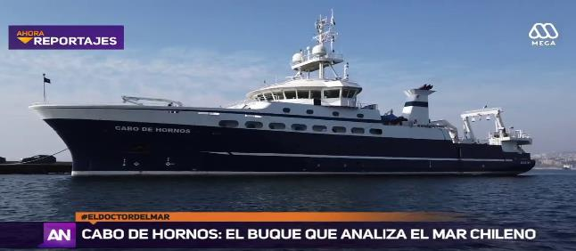
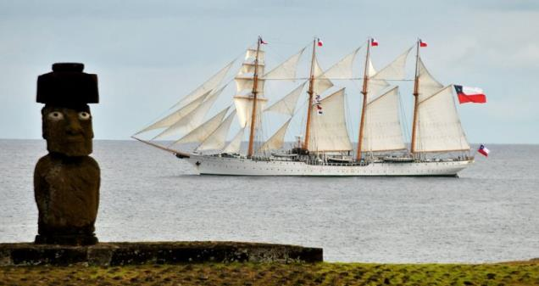
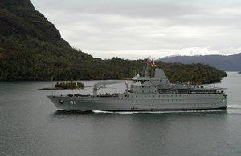
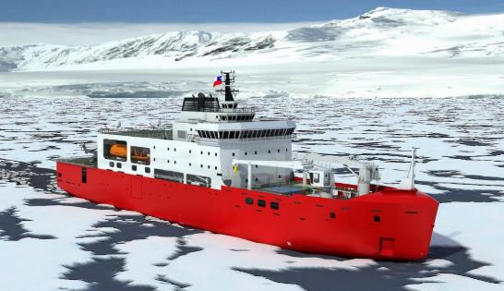
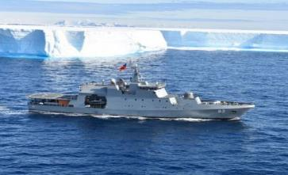
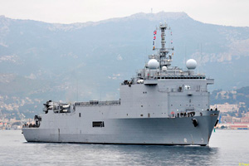
CHILE NAVY WEATHER SERVICE RECRUITED V.O.S. WORLDWIDE TRAINING SHIP, EASTERN SOUTH PACIFIC OCEAN SCIENTIFIC VESSEL, TRANSPORT, PATROL AND LOGISTICS FOR ANTARCTIC CAMPAIGNS, NEXT ICEBREAKER UNDER CONSTRUCTION
ESMERALDA (CCES)
CABO DE HORNOS (CCCH)
AQUILES (CCAQ)
MRO.FUENTEALBA (CCMF)
SGT.ALDEA (CCAL)
OSCAR VIEL (CCOV)

Slide 4
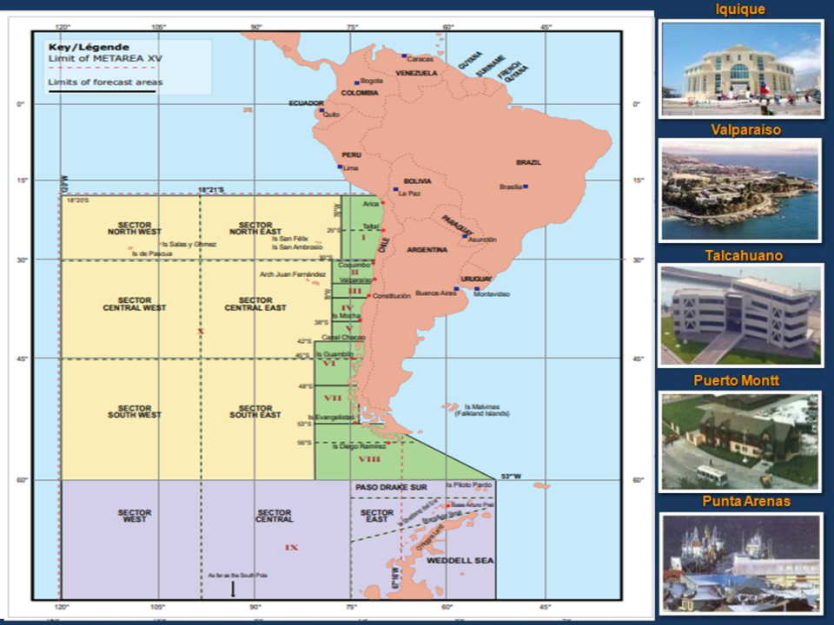

Slide 5
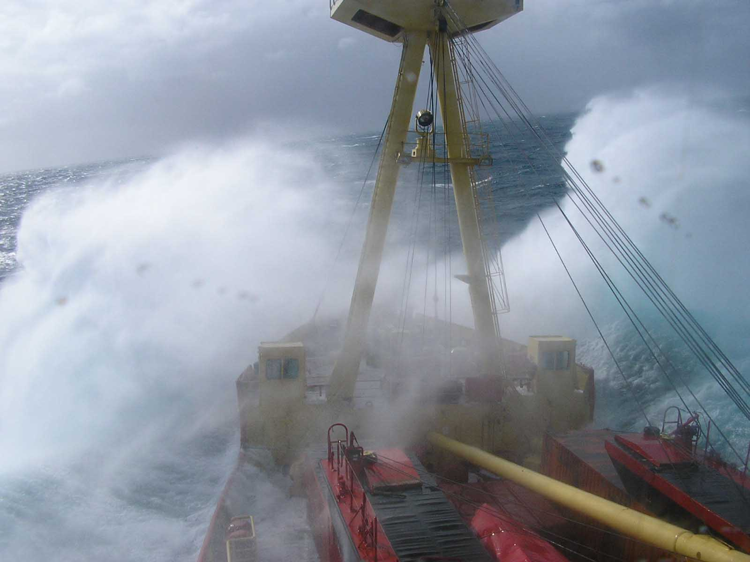
Expression of Interest as Recipients in the V.O.S. Donation Program

Slide 6
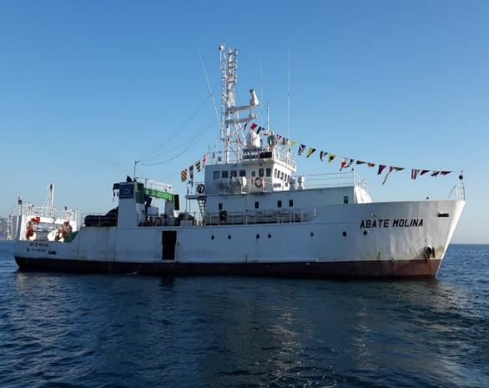
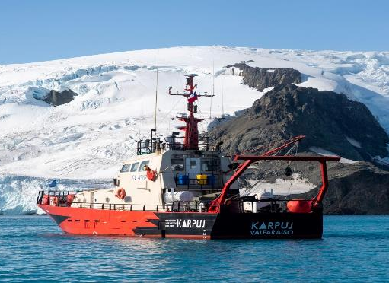
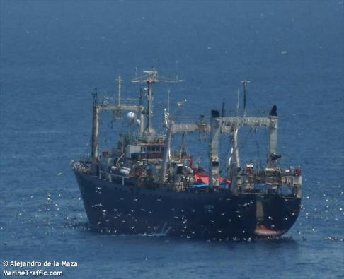
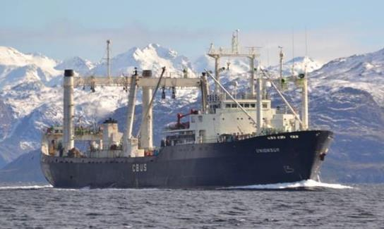
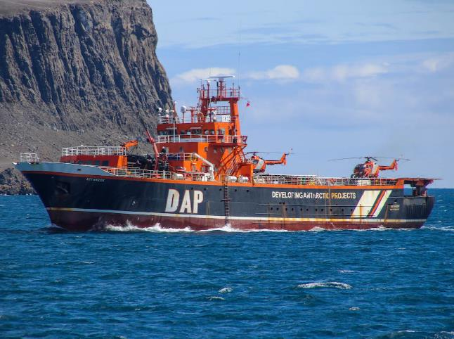
POSSIBLE CANDIDATES FOR RECIPIENT THE V.O.S. DONATION PROGRAM AMONG TECHNICAL COOPERATION AGREEMENTS
RV ABATE MOLINA (IFOP)
RV KAYKAY II (UDEC)
RV KARPUJ (INACH)
BF UNZEN
BF UNION SUR
BETANZOS (DAP)

Slide 7
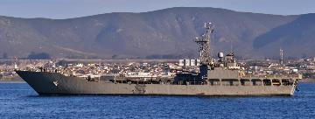
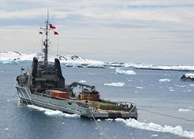
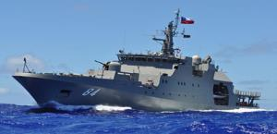
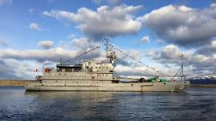
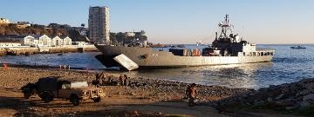
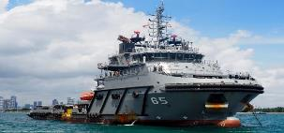
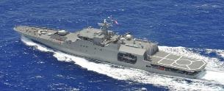
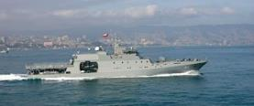
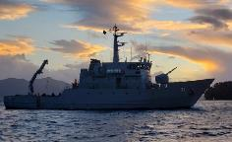
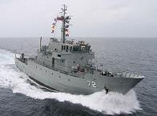
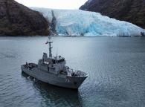
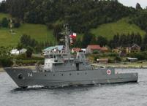
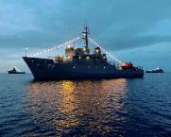
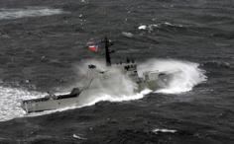
FUTURE TARGETS FOR EXPAND THE V.O.S. RECRUITMENT PROGRAM ON BOARD CHILE NAVY TRANSPORTS AND PATROLS
LST: CHACABUCO & RANCAGUA
ATF: GALVARINO & JANEQUEO
OPV: PILOTO PARDO, CMTE.TORO, CB.ODGER
BRS SLIGHT
PSG: MICALVI, ORTIZ, ISAZA, VIDELA, CABRALES, SIBBALD

Slide 8
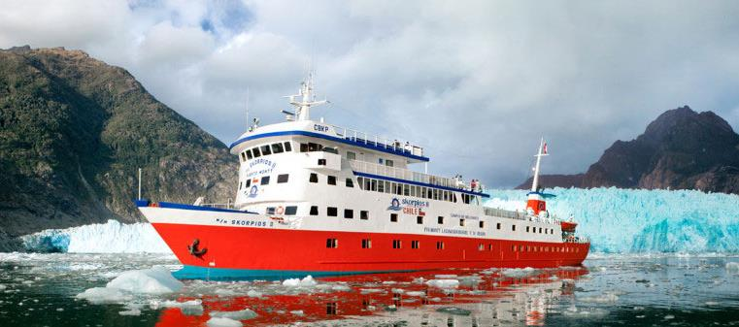
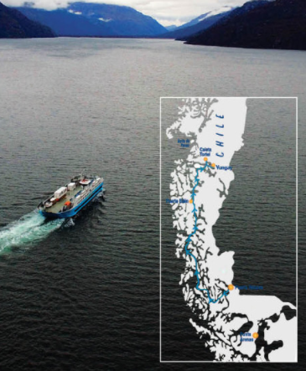
PATAGONIAN CHANNELS AND MAGELLAN STRAIT NAVIGATIONS: PAX & CARGO V.O.S.-D.P. CANDIDATES
“Skorpios” II-III
Ferry Dalka
F. Esperanza
F. Trinidad

Slide 9
x-Cdr. Alejandro de la Maza
S.O.T. – V.O.S. National Report
CHILE NAVY WEATHER SERVICE
PATRIOTISMO
HONOR LEALTAD VALENTÍA INTEGRIDAD DEBER

