Slide 1
Martin KRAMP
SOT Technical Coordinator
mkramp@ocean-ops.org

Slide 2
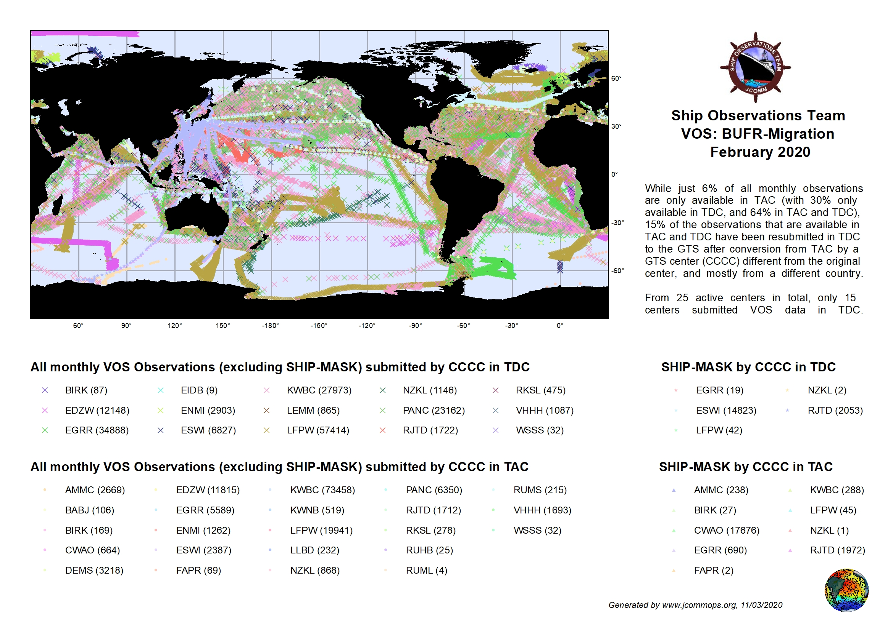
VOS: Migration Status 2/2020

Slide 3
VOS: Migration Status 8/2021
Number of TDC producing centers: 14 (15); TAC-only: 9
Percentage of GTS duplicates (VOS): > 50%; TAC-only messages: < 5%
BUFR not SHIP |  |  |  | TAC not SHIP |  |  |  | TAC SHIP
CCCC | Country | OBS |  | CCCC | Country | OBS |  | CCCC |  | OBS
BIRK | Iceland | 76 |  | AMMC | Australia | 2824 |  | AMMC | Australia | 97
EDZW | Germany | 8151 |  | BABJ | China | 279 |  | BIRK | Iceland | 3
EGRR | United Kingdom | 32272 |  | BIRK | Iceland | 180 |  | CWAO | Canada | 19631
ENMI | Norway | 2212 |  | CWAO | Canada | 321 |  | DEMS | India | 1
ESWI | Sweden | 20170 |  | DEMS | India | 3266 |  | FAPR | South Africa | 4
KWBC | United States | 5048 |  | EGRR | United Kingdom | 2949 |  | KWBC | United States | 324
LEMM | Spain | 744 |  | ESWI | Sweden | 1298 |  | NZKL | New Zealand | 1
LFPW | France | 111241 |  | FAPR | South Africa | 18 |  | RJTD | Japan | 3636
NZKL | New Zealand | 1225 |  | KWBC | United States | 105484
PANC | United States | 77640 |  | LFPW | France | 1955 |  | BUFR SHIP
RJTD | Japan | 2168 |  | LGAT | Greece | 16 |  | CCCC | Country | OBS
RKSL | Korea (Republic Of) | 1286 |  | LLBD | Israel | 240 |  | ESWI | Sweden | 529
VHHH | Hong Kong (China) | 1185 |  | NZKL | New Zealand | 910 |  | NZKL | New Zealand | 4
WSSS | Singapore | 50 |  | PANC | United States | 15261 |  | RJTD | Japan | 4438
 |  |  |  | RJTD | Japan | 1901
 |  |  |  | RKSL | Korea (Republic Of) | 534
 |  |  |  | RUHB | Russian Federation | 70
 |  |  |  | RUMS | Russian Federation | 199
 |  |  |  | VHHH | Hong Kong (China) | 1803
 |  |  |  | WSSS | Singapore | 50

Slide 4
Issues with BUFR migration
Resubmission in BUFR of native TAC and/or even TDC data by other CCCCs, with partially enriched area indicator, make duplicate detection very challenging. What to do? uIDs?
ASAP and XBT data from reference lines are fully available in TDC
Should we set a formal TAC end date? Are data users ready for “BUFR only”, and ready for latest BUFR templates like 308014 ?
Use full set of metadata fields in BUFR!

