Slide 1
11th Session (Virtual)
Ship Observation Team (SOT-11)
13-16 September 2021
Sarah North
WMO Contractor
sc.north@virgin.net

Slide 2
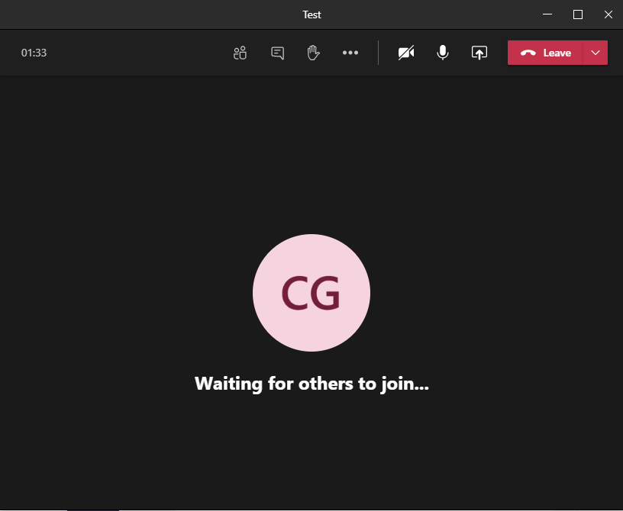
Virtual Meeting Tools Microsoft Teams
Chat box
(Type your comments questions here)
Share your screen
Raise Hand
Turn on/off your
Microphone
Turn on/off your camera

Slide 3
Virtual Meeting Etiquette
By default, please keep your microphone muted unless you are speaking. [We will try to use video, unless it presents a problem for bandwidth, so join with your camera on].
If you have a question or comment, please either use the “chat box” in Teams Meeting to type your question/comment, or indicate by “raise hand” in order to be called upon by the moderator.
Please be succinct in both your questions and answers.
The sessions will be recorded for the purpose of writing the Final Report, and the recordings deleted afterwards

Slide 4
Rapporteurs & Moderators
Names are listed in
SOT-11/Doc. Inf. 5
Rapporteurs should aim to record a very short coherent summary of discussions and to capture the main conclusions/decisions/actions/recommendations. Basic guidance is posted on the SharePoint directory at
https://wmoomm-my.sharepoint.com/:f:/g/personal/mkramp_wmo_int/Etoub2qAsa1PmKTPZYC6mKgBIpsOcSaXrgNxMIIa74nm4Q?e=oAXXD0
Rapporteur records should ideally be posted on this directory within 24 hours of the end of the SOT-11 Session
Moderators should introduce the presenters (unless already introduced by the Chair) and make sure that presentations/discussions keep to time. They should keep an eye on questions raised in the chat and on delegates who raise hands.
There may not be time for all questions to be addressed – if so they will be captured and replied to after the meeting

Slide 5
Reminders
Meeting agenda, documents and Teams Links are available at
https://www.goosocean.org/SOT-11
or
https://oceanexpert.org/event/3065
If you haven’t done so already, please send your presentations to sc.north@virgin.net and mkramp@ocean-ops.org ASAP
Messages related to the SOT-11 session can be sent to event@jcommops.org
Thank you
Merci

