Slide 1
Tropical Americas a Healthy and Resilient Ocean Co-design Workshop
Part 1
Overview of the Ocean Decade

Slide 2
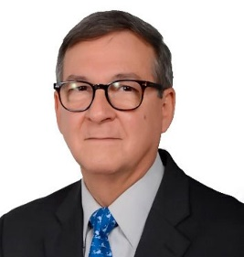
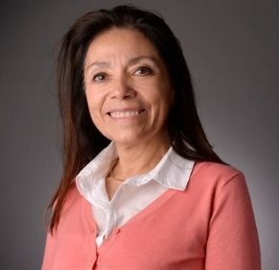
Part 1 Welcome / Overview
Overview of Ocean Decade
MODERATOR
Panelist
Francisco Arias-Isaza
Chair WTA WG
Elva Escobar
Member of the Executive Planning Group of the UN Decade

Slide 3
Tropical Americas a Healthy and Resilient Ocean Co-design Workshop
Part 2
State of the Ocean Health in the Tropical Americas

Slide 4
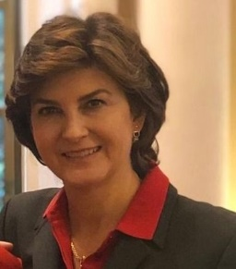
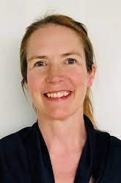
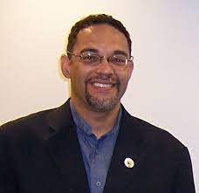
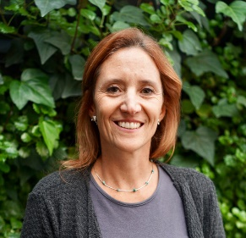
Part 2 - Panelists
State of the Ocean Health in the Tropical Americas
MODERATOR
Elva Escobar
Member of the Executive Planning Group of the UN Decade
Julia Miranda
Deputy President
IUCN - WCPA
Lucy Scott
Project Manager of the
IOC Ocean InfoHub
Francisco Arias-Isaza
Chair WTA WG
Christopher Corbin Programme Officer, AMEP & CETA - UNEP
Maria Claudia Diazgranados
Blue Carbon Program Director - CI

Slide 5
Tropical Americas a Healthy and Resilient Ocean Co-design Workshop
Part 3
Open Panel: Identifying knowledge gaps and priority areas

Slide 6
Part 3 - Panel questions
KEY QUESTION - 1
What are the barriers that hinder progress towards achieving the Societal Outcomes of the Ocean Decade in the region?
KEY QUESTION - 2
What transformative ocean science solutions will help overcome these barriers, and how could they be implemented throughout the Ocean Decade?

Slide 7
Tropical Americas a Healthy and Resilient Ocean Co-design Workshop
Part 3 – Cont.
General summary / results of the workshop

Slide 8
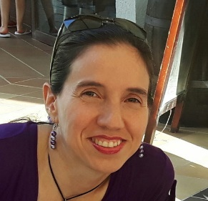
Part 3 - General summary
Results of the workshop
Paula Cristina Sierra-Correa
INVEMAR

Slide 9
Tropical Americas a Healthy and Resilient Ocean Co-design Workshop
Part 4
Call to Action - Closing Session

Slide 10
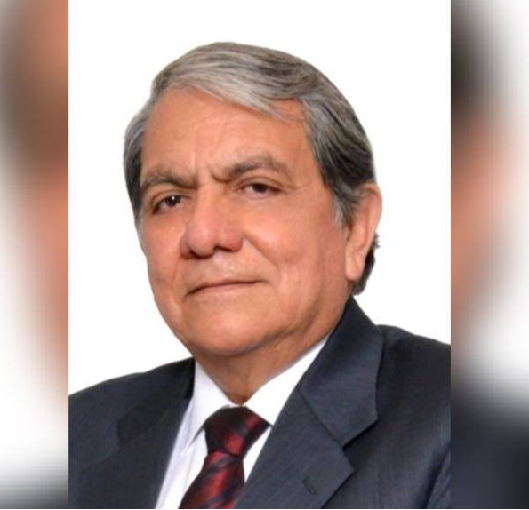
Part 4 - Call to action
Closing Session
Francisco Arias-Isaza
Chair WTA WG
Edgar Cabrera
Senior Consultant - IOCARIBE

