Slide 1
Benefits of Ocean Observation Catalog (BOOC)
GOOS Regional Alliance Council
September 9, 2021

Slide 2

BOOC website www.booc.info

Slide 3
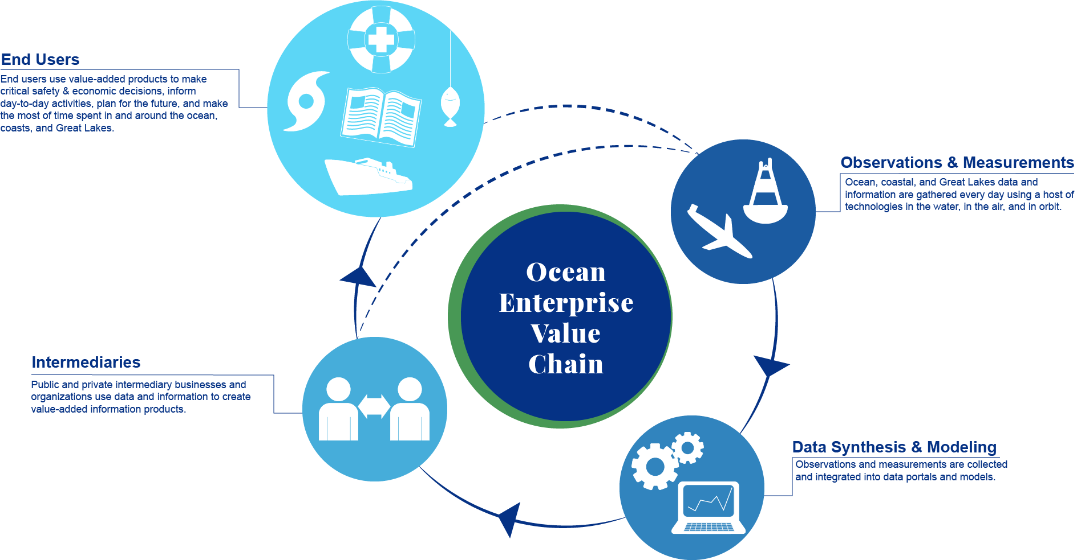
Ocean Observing Value Chain

Slide 4
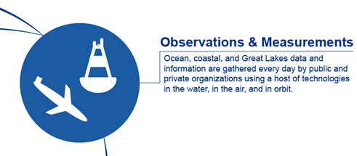
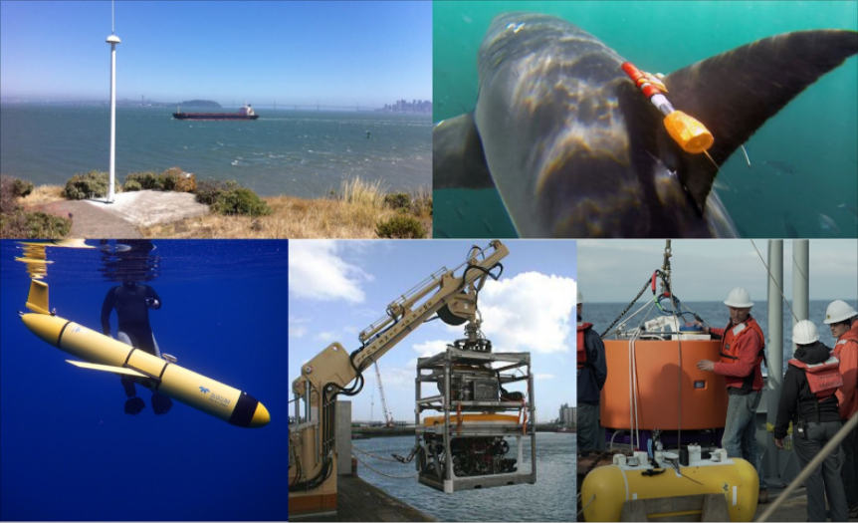
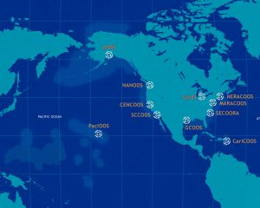
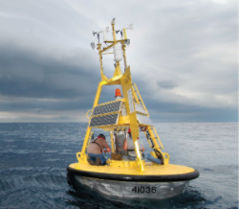
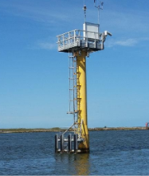
Observations and Measurements
Ocean and coastal data and information are gathered, primarily by public organizations organized under GOOS

Slide 5
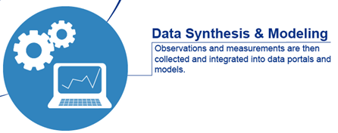
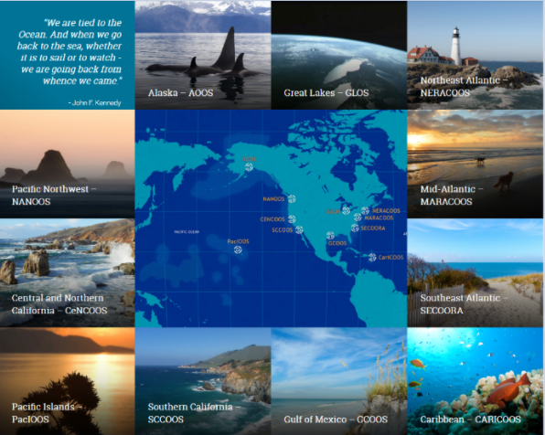
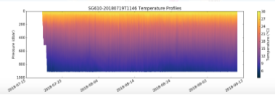
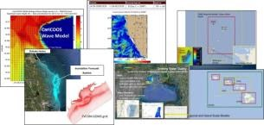
Data Synthesis and Modeling
Regional Portals: Portals integrate data at a local level and provide core information able to support multiple uses.
Observations and measurements are integrated through data portals and models

Slide 6
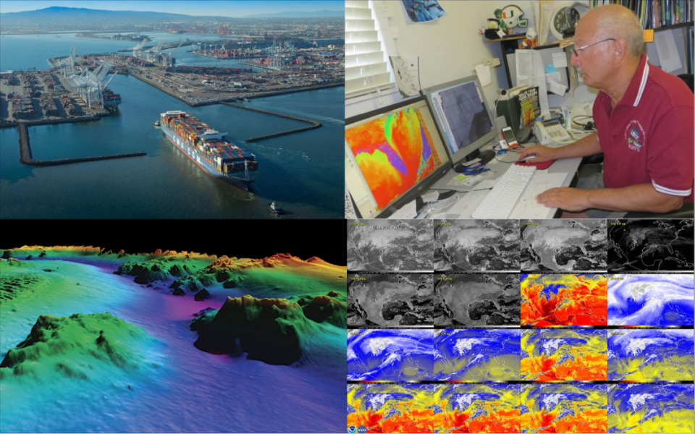
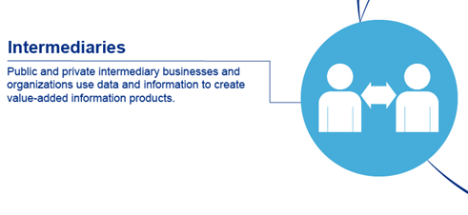
Public and Private Intermediaries
Public and private intermediary businesses and organizations use core ocean information to create value-added information products tailored to particular end-uses.
Firm
Information
Products/services

Slide 7
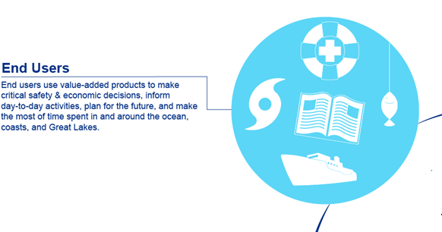
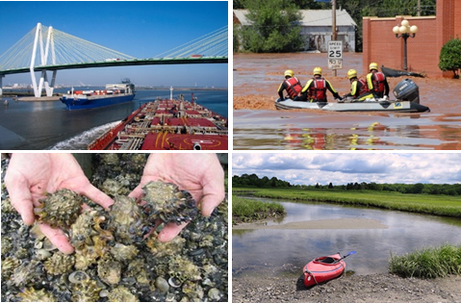
End-Users
End-users derive benefits from value-added products to make critical safety, economic and ocean stewardship decisions, inform daily activities, and plan for the future

Slide 8


Benefits of Ocean Observations

Slide 9
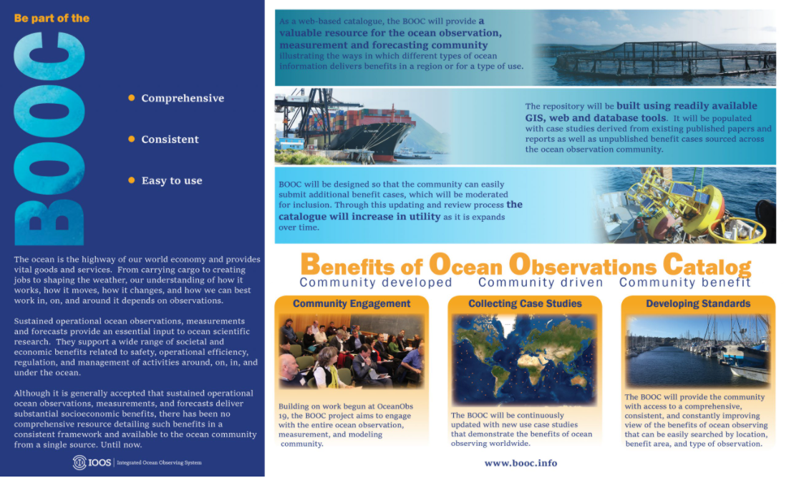
The Benefits of Ocean Observations Catalog

Slide 10

Socioeconomic benefits of ocean observations
Building a better understanding of how ocean observations, measurements and forecasts deliver societal and economic benefits

Slide 11
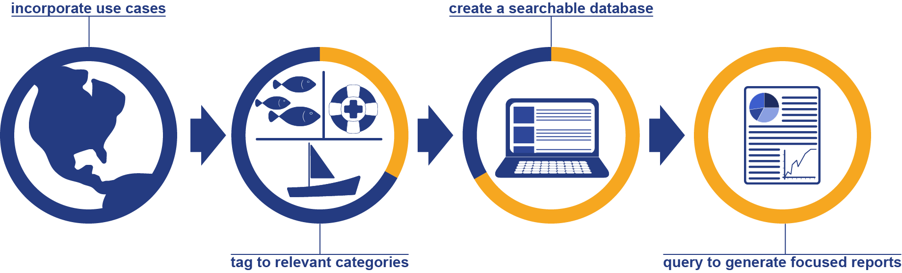
The Benefits of Ocean Observations Catalog

Slide 12
Ocean Observing Value Chain

Slide 13
The Benefits of Ocean Observations Catalog
Observations and Measurements
Public/private/both?
Types of data
Geographical attributes
etc
Data synthesis and Modeling
Source repository
Type of synthesis/model
etc
Intermediaries
Public/private?
Organization name(s)
Nature of end-use
Geographical attributes
etc
End-use/End User
Who?
Where?
etc
Value/Benefit
Qualitative/quantitative?
Assessment method?
Bibliographic/source ref?
etc

Slide 14
BOOC Work Packages
Task 1 Define function and structure
Input system, taxonomy, database structure, geographical interface, reporting tools
Task 2 Develop prototype
Build prototype able to deliver agreed functional specification
Task 3 Testing of prototype
Test prototype for a range of use cases/geographical areas working with range of trial users
Task 4 Develop deployment plan
Update prototype based on trial user feedback, expand to global capability, determine governance/management structure
Task 5 Implement deployment plan
Roll out global system, governance and administrative structure

Slide 15


Slide 16
Next Steps with GRAs for BOOC
NEXT STEPS
Engagement Process starts NOW
Define taxonomy, input process and final structure
Join a prototype user/test group
Help with identification and development of use cases
Work with existing efforts at Copernicus, GEOValue, IODE, EMODnet etc.
Develop templates for use case development
Convene mini workshops on developing use cases in late 2021and into 2022

Slide 17
Open Discussion: GRA engagement and use case provision
Engagement in prototype development stages
Supply existing use cases
Work on development of new use cases
Engagement in prototype testing
Engagement in roll-out planning

Slide 18
Thank you!
ioos.noaa.gov || ioos.us

