Slide 1

SOT – 11
Global CPR update 20/21
David Johns, Head of Continuous Plankton Recorder Survey (MBA, UK)
+ input from Frank Coman (CSIRO) Claire Davies (CSIRO), Jenny Huggett (DFFE) John Kitchener (AAD), Clare Ostle (MBA) and
Ant Richardson (CSIRO)
Est. 1884
Incorporated by
Royal Charter
www.mba.ac.uk

Slide 2
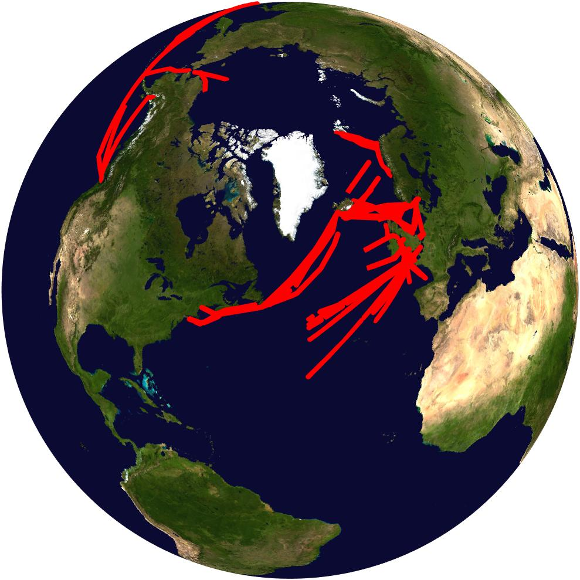
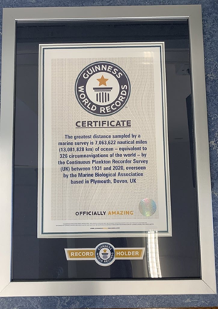
North Atlantic
First 6 months of 2021 22 routes operated and over 50k miles of sampling, collecting over 4500 samples (no issues)
2019 sample data completed (slight delay due to covid lab restrictions)
Guinness World Record awarded for the greatest distance sampled by a marine survey (over 7 million miles)
CPR 90th Anniversary – today!
MC route (Gulf of Maine) successfully restarted. In discussions with NOAA to restart second route (MB)
New route of South Africa to Brazil (EU AtlantECO project) should be towing 14th October to 26th October
CPR data continue to be used extensively in marine policy (UK and EU)

Slide 3
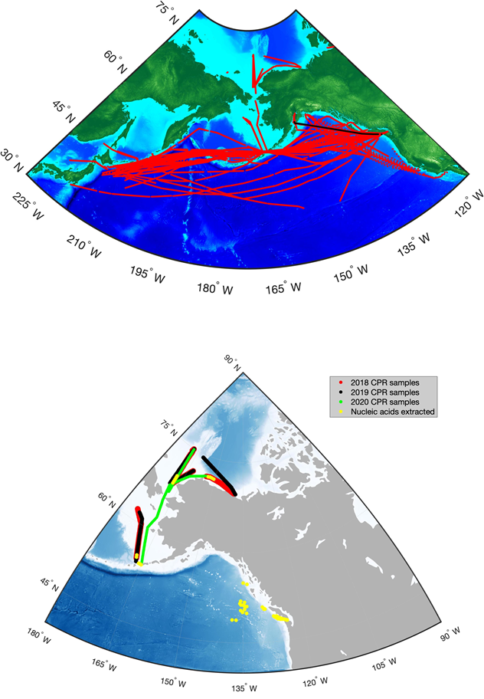
North Pacific CPR Survey
Clare Ostle has taken over Sonia Batten’s role as coordinator of the Pacific CPR Survey, as Sonia is the new Executive Secretary of PICES.
Sampling for the first half of 2021 in the Pacific (AT and VJ routes) has gone to plan.
New route around Alaska into the Arctic is sampling for the 4th consecutive summer (2018-2021).
Data contributed to the 2020 NOAA Ecosystem Status Reports
New publication: Ashlock L, García-Reyes M, Gentemann C, Batten S and Sydeman W (2021) Temperature and Patterns of Occurrence and Abundance of Key Copepod Taxa in the Northeast Pacific. Front. Mar. Sci.

Slide 4
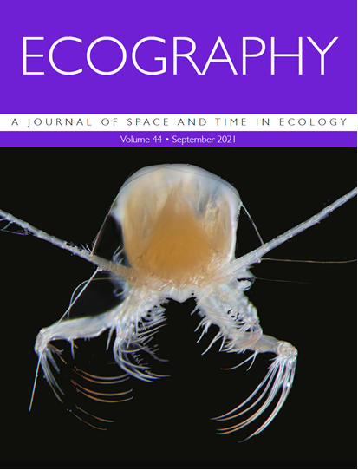
Global Alliance of CPR Surveys
Campbell MD, Schoeman DS, Venables W, Abu-Alhaija R, Batten SD, Chiba S, Coman F, Davies CH, Edwards M, Eriksen R, Everett JD, Fukai Y, Fukuchi M, Garrote OE, Hosie G, Huggett J, Johns DG, Kitchener JA, Koubbi P, McEnnulty F, Muxagata E, Ostle C, Robinson KV, Slotwinski A, Swadling K, Takahashi KT, Tonks M, Uribe-Palomino J, Verheye HM, Wilson W, Worship M, Yamaguchi A, Zhang W, Richardson AJ (2021) Testing Bergmann’s Rule in marine copepods. Ecography 44: 14 pp.
We conducted a near-global comparative
analysis on marine copepods (97 830 samples, 388 taxa) to test Bergmann’s
rule, considering other potential drivers. Supporting Bergmann’s rule, we found temperature
better predicted size than did latitude or oxygen, with body size decreasing by 43.9% across the temperature range (-1.7 to 30ºC). Body size also decreased by 26.9% across the range in food availability. Our results provide strong support for Bergman’s rule in copepods, but emphasises the importance of other drivers in modifying this pattern. As the world warms, smaller copepod species are likely to emerge as ‘winners’, potentially reducing rates of fisheries production and carbon sequestration.

Slide 5
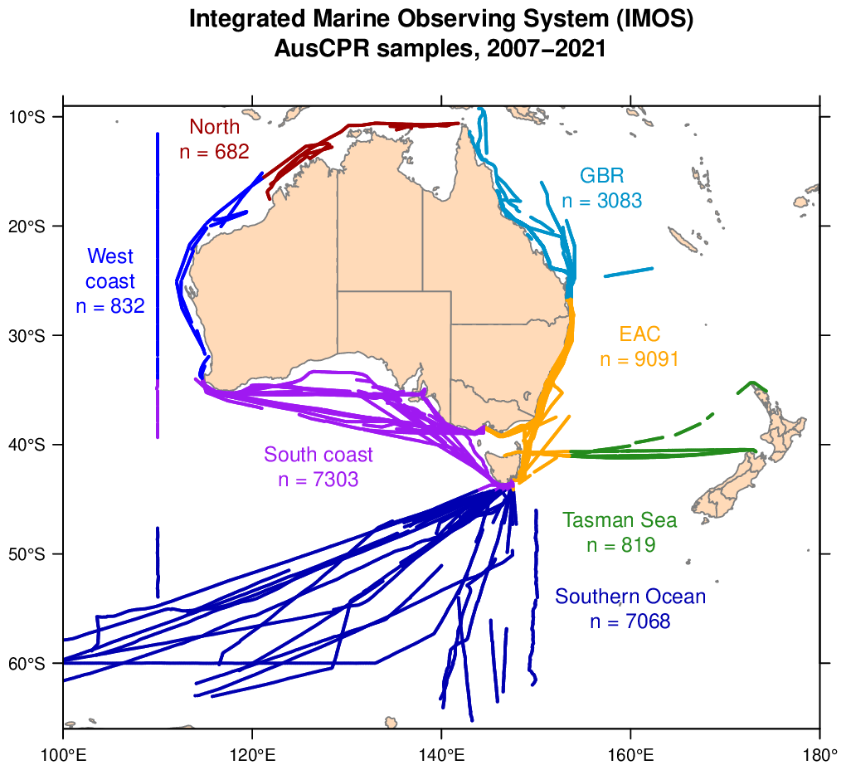
AUS CPR
Key applications
1.Ecosystem assessments. Regional (e.g. Great Barrier Reef Status Report), National (e.g. State of Environment), Global (IPCC)
2.Model assessment. Co-developing plankton data products with modellers (e.g. Maps of zooplankton biomass and functional groups)
Enhancing data availability
1.Developing a data portal for delivering all AusCPR data the way users need it
2.Developing a new visualisation and data access App with R Shiny to enhance data awareness and uptake
Highlights
Fiona Scott (UTAS/AAD) has counted a backlog of Southern Ocean CPR silks for phytoplankton, completing over 1000 samples in the last year

Slide 6
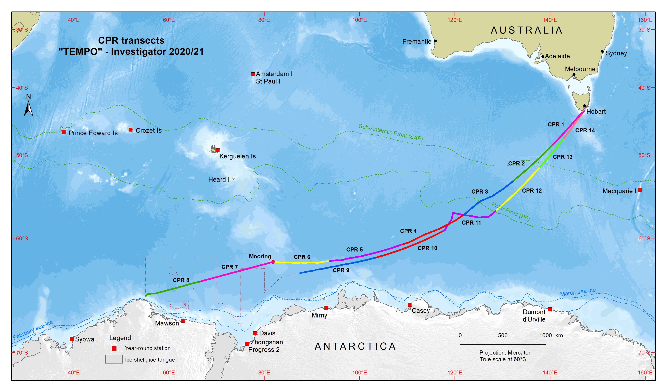
Southern Ocean CPR
Due to COVID and shipping constraints, the Australian Antarctic Division (AAD) was only able to tow on a single Investigator voyage during 20/21 – 14 CPR tows, with the southern transit the longest SO CPR run (3197 nm, 8 tows)
January 2021 marked the 30th anniversary of the Aurora Australis deploying it’s first CPR
A "Report on the Status and Trends of Southern Ocean Zooplankton” based on the SCAR SO-CPR Survey was published as a bulletin in June 2021: https://www.scar.org/scar-library/reports-and-bulletins/scar-bulletins/5672-scar-bulletin-206/ .This substantial bulletin brings together all the information and highlights achievements over nearly 30 years of SO-CPR dataset analyses

Slide 7
South African CPR
• Annual tow conducted between Cape Town and Marion Island (April 2021)
• Annual tow conducted between Cape Town and Antarctica (SANAE, Dec 2020-Jan 2021)
• AtlantECO: preparing for 1st CPR tow across South Atlantic (South Africa-Brazil) planned for September 2021 in collaboration with MBA (UK), FURG & FUSP (Brazil) on MV Lodur.
• Containerised laboratory for CPR sample analysis under construction (due Nov 2021)
2022 we hopefully will be able to report on finally getting our CPR sample analysis underway! Our priority will be samples collected on the SA-Marion Island route for the Pelagic Eco-regionalisation in the Sub-Antarctic realm project, in collaboration with Philippe Koubbi et al.

Slide 8
Questions?
David Johns
djoh@mba.ac.uk
Est. 1884
Incorporated by
Royal Charter
www.mba.ac.uk

