Slide 1
The Ship Of Opportunity Program Implementation Panel Report, SOT-11, 2021
Francis Bringas, on behalf of the SOOPIP community

Slide 2
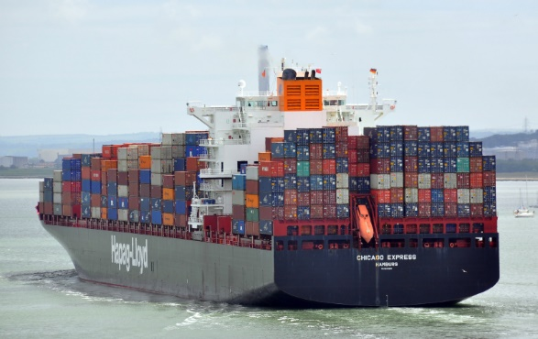
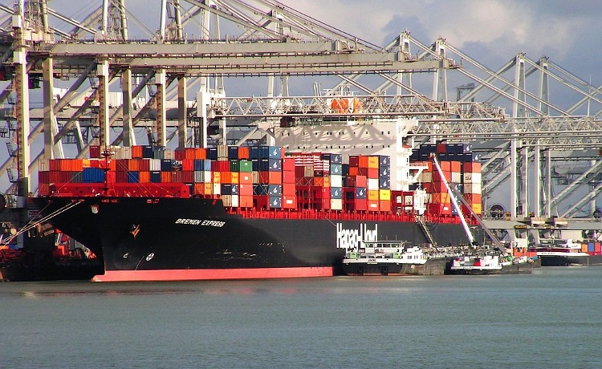
The Ship Of Opportunity Program
SOOP is an international program mainly involved in the implementation, maintenance, enhancement, and data management of upper ocean measurements from SOO:
Expendable BathyThermographs (XBTs) but not limited to SOO
ThermoSalinoGraphs (TSGs)
pCO2 systems
CPR systems
Additionally, SOOP supports other observational platforms, including
deployment of drifters and profiling floats
And many others (IQuOD, GTSPP, VOS, GOSUD, etc)
Hapag-Lloyd Chicago Express and Bremen Express participate in repeated XBT cruises

Slide 3
The XBT Network
SOOP supports (scientific and operational) efforts to help improve our knowledge of the ocean environment, through data analysis and contribution to modeling efforts.
What questions are we trying to answer with data obtained from the XBT network? (OceanObs99, OceanObs09).
Meridional Heat Transport and MOC studies, assessments
Studies and monitoring of surface current variability
Contribution to upper ocean heat content studies
Contribution to initialize and validate modeling efforts

Slide 4
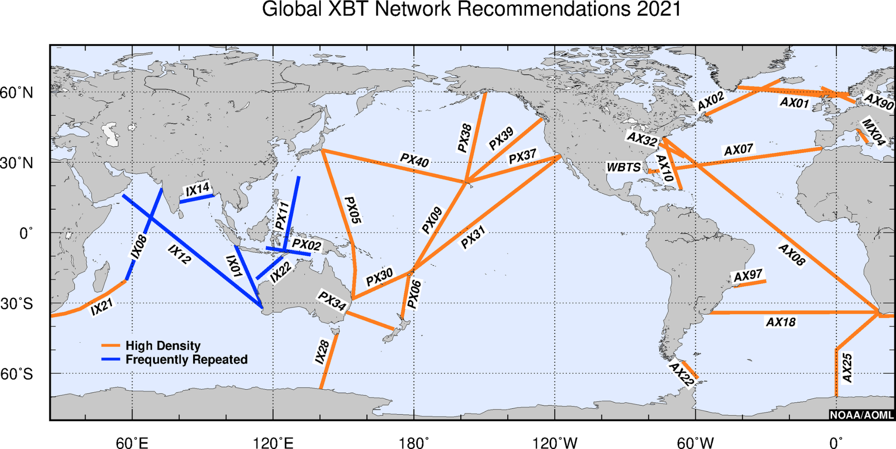
The XBT Network - Recommendations
Frequently Repeated:
6 - 8 deployments per day
1 deployment every 100 – 150 km
12 - 18 transects per year
High Density:
18 - 35 deployments per day
1 deployment every 25 - 50 km
4 transects per year

Slide 5
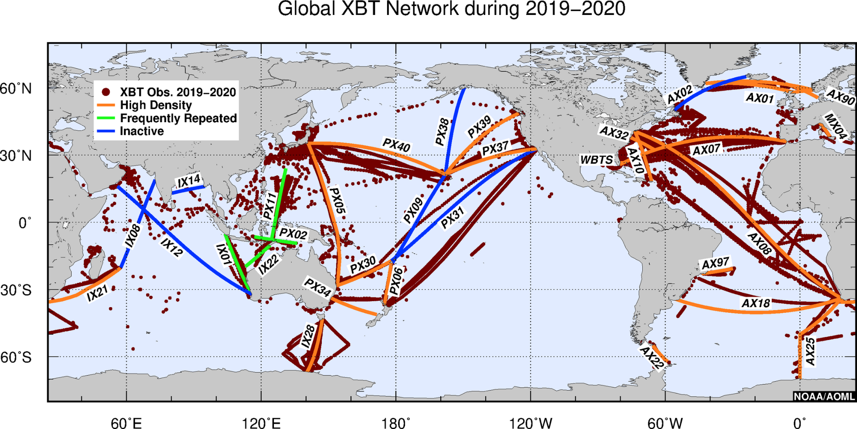
The XBT Network – Status 2019-2021
SOOPIP participating countries (operations):
Argentina, Australia, Brazil, Canada, China, France, Germany, India, Italy, Japan, New Zealand, South Africa, United States
Contributions from each country may be in the form of probes/equipment, ship recruitment, ship riders or data QC and distribution

Slide 6
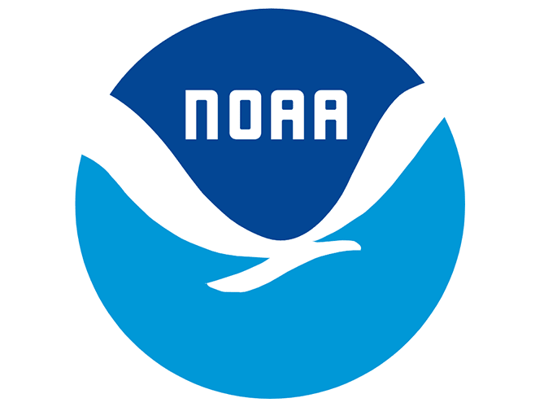
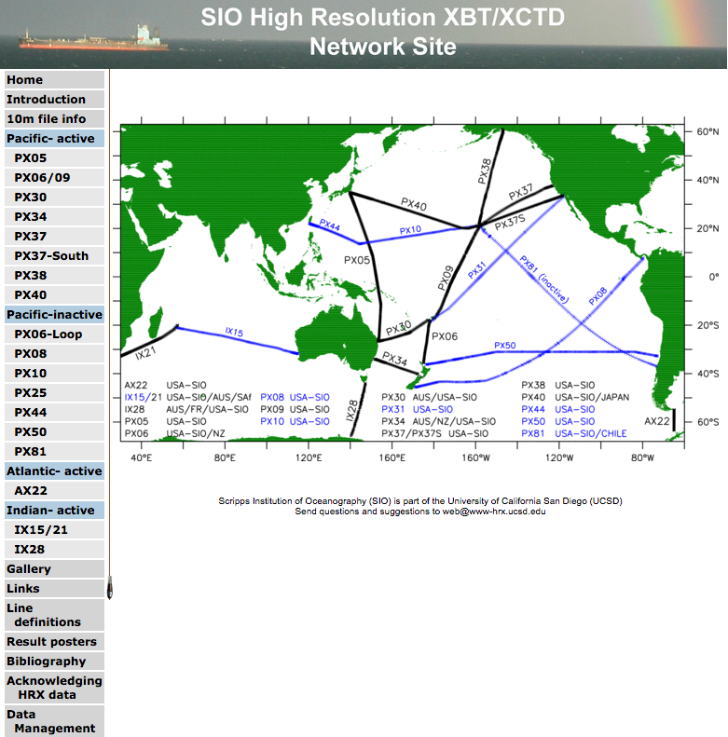
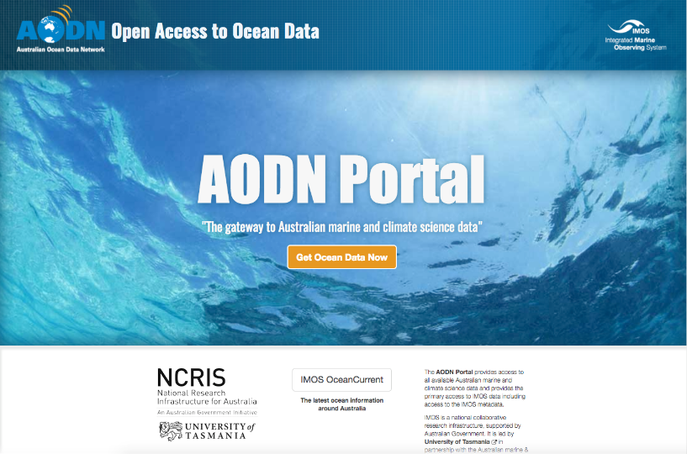
XBT Data Distribution
Links to some of the data through:
http://www.aoml.noaa.gov/phod/goos/xbtscience/data.php
https://www.aoml.noaa.gov/phod/hdenxbt/
Scripps:
http://www-hrx.ucsd.edu/index.html
IMOS/AODN:
https://portal.aodn.org.au/
Global datasets:
World Ocean Database (NCEI)
GTSPP (NCEI)

Slide 7
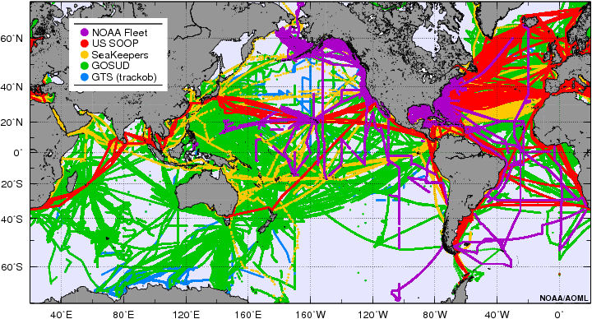
Thermosalinograph (TSG) Observations
Approximately 80 ships collecting and reporting more than 5 million TSG records per year during 2019-2020
Data distributed in real-time and near real-time through GOSUD and archived in GOSUD and NCEI. Data are also distributed in delayed-mode by GOSUD
Location of TSG observations conducted by the international community since 2000
Thermosalinographs (TSG) measure Sea Surface Temperature and Sea Surface Salinity along ship tracks. Applications include:
■ Determination of boundary regions in ocean currents
■ Climate and Ocean Dynamic research
■ Input for climate and weather forecast models
■ Support efforts to globally inventory carbon dioxide in the ocean (pCO2)
■ Operation carried during the last 20+ years; observations are critical for understanding long-term changes in the marine environment

Slide 8
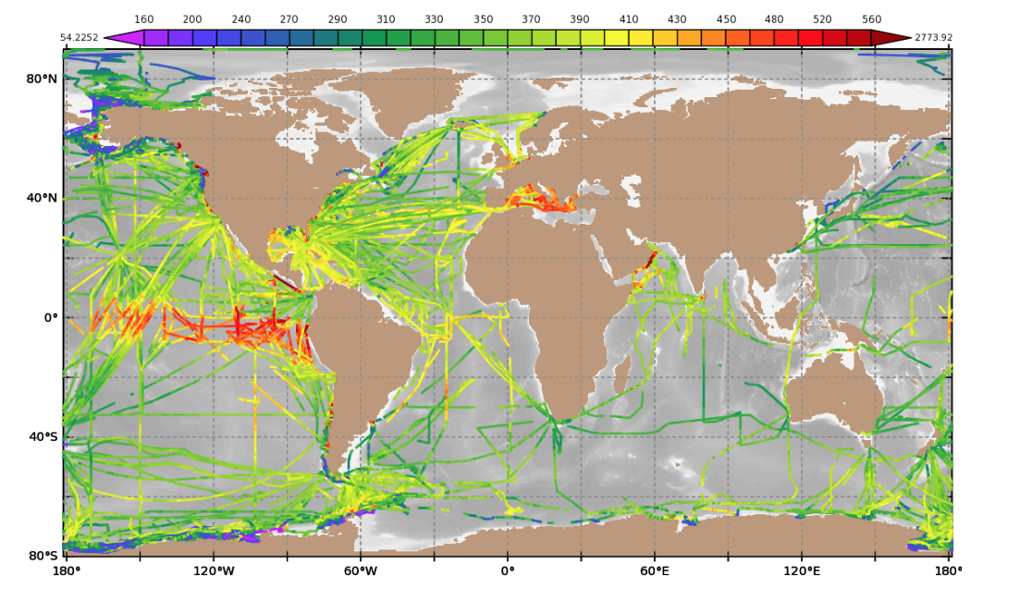
pCO2 Obs. from Ships Of Opportunity
Program conducted by researchers in more than 15 countries
Observations collected globally, including at high latitudes
Hundreds of cruises per year are conducted to collect over 1,000,000 observations
Surface water pCO2 along SOOP-CO2 transects since 1990
The objectives of this sustained effort are:
■ Produce CO₂ data at sufficient accuracy to constrain sea-air CO₂ fluxes to 0.2 Pg C yr⁻¹.
■ Facilitate capacity building through instrumentation and data reduction guidance to attain a global network of SOOP-CO2.
■ Create CO₂ flux maps and related data products.

Slide 9
Accomplishments
77% of transects active despite recent restrictions
Collection of more than 10,500 XBT profiles (~9,000 along recommended transects), 1,000,000 pCO2 and 500,000 TSG annual obs. globally
Transmission of more than 90% of XBT profiles to the GTS in RT. Perform DT QC on XBT data for science applications
Recommendations from the XBT Science Team to the GTSPP and IQuOD projects
SOOP continues to support the deployment of other observational platforms such as drifters and Argo floats
Continue the active development of software for data collection and instruments for data collection and transmission (Iridium antennas, data recorders, automated weather stations)
XBT data has been used in more than 1800 scientific and technical publications since 2000
Continue to review and update the maintained XBT transects, creating up to date maps and KPIs via OceanOps
Ongoing review of the metadata formats and content supplied to OceanOps yearly
Participation of the SOOPIP Chair and Vice-Chair in the OCG roundtable meetings.

Slide 10
Challenges and Difficulties
Strong restrictions in travel, ship and facilities access since 2020 require a high level of adaptability in order to maintain operations.
Level funding for ocean-spanning routes, and high scientific value in sustained boundary current observations, lead to challenges in adapting the design of existing networks to meet the new constraints and requirements.
GTS delivery in BUFR format not complete for all agencies
Delivery of metadata to OceanOps continues to be problematic for some agencies
Adoption of the SOT-ID scheme still to be completed
Reduction in support for some transects and for the XBT program overall

Slide 11
Future Work
Continue the application/development of new technologies for data acquisition and transmission
Continue the development and maintenance of a flexible XBT data management system that meets all the community requirements for data dissemination and applications.
Participate in projects to facilitate data distribution, such as OpenGTS.
Highlight the importance of the SOOP network for science
Work with other ocean observing platforms and end users to enhance SOOP data usage
Review the network regularly to meet needs of the community
Enhance partnerships with other programs like Argo, drifting buoys, VOS etc
Seek feedback from end users on the importance of SOOP data (eg, to model assimilations)
Continue the work with the TSG, pCO2 and CPR community in operational and data management efforts within those groups

