Slide 1
Task Team on ASAP Agenda item 9.1
Rudolf Krockauer
Chairperson ASAP Task Team,
E-ASAP Programme Manager

Slide 2
1. ASAP stations 2. Performance

Slide 3
ASAP stations
Regular ASAP ships:
European E-ASAP ships - 18 stations under the umbrella of the European Meteorological Network EUMETNET, - 14 out of 18 ships are merchant ships in regular trans Atlantic service, - Sounding area: North Atlantic (>90% of all soundings).
Japanese ASAP ships - 2 governmental research ships (mainly North Pacific).
German Research Vessel POLARSTERN (mainly polar regions)
plus
Some independent research vessels which transmit their data to the GTS.
3

Slide 4
Regular ASAP ships: EUMETNET-ASAP fleet
No | SOT-ID | Ship name | Operating area | Vessel type
1 | LRYQE3U | Atlantic Sail | North Europe – East coast US | Research
2 | JNKN7JF | Atlantic Sea | North Europe – East coast US | Merchant
3 | 7JUNA4N | Atlantic Sky | North Europe – East coast US | Merchant
4 | YLV96WM | Atlantic Sun | North Europe – East coast US | Merchant
5 | KMPLHPW | Atlantic Star | North Europe – East coast US | Merchant
6 | WDK38HS | Kronprins Haakon | Research vessel, mainly Atlantic | Research
7 | FPUW5GN | Maria S. Merian | Research vessel, mainly Atlantic | Research
8 | ZVQEQCM | Meteor | Research vessel, worldwide | Research
9 | VKB4L5Q | Liverpool Express | Mediterranean - West coast South America | Merchant
10 | XQFJRGX | Ottawa Express | North Europe – Montreal | Merchant
11 | ATGU3FT | Tukuma Arctica | Denmark – West coast Greenland | Merchant
12 | HTXUH4H | Mary Arctica | Denmark – West coast Greenland | Merchant
13 |  | Currently inactive | Denmark – West coast Greenland | Merchant
14 | UXK5JTU | Fort Saint Charles | North West Europe – French West Indies | Merchant
15 | KJJF9XN | Fort De France | North West Europe – French West Indies | Merchant
16 | 2EERVTP | Fort Fleur D’Epee | North West Europe – French West Indies | Merchant
17 | BPMWB2N | Fort Royal | North West Europe – French West Indies | Merchant
18 | XKQLWQB | Esperanza del Mar | Off Mauretania and Canary Islands | Hospital
4

Slide 5
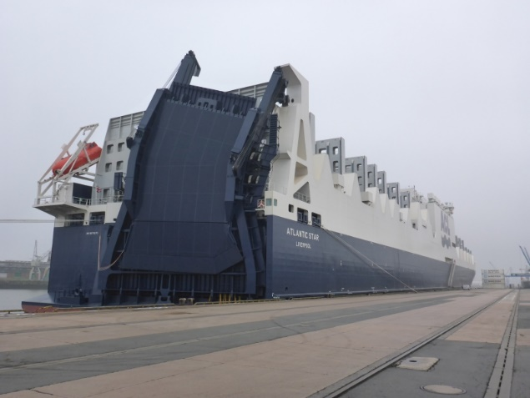
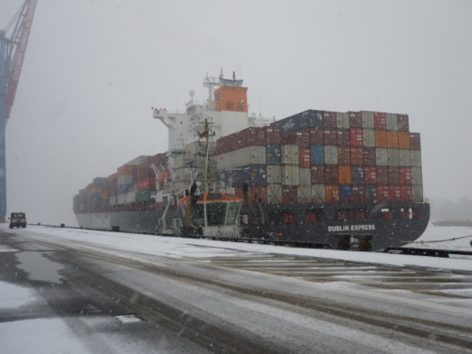
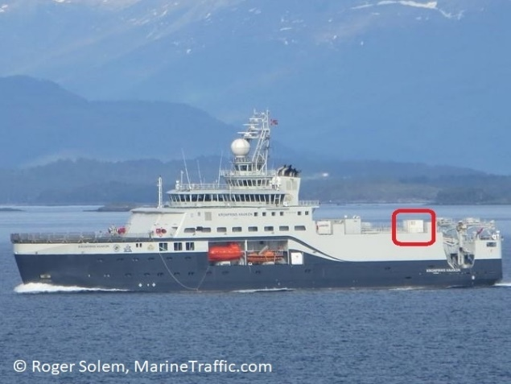
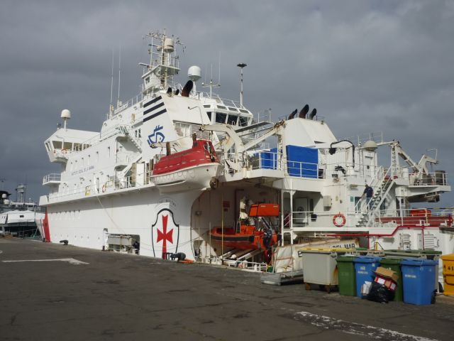
Regular ASAP ships: EUMETNET-ASAP fleet
14 Merchant ships
Atlantic
Star
Liverpool
Express
+ 3 Research ships and 1 Hospital Ship
Kronprins
Haakon
Esperanza
Del Mar
5

Slide 6
Other ASAP ships 2019/2020 (research vessels)
Country | Ship name | Station | Area | Received snd. 2020
Japan | Mirai | JNSR | North West Pacific | ?
Japan | Ryofu Maru | JGQH | North West Pacific | 70
Germany | Polarstern | DBLK | Arctic and Antarctic | 1168
France | Atalante | Atalante | West Indies | 114
Germany | Sonne | 4DC8UUK | Tropical Atlantic | 153 (July 2021)
6

Slide 7
1. ASAP stations 2. Performance
7

Slide 8
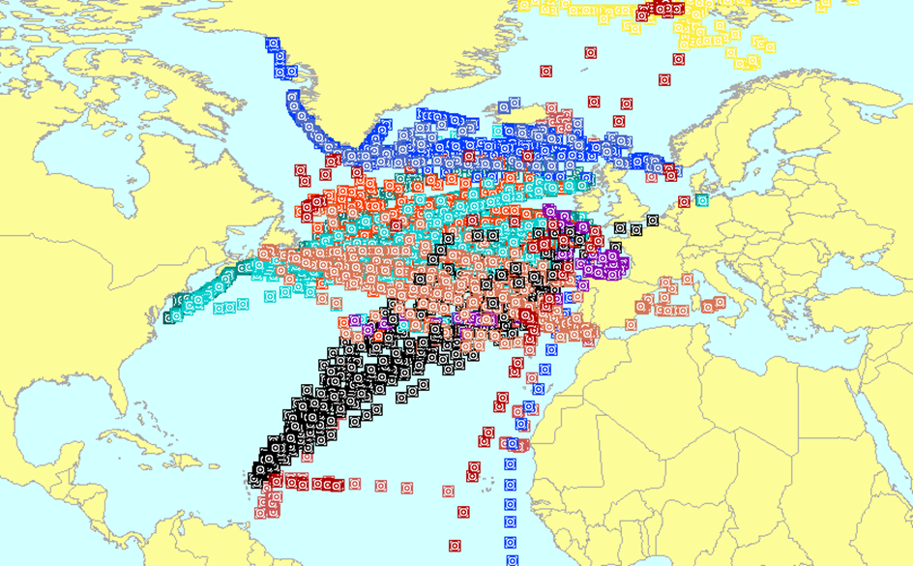
E-ASAP 2020
15 ships provided 3180 soundings on the GTS
8

Slide 9
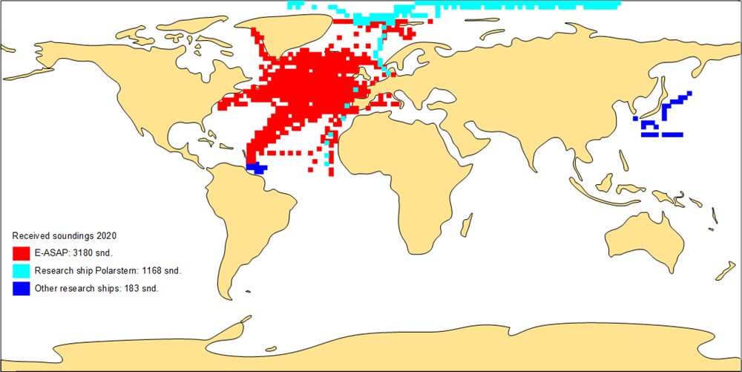
Global ASAP 2020
Received soundings 2020: 4531
9

Slide 10
Quality
Data quality generally good (very few soundings rejected by ECMWF)
 | Received snd. GTS | Median Timeliness (min +HH) | Median Height hPa
E-ASAP | 3180 | 19 | 30
Japan | 70 | 157 | 150
RV Polarstern | 1168 | 70 | 7
RV Atalante | 114 | 180 | 20
RV Sonne | 153 (July 2021) | 27 | 37
10

Slide 11
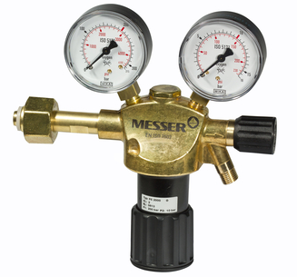
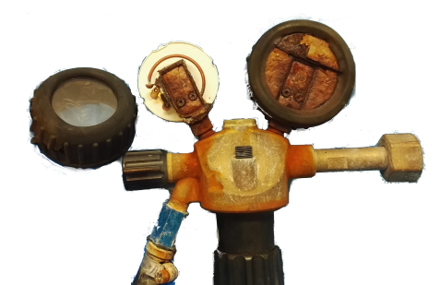
Technical issues
Average failure rate of 10% on board merchant E-ASAP ships due to
technical problems of the equipment,
unfavourable wind conditions at 15-20 knots sailing speed,
unexperienced operators, and
poor satellite communication.
Helium
pressure
reducer
11

Slide 12
Recommendation
Scientific studies confirm the positive impact of upper air soundings in data sparse ocean regions. WMO members are therefore encouraged to participate in global ASAP observations by operating ASAP stations on board ships.
12

